Slide 1
Strengthen Agricultural Market Access Control by Applying Sanitary and Phytosanitary (SPS) Principle
Urumqi Customs ,GACC
Animal and Plant Quarantine Department
Speaker：Xu Jun

Slide 2
Trade status of agricultural products imported from kazakhstan, Uzbekistan and Tajikistan to China
动植物检疫准入的基本程序及要求
Basic procedures and requirements for animal and plant quarantine access
Registration of production and processing enterprises of animals, plants and their products to be exported into China
第一节 动物检疫国际组织
CONTENTS
An introduction to the questionnaire on China's imported plants and animals and their products
Problems and Suggestions on agricultural trade to China

Slide 3
一.《Trade status of agricultural products imported from kazakhstan, Uzbekistan and Tajikistan》
Agricultural products exported from Kazakstan to Xinjiang (2017 - 2019)
NO. | Commodity | 2017 |  |  | 2018 |  |  | Jan.-Oct. 2019
 |  | Batch | Quantity (ton) | Value （ten thousand USD） | Batch | Quantity (ton) | Value （ten thousand USD） | Batch | Quantity (ton) | Value （ten thousand USD）
1 | Horseflesh |  |  |  | 15 | 82.9 | 44.2 | 2 | 23.1 | 9.3
2 | Beef |  |  |  |  |  |  | 35 | 603.2 | 195.9
3 | Mutton |  |  |  | 1 | 16.3 | 4.2
4 | Frozen fish | 157 | 298.5 | 449 | 193 | 3682.4 | 550.7 | 116 | 2229.1 | 332.4
5 | Hides category | 252 | 11305.6 | 584.3 | 208 | 6054.2 | 715.6 | 170 | 4757.6 | 715.8
6 | Mane class | 172 | 4237.9 | 247 | 254 | 6014.9 | 373.7 | 24 | 581 | 72.5
7 | Wheat | 997 | 166696.2 | 2637.4 | 2430 | 452126.1 | 8036.3 | 1143 | 86252.5 | 1678.8
8 | Barley |  |  |  |  |  |  | 201 | 14126.1 | 278.5
9 | Soybean | 74 | 5422.2 | 219.8 | 74 | 18405.1 | 803.4 | 217 | 14197.5 | 694
10 | Sheet material | 40 | 2423.7 | 66 | 78 | 4849.2 | 133.8 | 124 | 7516.7 | 208.3
11 | Rapeseed dregs |  |  |  |  |  |  | 709 | 47368.7 | 1230.3
12 | Wheat bran | 113 | 16703.1 | 160 | 501 | 39430.9 | 492.6 | 1257 | 78015.9 | 1072.7
13 | Sunflower seed cake | 11 | 2625.4 | 27.9 | 54 | 9566.2 | 131.4 | 62 | 3364.6 | 63.6
14 | Cotton class | 21 | 2129.2 | 349.8 | 130 | 10108.6 | 1717.9 | 257 | 12317.1 | 1700.3
15 | Oil PLANT | 2940 | 168131.5 | 5721.7 | 3437 | 1663.3 | 5123.6 | 4884 | 169149 | 5292
16 | Virgin vegetable oil | 364 | 56398.7 | 4420.2 | 671 | 75453.8 | 5749.9 | 886 | 60288.2 | 4419
17 | Liquorice | 413 | 9504 | 655.7 | 417 | 9465.4 | 726.7 | 457 | 10425.6 | 806.7
18 | Flour | 145 | 8698.2 | 235.3 | 457 | 26614.7 | 695.4 | 326 | 20742 | 589.1
19 | Brine shrimp eggs | 19 | 417.1 | 92.5 | 27 | 521.2 | 109.2 | 7 | 134.9 | 27

Slide 4
一.《Trade status of agricultural products imported from kazakhstan, Uzbekistan and Tajikistan》
Agricultural products exported from Tajikistan to Xinjiang (2017 - 2019)
NO. | Commodity | 2017 |  |  | 2018 |  |  | Jan.-Oct. 2019
 |  | Batch | Quantity (ton) | Value （ten thousand USD） | Batch | Quantity (ton) | Value （ten thousand USD） | Batch | Quantity (ton) | Value （ten thousand USD）
1 | Hides category | 74 | 2822.8 | 369.56 | 133 | 3379.8 | 444.4 | 111 | 3013.5 | 462.1
2 | Cotton class |  |  |  | 1 | 300 | 52.8
3 | Dried fruit class | 4 | 86.6 | 6.7
4 | Cherry | 54 | 43.4 | 26 | 41 | 46.2 | 26.2 | 92 | 93.8 | 51.8
Agricultural products exported from Uzbekistan to Xinjiang (2017 - 2019)
NO. | Commodity | 2017 |  |  | 2018 |  |  | Jan.-Oct. 2019
 |  | Batch | Quantity (ton) | Value （ten thousand USD） | Batch | Quantity (ton) | Value （ten thousand USD） | Batch | Quantity (ton) | Value （ten thousand USD）
1 | Chews | 1 | 141.1 | 37.6 | 23 | 432.3 | 117.6 | 23 | 420.5 | 80.4
2 | Hides category | 361 | 15035.4 | 2145.8 | 329 | 12223.3 | 1716.3 | 283 | 6764 | 1379.2
3 | Mane class | 2 | 43.3 | 1.5 | 6 | 115 | 4.9 | 5 | 109.6
4 | Cotton class | 159 | 8532.8 | 703.8 | 65 | 3145.7 | 178.4
5 | Liquorice | 169 | 4068 | 315.1 | 134 | 3197.5 | 252.7 | 105 | 2242.5 | 181.6
6 | Dried fruit class | 675 | 21637.6 | 172.7 | 937 | 27139.5 | 2093.5 | 829 | 21093.1 | 1775.7
7 | Brine shrimp eggs | 4 | 134.1 | 51.2 | 6 | 105.3 | 26.1 | 11 | 216 | 58
8 | Mung bean |  |  |  | 47 | 1957.4 | 122.4 | 71 | 1802 | 110.3
9 | Cherry |  |  |  | 4 | 2.4 | 1.4 | 28 | 34.8 | 18.7

Slide 5
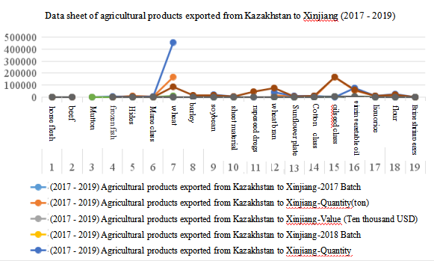
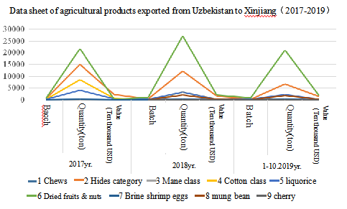
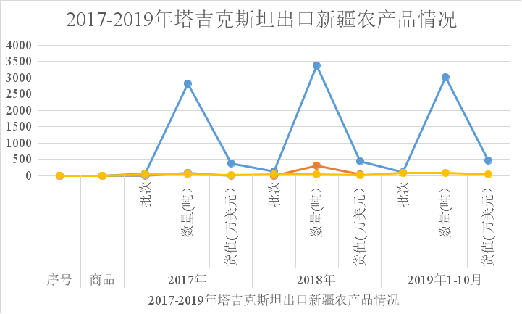
一.《Trade status of agricultural products imported from kazakhstan, Uzbekistan and Tajikistan》
Data sheet of Agricultural products exported from Tajikistan to Xinjiang (2017-2019)
batch
quantitity(ton)
Value
（ten thousand USD）
batch
quantitity(ton)
Value
（ten thousand USD）
batch
quantitity(ton)
Value
（ten thousand USD）
No
Commodity
2017
2018
Jan.-Octo.2019
Agricultural products exported from Tajikistan to Xinjiang (2017 - 2019)

Slide 6
China's market demand for imported agricultural products
Animals and their products: Equine animals for slaughter and breeding, Cattle, Sheep and their meat products（China imports an average of 5 million tons annually）, casings, pet food, etc.
Plants and their products: Prune, Marina, Peach, Watermelon, Elaeagnus angustifolia ,Chickpea, Grape,Pepper, Oil plant, Cereal grains,Dried fruit class，and Virgin vegetable oil

Slide 7
二.《Basic procedures and requirements for animal and plant quarantine access》
（Ⅰ)Submit an application
1.Application: Where a country intends to export general and high-risk animal and plant products into China, an application for export should be submitted by its competent authority to the General Administration of Customs of China in writing, specifying the type of exported animals and plants or their products and recommending the production and processing enterprises of exported animals and plants.
2.Start an access procedure: China decides whether to start an access procedure according to the animal and plant epidemic situation in the country or region that intends for export.
3.If diseases on List A for imported animals regulated by China or plant quarantine pests against which China has issued a ban exist in the export country, a ban-lifting procedure should be performed.

Slide 8
二.《Basic procedures and requirements for animal and plant quarantine access》
(II） Risk analysis
1. Questionnaire: China acts as the main body.
China will, in accordance with the relevant provisions, assess the animal and plant health and public health system of export country or region. The assessment may be conducted in the form of written questionnaire. Risk assessment is no longer needed for non-edible animal and plant products to be imported without any hazard factors upon China’s confirmation.
2. Provide information: Exporter acts as the main body.
Countries or regions that intend for export should provide relevant technical information as required by the questionnaire, including but not limited to animal and plant health and public health system-related laws and regulations system, organizational structure (system), animal and plant epidemic prevention service system, quality management system, security and sanitation control system, and detection, monitoring and regionalization of animal and plant epidemic diseases.
3. Risk assessment: China acts as the main body.
China organizes experts to conduct risk analysis and assessment on the information provided, and if assessment show that the information is within acceptable levels of risk, the next procedure can be performed.
4. Feedback of assessment opinions: risk exchange process
(1) Supplement the questionnaire; or
(2) Consult about the next step of work: conduct on-the-spot investigation for further assessment.
(3) Detailed, logical and latest answers to the questionnaire can speed up the assessment process.

Slide 9
二.《Basic procedures and requirements for animal and plant quarantine access》
(III) On-the-spot investigation assessment
China acts as the main body and the exporter provides support. China organizes experts to conduct on-the-spot investigation in the export country or region for assessing the occurrence, laws and regulations of animal and plant epidemic diseases, the quarantine technical capacity and related scientific researches, the establishment and management system of animal and plant quarantine institutions, the production and processing enterprises of animals and plants or their products, etc.
Registration assessment should be made for the enterprises that intend to export high-risk animal and plant products, which also acts as a field validation of the answers given by the countries or regions that intend for export to the questionnaire.

Slide 10
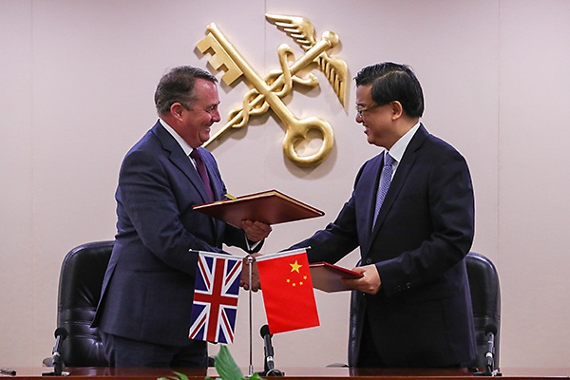
二.《Basic procedures and requirements for animal and plant quarantine access》
(IV) Negotiate to sign the bilateral quarantine protocol
1. Both sides should negotiate about the contents of the protocol on quarantine and sanitary conditions (agreement, memorandum, etc.) of the exported animals, plants and their products. The protocol should be signed upon reaching a consensus, and the content and sample of the Veterinary sanitary and phytosanitary certificate should be confirmed according to the protocol.
2. The main contents of the protocol should include: national responsible agency for the exported products / national animal and plant health requirements / daily management requirements of farms or enterprises / epidemic disease types and quarantine methods / isolation (animals and plants) or registration (production enterprises for animal and plant products) requirements / certificate requirements / preventive measures requirements (expelling parasite, immunization or preventive treatment, disinfection) / transportation requirements.

Slide 11
三.《Registration of production and processing enterprises of animals, plants and their products to be exported into China》
In accordance with China’s relevant laws and regulations and the international trade customs, China implements a registration administration system for the production and processing enterprises of some imported animals, plants and their products. Specific requirements are as follows:
(I) Overseas production and processing enterprises that export animals, plants and their products into China should conform to relevant provisions of the laws, regulations and standards of the export country or region, and satisfy the requirements of China’s relevant laws, regulations and standards.
(II) After being examined and approved by the competent authority of the export country or region, the production and processing enterprises needing registration administration will be recommended to the General Administration of Customs of China.
After the recommending materials have been received and accepted upon written examination by the General Administration of Customs of China, if necessary, through consultation with the competent authority of the export country or region, an expert group may be sent to the export country or region for conducting assessment or retrospective investigation on its supervision system and inspecting the production and processing enterprises that apply for registration.

Slide 12
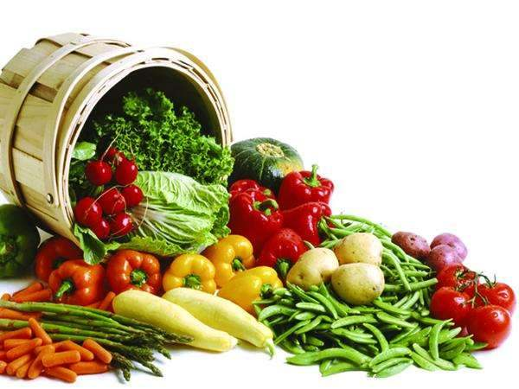
三.《Registration of production and processing enterprises of animals, plants and their products to be exported into China》
(III) Overseas production and processing enterprises of the countries or regions that meet the requirements will be registered after passing the examination.
(IV) Registration requirements for overseas production and processing enterprises
(1) Relevant requirements as defined in the bilateral agreements, protocols, memorandums and other bilateral conventions;
(2) Relevant requirements as stipulated in the Certificate of Inspection and Quarantine confirmed by both parties;
(3) provisions of China’s laws, regulations and mandatory standards;

Slide 13
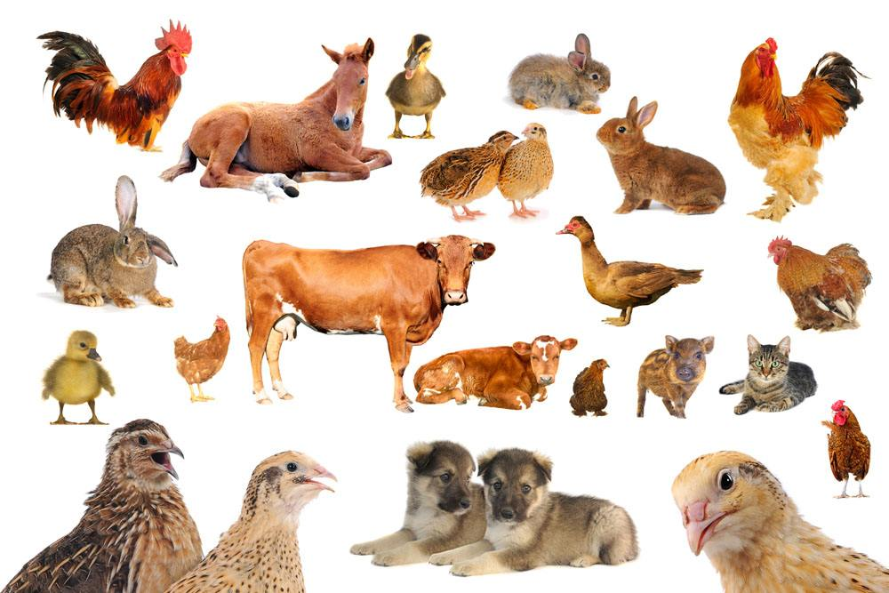
四.《An introduction to the questionnaire on China's imported plants and animals and their products》
I. Introduction to questionnaire for animal
(一） Questionnaire on animal sanitary conditions for countries that intend to export animals into the People’s Republic of China
1. Basic information of the countries that intend to export animals into China
(1) Veterinary competent authority responsible for animal health: name and address;
(2) Number of imported animals listed by region and classification (for breeding, production, slaughtering).

Slide 14
四.《An introduction to the questionnaire on China's imported plants and animals and their products》
2.Animal health status
（1）Information of veterinary institutions
（2） Animal health legislation
（3）Veterinary laboratory
（4） Basic condition of the breeding industry.
（5）Animal epidemic diseases to be notified
（6）Epidemic diseases and immunization.
(7) Exercise of relevant powers by veterinary competent authority according to law.

Slide 15
四.《An introduction to the questionnaire on China's imported plants and animals and their products》
II. Questionnaire on plant sanitary conditions for countries that intend to export animals into the People’s Republic of China
1.Phytosanitary, safety and sanitation authorities
2.Laws, regulations and standards,
3.Official or accredited testing laboratories
4.Safety and sanitation control of pests
5. Export situation of plant products
6.Supervision and administration,
7.Planting, production, processing, storage and transportation information of plant products

Slide 16
五.《Problems and Suggestions on agricultural trade to China》
Main problems:
1.The epidemic situation information is unclear; animal and plant epidemic disease prevention and control status cannot be queried on OIE and FAO official websites, and good SPS measures cannot be used to control it.
2.The detection capacity of the disease and the construction of FMD-free areas is unclear.
3.The enforcement of laws and regulations for the prevention and control of the country's overall epidemic situation needs to be strengthened.
Suggestions：
Facilitate communication between high-level officials of the state, establish a mechanism of meeting at ports to timely resolve differences and problems.
2. Establish a list of agricultural products exported to China, indicate the importance and urgency of trade, put forward package solutions and make application to China customs

Slide 17
五.《Problems and Suggestions on agricultural trade to China》
3.Actively strengthen the construction of epidemic-free zones and related legislation in accordance with international trade rules, and obtain the approval of OIE and the Chinese government.
4.Strengthen the large-scale operation of animals, plants and their products, promote the safety certification of agricultural products, food HACCP (critical control point of risk analysis) system, ISO9000 quality management system, and promote the continuity of products exported to China.
5. Strengthen communication and coordination to resolve issues related to agricultural trade tax rates.
6.For products entering China through a third country, they shall not pass through countries or regions exporting agricultural products related to diseases to China.It is suggested to strengthen the construction of biosafety corridors between China and kazakhstan, Tajikistan and Uzbekistan, and consolidate them into a circle of friends for the safe trade of agricultural products between China and central Asia.

Slide 18
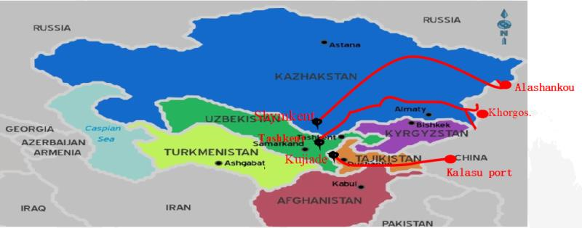
五.《Problems and Suggestions on agricultural trade to China》
Fruits exported from China through a third country are allowed to enter Uzbekistatan through five ports: Dostlik, Yallama, Tashkent, Oybek and Keles.
Fruits exported from Uzbekistan through a third countries are allowed to enter China from four ports: Horgos, Alashankou, Irkeshtam and Turgart.

Slide 19
THANK YOU!
Xu Jun
Phone:13999233298
Tel：+860991-3627330
E-mail：alskxj@sina.com

