Slide 1
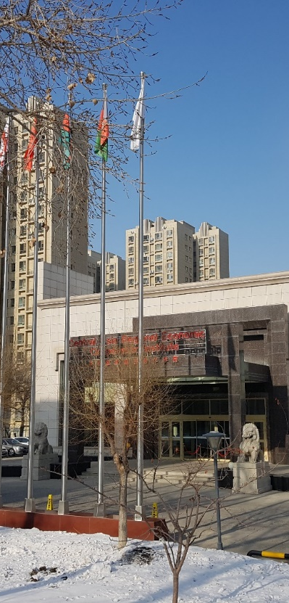


CAREC Institute Work Plan and Key Highlights
Presentation at Virtual CAREC NFPs Meeting
By
Syed Shakeel Shah
Director

Slide 2
Research
Economic and Financial Stability Cluster
Trade, Tourism, and Economic Corridor Cluster
Financial Inclusion in the CAREC Region: Promoting Fintech to Meet Underserved Needs in Trade - Completed
Financial Inclusion and Fintech in CAREC: Constraints and Prospects – Completed
COVID-19 and MSME in CAREC Region: Impacts and Policy Lessons - Completed
Debt and Financial Sustainability in the CAREC Region – On-going
Infrastructure and Economic Connectivity
Infrastructure in Central Asia and Caucasia-Book Chapter in ADBI Project – Completed
Sustainable Pathway of Energy Transition in CAREC Region – A Governance Perspective - On-going
Agriculture and Water Cluster
Climate Insurance, Infrastructure and Governance in CAREC Region - Completed
Assessing the Economic Impact of Climate Change on Agriculture in Central Asia - Completed
Regional Climate Vulnerability in CAREC and Perspectives for Regional Cooperation - On-going
Framework for E-Commerce Development in CAREC – Focus on Infrastructure Development - Phase II - Completed
Developing a Framework for Mutual Recognition and Electronic Exchange of Phytosanitary Certificates in CAREC – Completed
Pakistan's trade with Central Asia- Chapter contribution in a book being published by Oxford – Completed
COVID-19 and Tourism Sector in CAREC Region: Harnessing Role of Technology in Promoting Safe Tourism Destination – Completed
Free Trade Agreement (FTA) Design for the CAREC Region – On-going
Digital CAREC: Analysis of Regional Digital GAP (Phase I) – On-going
Human Development Cluster
Reviewing Migration and Development: Local authorities' role in Central Asia – Completed
Development of Sustainable Water and Sanitation Systems in Rural Areas of CAREC Region with focus on China, Mongolia, Tajikistan, and Uzbekistan - Completed
Report on Public Attitudes Towards Vaccination in Selected CAREC countries

Slide 3
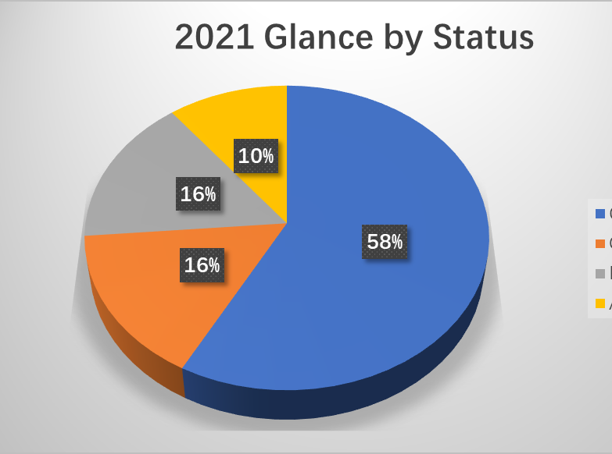
Capacity Building
Transformation to E-Learning
  Three-Tiered Approach – CI Research Based, Hybrid and Knowledge Broker
  Cascade Structure- Digital Materials, Physical Event, Virtual knowledge sharing and stakeholder engagement
2021 Activities Status – Total 12 activities planned for the year
  Already Completed 11
  Ongoing 3
  Planned 3
  Additional 2
Total planned and Additional in 2021 19

Slide 4
Knowledge Management
Main Activities
Outputs
External communication, outreach, media
Adaptations, visual communications
Knowledge creation, advocacy
Host country partnership
Regular Products: 8 e-newsletters, 2020 Annual report, Economic Brief reaching over 3,000 external stakeholders
Media outreach: coverage of 14 CAREC Institute topics and events in 46 media outlets in 8 countries in 3 languages in 2021
Social media: LinkedIn account saw a 39%? Chinese social media - Weibo, WeChat and TikTok – a series titled “CAREC Images” was launched
Development Asia partnership - 14 knowledge adaptations
2021 Research conference 8-page synopsis (summary of 10 research papers) was produced and shared with NFP in English and Russian
17 more Russian translations of 2020-21 knowledge products have been produced, 10 event flyers and 12 publication covers in 2021 to enhance the Institute’s visual communication
Host country partnership: WASH and TVET research project, series of knowledge-sharing webinars , China City Development Alliance (CCDA) on the topic of cross-border trade with strong participation of Chinese and Central Asian stakeholders.

Slide 5
Macro-Economic Analysis and CAREC Regional Integration Index (CRII)
Macro-Economic Analysis and CRII
CRII Updated for latest values
  To be updated annually
Quarterly Economic Monitors as regular product
  Economic data , COVID19 Impact, Vaccination Update
Economic Briefs
  Analysis of Issues of Relevance to Economic Development and Policy Options
Sustainable Development in Asia and the World: The Road towards Sustainable Recovery in a Fast-Changing World-Chapter contributed by CI in Boao Forum Report 2021
Planned :
  CAREC household survey , twice a year
  Household welfare related to incomes, cost of living, education opportunities

Slide 6

Institutional Development
CI’s Strategy 2021-2025 is presented to its 11th Governing Council (GC).
Proposal on Revamping CI’s Advisory Council (AC) approved by GC, will hold 4th AC meeting.
Financial Sustainability and Resource Mobilization Strategy underway. PAK pledged another support of US$100,000.
The 11th Governing Council meeting in July deliberated on CI Strategy, CI’s financial sustainability, revamping of AC. The 12th GC Meeting Planned in December.
CAREC Think Tanks Forum in Nov, CTTN Virtual Dialogue in March, Research grants provided to 5 regional think tanks.
New MoUs with XUAR Institute of Standardization, University of Shenzhen and International Finance Forum (IFF)
Project partnerships with WEF, IsDB, UNICEF . AIIB, MCDF, SCO and Civil Aviation Administration of China.
New ADB Knowledge Support Technical Assistance US$2mln. for 2021-2023 started in April 2021.

Slide 7


