Slide 1
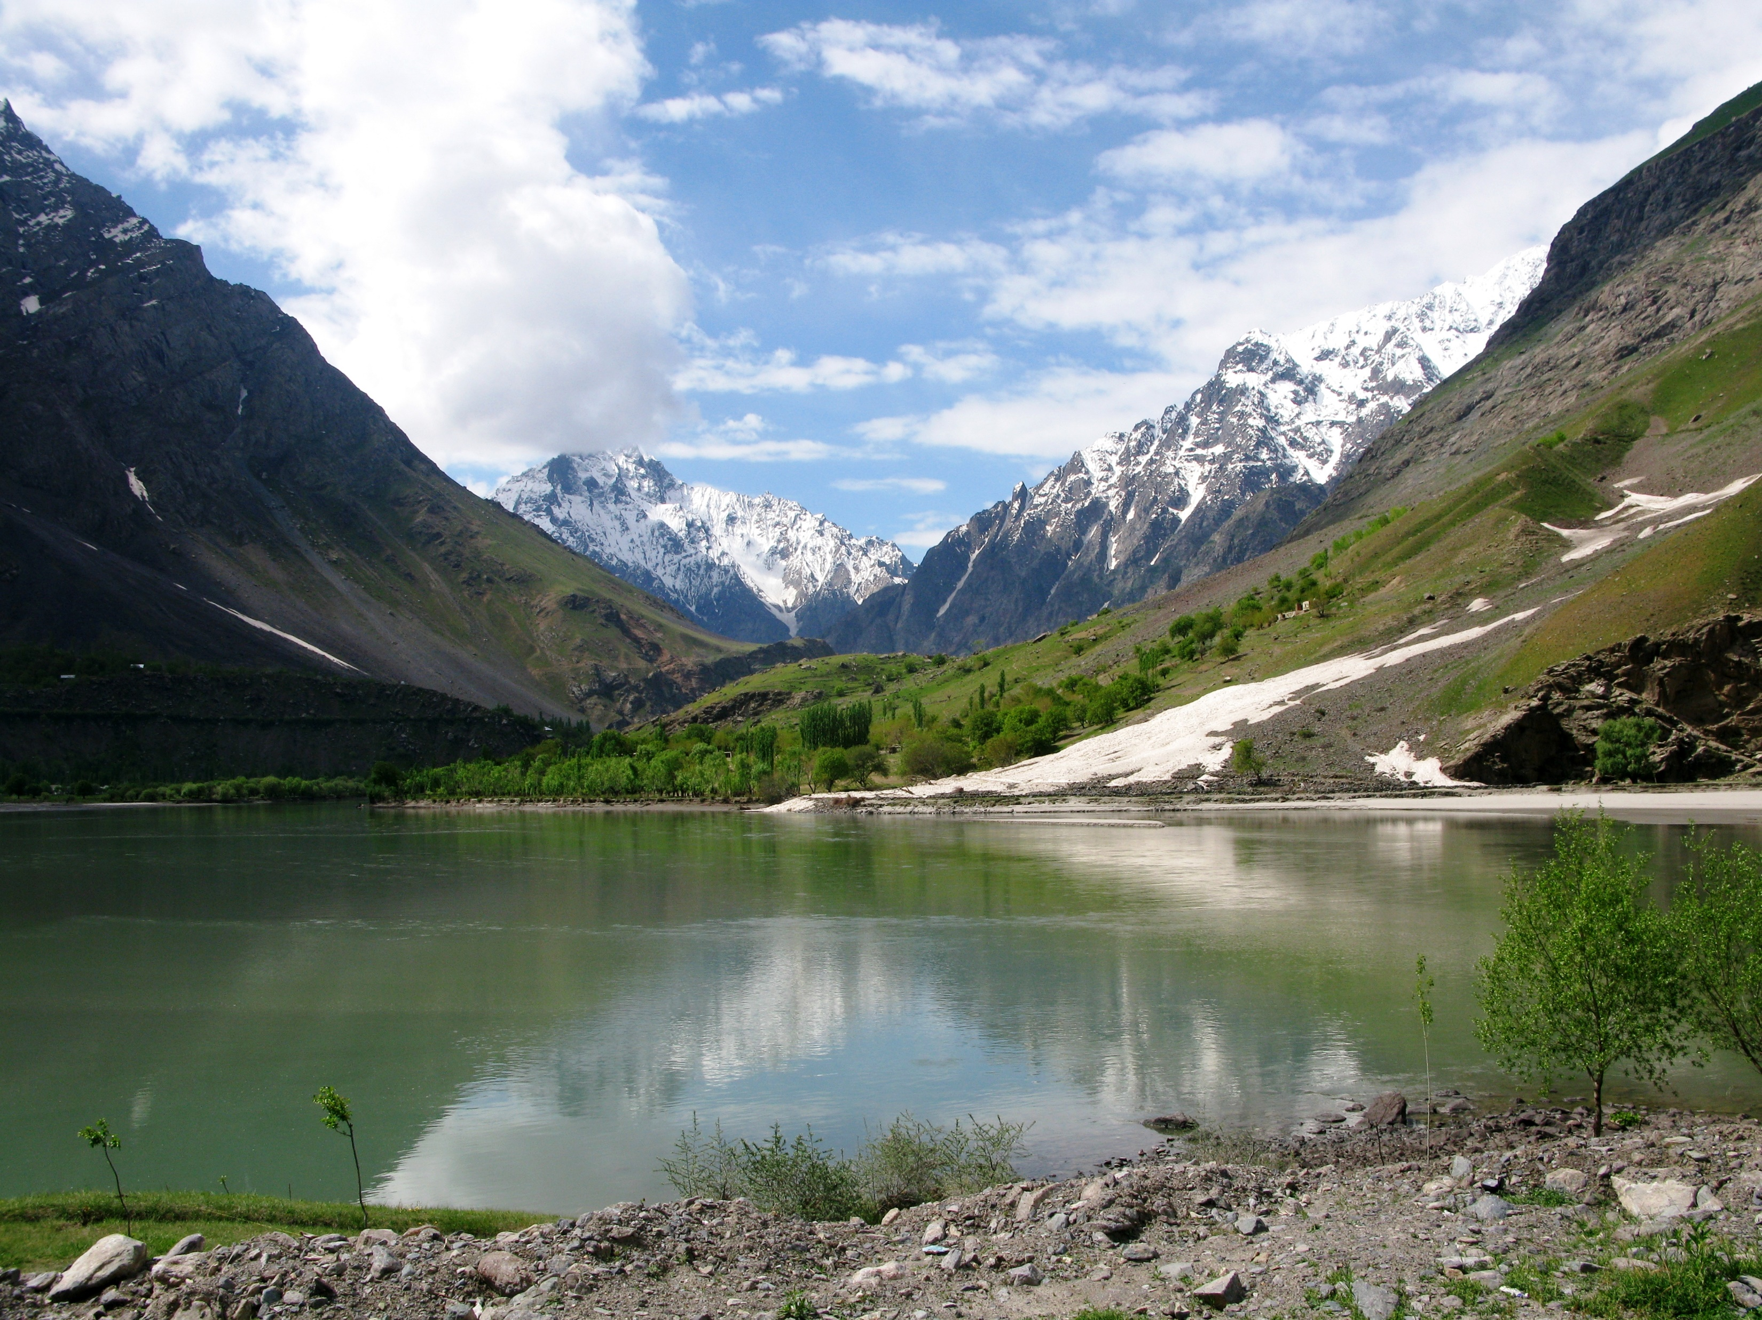
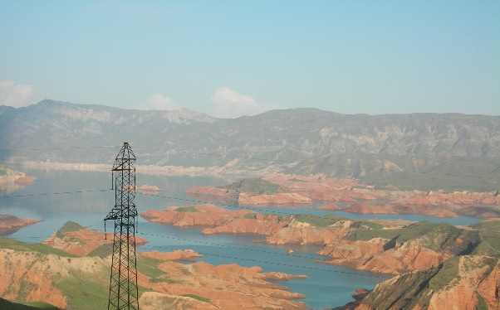
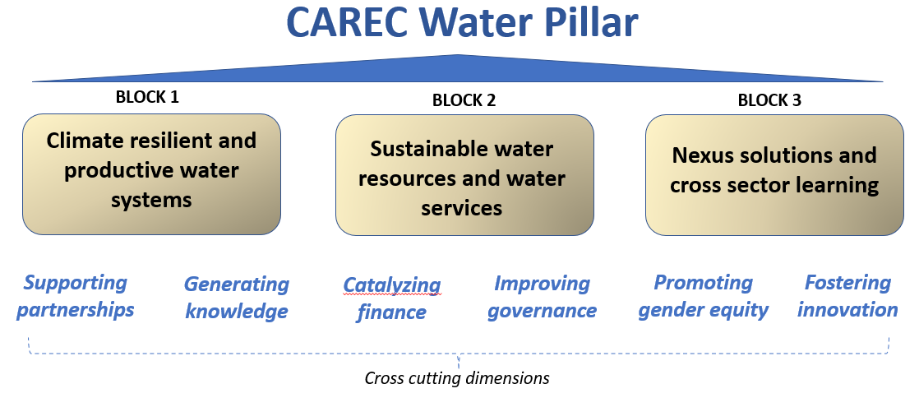
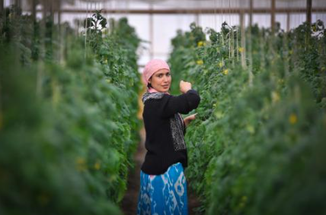
Developing the CAREC Water Pillar
Vision: ‘a sustainable, climate resilient, productive and water secure region with shared benefits among States and communities.’
Initial focus is on Aral Sea Basin region – later expansion to broader CAREC membership.
Builds on existing initiatives of inter-governmental organizations, bilateral agreements, and regional development programs.
Provides investment support, joint knowledge generation, dialogue platform, facilitator of capacity development – all as part of a long-term partnership program.
Notes:
Photo sources:
J Bird
Water Resources Management in Uzbekistan, OSCE 2018
V Sokolov

Slide 2
Timeline – CAREC Water Pillar
Nov 2020-Feb 2021 | Desk study and literature review; stakeholder consultations with regional partners
March 2021 | National consultations with country focal points Drafting of 3 thematic papers – climate, economics, legal
16 Apr 2021 | First regional consultation on preliminary findings and proposal for the Water Pillar framework with country water focal points and other regional partners.
June – August 2021 | Circulation of initial draft Scoping Study Report and review by national agencies, inter-governmental bodies and development partners
14 September 2021 | Second regional consultation to exchange feedback and discuss way forward
28 Sept 2021 | Circulation of Draft Final Scoping Study Report – information item for CAREC National Focal Point meeting in mid-October
October 2021 –March 2022 | Development of concept papers for selected priority activities
November 2022 | Presentation of the CAREC Water Pillar at the CAREC Ministerial Conference

