Slide 1
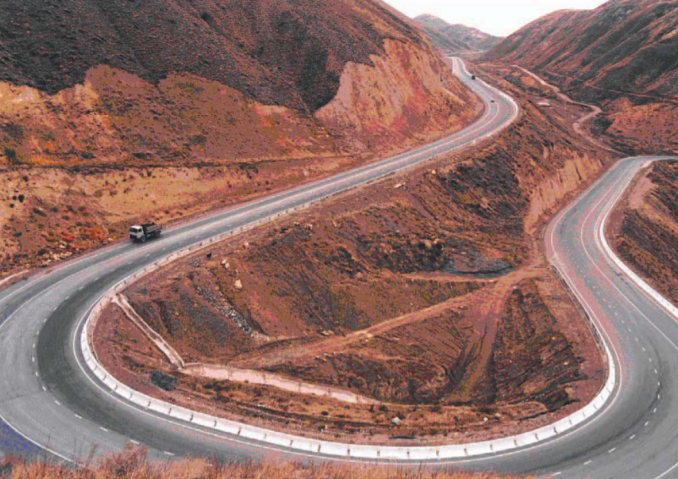
CAREC Regional Infrastructure Projects Enabling Facility (RIPEF) CAREC 2030 will continue to advance the regional infrastructure agenda, in line with the SDGs’ call for reliable and sustainable infrastructure, including regional and cross border infrastructure.
Objectives
A dedicated financing facility created to support CAREC governments in project preparation and readiness, initial design, and in application of appropriate financial solutions while promoting knowledge exchange and capacity building
Progress and Next Steps
Small-scale Technical Assistance (approved in Sept 2020)
ongoing groundwork for the CAREC RIPEF
zero draft prepared and under internal review and revision
Pilot Transaction TA Facility (for 2021 approval)
to provide project preparation funding for regional infrastructure projects
start with KGZ Sustainable Tourism project support and seek additional funding ($2million) to expand
Stakeholder and development partner consultation (October 2021 onwards)
governments of CAREC member countries and other stakeholders will be consulted on the draft CAREC RIPEF concept
multilateral and bilateral development partners are invited to participate in the Facility by providing technical and financial support
Deliverables for the Ministerial Conference
To ensure sufficient coordination (internal/external) and quality of the report, the delivery of the final report will be postponed to 2022. The progress report will be presented during Ministerial Conference.

