Slide 1
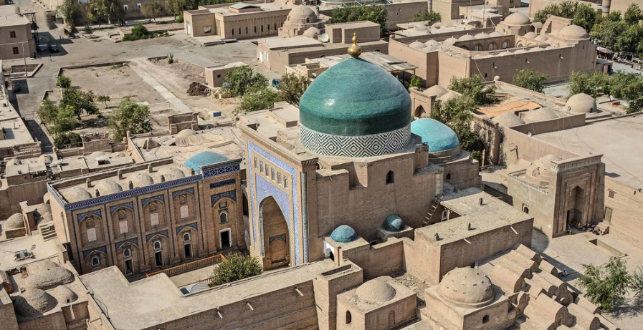
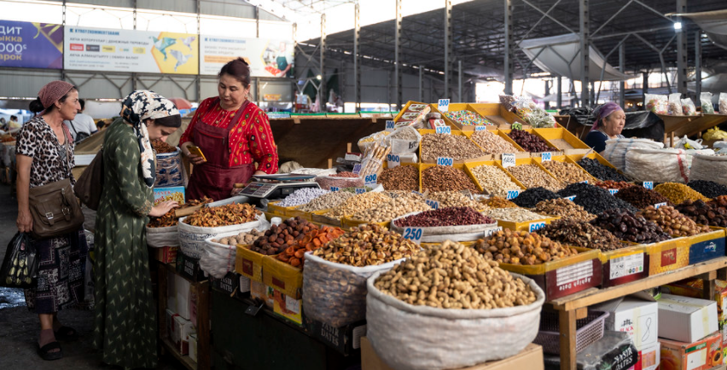

CAREC
Regional Economic Outlook
November 17, 2021
Subir Lall
Deputy Director
Middle East and Central Asia Department
Notes:
(from top to bottom; separator: //): City of Bukhara in Uzbekistan // Kyrgyz women shop for dried fruits at Osh Bazaar in Bishkek // Nurse at vaccine buses in Tbilisi districts.
Distinguished Ministers of the CAREC Member Countries, Dear Participants, Ladies and Gentlemen,
On behalf of the IMF, I would like to convey our warm greetings to you from Washington D.C. as we are delivering this presentation to you in a pre-recorded format.
Today, I would like to share with you the Fund’s assessments of the regional economic outlook and risks.

Slide 2
Uneven and Fragile Recovery Amid Ongoing Pandemic

Slide 3
Vaccination efforts and an economic recovery are underway, although price pressures are also picking up
Despite the ongoing pandemic, the recovery is underway
Headline and food inflation are increasing; depreciation and domestic factors contribute…
Real GDP Growth
(Index, 2019Q4=100, 4-quarters sum, sa)
Headline and Food Inflation
(Year-over-year percent change; simple average)
Sources: Haver Analytics; and IMF staff calculations.
Note: The sample includes 8 CAREC countries: Azerbaijan, China, Georgia, Kyrgyz Republic, Kazakhstan, Mongolia, Tajikistan, Uzbekistan. Only Tajikistan has released up to 2019Q3 data.
.
Sources: Haver Analytics; National Authorities; IMF, CPI database; and IMF staff calculations.
Note: CAREC includes 9 countries. TKM and AFG are not included due to lack of recent data. Latest data are as of Aug. 2021 except for TJK (Jul. 2021). Data were extrapolated based on latest available inflation growth rates as indicated. Data for the world are as of Jul. 2021.
Notes:
Chart 1. Despite the recent waves of the outbreak of Covid-19, we observe a broad-based recovery around the world and across the region. This reflects, among other things, countries’ progress toward vaccinating their populations and thus, their ability to gradually unwind pandemic-related restrictions. Real GDP growth in the first half of 2021 has picked up, but on average GDP remains below its 2019 level. As shown in the figure, the blue line, which is a real GDP index for the median economy, in 2021:Q2 was still below the red line, which is its pre-pandemic level. Furthermore, as can be seen from the upper and lower bounds of the growth trajectory, the dispersion among the CAREC countries’ growth rates is quite high – suggesting an uneven path toward the post-pandemic recovery.
Chart 2. While growth is picking up, headline inflation has also been increasing in the region, reflecting higher global food and energy prices and supply constraints, pass-through from earlier exchange rate depreciations, and demand pressures in some countries which is consistent with the ongoing domestic recovery. Food inflation in CAREC countries has been particularly high and running well above the global average, which is suggestive of the particular severity of supply chain constraints in the region and the fact that a large part of the recovery in demand has been due to food consumption.

Slide 4
Macro policy settings are tightening
…prompting some central banks to raise rates from their troughs in 2020.
At the same time, fiscal support is declining.
Monetary Policy Rates
(Percent)
Fiscal Impulse
(Negative change of primary balance, percent of GDP)
Source: Haver analytics.
Note: China's rate represents PBC's 1-year loan prime rate.
Country abbreviations are International Organization for Standardization country codes.
Sources: National authorities; and IMF staff calculations.
Note: The general government primary balance excludes the effect of oil revenues for oil exporting countries.
Notes:
Most countries in the region used policy buffers to provide strong monetary and fiscal stimuli in 2020, but high inflation and rising debt levels have prompted policy rebalancing this year.
Chart 1. Some Caucasus and Central Asia (CCA) countries have begun to tighten monetary policy in response to rising inflation to prevent the un-anchoring of inflation expectations. While in Uzbekistan, Pakistan, Mongolia, Azerbaijan, and China policy rates remain below the pre-pandemic levels, Tajikistan, Kazakhstan, Georgia and the Kyrgyz Republic have already raised interest rates above those levels.
Chart 2. Fiscal balances are expected to gradually improve due to a cyclical recovery in revenues, phasing-out of pandemic-related spending, and the planned medium-term fiscal adjustments in countries with elevated debts. Already in 2021, fiscal deficits are expected to decline in most CAREC countries, reflecting the winding down of emergency spending measures and revenue recovery, including because of higher oil prices for oil exporters.

Slide 5
Outlook: A Multispeed Recovery with Persistent Output Losses

Slide 6
The multi-speed growth recovery is expected to firm up in 2022, with inflation moderating
Growth is expected to strengthen in 2021 and continue in 2022
Inflation is projected to moderate after peaking in 2021
Real GDP Growth
(Year-over-year percent change)
Headline Inflation
(Year-over-year percent change, average)
Projections
Sources: National authorities; IMF, WEO; and IMF staff calculations.
Note: AFG is excluded from CAREC and CAREC OI averages.
Sources: National authorities; IMF, WEO and IMF staff calculations. Note: AFG is excluded from projections of CAREC and CAREC OI averages.
Notes:
The outlook is for a strong recovery in the region over the near term, while the recent rise in inflation is a concern, but we see this as mostly transitory assuming appropriate monetary policy responses going forward as well.
Chart 1. After contracting by 1.4 percent in 2020, which excludes China, real GDP in the region is projected to expand by 7.7 percent in 2021 and 5.5 percent in 2022. Oil importers are expected to grow much stronger than oil exporters in the region, especially in 2021, and to outperform EMDE’s (excluding China).
Chart 2. Inflation for the region is expected to peak in 2021 at about 8 percent, and moderate thereafter with the easing of supply chain constraints and demand pressures, in line with global trends. Regional inflation is projected to stabilize around 5 percent in the medium term but will remain higher compared to other EMs. Within the region, oil exporters are projected to continue to have a higher inflation path than oil-importers.

Slide 7
Headwinds dominate the outlook for the region
Low vaccine availability, declining policy space, and exposure to tourism will weigh on outlook for some countries
Diverse Set of Factors Affecting the Near-Term Outlook
(Each colored square represents a CAREC member country)
Sources: Country authorities; IMF World Economic Outlook database; and IMF staff calculations.
1/ Vaccination rollouts: green represents 40 percent population coverage by end-2021; otherwise, red.
2/ Fiscal policy space: red represents no market access and/or debt-to GDP at or above the median; otherwise, green.
3/ Monetary policy space: red is whether IMF World Economic Outlook inflation projections for 2021 are at or above median or inflation target; green represents below median and target; orange represents peggers and currency boards.
4/ Tourism dependence: red is if both, the tourism share of GDP and the tourism share of total employment, are greater than 10 percent; orange if either one of these criteria is met; otherwise, green.
Notes:
Chart 1. The outlook, however, is subject to significant risks for many countries in the region. Some of the key factors that can affect the recovery include the pace of vaccination which is essential to contain the spread of the virus; availability of policy space to support the recovery; and the degree of dependence of economies on tourism and other sectors that are contact-intensive. In the heatmap, for each of these factors green squares indicate a favorable position, red squares indicate an unfavorable position, and orange square(s) indicate a partially unfavorable position. As such:
The countries that have more successfully rolled out vaccines, will be more resilient to new waves of the pandemic or emergence of new variants of COVID. As the heatmap shows, inadequate vaccination remains a major headwind for many countries.
Only a handful countries in the region have macro policy space with low debt and low inflation to support the recovery without undermining macroeconomic stability. Oil exporters are particularly constrained on the monetary side, including because of inflexible exchange rates, while oil importers face significant fiscal constraints due to high public debt.
Countries that rely more on tourism and contact-intensive sectors are likely to face greater challenges in achieving recovery. One country in the region (i.e. Georgia) with tourism accounting for more than 10 percent of GDP and more than 10 percent of total employment is particularly vulnerable. Because of likely strong negative correlation between tourism and the spread of the pandemic, vaccination will play a particularly important role in those economies.
Other risk factors, that are not shown in the heatmap, include oil prices and social challenges:
Higher oil prices would support oil exporters but would weaken growth and exert inflation pressures in oil importers.
The pandemic has exacerbated social challenges and inequalities in some countries. Persistent high unemployment could increase the risk of social unrest and political instability. International mediation to resolve conflicts and address humanitarian problems will be essential to contain the vulnerabilities in the affected countries and minimize spillover risks.

Slide 8
Elevated Risks and Vulnerabilities
Social unrest, geopolitical & security risks
Scarring
Crisis legacies
Widening of inequalities
Climate shocks
other
New outbreaks
Premature withdrawal of policy support
Pandemic
Tighter global financial conditions
Persistently high inflation
MACRO
Downside risks
Higher
oil
prices
Accelerated vaccine production and distribution
Upside risks
Notes:
Diagram 1. This diagram illustrates the balance of risks, which is tilted to the downside. In addition to a resurgence of the pandemic, and a withdrawal of policy support before the recovery is fully established, including due to lack of policy space, downside risks stem from a possible tightening of global financial conditions; persistently high inflation; social unrests due to increased unemployment, inequality and poverty, and geopolitical risks; significant economic scarring; and more frequent and intense climate shocks.
The one upside risk is the acceleration of vaccine production and distribution. Higher-than-expected oil prices are an upside risk for oil exporters and a downside risk for oil importers, particularly among LICs. That being the case, volatility in the global energy prices is a significant concern for both oil exporters and importers.

Slide 9
Without accelerated vaccination efforts the impact of the crisis on output will be long lived
Unless the vaccine delivery picks up, many countries will not achieve wide full vaccine coverage
Real GDP is projected to remain persistently below its pre-crisis trend
Months to Vaccinate 40-60 Percent of Population
(Months, calculated based on current pace of inoculation)
Output Losses Relative to Pre-Crisis Projections
(Percent difference)
Sources: Our World in Data (OWID); and IMF staff calculations.
Note: TKM is not included due to lack of data
Sources: National authorities; and IMF staff estimates, projections and calculations.
Note: Pre-crisis projections are for October 2019. AFG is not included in CAREC and CAREC OI averages.
Notes:
Chart 1. Vaccine delivery needs to pick up to achieve wide vaccine coverage and contain the pandemic, resurgence of which is the primary risk to the outlook. At the current pace of inoculation, more than half of the countries in the region will achieve 60-percent population coverage by mid-2022. Most low-income countries will not reach this target until 2023, while Afghanistan will need 40 months to reach the 40 percent vaccination coverage.
Chart 2. The pandemic is expected to have a lasting effect on output. The chart on the right shows that real GDP is projected to remain below the pre-crisis projections in the medium term, implying permanent output loss. Oil importers are expected to outperform the world and emerging market averages, while oil exporters would underperform. These projections underscore the importance of accelerating structural reforms in the region and elsewhere, but especially among oil exporters, to forestall the structural erosion in the growth potential.

Slide 10
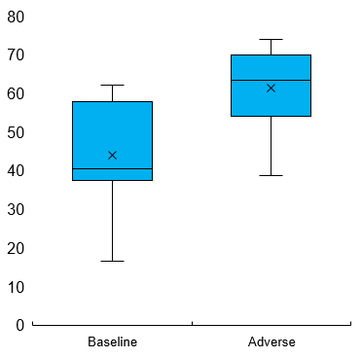
A sudden tightening of global financial conditions could pose capital flight and debt stabilization risks
A sudden tightening of global financial conditions could lead to capital flight, hitting vulnerable countries more…
…and raise debt non-stabilization concerns, particularly if downside risks materialize
CAREC excl. China: Cumulative Capital Flows
(Millions of US dollars)
China: Cumulative Capital Flows
(Billions of US dollars)
Baseline versus Adverse Scenario Probabilities of Debt Non-Stabilization
(Percent)
Probability of Debt (2024)>Probability of Debt (2023)
Sources: Haver Analytics, EPFR flows; and IMF staff calculations.
Note: CAREC sample includes: AZE, KAZ, GEO, and CHN.
At time t measured in weeks since the crisis onset, if the country is below the median value (of FX reserves), then it is characterized as “Vulnerable”.
Sources: Sources: IMF, IFS; IMF, WEO; and IMF staff calculations.
Note: Includes all CAREC countries except for CHN, MNG, and UZB.
Notes:
Chart 1. The current financial conditions are accommodative, allowing countries with market access to low-cost financing. However, a sudden tightening of financial conditions could lead to capital flight, which would particularly affect the countries with weaker external accounts, fundamentals, and buffers. For example, the first figure shows that countries with lower reserve coverage, labeled “Vulnerable”, experienced greater capital outflows during the taper-tantrum and the early stages of the COVID-19 pandemic, even if capital flows since then have recovered. It is important to note two mitigating factors to the risk of capital outflows: (i) although external debt is now higher relative to the Taper Tantrum episode, it reflects to some extent higher official debt in many of these countries, reducing the risk of capital outflows; and (ii) many of the CAREC countries have sufficient reserves, providing a buffer against sharp capital outflows. Furthermore, we also acknowledge that countries that have no access to international capital markets, do not face this risk of immediate outflows, as there are no portfolio investments. However, these countries may face difficulties in refinancing some of their existing debt.
Chart 2. Similar observations can also be made for China but given its sheer size, we preferred to present the Chinese data separately in the second Chart.
Chart 3. The COVID-19 shock raised public debt-to-GDP ratios across the region, weakening debt sustainability in several countries. In particular, some countries face a higher probability that debt would not stabilize over a three-year horizon compared with pre-COVID probabilities even in the baseline scenario. These probabilities increase further in an adverse scenario, which assumes higher real interest rates, weaker growth, weaker primary fiscal balances, and realization of additional contingent liabilities (government guaranteed private debt). This prospect of higher and increasing debt path calls for vigilance in public finances beyond the immediate recovery phase.

Slide 11
Employment may not recover easily, due to hysteresis effects and low responsiveness to growth
Unemployment decreases more slowly during expansions than it increases during recessions
Okun's Coefficients for CAREC
Source: IMF Staff calculations.
Notes:
Chart 1. The COVID crisis has led to a significant increase in unemployment. While the ongoing recovery should bring some jobs back, the reversal is unlikely to be full for two reasons. First, part of employment may not be recouped due to the permanent output loss; and second, the data suggest that employment gains during economic expansions are slower than job losses during downturns. This asymmetry, which is shown in the chart for CAREC, is at least partly explained by structural weaknesses of the labor market, such as the high levels of informality, large public sector employment and high wages in the sector, which tend to be stable, and rigid product and labor market regulatory frameworks. This may also reflect the “hysteresis effect”, whereby prolonged unemployment during recessions result in erosion of skills, which makes it difficult for some people to return to the labor force. Therefore, the longer it takes to recover from the pandemic, more lasting unemployment is likely to be.
This hysteresis, coupled with a protracted pandemic, high and rising inflation, particularly for food, and growing poverty and income inequality, may increase the risk of social unrest in the region.

Slide 12
Significant challenges arise from climate change
Climate change will continue to be felt throughout the region
Achieving targets requires action and cooperation
today
Need to accelerate economic diversification and reduce hydrocarbon dependence
Average Summer Temperatures, 1986–2059
Scenario with Ambitious Global Reductions of GHG Emissions (RCP 4.5)
(Degree Celsius)
Envisaged NDC Reduction in 2030 GHG Emissions Relative to Business as Usual
(Percent)
Oil Exporters: Hydrocarbon Revenues
(Percent of total revenues)
Sources: Climate Lab; and IMF staff calculations.
Sources: Country NDC reports; Intended Nationally Determined Contributions; and IMF calculations.
Sources: Country authorities; and IMF staff calculations.
Notes:
Lastly, significant additional challenges are presented by climate change, to which the region is particularly susceptible. Climate change will continue to be felt throughout the CAREC region, underscoring the need to prioritize adaptation policies.
Chart 1. As shown in Chart 1, average summertime temperatures are expected to rise throughout the region by about 2.6 degrees Celsius by 2050, even under a scenario of ambitious reductions in global Green House Gas emissions. This projected warming in the region will likely have significant and potentially very adverse climatic implications. Therefore, the authorities need to prioritize adaptation policies in their national agendas.
Chart 2: The CAREC region – excluding China - is a relatively small contributor to global emissions, but collective mitigation efforts will be important over the coming decade. The region accounts for around 30 percent of global greenhouse gas emissions, with large contributions from just a few countries. Many countries have committed to mitigation targets in their Nationally Determined Contributions as part of the Paris Agreement. Achieving these targets by 2030 requires coordinated action today and countries should seize the opportunity to foster growth through a green recovery while also reaping health benefits from cleaner air and better climate. These efforts will need to be supported by technical and financial assistance from international partners, especially to low-income counties.
Chart 3. When it comes to transition, while the share of non-oil revenues has increased in recent years, oil revenues remain high, and wide-ranging reforms to accelerate economic diversification and rationalize government expenditures will be required to navigate the fiscal transition in oil-producing countries. Phasing out energy subsidies would also be critical to reduce energy consumption and carbon footprint, as well as to facilitate more efficient allocation of resources.

Slide 13
Increased Tradeoffs and Difficult Handoff:
From Crisis Management Towards an Inclusive and Transformational Recovery

Slide 14
ACCELERATE VACCINATION
To save lives
To support recovery
To reduce inequalities
Regional cooperation and IMF Support & SDR Allocation
  Target support toward most vulnerable and distressed but viable firms. If there is policy space, withdraw gradually
  Tighten if inflation persistent and expectations get de-anchored, keep policy rates low otherwise
  Support employment: Pursue reallocation policies and promote a return to active job search; support job creation schemes
  Rebuild fiscal policy space, with growth-friendly and equitable fiscal adjustment
  Improve macro policy frameworks: Anchor fiscal adjustment with MTFF; improve monetary frameworks
  Closely monitor corporate and bank vulnerabilities
Foster stronger, and inclusive recovery
Preserve fiscal & financial stability
Invest in the future
Manage policy trade-offs
  Adapt to climate change and diversify economies
  Invest in digital economy
  Rethink the role of the state, reform SOEs & improve governance
  Invest in youth & women, reduce informality
Notes:
Going forward, the main challenge facing policymakers is to balance two competing objectives: continue supporting the economy until the recovery is entrenched and strengthen resilience of economies including by reducing public debt and inflation.
Diagram 1.
Protecting lives and livelihood is still the number one priority, which first and foremost requires vaccination. To this end, strong global and regional cooperation is essential to further increase availability of vaccines.
But near-term policy tradeoffs have become more acute. Many countries in the region are facing protracted recovery, while policy buffers are shrinking. High public debts, especially in oil importing countries, limits fiscal space to provide support to vulnerable firms and households, and rising inflation puts constraints on monetary policy. Country authorities need to strike the right balance between fostering a self-sustaining and inclusive recovery, and strengthening macroeconomic stability, while also promoting green investment to prepare for the post-pandemic world. To this end:
Fiscal support should be carefully targeted to those who need it the most while aiming to gradually reduce debt.
Difficult tradeoffs for monetary policy imply that interest rates might need to increase if inflation persists
Improving macro policy frameworks would help reduce these tradeoffs
Structural reforms need to accelerate to raise productivity and inclusiveness, and support job creation and incomes.
On this last point, the region faces long-standing structural issues, which if left unaddressed, would weaken resilience and competitiveness in the post-pandemic world. The region needs a new growth model with the private sector in lead and the state providing a supportive investment environment by strengthening governance and leveraging new growth opportunities offered by digitalization, green investment, and regional and global integration. Investing in health and education, supporting youth and women employment, and reducing informality should be essential components of this strategy.

Slide 15
The IMF remains intensely engaged in supporting the region
IMF Financing to CAREC Countries Since the Start of the Pandemic
(January 2020 – July 2021, millions of USD)
Bilateral assessments and policy advice to authorities
Regular engagement with country authorities for more tailored policy discussions
Dissemination of global policy initiatives and COVID-related policy guidance
Integration of CD and surveillance: CCAMTAC,
Policy Support and technical advice
Financial Support
Close coordination with the World Bank, EBRD, ADB and other IFIs
Increased collaboration with various UN agencies – UNDP/ILO/UNHCR/UNICEF
Mobilization for financial resources, donor support, and debt relief
Catalyzed additional funding from other official creditors
Coordination and Outreach
US$3.25 billion of new financing to the region
SDR allocation to boost the region’s reserve assets by US$48.7 billion
Notes:
Diagram 1.
The Fund has been supporting and will continue to support its membership during this difficult period by providing financing, policy advice, and technical assistance.
Financing: since the start of the pandemic, the IMF disbursed US$20 billion to its members in the region through Emergency Financing and Fund-supported programs. Nearly US$49 billion was provided to the region through new SDR allocations; and Afghanistan, Tajikistan and the Kyrgyz Republic benefited from debt relief under the CCRT. In addition, the Fund facilitated the G20 Debt Service Suspension Initiative, supported the Common Framework for debt treatments beyond the DSSI, and continued to play its catalytic role in mobilizing additional financial resources from donors and international organizations.
Policy advice: The Fund has closely engaged with all its member countries in the region and around the world to provide policy advice, tailored to country circumstances, on tackling the COVID-crisis and disseminating global policy initiatives, developing exit strategies, and enhancing longer term growth potentials. In addition to its traditional areas of expertise, such as fiscal, monetary and financial sector, the Fund has expanded its coverage of cutting-edge areas including climate change, digitalization, governance, and gender equality.
Capacity Development. Lastly, the IMF has continued to provide extensive support to its members in capacity development. A new regional capacity development center – CCAMTAC – has been recently launched to serve the needs of many CAREC countries.

Slide 16
Thank you

