Slide 1

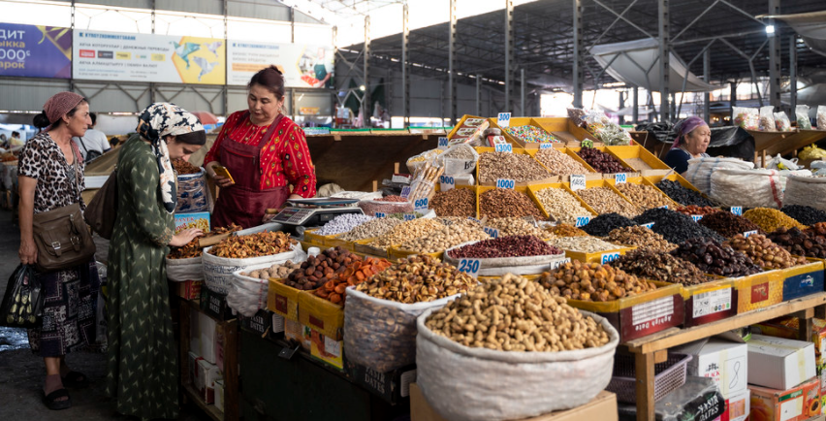

CAREC
区域经济展望报告
2021年11月17日
苏比尔拉尔
副主任
中东和中亚部
Notes:
(from top to bottom; separator: //): City of Bukhara in Uzbekistan // Kyrgyz women shop for dried fruits at Osh Bazaar in Bishkek // Nurse at vaccine buses in Tbilisi districts.
Distinguished Ministers of the CAREC Member Countries, Dear Participants, Ladies and Gentlemen,
On behalf of the IMF, I would like to convey our warm greetings to you from Washington D.C. as we are delivering this presentation to you in a pre-recorded format.
Today, I would like to share with you the Fund’s assessments of the regional economic outlook and risks.

Slide 2
在疫情持续期间，复苏不平衡且脆弱

Slide 3
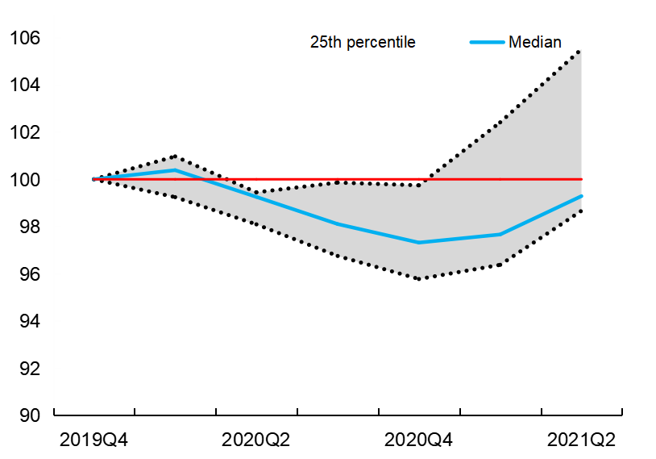
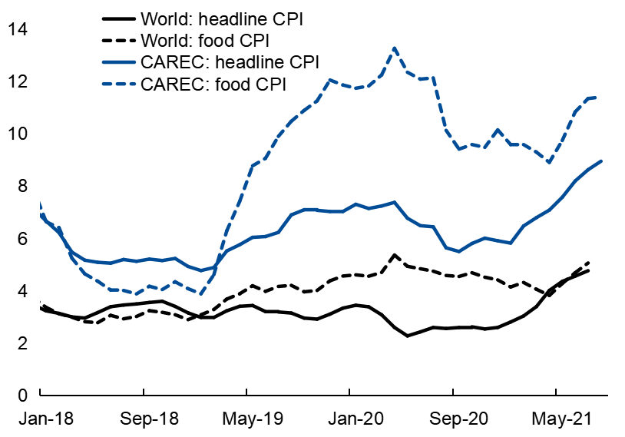
疫苗接种工作和经济复苏井然有序，但是价格压力也在增大
尽管疫情仍未结束，但我们正在复苏当中
整体通胀和食品通胀正在上升；有折旧和国内因素的影响…
实际GDP增长
（指数，2019Q4=100，四个季度总和，sa）
整体通胀与食品通胀
（同比百分比变化；简单平均值）
资料来源：哈弗分析；以及国际货币基金组织工作人员的计算。
注：样本包括8个CAREC国家：阿塞拜疆、中国、格鲁吉亚、吉尔吉斯共和国、哈萨克斯坦、蒙古、塔吉克斯坦、乌兹别克斯坦。只有塔吉克斯坦发布了截至2019年第三季度的数据。
.
资料来源：哈弗分析；国家机关；国际货币基金组织， 消费物价指数数据库； 以及国际货币基金组织工作人员的计算。
注：CAREC包括9个国家。由于缺乏最新数据，未包括TKM和AFG。除TJK（数据截至2021年7月）外，最新数据截至2021年8月。如图所示，数据是根据最新可用的通货膨胀增长率推断出来的。全球数据截至2021年7月。
Notes:
Chart 1. Despite the recent waves of the outbreak of Covid-19, we observe a broad-based recovery around the world and across the region. This reflects, among other things, countries’ progress toward vaccinating their populations and thus, their ability to gradually unwind pandemic-related restrictions. Real GDP growth in the first half of 2021 has picked up, but on average GDP remains below its 2019 level. As shown in the figure, the blue line, which is a real GDP index for the median economy, in 2021:Q2 was still below the red line, which is its pre-pandemic level. Furthermore, as can be seen from the upper and lower bounds of the growth trajectory, the dispersion among the CAREC countries’ growth rates is quite high – suggesting an uneven path toward the post-pandemic recovery.
Chart 2. While growth is picking up, headline inflation has also been increasing in the region, reflecting higher global food and energy prices and supply constraints, pass-through from earlier exchange rate depreciations, and demand pressures in some countries which is consistent with the ongoing domestic recovery. Food inflation in CAREC countries has been particularly high and running well above the global average, which is suggestive of the particular severity of supply chain constraints in the region and the fact that a large part of the recovery in demand has been due to food consumption.

Slide 4
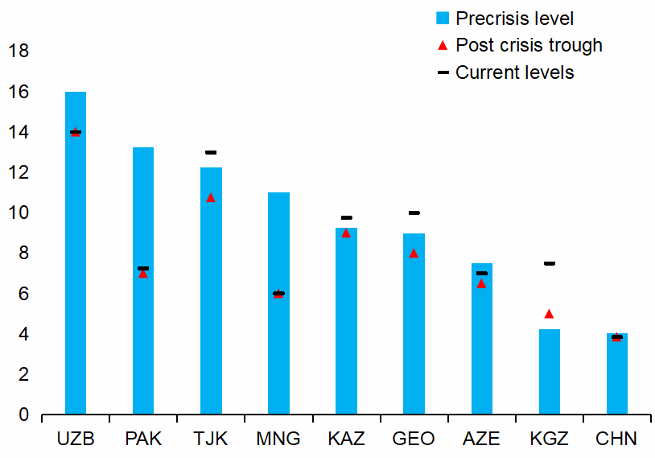
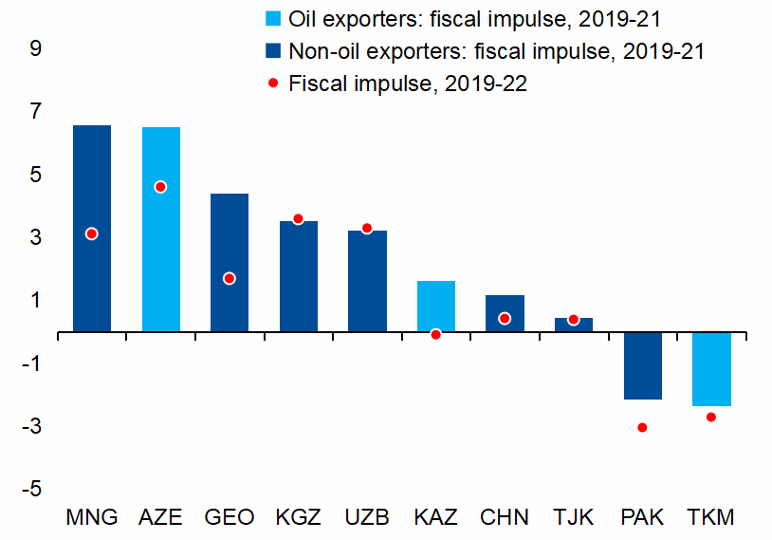
宏观政策正在收紧
…促使一些央行在2020年的利率低谷期后提高利率。
与此同时，财政支持正在下降。
货币政策利率
（百分比）
财政脉冲
（基本财政支出占GDP的百分比的下降）
资料来源：哈弗分析。
注：中国利率是指中国人民银行1年期贷款最优惠利率。
国家缩写是国际标准化组织的国家代码。
资料来源：国家机构；以及国际货币基金组织工作人员的计算。
注：一般政府基本财政收支排除了石油出口国的石油收入影响。
Notes:
Most countries in the region used policy buffers to provide strong monetary and fiscal stimuli in 2020, but high inflation and rising debt levels have prompted policy rebalancing this year.
Chart 1. Some Caucasus and Central Asia (CCA) countries have begun to tighten monetary policy in response to rising inflation to prevent the un-anchoring of inflation expectations. While in Uzbekistan, Pakistan, Mongolia, Azerbaijan, and China policy rates remain below the pre-pandemic levels, Tajikistan, Kazakhstan, Georgia and the Kyrgyz Republic have already raised interest rates above those levels.
Chart 2. Fiscal balances are expected to gradually improve due to a cyclical recovery in revenues, phasing-out of pandemic-related spending, and the planned medium-term fiscal adjustments in countries with elevated debts. Already in 2021, fiscal deficits are expected to decline in most CAREC countries, reflecting the winding down of emergency spending measures and revenue recovery, including because of higher oil prices for oil exporters.

Slide 5
展望：各国复苏速度各异，产出持续下降

Slide 6
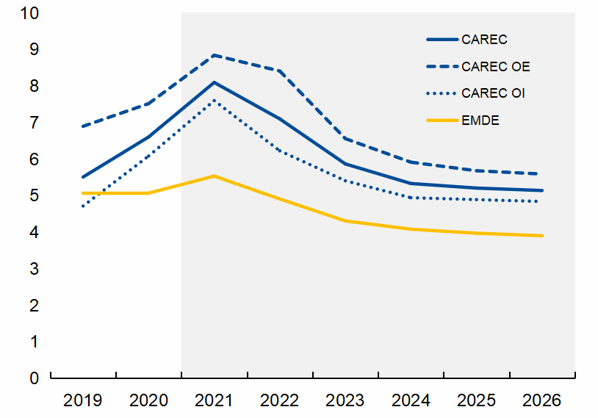
随着通胀放缓，不均衡的经济复苏预计将在2022年提速
预计经济增长将在2021年加速，势头将保持到2022年
预计通胀在2021年达到峰值后将趋于缓和
实际GDP增长
（同比百分比变化）
整体通货膨胀
（同比百分比变化，平均值）
预测
资料来源：政府机构；国际货币基金组织， WEO; 以及国际货币基金组织工作人员的计算。
注：AFG不包括在CAREC和CAREC OI平均值中。
资料来源：政府机构 ；国际货币基金组织、世界经济展望组织和国际货币基金组织工作人员的计算。注：CAREC和CAREC OI平均值的预测中不包括AFG。
Notes:
The outlook is for a strong recovery in the region over the near term, while the recent rise in inflation is a concern, but we see this as mostly transitory assuming appropriate monetary policy responses going forward as well.
Chart 1. After contracting by 1.4 percent in 2020, which excludes China, real GDP in the region is projected to expand by 7.7 percent in 2021 and 5.5 percent in 2022. Oil importers are expected to grow much stronger than oil exporters in the region, especially in 2021, and to outperform EMDE’s (excluding China).
Chart 2. Inflation for the region is expected to peak in 2021 at about 8 percent, and moderate thereafter with the easing of supply chain constraints and demand pressures, in line with global trends. Regional inflation is projected to stabilize around 5 percent in the medium term but will remain higher compared to other EMs. Within the region, oil exporters are projected to continue to have a higher inflation path than oil-importers.

Slide 7
该区域的前景充满不利因素
疫苗供应量低、政策空间减少以及旅游业的风险敞口将影响一些国家的前景
影响近期前景的各种因素
（每个彩色方块代表一个CAREC成员国）
资料来源：政府机构；货币基金组织世界经济展望数据库；以及国际货币基金组织工作人员的计算。
1/疫苗推广：绿色代表在2021年底前达到40%的人口覆盖率；红色代表未达到。
2/财政政策空间：红色表示没有市场准入和/或债务占GDP的比例达到或高于中位数；反之则呈绿色。
3/货币政策空间：红色代表国际货币基金组织《世界经济展望》对2021年的通胀预测是否达到或高于中位数或通胀目标；绿色表示低于中位数和目标值；橙色代表钉住汇率制和通货委员会。
4/旅游业依赖性：红色表示旅游业占GDP的比重和旅游业占总就业的比重都大于10%；如果满足上述任一标准，则为橙色；如果一项都不满足，则为绿色。
Notes:
Chart 1. The outlook, however, is subject to significant risks for many countries in the region. Some of the key factors that can affect the recovery include the pace of vaccination which is essential to contain the spread of the virus; availability of policy space to support the recovery; and the degree of dependence of economies on tourism and other sectors that are contact-intensive. In the heatmap, for each of these factors green squares indicate a favorable position, red squares indicate an unfavorable position, and orange square(s) indicate a partially unfavorable position. As such:
The countries that have more successfully rolled out vaccines, will be more resilient to new waves of the pandemic or emergence of new variants of COVID. As the heatmap shows, inadequate vaccination remains a major headwind for many countries.
Only a handful countries in the region have macro policy space with low debt and low inflation to support the recovery without undermining macroeconomic stability. Oil exporters are particularly constrained on the monetary side, including because of inflexible exchange rates, while oil importers face significant fiscal constraints due to high public debt.
Countries that rely more on tourism and contact-intensive sectors are likely to face greater challenges in achieving recovery. One country in the region (i.e. Georgia) with tourism accounting for more than 10 percent of GDP and more than 10 percent of total employment is particularly vulnerable. Because of likely strong negative correlation between tourism and the spread of the pandemic, vaccination will play a particularly important role in those economies.
Other risk factors, that are not shown in the heatmap, include oil prices and social challenges:
Higher oil prices would support oil exporters but would weaken growth and exert inflation pressures in oil importers.
The pandemic has exacerbated social challenges and inequalities in some countries. Persistent high unemployment could increase the risk of social unrest and political instability. International mediation to resolve conflicts and address humanitarian problems will be essential to contain the vulnerabilities in the affected countries and minimize spillover risks.

Slide 8
高风险和脆弱性
社会动荡、地缘政治与安全风险
社会创伤
危机后遗症
扩大不平等
气候冲击
其他
新疫情
过早结束政策支持
大流行病
全球金融形势趋紧
持续高通胀
宏观
下行风险
油价
攀升
加速疫苗生产和分配
上行风险
Notes:
Diagram 1. This diagram illustrates the balance of risks, which is tilted to the downside. In addition to a resurgence of the pandemic, and a withdrawal of policy support before the recovery is fully established, including due to lack of policy space, downside risks stem from a possible tightening of global financial conditions; persistently high inflation; social unrests due to increased unemployment, inequality and poverty, and geopolitical risks; significant economic scarring; and more frequent and intense climate shocks.
The one upside risk is the acceleration of vaccine production and distribution. Higher-than-expected oil prices are an upside risk for oil exporters and a downside risk for oil importers, particularly among LICs. That being the case, volatility in the global energy prices is a significant concern for both oil exporters and importers.

Slide 9
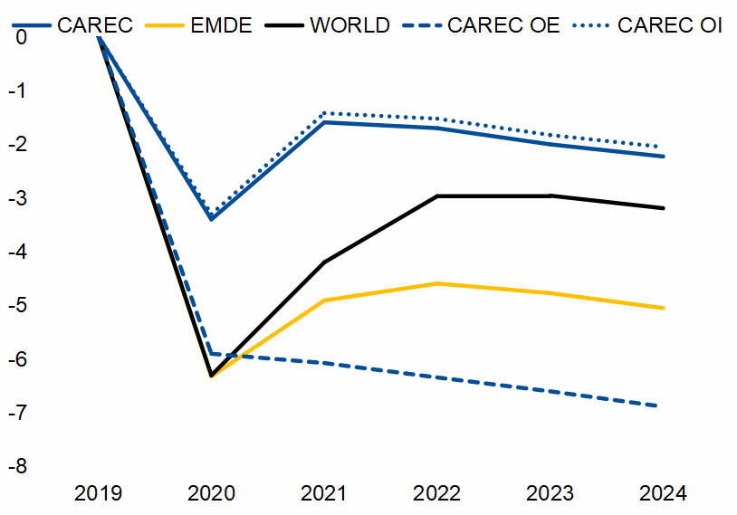
如果不加快疫苗接种工作，危机对产出的影响将长期存在
预计实际GDP将持续低于危机前的水平
除非疫苗的接种率提高，否则许多国家将无法实现广泛的疫苗覆盖率
为40-60%的人口接种疫苗需要几个月
（月份，根据当前接种速度计算）
产出损失相比危机前的预测
（百分比差异）
资料来源：我们的数据世界（OWID）；以及国际货币基金组织工作人员的计算。
注：由于缺乏数据，不包括TKM
资料来源：政府机构；以及国际货币基金组织工作人员的估计、预测和计算。
注：危机前的预测值指的是2019年10月的预测值。AFG不包括在CAREC和CAREC OI平均值中。
Notes:
Chart 1. Vaccine delivery needs to pick up to achieve wide vaccine coverage and contain the pandemic, resurgence of which is the primary risk to the outlook. At the current pace of inoculation, more than half of the countries in the region will achieve 60-percent population coverage by mid-2022. Most low-income countries will not reach this target until 2023, while Afghanistan will need 40 months to reach the 40 percent vaccination coverage.
Chart 2. The pandemic is expected to have a lasting effect on output. The chart on the right shows that real GDP is projected to remain below the pre-crisis projections in the medium term, implying permanent output loss. Oil importers are expected to outperform the world and emerging market averages, while oil exporters would underperform. These projections underscore the importance of accelerating structural reforms in the region and elsewhere, but especially among oil exporters, to forestall the structural erosion in the growth potential.

Slide 10
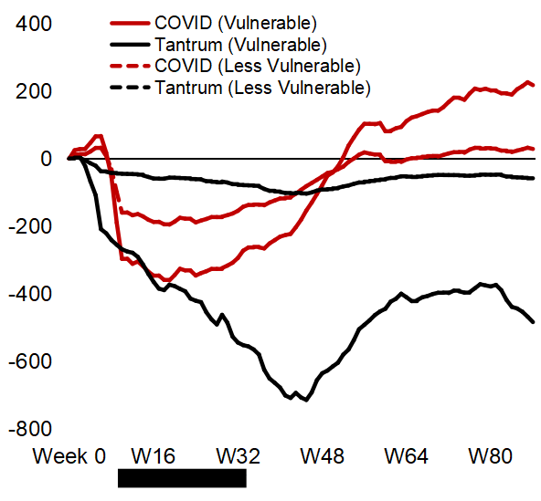
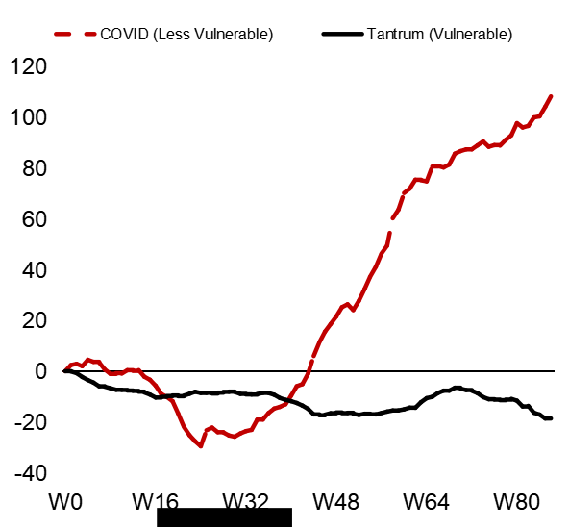
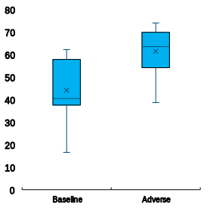
全球金融状况突然收紧可能会带来资本外逃和债务稳定风险
全球金融状况突然收紧可能导致资本外逃，对脆弱国家的打击更大…
…并引发对债务不稳定的忧虑，特别是当下行风险出现时
不包括CAREC中国：累积资本流动
（百万美元）
中国：累积资本流动
（十亿美元）
债务不稳定的基线与不利情景概率
（百分比）
债务概率（2024年）＞债务概率（2023年）
资料来源：哈弗分析、EPFR flows；以及国际货币基金组织工作人员的计算。
注：CAREC样品包括：AZE、KAZ、GEO和CHN。
在危机爆发后的第t周，如果该国低于（外汇储备）的中位数，则该国被定性为“脆弱国家”。
资料来源：资料来源：IMF、 IFS;IMF WEO; 以及国际货币基金组织工作人员的计算。
注：包括除CHN、MNG和UZB以外的所有CAREC国家。
Notes:
Chart 1. The current financial conditions are accommodative, allowing countries with market access to low-cost financing. However, a sudden tightening of financial conditions could lead to capital flight, which would particularly affect the countries with weaker external accounts, fundamentals, and buffers. For example, the first figure shows that countries with lower reserve coverage, labeled “Vulnerable”, experienced greater capital outflows during the taper-tantrum and the early stages of the COVID-19 pandemic, even if capital flows since then have recovered. It is important to note two mitigating factors to the risk of capital outflows: (i) although external debt is now higher relative to the Taper Tantrum episode, it reflects to some extent higher official debt in many of these countries, reducing the risk of capital outflows; and (ii) many of the CAREC countries have sufficient reserves, providing a buffer against sharp capital outflows. Furthermore, we also acknowledge that countries that have no access to international capital markets, do not face this risk of immediate outflows, as there are no portfolio investments. However, these countries may face difficulties in refinancing some of their existing debt.
Chart 2. Similar observations can also be made for China but given its sheer size, we preferred to present the Chinese data separately in the second Chart.
Chart 3. The COVID-19 shock raised public debt-to-GDP ratios across the region, weakening debt sustainability in several countries. In particular, some countries face a higher probability that debt would not stabilize over a three-year horizon compared with pre-COVID probabilities even in the baseline scenario. These probabilities increase further in an adverse scenario, which assumes higher real interest rates, weaker growth, weaker primary fiscal balances, and realization of additional contingent liabilities (government guaranteed private debt). This prospect of higher and increasing debt path calls for vigilance in public finances beyond the immediate recovery phase.

Slide 11
由于滞后效应和对增长反应不强烈，就业可能不容易恢复
经济扩张期间失业率的下降速度比经济衰退期间的上升速度要慢
CAREC的奥肯系数
资料来源：货币基金组织工作人员的计算。
Notes:
Chart 1. The COVID crisis has led to a significant increase in unemployment. While the ongoing recovery should bring some jobs back, the reversal is unlikely to be full for two reasons. First, part of employment may not be recouped due to the permanent output loss; and second, the data suggest that employment gains during economic expansions are slower than job losses during downturns. This asymmetry, which is shown in the chart for CAREC, is at least partly explained by structural weaknesses of the labor market, such as the high levels of informality, large public sector employment and high wages in the sector, which tend to be stable, and rigid product and labor market regulatory frameworks. This may also reflect the “hysteresis effect”, whereby prolonged unemployment during recessions result in erosion of skills, which makes it difficult for some people to return to the labor force. Therefore, the longer it takes to recover from the pandemic, more lasting unemployment is likely to be.
This hysteresis, coupled with a protracted pandemic, high and rising inflation, particularly for food, and growing poverty and income inequality, may increase the risk of social unrest in the region.

Slide 12
气候变化带来了重大挑战
整个区域将继续感受到气候变化
实现目标需要现在行动和合作
需要加快经济多样化，减少对碳氢化合物的依赖
1986-2059年夏季平均温度
全球温室气体排放量大幅减少的情景（RCP 4.5）
（摄氏度）
预计2030年通过国家自主贡献目标可减少的温室气体排放量对比不自主减排
（百分比）
石油出口国：碳氢化合物收入
（占总收入的百分比）
资料来源：气候实验室；以及国际货币基金组织工作人员的计算。
资料来源：国家数据中心报告；国家自主贡献预案(INDC）；和国际货币基金组织的计算。
资料来源：政府机构；以及国际货币基金组织工作人员的计算。
Notes:
Lastly, significant additional challenges are presented by climate change, to which the region is particularly susceptible. Climate change will continue to be felt throughout the CAREC region, underscoring the need to prioritize adaptation policies.
Chart 1. As shown in Chart 1, average summertime temperatures are expected to rise throughout the region by about 2.6 degrees Celsius by 2050, even under a scenario of ambitious reductions in global Green House Gas emissions. This projected warming in the region will likely have significant and potentially very adverse climatic implications. Therefore, the authorities need to prioritize adaptation policies in their national agendas.
Chart 2: The CAREC region – excluding China - is a relatively small contributor to global emissions, but collective mitigation efforts will be important over the coming decade. The region accounts for around 30 percent of global greenhouse gas emissions, with large contributions from just a few countries. Many countries have committed to mitigation targets in their Nationally Determined Contributions as part of the Paris Agreement. Achieving these targets by 2030 requires coordinated action today and countries should seize the opportunity to foster growth through a green recovery while also reaping health benefits from cleaner air and better climate. These efforts will need to be supported by technical and financial assistance from international partners, especially to low-income counties.
Chart 3. When it comes to transition, while the share of non-oil revenues has increased in recent years, oil revenues remain high, and wide-ranging reforms to accelerate economic diversification and rationalize government expenditures will be required to navigate the fiscal transition in oil-producing countries. Phasing out energy subsidies would also be critical to reduce energy consumption and carbon footprint, as well as to facilitate more efficient allocation of resources.

Slide 13
更多的权衡和困难的过渡：
从危机管理走向包容性和转型性复苏

Slide 14
加速接种
拯救生命
支持复苏
减少不平等
区域合作和国际货币基金组织的支持；特别提款权分配
  有针对性地扶持最脆弱、最困难但有生存能力的公司。如果有政策空间，则逐步减少扶持
  收紧政策，前提是通胀持续，预期脱锚，否则保持低政策利率
  支持就业：推行再分配政策，鼓励人们回归劳动力市场积极求职；支持创造就业岗位的计划
  重建财政政策空间, 有利于增长和公平的财政调整
  改善宏观政策框架: 用中期财政框架MTFF锚定财政调整；改善货币框架
  密切监控企业和银行的漏洞
促进更强劲、更包容的复苏
保持财政和金融稳定；金融稳定
投资未来
管理政策权衡
  适应气候变化和经济多样化
  投资数字经济
  重新思考国家的作用改革国企,；改善治理
  投资于青年与女性，减少非正规就业
Notes:
Going forward, the main challenge facing policymakers is to balance two competing objectives: continue supporting the economy until the recovery is entrenched and strengthen resilience of economies including by reducing public debt and inflation.
Diagram 1.
Protecting lives and livelihood is still the number one priority, which first and foremost requires vaccination. To this end, strong global and regional cooperation is essential to further increase availability of vaccines.
But near-term policy tradeoffs have become more acute. Many countries in the region are facing protracted recovery, while policy buffers are shrinking. High public debts, especially in oil importing countries, limits fiscal space to provide support to vulnerable firms and households, and rising inflation puts constraints on monetary policy. Country authorities need to strike the right balance between fostering a self-sustaining and inclusive recovery, and strengthening macroeconomic stability, while also promoting green investment to prepare for the post-pandemic world. To this end:
Fiscal support should be carefully targeted to those who need it the most while aiming to gradually reduce debt.
Difficult tradeoffs for monetary policy imply that interest rates might need to increase if inflation persists
Improving macro policy frameworks would help reduce these tradeoffs
Structural reforms need to accelerate to raise productivity and inclusiveness, and support job creation and incomes.
On this last point, the region faces long-standing structural issues, which if left unaddressed, would weaken resilience and competitiveness in the post-pandemic world. The region needs a new growth model with the private sector in lead and the state providing a supportive investment environment by strengthening governance and leveraging new growth opportunities offered by digitalization, green investment, and regional and global integration. Investing in health and education, supporting youth and women employment, and reducing informality should be essential components of this strategy.

Slide 15
国际货币基金组织仍在全力支持该地区
自疫情爆发以来，国际货币基金组织向CAREC国家提供了资金
（2020年1月至2021年7月，百万美元）
向当局提供双边评估和政策建议
定期与政府部门接触，以进行更有针对性的政策讨论
传播全球政策倡议和新冠疫情相关政策指导
结合能力建设（CD）和监督：CCAMTAC，
政策支持和技术咨询
财政支持
与世界银行、欧洲复兴开发银行、亚洲开发银行和其他国际金融机构密切协调
加强与联合国各机构的合作 -开发署/劳工组织/难民署/儿童基金会
调动财政资源、捐助国支持和债务减免
推动其他官方债权人提供额外资金
协调和外联
向该地区提供32.5亿美元的新融资
特别提款权的分配将使该地区的储备资产增加487亿美元
Notes:
Diagram 1.
The Fund has been supporting and will continue to support its membership during this difficult period by providing financing, policy advice, and technical assistance.
Financing: since the start of the pandemic, the IMF disbursed US$20 billion to its members in the region through Emergency Financing and Fund-supported programs. Nearly US$49 billion was provided to the region through new SDR allocations; and Afghanistan, Tajikistan and the Kyrgyz Republic benefited from debt relief under the CCRT. In addition, the Fund facilitated the G20 Debt Service Suspension Initiative, supported the Common Framework for debt treatments beyond the DSSI, and continued to play its catalytic role in mobilizing additional financial resources from donors and international organizations.
Policy advice: The Fund has closely engaged with all its member countries in the region and around the world to provide policy advice, tailored to country circumstances, on tackling the COVID-crisis and disseminating global policy initiatives, developing exit strategies, and enhancing longer term growth potentials. In addition to its traditional areas of expertise, such as fiscal, monetary and financial sector, the Fund has expanded its coverage of cutting-edge areas including climate change, digitalization, governance, and gender equality.
Capacity Development. Lastly, the IMF has continued to provide extensive support to its members in capacity development. A new regional capacity development center – CCAMTAC – has been recently launched to serve the needs of many CAREC countries.

Slide 16
非常感谢。

