Slide 1







Georgia: Model Law on Electronic Transferable Records (MLETR)
Capacity Building
20 April 2023, Thursday, 10:30 AM – 4:00 PM
Tbilisi Marriot Hotel

Slide 2
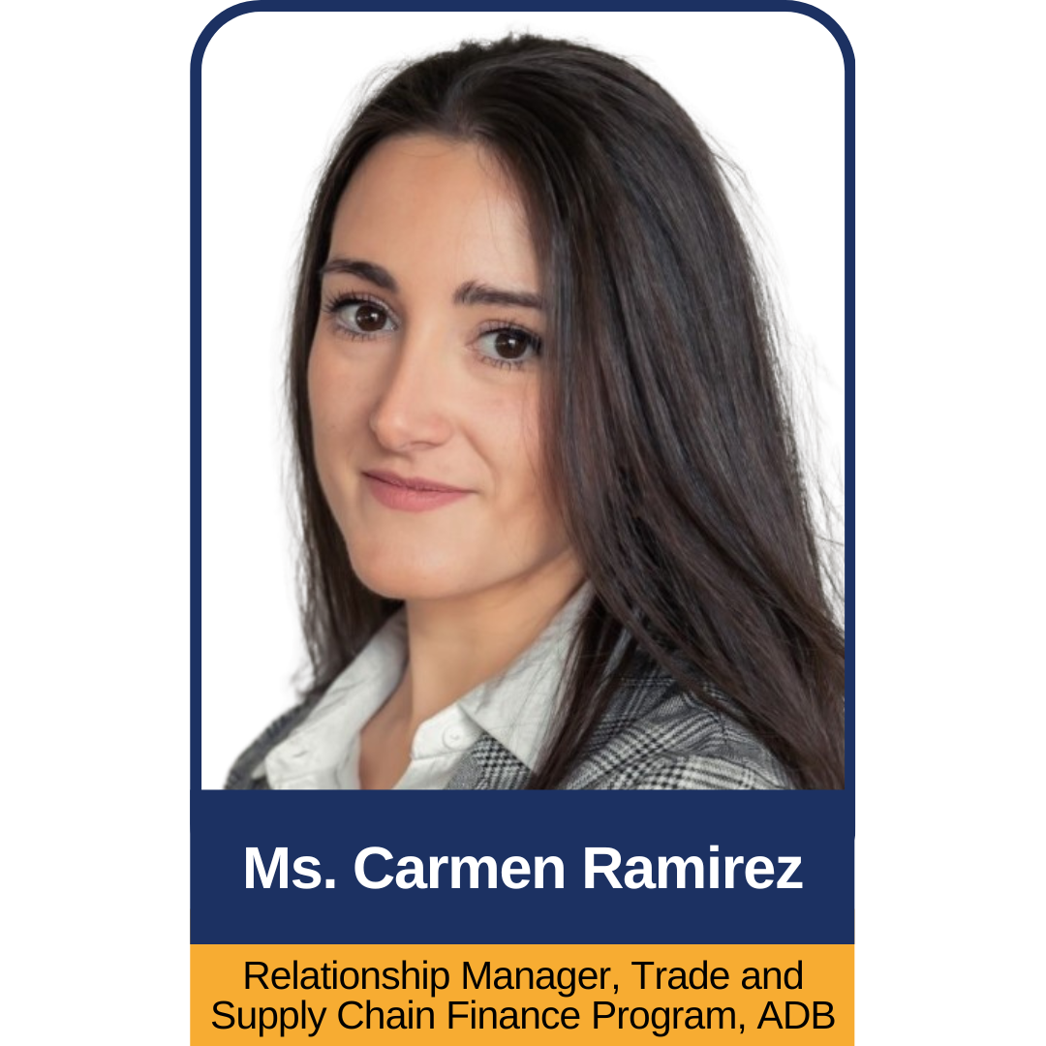
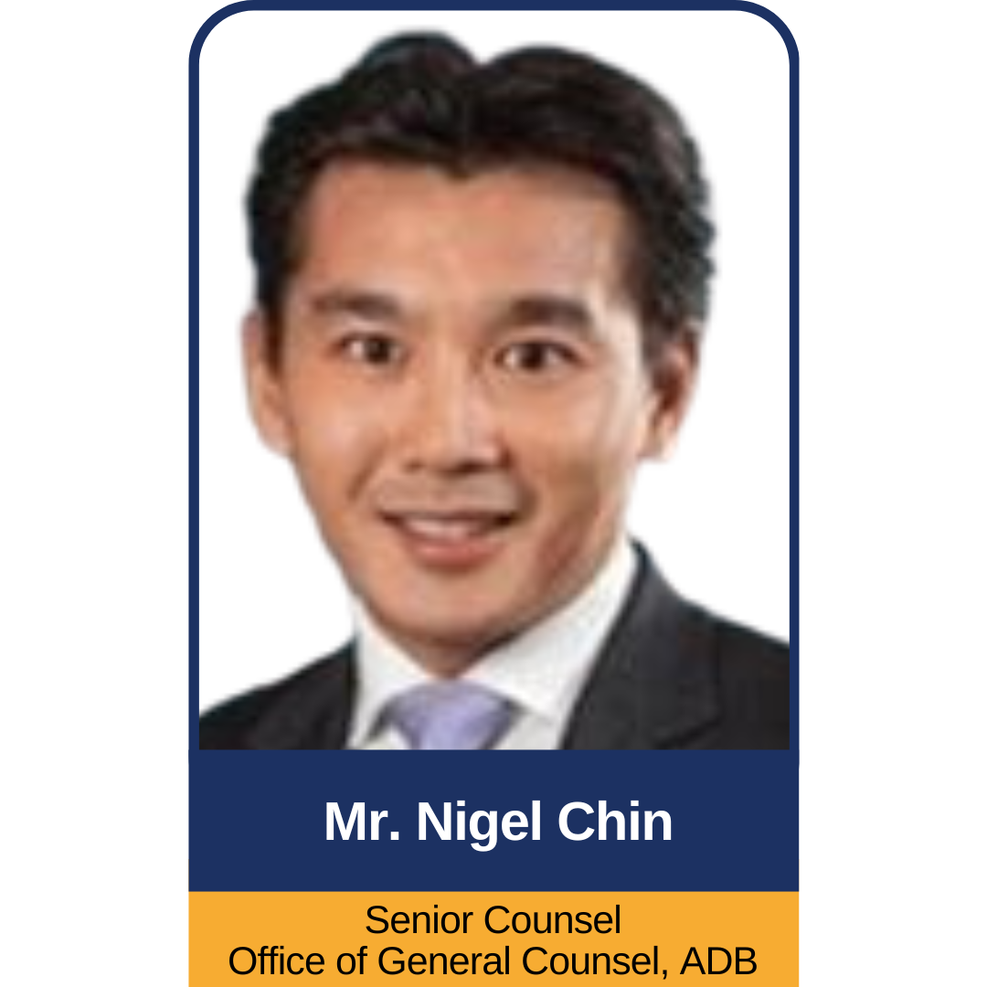
OPENING & SCOPE
Georgia: Model Law on Electronic Transferable Records (MLETR) Capacity Building

Slide 3

WELCOME REMARKS
Mr. Kamel Bouhmad
Deputy Director
ADB Georgia Resident Mission
Georgia: Model Law on Electronic Transferable Records (MLETR) Capacity Building

Slide 4

WELCOME REMARKS
Mr. Vladimer Khundadze
Deputy Head of the Service
Georgia Revenue Service
Georgia: Model Law on Electronic Transferable Records (MLETR) Capacity Building

Slide 5

Criticality of Digital Trade
Mr. Giorgi Kacharava
Executive Director
EU – Georgia Business Council
Georgia: Model Law on Electronic Transferable Records (MLETR) Capacity Building

Slide 6

The need for a 21st century fit digital trade ecosystem:
The importance of legal reform
Mr. Chris Southworth
Secretary General
ICC United Kingdom
Georgia: Model Law on Electronic Transferable Records (MLETR) Capacity Building

Slide 7

Today
Digital Trade Roadmap
2023
Future
Action plan
The system is inefficient, costly and complex.
System’s interoperate enabling trade to be cheaper, faster, simpler and more sustainable.
Digitalise 60-80% world trade by 2026
Antiquated laws — heavily paper-based systems
Digitalised commercial trade documents not accepted in 188 countries
27 documents in a typical trade transaction
4 billion paper based documents
2–3 months average trade transaction time
1% of bills of lading are in digital form
Digital islands – fragmented systems
Information unable to flow between actors in standardised formats
Data can’t be aggregated across global supply chains
Technology solutions unable to scale effectively across borders
Trade finance gap - access to working capital
$1.7 trillion trade finance gap
Trade is paperless and frictionless — all trade documents are handled in digital form
Trade platforms, systems and processes are fully interoperable — information is flowing in standardised form across borders between the public and private sector
Trade finance gap is reduced 50%
Trade transaction costs are 80% cheaper
Average cross border compliance processing time is 1 day instead of 25 days
Atomic settlement is the norm — payment happens automatically when goods cross the border
Smart technology solutions are reducing the burden of KYC and AML bureaucracy and tackling fraud
Smart contracts are the norm
Transparent, real time data provides greater supply chain transparency
Remove legal barriers to digitalizing commercial trade documents
Align legal systems to UNCITRAL Model Law on Electronic Transferable Records [MLETR]
Provide a scalable legal environment - support the MLETR commitment in WTO Ecommerce negotiations [Joint Statement Initiative]
Apply common digital standards across public and private sector platforms and systems - WTO/ICC Standards Toolkit for Paperless Cross Border Trade

Slide 8
Key messages
Digitalisation is about establishing a modern trade system, fit for purpose for the 21st century
The business case is clear
Cheaper, faster, simpler trade
Enabling sustainable global supply chains
Trading more securely
Increasing access to short term working capital to fund SME trade growth
Promoting inclusion – making trade work for everyone
Open, interoperable systems are the priority
Enable platforms and systems to connect so commercial [B2B] trade information to flow in unhindered in standardised, digital formats
Digitalisation is an opportunity to use data more effectively
Simplify the way we trade – not digitalise a bureaucratic system that is 200 years old
Public, private partnership
Digitalisation is a shared endeavour between nations, industry and governments - collaboration not competition

Slide 9

Introduction to MLETR
Ms. Tianmi Stilphen
Lead, Regulatory Affairs
ICC Digital Standard Initiative
Georgia: Model Law on Electronic Transferable Records (MLETR) Capacity Building

Slide 10
Model Law on Electronic Transferable Records (MLETR)
Introduction
Prepared for Georgia Revenue Services
April 2023

Slide 11

THE CHALLENGE TODAY
The Challenge Today
The current legal treatment of electronic transferable records inhibits market demand and innovation.
Most jurisdictions continue to require paper-based trade documentation.
Parties to a transaction cornered to use private law contracts within closed-loop trading platforms.
As a result, organizations must adopt multiple products for customers in different jurisdictions to enable the transferal of electronic records.
This is inefficient for large organizations and cost-prohibitive for SMEs.
End result: 0.1% of BLs issued electronically in 2020.
5% made the full transition to eBL; 27% using eBL + paper; all rest use paper*
*278 participants from banks, freight forwarders, carriers, shippers, agents, consignees, and others across 66 countries

Slide 12
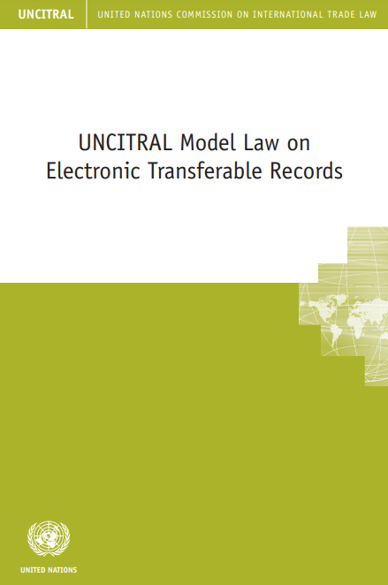
The Solution: MLETR
The UNCITRAL Model Law on Electronic Transferable Records (MLETR) creates an enabling legal environment for paperless trade. It:
provides an international framework to align national laws and enable the legal use of electronic documents of title (electronic transferable records or “ETRs”) both domestically and across borders;
builds on the principles of non-discrimination against the use of electronic means, functional equivalence, and technology neutrality underpinning all UNCITRAL texts on electronic commerce;
enables the use of all technologies including registries, tokens and distributed ledgers;
was drafted in a multi-year, inclusive and transparent process by the United Nations Commission on International Trade Law, a subsidiary body of the UN General Assembly with a mandate to further the progressive harmonization and modernization of international trade law.

Slide 13

Advantages for SMES
Enables SMEs to leverage a wide range of tools, from email to more expensive trade documentary flow solutions to enable trade.
Prevents SMEs from having to sign up to multiple different documentary flow solutions with different rules and legal jurisdiction requirements.
Simplifies operating models and risk profiles of all shippers, customs departments, banks, buyers and sellers.
Incentivizes new business models and greater global inclusion.

Slide 14
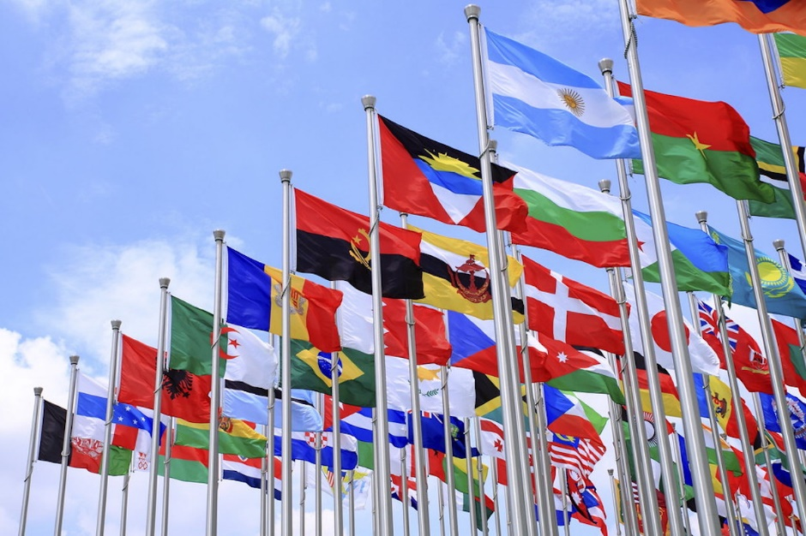

Advantages for States
Enhanced local and global value chain resilience to financial crises, commodity price movements, and pandemic events.
Promotion of rules-based trade documentation governed by state legislation, not private contracts.
Encourages modernization of business models, increasing market efficiency and enabling technological advancements.
Contributes towards the attainment of the UN
.

Slide 15




Sustainable Development Goals
SDG | Benefits
 | Digitization can alleviate poverty and reduce inequalities by facilitating global trade, reducing trade barriers, and promoting shared prosperity. Paperless trade will lead to trade-related efficiencies and tackle the trade finance gaps that dampen economic growth and job creation, lifting people from poverty and improving living standards.
 | Paperless trade will reduce the cost of trade finance, enhance inclusion for MSMEs by eliminating costly paper-based processes, reduce due diligence costs, simplify risk mitigation actions, and vastly reduce process turnaround times. These factors will enhance the sustainability of trade as an engine of economic growth.
 | An estimated 4 billion trade documents are in circulation. If stacked on each other, the documents would be 520,000 meters high and constitute approximately half a million trees.
 | Current technologies that could be enabled by legislative reform, including distributed ledger technology, will substantially reduce fraud risk via smart contracts, bringing greater trust to the international trade finance system.

Slide 16
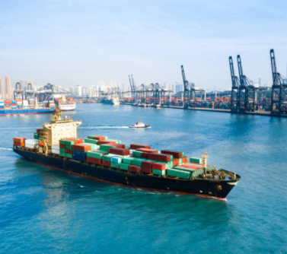
Economic Advantages: the UK Case
According to a study conducted by Coriolis Technologies and commissioned by ICC United Kingdom, modernizing laws in the UK will unleash SME growth and:
Generate £25 billion in new economic growth – 25% extra SME trade by 2024
Reduce the number of days needed for processing documents by up to 75%
Free up £224 billion in efficiency savings which can be recycled into the real economy
      £171 billion from bills of lading
      £26 billion from bills of exchange
      £27 billion from promissory notes
  Generate £1 billion to tackle the trade finance gap
Business Cases are also available on ICC DSI Website for:
G7
Germany
Commonwealth

Slide 17
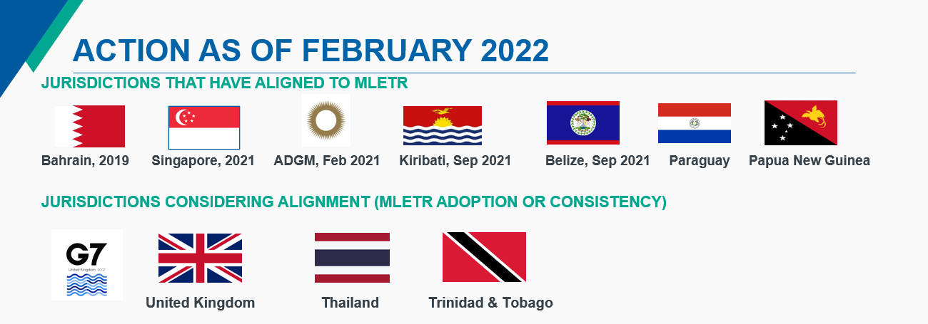









Adoption & Global Momentum
Jurisdictions that have adopted MLETR or Equivalent Legislations
*
Germany US
Jurisdiction in the Pipeline
UK Netherlands Canada France Japan Italy Thailand
June 2023
Trade Commitment & Multilateral Agreement
UK and Singapore reintroduced a provision in the E-commerce JSI
Chile, New Zealand, and Singapore Digital Economy Agreement
Singapore Australia Digital Economy Agreement

Slide 18
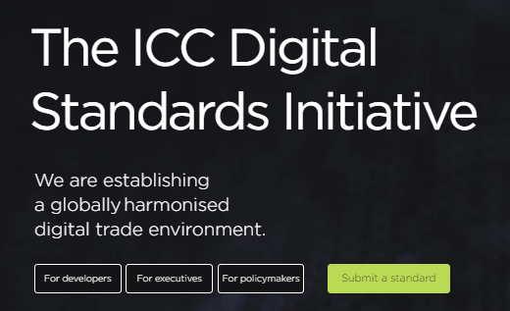
Thank you
https://www.dsi.iccwbo.org/lrab-legal-reform-advisory-board

Slide 19

MLETR in the global trade context
Ms. Angelia Chia
Partner
Simmons & Simmons
Georgia: Model Law on Electronic Transferable Records (MLETR) Capacity Building

Slide 20
MLETR in the global trade context
Tbilisi, Georgia
20 April 2023

Slide 21
UNCITRAL Model Law on Electronic Transferable Records (MLETR)
Background
Aims to harmonise rules on the recognition of electronic transferable records and consequently facilitate cross-border trade and economic development
MLETR does not change the
    substantive law on electronic transferable records
    private international law / conflicts of laws under the substantive law
MLETR builds on the fundamental principles underlying existing UNCITRAL texts in the area of electronic commerce, namely
    non-discrimination against the use of electronic communications,
    functional equivalence and
    technological neutrality

Slide 22
UNCITRAL MLETR – General principles
General Principle
Functional equivalence:
      “Purposes and functions of paper-based requirements may be satisfied with electronic communications, provided certain criteria are met.”
Technological neutrality:
      “Legislation shall not impose the use of or otherwise favour any specific technology.”

Slide 23
Conflict of laws
Conflict of laws
Conflicts of laws – bills of exchange are financial instruments created by statute in one jurisdiction, as such their
    form
    form of negotiation
    form of acceptance
    need for noting and protesting in other jurisdictions
give rise to conflicts of law issues / considerations
Convention for the Settlement of Certain Conflicts of Laws in connection with Bills of Exchange and Promissory Notes – ratified by 18 countries

Slide 24
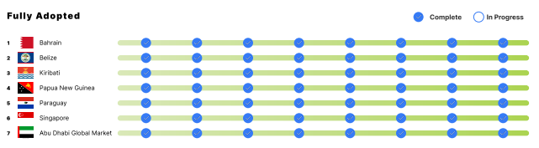

UNCITRAL MLETR adoption – status
MLETR Adoption
Source: ICC Digital Standards Initiative

Slide 25
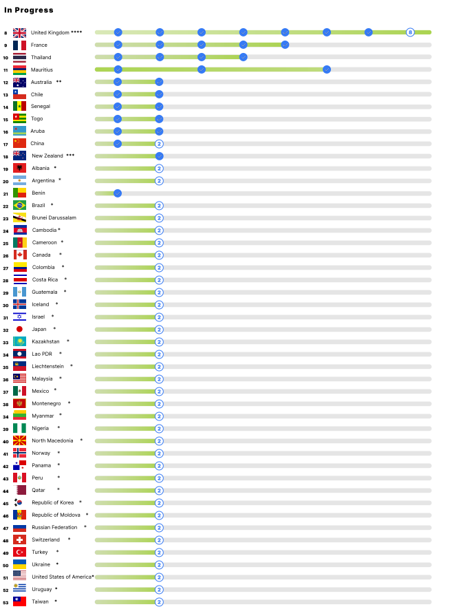
UNCITRAL MLETR adoption – status
MLETR Adoption
Source: ICC Digital Standards Initiative

Slide 26
Use Case
Use Case
Digital Bills of Exchange
Digital Promissory Notes
Digital Bills of Lading
Digital Warehouse receipts

Slide 28
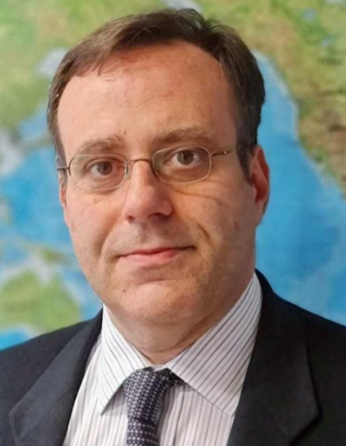
Trade digitization: the case for the adoption of the MLETR
Mr. Luca Castellani
Legal Officer
UNCITRAL
Georgia: Model Law on Electronic Transferable Records (MLETR) Capacity Building

Slide 29
Trade digitization: the case for the adoption of the MLETR
Luca Castellani
UNCITRAL Secretariat
The views expressed are those of the author and do not necessarily reflect the views of the United Nations and of UNCITRAL

Slide 30
Promoting digital trade
High-level goals:
  Make information available everywhere, anytime
  Enable data reuse and analysis
Success in digital trade is the result of policy, technical and legal choices
Need to have certainty and predictability on legal status
  Certain business is particularly risk-averse

Slide 31
Which laws are relevant for digital trade?
Digital trade law is a cross-cutting issue
  Contract, dispute resolution, transport, financing, etc.
Digital trade law is made of various components:
  E-transactions and e-signatures
  Data privacy and protection
  Cybercrime
  Consumer protection
Payments and intellectual property rights are also relevant
The implementation of these laws requires different resources
  For example, dedicated bodies to enforce cybercrime, data privacy and protection

Slide 32
UNCITRAL and digital trade law
UNCITRAL is the core legal body of the United Nations system in the field of commercial law
It is tasked with modernizing and harmonizing international business rules
  By drafting treaties and model laws
Has operated for 50+ years based on universal membership
UNCITRAL started working on legal aspects of electronic commerce already in the 1980s
UNCITRAL texts on digital trade (e-commerce) have been enacted in more than 100 States
Texts, status, preparatory and explanatory materials are available on the UNCITRAL website

Slide 33
UNCITRAL texts on electronic commerce
UNCITRAL Model Law on Electronic Commerce, 1996
  Enacted in over 80 States.
UNCITRAL Model Law on Electronic Signatures, 2001
  Enacted in about 40 States
United Nations Convention on the Use of Electronic Communications in International Contracts, 2005
  18 signatories, 18 States parties
  30+ States have enacted domestically its provisions
UNCITRAL Model Law on Electronic Transferable Records, 2017
  Enacted in 7 jurisdictions
UNCITRAL Model Law on the Use and Cross-border Recognition of Identity Management and Trust Services, 2022

Slide 34
The issue
Transferable documents and instruments / documents of title
  Holder may receive money or goods
  Examples: bills of lading, checks, bills of exchange, promissory notes, warehouse receipts, letters of credit
Can be used as collateral for financing
Contain best quality data about the commercial transaction
Law developed based on the use of paper
  How to enable their use in electronic form?

Slide 35
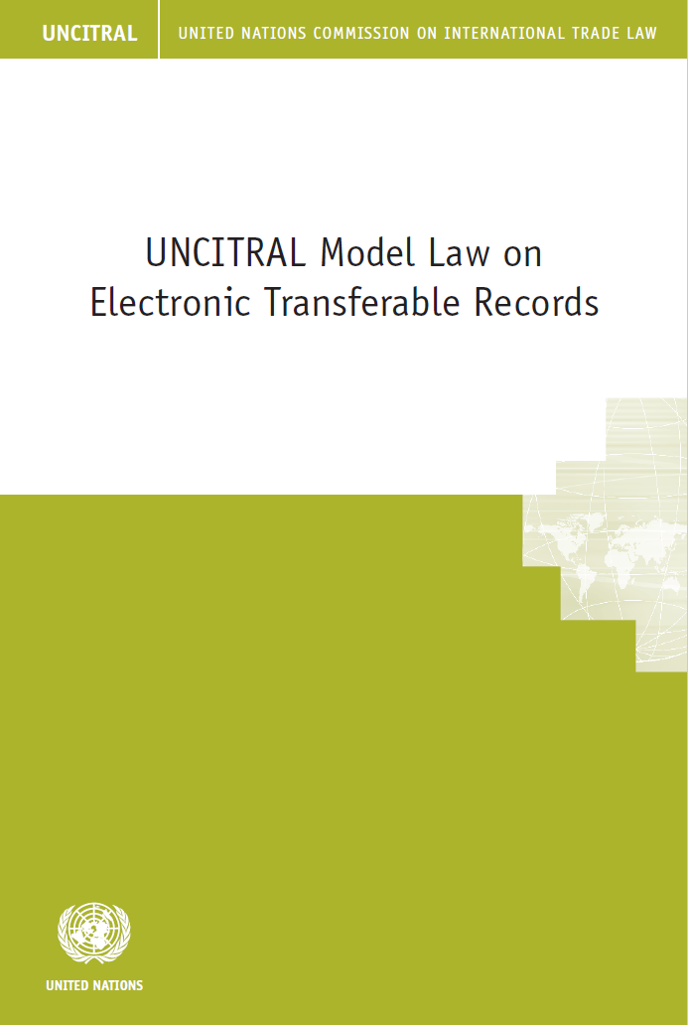
The solution:
UNCITRAL Model Law on Electronic Transferable Records (MLETR)
Adopted in July 2017
Text and explanatory note to the MLETR are available on the UNCITRAL website

Slide 36
MLETR: the features
  Enabling law: no new regulation or prescription
  Functional equivalence: apply same legal regime to electronic and paper-based documents
  Technology neutral (with DLT guidance)
  Main features:
    Singularity: prevent double spending
    Control: ensure that the person disposing of the ETR (e.g. requesting performance) is the one supposed to do so
    Integrity: record all events

Slide 37
Requirements for an ETR (art. 10)
ETR contains all information needed for paper document
  Plus, dynamic information (oracles, smart contracts)
A reliable method must be used to
  Identify an electronic record as the electronic transferable record
  Make the ETR subject to control for its whole lifecycle
  Retain the integrity of the ETR
All information relating to the ETR use during its lifecycle must be recorded

Slide 38
Possession and control (art. 11)
One key challenge is to define the equivalent of “possession”
  Possession is a factual circumstance that refers to tangible goods
  How to possess in a virtual environment?
The ETR management system must:
  Establish exclusive control over the ETR
  Identify the person in control

Slide 39
Preventing double-spending
Need to avoid multiple requests for the same performance
  Paper-based documents are supposed to be in original (often, a single document)
  From experience, paper-based documents are reliable, but far from perfect
  Documentary credit fraud is on the rise
The MLETR combines the notions of “control” and “singularity” to prevent multiple claims
One ETR = one claim for performance

Slide 40
Assurance of control and integrity
Control and integrity are to be implemented through technical solutions such as trust services
  For instance, transfer of control may be recorded with an electronic registered delivery service
Integrity requires that information remains “complete and unaltered”
  Blockchain / DLT may provide a higher assurance of integrity
Integrity does not mean immutability of the legal effects of the information recorded
  It is possible to record information that has legal effect contrary to the previous one

Slide 41
MLETR and business process re-engineering
Dematerialisation of commercial documents is a necessity
This provides an occasion to reengineer business processes and adapt them to current reality without affecting regulatory requirements
  E.g., confirmation of legal validity of e-bills of lading as a result of MLETR enactment may reduce banks’ capital requirements for financing under Basel III
  In the European Union, need to comply with
    eIDAS Regulation for trust services
    eFTI Regulation for B2G submissions

Slide 42
MLETR and paperless trade implementation
The commercial transaction is one: do we really need several commercial documents in electronic form?
A single ETR containing all trade-related data:
  replaces all commercial and compliance documents
    information is selectively shared with business partners
  enables integration of all data elements from various sources in a supply chain (“data pipeline”)
  ensures best data quality:
    up-to-date, complete, accurate and authentic
ETRs lie at the core of ecosystems enabling electronic transactions about logistics, finance and customs

Slide 43
MLETR and COVID-19 related trade disruptions
Risk reduction:
  paperless operations minimise risks and delays arising from personal interaction
Faster response:
  full control over logistics and customs supply chain allow to prioritise delivery of critical shipments
Robust economic recovery:
  improved management of trade financing allows easier, faster and more affordable access to credit, especially by SMEs.

Slide 44
How to enact the MLETR?
Some 100 States have already enacted UNCITRAL texts on e-commerce
The G7 has endorsed MLETR twice
UK, France, Japan are adopting MLETR
Germany and US have already adopted similar laws
Countries that have already adopted UNCITRAL texts may enact the MLETR as a new chapter of the electronic transactions law or as a separate chapter

Slide 45
MLETR in Georgia
Georgia has not yet adopted UNCITRAL texts
Law On Electronic Documents and Electronic Trust Services (სსიპ “საქართველოს საკანონმდებლო მაცნე”)
Scope
  Does not exclude electronic transferable records
  Leaves the possibility of using different standards in the financial sector (art. 1(3))
Issues
  Technology neutrality of trust services
  Cross-border recognition of e-documents (art. 12)

Slide 46
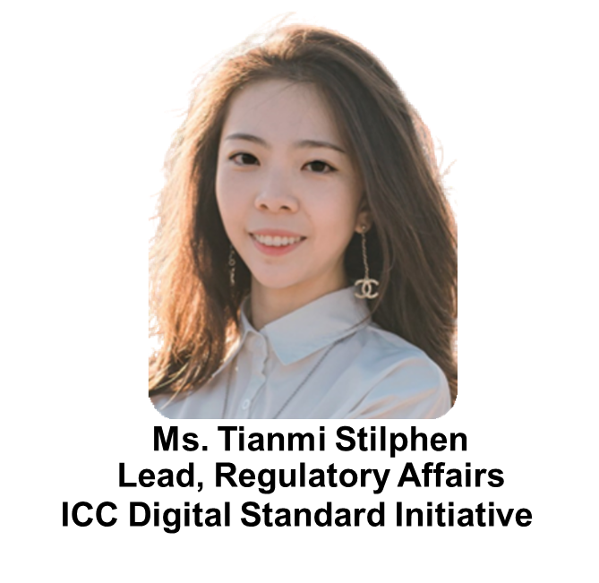

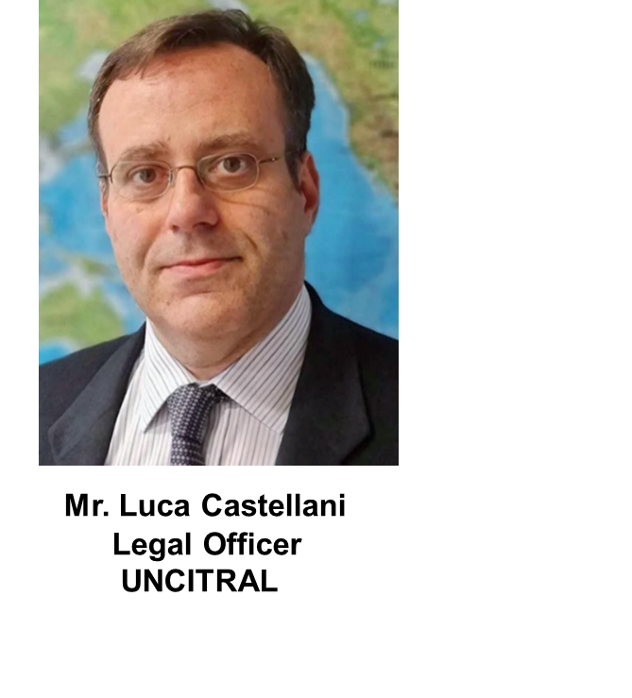
MLETR: Legal and technical practicalities
MODERATOR
PANELISTS
Georgia: Model Law on Electronic Transferable Records (MLETR) Capacity Building

Slide 47
QUESTION AND ANSWER
Georgia: Model Law on Electronic Transferable Records (MLETR) Capacity Building

Slide 48
LUNCH BREAK
13:00 – 14:15
Georgia: Model Law on Electronic Transferable Records (MLETR) Capacity Building

Slide 49

2nd Panel discussion
Implementation and benefits for private sector
Georgia: Model Law on Electronic Transferable Records (MLETR) Capacity Building

Slide 50
Singapore knowledge sharing
Trade Digitalisation:
TradeTrust
Mr. Kay Ren Yuh
Assistant Director
Infocomm Media Development Authority (IMDA)
Georgia: Model Law on Electronic Transferable Records (MLETR) Capacity Building

Slide 51
Trade Digitalisation:
TradeTrust
Transform the way you trade
Mr Kay Ren Yuh
Assistant Director, TradeTrust
Digital Utilities Cluster

Slide 52



IMDA - ARCHITECTS OF SINGAPORE’S DIGITAL FUTURE
Mission
Drive Singapore’s digital transformation with infocomm media
Vision
A dynamic digital economy and cohesive digital society, driven by an exceptional infocomm and media ecosystem
DIGITAL CHAMPION
INDUSTRY DEVELOPER
REGULATOR & PROTECTOR
ENABLER
Drive digital transformation across industries
Drive digital innovation for a vibrant digital workforce and a safe and inclusive digital society
Develop the digital tech and media industries as an engine of growth for Singapore
Drive cross-border digital collaborations to enable businesses to connect and transact globally
Master-planner for connectivity, digital infrastructure & standards
Help businesses leverage opportunities of digitalisation through programmes & technologies
Ensure resilient telecom & broadcast networks
Govern market conduct and protect consumer interest through infocomm, media, postal and data protection regulation
52

Slide 53
TRADE DIGITALISATION TO ADDRESS DIFFICULTIES WITH PAPER IN CROSS BORDER TRADE
Current State
Future State
Inefficient
• Manual handling
• Vulnerable to fraud
Trade Digitalisation could save^:
US$6.5billion in direct costs
US$15.5 billion indirect benefit to the shipping ecosystem
Enable US$30billion-$40billion in new global trade through the adoption of electronic Bills of Lading (eBLs) in international trade
Info exchanges
Fragmented
Systems
• Costly connections
• No interoperability
Shipping Cost
20%
Just 1 shipment involves
Many parties across different sectors
Many exchanges of information
Many silo systems
Up to 50 sheets of paper, exchanged up to 30 different stakeholders^
Cost of documentation is 20%* of cost of shipping
This inefficiency is costly
*Maersk and IBM’s Paper Trail Research in 2014 ^McKinsey Study in 2022
53

Slide 54
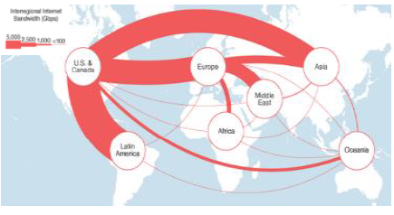

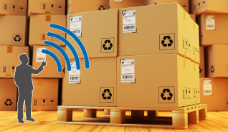
THE FUTURE OF TRADE IS DIGITAL
Geographical boundaries
redefined with digitalisation
E-commerce driving economic growth
Technologies changing trade and supply chains
By 2014, data flows accounted for a USD2.3 trillion in global GDP (~3.5% of total world GDP)
Global e-commerce sales hitting estimated $29 trillion
Radio Frequency Identification (RFID) used 13% of businesses in Europe (2017)
McKinsey analysis, Jan 2017
UN Conference on Trade and Development, Mar 2019
The Future of Trade, 2019
54

Slide 55




TOP OF MIND CONCERNS BY BUSINESSES
Lockdowns and supply-chain breakdowns have introduced
challenges for all countries’ businesses
Can we be sure of who we are trading with if we cannot meet them?
Can we still send invoices overseas and make payment?
Can we continue selling products and make deliveries to overseas clients?
What about physical trade documentation for bank loans and trade financing?
55

Slide 56



SINGAPORE’S DIGITAL ECONOMY BLUEPRINT
VISION
SINGAPORE AS A LEADING DIGITAL
ECONOMY WHICH CONTINUALLY REINVENTS ITSELF
STRATEGIC
PRIORITIES
ACCELERATE
COMPETE
TRANSFORM
DIGITALISING
INDUSTRIES
INTEGRATING
ECOSYSTEMS
INDUSTRIALISING
DIGITAL
Accelerate digitalisation
of existing sectors
Grow Singapore’s competitiveness by fostering new ecosystems, enabled by digital
Developing the next gen digital industry as
an engine of growth
ENABLERS
TALENT
RESEARCH & INNOVATION
POLICY, REGULATIONS & STANDARDS
PHYSICAL & DIGITAL INFRASTRUCTURE
56

Slide 57
START WITH THE END IN MIND - INTEROPERABILITY
No expectation that all links in the supply chain use the same technology platform or vendor
All links in the supply chain free to chose the technology stack /platform vendor of their choice
Interfaces between systems based on open, neutral and royalty-free data and protocol standards that enable multi platform, multi vendor, cross-border interoperability
Interoperability is the key
57

Slide 58
TRADETRUST’S 3 KEY FUNCTIONALITIES: AUTHENTICITY, SOURCE & TITLE OWNERSHIP FOR TRADE DOCUMENTS
TradeTrust is designed to provide industry the means to verify the authenticity and source of a document, as well as to create Electronic Transferable Records (ETRs) that are functionally equivalent^ to their paper versions (e.g. able to effect title transfers).
Core-Tech of TradeTrust
Verifiable Document
Transferable Documents
e.g. Certification, Licenses, Packing List, Purchase Orders, etc.
e.g. Bill of Lading
Uses Decentralised Identifiers (DID) and digital signatures to verify the source and authenticity of documents.
Uses Blockchain to create Non-Fungible Tokens (NFTs) to represent title ownership and enable transfers from one party to the next.
Verifying using DID* and digital signature
Using Non-Fungible Tokens (NFT) and smart contract
1
Authenticity
Any tampering
would be evident
2
Source
Genuine creators
of documents like Carriers, Govt authorities
3
Title Transfer
Legally-valid Performance
Obligation Transfer
^Singapore’s 2021 amendment of its Electronic Transactions Act (ETA), one of the first few internationally, enables the creation and use of ETRs such as electronic Bills of Lading (eBLs), empowering practitioners to reap the benefits of digitalisation more easily.
*Decentralized Identifiers (DID) are a new type of unique cryptographically verifiable identifiers that are designed to be decoupled from centralized registries, identity providers and certificate authorities
58

Slide 59

WHAT IS TRADETRUST?
TradeTrust is a framework that comprises globally-accepted standards that connect governments and businesses to a public blockchain to enable trusted interoperability of electronic trade documents across digital platforms AND it is offered as a digital utility.
4 Key Components of TradeTrust
2
Standards Development
1
Legal Harmonisation
Develop international standards that TradeTrust complies to
Provide legal validity for electronic negotiable documents through compliance to MLETR requirements
3
Accreditation Framework
Software Components
Certify technical solutions meet the requirements of the law
4
A set of open-source software code that can easily integrate backend solutions to the TradeTrust network
59

Slide 60
PRINCIPLES FOR DIGITAL DEVELOPMENT*
TRADETRUST DESIGN PRINCIPLES
Public Blockchain
Data Off-Chain
Payload Agnostic
No central governance
authority
Preserves data
confidentiality
No data format or
standards restrictions
Open-Source
MLETR-Compliant
Full transparency for faster adoption
Meet the requirements of the law
(for electronic negotiable documents)
*https://digitalprinciples.org/
MLETR = Model Law on Electronic Transferable Records published by United Nations Commission on International Trade Law in Sept 2017
60

Slide 61
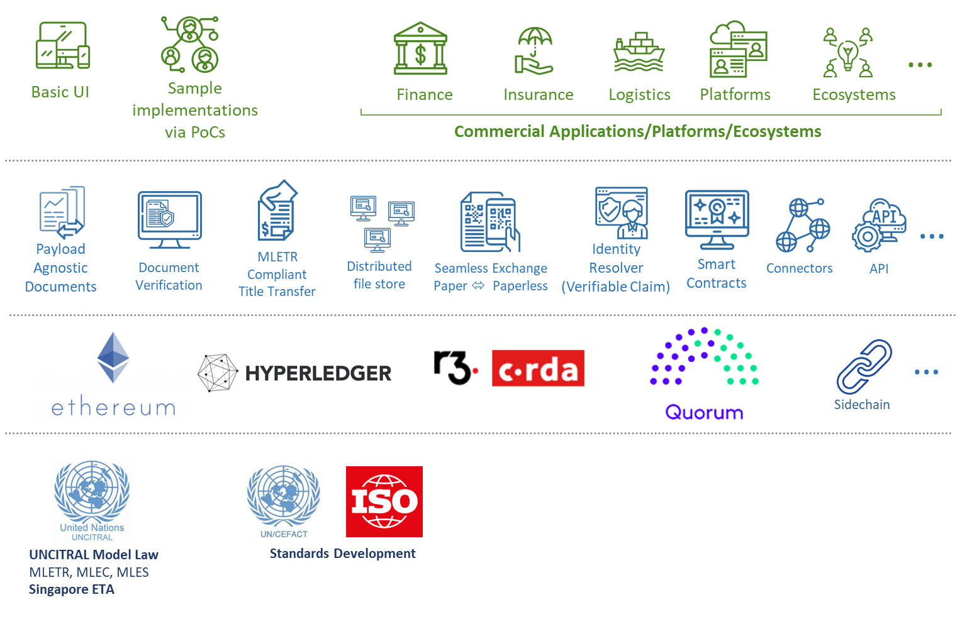


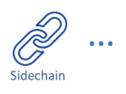

TRADETRUST FRAMEWORK IS ACCESSIBLE TO ALL
Application Layer
Blockchain Layer
61

Slide 62

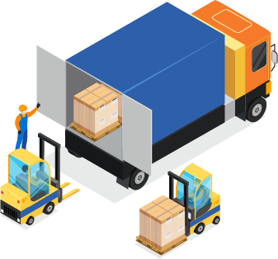
USE CASES
Impact
Use Case A
Trade Finance
Use Case B
Trade & Logistics
Other Use Cases?
Tech/Platform Service Providers
Improve operational efficiency through faster transfers of title and other documents digitally and automate document validation
Reduce risk of trade finance fraud and increase confidence in financing
Who can benefit?
Financing Banks, Exporters, Importers, Carriers, Insurers, Surveyors
Increase productivity and optimise asset utilisation through land logistics efficiency
Lower overhead cost of paper and reduce unnecessary demurrage and detention charges of holding cargo due to delay in documentation
Who can benefit?
Shippers, Consignees, Carriers, 3PL agents, Borders Control Authority, Port Operators, bunkering service providers
Improve service offerings through the development of innovative digital products and services using TradeTrust open-source code
Increase new business and partnership opportunities to drive a vibrant digital economy
Who can benefit?
Platform providers in bunkering, trade compliance, FinTech, digital art, supply chain, logistics services
62

Slide 63

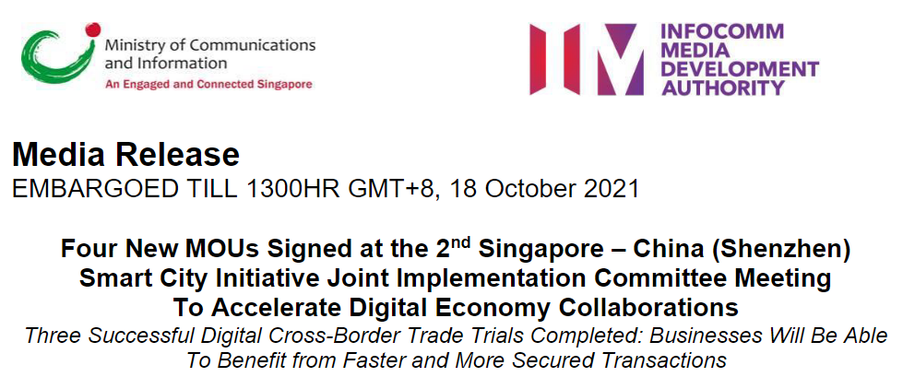


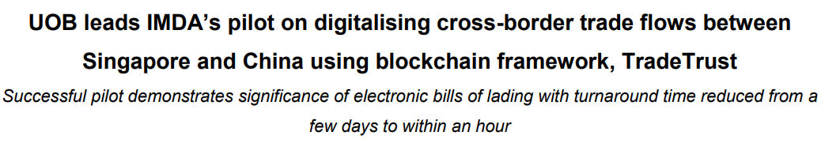
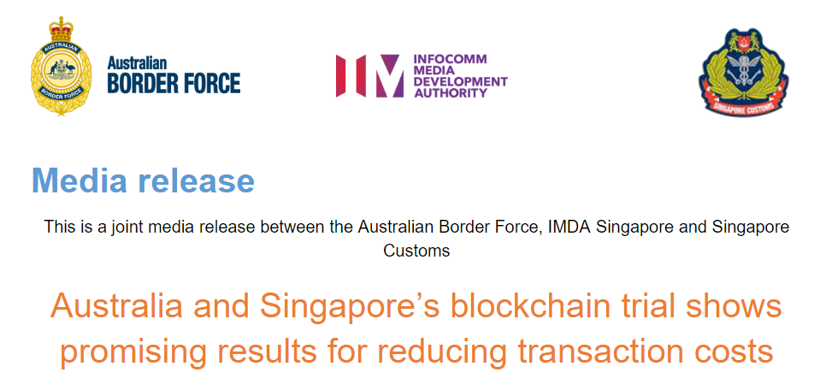



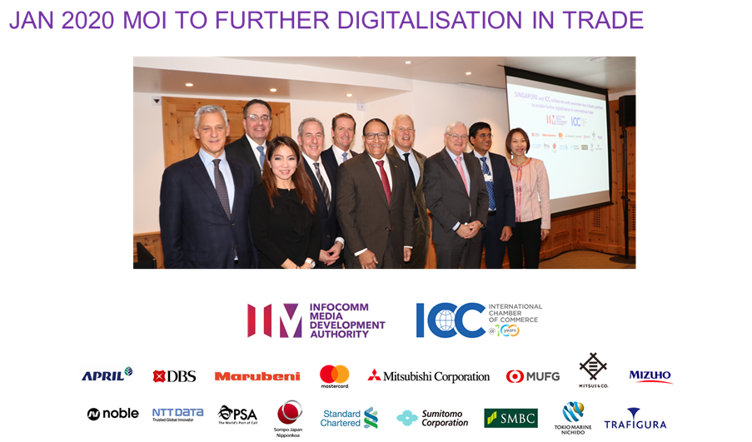
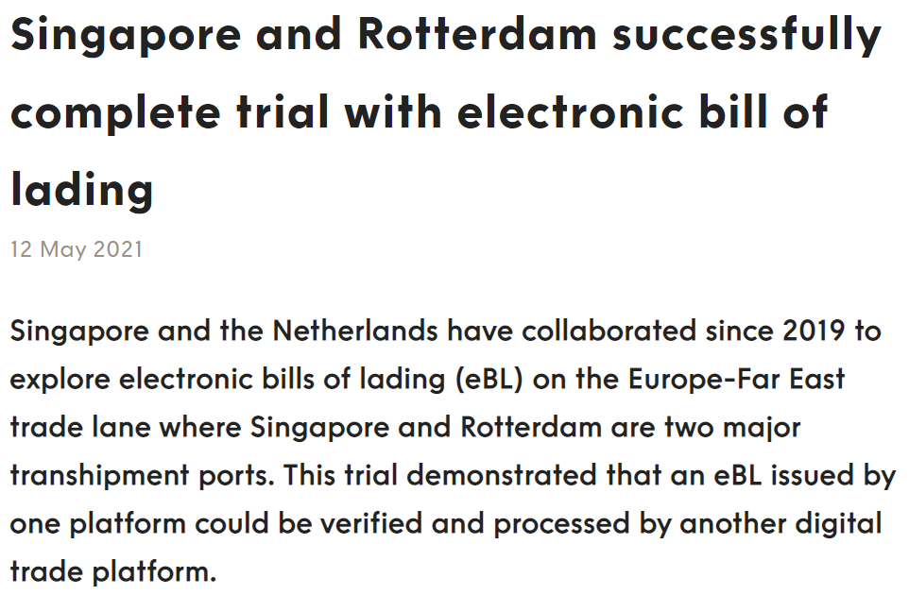

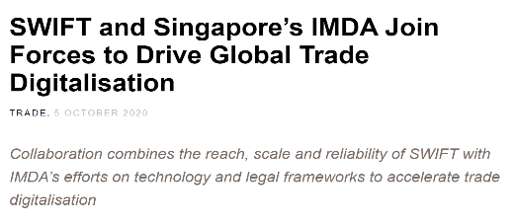







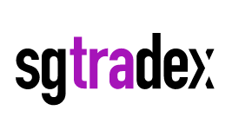





GLOBAL PARTNERSHIPS
c
c
c
PLATFORM PROVIDERS
63

Slide 64




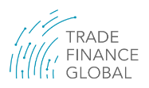


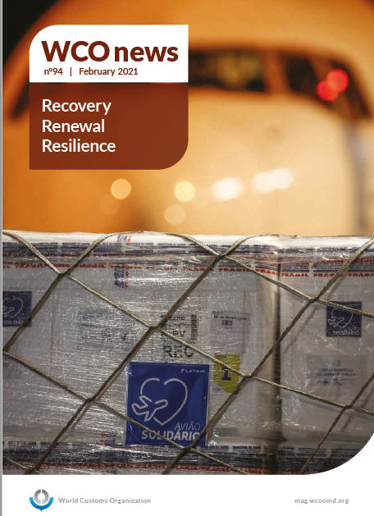
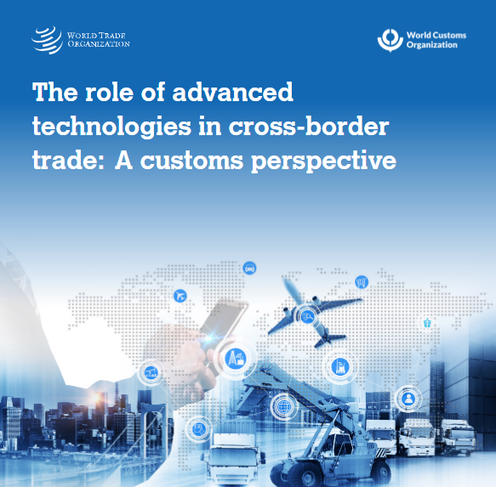
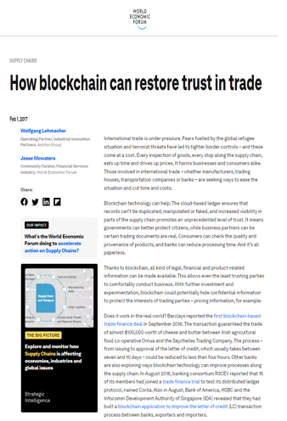
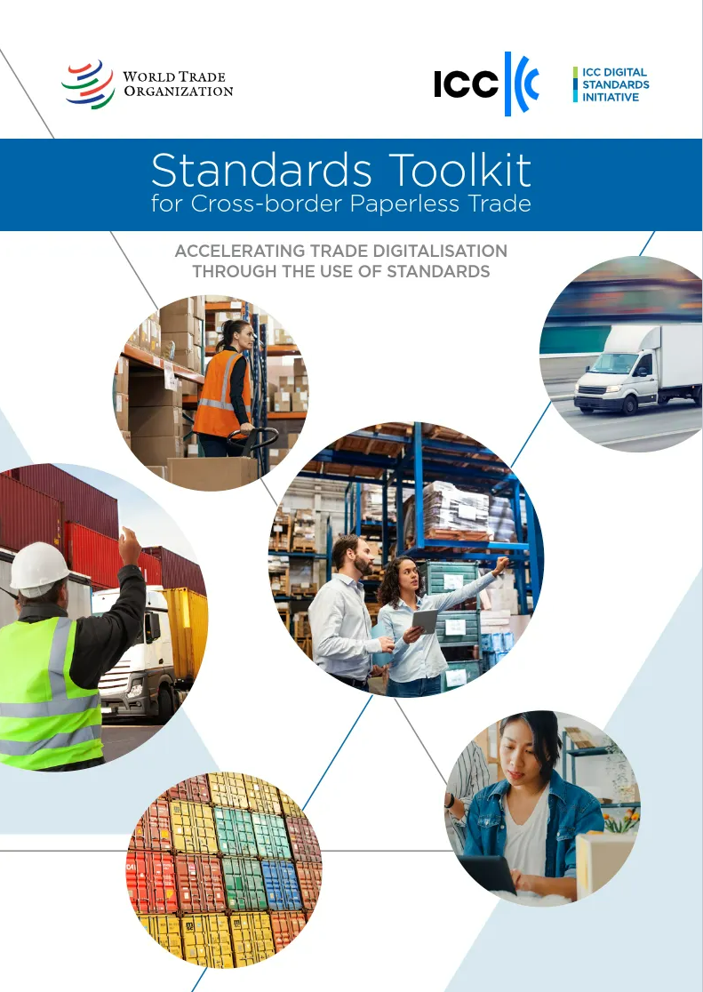
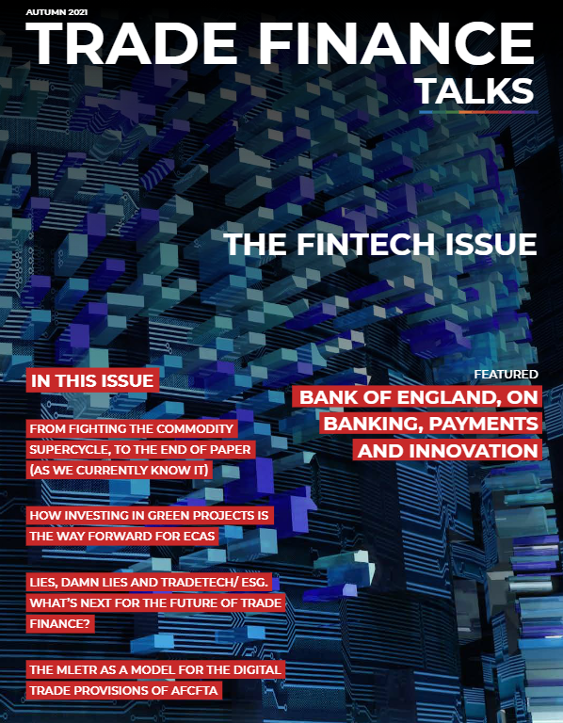
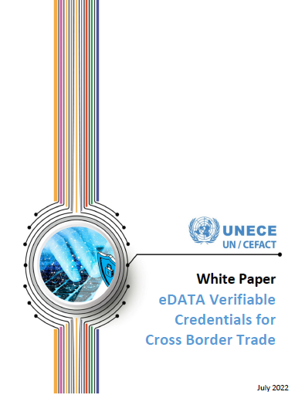
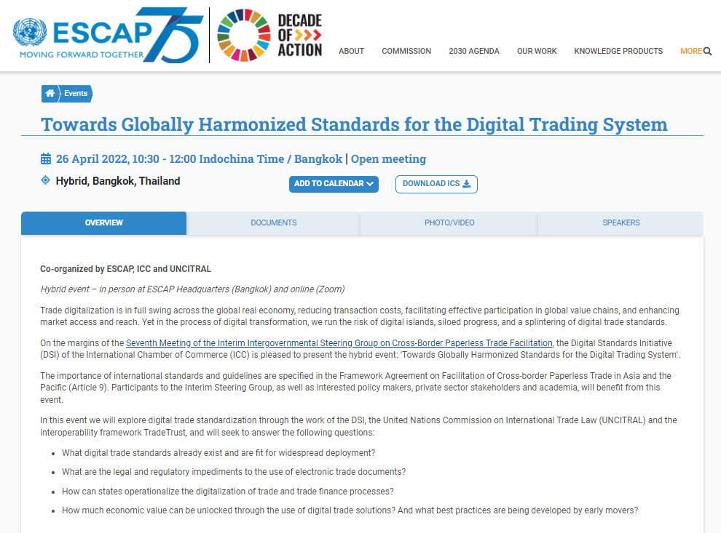

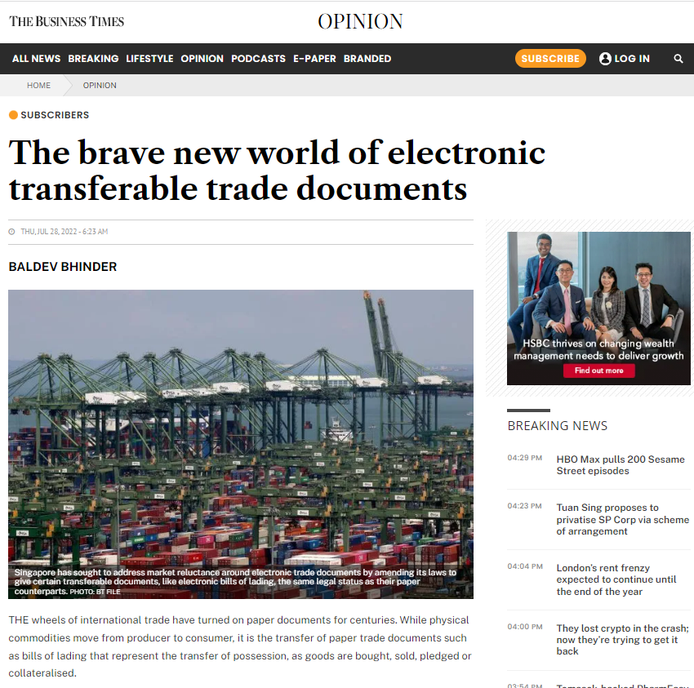
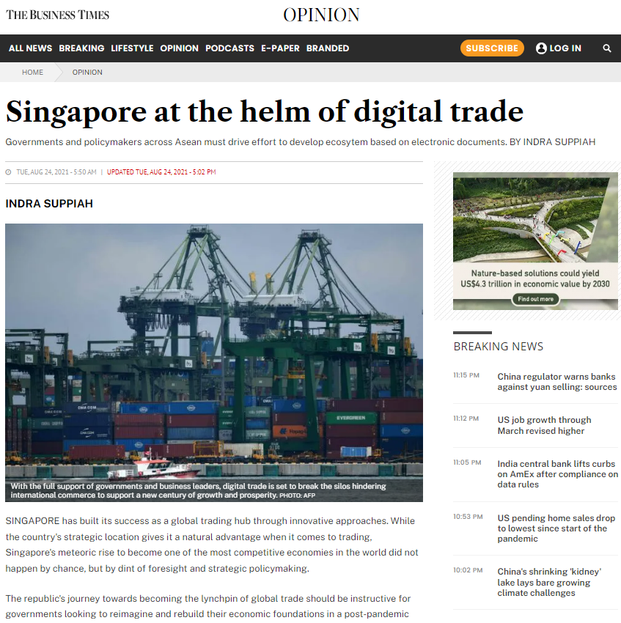
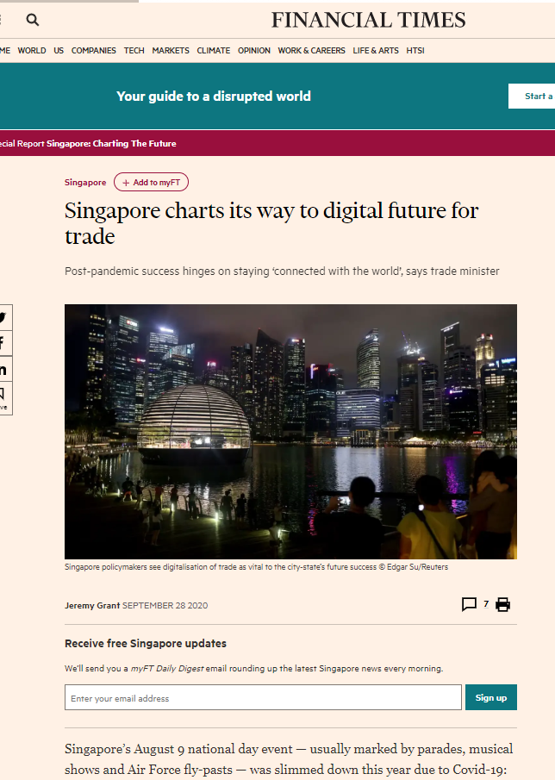
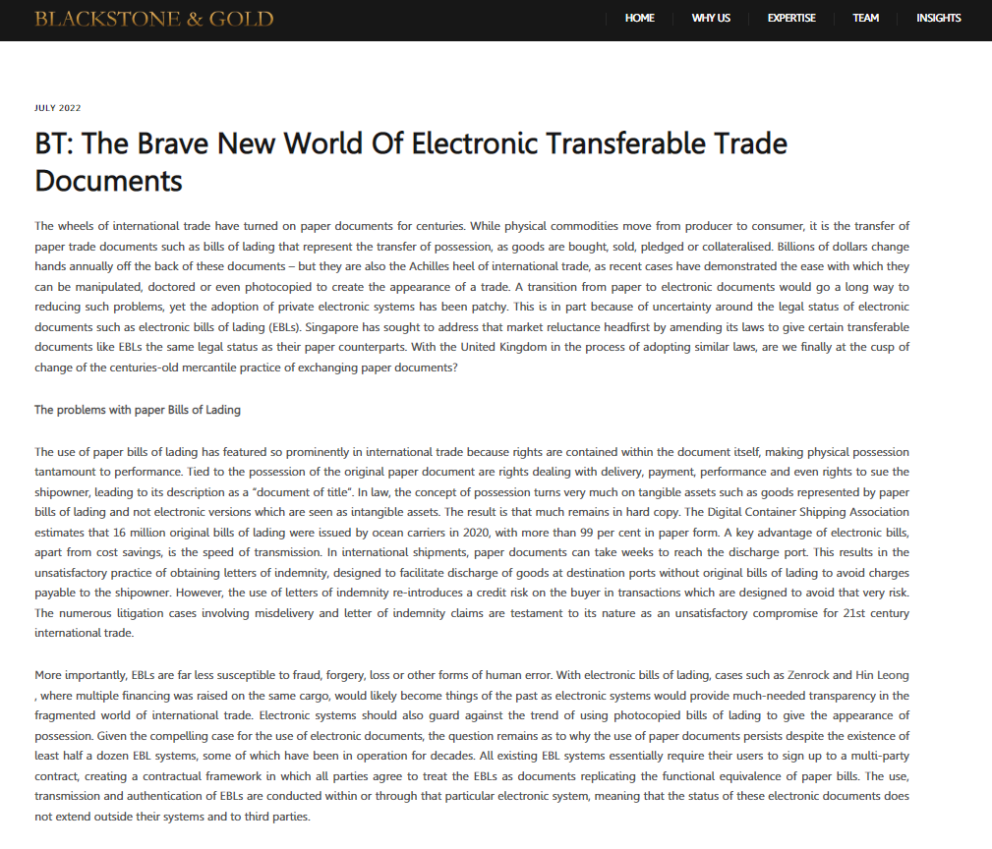
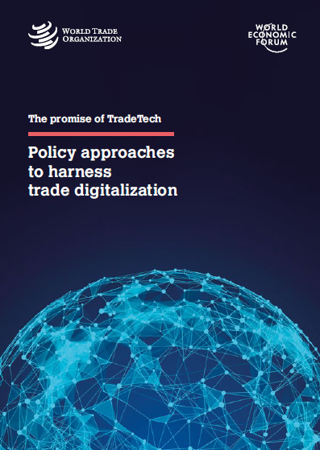
INTEREST FROM NOTABLE INSTITUTIONS GLOBALLY
https://mag.wcoomd.org/magazine/wco-news-94/tradetrust-accelerating-the-digitalization-of-international-trade
www.wto.org/english/res_e/publications_e/wcotech22_e.htm
www.weforum.org/agenda/2017/02/blockchain-trade-trust-transparency
https://iccwbo.org/publication/standards-toolkit-for-cross-border-paperless-trade
www.tradefinanceglobal.com/posts/imda-tradetrust-interoperability-framework-road-to-achieving-cross-border-paperless-trade
unece.org/sites/default/files/2022-06/010_Verifiable-Credentials-CBT.pdf
www.unescap.org/events/2022/towards-globally-harmonized-standards-digital-trading-system
www.businesstimes.com.sg/opinion/the-brave-new-world-of-electronic-transferable-trade-documents
www.businesstimes.com.sg/opinion/singapore-at-the-helm-of-digital-trade
www.ft.com/content/05504fcb-11e6-47a0-8860-7d156d1d82ab
www.blackstonegold.com/bt-the-brave-new-world-of-electronic-transferable-trade-documents
www.wto.org/english/res_e/publications_e/
tradtechpolicyharddigit0422_e.htm
64

Slide 65
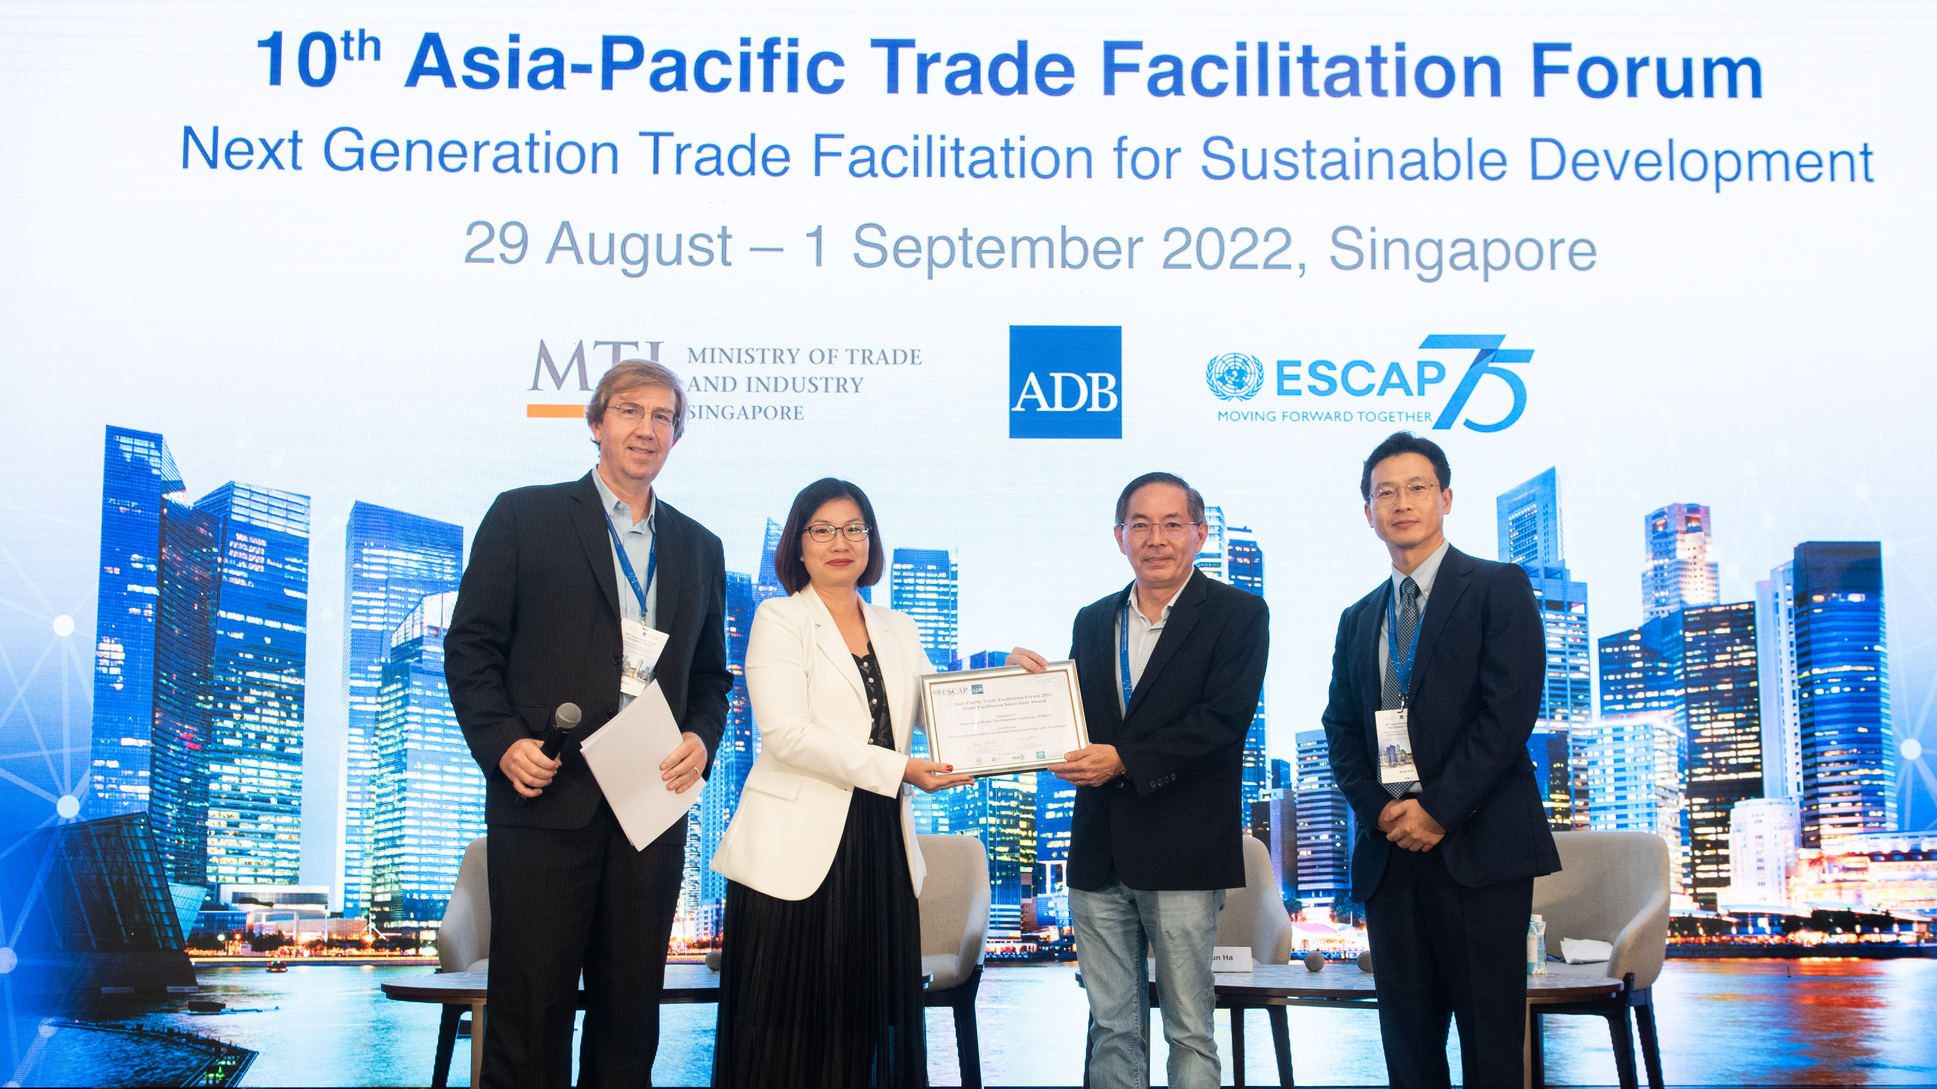
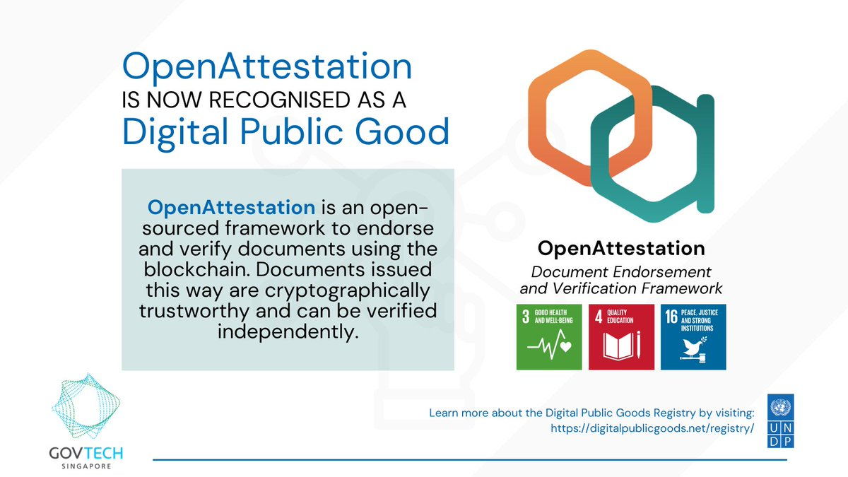
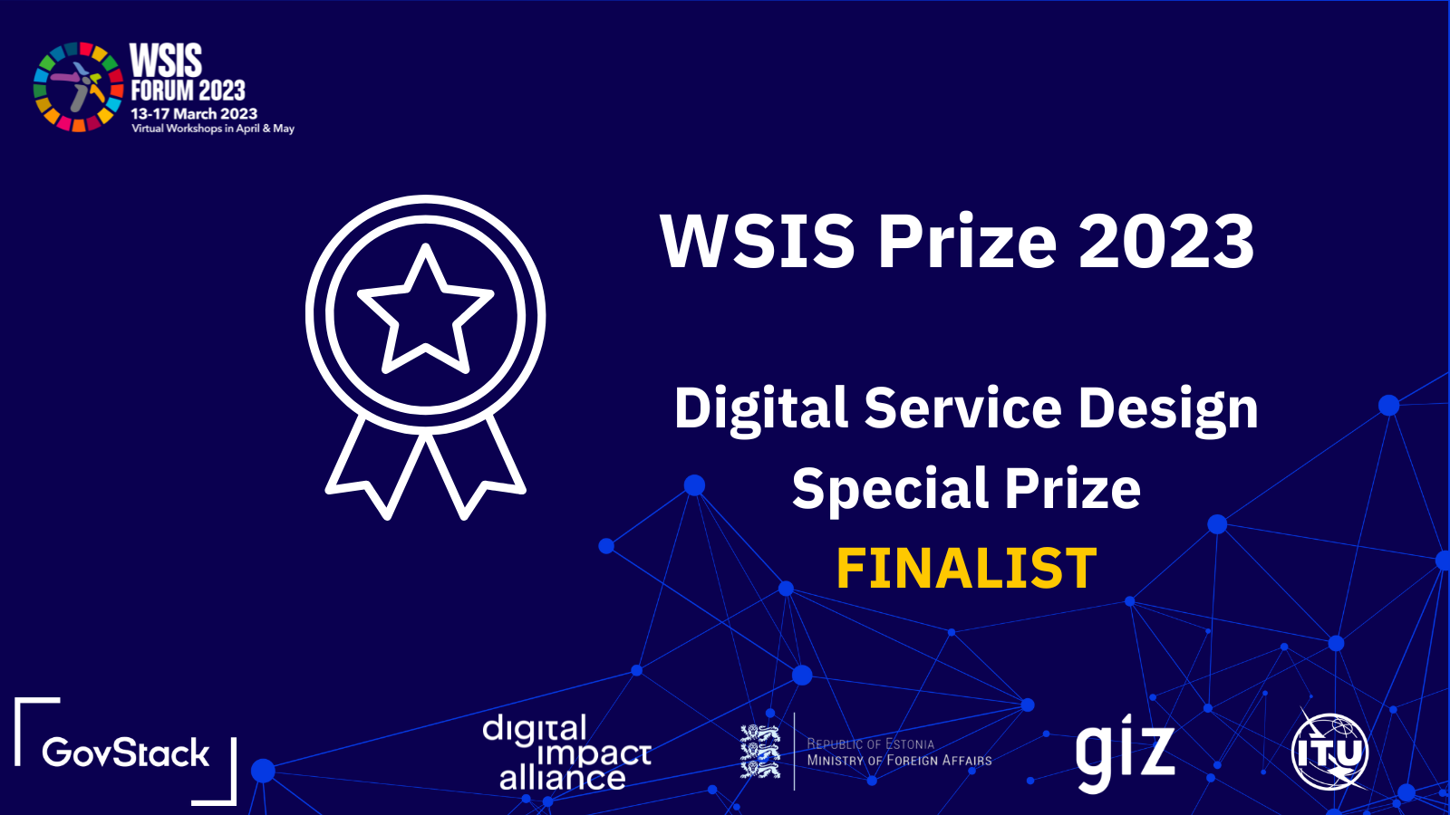
INTERNATIONAL RECOGNITON OF TRADETRUST IS GROWING
July 2022
Publication of eData VC for Cross-Border Trade, with OA/TT listed as Recommended Solution
September 2022
Winner of APTFF 2022 - Trade Facilitation Innovation Award
Jan 2023
OA (which TT is built upon) registered as a Digital Public Good (DPG)*
March 2023
WSIS GovStack Digital Service Design Special Prize - Finalist
TradeTrust has been featured by international organisations such as:
ICC and WTO: ICC DSI and WTO’s Standards Toolkit for Paperless Trade.
WTO/WCO Report on Disruptive Technologies(2022)
WTO-WEF TradeTech Report (2022)
*https://digitalpublicgoods.net/digital-public-goods/
DPG Alliance Board: UNDP, UNICEF, German Federal Ministry for Economic Cooperation and Development (BMZ), iSPIRIT, Norwegian Agency for Development Cooperation (Norad), Sierra Leone Directorate of Science, Technology and Innovation (DSTI)
65

Slide 66

CALL TO ACTION
1) Use TradeTrust to co-create
If you’re from:
Shipping lines
Shippers/Consignees
Logistics Service Providers
Financial Institutions providing Trade Financing Service
Govt Authorities involved in cross-border matters
Surveyors
Bank
TRUST
Rail
Broker
2) Incorporate TradeTrust code into your Applications
Air Carrier
Competent Authorities
If you’re from:
Tech Companies
Platform Providers
Useful URLs:
Reference Implementation Website: https://tradetrust.io/
Docs: https://docs.tradetrust.io/
Source code: https://github.com/TradeTrust
TRUST
TRUST
Insurance
Customs
Road
Logistics/FF
Chambers of Commerce
For more info, contact us at:
tradetrust@imda.gov.sg
66

Slide 67
THANK YOU

Slide 68
Adoption of MLETR in Germany
Mr. Oliver Wieck
Secretary General, ICC Germany
Georgia: Model Law on Electronic Transferable Records (MLETR) Capacity Building

Slide 69

Adoption of MLETR in Germany
“Georgia: MLETR Capacity Building”
April 20, 2022

Slide 70
Context
Legal situation 2021
Legal situation 2022/23
Paperless Trade Initiative
Our services
Contact us

Slide 71
Context
The main obstacles to the digitisation of trade are:*
States are at different stages of regulating and legalising electronically negotiable documents.
The global trading system has different taxonomies, standards and technologies. Adaptations and alignment are gradual.
Digital networks are developing their own approaches and standards ("islands") without ensuring compatibility or interoperability with other networks.
*Result of an industry survey by the ICC in 2021

Slide 72
Legal Situation in Germany 2021
Digital opening clause in the German Commercial Code from 2013: electronic bills of lading, e-consignment notes, e-warehouse receipts, e-waybills and e-sea waybills:
  An electronic record performing the same functions as a document shall be deemed equivalent to a bill of lading, provided that the authenticity and integrity of the record are ensured.
Delegated regulation Art. 80 GG: The Federal Ministry of Justice and the Federal Ministry of the Interior are authorised to regulate the details by ordinance
Sept. 2021 (British G7 presidency): Proposal by German business associations to regulate the details of the use of electronic trade documents
October 2021: Establishment of a working group at ICC Germany to develop a draft regulation

Slide 73
Legal Situation in Germany 2022/23
March 2022: Decree of the Federal Minister of Justice on the development of an regulation.
Criteria for functional equivalence are included in the G7 Digital Ministerial Declaration in May 2022.
October 2022: ICC Germany presents a proposal by eleven trade associations for a regulation on the details of electronic freight and warehouse documents and a legal framework for electronic transport insurance.
February 2023: German Bundestag passes amendment to HGB and VVG on electronic transport insurance certificates = Germany 99% MLETR compliant (missing: e-bills of exchange)
Next steps 2023 (?): Adoption of the regulation

Slide 74
Paperless
Trade
Initiative
2023 Goals
Methodology
Pilots of national and international transactions in the sandbox
At least one fully digital live transaction between Germany and another MLETR country within one year
The aim is to execute one transaction with a letter of credit
Establishment of a PoC consortium: two commercial banks, one exporter, one importer, one freight forwarder, one technology provider
No fixed set of participants, open to additional partners/PoCs

Slide 75
Unsere Leistungen
How can ICC Germany help?
We offer know-how in the field of international trade, financing & digitalisation, especially with regard to the regulatory framework
We promote, support, advice and/or manage at least one transaction
We offer interdisciplinary and cross-sector exchange between all parties involved in a transaction
We consult in partner companies to facilitate internal processes
We take care of public relations incl. media, social networks, ICC Germany magazine, "Logistik & Recht" magazine, ICC events and much more

Slide 76
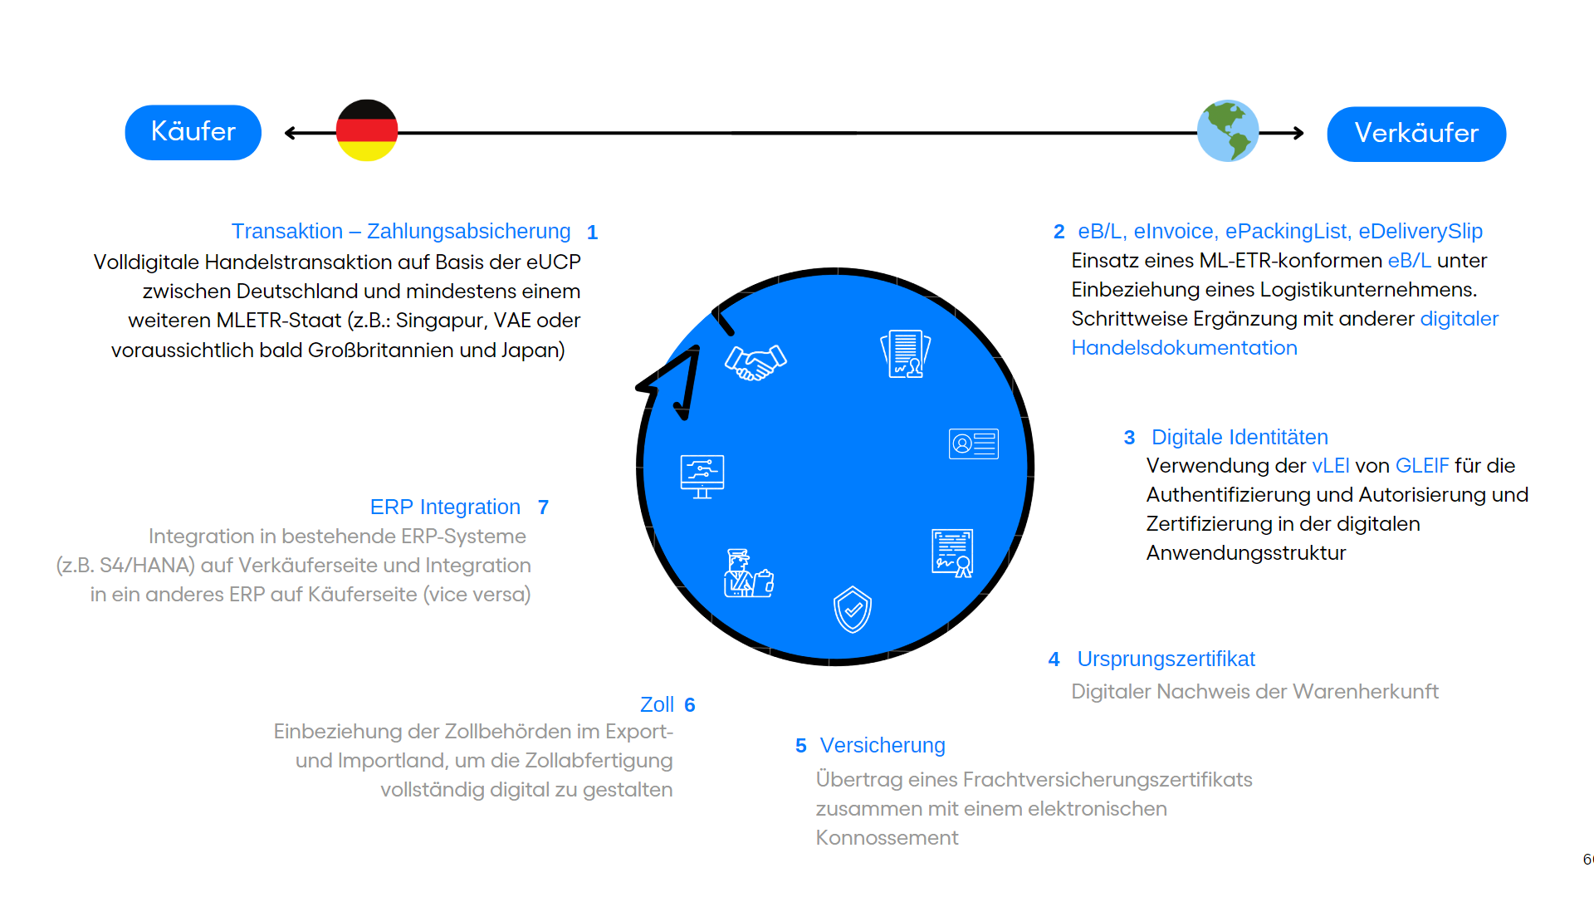
Outlook

Slide 77



Contact
Oliver Wieck
oliver.wieck@iccgermany.de
Dr. David Saive, LL.M.
d.saive@iccgermany.de
Wilhelmstr. 43g, 10117 Berlin
+49 30 / 200 73 63 00
icc@iccgermany.de
www.iccgermany.de

Slide 78
Implementation and benefits for private sector
Mr. Kay Ren Yuh
Assistant Director
Infocomm Media Development Authority
Mr. Oliver Wieck
Secretary General
ICC Germany
MODERATOR
PANELISTS
Georgia: Model Law on Electronic Transferable Records (MLETR) Capacity Building

Slide 79
QUESTION AND ANSWER
Georgia: Model Law on Electronic Transferable Records (MLETR) Capacity Building

Slide 80
CLOSING REMARKS
Ms. Eka Kubusidze
Head of Communications
Information and Modern Technologies Department
Ministry of Economy and Sustainable Development
Georgia: Model Law on Electronic Transferable Records (MLETR) Capacity Building

Slide 81
CLOSING REMARKS
Mr. Steven Beck
Head of Trade and Supply Chain Finance Program, ADB
Georgia: Model Law on Electronic Transferable Records (MLETR) Capacity Building

Slide 82
https://uncitral.un.org/en/texts/ecommerce/modellaw/electronic_transferable_records
https://www.dsi.iccwbo.org/
www.dsi.iccwbo.org/_files/ugd/8e49a6_3b277f4444f04ffcaef2b16f667ef6e4.pdf
https://www.unescap.org/kp/2022/readiness-assessment-cross-border-paperless-trade-georgia
Georgia: Model Law on Electronic Transferable Records (MLETR) Capacity Building

Slide 83
Thank you for Joining us Today!
Questions/Inquiries, please send to
TSCFP Knowledge Center
tscfpknowledge@adb.org
Georgia: Model Law on Electronic Transferable Records (MLETR) Capacity Building

