Slide 1



HIGH LEVEL ASSESSMENT OF Potential of Hydrogen Development in Central Asia
Overview of the Study Objectives
June 10, 2021

Slide 2
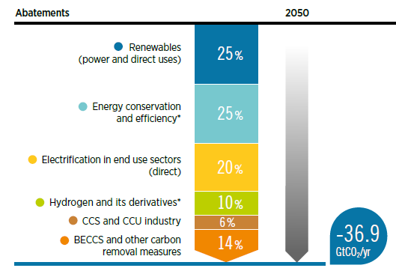
Introduction What drives the world-wide hydrogen economy?
Main levers to reach climate neutrality
Hydrogen is one of the main six components of the energy transition strategy
1. Energy Efficiency & Conservation
2. Renewables
3. Electrification end-use sectors
4. (Sustainable) BECCS
5. Hydrogen & Derivatives
6. CCS / CCU
Source: IRENA (2021), World Energy Transition Outlook
Notes:
A combination of technologies is needed to keep us on a 1.5°C climate pathway, in particular:
Stabilised energy demand through increased energy efficiency and circular economy measures while maintaining economic growth;
Decarbonised power systems with supply dominated by renewables to meet growing needs;
Electrification of end-use sectors, with the increased use of electricity in buildings, industry and transport;
Expanded production and use of green hydrogen, synthetic fuels and feedstocks to pursue indirect electrification;
Targeted use of sustainably sourced biomass, particularly in place of high-energy-density fuels such as those used in aviation and other transport modes, or in greening gas grids
The abatement estimates in the figure between the PES and 1.5-S include energy (incl. bunkers) and process related CO2 emissions along with emissions from non-energy use.
Renewables include renewable power generation sources and direct use of renewable heat and biomass.
Energy efficiency includes measures related to reduced demand and efficiency improvements. Structural changes (e.g. relocation of steel production with direct reduced iron) and circular economy practices are part of energy efficiency.
Electrification includes direct use of clean electricity in transport and heat applications.
Hydrogen and its derivatives include use of hydrogen and synthetic fuels and feedstocks.
CCS describes carbon capture and storage from point-source fossil-fuel-based and other emitting processes mainly in industry.
BECCS and other carbon removal measures include bioenergy coupled with CCS (BECCS) in electricity and heat generation, and in industry and other measures in industry.
Renewable energy plays a key role in the decarbonization effort. Over 90% of the solutions in 2050 involve renewable energy through direct supply, electrification, energy efficiency, green hydrogen and BECCS. Fossil-based CCS has a limited role to play, and the contribution of nuclear remains at the same levels as today.

Slide 3
Why looking to the hydrogen economy in Central Asia? –
Opportunities from a worldwide move to climate neutrality
A global transition to carbon neutrality induces risks in the region notably for countries with dependence on oil and gas exports
Renewable energy sources and (Green) H₂ production go hand in hand and can provide opportunities for the energy and industrial sector
  Large potentials for renewable energy sources in the region (solar PV, solar CSP, wind energy and hydro power)
  Renewable energy markets to reach 2.15 trillion USD by 2025
Links to China, Russia and potentially to Europe via existing or planned natural gas pipelines
Prospects for strengthening cooperation in the region on infrastructures (extending electricity interlinkages; upgrading gas infrastructures to the use and transport of H2)
Fit of downstream production of hydrogen-related products (ammonia, methanol, synthetic fuels, synthetic petrochemicals...) to present industrial policies to diversify industrial production and to put an accent of higher value products.
Source: Statista for size of renewable markets by 2025 (https://www.statista.com/statistics/639788/renewable-energy-market-size-worldwide-projection/)

Slide 4
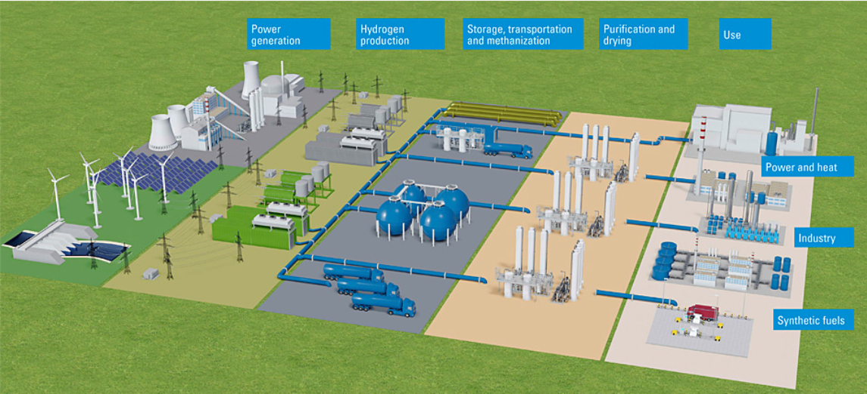
The Hydrogen Value Chain
Hydrogen value chain
Power generation (renewables, natural gas)
H2 Production
H2 Storage, transportation and methanization
H2 Purification and drying
H2 Use
Picture source: https://www.bilfinger.com/en/press/customer-magazine-bilfinger-now/articles/2020/03/the-hydrogen-value-chain/

Slide 5
Study Design – High level assessment of potential development of hydrogen in Central Asia
Objectives
Characterization of the renewable energy (RES) potentials by country
Techno-economic analysis for the cost of (Green) hydrogen and down-stream products in the region
Time horizon: Today (based on present RES cost), 2030/2050 (based on expected world-wide development of RES cost and electrolyser cost)
Estimates of Production – Hydrogen and Downstream Products
  Hydrogen
  Synthetic Ammonia
  Synthetic Methanol (includes also cost for carbon recycling (Direct Air Capture DAC)
  Synthetic Methane (includes also cost for carbon recycling (Direct Air Capture DAC)
  Green Steel (based on direct reduced iron + H2)
High-level analysis of domestic use of hydrogen in Central Asia (production sectors with potential H2 demand, supply relevance) (based on national production statistics)
High-level analysis of trade perspective (strength in exports with potential relevance for H2 demand, supply) (based on UN Comtrade import/export statistics)

Slide 6
Next Steps
Consultation with government counterparts on results of the assessment
Dissemination of results in the next CAREC ESCC Meeting
Support knowledge sharing on hydrogen development

