Slide 1

Presentation by Working Group Chairs:
Progress on CAREC Energy 2020-2022 Deliverables
31st ESCC Meeting
10 June 2021

Slide 2
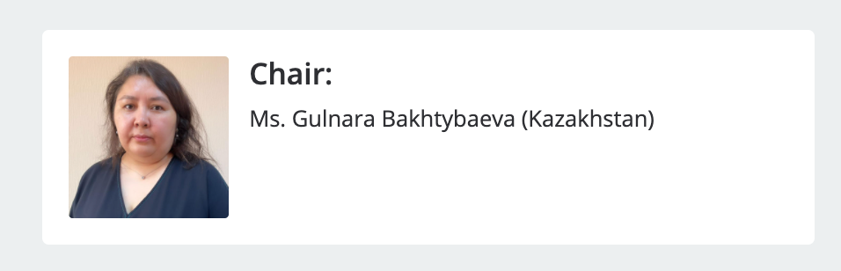
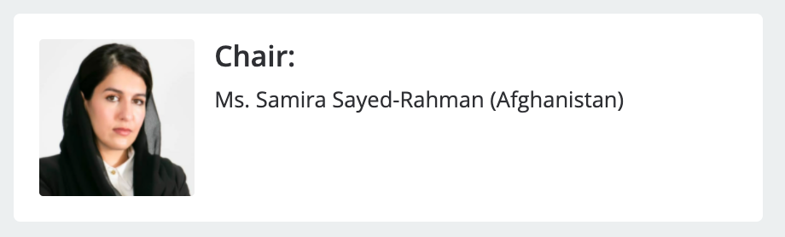
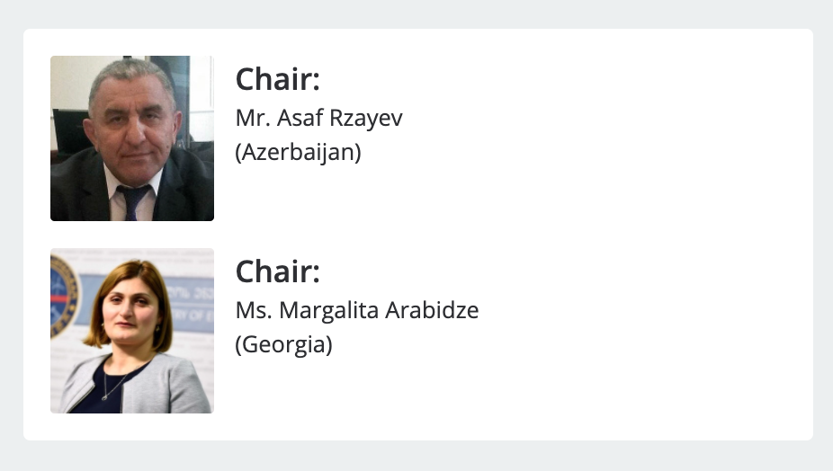
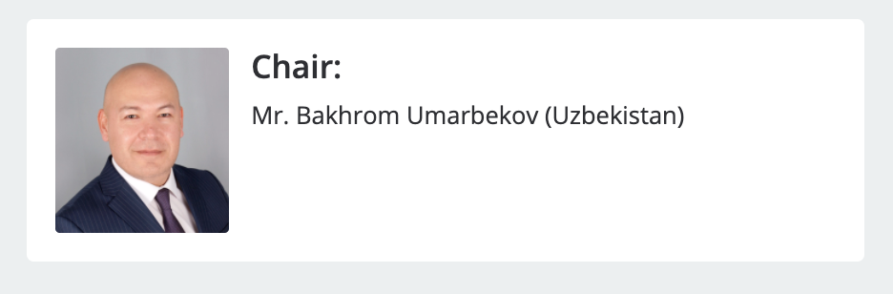
CAREC ENERGY WORKING GROUP CHAIRS
Energy Security and Connectivity
Women Empowerment
Energy Sector Reform
Greening the Energy System

Slide 3
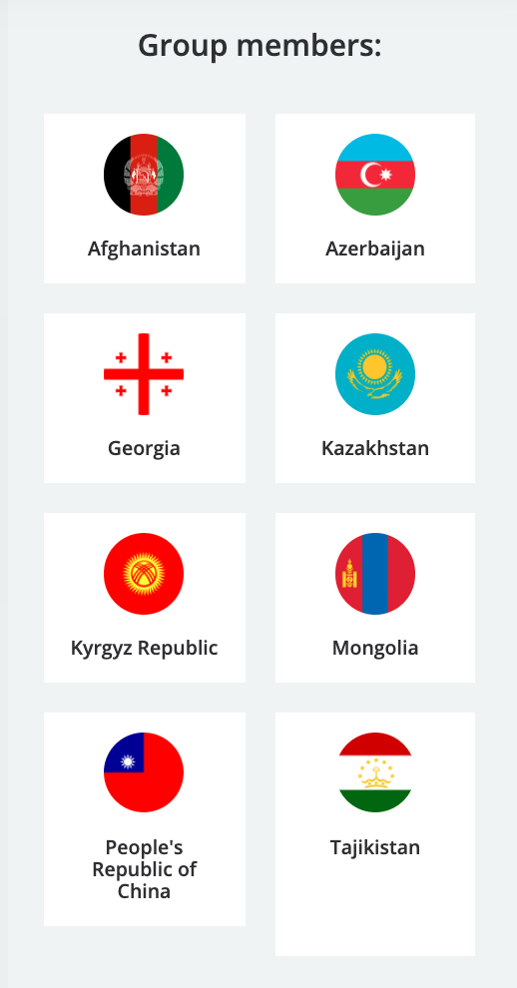


Slide 4

Energy Security and Connectivity
Conceptualization of a new regional
Transmission Cooperation Association (CATCA)
ROLE
BENEFITS
In-house project planning and professional implementation
No need for special agreements between countries
All CAREC countries can become members
Decisions making by high-level political decision makers
Strategic regional network planning
Centralized project management
Development of region-wide grid operation rules and standards

Slide 5
Approach
STEP 1 Develop Organizational Mandate | STEP 2 Prepare Roadmap | STEP 3 Produce Founding Documents
Organizational structure Decision making bodies Governing rules Responsibilities Working arrangements | Implementation phases Implementation schedule Staffing and structure at each phase | Elaborate draft founding documents for the establishment of CATCA

Slide 6



Slide 7

Sector Reforms
Development of a Virtual CAREC Energy Reform Atlas
www.carecenergy.org
Reform Atlas
Tariff Reform Toolkit
Manual on Unbundling
Vulnerable Consumer Protection Guide
Any other topic of interest
virtual toolkit with answers to typical dilemmas policymakers face during the reform process
interactive features, logical navigation, and professional layout
key principles
Visually appealing
User-friendly
Easy to update & extend
Links to examples

Slide 8





The Manual on Unbundling will focus on a 10-step unbundling implementation approach and discuss potential pitfalls to avoid
Reform Atlas Ideas – Digital Roadmaps
STEPS TO UNBUNDLING
Step 2:
Determine the appropriate number of entities at each value chain point
Step 5:
Assess the role of the regulator, markets, and competition
Step 1:
Identify appropriate points in the value chain to establish individual entity activities
1
2
Step 4:
Establish starting contractual relationships
Will identify potential “potholes” or pitfalls along the way that policymakers should be aware of and avoid. These will be informed by the case study analysis.
Step 3:
Delineate assets, accounts, and staffing
3
4
5
Step 6:
Explore the role of private sector and foreign investors
Step 7:
Optimize the capital structure for each entity
6
7
Step 8:
Allocate legacy liabilities
8
Step 9:
Examine whether protections for vulnerable customers are necessary
9
Step 10:
Develop long-term strategic plans for each entity
10

Slide 9


Slide 10

Women in Energy
Development of the 1st Women in Energy Program
Focus Area 1
Increase employability of women
Focus Area 2
Boost women’s education in key fields for the energy sector
Focus Area 3
Support visibility of CAREC women internationally
Focus Area 4
Enhance organizational capacity in designing gender friendly policies and workplaces
Action Plan 2030
Employability
Education
Visibility
Capacity

Slide 11
Women in Energy
Status Report on Women in Energy
We will be gathering data to compile a status report including:
  Data on women’s employment, generally and in the energy sector
  A summary of the barriers, obstacles or challenges that women face in advancing careers in the energy sector
  Individual country profiles
Please support us in disseminating our Questionnaire:
Links to English and Russian
3 March 2022: 1st CAREC Women in Energy Summit

Slide 12


Slide 13

Sustainable Energy
Concept for a new regional green financing vehicle &
Awareness Raising for Energy Efficiency
CAREC Green Energy Alliance
Proposed Scope: Renewables and Energy Efficiency
For Investors: Shopping mall for investment ready projects
For CAREC members:
Choice of Financiers (IFIs, private, commercial)

Slide 14

Consumer Leaflet on Energy Efficiency

Slide 15
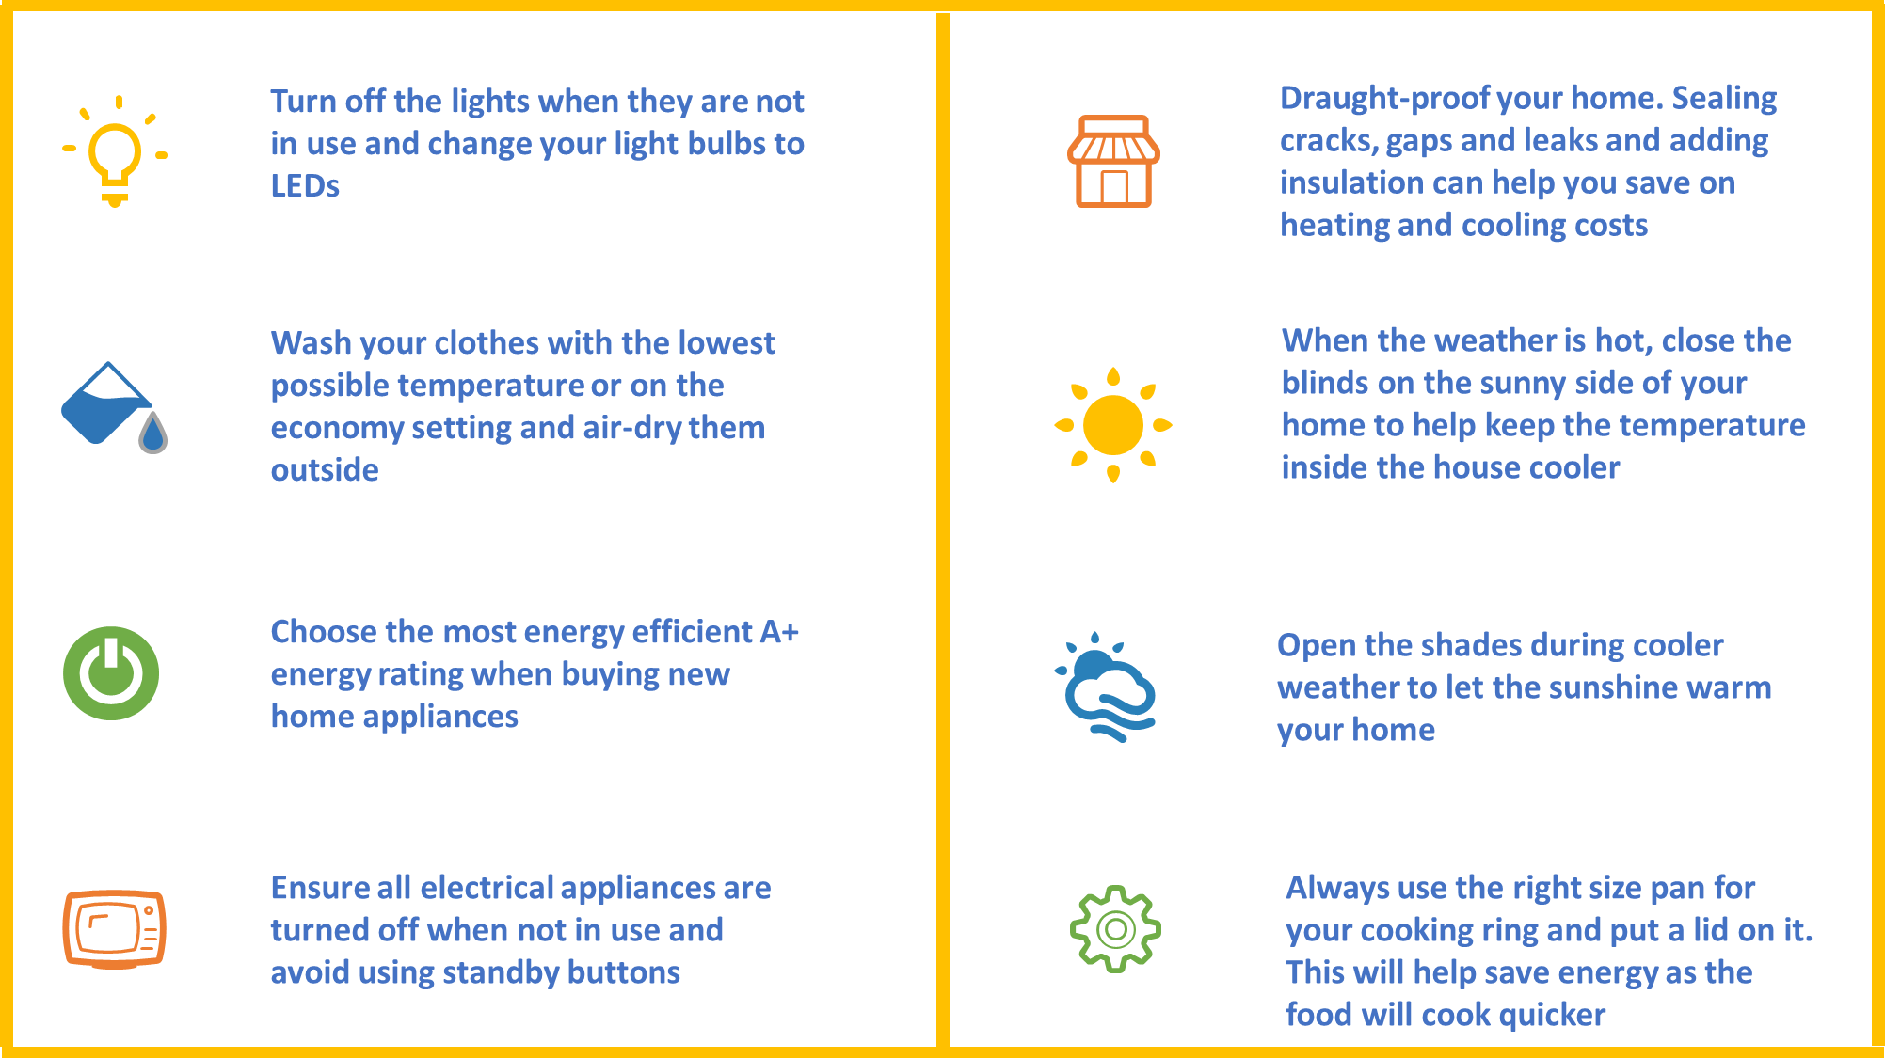
Consumer Leaflet on Energy Efficiency

Slide 16
Radio Commercial – Energy Efficiency
https://soundcloud.com/chirag-gupta-916115701/radio-commercial-carec-eng

Slide 17
TV Commercial – Energy Efficiency
https://youtu.be/1X1BfE0LrGY

Slide 18
Thank you!

