Slide 1

Launching a fresh era of cooperation:
New virtual connectivity and innovative working methods in ESCC
Sarin Abado, Asian Development Bank
31st ESCC Meeting
10 June 2021

Slide 2

CAREC Energy Strategy 2030:
From adoption to implementation
2019
CAREC ENERGY STRATEGY 2030 ADOPTION
2020 (COVID-19)
STRATEGY IMPLEMENTATION PLAN DEVELOPMENT
2020-2030
IMPLEMENTATION PERIOD
ESCC WORKPLAN 2020-2022

Slide 3






2030 Strategic Priorities &
Cross Cutting Themes
Strategic Priorities
Energy Security
Sector Reforms
Sustainable
Energy
Cross-Cutting Themes
Knowledge &
Partnerships
Private Sector
Enhancement
Women in
Energy

Slide 4
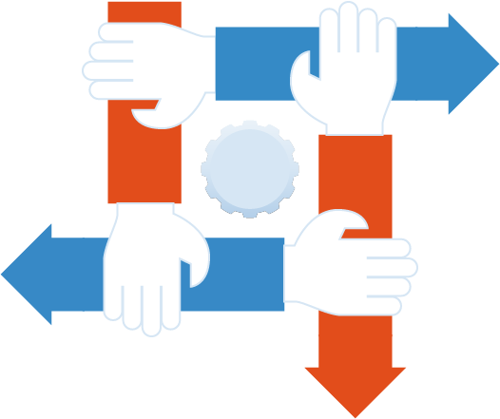
Proposed Implementation Method
Team Work
in new task forces &
working groups
New Leadership Roles for members
Better facilities for Remote Working

Slide 5
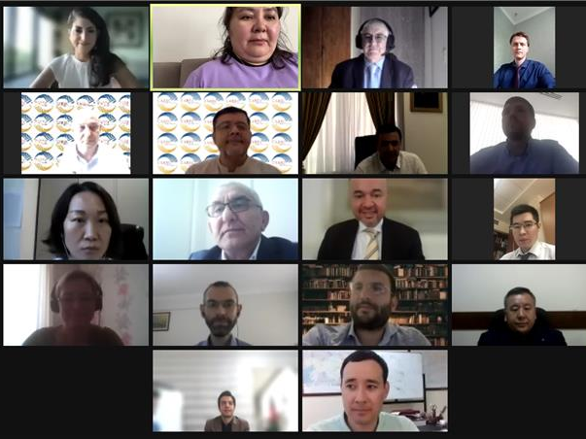
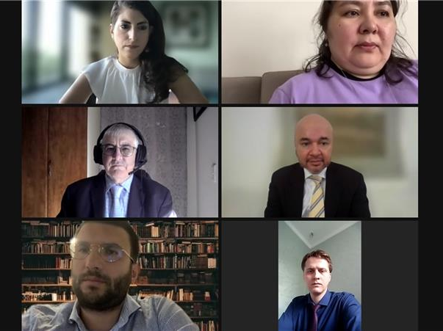
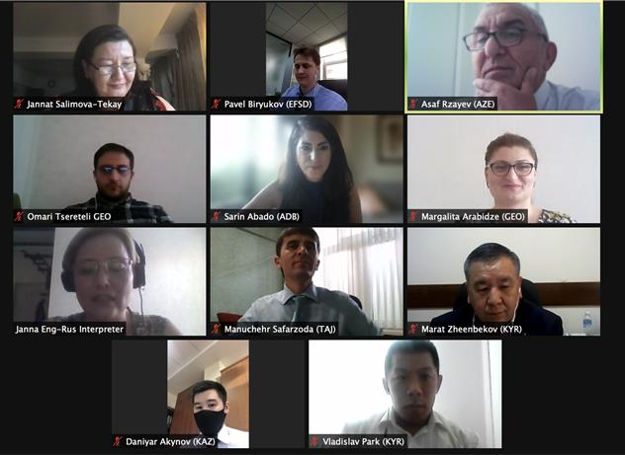
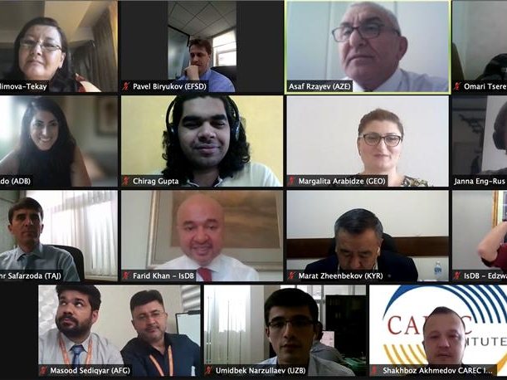
New CAREC Energy Family & Team Work

Slide 6
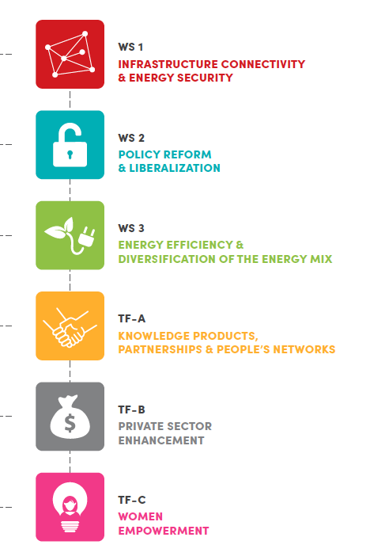
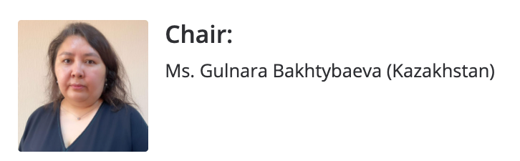
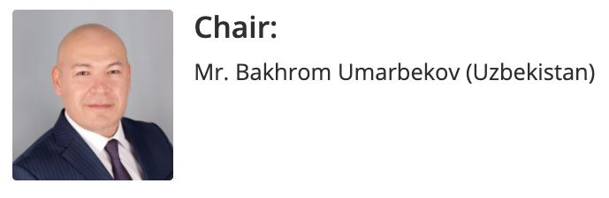
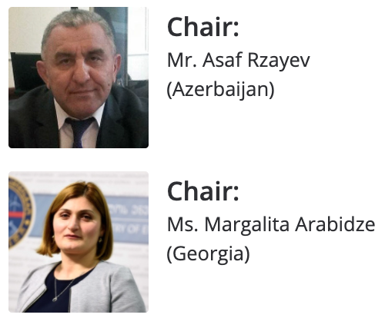
CAREC Energy Community Leaders
Working Groups and their Chairs

Slide 7
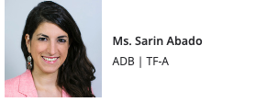

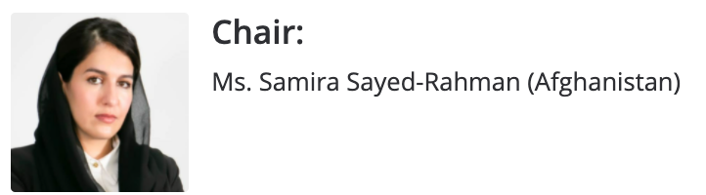
CAREC Energy Community Leaders
Task Forces and their Chairs

Slide 8
1st Work Stream and Task Force Meetings successfully completed
25 May 2021
27 May 2021
10 June 2021
ESCC Meeting
Work Streams and Task Forces are part of the Energy Sector Coordinating Committee (ESCC)
They prepare deliverables and present them to ESCC for endorsement
Each Work Stream and Task Force is chaired by 1 or 2 Member Countries who lead the process, ensure progress and report results at ESCC meetings
International lead consultant assist each working group in preparing the assigned deliverables

Slide 9
New Virtual Connectivity and
Remote Working
www.carecenergy.org
Public Web Portal
CAREC Energy Website
Members Area
already available
Log-in only for CAREC Members and Development Partners
Conference
Hub
Strategy Implementation Tracker
Collaboration platform for Working Groups
Meeting registration and connection links
Document Downloads
CAREC Energy Conference websites (EIF, Women in Energy Summit, etc.)

Slide 10



CAREC Energy Social Media
https://www.facebook.com/ADBCAREC
https://www.instagram.com/carecenergy/
https://twitter.com/CARECEnergy

Slide 11
Thank you!

