Slide 1
Climate Change Risks to Financial Stability in the CAREC Region
June 14, 2023
Selim Çakır
IMF Resident Representative to Georgia
Notes:
In this presentation I would like to share with you the preliminary findings of a departmental paper that is planned to be released this Fall. A large team from the IMF’s Middle East and Central Asia Department is working on this project – including, A. Al-Eyd, R. Bi, B. Radzewics-Bak, J. Ma, T. Mirzoev, and J. Vacher. For full disclosure purposes, I am not among the authors of this paper. With limited fiscal space following the COVID-19 pandemic and already elevated levels of public debt in many countries, public resources alone will not suffice to cover the costs of climate change mitigation and adaptation. Therefore, financial sectors will have to play a bigger role in meeting countries’ climate objectives and thus contributing to their sustainable growth and development. Their role will be particularly important in providing access to and mobilizing private finance, in promoting investments in green technologies, and in building capacity to use green finance to facilitate the transition to a green economy. Addressing climate-related financial stability vulnerabilities therefore appears to be a precondition for unlocking more private sources of financing and enabling financial sectors in the region to contribute effectively to green and sustainable growth. I will share some charts from the above-mentioned paper for further discussion.

Slide 2
Green transition will be challenging for the CAREC region
Climate-related investment needs are high in the region
Countries with proportionally the largest investment needs are also among the financially least developed
Notes:
The transition to a green economy will be challenging for the financial systems of the CAREC region.
Chart 1. The first chart shows the climate-related financing needs in the region. Blue and yellow bars indicate the adaptation and mitigation needs as a percent of GDP (left column), respectively. The red dots show the available financing in billions of USD (right column). The chart reveals that investment needs for climate adaptation and mitigation are high in the region and the available financing has so far been very limited (with the exception of CHN).
Chart 2. As you can see from the second chart, countries with proportionally the largest investment needs are also among the net energy importers and financially least developed.

Slide 3
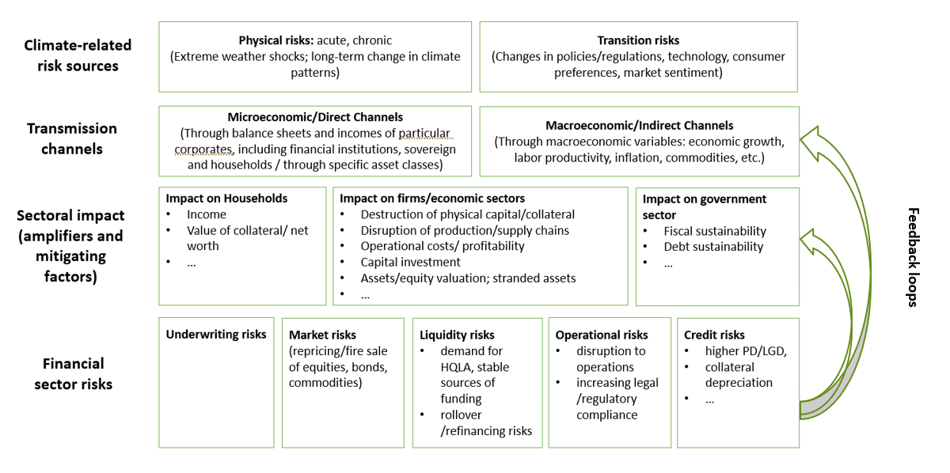
Domestic financial sectors could support the transition to a green economy, but they are themselves vulnerable to climate change risks
Notes:
In this chart, I would like to share with you some stylized facts about:
the sources of climate-related risks – such as physical risks and transition risks. Physical risks arise from: (i) extreme weather shocks (acute risks), and (ii) gradual changes in climate patterns (chronic risks). Transition risks include shifts in consumer preferences and investor sentiment away from carbon-intensive companies/sectors, which in turn can affect financing conditions for these investments, potentially leading to higher operating costs, weaker profitability, and asset repricing.
the transmission channels – which could be direct, through sectoral balance sheets or indirect through the impact of macroeconomic factors (second round effects) such as economic growth, labor productivity and sovereign credit rating, which in turn will affect financial institutions through their impact on the economic environment in which they operate
climate change may exacerbate already existing vulnerabilities in the financial sectors. Climate risks can exacerbate underlying vulnerabilities, particularly in small and concentrated (in terms of assets) banking sectors, and those with exposure to climate-sensitive sectors such as agriculture (e.g., CCA), real estate (some countries in the GCC) and tourism (Tunisia) or carbon-intensive industries (oil exporters).
and finally the risks facing the financial sector – the study finds that climate related disasters have the potential to pose more significant systemic risk challenges if they transpire during a period of pre-existing financial distress, or if their realization and severity increase over time.

Slide 4
Physical risks for banks in the region may be significant going forward
The frequency and costs associated with climate disasters have increased overtime
...suggesting larger projected costs in the decades ahead
Disaster Cost for Financial Institutions
(In billions of 2021 U.S. dollars)
Estimated Physical Risk Costs for Banks
(In billions of 2021 U.S. dollars)
Sources: EM-DAT, CRED / UC Louvain, Brussels, Belgium; IMF staff calculations.
Notes:
CAVEAT: [These charts are constructed based on the data from the International Disaster Database of the Universite Catholique de Louvain, Belgium] Reflecting the structure of the source data, the country coverage is slightly different in this slide as the charts reflect the entire Middle East and Central Asia region. Nevertheless, we believe the message remains relevant for the non-ME&CA members of the CAREC as well.
Let me look more closely into the physical risks facing the CAREC banking systems.
Chart 1. The exposure of banks in the region to physical risk has grown overtime, both due to the increased frequency of climate related natural disasters (droughts, floods and extreme temperature events) and because of rising costs associated with the. We estimate that the total cost for ME&CA banks of natural disasters since 1980 (until 2021) may amount to around 40 billion (exact number is 37 USD billion) of 2021 USD. The simulated losses are related to bank credit, not bank capital.
Chart 2. We also carried out a simulation exercise to project the possible costs to be borne by ME&CA banks in relation to natural disasters from 2022 to 2050, taking into account the increase in the frequency and magnitude of natural disasters (as estimated on the EM-DAT dataset over the period 1960 to 2021). In total, we estimate that the region’s banks could be exposed to losses corresponding to 50 USD billion. This is likely an optimistic estimate as it does not account for a possible acceleration of adverse climate dynamics as climate change progresses.

Slide 5
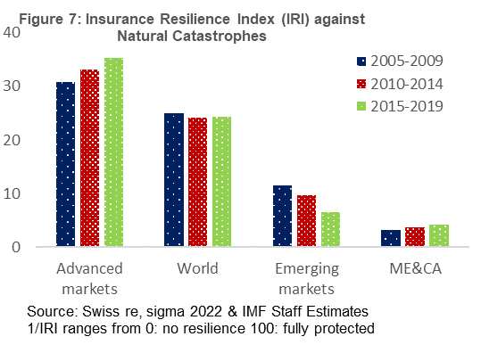
Buffers to deal with climate shocks are small as insurance penetration is still limited in the region
Insurance Resilience Index (IRI) Against Natural Catastrophes
Economic Losses and Insured Losses due to Climate related Events in the ME&CA Region ($bn)
Notes:
CAVEAT: [These charts are constructed based on the research by the Swiss Re Group] Reflecting the structure of the source data, the country coverage is slightly different in this slide as the charts reflect the entire Middle East and Central Asia region. Nevertheless, we believe the message remains relevant for the non-ME&CA members of the CAREC as well.
Buffers to deal with climate shocks are small as insurance penetration is still limited in the region
Chart 1. The Insurance Resilience Index, produced by the Swiss Re Group, is an aggregate of three sub-indices of insurance coverage for health, mortality, and natural catastrophes. As you can see from the first chart, the insurance coverage in the broader Middle East and Central Asia is consistently lower than the global and emerging market averages.
Chart 2. While climate-related economic losses amounted to USD25 bn (2007-19), the insured losses accounted for just $1.3 billion. Limited penetration of the insurance sector in the ME&CA region leads to a significant economic impact from climate-related losses, primarily placing burdens on domestic fiscal budgets.

Slide 6
Share of oil in the total energy trade is higher than in other regions
…with utilities, transportation, and manufacturing sectors leading the sectoral emissions
High reliance on carbon-intensive industries and limited investments in renewables complicate the transition to a low carbon economy
Source: IMF World Economic Outlook, IEA Global Energy Review, and staff calculations
Notes:
Transition risk refers to the negative economic impact resulting from the introduction of climate policies, technological advances and changes in consumer sentiment. Transition risk is of particular relevance to some countries (e.g., AZE, TKM, KAZ) in the region given their outsized reliance on hydrocarbon related industries and limited investments in renewables so far. As the world moves away from hydrocarbons, the business model of many firms, industries, sectors and economies in the region will come under pressure. And even though the transition to a low-carbon economy is a gradual process, risks can materialize sooner rather than later through the change in market expectations regarding future policies leading to large fluctuations in asset valuations [the so-called “Climate Minsky Moment”].
Chart 1. The first chart shows the share of hydrocarbons in the total external trade across different regions – and the CCA region, comes across as to have one of the most hydrocarbon-dependent trading structures.
Chart 2. When we look at the sectoral composition of the GHG emissions; we see that utilities, manufacturing, and transportation accounts for nearly 90 percent of the region’s emissions.

Slide 7
Banks' exposures to transition risks are higher than for the overall economy
Banking system loan portfolios are more emission intensive than GDP
Emission intensive sectors are over-represented in banks’ loan books.
Loans at risk from increasing carbon prices could be substantial
Emission Intensity of GDP and Banking Systems’ Loan Books
Banks Sectoral Exposure
(Percent of Outstanding Corporate Loans)
Share of Loans at Risk
(Percent of Outstanding Corporate Loans)
Source: IMF World Economic Outlook, Haver Analytics, National authorities and Staff calculations
Notes:
[CAVEAT: For analytical robustness, the coverage is again for ME&CA banks, where data is available]
Chart 1. By constructing an emission intensity index for both GDP and banking system loans books, we discovered that banking system loan portfolios in the region are even more emission intensive than economic activity, particularly among oil-exporters, further exacerbating transition risks to the financial sector.
Chart 2. This is mainly due to the over representation of emission intensive sectors in banks’ loan books. The share of utilities, manufacturing, and transportation in loan book portfolios is almost double that in GDP.
Chart 3. We also ran stress tests for the banking systems of the economies that are exposed to transition risks (i.e., oil exporters) – by imposing two levels of carbon costs as a shock. The results are shown on the third chart where you can see that the loans in the emissions-intensive sectors are particularly prone to decarbonization policies.

Slide 8
Climate financing has remained small relative to investment needs
Climate-related financial inflows to the region have been lower than the global average
…with bulk of the financing being tied to mitigation – leaving significant gaps for investment in adaptation
Climate Finance Flows
In percent of GDP
Climate Finance by Objective
2019/2020 average
Notes:
Chart 1. This chart has been constructed based on data from the Climate Policy Initiative and thus, the country classifications reflect that of the original data source. Here, what is clear is that climate-related financial flows to the ECA and MENA regions which include most of the CAREC members (with the notable exception of China) have so far been quite limited – both in proportion to the countries’ GDP and relative to the rest of the world.
Chart 2. The second chart shows the breakdown of the available climate financing by its objectives. Globally, the bulk of the climate-related financial flows is dedicated to mitigation activities, which leaves significant gaps for adaptation. Besides, this structure does not differ much with respect to the source of financing – i.e., private or public.

Slide 9
Private climate-related inflows remain low in the region
…both in comparison to other regions
…and to public financial flows
Private Climate Finance, 2019/20
In percent of GDP
Public vs. Private Share of Climate Finance, 2019/20
In percent
Sources: Climate Policy Initiative; and IMF staff calculations.
Notes:
Speaking of the private financial flows, one thing we need to stress is the rather limited role they play in the region both relative to some other regions (as you can see from the first chart) and with respect to public finance. Therefore, we see a huge untapped potential for mobilizing private climate finance for advancing toward climate objectives in the CAREC region.

Slide 10
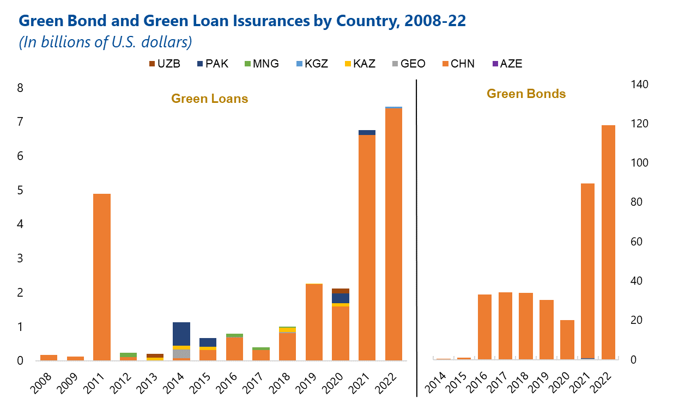
Green bonds and loans remain so far limited to a few issuers
Sources: Bloomberg BNEF.
Notes:
Within the climate finance envelope, green loans and bonds assume an increasingly important role globally. When we look at the situation in the CAREC situation, we see that apart from China, which has been actively using these vehicles (orange bars), the use of green bonds and loans have been confined to a few issuers. We therefore see more potential for growth in this segment. Let me add that domestic lenders face wide-ranging barriers in scaling up financing for green projects. Banks have the potential to contribute more to the development of green finance and benefit from these opportunities, but for this to happen, an enabling environment needs to be created.

Slide 11
Policymakers should create an enabling environment for climate risk assessment and private green finance development
 | - Better measure and understand climate risks
 | - Promote climate risk data disclosure by financial institutions
 | - Develop and enhance existing climate risk models and climate forecasting
 | - Adopt sound risk management in financial sector institutions
Notes:
The unlocking of private green finance potential is crucial for a successful transition to a low-carbon economy in the region. The financial sector has the potential to catalyze this financing and therefore contribute significantly to the green future of the region. To enhance the resilience of the financial sectors to climate change-related risks, it will be important to:
• Better measure and understand climate risks: Effective climate risk management begins with accurate measurement and understanding of such risks. Policy actions must prioritize the implementation of standardized methodologies for quantifying and reporting climate risks. This entails developing comprehensive frameworks that capture both physical risks (e.g., extreme weather events, sea-level rise) and transition risks (e.g., policy changes, consumers’ preferences shift). By adopting consistent methodologies and metrics, financial institutions (as well as their regulators and supervisors) can better assess and compare their exposure to climate risks, facilitating informed decision-making processes.
• Promote climate risk data disclosure by financial institutions: This disclosure should extend beyond just compliance and strive for comprehensive and consistent reporting, enabling stakeholders to make informed a
assessments of an institution's exposure to climate-related risks. Standardized reporting frameworks can provide guidance to the region on best practices in climate risk disclosure.
• Develop new and enhance existing climate-risk models and climate forecasting: As climate risks evolve, it becomes imperative to assess their potential impact on the financial sectors’ resilience. Policy actions should prioritize the development of robust models capable of evaluating and quantifying the implications of climate risks on financial institutions. These models should consider various scenarios and stress tests, integrating both physical and transition risks. By comprehensively assessing the potential impacts, financial institutions can identify vulnerabilities, allocate resources effectively, and implement necessary risk management strategies.
•Adopt sound risk management in financial sector institutions: This involves gathering reliable, up-to-date information on climate-related exposures and vulnerabilities, and enhancing risk governance, internal controls, and accountabilities within financial institutions, as well as ensuring that climate risks are properly identified, monitored, and managed at all levels. This includes the development of robust risk management policies and practices and may require changing some existing liquidity and credit policies (e.g., shortening loan maturities in carbon-intensive sectors), creating stronger capital buffers, and setting up thresholds on asset concentration, leverage, or specific sectoral exposures . Macroprudential tools can be used for that purpose such as sector specific risk weights, concentration thresholds, sectoral systemic risk buffers, among others.
Let me conclude by highlighting that policies should be geared towards reducing climate change-related risks in the financial sectors, deepening insurance markets, and creating enabling conditions to promote and develop green finance. The financial sectors in the region can help ensure that the necessary resources are available to finance climate adaptation and mitigation, but such support for sustainable development should take place in close collaboration with governments, financial regulators, and the private sector, and be well-integrated into the overall policy frameworks for climate adaptation and mitigation.

Slide 12
Thank you

