Slide 1
A Guide for raising funds and the Singapore startup ecosystem
Guest Lecture
Mustafa Rasheed
Asia Development Bank

Slide 2
Introduction
Over a decade in the start-up ecosystem
Singapore Public Sector (SME Centre)
ING Bank
KPMG
Angel Investor
Advised over 3,000 Startups
Advisor at 3 Accelerators
Founded 1 Angel Investor Group
Multiple Advisory Board

Slide 4
Knowledge sharing

Slide 5
Segments
Startups
Angel Investors
Venture Capital Firms
Corporate Venture Capital
Private Equity
Syndicates
Special Purpose Vehicles
Multipliers

Slide 6
Startup
Micro Business
Young Company
Tech Enabled
Innovative
Disruptive
Poised for High Growth

Slide 7
Angel Investors
Provides early-stage capital
High risk appetite
High risk high return
Risky Unproven ventures
Binary outcome ( 0 / 1)
Equity / Debt / SAFE note / etc.

Slide 8
Venture Capital Firms
High growth potential
Early-Mid stage startups
Equity
Exit – Acquisition or IPO

Slide 9
Private Equity
Invests in larger companies or growth stage startups
Larger investments minimum $25 Million
Series B, Series C, Series D Round etc.
Average fund size of $5 Billion
Hold till Acquisition, IPO

Slide 10
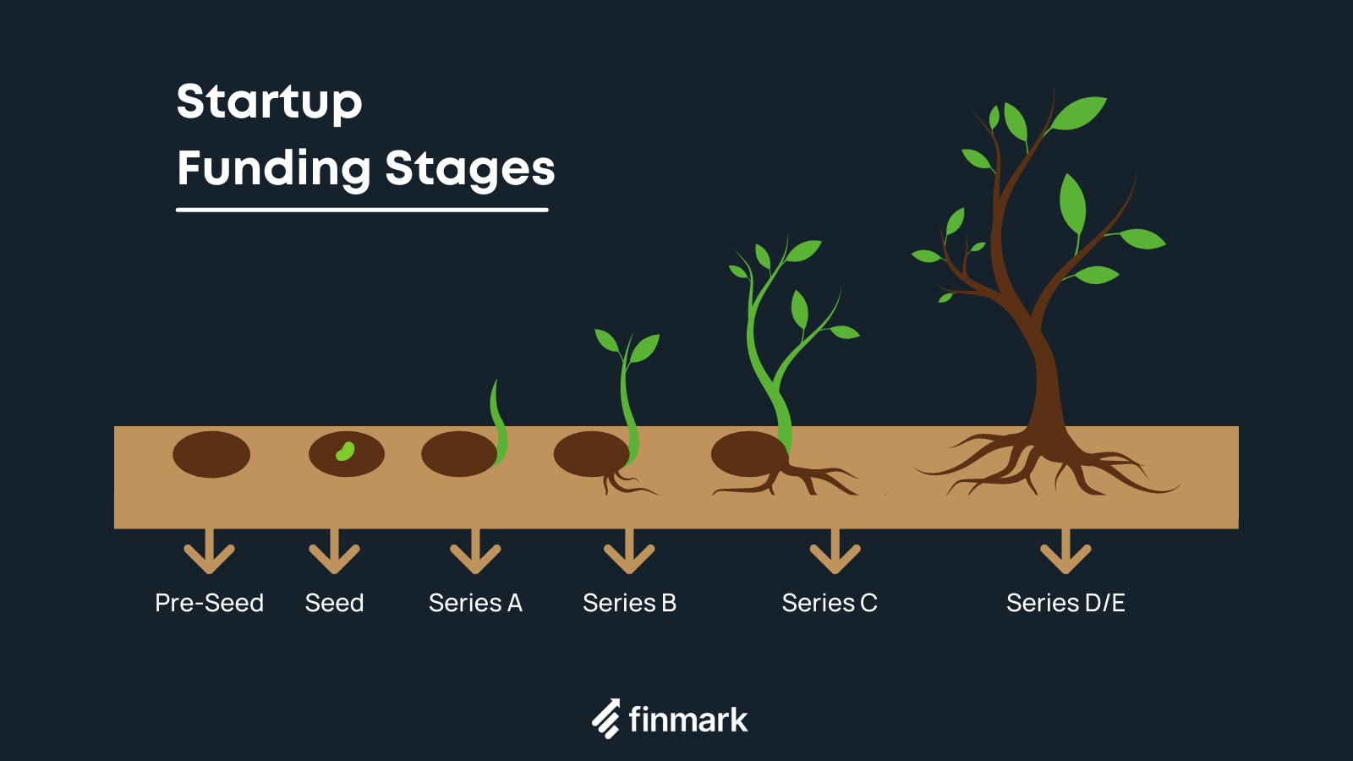
Startup Funding Rounds
Pre-Seed
Seed
Series A
Series B
Series C
Series D
image source: finmark.com

Slide 11
Startup Funding Rounds Rounds
Pre-Seed – Angel Investors & Accelerators
Seed – Angel Investors, Accelerators, Family Offices, Venture Capital Firms
Series A – Venture Capital Firms, Corporate Venture Funds, Family Offices
Series B - Venture Capital Firms, Corporate Venture Funds, Family Offices
Series C – Private Equity Funds, Venture Capital Funds, Corporate Venture Funds
Series D - Private Equity Funds, Venture Capital Funds, Corporate Venture Funds

Slide 12
Top Singapore VC firms 2022
Source: https://sharpsheets.io/blog/singapore-vc-venture-capital-firms/
Name | Sector focus | Round | Investment size | Investments
500 Global | Technology | Seed, Series A | Undisclosed | 2,771
8Capita Partners | SaaS, ECommerce, Marketplace, Platform, Media | Seed, Series A | $200K – $3M | 35
Alpha JWC Ventures | Technology | Seed, SeriesA, A+ | Undisclosed | 77
B Capital Group | Healthcare, Consumer, Enterprise Software | Seed, Series A, A+ | Undisclosed | 139
Coent | Financial Services, Intech, BioTech | Seed | $100K – $1M | 11
Expara | Technology | Seed | $200K – $500K | 18
Gobi Partners | Technology | Seed, Series A, A+ | $2M – $8M | 179
Golden Gate Ventures | Technology | Seed, Series A, A+ | $1M – $5M | 60
Jungle Ventures | Technology, Healthcare, Hospitality | Seed | Undisclosed | 101
Monk’s Hill Ventures | Technology | Series A | $1M – $3M | 56
NGC Ventures | Technology | Seed | Undisclosed | 100
Quest Ventures | Technology | Seed | Undisclosed | 85
Wavemaker Partners | Technology | Seed | $200K – $7M | 480
Spiral Ventures | Technology | Seed, Series A | $100K – $1M | 39
East VC | Technology | Seed, Series A | Undisclosed | 31
Cocoon Cap | Enterprise, Deep tech | Seed | SG$500K – SG$1M | 22

Slide 13
Syndicates
Pool many individual investors’ money together
Invests as 1 entity on 1 investment document
Does the necessary legal paperwork
Lowers minimum ticket the investor (200k->10k each)
BAN, BANSEA, AngelCentral, many more
Private groups
No individual control

Slide 14
Special Purpose Vehicles (SPV)
Business entity registered specifically to hold an investment
For a specific period of time
Syndicate invested at Series A -> Exited at Series B
SPV dissolved, all investors paid their principal + earnings

Slide 15
Venture Building
Corporate Venture Building - Inhouse
Venture Building Studios - External
Working with corporations to run venture building programs
Highly focused on industry pain points
Singapore government co-funds venture building
BCG-DV, FutureLabs, Leap by McKinsey, Rainmaking, Mach49

Slide 16
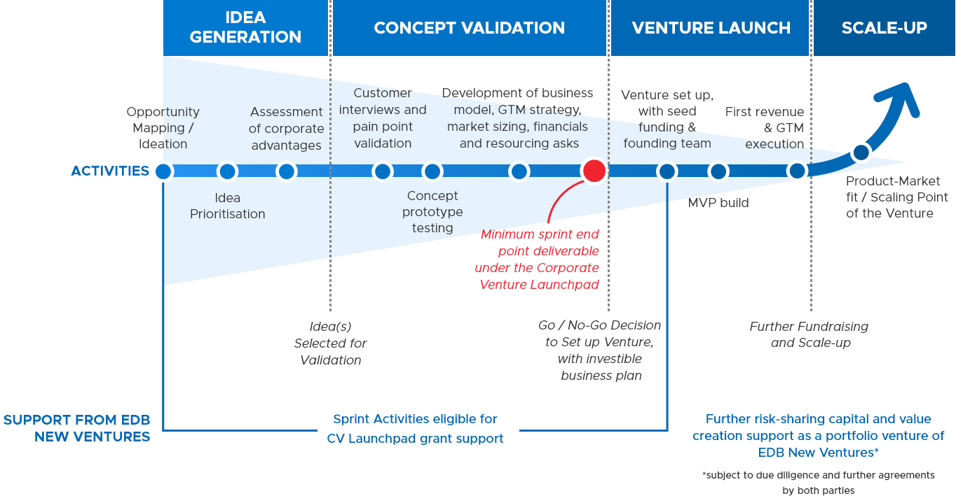
Venture Building - Diagram
Venture Building process
Source: Singapore Economic Development Board

Slide 17
Multipliers in the startup ecosystem
Accelerators
Incubators
Entrepreneur Communities
Angel Investor Groups
Co-working Spaces
Innovation Labs
University Innovation Hubs

Slide 18
Multipliers

Slide 19
Cryptocurrencies
Stable Coins
Base Coins
Alt Coins
Meme Coins
Exchanges
Wallets

Slide 20
If you are pitching to investors
When an Investor Says No, Accept It, But Always Ask for Feedback
Every Coffee Meeting or Call is an Opportunity to Ask for Introductions
Avoid Giving Away Equity, Use SAFE Notes
Identify Strategic Advisors / Advisory Board Members
Don’t ask Investors to sign NDAs they will probably ghost you..
Co-Founders, Try not to Interrupt Each Other or the Investor While Pitching

Slide 21
Identifying Angel Investors - 1
One Liner
Hi I’m Mustafa and I’m the Founder of X, We’re looking to help startups get the right tools and hacks in order to fund raise from the best investors FAST.
What's your ASK?
We’re raising 250k on a $3m valuation and I’d be happy to share more if you like.
Elevator Pitch
Hi I’m Mustafa and I’m the Founder of X. We’re looking to solve for the gap in early stage Startup funding by equipping founders with the right knowledge and hacks to fund raise faster. We’re looking to raise 250k from strategic angels and I’d be happy to share more if you like.

Slide 22
Identifying Angel Investors- 2
Incubators
Accelerators
Co-Working Spaces
Innovation Labs
Events
Conferences
Cold Outreach
Syndicates
Etc.

Slide 23
Identifying Angel Investors- 3
LinkedIn Search – angel investor, mentor, board advisor, venture partner, limited partner
Ask for advice, don’t ask for money immediately
“Hi Mustafa great to connect. I noticed from your profile that you've been in the startup ecosystem for over a decade. I'd love to get your feedback on my pitch and business model. Can I buy you a coffee sometime or connect over a call?”
Instant yes!

Slide 24
Pitch deck Best Practices
10/20/30 Rule
It’s a presentation not a document
You want the viewer to listen to you
Not be trying to read all the content on your slides
Use less words

Slide 25
If you are an angel investor
Founders Personality
Data Driven Approach
Registration Domicile
Valuation Cap
Valuation Matrix
Valuation Journey
Market Size
Exit Opportunities

Slide 26
Career Lessons
Its OK to Walk Away From Deal
Every Coffee Meeting Counts
Build a Strong Network
Have a Quick Personal Pitch
Be Flexible About How
Keep an Open Mind
Salary is Not Everything
Don’t be Afraid

Slide 27
Happy to take your questions
Hope you found this informative!
Mustafa Rasheed
mustafar84@gmail.com
https://www.linkedin.com/in/mustafarasheed/

