Slide 1
Main Challenges for Startup Ecosystem Growth
Eli David, CEO of StartupBlink

Slide 2
Structure
Cultural Challenges and Entrepreneurial Mindset
Legislation Challenges
Infrastructure Challenges
Talent Challenges
Narrative and Promotion Challenges
Data Flow Challenges
The Critical Mass Challenge

Slide 3
Intro
An ecosystem is sometimes just as strong as its weakest link
Each ecosystem is unique and has different types of challenges
Sometimes a challenge that is shared by ecosystems has different root causes (The repeating Why question, e.g. for lack of investors)

Slide 4
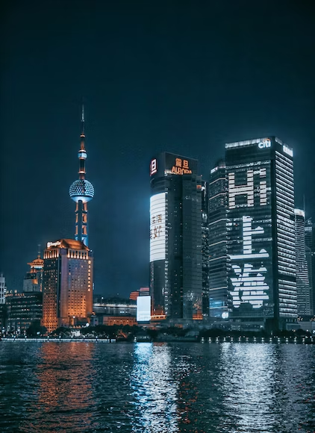
Cultural Challenges and Entrepreneurial Mindset

Slide 5
The unhelpful mindset
Risk averseness (90% failure)
Safeguarding reputation
Modesty (The paradox)
Not trust by default (Zero sum game)
Mostly common in Scandinavia /Asia

Slide 6
The helpful mindset
Optimism about the 10% chance to create massive change
Fake it until you make it (with its disadvantages)
Trust and help by default (Win Win)
Mostly common in USA/Israel (Chutzpah)

Slide 7
Elements of culture related to Entrepreneurship
Individualism compared to collectivism in the ability to disconnect and create something new (Asia)
Social pressure to either get a stable job, or to become an entrepreneur

Slide 8
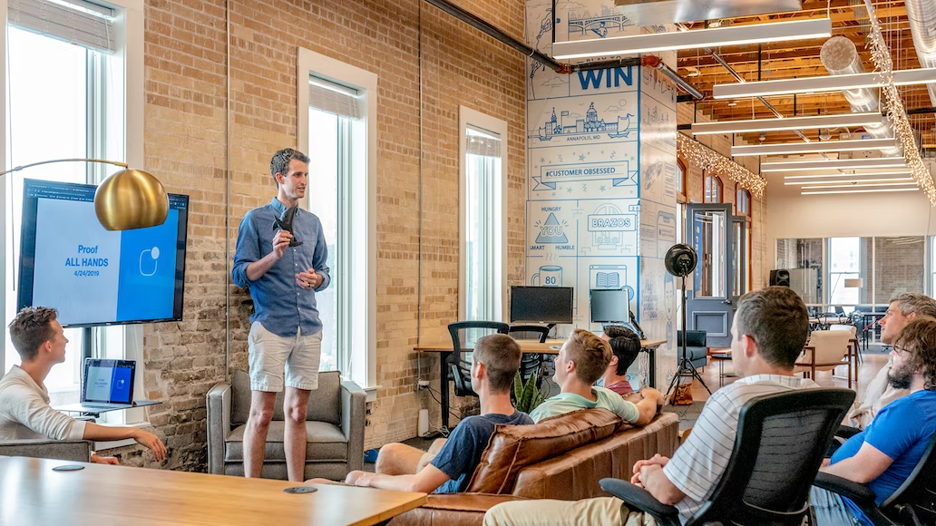
Elements of culture related to Entrepreneurship
The perception of successful people- heroes vs. manipulators + celebrating success/serial entrepreneurs who stay (Previous communist countries)
Cash flow and quick wins vs. skin in the game and perseverance (initial investment, the dip)

Slide 9
Elements of culture related to Entrepreneurship
Victimized mindset (the game is rigged), dependence and expectancy of government support, vs. self reliance and focus on markets and products
Trust and give first mentality vs. NDA mentality (with ideas, co-founders, investors, suppliers)

Slide 10
Impact of success stories on entrepreneurial mindset
How does one leverage success stories?
Celebrate them
Result- Popularizing entrepreneurship + Successful Entrepreneurs becoming local investors

Slide 11
Serial entrepreneurs
Investors (FOMO)
Tax revenue and jobs
Impact of success stories on entrepreneurial mindset
Inspiration (It can be done)
Envy (If they could exit, why can’t I?)
Someone you know
Serial entrepreneurs
Investors (FOMO)
Tax revenue and jobs

Slide 12
Complex and high taxes/social security payments on startups and individuals
Difficulties in opening a company/close company
Inability to form investment funds legally or lack of tax incentives for investors
Legislation Challenges
Flexible employment laws (hire/fire)
Visas for foreign entrepreneurs
If governments could choose only one course of action, that should be to avoid damaging their own startup ecosystems

Slide 13
Infrastructure Challenges
Internet
Electricity
Roads (Mainly for secondary ecosystems)
Airport connections
Conference rooms and event places
Coworking spaces

Slide 14
Talent and Capacity building challenges
Accelerator
Knowledge of English
Events
Communities
Modern curriculum in universities
Mentors

Slide 15
Narrative and Promotion Challenges
Your most ambitious entrepreneurs will leave an underperforming ecosystem
Foreign entrepreneurs go to the international hubs (SF, London, the Shopify example)
No budgets assigned to promotion (Only governments can do it)
A Startup Ecosystem is a product, a non branded product with no marketing budget will underperform

Slide 16
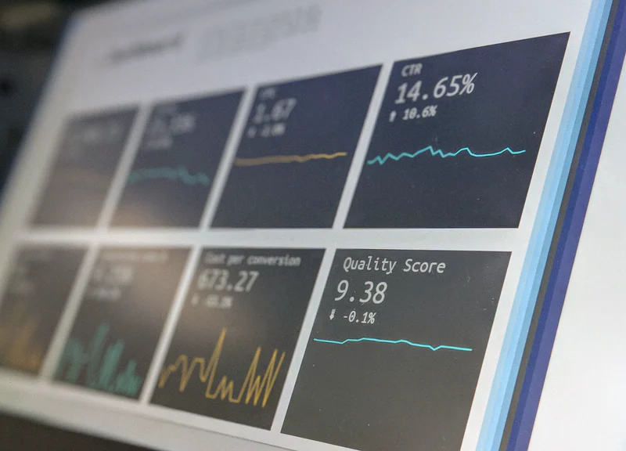
Data Flow Challenges
To develop your ecosystem with a effective strategic and promotion plans, you first have to map its main stakeholders
Other stakeholders will benefit from a public interactive resource showing them who is present in the ecosystem

Slide 17
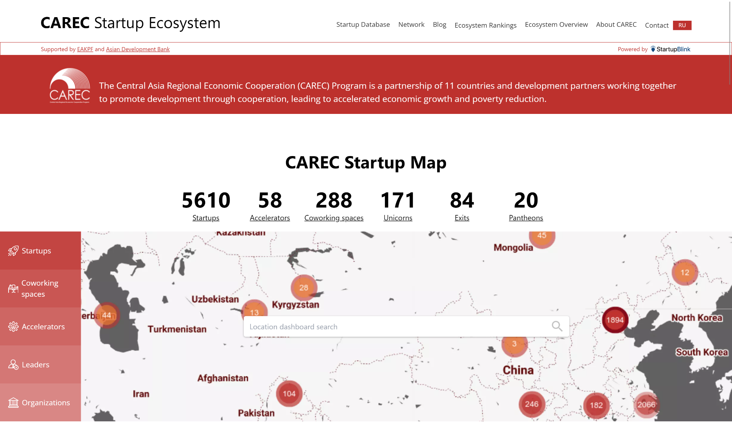
CAREC Startup Ecosystem Portal
Visit: https://www.startupcarec.org/

Slide 18
The Critical Mass Challenge
Achieving a critical mass for your startup ecosystem prevents brain drain, builds an ecosystem of investors, and changes the psychology and narrative of the ecosystem
Remember the second tier cities and ecosystem variety to achieve economic variety
Snowball theory: Public sector needs to get it started as there is no ROI for private sector
Advice to entrepreneurs: If your ecosystem underperforms, leave it, or lead it.

Slide 19
Thank you for your participation
Questions?
eli@startupblink.com

