Slide 1
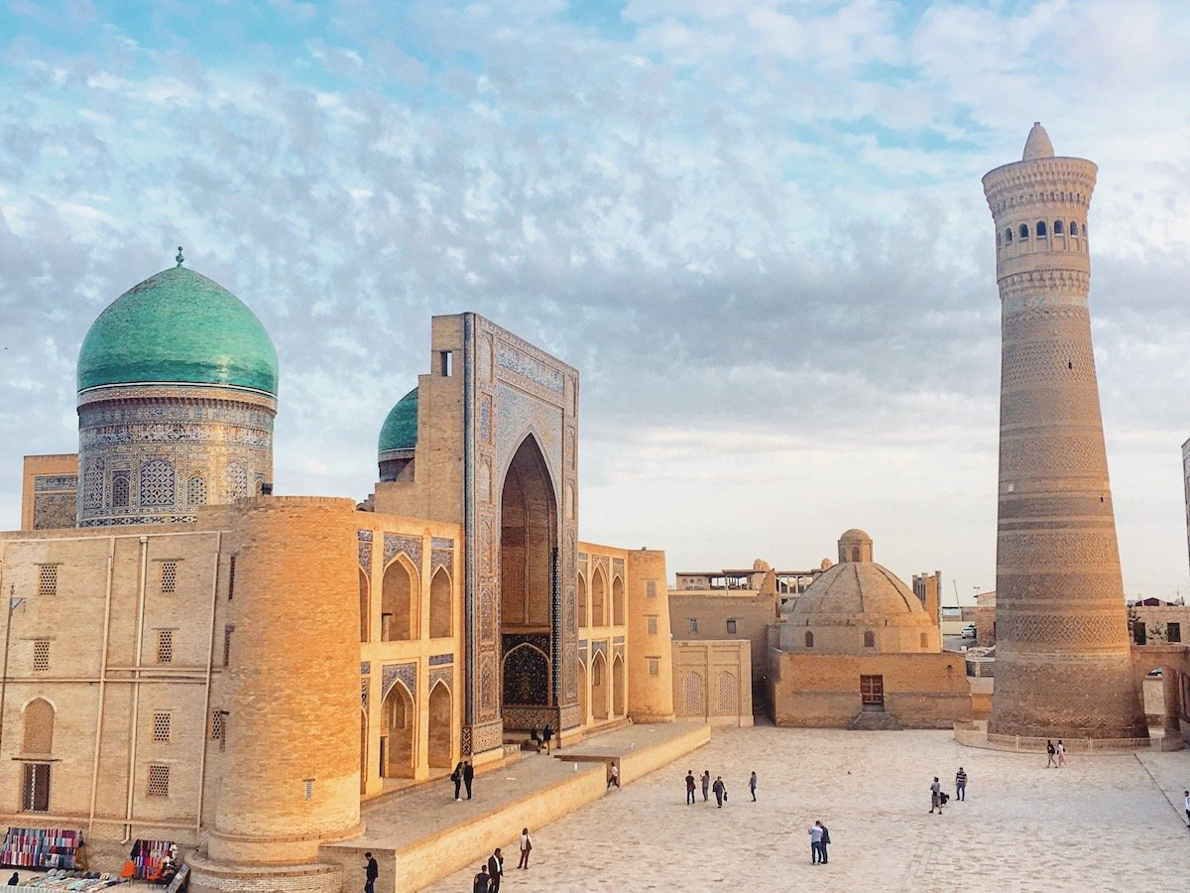
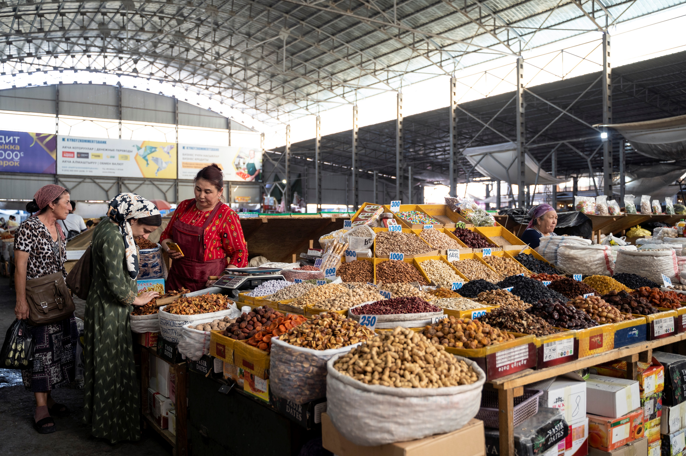
CAREC Spillovers from the War in Ukraine and Global Monetary Tightening
Placeholder for images
OCTOBER 4, 2022
Subir Lall
Deputy Director
Middle East and Central Asia Department

Slide 2
Pre-war: Economic recovery gained momentum despite challenges
Growth surprised on the upside in the CCA
Inflation surged in 2021 driven by food prices
Countries emerging from the pandemic
with higher levels of debt
CCA: Real GDP Growth, 2021
(Year-over-year percent change)
CCA: Mean Headline and Core Inflation
(Percent change, year over year)
General Government Debt
(Percent of GDP)
Sources: IMF WEO; and IMF staff calculations.
Sources: Haver Analytics; National Authorities; IMF, CPI database; and IMF staff calculations.
Note: CAREC = Central Asia Regional Economic Cooperation. CAREC includes AFG, AZE, CHN, GEO, KAZ, KGZ, MNG, PAK, TJK, and UZB. Latest data: Feb. 2022.
Sources: IMF WEO; and IMF staff calculations.

Slide 3
Multifaceted spillovers from war are shaping the outlook
TRANSMISSION CHANNELS
Commodity and financial channels
Direct channels
Exports to Russia and Ukraine
Oil and gas prices
Food and agriculture input prices
Investor sentiment: Risk-off events
Supply chain disruptions
Secondary spillovers due to weaker global demand
Aid diversion
CAREC OIs
Energy import dependence
Wheat and fertilizer import dependence
Remittances
Tourism
CAREC OEs
Banking and cross-border payments
Currency depreciation
Negative spillovers
Positive spillovers

Slide 4
So far, the fallout from the War in Ukraine seems to have been contained
The region maintains positive growth momentum...
Initial pressures on exchange rates abated somewhat
…with exports remaining strong.
CAREC: Economic Activity Indicators
(Average of year-on-year percent change)
Total Exports
(Year-on-year percent change)
CAREC: Exchange Rates
(LC/USD, percent change relative to end 2021)
Appreciation
Depreciation
Source: Haver and National Authorities.
Note: All data are seasonally adjusted. Data for UZB, TJK, KGZ, MNG and PAK show industrial production. Data for KAZ show economic activity, and data for GEO and AZE show GDP flash estimates.
Source: Haver (National Authorities).
Source: Haver (National Authorities).
Note: AZE and TKM have pegged exchange rates.

Slide 5
Inflation is still an immediate concern
Inflation edged up across the region…
Monetary policy is on a tightening trend
…buoyed by food and commodity prices
Headline CPI
(Year-on-year percent change)
CCA: Food CPI
(Year-on-year percent change)
CAREC: Monetary Policy Rate
(Percent)
Source: Country Authorities.
Sources: Haver Analytics; and IMF staff calculations.

Slide 6
Uncertainty remains high and risks weigh on CAREC prospects
Global financial conditions have tightened sharply
Growth projection for Russia has been revised down in 2023
Russia Projected Real GDP Growth Projections
(Year-on-year percent)
Global Financial Conditions Index
Tighter
Looser
Source: IMF World Economic Outlook.

Slide 7
Uncertainty remains high and risks weigh on CAREC prospects -- continued
Commodity prices remain high and volatile
Socio-political tensions are elevated in the region
Global Food and Energy Prices
(2016 = 100)
Recent Trends in Social Unrest
(Fraction of countries, percent, 6-month moving average)

Slide 8
Managing policy tradeoffs while advancing transformational recovery
Fiscal policy:
Protect the recovery and the vulnerable through targeted support while safeguarding sustainability
Monetary policy: Fight inflation but avoid derailing the recovery
Long-term growth and inclusion: Keep the course of reforms
(private sector development, climate-related challenges)

Slide 9
The IMF as a Key Partner for the CAREC Region
COORDINATION AND OUTREACH
POLICY SUPPORT AND TECHNICAL ADVICE
FINANCIAL SUPPORT
Financing programs (PAK, GEO)
Debt relief during the pandemic (TJK)
SDR allocation
RST: affordable long-term financing
Enhancing the emergency financing toolkit
Timely and country-specific policy advice
Integration of CD and surveillance (e.g., CCAMTAC)
New Fragile and Conflict-Affected States strategy
Support coordinated with the World Bank, EBRD, ADB, UN agencies, and regional organizations (CAREC)
Additional financial resources, donor support, and debt relief

Slide 10
Thank you

