Slide 1
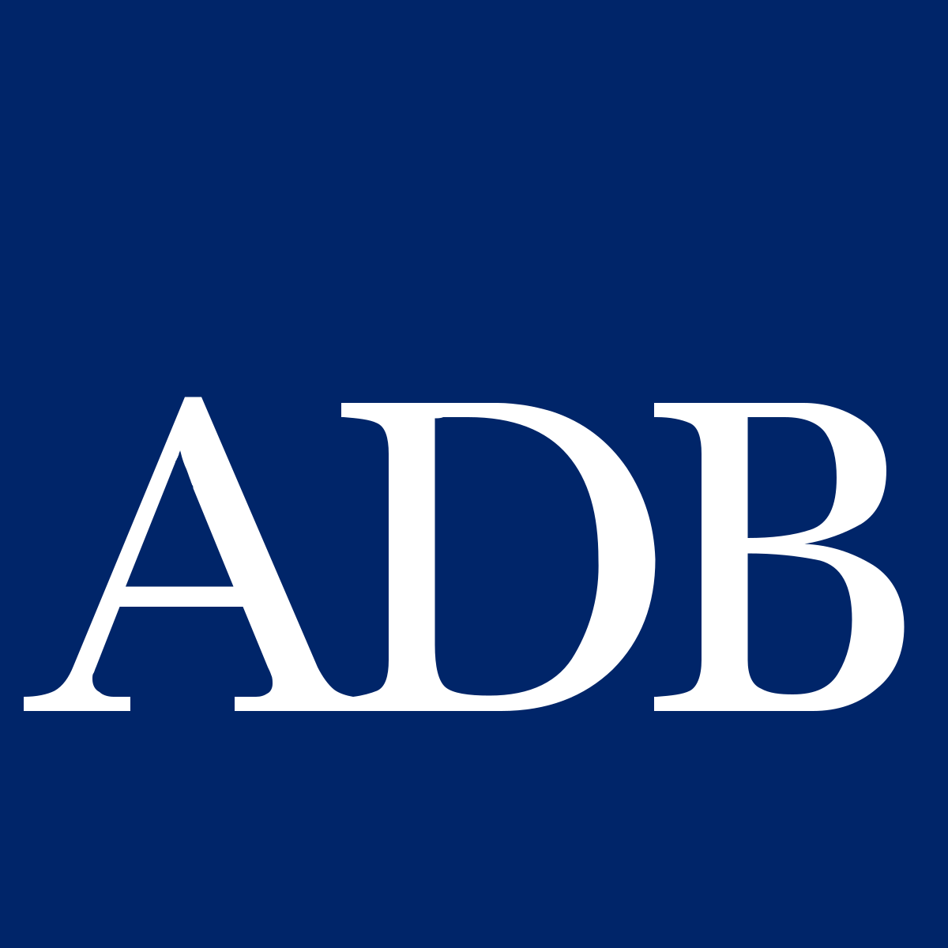
Session 9: Disaster Relief Bonds
Central Asia Regional Economic Cooperation Program Disaster Risk Engagement Meeting
Istanbul, Türkiye
November 2022

Slide 2
Objectives
1. Overview of insurance linked securities and disaster relief bonds
2. Present opportunities and options for disaster relief bonds in Central Asia
3. Share risk modelling and pricing options
4. Outline roadmap for implementation
Notes:
Mention the format for Discussions
Underlying objectives to the deliverables is to agree how best to work with you to improve data, modelling and understanding of your requirements and so allow us to work with you to determine appropriate disaster risk financing instruments

Slide 3
Overview ILS and Catastrophe Bonds
Catastrophe (cat) bonds are a viable form of disaster risk financing, benefitting from a new community of capital
Cat bonds are a form of insurance-linked securities (ILS), where risk is transferred usually from a catastrophe or natural disaster through a sponsor, typically in a commercial context an insurer, to investors
Over recent years the use of catastrophe bonds has spread with governments acting as sponsors
Cat bonds are vital where there is insufficient insurance/reinsurance availability
Unlike most insurance, cat bonds typically cover a 3 year period and have little or no counterparty risk
But catastrophe bonds usually cost more, the risk margin (the premium equivalent) is typically higher than the insurance equivalent and there are significant frictional costs

Slide 4
Towards Disaster Relief Bonds
A Disaster Relief Bond (DRB) builds on the well-established cat bond but introduces a requirement that proceeds from a bond pay-out be used to implement relief, rehabilitation and recovery measures, enabling fast, effective disaster response.
All other aspects of bond design, structure, triggers and potential benefits to sponsors and investors remain the same as a catastrophe bonds.
The appetite for parametric insurance from Sovereign Risk Pools, such as CCRIF SPC, the African Risk Capacity, the Pacific Catastrophe Risk Insurance Company, and the Southeast Asian Disaster Risk Insurance Facility, has demonstrated the utility of and demand for fast paying insurance mechanisms.
A regional approach, encouraged by a DRB, can reduce the cost of financing, support greater risk responsibility and ownership, and produce services and solutions developed to address participating countries’ challenges in disaster risk finance and insurance.
Issuing a DRB via the ADB’s Global Medium-Term Notes (GMTN) program, which dispenses with the traditional catastrophe bond need for the creation of a Special Purpose Vehicle, offers significant savings in frictional costs

Slide 5
Opportunities and Options for Disaster Relief Bonds in Central Asia

Slide 6
Hazards
 | Earthquake A well-defined risk with agreed methodologies that are familiar to the (re)insurance and capital markets. The modeling to support an earthquake DRB can be put into place relatively quickly and should be able to build on the modeling already performed as part of this TA.
 | Flood More complex to model and so harder to determine an appropriate trigger. However, flood risk will be the predominant concern for many countries, driven by river-flooding (fluvial), flash flooding (pluvial) and/or storm surge (coastal). Depending upon the nature of the risk, a modeled loss approach may be appropriate, but potentially augmented or replaced with earth observation and/or rainfall or gauge data.
 | Infectious Disease Differentiated considerations apply in design and issuance. A pandemic parametric insurance cover is likely to be closely coupled to funding for early detection, quarantine areas and anti-spread measures within and across borders. It is also more likely to be a stand-alone solution integrated in a regional health security and risk management investment framework.

Slide 7
Peril and Country Combination Options
 | Single Country | Multi-Country
Single Hazard | Default option. Parametric structure can be optimized to a specific country and hazard. No diversification benefits. No opportunity for cost saving. | Diversification benefit and so an incentive to share a bond limit. Cost savings from structuring, marketing and placement in one deal. Potential for higher “political basis risk” for a multi-country bond with a shared limit – careful structuring is needed.
Multi-Hazard | Diversification benefit and so an incentive to share a bond limit. Cost savings from structuring, marketing and placement in one deal as well as applying a multi-peril bond limit. Significantly lower “political basis risk” than a multi-country bond with a shared limit. | Greatest diversification benefit and so the greatest incentive to share a limit. Greatest cost saving with the least risk of bond exhaustion for a shared limit.

Slide 8
Structure: Use of ADB’s Global Medium-Term Notes program over an SPV
Risk Transfer Agreement
Disaster Relief Bond
Selected CAREC Member States
Investors
Payment [X%]
ADB funding rate + [X%]
Loss Payments
Proceeds
Issuing a DRB via the ADB’s Global Medium-Term Notes (GMTN) program could allow for direct DRB issuance and brings several benefits.
The structuring process is greatly simplified which reduces setup costs.
If ADB acts as an intermediary between the developing member countries (DMCs) as the sponsor, investors credit risk exposure is very low.
Technical and financial efficiencies can be passed onto CAREC member states, reducing the overall cost.
This structure allows ADB to receive the proceeds from issuance, which can then be utilized at ADB’s discretion. It is, however, required that ADB retain sufficient liquidity to pay-out the bond limit to CAREC member states if a qualifying trigger event happens.

Slide 9
Types of Trigger
A cat bond trigger specifies the conditions that would cause the release of the principal to the sponsor (i.e., a pay-out).
Indemnity triggers provide fuller protection, but they are unable to match the fast pay-outs offered by parametric products, which can take different forms.
The simplest (Pure Parametric) offers the most transparency but potentially greater basis risk
Modelled loss can reduce basis risk, but its complexity and opacity gives a greater chance of "political basis risk
A parametric index, which offers relative transparency and lower actual and political baris risk, is likely to provide the optimal solution.
Pure Parametric
Parametric Index
Modeled Loss
Transparency For Investors
Hybrid Trigger
Indemnity
Basis Risk to Issuer
Increased Cost and Complexity to Structure

Slide 10
Choice of Listing Location
The experience and willingness of the local regulator as well as the attitude of the sponsor’s home regulator affects the relative attractiveness of different listing locations.
Management fees are not expected to differ vastly between jurisdictions, although some jurisdictions may offer subsidies.
Singapore. Relatively new but increasingly attractive location. Already one of the largest specialty insurance and reinsurance centers in Asia as well as the largest Asia Pacificcaptive domicile. A DRB for Central Asia is likely to be well received given Singapore’s ambitions to be a green finance leader for Asia-Pacific
Hong Kong. Very new location (March 2021). Uniquely, mainland Chinese insurers may be able to cede risks to the capital markets through Hong Kong domiciled structures more easily because of Hong Kong’s status as a special administrative region (SAR).
Bermuda. Most experienced ILS regulator and a global leading jurisdiction for issuance. The island’s robust risk transfer for catastrophe bond issuance, adaptive regulatory environment and ability to innovate means it remains an attractive jurisdiction for catastrophe bond listing, even though there’s now more choice than ever in terms of domiciles.

Slide 11
Optimizing the Cost of Disaster Relief Bond(s)
A regional approach allows savings and efficiencies to be made, these can include:
Common modeling approach | Common trigger structure | Common documentation
Placement efficiency | Structural diversification

Slide 12
Risk Modeling for CAREC Disaster Relief Bonds

Slide 13
What is Modeled?
Flood and earthquake have been considered
The risk model uses the same data that is used to underpin a risk visualization and analysis tool developed for CAREC member countries under this technical assistance project, the Disaster Risk Management Interface (DRMI)
However, as a DRB typically has 3-year tenor, 3 years are modelled, each year independent of each other
Unlike insurance, which typically includes the option to reinstate cover after loss, DRBs are “single shot"; the coverage limit (or bond amount) is gone once exhausted. No further risk margin is payable after exhaustion, the modeling therefore estimates of average annual risk margin paid as well as pay-outs made.

Slide 14
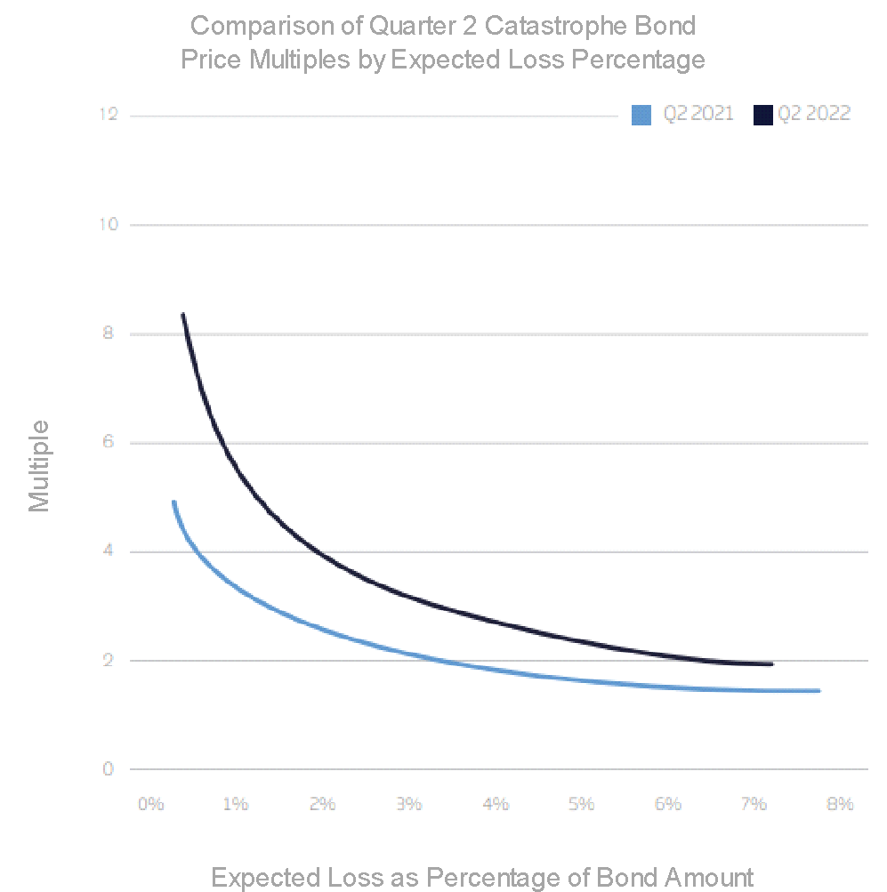
Pricing Assumptions
The pricing multiple, which expresses the relationship between the risk margin of a DRB and the average expected recovery, is set at 1.8 which is consistent with recent World Bank Capital at Risk Notes issuance for the Philippines in 2019*
Larger DRBs are often tranched (cut into slices) to ease placement and attract investors with different appetites
Bond structures per country typically have expected annual losses of 3% to 5% of the bond amount
Market bond multiples are higher for bonds/tranches where there is greater volatility but lower expected loss
Source: https://www.artemis.bm/deal-directory/ibrd-car-123-124/

Slide 15
DRB Pay-out Structure
Assumes DRBs have similar triggers and policy terms to the parametric insurance policies bought by countries from existing regional emergency response facilities
Operates on a “modeled loss basis” – a stochastic catastrophe risk model underpins the transaction. Whilst this may not be the final structure, it gives a good indicative price.
If a given event is modeled to have a severity:
below the attachment threshold, there is no pay-out;
at the attachment threshold, a minimum pay-out is made;
at or above the detachment threshold, a full pay-out, the bond amount, is paid;
between the attachment threshold and detachment threshold, a payment between the minimum payment and the bond amount proportionate to the severity of the event
All subject to the term limit of the amount of the bond: later pay-outs will be limited to the amount of the bond remaining after earlier payments.

Slide 16
DRB Pay-out Structure (continued)
Many Capital Notes at Risk transactions placed by the World Bank use a different payout structure – a stepped pay-out function
There is a big difference in pay-outs for a very small difference in modeled loss,
Post loss this can lead to a lack of confidence in the trigger and the process
Typically, it pays out less than a continuous payment function and so will look cheaper compared to the bond amount

Slide 17
Country and Portfolio Models
A model of each individual country has been created for flood and earthquake, allowing structures to be tested and modeled quickly and easily. The following variables can be amended to test the cost benefit of different options:
Annual Attachment Probability (expressed as a Return Period) – CAREC countries were split into three groups based on their estimated protection gap to inform the choice
Minimum Pay-out at Attachment – Defined as a percentage of Bond Size
Annual Detachment Probability (expressed as a Return Period) - common to all countries within perils, 1-in-200 for earthquake and 1-in-100 for flood
Bond Size (maximum pay-out) - set to the modeled emergency response requirement for the given exhaustion return period, capped for this example at USD 250 million
Pricing Multiple – set at 1.8 for all countries

Slide 18
Country Models – Earthquake Risk
Earthquake
Group Name | Countries | Annual Attachment Probability | Minimum Pay-out at Attachment (US$) | Annual Detachment Probability | Bond size (US$)
Critically Insufficient Financing (80% or more of AALs from floods and earthquakes are not covered by ex-ante mechanisms) | Pakistan | 1 in 20 | 25,000,000 | 1 in 200 | 250,000,000
 | Tajikistan | 1 in 20 | 16,400,000 | 1 in 200 | 164,000,000
Weak Financing (~0%-80% of AAL not covered by ex-ante mechanisms)* | Kyrgyz Republic | 1 in 25 | 17,400,000 | 1 in 200 | 174,000,000
 | Mongolia | 1 in 25 | 100,000 | 1 in 200 | 1,000,000
 | Uzbekistan | 1 in 25 | 25,000,000 | 1 in 200 | 250,000,000
Modest Financing (AALs from flood and earthquakes are covered) | Azerbaijan | 1 in 50 | 13,900,000 | 1 in 200 | 139,000,000
 | Georgia | 1 in 50 | 5,100,000 | 1 in 200 | 51,000,000
 | Kazakhstan | 1 in 50 | 20,800,000 | 1 in 200 | 208,000,000
Insufficient data | People’s Republic of China (Inner Mongolia Autonomous Region and Xinjiang Uyghur Autonomous Region) | 1 in 50 | 25,000,000 | 1 in 200 | 250,000,000
 | Turkmenistan | 1 in 20 | 3,400,000 | 1 in 200 | 34,000,000
The People’s Republic of China (PRC) Inner Mongolia Autonomous Region and PRC Xinjiang Uyghur Autonomous Region are modelled together under a single model.

Slide 19
Country Models – Flood Risk
Flood
Group Name | Countries | Annual Attachment Probability | Minimum Pay-out at Attachment (US$) | Annual Detachment Probability | Bond size (US$)
Critically Insufficient Financing (80% or more of AALs from floods and earthquakes are not covered by ex-ante mechanisms) | Pakistan | 1 in 5 | 25,000,000 | 1 in 100 | 250,000,000
 | Tajikistan | 1 in 5 | 12,500,000 | 1 in 100 | 125,000,000
Weak Financing (~0%-80% of AAL not covered by ex-ante mechanisms)* | Kyrgyz Republic | 1 in 10 | 15,600,000 | 1 in 100 | 156,000,000
 | Mongolia | 1 in 10 | 8,800,000 | 1 in 100 | 88,000,000
 | Uzbekistan | 1 in 10 | 25,000,000 | 1 in 100 | 250,000,000
Modest Financing (AALs from flood and earthquakes are covered) | Azerbaijan | 1 in 15 | 7,900,000 | 1 in 100 | 79,000,000
 | Georgia | 1 in 15 | 3,400,000 | 1 in 100 | 34,000,000
 | Kazakhstan | 1 in 15 | 25,000,000 | 1 in 100 | 250,000,000
Insufficient data | People’s Republic of China (Inner Mongolia Autonomous Region and Xinjiang Uyghur Autonomous Region) | 1 in 15 | 25,000,000 | 1 in 100 | 250,000,000
 | Turkmenistan | 1 in 5 | 18,300,000 | 1 in 100 | 183,000,000

Slide 20
Expected Recoveries by Hazard and Country
Earthquake
Flood

Slide 21
Diversification Benefit
Using standard insurance pricing methodologies, we see a similar pattern of high multiples for bonds with lower average pay-outs - blue (earthquake) and red (flood)
The implied price of bonds covering two hazards(yellow) is lower reflecting the value of diversification, combining countries (arrowed) reduces the theoretical cost further

Slide 22
Example Transaction
Annual Rate
The example bond covering a randomly selected 5-country group is considered
It is assumed that capital markets will allow only 25% of the diversification benefit estimated using the insurance pricing methodology illustrated previously
For single-country bonds, the market will apply a multiplier of 1.8 to expected recoveries.
 | Total without Diversification | Total with Diversification
EQ | 3.04% | 2.92%
Flood | 10.20% | 9.98%
Combined | 6.80% | 6.50%
US$1 Billion Bond
 | Total without Diversification | Total with Diversification
EQ | 30,447,447 | 29,180,873
Flood | 102,032,912 | 99,813,985
Combined | 67,994,725 | 64,972,154
Notes:
The graph illustrates the diversification benefit that could be achieved to the Annual Risk Margin by grouping countries within a DRB, making coverage cheaper for each participating country

Slide 23
Implementation

Slide 24
Roadmap
Country Engagement |  | Appointment of Modeling and Structuring Agent |  | Timeline
Purpose is to agree on a DRB structure which is tailored to meet the financing needs of member countries. Stakeholders may include DRM and DRF government agencies, ministries of finance, academia, etc. |  | Modeling agents to provide appropriate models and/or data to estimate the risk and potential losses. Structuring agents assist the issuer in selecting the trigger and level of protection. CAREC countries may wish to collaborate to appoint a common modeling and structuring agent. |  | Depends on a variety of factors, including the complexity of the structure and the bond’s trigger type and the status of the market. Optimistic timeline is 9 months. ADB could leverage relationships with existing investors in the GMTN program to speed up the process of securing investment for a DRB

Slide 25
Role of ADB
ADB will provide CAREC countries with both specialized technical assistance relating to the DRB and support executing the capital market transaction(s)
ADB’s Global Medium-Term Notes (GMTN) replaces the SPV in the classic catastrophe bond structure
Reduces frictional costs of bond issuance and management
ADB’s AAA credit rating and market power allow the team to pass on cost efficiencies to CAREC countries to support their management of disaster risks
ADB will manage the issuance process including the appointment of modelling, structuring and placement agents, assist in evaluating risk transfer options and reviewing legal documentation to accommodate different legal and regulatory environments

Slide 26
Summary
A DRB builds on the licensed and regulated catastrophe bond by introducing a requirement that proceeds from a bond pay-out be used to implement relief, rehabilitation and recovery measures.
It is a form of Insurance-Linked Securities (ILS), a group of financial instruments which embed and insurance mechanism. ILS have been used by governments around the world – they can provide large amounts of risk coverage over multi-year periods
DRB's can be issued for flood, earthquake, and infectious disease. Earthquake is possibly the fastest option to market.
Pricing options for countries to collaborate on a bond are presented, with an indicative overview of prices and potential benefits. This is technical modeling, rather than an indication of the pricing which will need to be tested in the market.
Use of ADB’s Global Medium-Term Notes (GMTN) program will allow for direct DRB issuance and reduce the costs for CAREC member countries
An optimistic timeline for delivery is 9 months. This project will submit a concrete option for consideration based on further engagements with CAREC member countries, ADB board of directors and donors.

Slide 27
Q&A

Slide 28
Disclaimer
This analysis has been prepared by Willis Limited for the Asian Development Bank under a Technical Assistance contract.
Willis Limited has relied upon data from public and/or other sources when preparing this analysis. No attempt has been made to verify independently the accuracy of this data. Willis Limited does not represent or otherwise guarantee the accuracy or completeness of such data nor assume responsibility for the result of any error or omission in the data or other materials gathered from any source in the preparation of this analysis.
There are many uncertainties inherent in this analysis including, but not limited to, issues such as limitations in the available data, reliance on client data and outside data sources, the underlying volatility of loss and other random processes, uncertainties that characterize the application of professional judgment in estimates and assumptions, etc. Ultimate losses, liabilities and claims depend upon future contingent events, including but not limited to unanticipated changes in inflation, laws, and regulations. As a result of these uncertainties, the actual outcomes could vary significantly from Willis Limited’s estimates in either direction. Willis makes no representation about and does not guarantee the outcome, results, success, or profitability of any insurance or reinsurance program or venture, whether or not the analyses or conclusions contained herein apply to such program or venture.
Willis does not recommend making decisions based solely on the information contained in this analysis. Rather, this analysis should be viewed as a supplement to other information, including specific business practice, claims experience, and financial situation. Independent professional advisors should be consulted with respect to the issues and conclusions presented herein and their possible application. Willis makes no representation or warranty as to the accuracy or completeness of this document and its contents.
Willis does not provide legal, accounting, or tax advice. This analysis does not constitute, is not intended to provide, and should not be construed as such advice. Qualified advisers should be consulted in these areas.
Willis makes no representation, does not guarantee and assumes no liability for the accuracy or completeness of, or any results obtained by application of, this analysis and conclusions provided herein.
Acceptance of this document shall be deemed agreement to the above.

