Slide 1
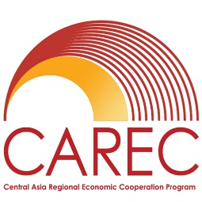
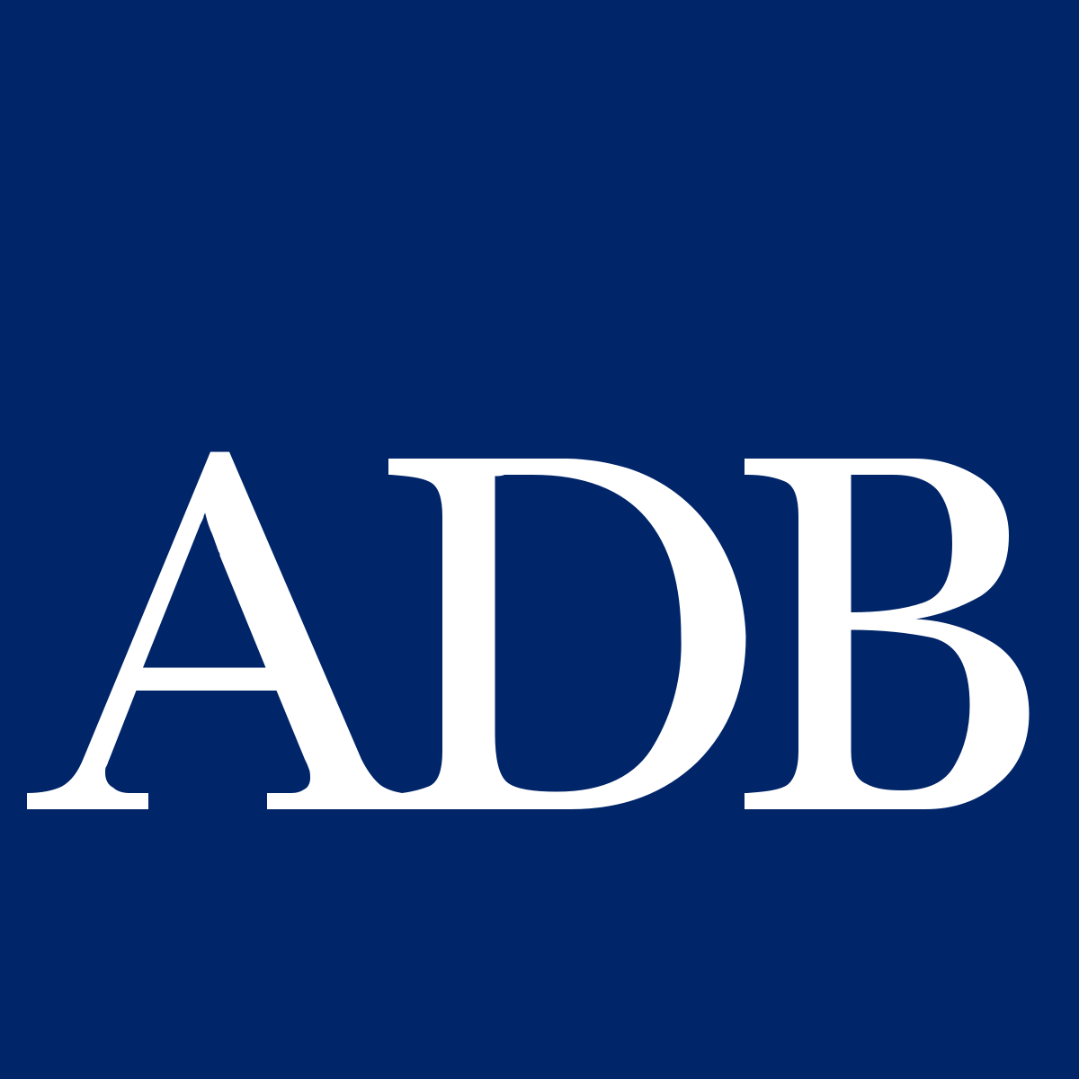
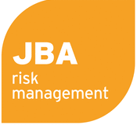
Session 7: Summary
Central Asia Regional Economic Cooperation Program Disaster Risk Engagement Meeting
Istanbul, Türkiye
November 2022

Slide 2
Options for CAREC’s Regional Disaster Risk Financing Facility

Slide 3
Main Stages of Facility Development
Stage 1: Facility Creation |  | Decision points needed to create the facility's legal entity are: Country of domicile or recognition; Operational entity or legal nature, including its ownership structure; Sources of initial capitalization; Corporate governance structure; Key advisors; and, Initial product offering
Stage 2: Facility Operations |  | Decision points needed to fulfil the facility's functions in a viable, efficient, effective, and financially sustainable manner are: Operational structure; Alternative sources of capital required for longer-term financial sustainability; Evolution of its products; and, Country engagement program, which includes providing capacity-building for country stakeholders to build support from countries.

Slide 4
Functions of a CAREC Disaster Risk Facility
A CAREC facility can serve several functions:
Collaboration
Arranges risk transfer
Retains risk
(risk pooling)
Sharing of best practice, of data, and of regional management to disaster risk management
Facilitates risk coverage for participating countries, including insurance and ILS
A licensed and regulated insurance company to which countries transfer risks in exchange for premiums
Level of Complexity and Involvement

Slide 5
Q&A and Discussion

Slide 6
Disclaimer
This analysis has been prepared by Willis Limited for the Asian Development Bank under a Technical Assistance contract.
Willis Limited has relied upon data from public and/or other sources when preparing this analysis. No attempt has been made to verify independently the accuracy of this data. Willis Limited does not represent or otherwise guarantee the accuracy or completeness of such data nor assume responsibility for the result of any error or omission in the data or other materials gathered from any source in the preparation of this analysis.
There are many uncertainties inherent in this analysis including, but not limited to, issues such as limitations in the available data, reliance on client data and outside data sources, the underlying volatility of loss and other random processes, uncertainties that characterize the application of professional judgment in estimates and assumptions, etc. Ultimate losses, liabilities and claims depend upon future contingent events, including but not limited to unanticipated changes in inflation, laws, and regulations. As a result of these uncertainties, the actual outcomes could vary significantly from Willis Limited’s estimates in either direction. Willis makes no representation about and does not guarantee the outcome, results, success, or profitability of any insurance or reinsurance program or venture, whether or not the analyses or conclusions contained herein apply to such program or venture.
Willis does not recommend making decisions based solely on the information contained in this analysis. Rather, this analysis should be viewed as a supplement to other information, including specific business practice, claims experience, and financial situation. Independent professional advisors should be consulted with respect to the issues and conclusions presented herein and their possible application. Willis makes no representation or warranty as to the accuracy or completeness of this document and its contents.
Willis does not provide legal, accounting, or tax advice. This analysis does not constitute, is not intended to provide, and should not be construed as such advice. Qualified advisers should be consulted in these areas.
Willis makes no representation, does not guarantee and assumes no liability for the accuracy or completeness of, or any results obtained by application of, this analysis and conclusions provided herein.
Acceptance of this document shall be deemed agreement to the above.

