Slide 1
Developing a Disaster Risk Transfer Facility in the Central Asia Regional Economic Cooperation Region
Central Asia Regional Economic Cooperation Program Disaster Risk Engagement Meeting
Istanbul, Türkiye
November 2022

Slide 2
Part 1: Disaster Risk Financing Overview

Slide 3
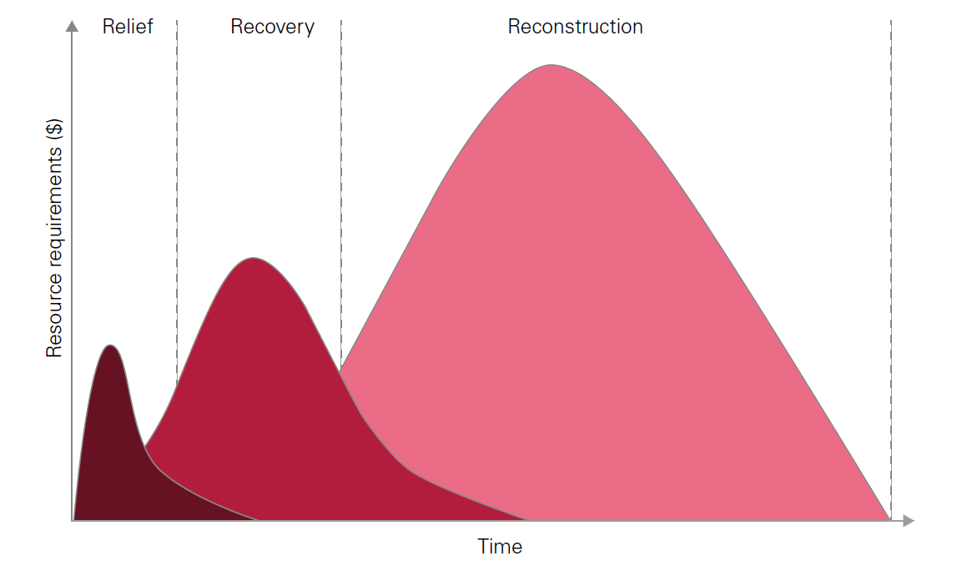
Early, Effective Emergency Response is Vital
Key requirements for relief and early recovery:
Timeliness of funds
Predictability of funds
$1 received immediately after a disaster is worth up to $5 delivered later in typical aid cycle
The current approach typically relies on budget reallocation or external support
Relief: Within 2 months of disaster
Humanitarian response
e.g. providing food, medicine, shelter
Recovery: Within 9 months of disaster
Restoration of basic services and economic productivity
e.g. Re-starting transport, energy supplies, markets

Slide 4
Disaster Risk Management – Quantification and Risk Layering
Modelling disaster risk profiles for informed DRM decisions
Risk layering: no single financial instrument can address all risks
Aggregated annual damage exceedance probability curves: what is the annual probability (expressed as the one in X-year) of exceeding a disaster impact of $Y?
How to choose the appropriate DRF instruments for which circumstances and targeted measures?
High Severity
Disaster Risk Reduction
Loans, grants, micro-credit, bonds, subsidies, tax breaks, crediting, impact bonds
Disaster Risk Protection
Reserves and contingency budgets
Post Disaster reallocation budgets, emergency assistance loans and borrowing
Contingent disaster finance
Disaster Risk Transfer
Regional/Sovereign
Local insurance markets
International reinsurance markets
Insurance Linked Securities / Cat bond markets
International Assistance
Exceptional Events / Acts of God
Annual Disaster Impact
Low Severity
High Frequency
Return Period
Low Frequency

Slide 5
Disaster Risk Financing
Review / Needs Assessment
Ex-Ante
Layered approach to risk finance
Provides flexibility
Different mechanisms to respond to different severities of events and different timescales
Relatively small amounts of financing available and deployed quickly often significantly reduce the overall negative financial impact of shock events
Innovative and traditional options will be assessed with the aim of identifying the optional mix of each country
Ex-Post
Low frequency / high severity
Parametric risk transfer
Indemnity risk transfer
Sovereign debt
Contingent credit
Sovereign reserves
High frequency / low severity
Budget reallocation
Response / early recovery
Long-term recovery / reconstruction

Slide 6
Emergency Response Insurance
Provides social and economic benefits as well as cost savings
Social benefits
Economic benefits
Cost savings
Timely funding reduces impacts on vulnerable groups from disasters, such as loss of education and health services, and ensures more rapid income recovery.
Short-term support can reduce long term impacts on poor households, who are better able to invest if incomes are stable
For example, Filipino evidence suggests incomes fall by 6.6% and spending on health / education by >10% after a serious typhoon.
Timely and well targeted funding can expedite economic recovery.
Budgetary support can remove need for reallocation away from essential services and long-term capital projects (via Development Fund)
In Mexico, rapid post-disaster recovery increased size of local economy by 2-4 per cent.
Certainty and speed of funding allows more effective planning, which increases the effectiveness and reduces the cost of the post-disaster response
Studies suggest that delays in funding can increase long-term post-disaster costs by between 100% and 400%.
Sources: Anttila-Hughes and Hsiang (2013), de Janvry et al. (2016), Wold Bank Group (2017).

Slide 7
Part 2: Interactive Session

Slide 8
Part 2: Current Position
Does your country have a DRF strategy? What does it look like?
Which DRF approach(es) are currently used by your country?
Which DRF approach(es) are being considered by your country?
Are there any DRF approach(es) your country would not consider? Why?
Are there any DRF approach(es) mentioned that you would like to hear more about?

Slide 9
Part 2: DRF Needs
What do you see as the main DRF needs for your country?
Funding emergency response needs immediately after an event
Funding medium term recovery and/or longer term reconstruction
Protecting public property and/or critical infrastructure
Covering additional public financing needs after an event: for example, increased welfare payments, lower tax income
Protection of particular sectors: for example agriculture, tourism, small and medium enterprises

Slide 10
Part 2: Regional Facility
What do you see as the main benefit of regional co-operation?
Sharing knowledge/expertise
Co-ordination of cross-border disaster response
Reduction in cost of DRF
Which existing facilities are you aware of?
Are there any that you feel could be a template for CAREC
Are there elements of other schemes that can be applied to CAREC
Are there any special issues that a CAREC programme must consider
Do you believe your country:
Will want to be actively involved in the management of the facility?
Has a strong view about where the facility is located?
Thinks CAREC is the right body to host a regional facility? If not, who else?

Slide 11
Part 2: Country Context
Who manages DRF in my country?
Is responsibility clear?
Is Disaster Risk Financing well integrated with Disaster Risk Reduction?
Do the responsible organisations need:
Capacity building/training?
Better data and analytical tools?
Better funding? If so what sources could/should provide that funding?
Are their specific, additional regional DRF requirements in my country?
Should these needs be managed locally or nationally?
Are local governments and adequate capacity and resource?

Slide 12
Part 3 – Conclusions

Slide 13
The Disaster Risk Management Interface (DRMI)
Conclusions
What is your country’s main takeaway from this meeting?
What are your main immediate information and/or support needs?
Would your country support a regional facility?
What services would you want that regional facility to provide?
How can the ADB and the project team best help you to define and implement your optimal DRF programme?

Slide 14
Disclaimer
This analysis has been prepared by Willis Limited for the Asian Development Bank under a Technical Assistance contract.
Willis Limited has relied upon data from public and/or other sources when preparing this analysis. No attempt has been made to verify independently the accuracy of this data. Willis Limited does not represent or otherwise guarantee the accuracy or completeness of such data nor assume responsibility for the result of any error or omission in the data or other materials gathered from any source in the preparation of this analysis.
There are many uncertainties inherent in this analysis including, but not limited to, issues such as limitations in the available data, reliance on client data and outside data sources, the underlying volatility of loss and other random processes, uncertainties that characterize the application of professional judgment in estimates and assumptions, etc. Ultimate losses, liabilities and claims depend upon future contingent events, including but not limited to unanticipated changes in inflation, laws, and regulations. As a result of these uncertainties, the actual outcomes could vary significantly from Willis Limited’s estimates in either direction. Willis makes no representation about and does not guarantee the outcome, results, success, or profitability of any insurance or reinsurance program or venture, whether or not the analyses or conclusions contained herein apply to such program or venture.
Willis does not recommend making decisions based solely on the information contained in this analysis. Rather, this analysis should be viewed as a supplement to other information, including specific business practice, claims experience, and financial situation. Independent professional advisors should be consulted with respect to the issues and conclusions presented herein and their possible application. Willis makes no representation or warranty as to the accuracy or completeness of this document and its contents.
Willis does not provide legal, accounting, or tax advice. This analysis does not constitute, is not intended to provide, and should not be construed as such advice. Qualified advisers should be consulted in these areas.
Willis makes no representation, does not guarantee and assumes no liability for the accuracy or completeness of, or any results obtained by application of, this analysis and conclusions provided herein.
Acceptance of this document shall be deemed agreement to the above.

