Slide 1
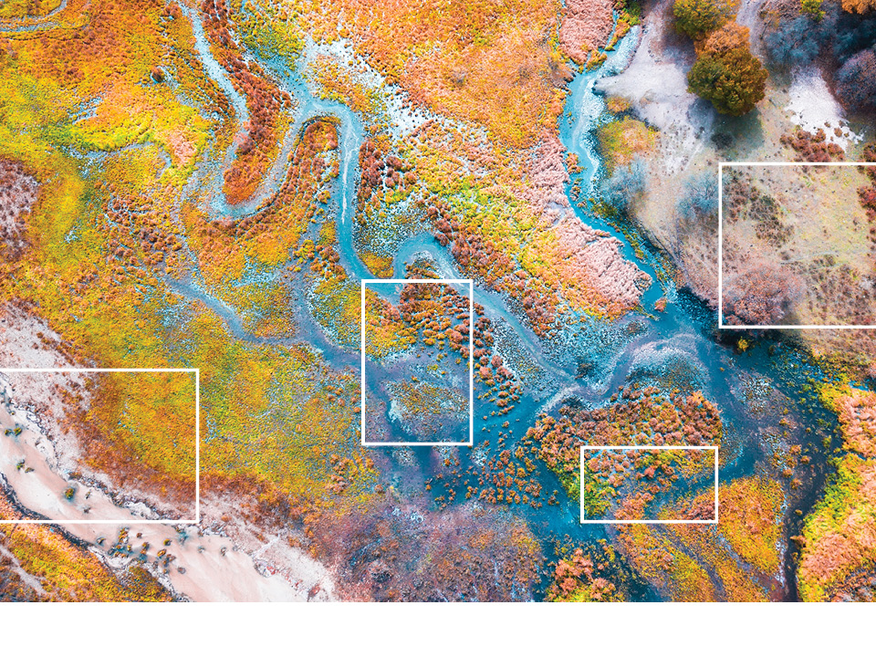



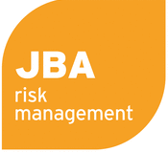




Session 5.A1: Disaster Risk Management Interface
Central Asia Regional Economic Cooperation Program Disaster Risk Engagement Meeting
Istanbul, Türkiye
November 2022

Slide 2



Part 1 – Introduction to the DRMI

Slide 3
The Disaster Risk Management Interface (DRMI)
The DRMI is a way to explore the outputs from risk modelling completed during this project. The DRMI has 5 sections
Deterministic Modeling
Earthquake
Flooding
Infectious Disease
Economic Loss
People Affected
Fatalities
Probabilistic Modeling
Earthquake
Flooding
Infectious Disease
Economic Loss
People Affected
Fatalities
Exposure Risk Calculator
Earthquake
Flooding
Exposure change
Average Annual Damages
Return Period Damages
Risk Adaptation
Earthquake
Flooding
Adaptation Scenarios
Future Climate and Exposure
Cost-Benefit Analysis
Risk Financing
Earthquake
Flooding
Financial Product Structure
Premium Price
Pay-outs by Event and Year

Slide 4
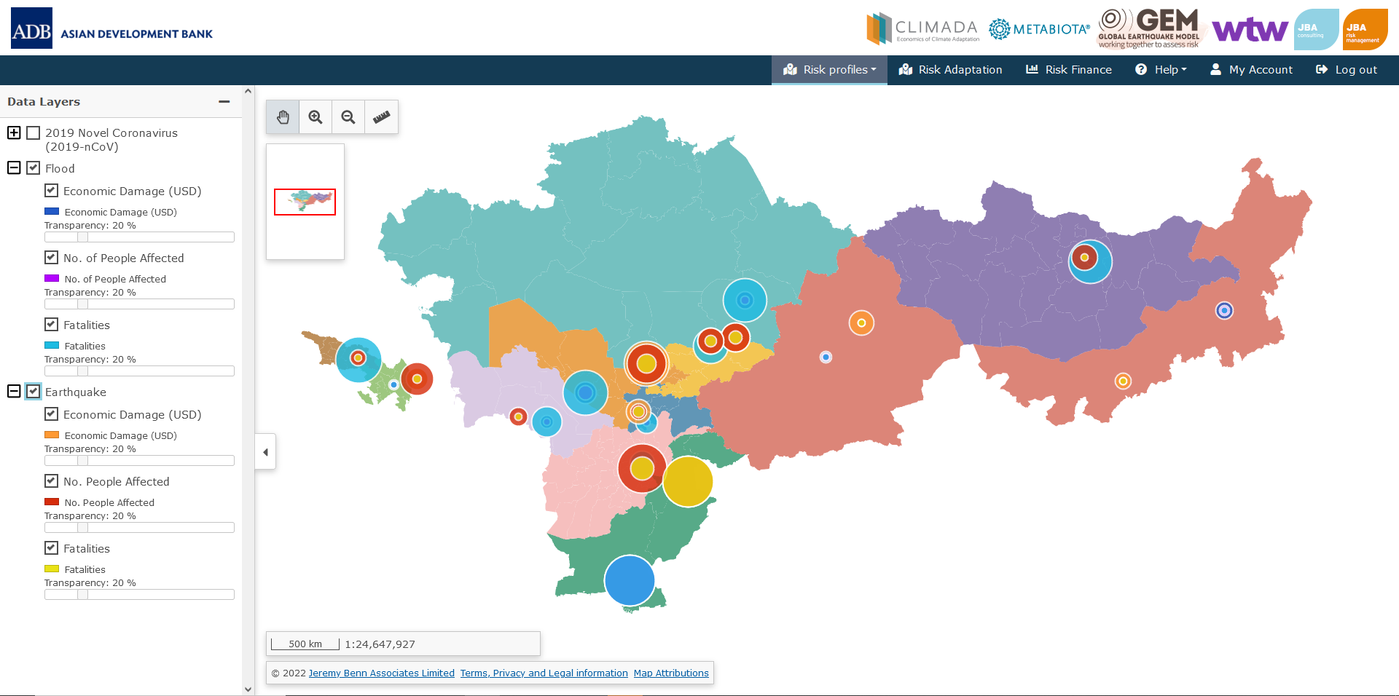
The Disaster Risk Management Interface (DRMI)
Deterministic Modeling
Earthquake
Flooding
Infectious Disease
Economic Loss
People Affected
Fatalities

Slide 5
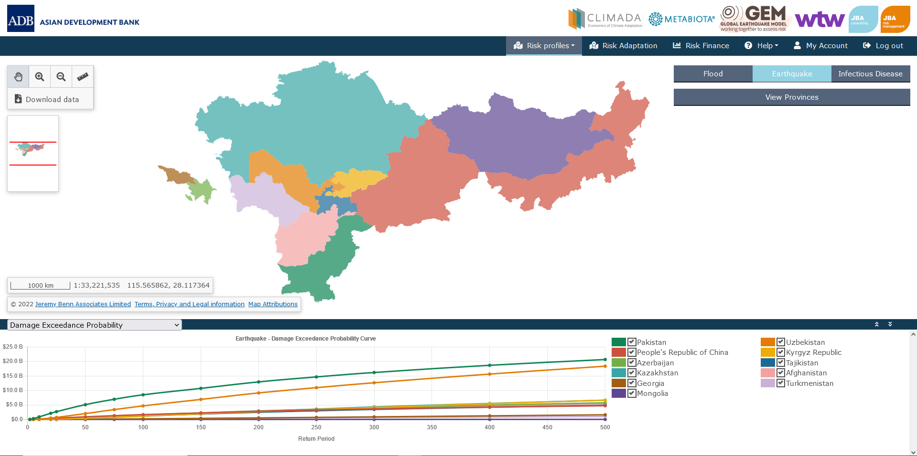
The Disaster Risk Management Interface (DRMI)
Probabilistic Modeling
Earthquake
Flooding
Infectious Disease
Economic Loss
People Affected
Fatalities

Slide 6
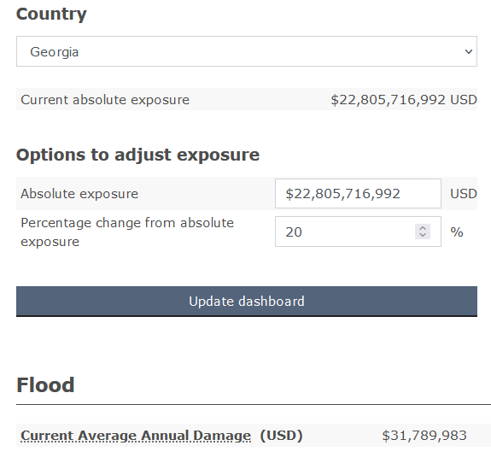
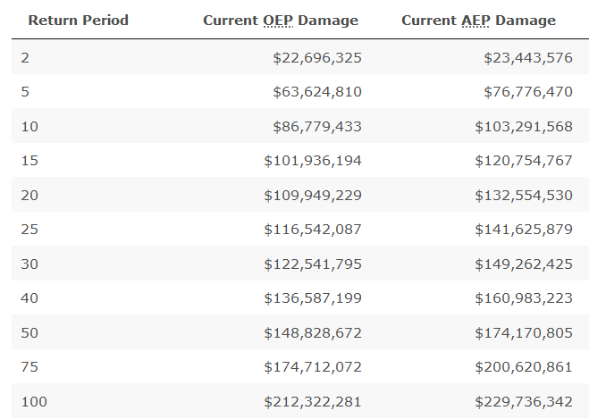
The Disaster Risk Management Interface (DRMI)
Exposure Risk Calculator
Earthquake
Flooding
Exposure change
Average Annual Damages
Return Period Damages

Slide 7
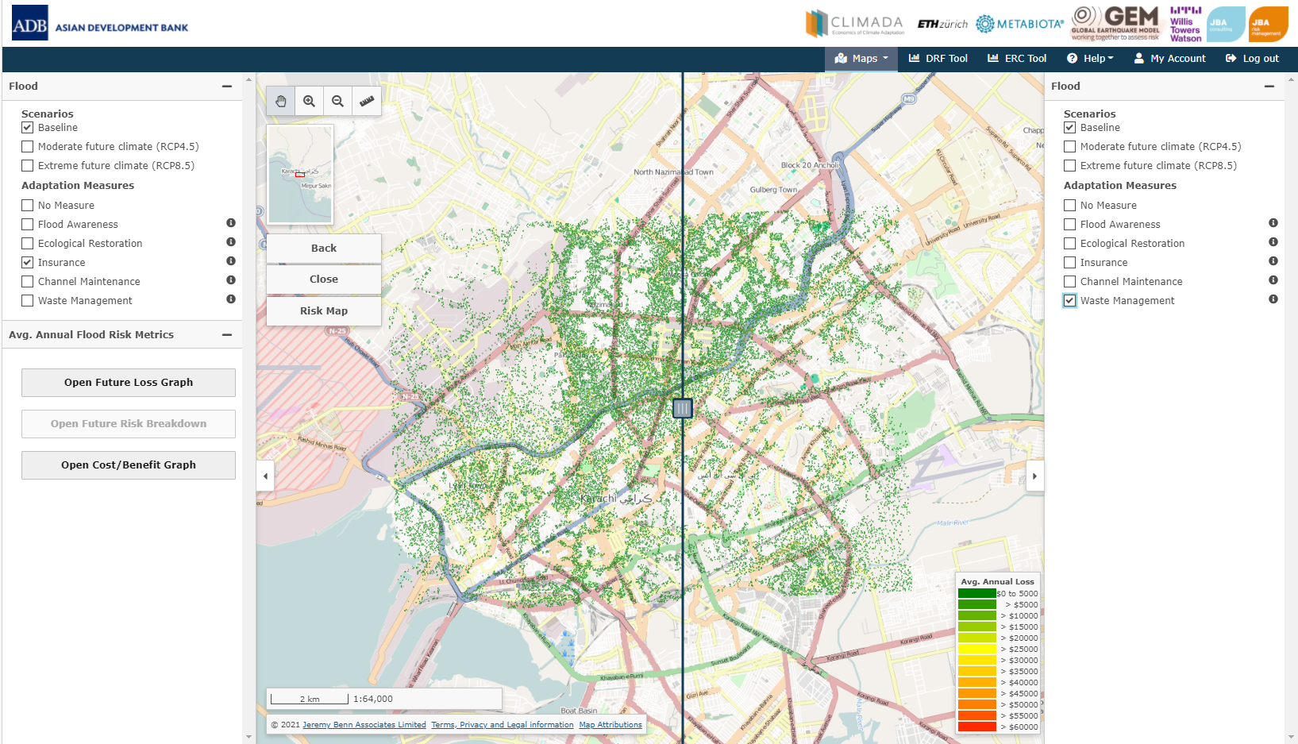
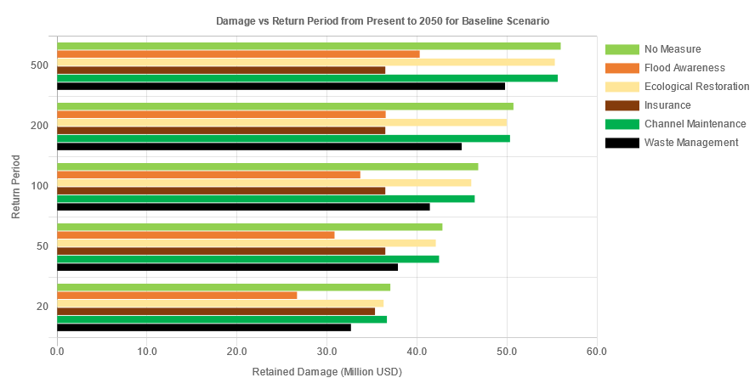
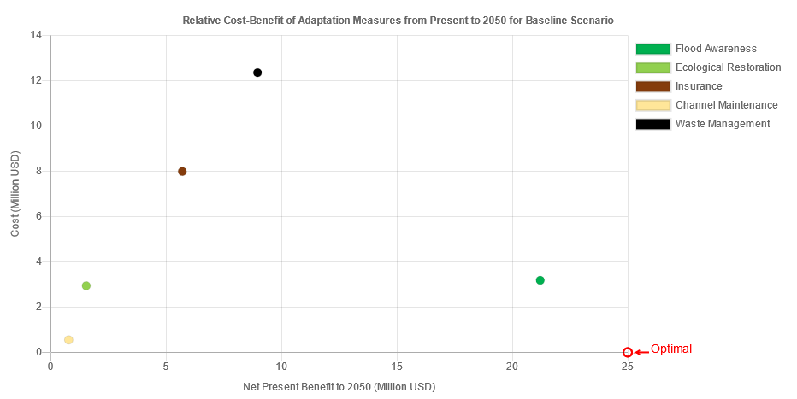
The Disaster Risk Management Interface (DRMI)
Risk Adaptation
Earthquake
Flooding
Adaptation Scenarios
Future Climate and Exposure
Cost-Benefit Analysis

Slide 8
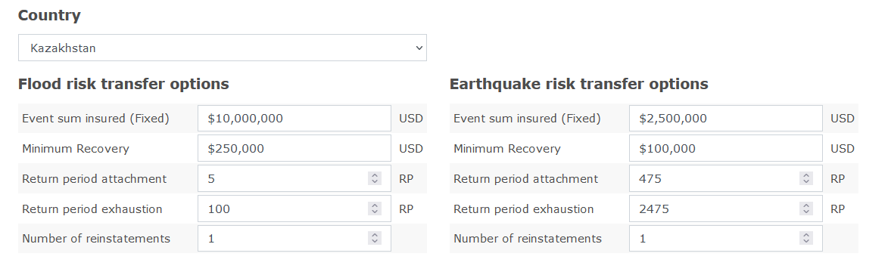
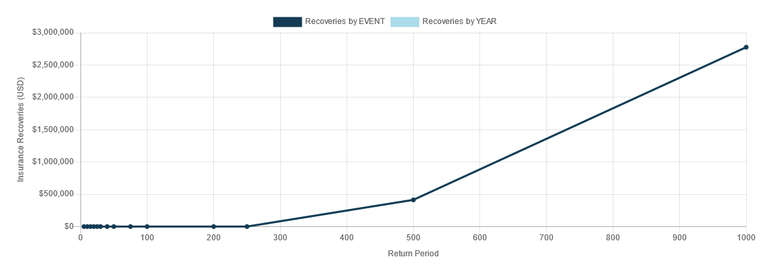
The Disaster Risk Management Interface (DRMI)
Risk Financing
Earthquake
Flooding
Financial Product Structure
Premium Price
Pay-outs by Event and Year

Slide 9
Part 2 – Interactive Sessions

Slide 10
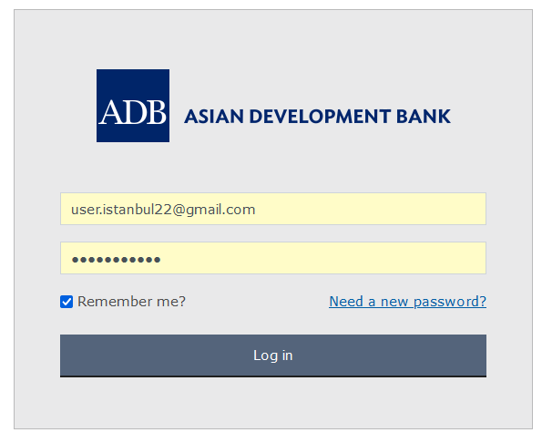
The Disaster Risk Management Interface (DRMI)
Website: https://carec-engagement-tool.jbahosting.com
Username: user.istanbul22@gmail.com
Password: Istanbul#22

Slide 11
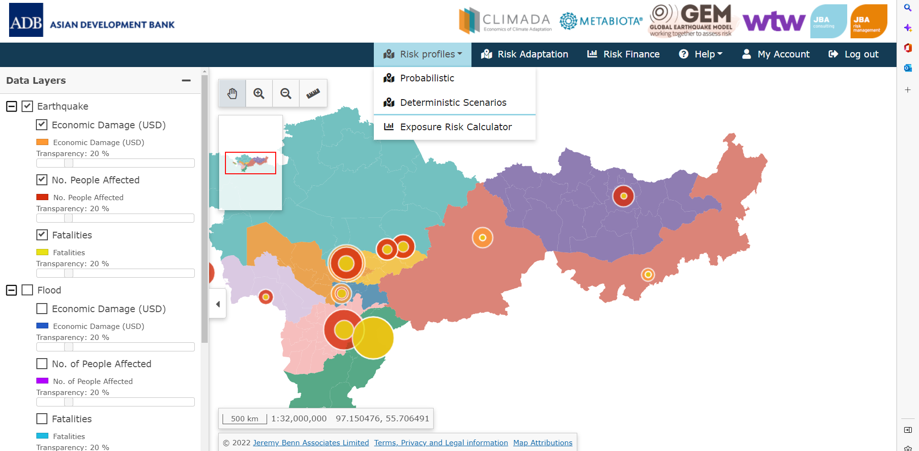
The Disaster Risk Management Interface (DRMI)
Deterministic Modeling
Earthquake
Flooding
Infectious Disease
Economic Loss
People Affected
Fatalities

Slide 12
The Disaster Risk Management Interface (DRMI)
Deterministic Modeling
What is the economic loss caused by this flooding event in my country?​
​What is the economic loss caused by this earthquake event in my country?​
What is the modelled number of people affected to population ratio?​
View the flood and earthquake maps.

Slide 13
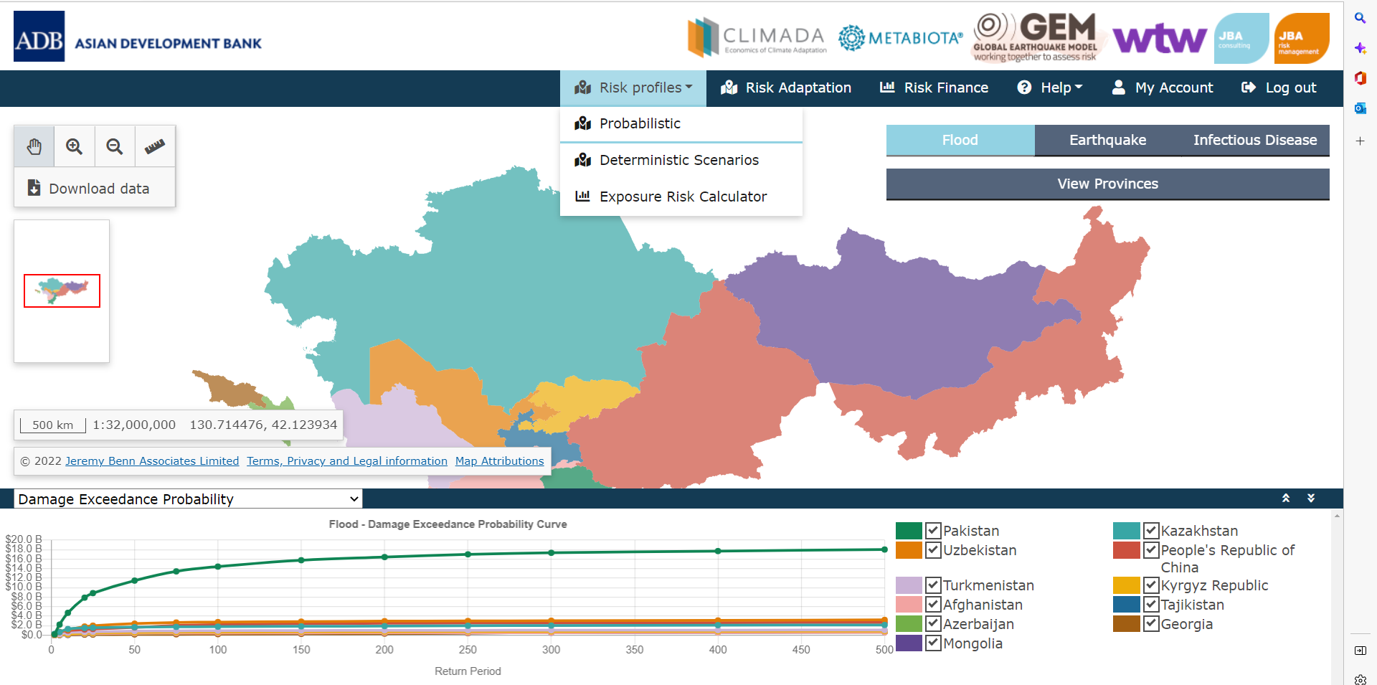
The Disaster Risk Management Interface (DRMI)
Probabilistic Modeling
Earthquake
Flooding
Infectious Disease
Economic Loss
People Affected
Fatalities

Slide 14
The Disaster Risk Management Interface (DRMI)
Probabilistic Modeling
Which hazard represents the biggest risk in terms of economic loss?
Which hazard represents the biggest risk in terms of fatalities and people affected?
What types of infectious disease impact my country?
Which province is most impacted by flood?
Which province is most impacted by earthquake?

Slide 15
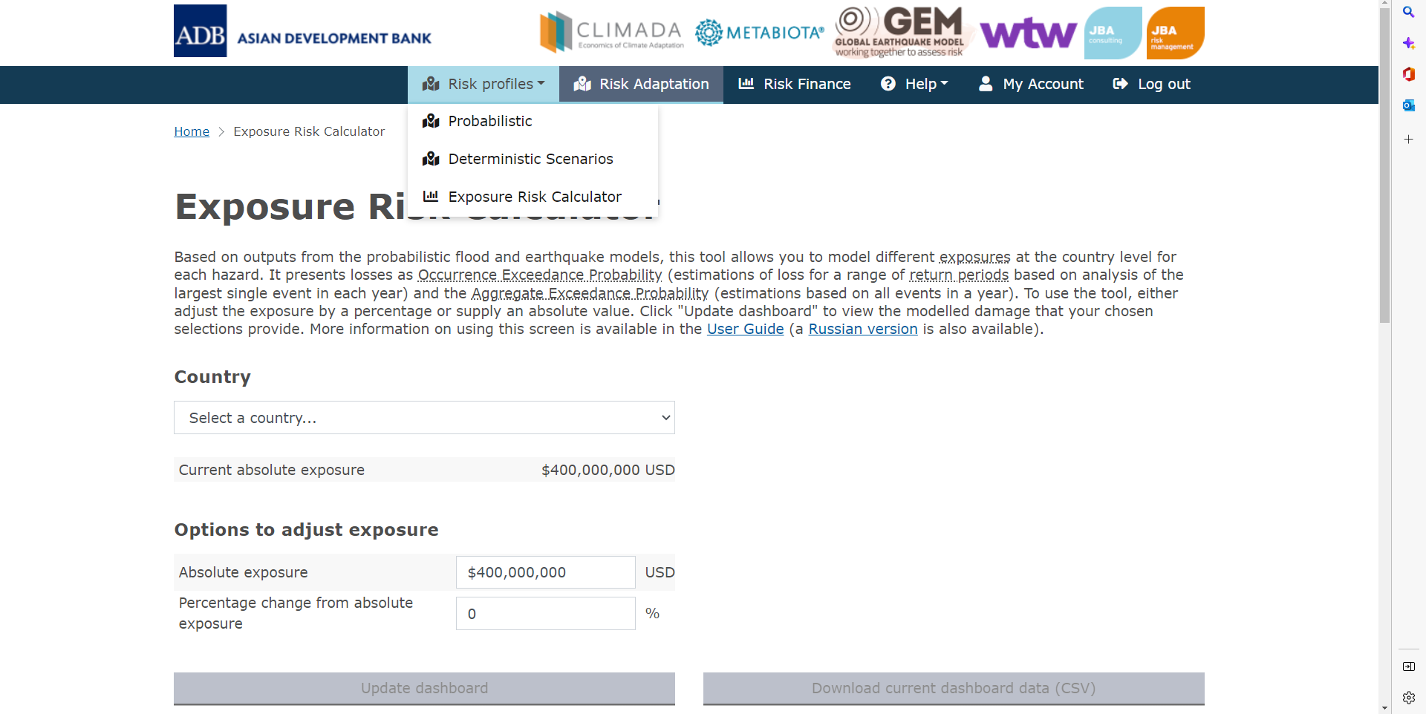
The Disaster Risk Management Interface (DRMI)
Exposure Risk Calculator
Earthquake
Flooding
Exposure change
Average Annual Damages
Return Period Damages

Slide 16
The Disaster Risk Management Interface (DRMI)
Exposure Risk Calculator
How much do you expect population to grow over the next 5-years, 10-years?
Which parts of your country do you expect to experience the greatest increase in population, buildings, building values?
Do areas of high population / buildings overlap with areas of high flood and earthquake hazard?

Slide 17
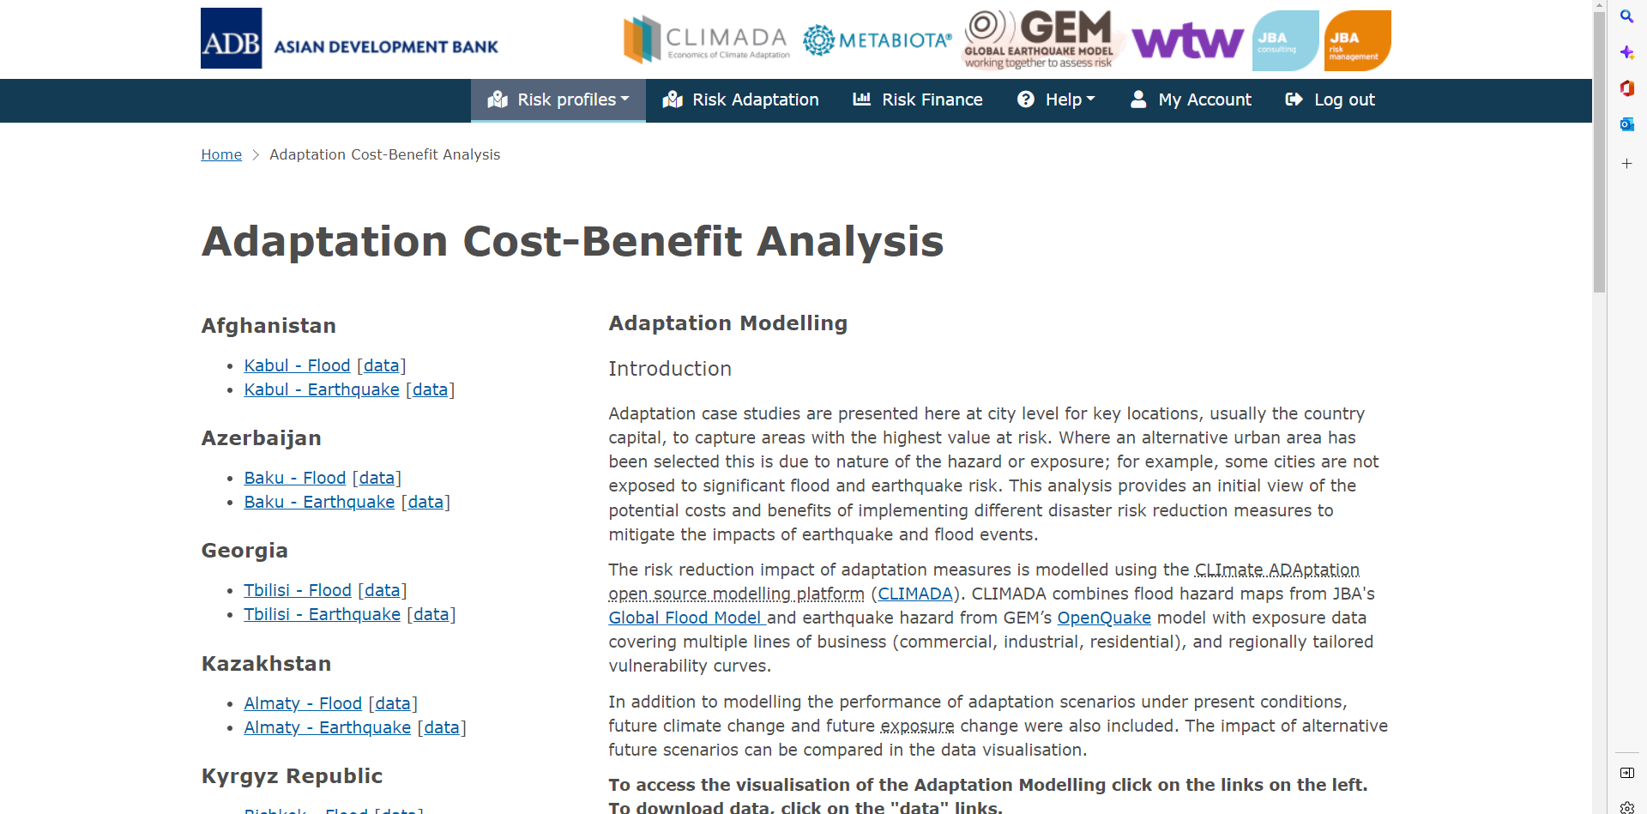
The Disaster Risk Management Interface (DRMI)
Risk Adaptation
Earthquake
Flooding
Adaptation Scenarios
Future Climate and Exposure
Cost-Benefit Analysis

Slide 18
The Disaster Risk Management Interface (DRMI)
Risk Adaptation
Which adaptation measures do you think would be appropriate for managing flooding?
Which adaptation measures do you think would be appropriate for managing earthquakes?
What major adaptation projects are already in place? Are any being planned at the moment?
Do you think these projects are cost-effective?
How do you think these adaptation measures will perform under future climate scenarios (for flood)?

Slide 19
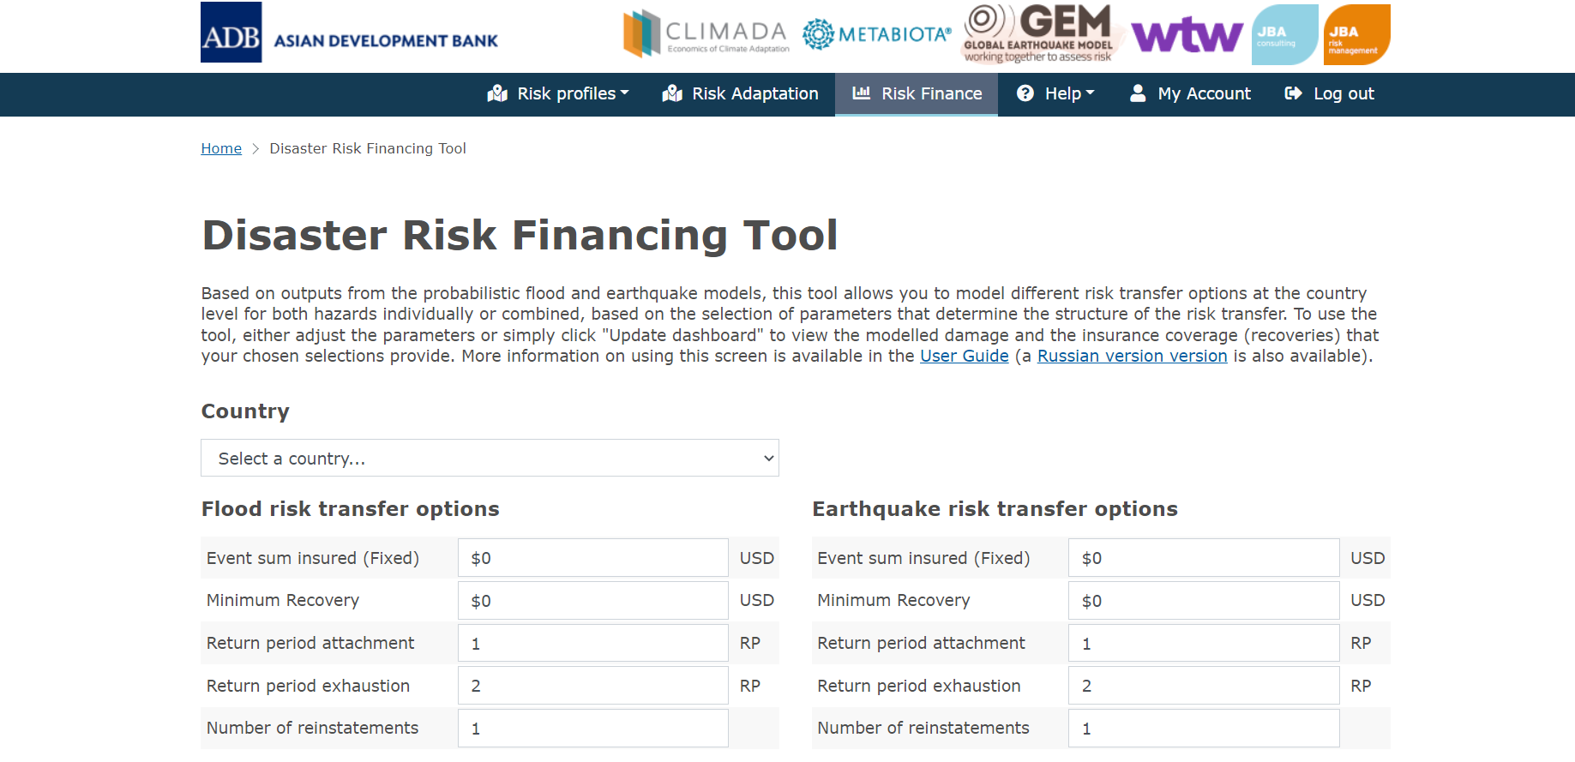
The Disaster Risk Management Interface (DRMI)
Risk Financing
Earthquake
Flooding
Financial Product Structure
Premium Price
Pay-outs by Event and Year

Slide 20
The Disaster Risk Management Interface (DRMI)
Risk Financing
How do you currently finance response to, and recovery from major earthquake and flooding events?
Are there typically sufficient funds for a) response (immediate to weeks after), b) recovery (weeks to months after), c) reconstruction (months to years after)
What kinds of financial products are you familiar with?
Which kinds of financial products do you think might be useful?

Slide 21
Part 3 – Conclusions

Slide 22
Conclusions
    How do you think the DRMI could be used to support decision making?
    Which sections of the DRMI do you find most useful for risk management decision making?
    Do you have additional datasets that could help better understand the key risks that your country faces?

Slide 23
Disclaimer
This analysis has been prepared by Willis Limited for the Asian Development Bank under a Technical Assistance contract.
Willis Limited has relied upon data from public and/or other sources when preparing this analysis. No attempt has been made to verify independently the accuracy of this data. Willis Limited does not represent or otherwise guarantee the accuracy or completeness of such data nor assume responsibility for the result of any error or omission in the data or other materials gathered from any source in the preparation of this analysis.
There are many uncertainties inherent in this analysis including, but not limited to, issues such as limitations in the available data, reliance on client data and outside data sources, the underlying volatility of loss and other random processes, uncertainties that characterize the application of professional judgment in estimates and assumptions, etc. Ultimate losses, liabilities and claims depend upon future contingent events, including but not limited to unanticipated changes in inflation, laws, and regulations. As a result of these uncertainties, the actual outcomes could vary significantly from Willis Limited’s estimates in either direction. Willis makes no representation about and does not guarantee the outcome, results, success, or profitability of any insurance or reinsurance program or venture, whether or not the analyses or conclusions contained herein apply to such program or venture.
Willis does not recommend making decisions based solely on the information contained in this analysis. Rather, this analysis should be viewed as a supplement to other information, including specific business practice, claims experience, and financial situation. Independent professional advisors should be consulted with respect to the issues and conclusions presented herein and their possible application. Willis makes no representation or warranty as to the accuracy or completeness of this document and its contents.
Willis does not provide legal, accounting, or tax advice. This analysis does not constitute, is not intended to provide, and should not be construed as such advice. Qualified advisers should be consulted in these areas.
Willis makes no representation, does not guarantee and assumes no liability for the accuracy or completeness of, or any results obtained by application of, this analysis and conclusions provided herein.
Acceptance of this document shall be deemed agreement to the above.

