Slide 1
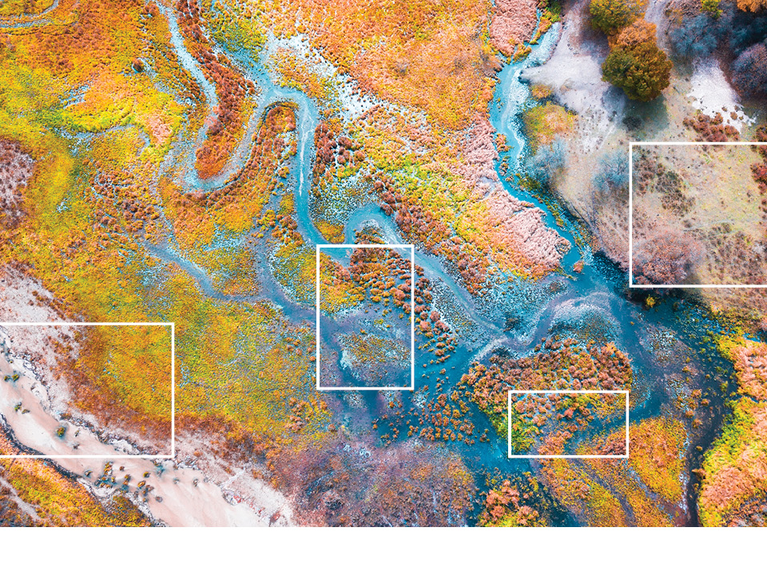







Session 4: Examples of Regional Disaster Risk Financing
Central Asia Regional Economic Cooperation Program Disaster Risk Engagement Meeting
Istanbul, Türkiye
November 2022

Slide 2
Objectives
1. Introduction: The fundamentals
2. Outline existing programmes and lessons learned
3. Regional disaster risk finance options for CAREC
4. Open Q&A
Notes:
Mention the format for Discussions
Underlying objectives to the deliverables is to agree how best to work with you to improve data, modelling and understanding of your requirements and so allow us to work with you to determine appropriate disaster risk financing instruments

Slide 3
Introduction: The Fundamentals

Slide 4

Requirement for immediate post disaster liquidity
Immediate funding is key
Funding Requirement
< 2 months after a disaster
Humanitarian response
e.g. Providing food, medicine, shelter
< 9 months after a disaster
Restoration of basic services
e.g. Re-starting transport, energy supplies, markets
> 4 months after a disaster
Reconstruction or rehabilitation of assets
e.g. Rebuilding infrastructure, homes, build back better
Relief
Early recovery
Reconstruction
Time
Time
Source: Vivid Economics

Slide 5

Parametric Insurance
Fast payment after an event
A different type of insurance
Parametric policies respond to an event, not a proven loss like traditional indemnity insurance
This means that loss payments can be made virtually immediately after the event
No time and cost of post disaster loss adjustment
Countries can buy insurance against windstorm, earthquake and excess rain
Countries know the expected pay-out within 3 day (allowing them to plan/spend) and will have recovered the money within 14 days
TRIGGER | INDEMNITY | PARAMETRIC INDEX
Speed of pay-out
Transparency
Cost effectiveness
Basis risk
FAST
OBJECTIVE
COST-EFFECTIVE

Slide 6



Forms of a Regional Risk Transfer Facility
Insurance Pool
A special purpose insurer is created either owned by, or run for the benefit of, member countries
The pool offers insurance to each country, retaining profit in the pool
The pool buys reinsurance or capital market protection in excess of its capitalisation, gaining diversification benefits of the pool to minimise cost
Collective Purchase – Single Policy, Separate Country Limits
Members collectively purchase cover together to minimise frictional costs and also gain benefit of combined diversification of the collective portfolio
Countries gain benefit of overall diversification whilst maintaining own limits
Cover can be procured as insurance or a capital market instrument
Collective Purchase – Separate Policies, Marketed Together
Similar to above, but separate contracts are marketed jointly (as per Pacific Alliance Catastrophe bond placement)
Reduced frictional costs, plus some diversification benefit may be allowed by markets

Slide 7

What is does Regional Collaboration on Risk
Financing look like?
National
National
National
Regional
Country A
Country B
Country C
Country A
Country B
Country C
Risk pooling results in lower cost of cover:
Sharing of costs and expenses
Benefits of scale
Shared modelling costs (with standardised data collection)
Diversification drives premium/risk margin savings

Slide 8
Existing Programmes: Implications and Learnings for CAREC

Slide 9

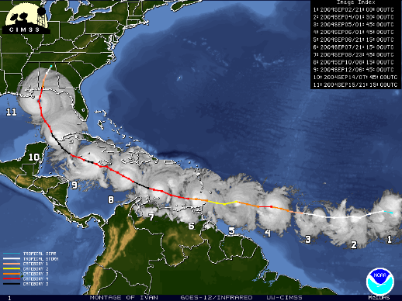
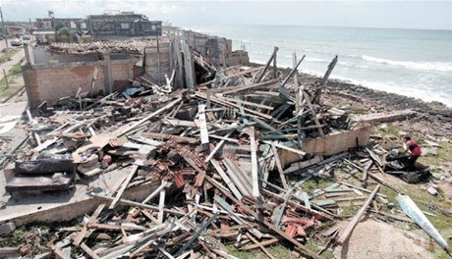
Caribbean Catastrophe Risk Insurance Facility (CCRIF)
The First Regional Emergency Response Scheme
Background
In 2004 Hurricane Ivan wreaked havoc in the Caribbean.
Estimated damage of nearly USD 4bn at current values, with severe loss and damage in Grenada, Jamaica and Cayman Islands
But social impact was much, much higher
Aid was promised, some of it arrived, but too little and, crucially, too late
Proposed solution
A reliable source of immediate post disaster funds that can reduce reliance on unreliable overseas largesse
Local control, a catalyst for better risk understanding and post disaster response planning
CCRIF SPC
A special insurance company owned by trust, with that trust representing the interests of Caribbean governments
A board of directors comprising representatives for Caribbean institutions
Sponsored by The Caribbean Community (CARICOM)
Offering parametric insurance policies to Caribbean governments

Slide 10



Lessons Learnt From CCRIF
A success story
1. CCRIF works
Over 14+ CCRIF has made 56 payments to 16 member countries totalling USD 245m. Every single payment has been made within 14 days of the event.
In 2017 alone after Hurricanes Irma and Maria, it paid USD 62m to 11 countries
2. CCRIF is good value
CCRIF offers affordable cover for a region highly exposed to natural disasters
It manages premium by use of its pooled capital augmented by reinsurance which can be purchased efficiently due to the diversity of CCRIF’s portfolio
3. CCRIF continues to grow and innovate
Expanding coverage options to clients, from the original tropical cycle and earthquake to excess rainfall and soon drought
Improving policy conditions, for example aggregated deductible cover providing a return of premium for significant events that do not trigger the policy and free reinstatement of cover
Innovating to cover new risks including livelihood protection for the poor (including program for fisherfolk linked to environmental protection) and utilities
Notes:
1. CCRIF works
Over 14+ CCRIF has made 56 payments to 16 member countries totalling USD 245m
In 2017 alone after Hurricanes Irma and Maria, it paid USD 62m to 11 countries
Every single payment has been made within 14 days of the event
2. CCRIF is good value
CCRIF offers affordable cover for a region highly exposed to natural disasters
It manages premium by use of its pooled capital augmented by reinsurance which can be purchased efficiently due to the diversity of CCRIF’s portfolio
It is far more expensive for one country to purchase cover directly from the insurance or capital markets; for example, recently one country purchased a donor-funded catastrophe bond for approximately double the cost of equivalent cover from CCRIF
3. CCRIF continues to grow and innovate
Expanding coverage options to clients, from the original tropical cycle and earthquake to excess rainfall and soon drought
Improving policy conditions, for example aggregated deductible cover providing a return of premium for significant events that do not trigger the policy and free reinstatement of cover
Innovating to cover new risks including livelihood protection for the poor (including program for fisherfolk linked to environmental protection) and utilities

Slide 11



Benefits Are More Than Just Insurance
Better risk understanding and management
1. Disaster insurance schemes like CCRIF contribute to:
Greater risk awareness
Better risk management
Planned, efficient disaster response
2. Working together, disaster insurance schemes can:
Facilitate cheaper fast, appropriately sized, immediate post-disaster response
Support sharing of ideas and best-practice
3. A regional or national scheme also support local risk initiatives:
CCRIF, directly or indirectly, has spawned a number of micro insurance initiatives
Underlying disaster risk modelling can be used to inform other disaster risk management initiatives, including other insurance schemes (e.g. critical infrastructure) and land use planning

Slide 12
African Risk Capacity
A program with capacity building at its heart
Formed in 2014 by the World Food Programme. An agency of the African Union with an associated mutual insurer.
African Risk Capacity (ARC) is predicated on capacity building:
At its core it is a parametric drought/crop failure insurance pool
But more important is the work it does to improve risk understanding and emergency response after disasters within member governments
Before being allowed to buy cover, countries must obtain a Certificate of Good Standing, meeting minimum standards of financial probity
They must also commit to engage in risk management processes and ultimately to purchase appropriate insurance cover
A process of engagement with ARC staff for 6 to 12 months to:
Identify who is at risk, how vulnerable they are and what action to take
Develop disaster contingency plans to maximize efficiency
Prepare audited final implementation plans as emergencies develop

Slide 13
Africa Risk Capacity
Aiming to save lives and livelihoods
ARC requires government clients to:
    Understand and define drought events that could occur
    Understand who would be affected and to what extent
    Understand what emergency response is required and develop appropriate contingency plans
Before an event specially developed software (called Africa RiskView) tracks the likelihood of a drought event occurring.
If a drought event develops countries must revisit their contingency plan to develop a Final Implementation Plan (FIP). That plan must be agreed by ARC Agency and its implementation is audited.
Donors are developing the concept of “Replica” covers. A linked policy where funds support local NGO’s/aid agencies
    BUT their emergency response plans must be integrated with the government’s own plans, so no competition for resource/duplication of effort

Slide 14



Speed of Payment is Key
Basis risk must be balanced against benefits
Saves lives and reduces damage to livelihoods
Immediately after an event it is important to protect, feed and rehouse those affected, to restore access to essential services, and to get the local economy and livelihoods moving again as soon as is practically possible
Cost-effective
An Oxford University study for African Risk Capacity showed that $1 received immediately after a drought occurs is worth up to $5 of aid received later (consistent with normal emergency response)
Balance overall programme value
Basis risk has to be seen in this context, balancing it against the benefit of swift insurance pay-outs after a qualifying catastrophe event
Parametrics are not perfect, but they are fast, reliable and lower operational cost
Clearly the scale is different for other perils, but the enhanced value of fast payment holds for all losses from all hazards
And basis risk works both ways: as likely to get overpayment than underpayment
Notes:
Saves lives and reduces damage to livelihoods
Immediately after an event it is important to protect, feed and rehouse those affected, to restore access to essential services, and to get the local economy and livelihoods moving again as soon as is practically possible
Cost-effective
An Oxford University study for African Risk Capacity showed that $1 received immediately after a drought occurs is worth up to $5 of aid received later (consistent with normal emergency response)
Clearly the scale is different for other perils, but the enhanced value of fast payment holds for all losses from all hazards
Balance overall programme value
Basis risk has to be seen in this context, balancing it against the benefit of swift insurance pay-outs after a qualifying catastrophe event
Parametrics are not perfect, but they are fast, reliable and lower operational cost
And basis risk works both ways: as likely to get overpayment than underpayment

Slide 15

Pacific Alliance
Catastrophe bond transaction
Overview
Joint issuance and marketing of catastrophe bonds to cover 4 countries (Chile, Colombia, Mexico and Peru)
Issued in 2018 and covered earthquake risk for 2-3 years
A total of US$1.36 billion in cover, the largest sovereign risk insurance transaction ever seen
Now exploring a new bond with new hazards
Successes and Challenges
By working together, the interest in the deal was very high
Peru received US$60 million in 2019 when a magnitude 8.0 earthquake triggered its catastrophe bond protection

Slide 16
Lesson Learned from Existing Regional Facilities
Developing a Disaster Risk Transfer Facility in the CAREC Region
    The schemes work
    The major criticism has been that the scale of pay-outs is too small
    Basis risk, real and political, needs to be addressed
    4. There must be a balance between product affordability and the facility's financial sustainability
    5. Local/regional stakeholders' ownership must be represented
Notes:
1. The schemes work
Over 14+ CCRIF has made 56 payments to 16 member countries totalling USD 245m. Every single payment has been made within 14 days of the event.
In 2017 alone after Hurricanes Irma and Maria, it paid USD 62m to 11 countries
2. The major criticism has been that the scale of pay-outs is too small
CCRIF offers affordable cover for a region highly exposed to natural disasters
It manages premium by use of its pooled capital augmented by reinsurance which can be purchased efficiently due to the diversity of CCRIF’s portfolio
3. CCRIF continues to grow and innovate
Expanding coverage options to clients, from the original tropical cycle and earthquake to excess rainfall and soon drought
Improving policy conditions, for example aggregated deductible cover providing a return of premium for significant events that do not trigger the policy and free reinstatement of cover
Innovating to cover new risks including livelihood protection for the poor (including program for fisherfolk linked to environmental protection) and utilities
4. Balance between product affordability and the facility's financial sustainability
Create and implement well-designed capitalization plans, including risk transfer policies.
Increase member countries' perceived value of the desirability of the facility
Promote the financial benefits: “ownership”, stability, responsiveness, low premiums, stable premiums
5. Local/regional stakeholders' ownership must be represented
Engage local or regional stakeholders in the facility's decision-making processes
Provide capability-building support for the facility's champions within country governments
Promote the non-financial benefits

Slide 17
Overall the benefits of risk pools overcome basis risk
It’s not all about how much is paid out
SPEED OF PAYMENT
BUDGET CERTAINTY
RISK AWARENESS
PREPAREDNESS
  The quantum of claim payment is known within days of event
  Payment is received shortly after
  Less reliance on central government / international generosity
  Pooling reduces exposure to re/insurance market price volatility
  A catalyst to improved risk understanding
  Supports risk-informed prioritization of disaster risk reduction actions
  Schemes can encourage development of detailed, audited contingency plans
  Provides a forum for shared expertise, potentially for shared resources

Slide 18
Questions and Answers with:
Isaac Anthony, CEO of CCRIF SPC
Mr. Héctor Santana Suarez, Head of Insurance, Pensions and Social Security, Ministry
of Finance, Mexico
Tim Nielander, Legal and Regulatory Specialist

Slide 19
Disclaimer
This analysis has been prepared by Willis Limited for the Asian Development Bank under a Technical Assistance contract.
Willis Limited has relied upon data from public and/or other sources when preparing this analysis. No attempt has been made to verify independently the accuracy of this data. Willis Limited does not represent or otherwise guarantee the accuracy or completeness of such data nor assume responsibility for the result of any error or omission in the data or other materials gathered from any source in the preparation of this analysis.
There are many uncertainties inherent in this analysis including, but not limited to, issues such as limitations in the available data, reliance on client data and outside data sources, the underlying volatility of loss and other random processes, uncertainties that characterize the application of professional judgment in estimates and assumptions, etc. Ultimate losses, liabilities and claims depend upon future contingent events, including but not limited to unanticipated changes in inflation, laws, and regulations. As a result of these uncertainties, the actual outcomes could vary significantly from Willis Limited’s estimates in either direction. Willis makes no representation about and does not guarantee the outcome, results, success, or profitability of any insurance or reinsurance program or venture, whether or not the analyses or conclusions contained herein apply to such program or venture.
Willis does not recommend making decisions based solely on the information contained in this analysis. Rather, this analysis should be viewed as a supplement to other information, including specific business practice, claims experience, and financial situation. Independent professional advisors should be consulted with respect to the issues and conclusions presented herein and their possible application. Willis makes no representation or warranty as to the accuracy or completeness of this document and its contents.
Willis does not provide legal, accounting, or tax advice. This analysis does not constitute, is not intended to provide, and should not be construed as such advice. Qualified advisers should be consulted in these areas.
Willis makes no representation, does not guarantee and assumes no liability for the accuracy or completeness of, or any results obtained by application of, this analysis and conclusions provided herein.
Acceptance of this document shall be deemed agreement to the above.

