Slide 1
Infectious Disease Risk Financing Framework in the context of the CAREC Health Strategy 2030
27 November, 2022

Slide 2
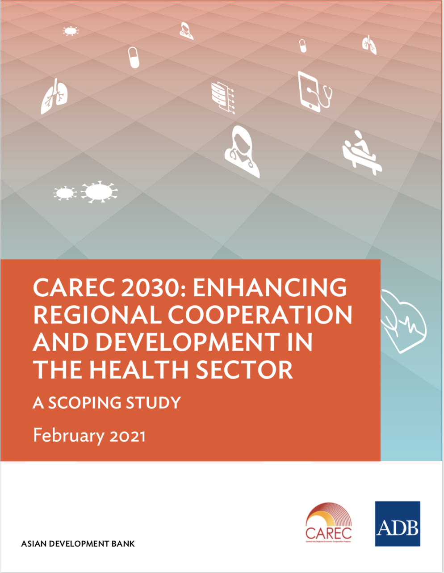
Development of CAREC Regional Health Cooperation
Endorsement of CAREC Health Strategy 2030
- Nov 2021
Regional Investment Framework – in 2022
?
Scoping Study on CAREC Health cooperation prepared
- 2020
Establishment of Working Group on Health
– March 2021
CAREC 2030 prioritizes Health Cooperation under Human Development Cluster
- 2017
FOCUS ON
IMPLEMENTATION
UNTIL 2030
28-29 November 2022 | Istanbul, Turkey
Notes:
In a first step a scoping study explored the potential and opportunities for promoting regional health cooperation. It was carried out by ADB in 2019 and 2020 through desk research…and….
Study recommended cooperation of CAREC countries in three areas:
regional health security,
health systems strengthening,
improving health services for migrants, mobile populations and border communities
In a second step, a CAREC Working Group on Health (WGH) was established in March 21 to further guide CAREC health cooperation towards 2030.
The WGH, supported by inputs from CAREC countries and development partners, developed a CAREC health strategy towards 2030 and elaborated areas of cooperation. The strategy is aligned with other CAREC strategies, such as the CAREC Gender strategy.

Slide 3
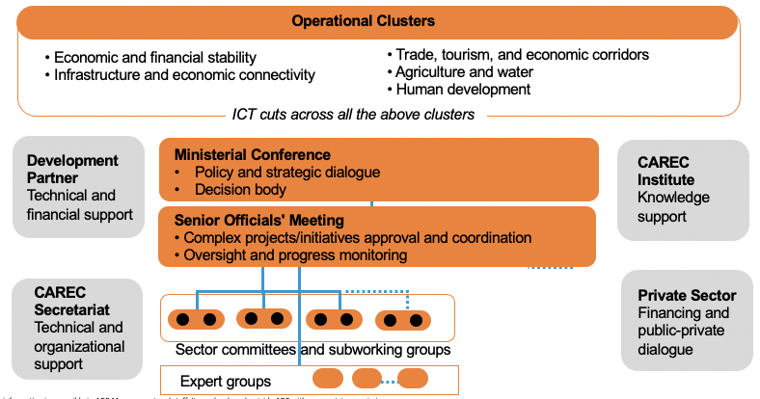
CAREC Working Group on Health
2nd Meeting of the CAREC Working Group on Health
11-13 October 2022 | Tbilisi, Georgia

Slide 4
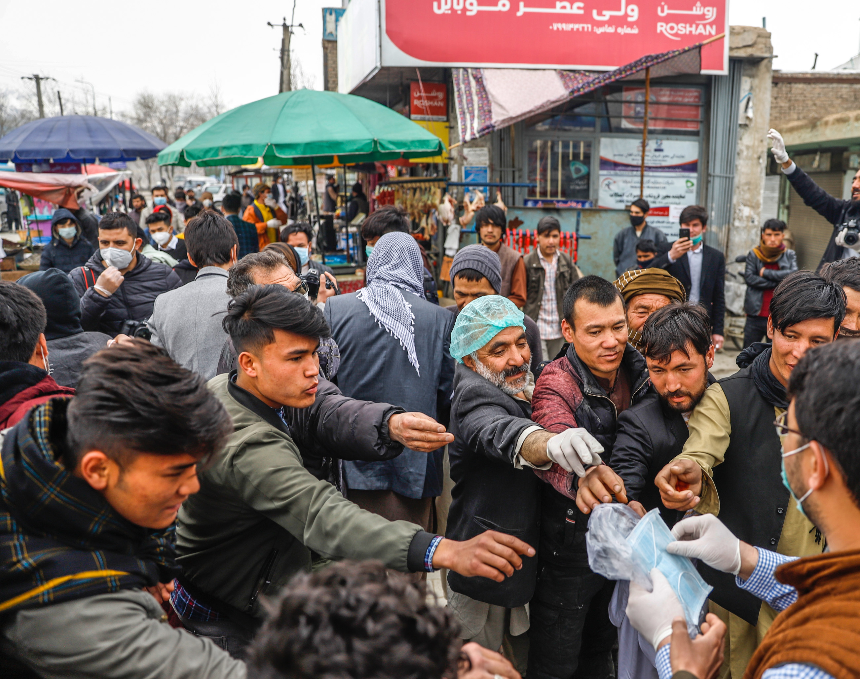
The region is highly susceptible to future outbreaks
Factors contributing to the spread of communicable diseases include:
Large numbers of persons living in close proximity to animals
Cross-border travel, incl. transboundary population and lifestock movements
Varying degrees of health systems capacity
Exclusion of migrants from access to essential health services
Notes:
Besides COVID-19, the region is highly susceptible to future outbreaks, alluding to a need to strengthening pandemic preparedness and health security capabilities

Slide 5
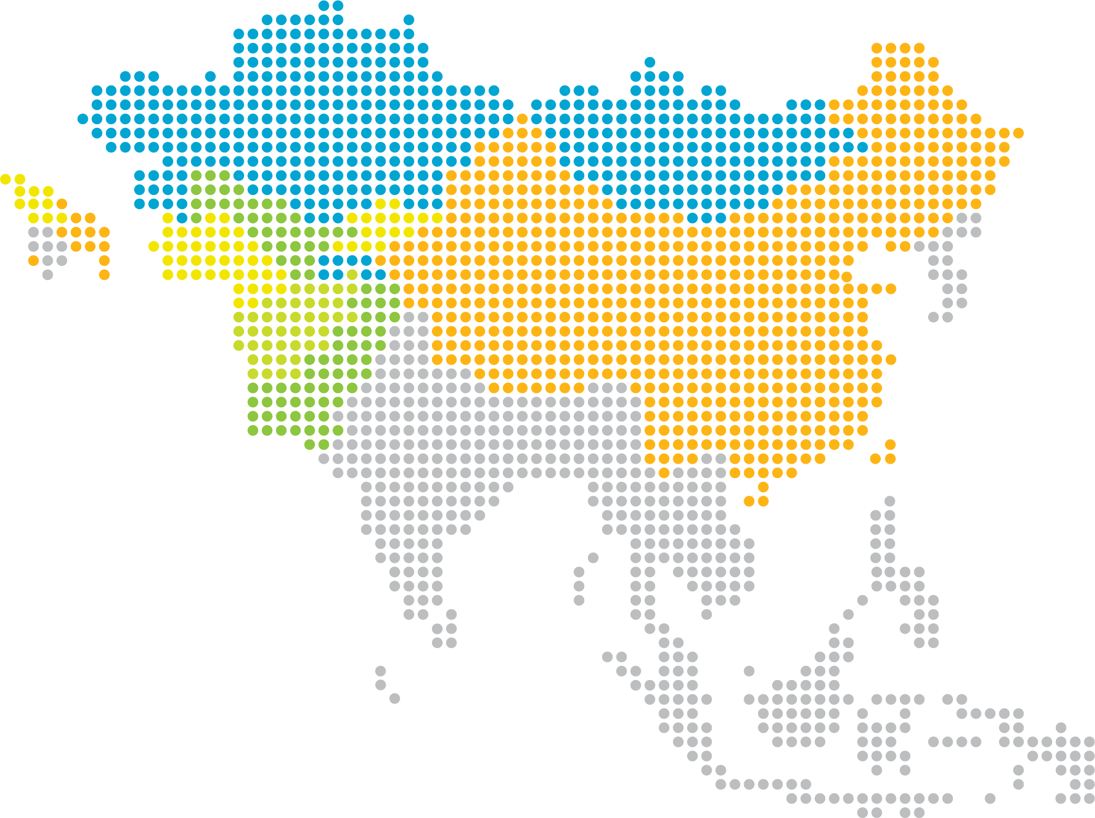
Regional challenges require regional solutions
Increasing interdependencies as disease agents cross borders…
However,
Investments mostly national rather than regional
Insufficient knowledge of - and solutions for - joint regional mechanisms and cross-border services
Fragmentation of regional institutions
…and health determinants need cross-sector and cross border solutions
Migration
Climate change
R&D
Trade
Notes:
Increasing interdependencies as disease agents such as viruses cross borders, and we also observe increasing globalization of health determinants/factors that impact health (e.g. vaccine development and manufacturing) which need cross-sector and cross border solutions (migration, climate change, R&D, trade etc.)

Slide 6
Drivers of regional cooperation in the CAREC context
Cultural/social
Geographici
Regulatory
Economic/ technological
Common “Semashko” legacy (8/11 countries)
Commonly spoken language of importance
Health professionals crossing borders for better education & opportunities
Employment opportunities and cost reduction (e.g., cross-border infrastructure such as hospitals)
Efficiency gains from information sharing and education/training of human resources
Economies of scale through aggregated demand/joint procurement
Uptake of mobile and e-health at the regional level (telemedicine projects)
Regional cooperation
Long common “porous” borders
Mountainous terrain, isolated border regions
Large migration flows
Epidemiological similarity based on growing NCD and infectious diseases burden
Multiple regional/bilateral agreements
Bilateral economic corridors
Common market
Notes:
There are many drivers that lay the foundations for advancing regional cooperation in the CAREC region
….drivers were identified across four dimensions.
Cultural/social….
Geographic demographic….
Regulatory…..
Economic/technological…..

Slide 7
CAREC Health Strategy 2030
Vision and Principles
Vision
Public health threats in the CAREC region are addressed comprehensively, efficiently and sustainably, through adopting a regional approach, while safeguarding the needs of the most vulnerable segments of the population.
Guiding Principles
Fostering multisectoral coordination
A clear focus on benefiting the population
Regional health cooperation
Ensuring feasibility and an evidence-based approach
Safeguarding sustainability and ownership
Alignment with international policies and frameworks

Slide 8
CAREC Health Strategy 2030
Strategic Framework
Enhanced Regional Health Security
PILLAR 1
PILLAR 2
PILLAR 3
PILLAR 4
CROSS-
CUTTING
Gender
Leadership and human resource capacity
Technical preparedness
Access to Supplies and Surge Capacity
Vulnerable population groups and border health
Digital health and Innovation
Institutional Setup
Cooperation and Partnerships
Capacity Support
CAREC institutional support
Stakeholder engagement
Training and knowledge sharing
Enabling Factors
Political commitment and policy dialogue
Working Group on Health
Research and knowledge products
Multisector coordination
Geographic clusters
2nd Meeting of the CAREC Working Group on Health
11-13 October 2022 | Tbilisi, Georgia

Slide 9
CAREC Health Strategy 2030
Strategic Framework
PILLAR 1
PILLAR 1
PILLAR 2
PILLAR 3
PILLAR 4
CROSS-
CUTTING
Coordination and governance
Workforce skills and capacity
Gender
Leadership and human resource capacity
Technical preparedness
Access to Supplies and Surge Capacity
Vulnerable population groups and border health
Digital health/ Innovation
Institutional Setup
Cooperation and Partnerships
Capacity Support

Slide 10
Issues in Governance, Financing and Human Resources for Health/Leadership
PILLAR 1
Governance, coordination for health security (preparedness and response)
Insufficient implementation of the IHR in half of CAREC countries
Weak legislation and policy instruments for IHR implementation
Whole-of-government coordination mechanisms established during COVID-19 response, however health sector is usually still leading preparedness and response
Insufficient data use and analytics for informed response planning
Lack of effective inter-sectoral coordination mechanisms
Inadequate One Health governance in most countries
Inadequate cross-border coordination and collaboration mechanisms
Low levels of development, funding and implementation of National Action Plans for Health security
Financing for health security
Chronic under & declining funding for health systems and IHR capacity building, although significantly increased funding during COVID19
Impeded/challenges in accessing emergency funding during pandemic response
Human Resources for Health
Shortcomings in planning, forecasting and management of health workforce and for their capacity,
Limited technical capacities of health care staff (e.g., surveillance, lab, infection prevention and control, case management, risk communication, epidemiology, case management in intensive care units, etc.).
Insufficient human resources for the National IHR Focal Point Function
2nd Meeting of the CAREC Working Group on Health
11-13 October 2022 | Tbilisi, Georgia

Slide 11
Opportunities for regional collaboration - Infectious Disease Risk Financing Framework (IDRFF)
PILLAR 1
Objectives: Develop regional risk financing mechanisms for infectious disease outbreaks to support rapid response and containment¹
1. Risk financing for health and economy
Aggressive, early action helps contain disease spread, save lives, reduce economic impact
Risk management and financing are closely linked and should be developed together
Regional collaboration coordinating preparedness (monitoring and controlling) and response (financing) will reduce overall costs
There is currently no planned emergency financing for the next outbreak in CAREC
2. Develop three regional risk financing mechanisms
Financing for rapid, aggressive action in the early stages of an outbreak
Spark Risk Cover
Containment Financing
Financing for action when a neighbouring country suffers an outbreak
SME Business Interruption
Financing to support the economy
Leveraging private (re)insurance and capital market to provide CAREC members with immediate financing to deliver emergency plans when the next outbreak occurs
3. Implement these mechanisms for CAREC members
Design emergency plans including required public health infrastructure and quantify related investment costs with ADB, WHO, Ministries of Health, Ministries of Emergency Management, and Ministries of Finance
Work with CAREC members and private sector to design risk financing products
2nd Meeting of the CAREC Working Group on Health
11-13 October 2022 | Tbilisi, Georgia
¹This work is part of a wider ADB project (TA-9878) that supports CAREC member countries to strengthen their earthquake, flood and infectious disease risk management strategies and public sector budget resilience.

