Slide 1
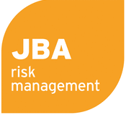
Disaster Risk Financing Theory and options for the Central Asia Regional Economic Cooperation Region
Central Asia Regional Economic Cooperation Program Disaster Risk Engagement Meeting
Istanbul, Türkiye
November 2022

Slide 2
Objectives
1. Principles of Disaster Risk Financing
2. Protection Gap Assessments
3. DRF Instruments Options
4. Conclusions
Notes:
Mention the format for Discussions
Underlying objectives to the deliverables is to agree how best to work with you to improve data, modelling and understanding of your requirements and so allow us to work with you to determine appropriate disaster risk financing instruments

Slide 3
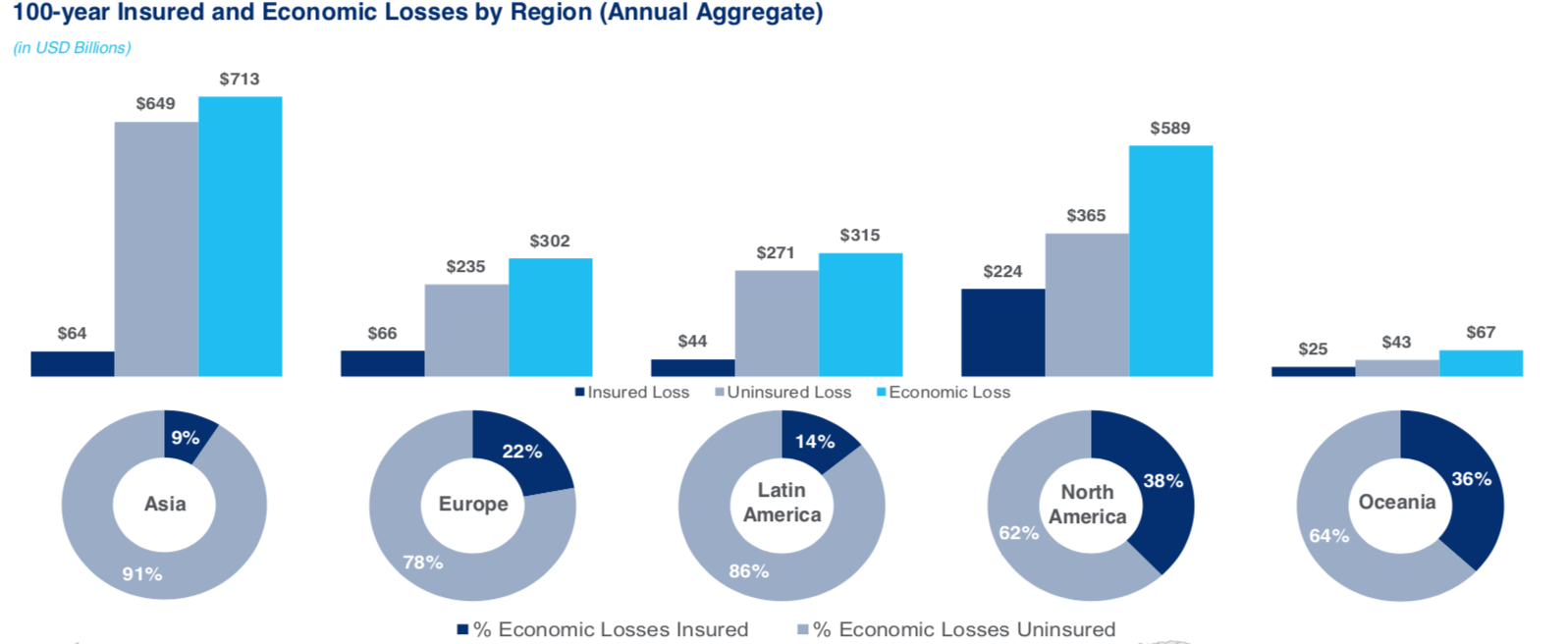
Disaster Risk Financing (DRF)
DRF addresses the fiscal impacts and economic losses caused by a range of disasters such as earthquakes, floods, droughts and infectious diseases. DRF methods ensure populations are financially protected from disasters, through tailored financial protection instruments, which act to respond quickly and effectively to disasters.
A Comprehesive Disaster Risk Financing Strategy is central to managing a country‘s disaster risk. This strategy requires proactive development and regular updates by the government in order to mitigate the financial, economic and social impacts of disasters.
Asia, including CAREC members, traditionally has a very low insurance penetration but a very high share of global natural disasters
Economic losses from natural disasters in Asia could reach over $700 billion in a 100-year cycle
The more a country is insured, the lower the economic impact of a natural disaster AND the faster the recovery

Slide 4
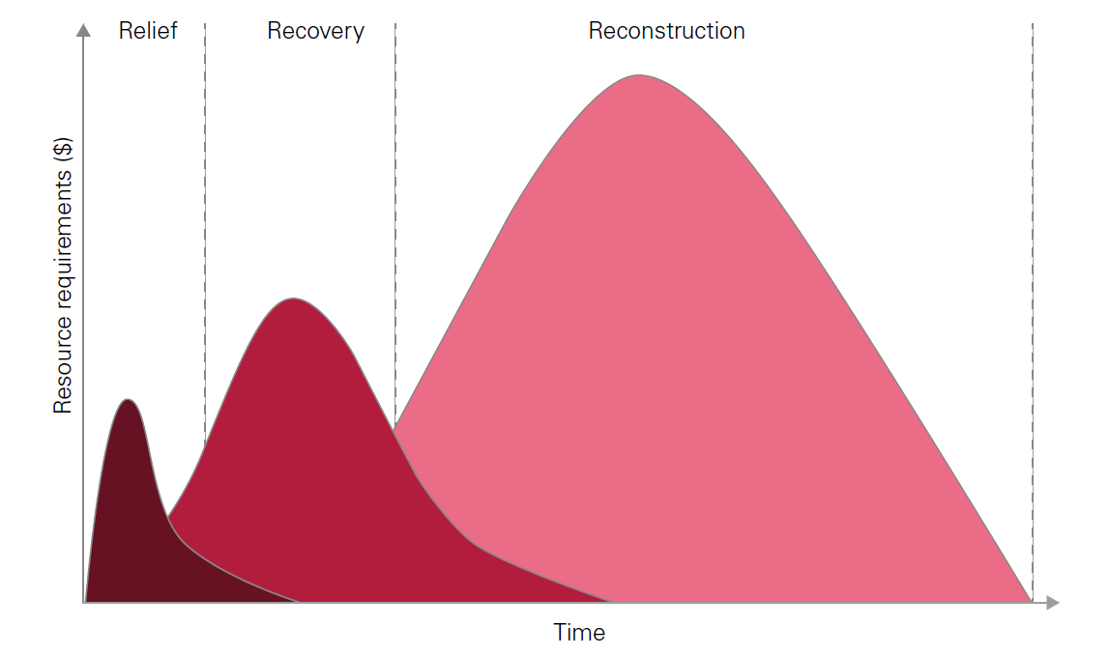
Early, Effective Emergency Response is Vital
Key requirements for relief and early recovery:
Timeliness of funds
Predictability of funds
$1 received immediately after a disaster is worth up to $5 delivered later in typical aid cycle
The current approach typically relies on budget reallocation or external support
Relief: Within 2 months of disaster
Humanitarian response
e.g. providing food, medicine, shelter
Recovery: Within 9 months of disaster
Restoration of basic services and economic productivity
e.g. Re-starting transport, energy supplies, markets
Notes:
“early response is an effective response” A variety of tools are available to ensure timely early response funding.
The project aims to determine the optimal mix for each CAREC member, considering both established mechanisms and new innovative ones.

Slide 5
Disaster Risk Management – Quantification and Risk Layering
Modelling disaster risk profiles for informed DRM decisions
Risk layering: no single financial instrument can address all risks
Aggregated annual damage exceedance probability curves: what is the annual probability (expressed as the one in X-year) of exceeding a disaster impact of $Y?
How to choose the appropriate DRF instruments for which circumstances and targeted measures?
High Severity
Disaster Risk Reduction
Loans, grants, micro-credit, bonds, subsidies, tax breaks, crediting, impact bonds
Disaster Risk Protection
Reserves and contingency budgets
Post Disaster reallocation budgets, emergency assistance loans and borrowing
Contingent disaster finance
Disaster Risk Transfer
Regional/Sovereign
Local insurance markets
International reinsurance markets
Insurance Linked Securities / Cat bond markets
International Assistance
Exceptional Events / Acts of God
Annual Disaster Impact
Low Severity
High Frequency
Return Period
Low Frequency

Slide 6
Disaster Risk Financing: Review / Needs Assessment
Ex-Ante
Layered approach to risk finance
Provides flexibility
Different mechanisms to respond to different severities of events and different timescales
Relatively small amounts of financing available and deployed quickly often significantly reduce the overall negative financial impact of shock events
Innovative and traditional options will be assessed with the aim of identifying the optional mix of each country
Ex-Post
Low frequency / high severity
Parametric risk transfer
Indemnity risk transfer
Sovereign debt
Contingent credit
Sovereign reserves
High frequency / low severity
Budget reallocation
Response / early recovery
Long-term recovery / reconstruction

Slide 7
What are the benefits of Emergency Response insurance?
Social benefits
Economic benefits
Cost savings
Timely funding reduces impacts on vulnerable groups from disasters, such as loss of education and health services, and ensures more rapid income recovery.
Short-term support can reduce long term impacts on poor households, who are better able to invest if incomes are stable
For example, Filipino evidence suggests incomes fall by 6.6% and spending on health / education by >10% after a serious typhoon.
Timely and well targeted funding can expedite economic recovery.
Budgetary support can remove need for reallocation away from essential services and long-term capital projects (via Development Fund)
In Mexico, rapid post-disaster recovery increased size of local economy by 2-4 per cent.
Certainty and speed of funding allows more effective planning, which increases the effectiveness and reduces the cost of the post-disaster response
Studies suggest that delays in funding can increase long-term post-disaster costs by between 100% and 400%.
Sources: Anttila-Hughes and Hsiang (2013), de Janvry et al. (2016), Wold Bank Group (2017).

Slide 8
Protection Gap Assessments

Slide 9
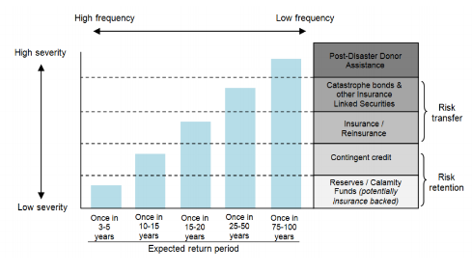
Disaster Risk Protection Gap
Protection Gap is defined as the proportion of losses from disaster events that are not insured. Identifying the level of risk which has not been reduced (through risk reduction investment) or transferred (through risk financing) is to identify the contingent liability that will need to be met in the event of a disaster. This is used as a fundamental input into the design of risk management and arrangement of risk financing.

Slide 10
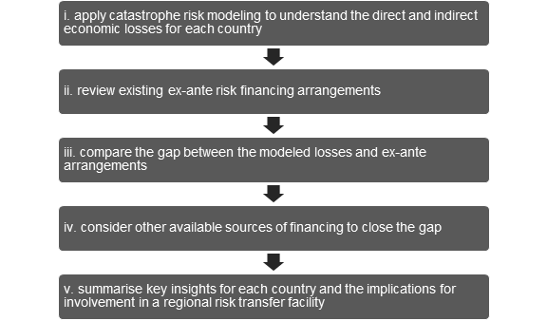
Illustrative Example of a Modelling Approach to Assess Protection Gap
A regionally consistent approach for Earthquake, Flood and Infectious Diseases
Earthquake used a hazard models included in the GEM Hazard Mosaic and the OpenQuake Engine
Flood was conducted using JBA’s probabilistic Global Flood Model at a consistent spatial resolution of 30m
A consistent exposure dataset was used across the earthquake and flood risk modeling, based on the GEM Global Exposure Database
The infectious disease model uses a deterministic, compartment model framework, which incorporates the epidemiological dynamics of pandemic influenza; and the Epidemic Preparedness Index, an estimator of epidemic preparedness.
This approach is transparent and uses cutting edge modeling tools across all CAREC member states

Slide 11
CAREC Country Protection Gap Classification
Catastrophe modelling analysis of the risk of CAREC Member’s to earthquake and flood risk has highlighted multiple countries are not sufficiently covered by ex-ante mechanisms
This stresses the need to look at DRF mechanisms to protect the financial stability of these countries
Classification Group | Countries
Critically Insufficient Financing (>80% of more of the AALs from floods and earthquakes are not covered by ex-ante mechanisms) | Afghanistan Pakistan Tajikistan
Weak Financing (~0%-80% of AAL not covered by ex-ante mechanisms | Kyrgyz Republic Mongolia Uzbekistan
Modest Financing (AALs from flood and earthquakes are covered) | Azerbaijan Georgia Kazakhstan
Insufficient data | PRC, Inner Mongolia Autonomous Region PRC, Xinjiang Uyghur Autonomous Region Turkmenistan

Slide 12
DRF Instrument Options

Slide 13
What is the end goal of DRF Tools for CAREC members?
Different Types of Coverage
Emergency Response
DRF instruments can provide rapid disbursement of funds to fund initial emergency response work including evacuation, search and rescue, fire-fighting, helicopters, provision of shelter, emergency infrastructure repairs etc.
Livelihood Protection
Funding payments to the vulnerable when their need is great but opportunity to find employment/follow their trade is low.
Property
Funds can be used to rebuild property and apply the concept of “building back better”
Critical Infrastructure
Repair, restoration and rebuild of critical infrastructure is key in order to enable efficient emergency response and faster economic recovery
Municipal Service Provision
Provision of services that are interrupted during a natural disaster, such as education and healthcare.
Fast Payments?
Full Payments?

Slide 14
Disaster Risk Reduction (DRR)
Augmenting Disaster Risk Finance
If possible risk should be reduced before being transferred
The DRF study includes an example risk reduction cost benefit exercise in each country
Disaster Relief Bonds would aim to embed Disaster Risk Reduction, although incentives can also be built into insurance, especially if offered by a risk pool
Plotted using data from: IDS (2018), Wethli (2014), Watkiss et al. (2014), Shreve and Kelman (2014), Kunreuther and Michel-Kerjan (2012), Holland (2008), World Bank (2010), and IFRC (2011).

Slide 15
Financing Strategy Options for CAREC Members
Direct Insurance
Clearing House Facility
Catastrophe Bonds and Disaster Relief Bonds
Risk Pooling

Slide 16
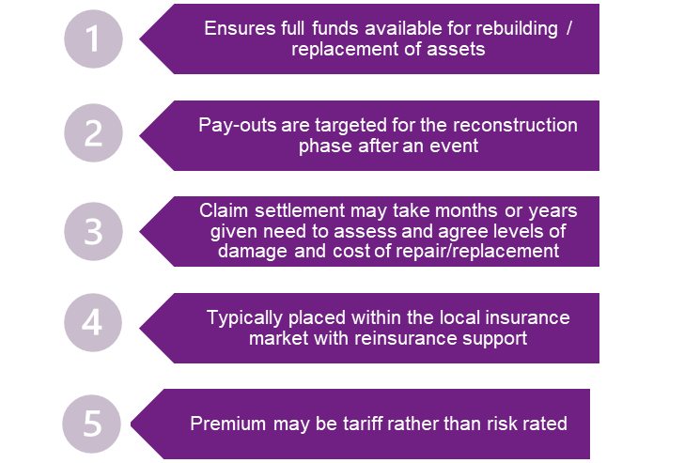
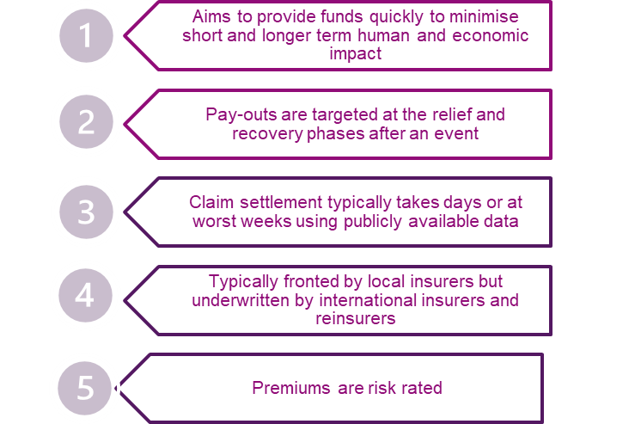
Direct Insurance
Each country purchases insurance directly from the international insurance markets. The form of that insurance may be indemnity or parametric. Indemnity Insurance provides pays out based on the proven amount of loss incurred, providing it is covered within the policy wording. By contrast parametric insurance pays of the occurrence of a defined event.
Buy individually allows each country to purchase exactly what it wants and needs but it likely to incur greater cost as the benefits of scale and diversification of a collective purchase and/or regional cooperation are lost.

Slide 17
Clearing House
A Clearing house can be defined as a central agency for the collection, classification and distribution, especially of information and assistance. Within DRF a clearinghouse can facilitate the efforts of parties to develop and implement comprehensive risk management strategies, by providing a repository for information on insurance and risk transfer. This may include standardization of data, procurement of risk modeling and other consultancy services.
Where to find data and information on climate change and disaster risks by region or country
Information repository on existing risk transfer approaches and insurance
Facilitator to assist in the procurement of data, modeling and services (e.g. advisory and broking)
Advisor on risk transfer strategies e.g. through insurance be incorporated into comprehensive risk management strategies

Slide 18
Catastrophe Bonds and Disaster Relief Bonds
ADB’s Global Notes Program
Underlying Countries
Derivative
Cat Bond
Investors
Payment [X%]
ADB funding rate + [X%]
Loss Payments
Proceeds
A catastrophe bond (cat bond) is essentially an insurance instrument placed In the capital markets
Cat bonds are vital where there is insufficient insurance/reinsurance availability (for example in peak zones such as Florida)
Unlike most insurance policies, cat bonds typically cover 3 year period and have little or no counterparty risk
But typically catastrophe bonds cost more, the risk margin (the premium equivalent) is typically higher than the insurance equivalent and there are significant frictional costs
ADB offer a lower cost platform to issue castraophe bonds, the Global Notes Program, which unlike “traditional” catastrophe bonds does not require the creation of an insurance entity, or Special Purpose Vehicle (SPV), reducing frictional costs considerably
Disaster Relief Bonds add incentives to reduce risk to a catastrophe bond

Slide 19
Risk Pooling
Risk pooling gives countries cost and other benefits by co-operating with other countries
A Special Purpose Insurance Company is created, owned by, or for the benefit of, client countries
Such schemes enable the benefits of pooling without explicit risk sharing
There are currently four existing regional risk pools, others are under consideration
Insurer
Risk Pool
Insured A
Insured B
Insured C
Insured A
Insured B
Insured C

Slide 20
Why create a risk pool?
The prime reason is to reduce the cost of insurance
Although there are many other benefits including being a catalyst for regional co-operation and risk ownership
Premium
Expected Loss
Uncertainty
Expenses
Profit
=
+
+
+
The average cost of claim payment: pooling does not reduce this element
Insurers charge for uncertainty and volatility: this can be retained within the pool, growing pool funds over time
Duplicated expense costs are eliminated, greater efficiency
The profit that insurers make can be retained in the pool

Slide 21
Possible Regional Disaster Risk Transfer Facility
Fa
Policyholder
of parametric insurance policies
Broker
Risk Modeler
MDBs and Development Partners
Hazard data
Country
Reinsurers/
Capital Markets
Country
Premium
CAREC
Disaster Risk Transfer
Facility
Risk Transfer Cost
Country
Claims
Trigger payouts
Facilitation and support
Fund support
External Donors
Country

Slide 22
Conclusions
Disaster Risk Financing is critical in order to financially protect a country against uninsured disaster losses
Different tools and products are available, the choice of which will be determined by the need and the financial resources available
Disaster risk transfer should be used in conjunction with disaster risk reduction measures such as structural interventions to better protect people, property and economies
Regional cooperation results in cost savings, a regional facility potentially acts as a catalyst and hub for regional co-operation on disaster risk management and understanding

Slide 23
Disclaimer
This analysis has been prepared by Willis Limited for the Asian Development Bank under a Technical Assistance contract.
Willis Limited has relied upon data from public and/or other sources when preparing this analysis. No attempt has been made to verify independently the accuracy of this data. Willis Limited does not represent or otherwise guarantee the accuracy or completeness of such data nor assume responsibility for the result of any error or omission in the data or other materials gathered from any source in the preparation of this analysis.
There are many uncertainties inherent in this analysis including, but not limited to, issues such as limitations in the available data, reliance on client data and outside data sources, the underlying volatility of loss and other random processes, uncertainties that characterize the application of professional judgment in estimates and assumptions, etc. Ultimate losses, liabilities and claims depend upon future contingent events, including but not limited to unanticipated changes in inflation, laws, and regulations. As a result of these uncertainties, the actual outcomes could vary significantly from Willis Limited’s estimates in either direction. Willis makes no representation about and does not guarantee the outcome, results, success, or profitability of any insurance or reinsurance program or venture, whether or not the analyses or conclusions contained herein apply to such program or venture.
Willis does not recommend making decisions based solely on the information contained in this analysis. Rather, this analysis should be viewed as a supplement to other information, including specific business practice, claims experience, and financial situation. Independent professional advisors should be consulted with respect to the issues and conclusions presented herein and their possible application. Willis makes no representation or warranty as to the accuracy or completeness of this document and its contents.
Willis does not provide legal, accounting, or tax advice. This analysis does not constitute, is not intended to provide, and should not be construed as such advice. Qualified advisers should be consulted in these areas.
Willis makes no representation, does not guarantee and assumes no liability for the accuracy or completeness of, or any results obtained by application of, this analysis and conclusions provided herein.
Acceptance of this document shall be deemed agreement to the above.

