Slide 1
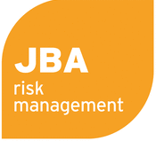
Session 1: Introduction to CAREC Disaster Risk Project and Summary of Initial Results
TA 9878 “Developing a Disaster Risk Transfer Facility in the CAREC Region” – Engagement Event
Istanbul, Türkiye
November 2022

Slide 2
Objectives
1. Overview of project objectives
2. Outline of progress achieved so far
3. Next steps for discussion
4. Ambitions and agenda for this conference
Notes:
Mention the format for Discussions
Underlying objectives to the deliverables is to agree how best to work with you to improve data, modelling and understanding of your requirements and so allow us to work with you to determine appropriate disaster risk financing instruments

Slide 3
Overview of Project Objectives: Developing a Disaster Risk Transfer Facility in the CAREC Region

Slide 4
Disaster Risk in CAREC
High exposure to flood, earthquake and infectious disease risk
Robust economic growth is increasing value at risk
Climate change is affecting the nature of disaster risk
COVID-19 undermined fiscal budgets and ability to respond
Risk management and financing efforts must strengthen to protect livelihoods and economic development
Notes:
Add a mention that fiscal budgets have been impacted by COVID19
Recent flood events:
Pakistan, 2022
Recent earthquake events
Uzbekistan: Fargona, Violyati (2011) - 6.1 Mw
Tajikistan: Rasht, Tojikobod (2021) - 5.8 Mw

Slide 5
Objectives of this Technical Assistance Project
Identify and quantify flood, earthquake and infectious disease risk
Assess and quantify the financial disaster risk protection gap
Provide access to modelling and capacity to assess the cost-benefit of adaptation investments
Investigate options for regional disaster risk financing to improve financial resilience and collaboration
Notes:
Provide access to modelling and capacity to assess cost benefit of adaptation investments

Slide 6
Progress Achieved

Slide 7
Key Outputs
Disaster risk profiles
Investigation and modeling of ILS instruments
Protection gap assessment
Infectious disease financing mechanisms
Inception Meeting
Risk Profile & COVID-19 Consultation
DRMI Training
Today’s Meeting
Disaster Risk Management Interface
COVID-19 scenarios and compound risk
Investigation of a regional risk facility
Notes:
Add hyperlinks

Slide 8
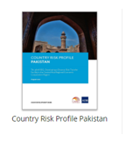
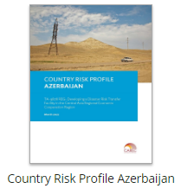
Disaster Risk Profiles
Profiles for each CAREC member have been developed and made publicly available on the CAREC program website
These use cutting edge catastrophe modelling to estimate the country wide impacts of floods, earthquakes and infectious disease outbreaks
Notes:
Modelling Approach – open

Slide 9
Disaster Risk Modelling Approach
A regionally consistent modelling approach using country specific hazard, vulnerability and exposure information
These models are developed by leading insurance industry modelling companies and incorporate latest science and data
A consistent exposure dataset for earthquake and flood risk modeling contained information on number of buildings, location, replacement costs, number of occupants and vulnerability classes of the building stock
This covered residential, commercial, and industrial assets – a nationally representative view of financial exposure

Slide 10
Disaster Risk Profiles – Average Annual Losses
Country | Flood (direct/total) | Earthquake (direct/total)
Afghanistan | $62m / $79m | $57m / $76m
Azerbaijan | $57m / $68m | $75m / $90m
Georgia | $30m / $36m | $14m / $17m
Kazakhstan | $419m / $473m | $58m / $73m
Kyrgyz Republic | $73m / $94m | $72m / $102m
Mongolia | $24m / $31m | $0.6m / $0.8m
Pakistan | $1.5bn / 1.6bn | $477m / $500m
PRC Inner Mongolia | $248m | $122m
PRC Xinjiang Uyghur | $106m | $283m
Tajikistan | $61m / $118m | $63m / $165m
Turkmenistan | $140m / $205m | $11m / $20m
Uzbekistan | $296m / $426m | $214m / $238m
Notes:
Covers direct and indirect – economic loss multiplier

Slide 11
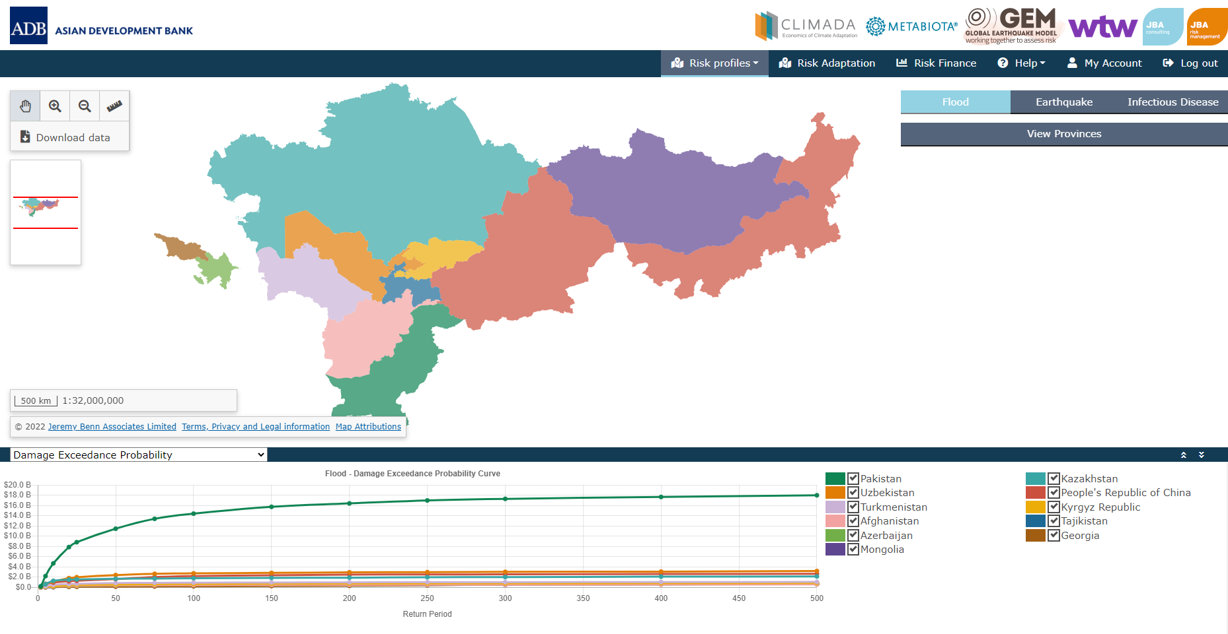
Disaster Risk Management Interface
The information from the disaster risk profiles is available on the CAREC Disaster Risk Management Interface:

Slide 12
Overview of the DRMI
Site Map
Landing page
Risk Profiles - Probabilistic
Country map
Data tables
Menu
Downloadable content
Probabilistic flood, earthquake, infectious disease outputs
Risk Profiles -Deterministic Scenarios
Risk Profiles - Exposure Risk Calculator
Risk Adaptation
Risk Finance
Help
My Account
Flood, earthquake, infectious disease
Flood and earthquake risk calculations
City flood and earthquake maps and charts
Flood and earthquake risk transfer options
User Guide
Technical Note
Password change, account management
Country and district maps
EP curves and data

Slide 13
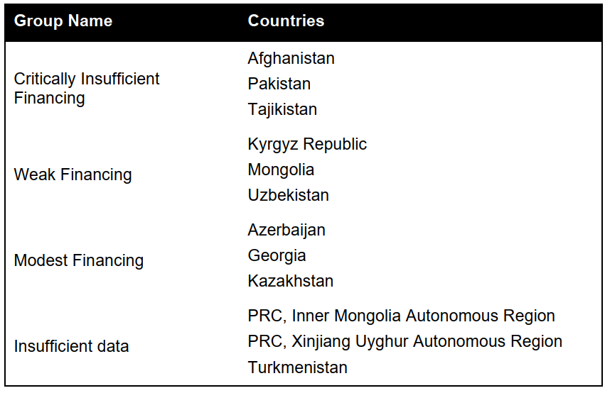
Protection Gap
Current financing levels for disaster risk were compared to the modelled results from the profiles to understand the size of the protection gap

Slide 14
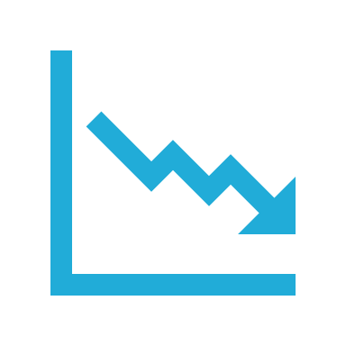
Protection Gap – Infectious Disease
The COVID-19 experience revealed the protection gap for infectious disease
Pandemic financing arrangements were virtually non-existent for the initial response to COVID-19
Instead, programs were rapidly designed: expensive and inefficient
Aggressive, early action is essential to containing disease spread and influential in determining overall economic cost
6-7% decrease from forecasted economic growth to actual¹
>$2bn committed by ADB to CAREC member states²
>$16tn spent by governments globally post-outbreak³
1 ADB. 2020. Asian Development Outlook Supplement December 2020
2 ADB 2020. News Releases on COVID-19 Financial Assistance to ADB Members
3 IMF 2021. Fiscal Monitor: Database of Country Fiscal Measures in Response to the COVID-19 Pandemic

Slide 15
Infectious Disease Risk Financing
Spark Risk Cover
Financing for rapid, aggressive action in the early stages of an outbreak
Containment Financing
Financing for action in the early stages of an outbreak in a neighbouring country to help contain spread in an unaffected country
SME Business Interruption
Financing to support a structural backbone of the economy

Slide 16
Functions of a CAREC Disaster Risk Facility
A CAREC facility can serve several functions:
Collaboration
Arranges risk transfer
Retains risk
Sharing of best practice, of data, and of regional management to disaster risk management
Facilitates risk coverage for participating countries, including insurance and ILS
A licensed and regulated insurance company to which countries transfer risks in exchange for premiums
Level of Complexity and Involvement

Slide 17
Next Steps for Discussion

Slide 18
Benefits of Regional Disaster Risk Financing Schemes
Countries around the world have collaborated on regional risk financing, including in the Caribbean and Central America, in South America, in Africa, in the Pacific, and in Southeast Asia
Regional risk financing brings benefits including:
Complementary to national risk financing programs
Reduce the cost through diversification and economies of scale
Share best practice
Incentivise standardized data collection
Attract private sector involvement
Promote improved ownership of risk management
These principles can be applied to benefit CAREC member states

Slide 19
Pending Project Deliverables and Next Steps
1. To understand CAREC member country interest in participation in a pilot for regional disaster risk financing
2. To develop regional disaster risk financing which meets the needs of CAREC member countries
3. To pilot regional disaster risk financing
4. Over the longer term, support CAREC members in their wider disaster assessment, management and financing needs (e.g. model infrastructure, institutional risk facility)
Notes:
Mention short vs long term

Slide 20
Ambition for this Conference

Slide 21
Ambition
Together, we can develop new forms of climate and disaster risk management, financing and collaboration by, and for, CAREC member states
Notes:
To investigate and develop options for regional risk financing, we ask of you:
Honest and enthusiastic engagement
All questions accepted
We are here to work together
We look forward to our collaboration over the coming days and months!

Slide 22
Questions and Discussion
Do you have any questions?
What are your expectations of this event?

Slide 23
Disclaimer
This analysis has been prepared by Willis Limited for the Asian Development Bank under a Technical Assistance contract.
Willis Limited has relied upon data from public and/or other sources when preparing this analysis. No attempt has been made to verify independently the accuracy of this data. Willis Limited does not represent or otherwise guarantee the accuracy or completeness of such data nor assume responsibility for the result of any error or omission in the data or other materials gathered from any source in the preparation of this analysis.
There are many uncertainties inherent in this analysis including, but not limited to, issues such as limitations in the available data, reliance on client data and outside data sources, the underlying volatility of loss and other random processes, uncertainties that characterize the application of professional judgment in estimates and assumptions, etc. Ultimate losses, liabilities and claims depend upon future contingent events, including but not limited to unanticipated changes in inflation, laws, and regulations. As a result of these uncertainties, the actual outcomes could vary significantly from Willis Limited’s estimates in either direction. Willis makes no representation about and does not guarantee the outcome, results, success, or profitability of any insurance or reinsurance program or venture, whether or not the analyses or conclusions contained herein apply to such program or venture.
Willis does not recommend making decisions based solely on the information contained in this analysis. Rather, this analysis should be viewed as a supplement to other information, including specific business practice, claims experience, and financial situation. Independent professional advisors should be consulted with respect to the issues and conclusions presented herein and their possible application. Willis makes no representation or warranty as to the accuracy or completeness of this document and its contents.
Willis does not provide legal, accounting, or tax advice. This analysis does not constitute, is not intended to provide, and should not be construed as such advice. Qualified advisers should be consulted in these areas.
Willis makes no representation, does not guarantee and assumes no liability for the accuracy or completeness of, or any results obtained by application of, this analysis and conclusions provided herein.
Acceptance of this document shall be deemed agreement to the above.

