Slide 1

Innovative Financing Schemes and PPP Models in Food Value Chain Development: Case of the People’s Republic of China
Shingo Kimura
Senior Natural Resources and Agriculture Specialist
East Asia Department
12 August 2022

Slide 2







Developing Sustainable and Resilient Food System requires whole supply chain approach
Climate Resilience and Environment
Food Security and Rural Development
Governance
Regional cooperation
Poverty
Gender
Livable Cities
Food System
Employment
Ecosystem services
Water pollution
GHG emissions
Nutrition and health
Food safety
Trade
Food Supply Chain
Food production & input supply
Processing and packaging
Retail and marketing
Consumers
Sustainable production practice
Regenerative Farming
Integration of smallholders with value chains
Use of renewable biological resource
Sustainable protein solution
Resilient logistic and food reserve system
Strengthening biosecurity to prevent zoonotic disease
Access to healthy and nutritious diet
Consumption choice based on environmental and climate footprint
Sustainable and Resilient Transformation

Slide 3
Hidden cost in global food systems
Source: The Food and Land Use Coalition (FOLU), Growing Better: Ten Critical Transitions to Transform Food and Land Use, 2019.
Notes:
10兆ドル

Slide 4
Food system transformation requires public and private finance, but barriers exist
Annual investment requirement for transformation of food and land use systems is between $300 billion to $350 billion by 2030 (Blended Finance Task force)
Little incentive for farmers
Barriers to scaling up financing for food system transformation
Lack of valuation system and environmental footprint
Budgetary pressure
Maturity mismatch
High transaction costs of SMEs
High investment risk but lack risk mitigation measure

Slide 5


ADB Publication provides a guidance to operationalize sustainable and resilient food system transformation in Asia and the Pacific
Publication was developed through dialogue between diverse stakeholders through ADB Sustainable Food Webinar Series in 2021
Designed to provide inputs to the milestone events: UN Food Systems Summit 2021 and Tokyo Nutrition for Growth Summit 2021

Slide 6
Action 1: Provide innovative financial instruments to unlock private investment
Blended finance
Public capital can take more risk to catalyze investments faster.
  - $5.30 of private financing for every $1 of public or donor capital invested in Global Agriculture and Food Security Program
Transitional finance
Use of loans wherein repayment terms are pushed back to accommodate multi-year return gaps.
  - Three-year operating loans to farmers transitioning to organic production, with market off-take support and repayment over 8 to 10 years through a 10-50% revenue share.
Structuring financial instruments to connect different pools of capital
Use of financing tools & special public funds to support SMEs that suffer from lack of access to long term financing
  - Innovative a dual pooled fund arrangement for SMEs in ADB’s Anhui Huangshan Project
Channeling green finance
Financial flow from the public, private and not-for-profit sectors to sustainable development priorities
  - Valuation of natural capital and simpler and standardized products

Slide 7
ADB’s support to Innovative Green Finance Mechanism in the PRC
Anhui Huangshan Xin’an River Ecological Protection and Green Development Project in the PRC
Cross-Provincial Eco-compensation Fund:financed from the compensation payments Huangshan Government received from the Xin’an River Eco-compensation Scheme between Anhui and Zhejiang provinces.
Huangshan Tea Farmer Green Incentive Mechanism: engages farmers to adopt environmentally sustainable farming practices through an innovative results-based incentive scheme.
Green Incentive and Investment Fund
Green Incentive Mechanism
CNY 60m
Green Investment
CNY 200m (ADB: 50m, KfW 50m)
Grant (GIM)
Equity based GIF
Economic incentives to change farming behavior & practices
Financial incentives to stimulate investments in water quality
Administered via general/score subsidy or reverse auction
Administrated through
issuance of shares
Green tea farming
Green Farming
-Green tea garden
-Organic rice
-Bamboo forestry
Eco-tourism
-Orchards
-Historical village
-Service industry
Awareness raising, value chain analysis, marketing, capacity building etc.
Eligibility subject to green criteria & goal

Slide 8
Green Incentive Fund – Key Features and ADB’s Value Addition
Create selection criteria.
Make agreement with selected farmers/farmer corporations.
Invite independent third.
New direction for the eco-compensation from input based to output based.
Involvement of TNC who had experiences in downstream. Promote high price marketing promotion.
Pilot approach.
Selection of Farmers/Farmer corporation
1
Third-party Certification
2
Output based eco-compensation
3

Slide 9
Action 2: Leverage digital technologies
Digital technologies are offering new financial models to support food system transformation
Climate change mitigation and adaptation. Sensor technologies, big data analytics. automated early warning systems for crop or livestock health, precision agriculture technologies.
Sustainable use of natural resources. Labeling and traceability system reflecting implicit value, IT-based, farm- or estate-level natural capital accounts showing farming externalities.
Reduce food loss and waste. E-extension for farmers/AI and machine learning to motivate consumers to buy near expiry foods.
Digital technologies can improve the productivity of entire food supply chains
At the production stage, big data analytics, Internet of Things (IoT), and sensors help farmers’ decision-making through accurate, timely, and location-specific price, weather, and agronomic data and information.
At the distribution stage, digital technologies can reduce the transaction costs including wholesalers and intermediaries for commodities, equipment, and processed goods, and improve product traceability and integrity.

Slide 10
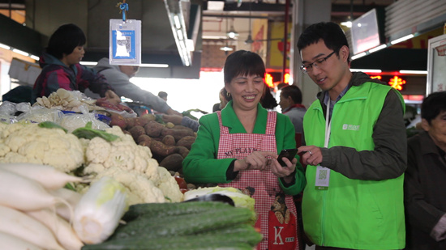
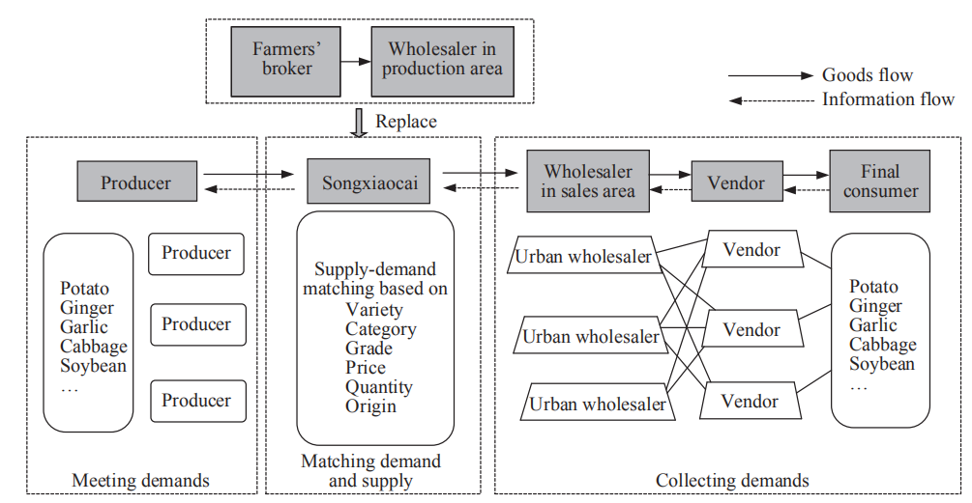
Case of Songxiaocai: Replacing the Traditional Vegetable Supply Chain with a Demand-driven Supply Chain
“There are more than 30 kinds of products in my vegetable booth. In the past, my husband spent a lot of time purchasing products in the wholesale market at deep night. Now, we can place orders online and it is really convenient.”
Food waste and loss: reduced to 0.2%
Notes:
In Songxiaocai’s case, the company has positioned itselfas a one-stop intermediary,eliminating some other intermediaries such as farmers’ brokers and wholesalers in the production area. In this demand-driven supply chain, vendors and wholesalers can place orders through one of the mobile applications maintained by Songxiaocai according to the requirements (including the variety, category, grade, price, quantity, and the origin of goods) of their final customers. This order informationcollected by Songxiaocai will be later passed on to producers onthe supply side. After receiving the specific orders from vendors and wholesalers, producers will prepare the deliverables to meet the demand.

Slide 11
Proposed TA: Sustainable, Resilient and Inclusive Agriculture and Rural Transformation with Digital Technologies
Period: December 2022–November 2024
EA: Ministry of Agriculture and Rural Affairs, PRC
Input: ADB $0.25 million + PRC Fund
Output 1: Assessment of baseline situation of the digital technology application in agriculture in PRC and other countries
Output 2: Cross country knowledge and south-south cooperation for digital technology application in agriculture and rural transformation
Output 3: Policy advice and recommendations on digital technology application in the agriculture and rural transformation for the PRC and other DMCs finalized

Slide 12
Action 3: Support DMC governments to reorient public finance and policy institutions
Of the USD 536 billion provided annually in public support to farmers:
about two-thirds is provided through measures that distort farm business decisions.
Reallocating the distortive form of support to sustainability policy objective:
EU policy reforms: 30% of payments to farmers conditional upon additional conservation measures.
Environmental taxes for forestry, fisheries, and water that provide incentives for more sustainable extraction and effective tax collection.
Payments for environmental services such as PRC's eco-compensation experiments.
Tradable permits for regulating. environmental externalities such as carbon credit trading.
Traceability and eco-labelling for market prices to integrate the true costs of producing and distributing food.

Slide 13
Financial Innovation for Ecosystem Services Protection
Evolution of eco-compensation mechanisms in the PRC
  Demonstration component under ADB’s Yangtze River Economic Belt (YREB) program ($2.9 billion) from 2015 to 2023 and YREC program ($2.3 billion) from 2018-2023
  Sharing co-benefits from natural capital investments between upstream and downstream provinces and townships
  Addressing environmental externalities and capturing returns on investments
  ADB-PRC partnership
  - International Conference on Eco-Compensation and Payment for Ecosystem Services
  - Special Policy Study on Eco-Compensation and Green Development Institutional Reform in the Yangtze River Economic Belt

Slide 14
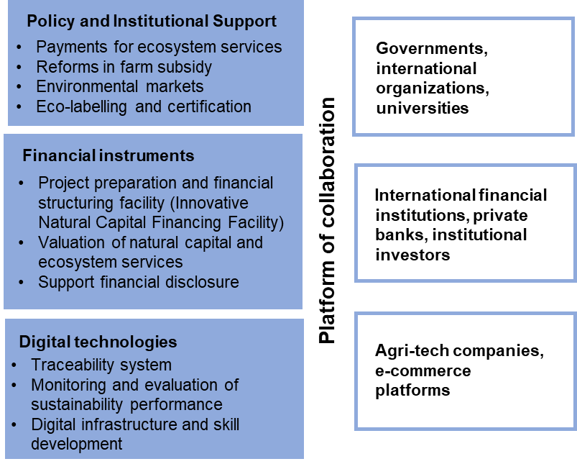
ADB can play a catalytic role in financing sustainable and resilient food system transformation

Slide 15

Thank you

