Slide 1

Institutional Reforms for Agricultural Modernization
Nodir Djanibekov
Leibniz Institute of Agricultural Development in Transition Economies (IAMO)
Halle (Saale), Germany
11-12 August 2022 || Hybrid format: Istanbul
Workshop on Agriculture Development and Food Security in the CAREC Region
Day 2, Session 2: Knowledge Sharing on Agriculture Modernization and Food Security

Slide 2
Structure
Farm size – productivity debate and facts
CAREC region: Farm structures
Approaches for overcoming the issues of smallness and fragmentation
  Consolidation, Cooperatives, Clusters
Challenges ahead to consider
Key take-home messages

Slide 3
Big vs Small farms: Oldest puzzles of development economics
Inverse relationship (IR) between farm size & land productivity
Direct Relationship
Inverse Relationship (IR)
Source: Garzón Delvaux et al. (2020a).
  Smallholders have a high labor/land ratio (rely on family labor & lower labor costs)
  Smaller farms are more productive than larger farms
Important policy implication: land reform that reduces the inequality in landholdings will increase agri productivity (Eastwood et al. 2010)
  Average farm size in many developing economies was declining
  Supporting evidence for addressing food and nutrition security issues by directing agri- and development policies towards smallholders

Slide 4
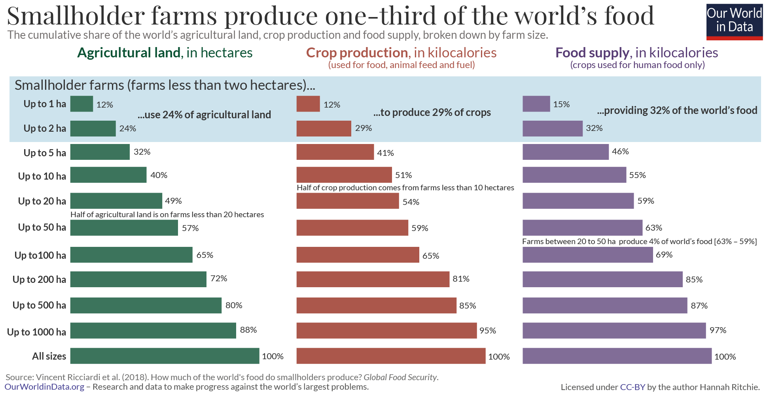
How much do smallholders contribute to the global food?
Global total in smallholder farms (< 2 ha):
produce 29% of the world’s crops, measured in kilocalories
use one-quarter (24%) of the world’s agricultural land
account for one-third (32%) of the world’s food supply

Slide 5
Selected characteristics of the CAREC countries
 | Rural population (%) | Employment in agriculture (% of total employment) | Agriculture, value added per worker (constant 2015 US$) | Agriculture, value added (% of GDP) | Personal remittances, received (% of GDP) | International tourism, receipts (% of GDP) | Total natural resources rents (% of GDP)
China | 40.9 | 26.1 | 5,257 | 7.2 | 0.2 | 3.6 | 1.3
Pakistan | 63.3 | 38.1 | 2,575 | 21.4 | 6.2 | 0.3 | 1.1
Mongolia | 31.5 | 26.9 | 5,263 | 11.4 | 3.2 | 4.1 | 17.2
Afghanistan | 74.5 | 43.2 | 1,198 | 24.7 | 4.4 | 0.3 | 0.8
Azerbaijan | 44.3 | 36.2 | 2,119 | 5.5 | 2.7 | 5.9 | 25.2
Georgia | 41.4 | 40.1 | 1,707 | 6.5 | 11.8 | 19.5 | 0.4
Kazakhstan | 42.6 | 15.7 | 7,180 | 4.5 | 0.3 | 1.5 | 18.3
Kyrgyzstan | 63.6 | 20.9 | 2,057 | 12.0 | 30.6 | 6.9 | 4.7
Tajikistan | 72.9 | 45.7 | 2,131 | 20.3 | 28.6 | 2.2 | 4.3
Turkmenistan | 48.4 | 21.7 | n.a. | 11.0 | 0.0 | 0.0 | 19.4
Uzbekistan | 49.5 | 26.5 | 7,527 | 26.7 | 13.4 | 2.2 | 14.2
Note: All values in average of 2017-2019.
Source: World Development Indicators (2022).
Notes:
The eight CAC countries vary in terms of their economies, which has been decisive in terms of COVID-19 impact (Table 1). Agriculture still forms a significant share of Gross Domestic Product (GDP) in most countries, except for the exporters of natural resources, and Georgia. Uzbekistan and Tajikistan top the list with a quarter and one-fifth of their GDPs still coming from agriculture.
The countries analysed in the framework of the project are Armenia, Azerbaijan, Georgia, Kazakhstan, Kyrgyzstan, Tajikistan, Turkmenistan and Uzbekistan.
Employment in agriculture still comprises a large share of total employment among the population in the region. In Tajikistan, almost half of the employed population works in agriculture. In Azerbaijan and Georgia, over one-third of jobs are in agriculture. Even in resource exporting economies, agriculture’s share in employment is close to 15 percent. Across all countries, the share in employment exceeds agriculture’s proportion of GDP, which points to comparatively low labour productivity.

Slide 6
Arable land per person and per farm
 | Arable land per rural populaion (ha) | Average farm size (ha) | Notes | Agriculture, value added (% of GDP)
China | 0.21 | 0.8 | About 230 mln farms, 93% of farms were less than 1 hectare. | OECD (2018)
Pakistan | 0.23 | 2.6 | Agricultural holdings smaller than 3 ha operate 28% of land | Structural data from 2015 agricultural censuses
Mongolia | 1.33 |  | Over 230 thous. farms (2011) | Lowder et al. (2016)
Afghanistan | 0.28 | 1-2 | Over 3 mln of farmers (2002) | Lowder et al. (2016)
Azerbaijan | 0.48 | 1.7 | 65% of agricultural holdings <1ha who operate 10% of land | Structural data from 2015 agricultural censuses
Georgia | 0.20 | 1.3 | 73% of farms are smaller than 1 ha and operate 19% of land | Structural data from the 2010 Agricultural Census
Kazakhstan | 3.84 | 117.4 | 80% of farms are <50ha (average size 11.3 ha), and < 8% of arable land | Official figure (2020)
Kyrgyzstan | 0.32 | 2.2 | operate 89% of arable land | Official figure (2016)
Tajikistan | 0.11 | 3.0 | 82% of total arable land | Official figure (2020)
Turkmenistan | 0.69 | 6.6 | Only about 2700 farms, operate 1% of total arable land. 70% of arable land under Dayhan farm unions (successors of Soviet collective farms) | Official figure (2020)
Uzbekistan | 0.25 | 23.6 | Individual farms operate about 75% of sown land | Official figure (2020)

Slide 7
Smaller farms in more densely populated areas
Farmers get bigger,
but also smaller
Sources: Offical Statistica Agency of Kazakhstan (2021).
Sources: OECD (2018), Offical Statistica Agency of Kyrgyzstan (2014).

Slide 8
Production of key food groups by farm size
Smallholder farms play a large role in key food production in China
Farms from 2-20 ha in other regions of CAREC countries
2/7:
Afghanistan
Pakistan
7/29:
Azerbaijan
Georgia
Kazakhstan
Kyrgyzstan
Tajikistan
Turkmenistan
Uzbekistan
1/3:
Mongolia
Source: Herrero et al. (2017).
Up to here, we can conclude that:
Most farms in CAREC countries are smallholders…
…and contribute a significant share to food production

Slide 9
Weakening of IR in developing countries
When agriculture becomes more capital intensive and wages rise:
Transformation of smaller farms into larger more capital-intensive farms (Otsuka et al. 2016)
  Production efficiency of small farms has declined relative to large farms
When measured in Gross Output -> IR: agricultural performance would decrease as farm size grows
When measured in Net Value and Efficiency indicators -> larger farms tend to be more performant than the smaller farms
Based on Panel data observations: Consistently declining IR through time:
A strong positive relationship between plot size and land yields in China (Wang et al. 2015)
A positive relationship between revenue/ha and cultivated land area in Kyrgyzstan (Savastano and Scandizzo 2009)
‘U-Shaped’ relationship in Tajikistan (Closset et al. 2015)
IR is not an advantage of a given type of farm, but:
A symptom of factor market imperfections and lack of opportunities for rural labor
Omitted relevant variables problem related to the lack of data on soil quality
Statistical issues, measurement errors

Slide 10
Future of small farms in the CAREC countries?
Source: Garzón Delvaux et al. (2020b).
Studies into farm size–agricultural performance relationship with more recent data are more likely to record less IR than those developed with older data
However, this does not suggest the abandonment of smallholders in agri-food policymaking
  Critical economic and social justifications of smallholders (rural welfare of rural population)
A revisited and expanded development role of medium-sized farms

Slide 11
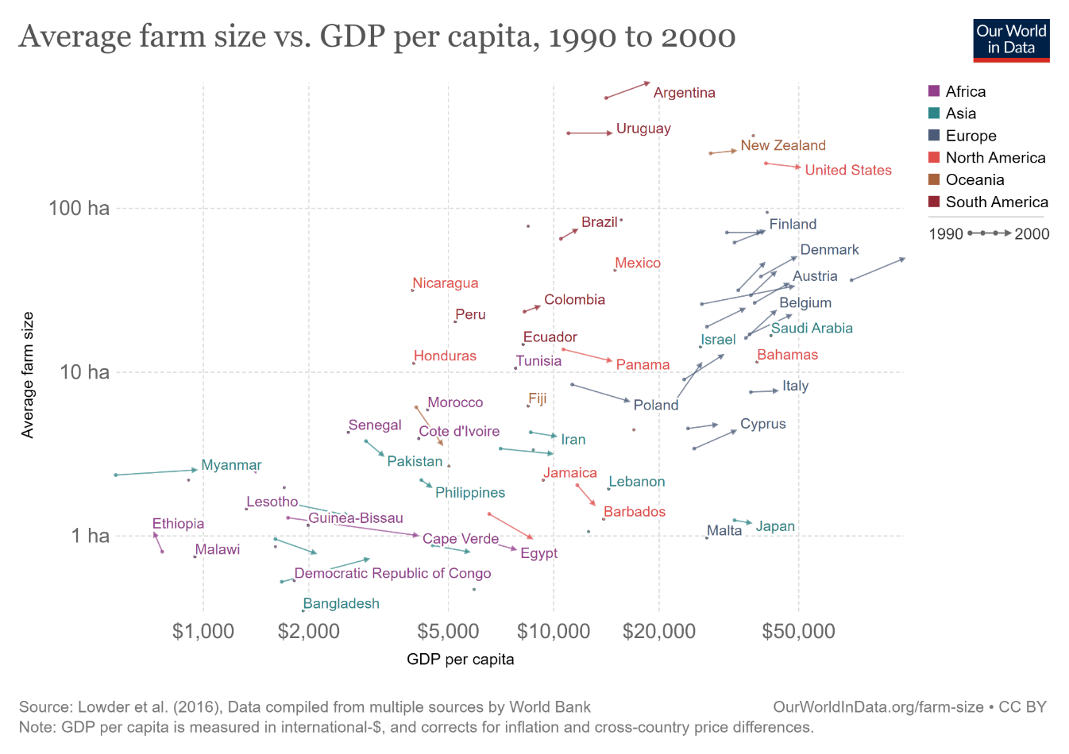
Debate about farm size
Positive relationship b/n Income and Farm Size
Richer countries tend to have larger farms

Slide 12
Problem of smallness: Is small still beautiful?
State/Collective farm with workers
State/Collective farm with workers
?
Land reform & fragmentation
Agricultural modernization
Low adoption rates of agricultural technologies (high transaction costs in accessing technologies)
Poor access to credits (lack of collateral)
Exclusion from marketing channels by bigger players (now bargaining power)
Do smallholders represent the obstacle to agricultural modernization?
Does the smallholder system threaten food security and hinders poverty alleviation?
What instruments are available to get the small farmers out of the “poor but efficient” trap?
  Re-organization of agricultural value chain & Land markets
  Promote policies & technologies aimed at smallholder productivity
  Enable smallholders to benefit from scale economies & participation in modern value chains

Slide 13
Institutional reforms to bring the economies of scales in small-scale farm-based fragmented agriculture
3C
Consolidation
Cooperatives
Clusters
Land tenure

Slide 14
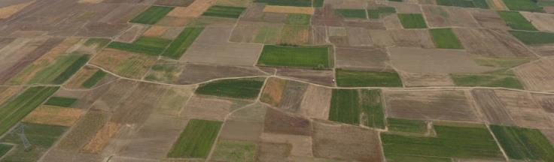
Land and farm consolidation
Fragmented agriculture: Farmers comprise several small plots scattered across space
Scattered plots may have different seasonal peaks for labor, water, or food production:
  Higher farmers’ flexibility, seasonal adjustments in input use, smoothened agricultural income, risk management for smallholders
However, higher costs to reach fragmented land -> penalized output, deterred intensive farming, and land value
Smaller scattered parcels hinder the use of heavy inputs (from machinery to pesticides)
Consolidation of farms through the exchange of parcels among farmers
  without increasing farm size nor changing power structure
Often resisted by smallholders due to low trust and lack of information on plots of other farmers
Limited ability of farmers to adjust fragmented plots over time due to land transaction restrictions
Photo: FAO MAINLAND project.

Slide 15
Farm consolidation in Uzbekistan
Schematic layout of the farm consolidation in Uzbekistan
Sporadic
Top-down
Without full farm compensation
Compromised trust and incentives for farm investments
Source: Djanibekov et al. (2012).
Evolution of average of individual farms in Uzbekistan
Source: Zorya et al. (2019).

Slide 16
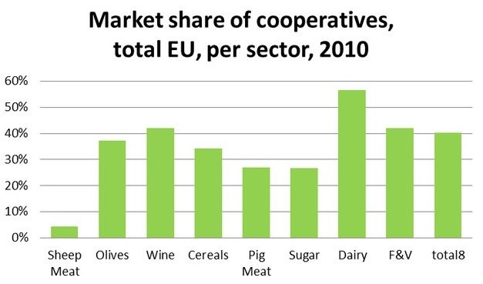
Agricultural cooperatives
Autonomous association of persons united voluntarily to meet their common economic, social and cultural needs and aspirations through a jointly owned and democratically-controlled enterprise (International Cooperative Alliance 2022)
NOT commercial institution formed by pooling resources and commodities of individual farmers
Major forms of coops:
Supply cooperatives
Marketing cooperatives (multi-purpose with credit and agronomy departments)
Cooperative Principles
Voluntary and open membership
Democratic member control
Member economic participation
Autonomy and independence
Education, training, and information
Cooperation among cooperatives
Concern for community
Source: International Cooperative Alliance (2022).

Slide 17
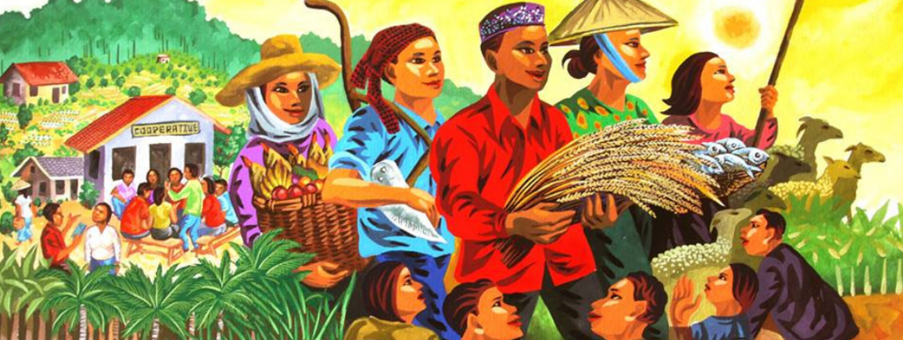
Coops: Empirically-confirmed theoretical characteristics
Grashuis and Su (2019): Cooperative:
Improves farm-gate prices in case of failures in input supply and output demand markets
Provides greater bargaining power in relation to monopolists and monopsonists
Increases members’ household income through higher productivity, input access, technical expertise, and off-farm work opportunities
Improve the productivity of fixed assets by better access to feed, seed, pesticide, fertilizer, knowledge, and machinery
Enhances the ability and willingness of members to improve product quality
Improved input-output efficiency: while (i) cooperatives are not necessarily more efficient than non-cooperatives, (ii) coop members are more efficient than non-members
Reduces per unit expenditure on inputs or/and higher adoption of total inputs (intensification of agriculture)
Photo: Asian Farmers' Association For Sustainable Development

Slide 18
Challenges of coops
State-controlled and managed enterprises for several decades, with collapsing conditions before fragmentation into individual farms or privatization
Donor-driven promotion of community-owned coops often lacks ‘friendly’ legislation
No proper understanding of local settings when introducing (forcing) coops, e.g. lack of trust among farmers, negative history of coops, heterogeneous farmers
Coops forced through legislation do not fit natural conditions
Management challenges due to a lack of farmers’ understanding of how to lead a cooperative
Free riding problem and side-selling by coop members: Increased heterogeneity in member attitudes and objectives affects commitment and participation (Hakelius and Hansson 2016)
Uneven distribution of benefits for small and large producers

Slide 19
Agrobased Clusters
Concentrations of producers, agribusinesses, and institutions that are engaged in the same agricultural or agro-industrial subsector, and interconnect and build value networks when addressing common challenges and pursuing common opportunities (FAO 2010)
  Inter-firm cooperation, spreading organizational and technical innovation, and mechanism for industry initiatives that benefit the entire value chain (FAO 2017)
Most benefits are as in Coops, plus:
High-value addition & innovations
Rely on skilled labor, capital, and technology-intensive
Particularly relevant when multiple products and a few downstream integrators (lead firms), lead to more open and diverse marketing channels
Reach to export markets
Source: FAO (2010).

Slide 20
Agrobased Clusters
to emerge naturally require good macroeconomic policy, a sound business-enabling environment, and good institutions (European Commission 2014)
Attempts to create or induce growth among clusters can lead to a new form of industrial policy:
  subsidies or protection skewing investment towards industries favored by policymakers
  cluster policies might be captured by special interest groups that have the best access to government (Pislaru 2004)
Successful Agrobased Clusters tend to be large, of high value, and export-oriented (FAO 2010)
Land tenure issues: limited investment and productivity due to communal ownership, lack of clear titles or sensitivity in acquiring land for commercial scale and modern development
External facilitation and funding: To avoid policies favoring one narrow group, cluster development requires that a non-interested actor looks out for the entire cluster

Slide 21
Rule of law & Control of Corruption
The success of Cooperatives, Clusters, and market-based Consolidation depends on good governance, e.g.
Rule of law
Control of corruption
Essential for trust among participants
  and incentives for private investments and minimizing agency problems
Source: Worldwide Governance Indicators (2022).
21

Slide 22
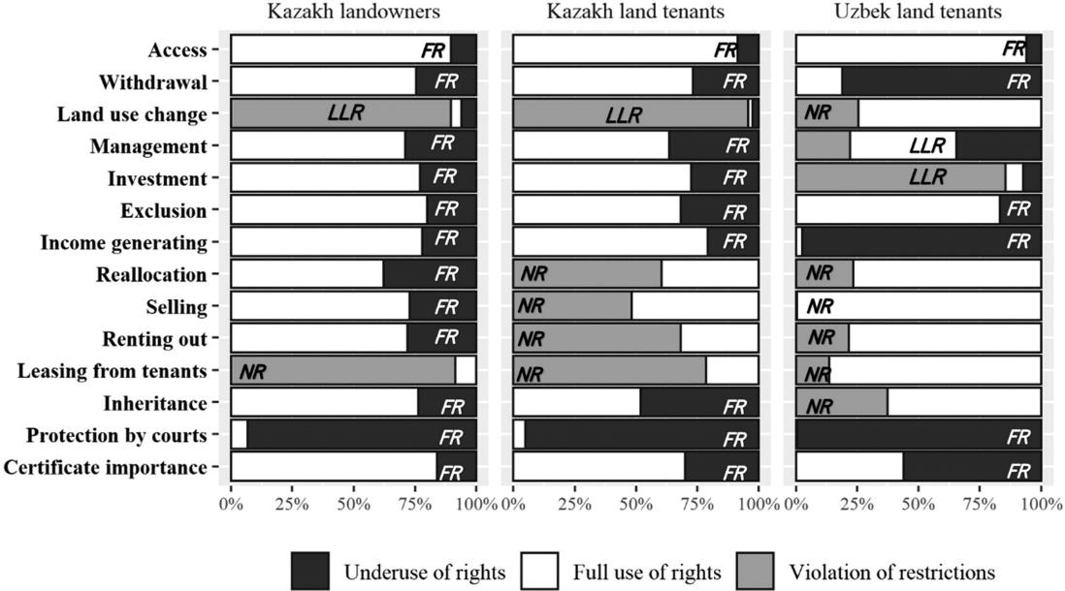
Land tenure
Promote more efficient and equitable land policies and institutions
Secure property rights to farmers:
  collateral for accessing credit
  confidence to invest in land quality and technology
  market-driven increase in farmland exchange and in farm size
Shares of discrepancies between legal rights and actual practices
Source: Akhmadiyeva and Herzfeld (2021).

Slide 23
Technology (or Reform) Treadmill
More successful farmers remain with technology
  Concentration of land ownership in a smaller number of larger farms
‘Laggards’ cannot compete on the treadmill and exit the farm business (Cochrane 1958)
  Resources (land, labor, machinery) of ‘Laggards’ are absorbed by technology adopters
An increasing number of rural landless poor and migrants to urban centers
Under “Land market” Treadmill,
  Farmers constantly bid for land and drive land prices up (Levins and Cochrane 1996)
  More absentee landowners and more farmers who farm rented land
  Rural economies lose income due to land payments to absentee farmers
  Competition for land can lead to a predator-prey relationship between various actors (Appel and Balmann 2022)
  Agricultural policies will not serve the purpose: Agricultural benefits are captured from absentee farmers
Source: Fan and Chan-Kang (2005)

Slide 24
Looking forward: Avoiding Technology Treadmill
Investment in agricultural research considering the needs of small farms
Subsidies targeted small farms on credit, inputs, and new technologies
Facilitate production of high-value commodities by small farms through agricultural research
  instead of spending the public budget predominantly on irrigation & large crop-extension programs
Attract private investment in transportation, retail chain stores, processing, and storage
Sound social safety net to avoid poverty traps & Policies to develop the rural nonfarm sector
Source: Fan and Chan-Kang (2005)

Slide 25
Key take-home messages
In many CAREC countries, arable land is operated by smallscale farmers
Smallholders and family farms contribute a significant share to CAREC food production
IR has been weakening which affects the comparative advantage of small-scale farming
Land consolidation, agricultural cooperatives and agrobased clusters are options to bring economies of scale to agriculture
Advances in land tenure and governance will make the models successful
Despite advantages policymaking needs to be aware and account for the challenges around these models
Source: Fan and Chan-Kang (2005)

Slide 26
Last, but not least
CAREC countries – Black (white) box?
Map showing source of data derived from agricultural censuses (purple) or household surveys (orange) at the country level
Source: Ricciardi et al. (2018b): Open-access dataset containing food production by farm size at the global scale.

Slide 27
IAMO Policy Briefs
Akhmadiyeva, Z., Herzfeld, T. (2020) How to align formal land rights with farmers’ perceptions in Central Asia? IAMO Policy Brief No. 38, Halle (Saale). https://www.iamo.de/fileadmin/user_upload/IAMOPolicyBrief38en.pdf
Petrick, M., Djanibekov, N. (2019) Farm restructuring in Uzbekistan: What next? IAMO Policy Brief No. 36, Halle (Saale). https://www.iamo.de/fileadmin/documents/IAMOPolicyBrief36_en.pdf

Slide 29
Used literature
Akhmadiyeva, Z., Herzfeld, T. (2021) How does practice matches land laws in Central Asia? Land Use Policy 109, 105726.
Appel, F., Balmann, A. (2022) Predator or prey? Effects of farm growth on neighbouring farms. Journal of Agricultural Economics. https://doi.org/10.1111/1477-9552.12503
Barrett, C.B., Bellemare, M.F., Hou, D.Y. (2010) Reconsidering conventional explanations of the inverse productivity–size relationship. World Development 38 (1), 88-97.
Bijman, J., Iliopoulos, C., Poppe, K.J., Gijselinckx, C., Hagedorn, K., Hanisch, M., Hendrikse, G.W.J., Kühl, R., Ollila, R., Pyykkönen, P., van der Sangen, G. (2012) Support for Farmers' Cooperatives. Final Report. Wageningen UR. https://edepot.wur.nl/245007
Closset, M., Dhehibi, B.B.B., Aw-Hassan, A. (2015) Measuring the economic impact of climate change on agriculture: A Ricardian analysis of farmlands in Tajikistan. Climate and Development 7 (5), 454-468.
Cochrane, W.W. (1958) Farm Prices: Myth and Reality. University of Minnesota Press, St. Paul .
Djanibekov, N., Van Assche, K., Bobojonov, I., J.P.A. Lamers, J.P.A. (2012) Farm restructuring and land consolidation in Uzbekistan: New farms with old barriers. Europe-Asia Studies 64 (6), 1101-1126.
Eastwood, R., Lipton, M., Newell, A. (2010) Farm Size. In: R. Evenson, P. Pingali (Eds.) Handbook of Agricultural Economics vol. 4, Elsevier, pp. 3323–3397.
European Commission (2014) Industry and Entrepreneurship. Clusters. http://ec.europa.eu/commission_2010-2014/tajani/priorities/clusters/index_en.htm
Fan, S., Chan-Kang, C. (2005) Is small beautiful? Farm size, productivity, and poverty in Asian agriculture. Agricultural Economics 32 (1), 135-146.
FAO (2010) Agro-based clusters in developing countries: Staying competitive in a globalized economy, by Eva Gálvez Nogales (Ed.), Rome, Italy.
FAO (2017) Territorial tools for agro-industry development – A Sourcebook, by Eva Gálvez Nogales and Martin Webber (Eds.), Rome, Italy.
Garzón Delvaux, P.A., Riesgo, L., Gomez y Paloma, S. (2020a) Farm size-performance relationship: A review. EUR 30471 EN, Publications Office of the European Union, Luxembourg.
Garzón Delvaux, P.A., Riesgo, L., Gomez y Paloma, S. (2020b) Are small farms more performant than larger ones in developing countries? Science Advances 6 (41). https://doi.org/10.1126/sciadv.abb8235

Slide 30
Used literature (cont.)
Graeub, B. E., Chappell, M. J., Wittman, H., Ledermann, S., Kerr, R. B., Gemmill-Herren, B. (2016) The state of family farms in the world. World Development 87, 1-15.
Grashuis, J, Su, Y. (2019) A review of the empirical literature on farmer cooperatives: Performance, ownership and governance, finance, and member attitude. Annals of Public and Cooperative Economics 90 (1), 77-102.
Hakelius, K., Hansson, H. (2016) Measuring changes in farmers’ attitudes to agricultural cooperatives: Evidence from Swedish agriculture 1993–2013. Agribusiness 32 (4), 531-546.
Herrero, M., Thornton, P. K., Power, B., Bogard, J. R., Remans, R., Fritz, S., Gerber, J.S., Nelson, G., See, L., Waha, K., Watson, R.A., West, P.S., Samberg, L.H., van de Steeg, J., Stephenson, E., van Wijk, M., Havlík, P. (2017) Farming and the geography of nutrient production for human use: A transdisciplinary analysis. Lancet Planetary Health 1 (1), e33-e42.
International Cooperative Alliance (2022) (https://www.ica.coop/en/cooperatives/cooperative-identity)
Levins, R.A., Cochrane, W.W. (1996) The treadmill revisited. Land Economics 72 (4), 550-553.
Lowder, S. K., Skoet, J., Raney, T. (2016) The number, size, and distribution of farms, smallholder farms, and family farms worldwide. World Development 87, 16-29.
OECD (2018) Innovation, Agricultural Productivity and Sustainability in China. OECD Food and Agricultural Reviews, OECD Publishing, Paris.
Otsuka, K., Liu, Y., Yamauchi, F. (2016) The future of small farms in Asia. Development Policy Review 34 (3), 441-461.
Pislaru, D. (2004) Prospects and challenges for cluster development: Possibilities for implementing the cluster model in Romania. OECD LEED Conference, Romania. http://www.oecd.org/regional/leed/31798594.pdf
Ricciardi, V., Ramankutty, N., Mehrabi, Z., Jarvis, L., & Chookolingo, B. (2018a) How much of the world’s food do smallholders produce?. Global Food Security 17, 64-72.
Ricciardi, V., Ramankutty, N., Mehrabi, Z., Jarvis, L., & Chookolingo, B. (2018b) An open-access dataset of crop production by farm size from agricultural censuses and surveys. Data in Brief 19, 1970-1988.
Savastano, S., Scandizzo, P.L. (2009) Optimal farm size in an uncertain land market: The case of Kyrgyz Republic. Agricultural Economics 40, 745-758.
Wang, J., Chen, K. Z., Gupta, S. D., Huang, Z. (2015) Is small still beautiful? A comparative study of rice farm size and productivity in China and India. China Agricultural Economic Review 7 (3), 484-509.
Zorya, S., Djanibekov, N., Petrick, M. (2019): Farm restructuring in Uzbekistan: How did it go and what is next?. Washington, D.C.: World Bank Group, http://hdl.handle.net/10986/31248

