Slide 1



OUTLOOK OF
AGRICULTURE SECTOR OF PAKISTAN
Workshop on Agriculture Development and Food Security in the CAREC Region
11 – 12 August, 2022
Istanbul, Türkiye

Slide 2
OUTLOOK OF
AGRICULTURE SECTOR OF PAKISTAN
Workshop on Agriculture Development and Food Security in the CAREC Region
11 – 12 August, 2022
Istanbul, Türkiye
SEQUENCE OF THE PRESENTATION
Key Issues in Agriculture Sector of Pakistan
Introduction – Pakistan at a Glance
Medium & Long-Term Challenges in Ensuring Food Security in Pakistan
Government’s Strategies and Priorities for Agricultural Development & Food Security
Opportunities for Regional Cooperation in Agricultural Development & Food Security

Slide 3

Workshop on Agriculture Development and Food Security in the CAREC Region
11 – 12 August, 2022
Istanbul, Türkiye
PAKISTAN AT A GLANCE
A country of 220 million people with 60% population below the age of 30;
Expanding middle-class of more than 100 million people;
Geo-economic and geo-strategic location;
Tremendous potential for global investors / companies to relocate their businesses and use immense raw materials and human capital for meeting their economic needs and exporting to other regions;
Largest irrigated land area in the world comes only after China, India and United States of America, which is a flat fertile plain being nurtured by the mighty Indus – one of the largest rivers in the world; and
Home to the remains of many ancient civilizations and some of the highest, most beautiful mountain ranges as well.
OUTLOOK OF
AGRICULTURE SECTOR OF PAKISTAN

Slide 4
Workshop on Agriculture Development and Food Security in the CAREC Region
11 – 12 August, 2022
Istanbul, Türkiye
PAKISTAN AT A GLANCE
Agro-Livestock Rankings of Pakistan
2nd in Buffalos
3rd in
Goats
9th in
Wheat & Sheep
4th in Cotton
5th in Sugarcane
12th in Rice
1/5th of Total GDP of Pakistan
OUTLOOK OF
AGRICULTURE SECTOR OF PAKISTAN

Slide 5
Workshop on Agriculture Development and Food Security in the CAREC Region
11 – 12 August, 2022
Istanbul, Türkiye
PAKISTAN AT A GLANCE
PILLAR | VARIABLE | UNIT | WORLD | PAKISTAN
Availability | Avg. dietary energy supply adequacy | Percent | 119 | 110
 | Avg. value of food production | $ per capita | 313 | 186
 | Avg. protein supply | g/capita/day | 79.9 | 64.7
 | Average fat supply | g/capita/day | 81.1 | 72.7
Access | GDP per capita (PPP) | Const. 2017$ | 16950.8 | 4690.5
 | PoU | Percent | 8.8 | 12.3
 | FIES | Percent |  | 15.92
Stability | Cereal Import Dependency Ratio | Percent | -1.8 | -17.2
 | Land equipped for irrigation | Percent | 24.1 | 45
 | Food import/Total export | Percent | 6.0 | 23
 | Political Stability | Index | -- | -2.27
 | Per capita food production variability | Const.2004-06 Th.Int$/cap | 1.6 | 3.2
 | Per capita food supply variability | Kcal/cap./day | 4.0 | 16
Utilization | People using at least basic drinking water | Percent | 89.6 | 91.5
 | Children < 5 years affected by wasting | Percent | 6.9 | 7.1
 | Children < 5 years stunted | Percent | 21.3 | 37.6
 | Prevalence of anemia among women (15-49 years) | Percent | 32.8 | 52.1
OUTLOOK OF
AGRICULTURE SECTOR OF PAKISTAN

Slide 6
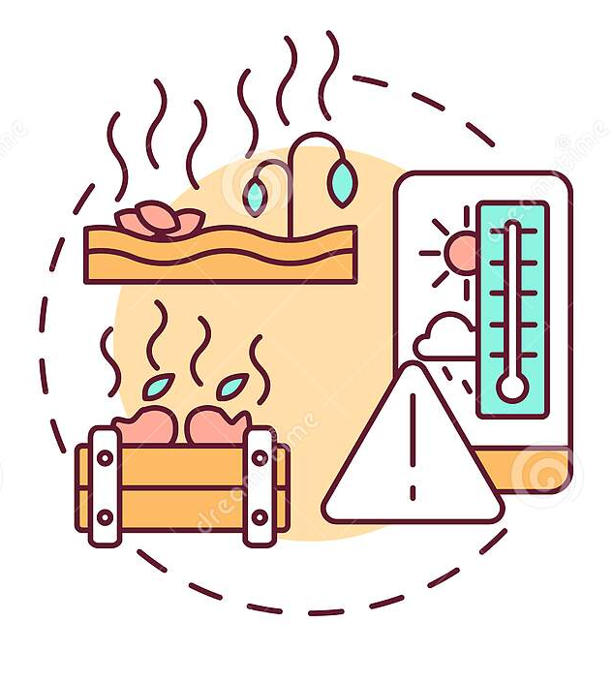
Workshop on Agriculture Development and Food Security in the CAREC Region
11 – 12 August, 2022
Istanbul, Türkiye
KEY ISSUES IN
AGRICULTURE SECTOR OF PAKISTAN
Stagnating crop yields with wide gaps between progressive and average farmers;
Poor quality and inadequate supply of inputs and lack of infrastructure;
Under-performance of rural factor and input markets;
High pre and post-harvest losses;
Declining investment in research, development and extension;
Frequent insect and pest attacks and high incidence of crop and livestock diseases;
Knowledge gap;
Insufficient capital and financial resources;
Poor infrastructure and low value addition;
Lack of international competitiveness of some agricultural commodities;
OUTLOOK OF
AGRICULTURE SECTOR OF PAKISTAN

Slide 7
Workshop on Agriculture Development and Food Security in the CAREC Region
11 – 12 August, 2022
Istanbul, Türkiye
KEY ISSUES IN
AGRICULTURE SECTOR OF PAKISTAN
Low crop diversification;
Highly skewed distribution of farm size and low economy of size and scale;
Inadequate supply of water and inefficient use of available water resources; and
Poor technology & information communication mechanism.
OUTLOOK OF
AGRICULTURE SECTOR OF PAKISTAN

Slide 8

Workshop on Agriculture Development and Food Security in the CAREC Region
11 – 12 August, 2022
Istanbul, Türkiye
MEDIUM AND LONG-TERM CHALLENGES IN ENSURING FOOD SECURITY IN PAKISTAN
Food security is still a key challenge due to high population growth, rapid urbanization, low purchasing power, high price fluctuations, erratic food production, and inefficient food distribution systems.
Overall 36.9% of the country's households are “food insecure” as per National Nutritional Survey 2018 conducted by the Ministry of National Health Services, Regulations & Coordination and UNICEF.
OUTLOOK OF
AGRICULTURE SECTOR OF PAKISTAN

Slide 9
Workshop on Agriculture Development and Food Security in the CAREC Region
11 – 12 August, 2022
Istanbul, Türkiye
MAJOR CHALLENGES TO
FOOD SECURITY IN PAKISTAN
Rising Population
Rapid Urbanization
Diversifying Diet Patterns
Increased Food Demand
Rising Food Prices
Declined Purchasing Power
Falling Water Tables
Low Irrigation Efficiency
Increased Soil Erosion
Inefficient Food Distribution Systems
Climate Change
Depleting Water Reserves
Limited Land Availability
Food Losses & Waste
OUTLOOK OF
AGRICULTURE SECTOR OF PAKISTAN

Slide 10
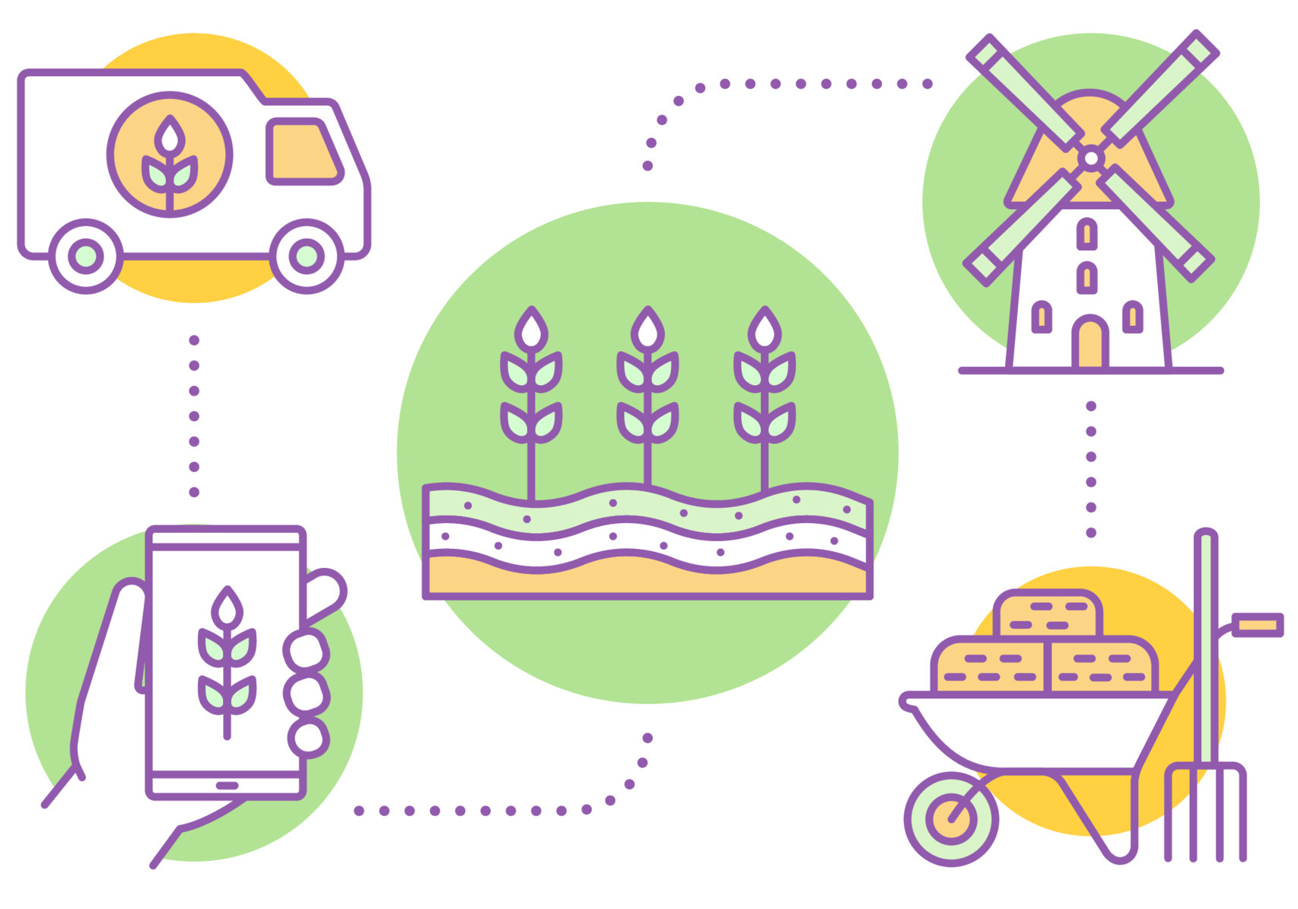
Workshop on Agriculture Development and Food Security in the CAREC Region
11 – 12 August, 2022
Istanbul, Türkiye
GOVERNMENT’S STRATEGIES AND PRIORITIES FOR AGRICULTURAL DEVELOPMENT & FOOD SECURITY
Food Availability Programs
PKR 270 billion
(US$ 1.1 billion)
Productivity Enhancement of Wheat, Rice & Sugarcane with cost of approximately PKR 34 billion (US$ 141.5 million);
Oilseeds Enhancement Program with cost of about PKR 10 billion (US$ 41.6 million);
Conserving Water Through Lining of Watercourses with a cost of PKR 180 billion (US$ 749.5 million);
Enhancing Command Area of Small and Mini Dams in Barani Areas with a cost of PKR 28 billion (US$ 116.5 million);
Water Conservation in Barani areas of Khyber Pakhtunkhwa with a cost of
PKR 13 billion (US$ 54.1 million);
Shrimp Farming for PKR 5 billion (20.8 million) and Cage Fish Culture for
PKR 7 billion (US$ 29.1 million);
Save & Fattening of Calf Program with more than PKR 5 billion (US$ 20.8 million);
Backyard Poultry Program with approximately PKR 3 billion (US$ 12.4 million)
OUTLOOK OF
AGRICULTURE SECTOR OF PAKISTAN

Slide 11
Workshop on Agriculture Development and Food Security in the CAREC Region
11 – 12 August, 2022
Istanbul, Türkiye
GOVERNMENT’S STRATEGIES AND PRIORITIES FOR AGRICULTURAL DEVELOPMENT & FOOD SECURITY
Access to Food Initiatives
Mechanized harvesting of wheat, rice, maize and fruits, silos for grain storage, cold storage facility for horticultural commodities and value-added products through provision of harvesting machinery for rice, cob and fruits;
Fast track access to credit/finance through Registration of farmers and FVOs and women through biometric mapping and issuance of Kissan (farmer) cards for subsidy and credit;
Import of more than 03 million tons of wheat and 0.3 million tons of sugar in recent days in order to stabilize wheat and sugar prices.
OUTLOOK OF
AGRICULTURE SECTOR OF PAKISTAN

Slide 12
Workshop on Agriculture Development and Food Security in the CAREC Region
11 – 12 August, 2022
Istanbul, Türkiye
GOVERNMENT’S STRATEGIES AND PRIORITIES FOR AGRICULTURAL DEVELOPMENT & FOOD SECURITY
Food Utilization Initiatives
Enhancement of accredited Food Quality Testing/certification/registration/branding facilities through Establishment/strengthening of specialized food safety testing labs and registration of brands via Pakistan Standards and Quality Control Authority.
Promotion and Certification body for organic products through Establishment of authorized department for certification at federal and provincial level.
Development of SOPs for industrial waste disposal and municipal waste disposal through SOPs enforcement and demonstration and dissemination of bioremediation technologies in Public-Private-Partnership mode.
OUTLOOK OF
AGRICULTURE SECTOR OF PAKISTAN

Slide 13
Workshop on Agriculture Development and Food Security in the CAREC Region
11 – 12 August, 2022
Istanbul, Türkiye
GOVERNMENT’S STRATEGIES AND PRIORITIES FOR AGRICULTURAL DEVELOPMENT & FOOD SECURITY
Food Stability Initiatives
Development of climate resilient variety through germplasm acquisition, develop climate resilient variety/ hybrids by conventional & molecular breeding and early generation seed production program.
Ministry of National Food Security & Research (MoNFS&R) has initiated its project for mapping of new agro-ecological zones across all provinces of Pakistan for cropping pattern and cropping zones.
Cluster Development on natural resource-based approaches. For this purpose, 82 cluster across the country has already been identified and feasibility report for 33 commodities has been developed.
Special Agricultural Economic Zones across the country have been developed with incentivize package for value addition and processing.
Dashboard for Food supply-chains & prices through central food security database have been developed in the MoNFS&R which will enable the policy maker for decision on Production Cycle Information for prices, import and export.
MoNFS&R has planned not only to revamp and restructure different research organizations but also chalked out to establish commodity specific centers of excellence.
Government is engaged to enhance agricultural and Livestock Production not only through domestic resources but also through collaboration with international agencies.
OUTLOOK OF
AGRICULTURE SECTOR OF PAKISTAN

Slide 14

Workshop on Agriculture Development and Food Security in the CAREC Region
11 – 12 August, 2022
Istanbul, Türkiye
OPPORTUNITIES FOR REGIONAL COOPERATION IN AGRICULTURAL DEVELOPMENT & FOOD SECURITY
Smallholder farming is an important engine for agricultural development across the region and a crucial employer of large rural population
A primary and immediate need is to establish systems that allow farmers of different regions to access modern technology, technical know-how, and production inputs to promote productivity growth
Investment in public goods, such as water, energy, and road infrastructure, can provide the kind of support that would aid household farmers and farm businesses of all types
Investing in public infrastructure must also focus on improving governance and the institutions that manage irrigation resources, road networks, and border points
Facilitate the cross-border exchange of expertise in developing infrastructure
OUTLOOK OF
AGRICULTURE SECTOR OF PAKISTAN

Slide 15
Workshop on Agriculture Development and Food Security in the CAREC Region
11 – 12 August, 2022
Istanbul, Türkiye
OPPORTUNITIES FOR REGIONAL COOPERATION IN AGRICULTURAL DEVELOPMENT & FOOD SECURITY
Improvements in agricultural infrastructure should be considered in the broader context and incorporate the development of support structures for trade, such as storage and logistics facilities;
Development and sharing facilities to sustain export activities and support regional countries to become global exporters of certain agricultural products;
Creating not only the physical infrastructure but also the accompanying institutional and regulatory frameworks will help regional agricultural products gain access to lucrative markets;
Improving veterinary services, sanitary and phytosanitary (SPS) inspections, and certification services would help increase foreign trade in meat and animal products;
National agricultural policies may be directed to consider constraints on growth, with an eye toward taking advantage of economic and trade opportunities;
OUTLOOK OF
AGRICULTURE SECTOR OF PAKISTAN

Slide 16
Workshop on Agriculture Development and Food Security in the CAREC Region
11 – 12 August, 2022
Istanbul, Türkiye
OPPORTUNITIES FOR REGIONAL COOPERATION IN AGRICULTURAL DEVELOPMENT & FOOD SECURITY
Evidence-based research, sound data, and information exchange must support these efforts;
Coordinating these strategies could motivate national policy makers to face shared challenges and derive ideas from collective expertise;
Integrated cooperation is key to reach national and Sustainable Development Goals (SDGs);
Fast-paced population growth, climate change, limited water resources make the achievement of food security one of the most important challenges;
Cooperating with strategic partners and intensifying agricultural investments is essential for the attainment of common development goals; and
Ways and mechanisms to support capacity building programmes, technical and policy experience sharing, and joined field interventions to further improve agriculture productivity and production to improve farmers’ livelihoods and sustain food security.
OUTLOOK OF
AGRICULTURE SECTOR OF PAKISTAN

Slide 17
THANK YOU
Workshop on Agriculture Development and Food Security in the CAREC Region
11 – 12 August, 2022
Istanbul, Türkiye

