Slide 1
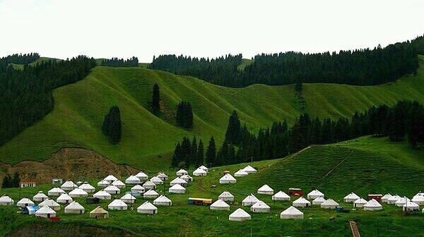
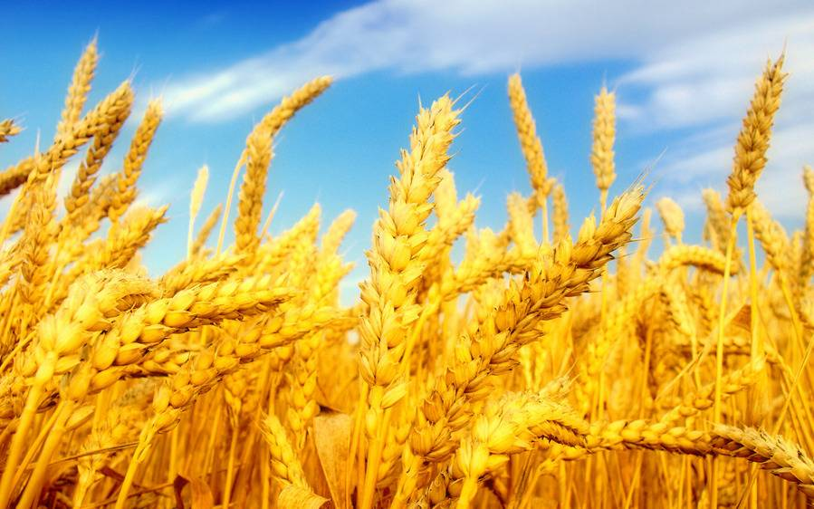
Ministry of agriculture of the Kyrgyz Republic
Chief specialist of the Strategic planning and analysis department N.N. Aidyralieva
Email: gs.strat@agro.gov.kg

Slide 2
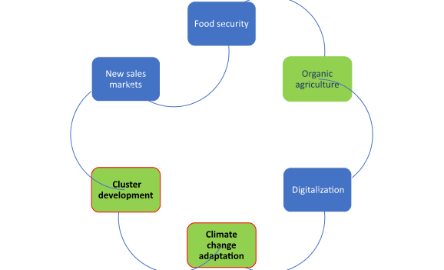
Priority areas of strategic development of agriculture in the Kyrgyz Republic
Food security
Organic agriculture
Digitalization
Climate change adaptation
Agrocluster development
New sales markets

Slide 3
Main strategic documents in the agroindustrial complex
The concept of agricultural development in the Kyrgyz Republic 2022-2032 submitted to the Cabinet of Ministers of the Kyrgyz Republic for approval
Effective strategic documents
State program for the development of irrigation of the Kyrgyz Republic 2017-2026
Organic agriculture development program in the Kyrgyz Republic 2017-2022
Food security and nutrition program the Kyrgyz Republic 2019-2023
The program for creation and development of trade and logistics centers for agricultural products in the Kyrgyz Republic 2019-2023
Framework program for ensuring phytosanitary security in the Kyrgyz Republic 2019-2023
Fishing and aqua culture development program in the Kyrgyz Republic 2019-2023.
The Program of the Government of the Kyrgyz Republic “Development of the veterinary service in the Kyrgyz Republic in 2018-2023”.
Concept for the development of the forestry sector of the Kyrgyz Republic 2040
In the course of execution of the above strategic documents certain results were achieved in the agroindustrial complex.

Slide 4
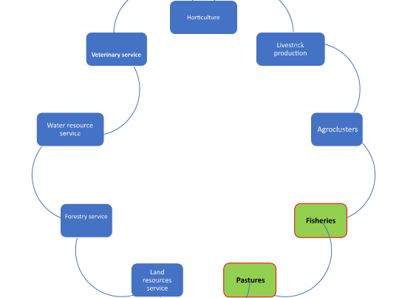
Governance structure of the Ministry of agriculture of the Kyrgyz Republic
Ministry of agriculture
of the Kyrgyz Republic
whilst ensuring food security
pursues state policy
in the agroindustrial complex,
including agriculture and forestry,
land and water resources.

Slide 5
Food provision to the population in 2021
OSZT
Source: National statistics committee of the KR

Slide 6
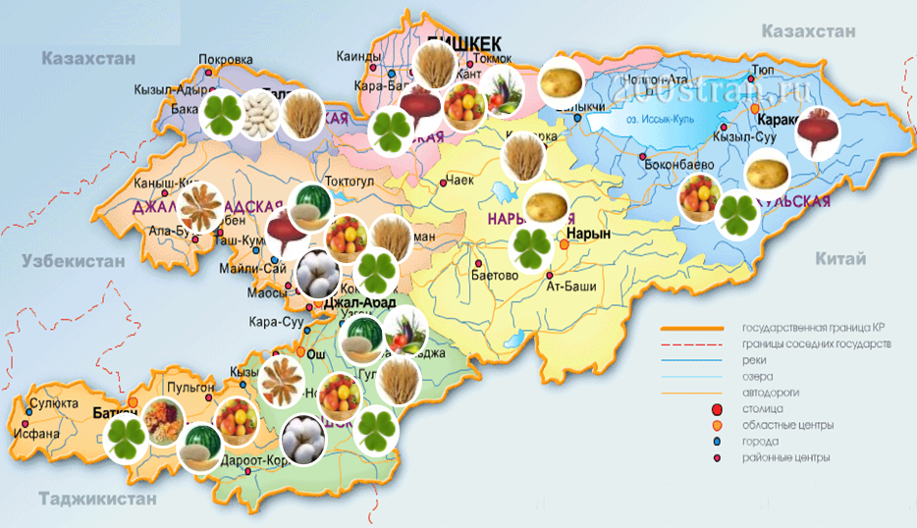
Organic agriculture
Law of the Kyrgyz Republic “On organic agricultural production in the Kyrgyz Republic” dated May 18 2019 No 65 was passed.
Aimaks producing organic products were allocated 3127,84 hectares certified by the PGS system
Aimaks (12) and pilot enterprises (123) in transition and selling their products at local markets and in local stores, have 8504 hectares
32780,67 hectares or 2% of total arable land across the republic are engaged in organic production

Slide 7
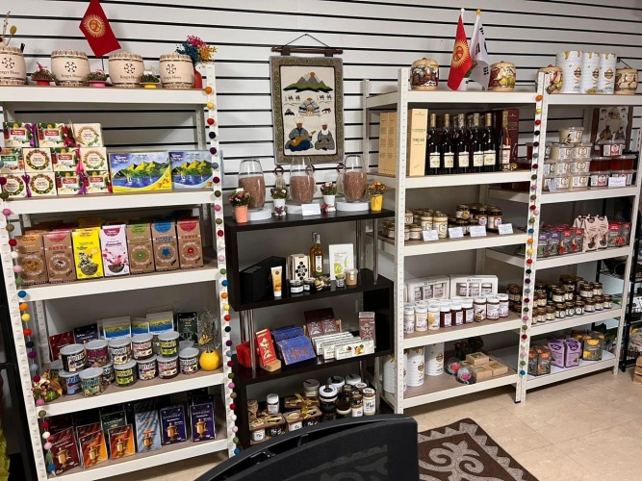
Organic agriculture
3 324 farmers are involved in organic agricultural production in Kyrgyzstan, and 32,000 га certified according to international organic standards
At present agricultural cooperatives
of the Kyrgyz Republic export organic products
to neighboring and other foreign countries
In 2021 7892 tons of certified organic products were exported,
including 6256 tons of vegetables,
166 tons of fruits
470 tons of organic cotton
1000 tons of medicinal herbs

Slide 8
Digitalization
As far as software is concerned, the following projects were developed and implemented:
- Food security atlas – agro.gov.kg/atlas;
- Tunduk system - agro.gov.kg/tunduk;
- Organic map - agro.gov.kg/organic-map;
- FaceID Telegram bot- t.me/Agroface_bot;
- Database of the food security department;
- Website of the ministry - agro.gov.kg;
- Electronic document control system (EDC).
National integrated cadaster system (NICS): www.cadastre.kg
Jashyl Muras Internet-platform
Server-based geoinformation system (Web-GIS)
“E-akimiat”, “Sanarim Aimak”, “Tunduk”

Slide 9
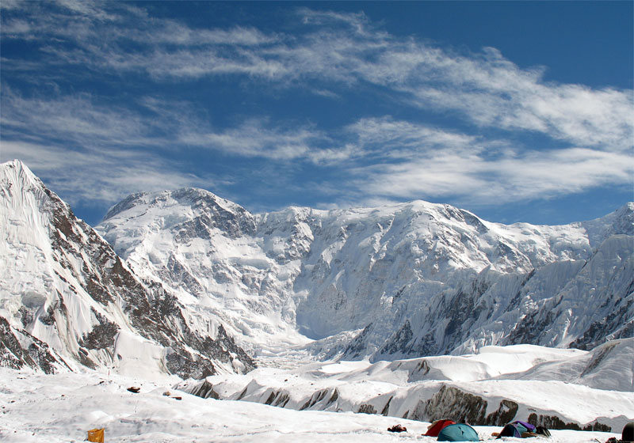
Climate change adaptation
As of 2013-2016, according to the Landsat-8 satellite imagery, Kyrgyzstan had 9959 glaciers with a total area of 6683,9 square kilometers, which is 3,345% of the total area of the KR. Thus the total reduction of the area of the country covered with glaciers was 0,66%.
The increase of green spaces is the only way to preserve mountain glaciers.
For these purposes the ministry created the Jashyl Muras Internet platform - a server-based geoinformation system (Web-GIS). As of August 1 2022, 5 million 393 thousand 159 seedlings were planted on a total area of 4 199,15 ha as part of the Jashyl Muras national campaign.
This will make it possible to pursue targeted restoration works and make a significant contribution to the increase of the forest areas in Kyrgyzstan.
Source: Azattyk

Slide 10
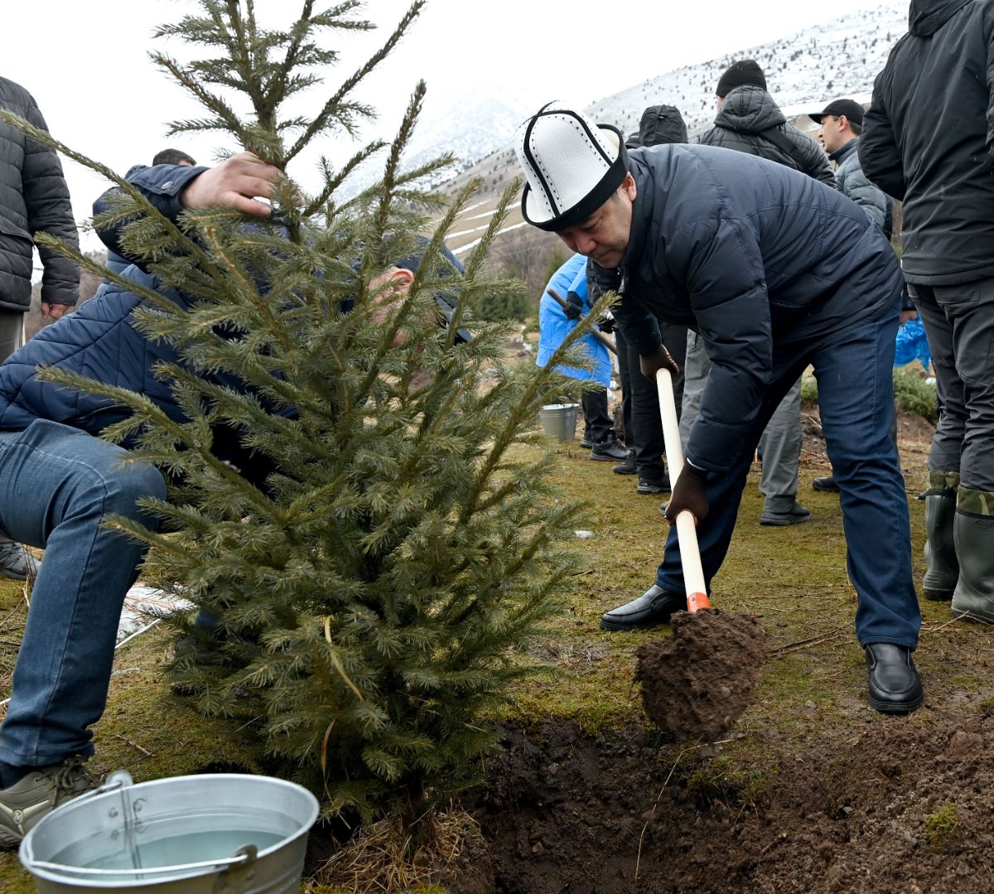
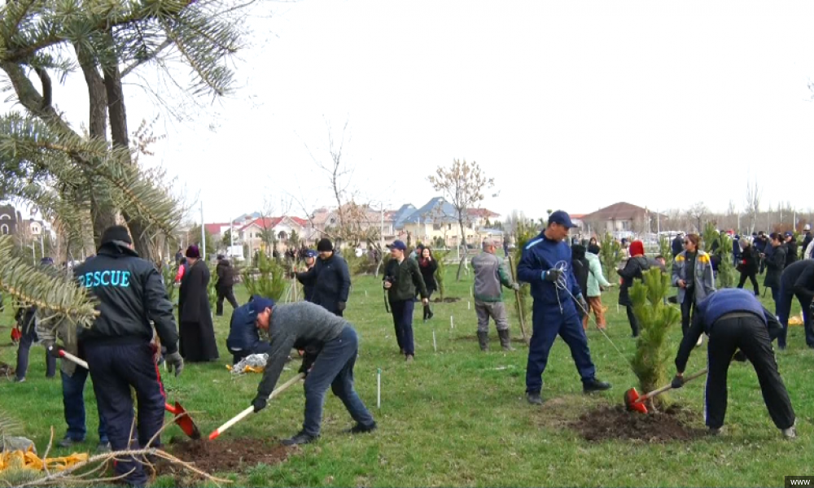
Climate change adaptation
 | 2021 | 2022 | +, - | %
Area of planted forests as envisaged by the plan, ha | 450 | 1100 | + 650 | 244.4
Actual area of planted forests, ha | 699 | 1180 | + 481 | 168.8
Number of planted seedlings, thousands | 1276.1 | 1397.1 | + 121 | 109.5

Slide 11
Agrocluster development
9 clusters
(meat, milk, eggs, sugar, grain, vegetable oil, potatoes, fruits and vegetables)
2 years
2024
(2022-23)
Full shift towards a cluster development system of the APC
Ensuring
80%
food security for the remaining 6 foods
Achieve 25% processing of agricultural products
(at present
17% processing)
Access to 50%
working capital,
30% refinancing,
Focus on priorities
Total revenues
increased by
30%

Slide 12
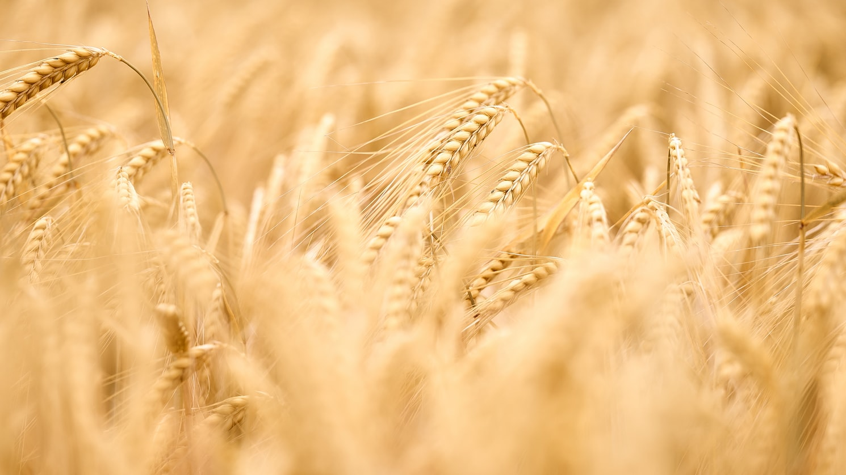
Digitalization
Jashyl Muras Internet-platform
Server-based geoinformation system (Web-GIS)
“E-Akimiat”
“Sanarip Aimak”
“Tunduk”
Thank you
for your attention!
Source: Stockholm Environment Institute, SDG Synergies Tool Manual

