Slide 1

food security of the republic of kazakhstan

Slide 2



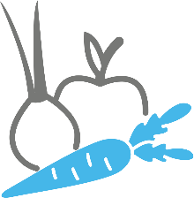

OPPORTUNITIES IN AGRIBUSINESS
200 MILLION HECTARES OF AGRICULTURAL LANDS
including 180 million hectares allocated for pastures, world ranking #2 by arable land per capita
ACCESS TO WORLD’S MAJOR MARKETS
China, Russian Federation, Middle East, and Southeast Asia
COMPREHENSIVE SUPPORT BY THE GOVERNMENT
Various incentives & subsidies, business-friendly environment, investors’ rights protection
SIGNIFICANT SOCIAL IMPACT AND SKILLED LABOR FORCE
20% of the employed population is engaged in agriculture and food production
NATIONAL PROJECT FOR THE DEVELOPMENT
of the agro-industrial complex for 2021 – 2025 has been developed
Vast opportunities across the subsectors 5 priority directions
Oilseeds
Cereals processing
Dairy
Fruits and Vegetables
Meat

Slide 3

OPPORTUNITIES IN AGRIBUSINESS
1
Increase labor productivity by 2.5 times
NATIONAL PROJECT for the development of the agro-industrial complex for 2021 – 2025
2
Provision of basic food products of domestic production
3
Increase the export of products of the agro-industrial complex by 2 times with bringing the share of processed products to 70%
4
Stable increase in the income of 1 million rural residents through the implementation of 7 large ecosystems including the production and processing of meat, fruits, vegetables, cereals, oilseeds, sugar and fish.
Source: Ministry of Agriculture of Kazakhstan

Slide 4
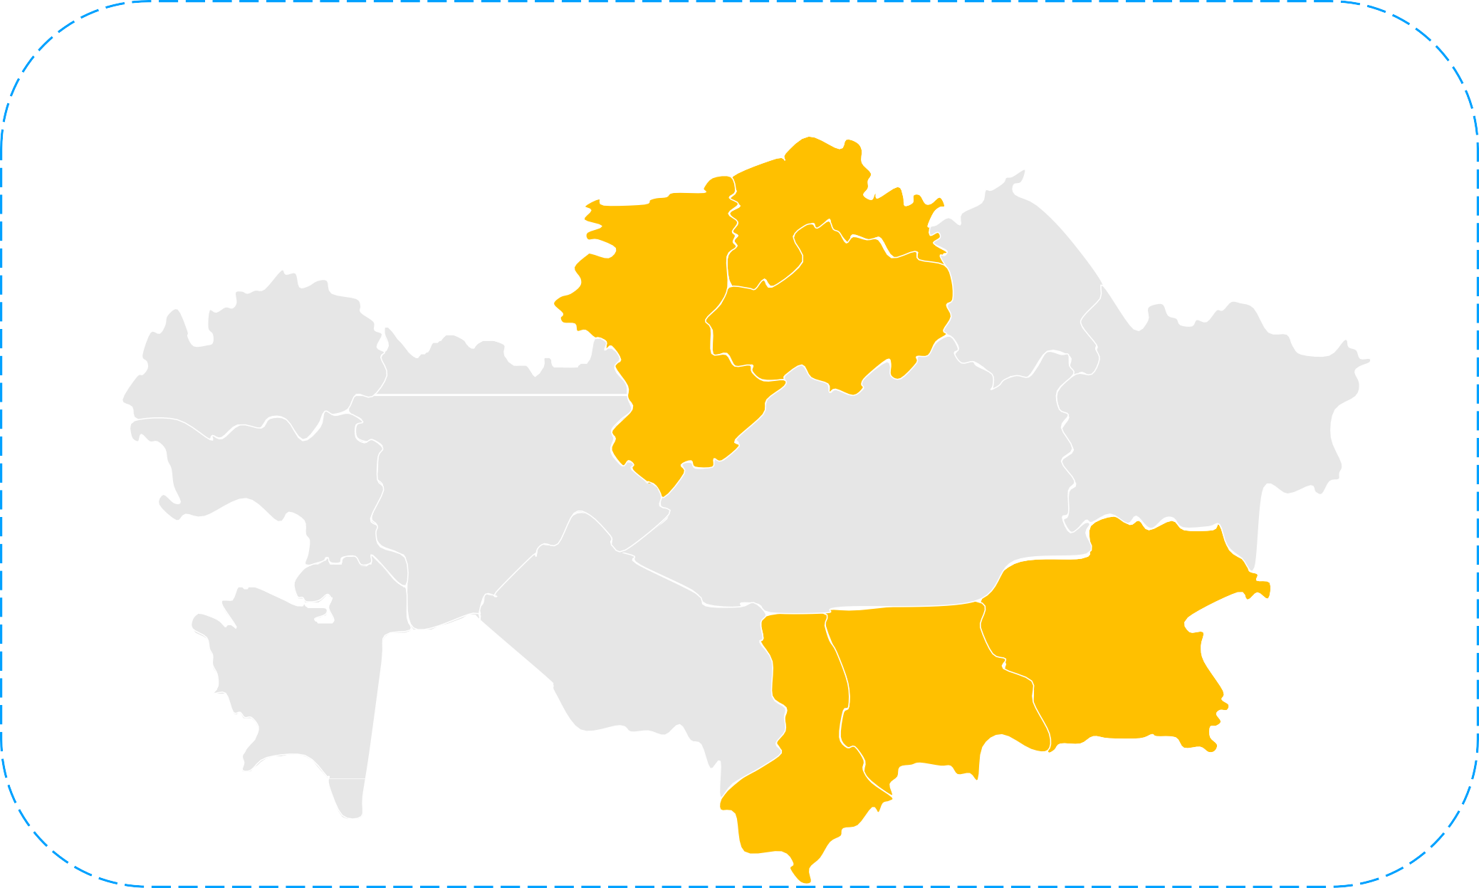











CEREALS
Location
6 regions with favorable climatic conditions for cereals processing
Overall – 16 096 thousand hectares:
9%
5%
4%
10%
wheat
12 885 thousand hectares –
wheat, barley, oat
43%
2 182 thousand hectares – 199 thousand hectares –
181 thousand hectares –
barley
oat
corn
649 thousand hectares –
other
29%
The average annual harvest
for 5 years amounted to 20 million tons​
corn
corn, rice
Grain harvest, thousand tons
wheat
11 814
Deep proccesing of grain, tons
Wheat export, thousand tons
barley
2 367
corn
1 130
rice
504
oat
182
beans
158
Gluten
Inulin
Starch
buckwheat
7604
24%
44 755
38%
14 574
4,2%
78

Slide 5
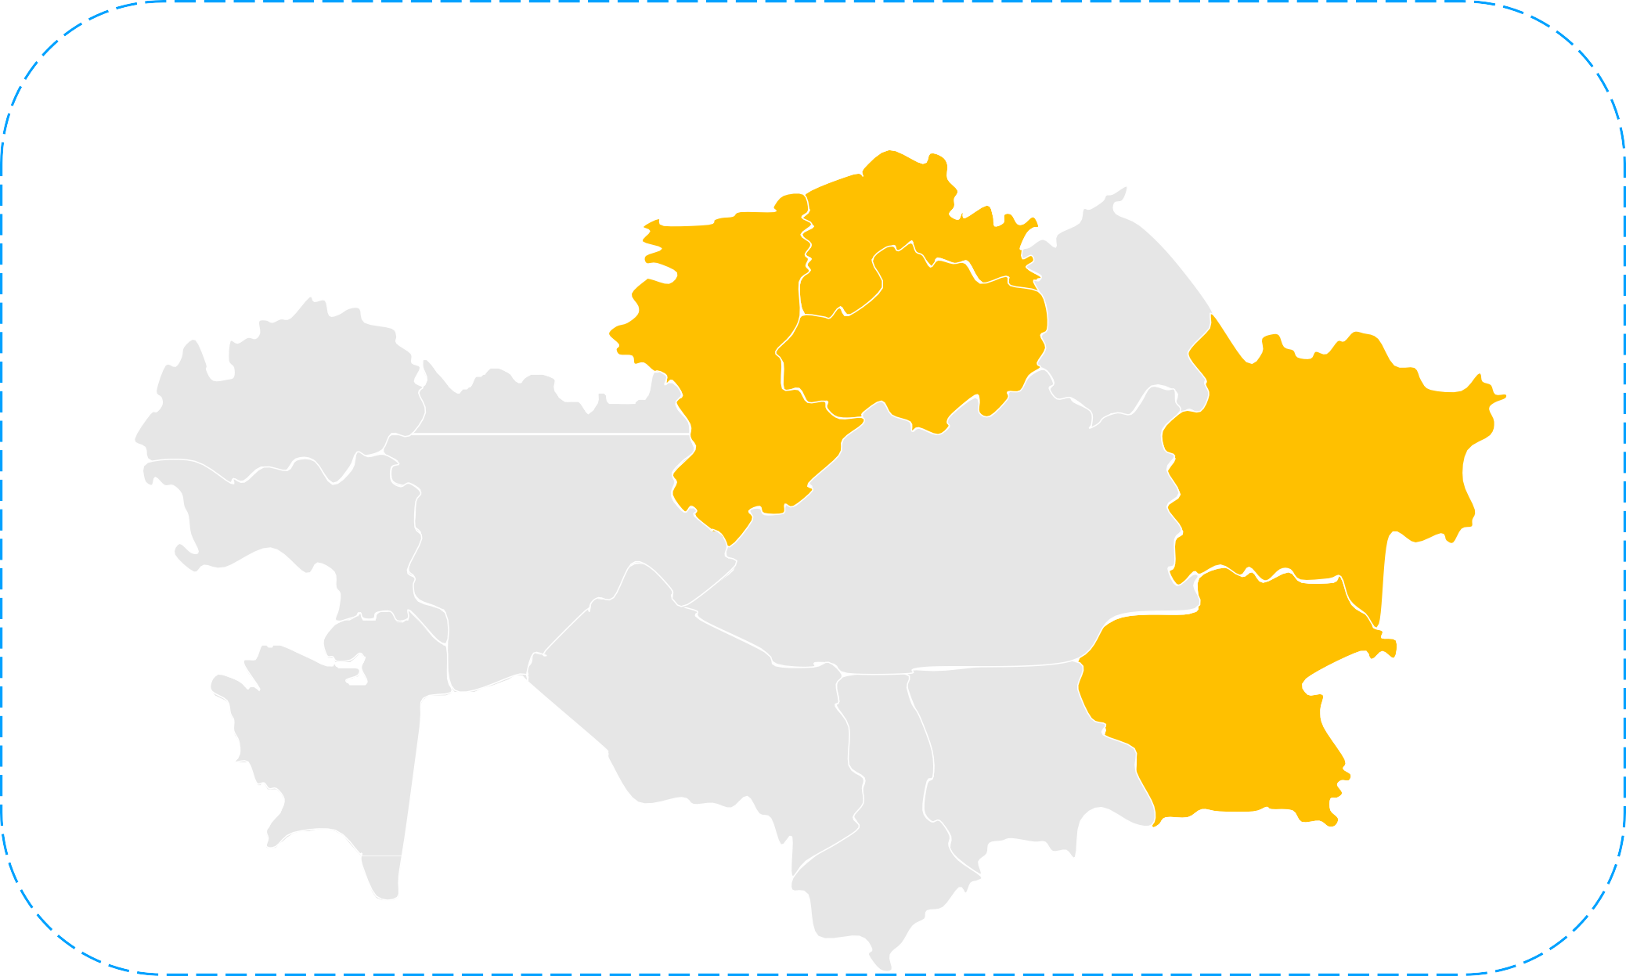
OILSEEDS
Sown area in 2021
Overall – 3 463 thousand hectares:
Location
5 regions with favorable climatic conditions for oilseed processing
flax, sunflower
9%
5%
4%
10%
1 415 thousand hectares –
flaxseed
43%
1 090 thousand hectares –142 thousand hectares –
sunflower
rapeseed
flax
flax
128 thousand hectares –
soybeans
646 thousand hectares - 38 thousand hectares –
safflower
sunflower
29%
other
safflower
Structure of oil exports in 2021
Soybean oil (1507)
Flax oil (1515)
12 512
tonnes
20 377
tonnes
Planted area for oilseeds will be increased to 5 million hectares by 2030
Flaxseed Rapeseed Safflower Soybean Sunflower
GROSS HARVEST OF OILSEEDS IN 2021
145,7
Sunflower oil (1512)
Rapeseed oil (1514)
2,4 million tons
of oilseeds were produced in Kazakhstan in 2021
237,8
1058
223,9
15
775,6
107 306
tonnes
21 467
tonnes
1031
thousand tons

Slide 6
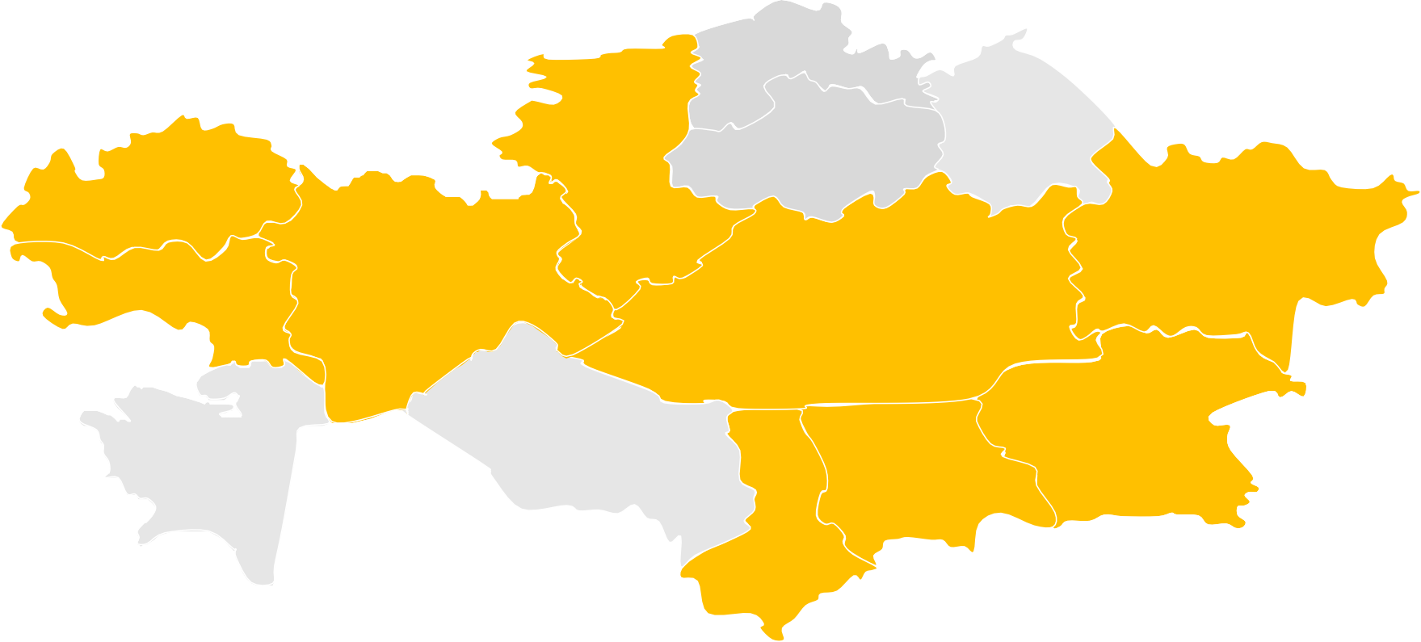







ANIMAL HUSBANDRY
Location
Animal husbandry is developed in all regions
meat production, thousand tons
540,2
151,2
155,4
272,6
Lamb balance (tons)
Poultry meat balance (tons)
Beef balance (tons)
31
1 298
174 265
282 285
553 057
175 532
426 511
24 320
540 765
168 546
Production Export Import Consumption
Production Export Import Consumption
Production Export Import Consumption
19 429
7 137

Slide 7
import substitution and export potential
 | export | import | + / -
CEREALS | 1 643 924 | 217 779 | 1 426 145
OILSEEDS | 354 318 | 69 819 | 284 499
VEGETABLES | 56 684 | 140 662 | (83 978)
meat production | 8 840 | 28 418 | (19 578)
milk production | 70 702 | 310 409 | (239 708)
FRUITS | 20 064 | 343 818 | (323 754)
 | 2 154 532 | 1 110 905 | 1 043 627
At the end of 2021, Kazakhstan is a net exporter of agro-industrial production, mainly due to the export of significant volumes of wheat and meslin, as well as flax seeds (oilseeds).
When drilling down by category such
as vegetables, meat products, dairy products products and fruits, Kazakhstan is a net importer.
The total potential for import substitution of the production of these products in the Republic
of Kazakhstan reaches 810 million dollars.
Within the framework of the National project for the development of the agro-industrial complex of the Republic of Kazakhstan for 2021-2025. investment projects are being implemented, incl. on import-dependent positions, to increase the production
of foodstuffs at a level of at least 80% (poultry meat - 100%, sausages - 100%, cheeses and cottage cheese - 100%, apples - 100%, fish - 100% and sugar - 80%).

Slide 8


GOVERNMENT SUPPORT FOR AGRIBUSINESS by Ministry of Agriculture
STATE SUPPORT FOR PROCESSING
(special regime for agriprojects by Tax Code)
SUBSIDIES FOR FARMERS
Corporate Income Tax
VAT
Discount 70%
Fertilizers
Seeds
Water
Chemistry
Harvest
Property Tax
Social tax
Agriculture machines - 25%
Storages - 25%
When exporting products, the cost of VAT is refunded at 100%
Irrigation infrastructure - 50%
Irrigation equipment - 50%
Land plots provided with infrastructure
25% Reimbursement of part of the investments
Compensation of transport costs during export

