Slide 1
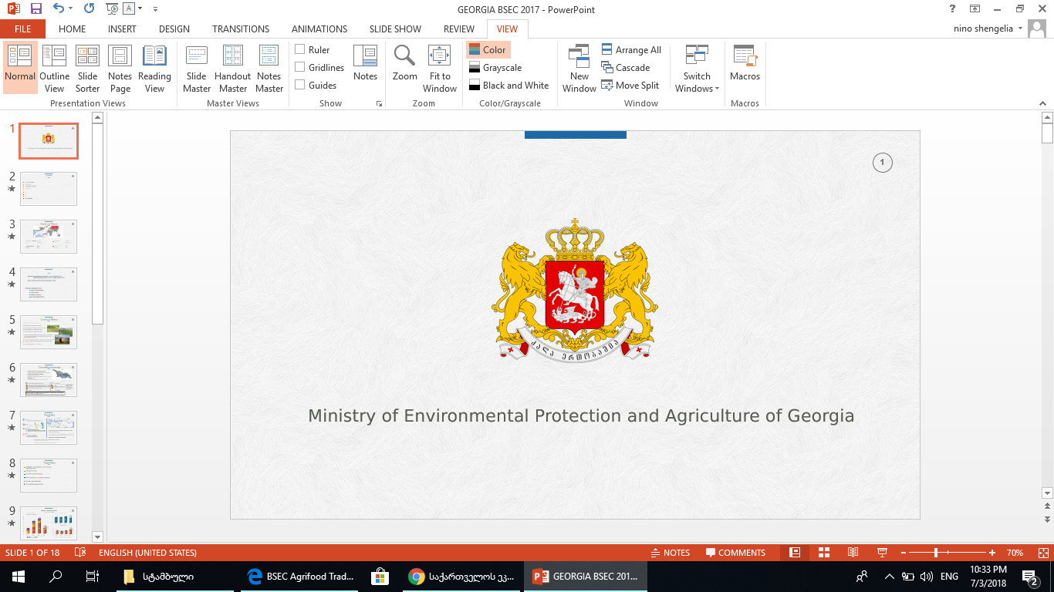

Ministry of Environmental Protection and
Agriculture of Georgia

Slide 2
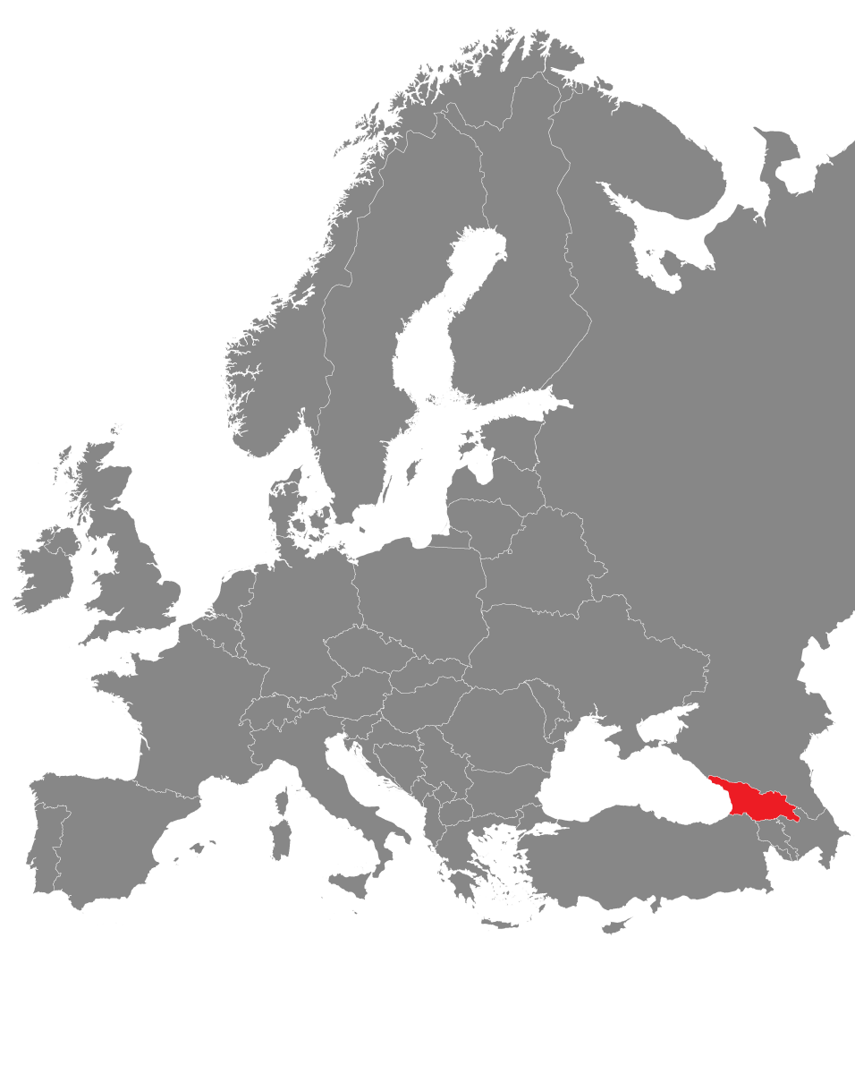
Country at Glance
Agriculture and agribusiness account for 12% of GDP (2021)
The share of plant growing and animal husbandry in the Gross Output of agricultural products is 44% and 50% (2021)
Export of agri-Food products account for 27% of export value (2021)
Import of agri-Food products account for 13% of import value (2021)
19% of the labor force is employed in the agriculture sector (2021)
Vision of the 2021-2027 Strategy of Agriculture and Rural Development of Georgia
Based on the sustainable development principles, to diversify/develop economic opportunities in rural areas, improve social condition and quality of life

Slide 3
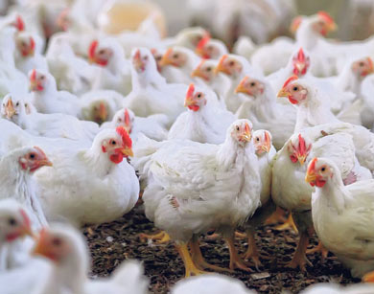
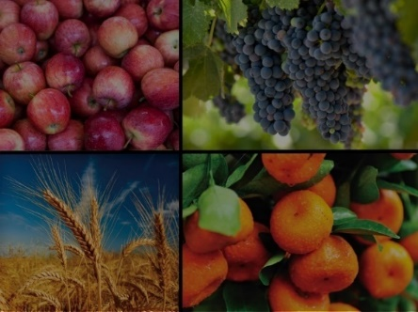

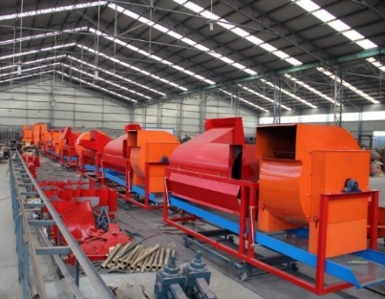
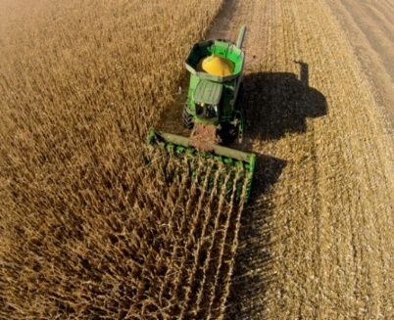

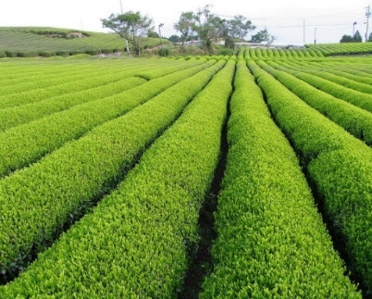
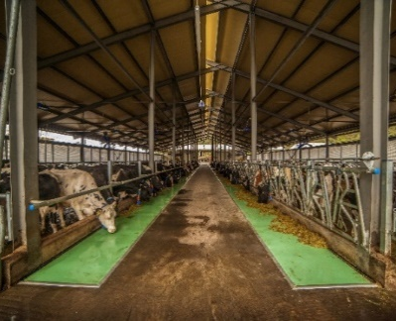
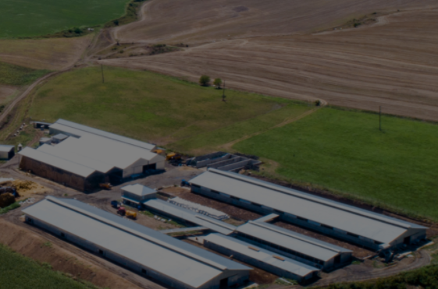
Projects
Preferential Agrocredit Project
Agroinsurance
Plant the Future
Co-financing of processing and storage enterprises
State program of co-financing agricultural mechanization
Rural development program
(UNDP)
Tea plantation rehabilitation program
State program of dairy modernization and market access (DIMMA)
Integrated development program for the pilot regions

Slide 4
Gross Output
Dynamics of Agribusiness Production (million GEL)
According to preliminary data, in 2021, the total output of agribusiness amounted 13.0 Billion GEL and exceeded the figure of 2020 by 10%.
* Preliminary data

Slide 5
Value Added
Value Added in Agricultural Sector (current prices, million GEL)
84%
According to preliminary data, in 2021, the value added of the agricultural sector and food and beverages industry at current prices amounted 6.5 Billion GEL and exceeded the figure 2020 by 7%.
* Preliminary data

Slide 6
Foreign Trade– Agri-Food Sector
Major Markets for Agri-food products (2021,%)

Slide 7
Foreign Trade– Agri-Food Sector
with CAREC members Countries
Major Markets for Agri-food products (2021,%)

Slide 8
Current Challenges – Food Security
Price growth trend for agricultural inputs -fertilizers, plant protection products, etc.
High import dependence - wheat, vegetable oil, sugar
Price growth trend in the global agricultural and food market
Supply Chain Challenges in the Global agricultural and food Market

Slide 9
Opportunities for Cooperation - Food Security
Support of value chain development in the food systems - implementation of co-financing and grant programs
Support to enhance farmers' competitiveness - extension, vocational education, introduction of standards, improving market access
Development of projects for diversification of the rural economy
Implementation of projects to improve self-sufficiency - grains, oilseeds, meat and meat products
Promotion of expansion of trade relationships in the agricultural and food sector

Slide 10

Ministry of Environmental Protection and Agriculture of Georgia
Thank You for Your Attention

