Slide 1
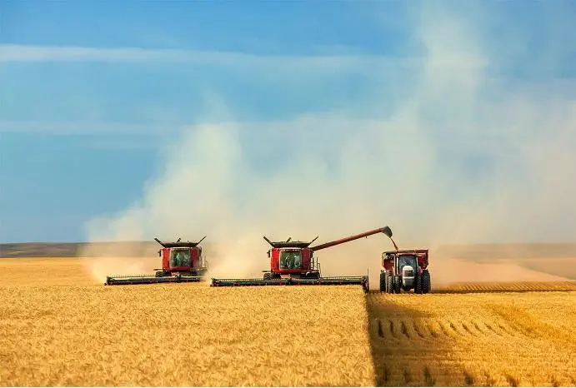
A Glance at China’s Agriculture and International Cooperation

Slide 2
China’s Agriculture and International Cooperation
2021 Production
Total food crop yield/output reach 6.8 million metric tons (MMT) in 2021
Include 3 major cereal grains
Rice: 2.31 Wheat: 1.37 Maize: 2.73

Slide 3
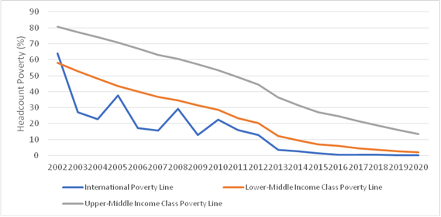
China’s Agriculture and International Cooperation
Poverty Reduction
By the end of 2021, China completely addressed its poverty issues in rural
areas, which means according to China’s absolute poverty line (U$2/day), the
corresponding population decreased from 98 million in 2012 to 0 in 2021.
China’s Poverty Incidence from 2002 to 2020
Source: World Development Indicators

Slide 4
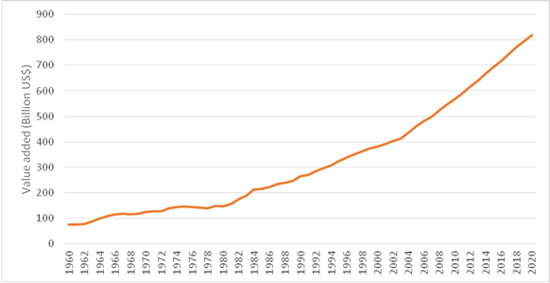
China’s Agriculture and International Cooperation
China’s Agri-food System Transformation in Past Four Decades
China’s development since late 1970s exemplifies the powerful role of the agricultural sector in a country’s social and economic transformation.
China Agriculture, Forestry, and Fishing Value Added, 1960 – 2020
Source: World Development Indicators

Slide 5
China’s Agriculture and International Cooperation
Factors Behind China’s Remarkable Agriculture Growth
Institutional reforms
Market liberalization
Technology progress (research and development, R&D)
Agriculture-related infrastructure investments
National poverty reduction programs
Subsidization replacing taxation

Slide 6
China’s Agriculture and International Cooperation
Challenge & Risk
Food Security
Rural Revitalization
Climate Change

Slide 7
China’s Agriculture and International Cooperation
International Cooperation between MARA and International Organizations
South-South Cooperation with FAO ( out of China )
Cooperation with ADB ( in China )
Loan Pipeline + KSTA
Loan Projects: Focus on Infrastructure (Farmland Enhancement), Value Chain Development, Green Agriculture (Biogas)
KSTA: Modern Agriculture, Investment, Rural Elderly Care, Green Technologies Approach In Infrastructure Development, etc.
New KSTA under Preparation ( in & out of China )
Accelerating Sustainable, Resilient and Inclusive Agriculture and Rural Transformation with Digital Technologies in the PRC and Its Implications to Developing Asia

Slide 8
China’s Agriculture and International Cooperation
Recommended Approach
Diagnose Study
Mach-Making Activities
PPP

Slide 9
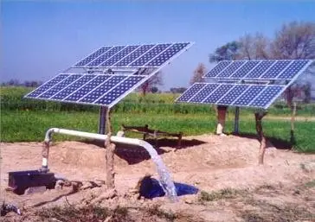
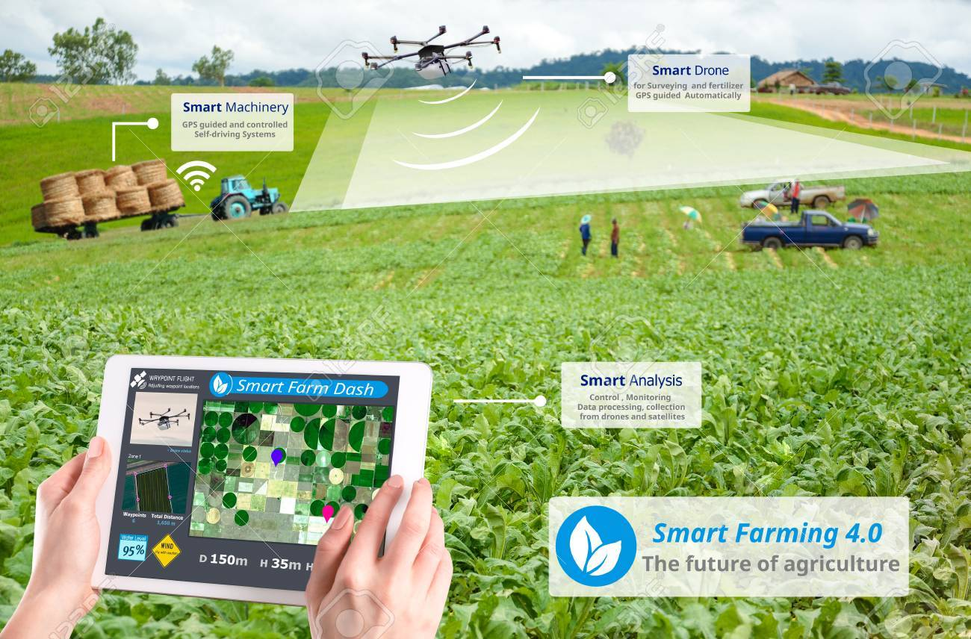
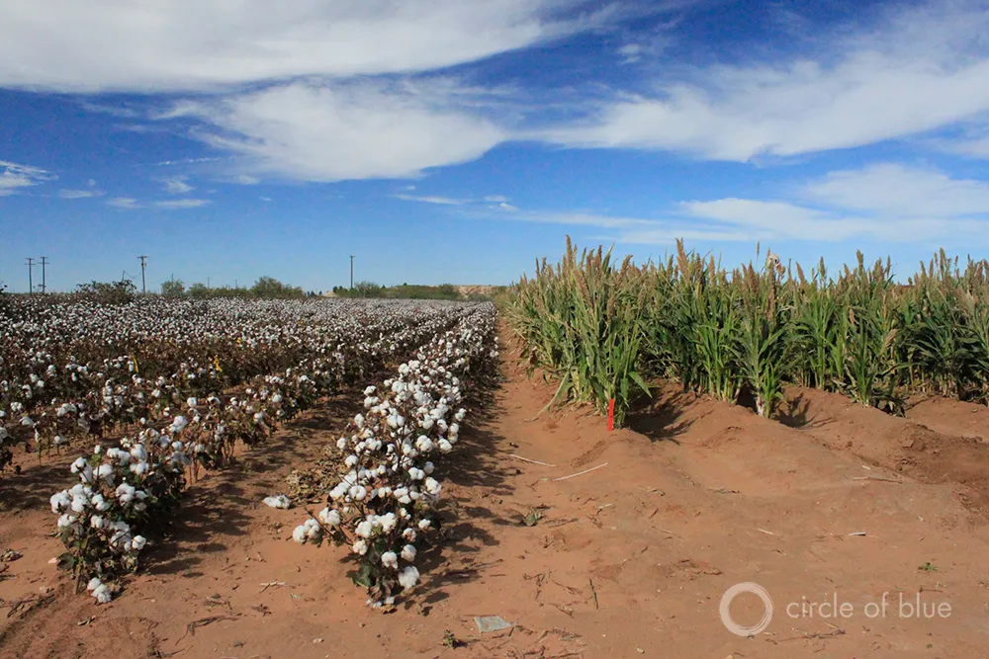
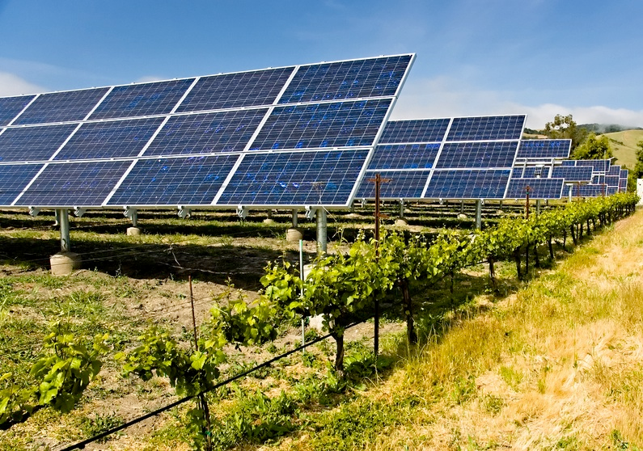
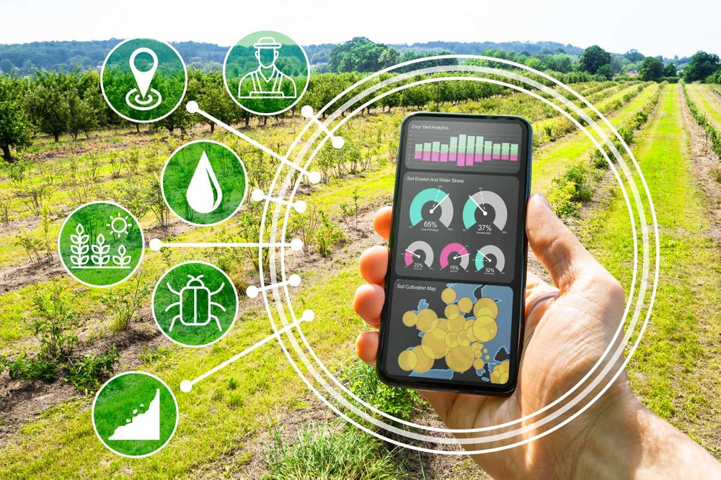
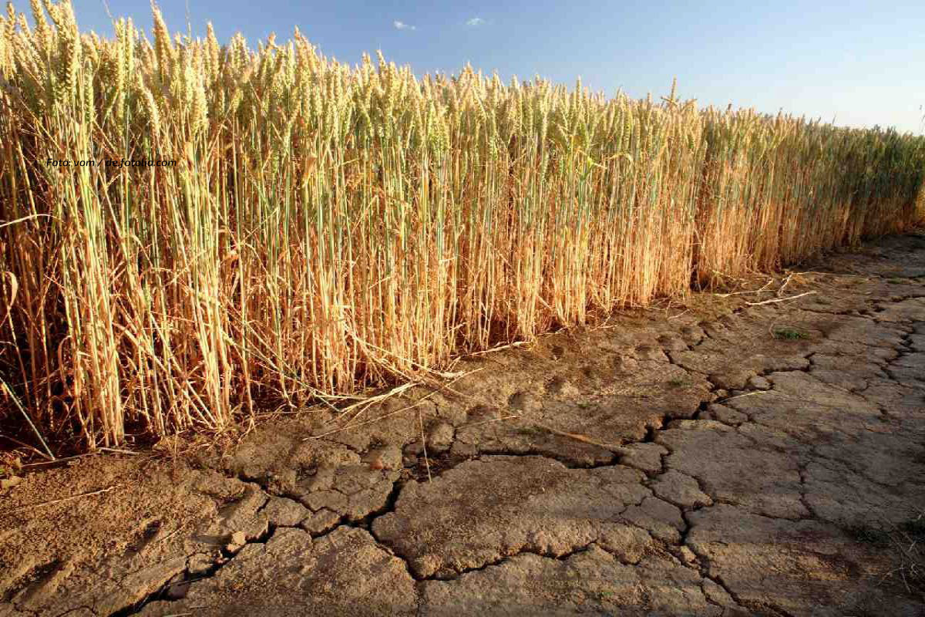
China’s Agriculture and International Cooperation
Possible areas
Green irrigation, Digital technologies, Dry-land planting technologies, etc.

Slide 10
Thanks

