Slide 1
Ministry of Agriculture
of Azerbaijan Republic
Agricultural Economics Research Center
under The Ministry of Agriculture
Agriculture of Azerbaijan
key issues of the sector
challenges in ensuring food security
development and food security strategies
opportunities for regional cooperation
Parviz Aliyev
Head of Research Department at The Agricultural Economics Research Center
under The Ministry of Agriculture of The Republic of Azerbaijan

Slide 2
General overview of the agricultural sector

Slide 3
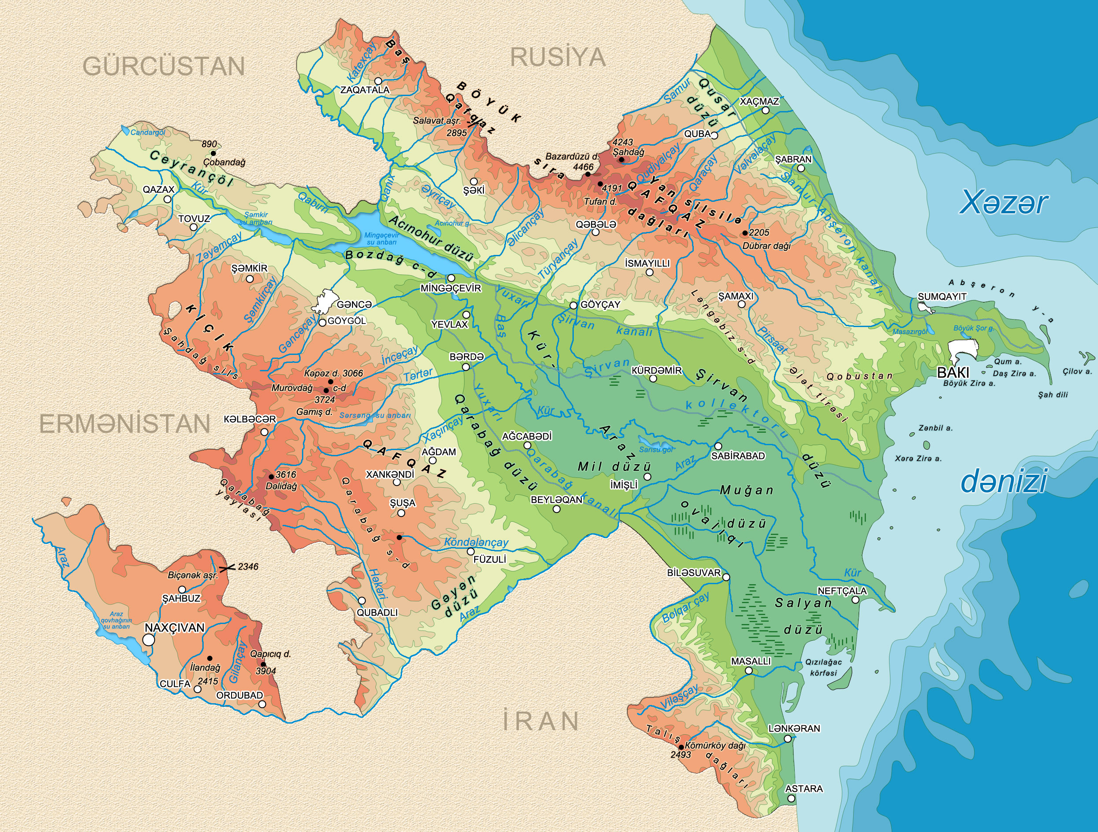
Area: 86.6 thousand km².
As of January 1, 2021,
12% of the territory covered with forests,
55.2% are agricultural lands (of which 28% hayfields and pastures).

Slide 4
UTILISED AGRICULTURAL AREA, 2021
GROSS DOMESTIC PRODUCT, 2021
Total utilized agricultural area: 4780,1 thsd ha
Total irrigated land: 1480,2 thsd ha
Total GDP for 2021: $54.6 billion
For 2020 the total Gross Agricultural Product in the country was $4958.2 million USD of which 52% fell to the share of livestock.
Source: The State Statistical Committee

Slide 5
SOWN AREA OF AGRICULTURAL CROPS, thousand hectare
1944.7 thsd. ha
1144.2 thsd. ha
1861.9 thsd. ha
For 2020, the total sown area of agricultural crops in Azerbaijan amounted to 2.0 million hectares, which is equal to 43% of total agricultural land in the country. More than half of arable land falls on hayfields and pastures, and 5.5% on perennial crops. Up to 53% of the arable land in the country is occupied by cereals and legumes, 20% by fodder crops, 13% by fruits and berries, 7% by potatoes, vegetables and melons, and the remaining 7% by industrial crops. 94% of cereals and legumes are wheat and barley, 82% of industrial crops are cotton, 63% of vegetables are tomatoes, onions and cucumbers, 71% of fruits and berries are nuts, apples, pomegranates and persimmons, and 96% of fodder crops are perennial grasses (mainly alfalfa).
Source: The State Statistical Committee

Slide 6
NUMBER OF ANIMALS, POULTRY AND BEE FAMILIES, thsd. heads
Years | Cattle | Sheep and goats | Poultry | Bee families | Pigs
2000 | 1961.4 | 5773.8 | 14711.1 | 57.0 | 19.7
2010 | 2582.4 | 8331.2 | 22041.6 | 193.2 | 5.3
2015 | 2697.5 | 8645.4 | 28851.7 | 251.2 | 6.1
2020 | 2646.6 | 8189.2 | 32230.2 | 596.7 | 5.7
2021 | 2650.7 | 8089.7 | 30175.8 | 625.3 | 5.9
2000/2021 | 135% | 140% | 2.1 | 11.0 | -3.3
MAIN ANIMAL PRODUCTION, thsd. tons
Years | Meat | Milk | Eggs, million units | Wool | Cocoon, ton | Honey
2000 | 153.6 | 1031.1 | 542.6 | 10.9 | 66.6 | 0.6
2010 | 244.9 | 1535.8 | 1178.6 | 15.6 | 6.0 | 1.9
2015 | 298.6 | 1924.5 | 1552.9 | 17.0 | 0.2 | 2.6
2020 | 346.0 | 2192.5 | 1906.2 | 16.1 | 446.6 | 6.6
2000/2020 | 2.3 | 2.1 | 3.5 | 148% | 6.7 | 11.0
Source: The State Statistical Committee

Slide 7
YIELD OF AGRICULTURAL PRODUCTS BY TYPE, ton/ha
PRODUCTIVITY OF LIVE-STOCK AND POULTRY, kg
Source: The State Statistical Committee

Slide 8
IMPORT AND EXPORT OF FOOD AND AGRICULTURAL PRODUCTS
For 2021, the total import of food and agricultural products in Azerbaijan amounted to 2.2 billion US dollars (19% share in total imports), and 1.1 billion US dollars in exports (5% share in total exports).
The most IMPORTED food and agricultural products to Azerbaijan are (2021):
Wheat and bread: 1.2 million tons, 411 million USD
Sugar and sugar products: 386 thousand tons, 369 million USD
Vegetable oils: 126 thousand tons, 172 million USD
Butter: 15 thousand tons, 79 million USD
Tobacco: 5 thousand tons, 73 million USD
Tea: 14 thousand tons, 62 million USD
Potatoes: 215 thousand tons, 56 million USD
Oil-cake and other solid residues (soy): 94 thousand tons, 55 million USD
These products account for more than half of the total value of food and agricultural imports of Azerbaijan.
The most EXPORTED food and agricultural products from Azerbaijan are (2021):
Cotton fiber and yarn: 139 thousand tons, 258 million USD
Tomatoes: 145 thousand tons, 160 million USD
Persimmon: 174 thousand tons, 126 million USD
Nuts: 18 thousand tons, 109 million USD
Potatoes: 92 thousand tons, 40 million USD
Apple: 67 thousand tons, 37 million USD
Sugar: 59 thousand tons, 32 million USD
Cherry: 19 thousand tons, 31 million USD
Pomegranate and juice: 32 thousand tons, 42 million USD
Peaches: 23 thousand tons, 29 million USD
These products make up 79% of the total value of food and agricultural exports.
Source: The State Customs Committee

Slide 9
MAIN DEVELOPMENT TRENDS IN AGRICULTURE
During 2011-2020, the real growth of agricultural production in the country was 42%. During this period, the production of agricultural crops increased by 47.1%, livestock production by 38.7% and food production by 31.1%.
Over the past 10 years, exports of agricultural and food products increased by about 23.4%, which was mainly due to an increase in exports of primary agricultural products.
During this period, the volume of imports of agricultural and food products increased by 37%.
In 2020, the share of agriculture in Azerbaijan's GDP was 6.9%, which is close to that in middle-income countries, yet agriculture takes up much of the country’s labor.
The Electronic Agricultural Information System (EKTIS) has been launched, subsystems for activities carried out by government agencies in many areas of agriculture have been established, electronic cabinets have been formed for farmers and since 2020, subsidies to farmers in the fields of crop and livestock production are provided only through EKTIS.
Comprehensive reforms have been carried out in the field of agrarian insurance, a new legal framework and a management system based on the public-private partnership mechanism have been established.
The country has created appropriate storage facilities and a production base for storing and processing food products imported on more favorable terms that can’t be produced by local farmers in the required volume and quality, as well as at affordable prices due to limited natural resources.

Slide 10
Key issues of the agricultural sector

Slide 11
KEY İSSUES of the agricultural sector are followings:
1. Technical knowledge and skills of small-scale farmers are relatively weak, coverage of the agricultural extension systems are limited across the country. People engaged in agricultural activities have poor knowledge of agro-technical norms. As a result of application of intensive production methods without following agro-technical rules, more than 1 million hectares (more than 20%) of agricultural lands are in a state of varying degrees of salinity, salinization, erosion, swamping and other forms of degradation. Next important consequence is that productivity of most agricultural crops and animals is low compared to developed countries. It should be noted that despite the fact that farmers' knowledge in this field has been increasing in recent times, there is still a need for capacity building in this field.
2. Producers of agricultural products are too fragmented. About 70% of farms across the country have up to 2 hectares of cultivated land. Also, 36% of the economically active population works in agriculture. The fact that the cultivated areas are small does not allow to use the economies of scale. At the same time, difficulties arise in farmers' access to foreign markets, provision of financial resources, as well as the application of innovative technologies.
3. Usage of traditional irrigation methods. About 50-55% of farmers suffer from water shortages in Azerbaijan, which is located in an arid zone and has limited water resources. Up to 70% of agricultural land in Azerbaijan is irrigated. The furrow method is the main irrigation method. This method leads to inefficient use of water and land degradation.

Slide 12
KEY İSSUES of the agricultural sector
continue…
4. Negative effects of climate change. Global climate changes have also affected Azerbaijan. The decrease and uneven distribution of precipitation, rising temperatures and strong winds have a negative impact on agriculture. The water level in the Kura River, which is the main source of irrigation in the country, sometimes drops so much that sea water fills the riverbed for kilometers.
5. Limited export geography of agricultural products. The main export market of agricultural and food products is the Russian Federation. Besides being a cheap market for agricultural products, this market is also unstable. In certain periods, for various economic and political reasons, Russia bans the import of certain agricultural products from Azerbaijan, as a result of which thousands of tons of products wait at the border, lose value or are destroyed altogether. The problem related to the expansion of the export geography is related to the poor knowledge of farmers in this field on the one hand, and the limited economic cooperation between countries on the other hand (membership in the European Union and the WTO).
6. Poor processing of agricultural products. The processing potential of agricultural products in the country is quite large. However, this potential is not used enough. Although many agricultural products are processed, a large amount of processed products are imported into the country. Poor processing is due to small size of farms as well as poor access to financial resources.

Slide 13
KEY İSSUES of the agricultural sector
continue…
7. Weakness of storage network. The warehouse (including cold storage) network for storing agricultural products does not allow the formation of the necessary amount of reserves. The weakness of the storage network leads to some fruit and vegetable products being offered to the market at a lower prices or to be thrown away in several cases during the season. The limited storage network has also led to high storage costs.
8. Price volatility. Farmers determine what to plant next year based on this year's prices. This leads to the fact that the products sold at a high price one year become too cheap the next year, and farmers face losses because of this. This happened in different years with apple, watermelon, garlic, onion, potato and other crops. Farmers sell products either on the basis of a verbal agreement or without any agreement at all. As a result, there is a lack of knowledge about the market, which does not allow farmers to plan for the next years and implement a considered investment policy.

Slide 14
Food security

Slide 15
KEY TRENDS
For 2021, Azerbaijan ranks 56th on Global Food Security Index¹ with 62.6 overall score, while the first three places belong to Ireland, Austria and United Kingdom, respectively.
For 2019, the Prevalence of undernourishment in Azerbaijan was about 2.5%², which is quite low.
Azerbaijan’s food system combines traditional and modern dynamics, with the former being dominant over the latter. As a result, Azerbaijan has an ‘informal and expanding’ type of food system³.
More inclusive economic growth, particularly in the last ten years, may have led to steeper declines in food insecurity. According to World Bank data, the level of prevalence of undernourishment in the country remains stable at 2.5% for the last 14 years which was 17.1% in 2001.
The share of per capita monthly consumption expenditures for food is 43% in the country. It should be noted that this figure is gradually declining. Thus, the share of food products in monthly consumption expenditures has decreased by 25 percentage points over the past 20 years⁴.
Modern trends in food production and distribution are rapidly gaining momentum, as evidenced by an increase in the market share of supermarkets, an intensification of agriculture and food production with improved varieties, and an increase in agricultural exports that meet stringent private and public quality standards in global value chains.
¹ https://impact.economist.com/sustainability/project/food-security-index/Index
² https://data.worldbank.org/indicator/SN.ITK.DEFC.ZS?locations=AZ
³ https://foodsystemsdashboard.org/compareandanalyze
⁴ https://www.stat.gov.az/source/budget_households/

Slide 16
LEVEL OF SELF-SUFFICIENCY, %
Agricultural products
Processed food products
 | 2010 | 2015 | 2020
Crops
Total of grains (excluding paddy) | 56.5 | 64.5 | 68.1
wheat | 48.9 | 54.8 | 57.1
barley | 87.7 | 95.1 | 94.6
maize | 64.5 | 54.1 | 86.6
porridge | 80.6 | 93.1 | 86.6
other grains | 1.0 | 6.3 | 93.9
Leguminous | 65.8 | 69.3 | 60.3
Potato | 100.5 | 89.1 | 90.6
Vegetables of all kinds | 97.6 | 103.4 | 110.4
Tomato | 106.0 | 113.7 | 131.0
Market garden crops | 100.0 | 100.0 | 100.8
Fruit and barries | 107.9 | 113.7 | 116.3
Walnut and hazelnut | 121.6 | 132.5 | 138.0
Pomegranate | … | 103.7 | 112.0
Grape | 90.4 | 93.1 | 95.8
Livestock
All types of meat and meat products | 87.7 | 94.7 | 84.5
beef and beef products | 95.5 | 91.8 | 87.4
mutton and goats meat and meat products | 99.7 | 99.3 | 97.3
pork and pork products | 19.7 | 17.8 | 4.7
poultry meat and meat products | 70.6 | 98.6 | 79.0
Milk and dairy products | 70.4 | 84.3 | 83.5
Egg | 97.9 | 99.7 | 100.0
Fish and fish products | 76.6 | 77.6 | 81.7
 | 2010 | 2015 | 2018
Brown rice | 13.0 | 9.6 | 19.4
Groats of all kinds | 11.3 | 17.9 | 26.2
Fresh bread without syrups, egg, cheese | 99.9 | 99.9 | 99.9
Pies, sweets and other bakery products | 70.6 | 66.6 | 78.0
Cracker, cookies and confectionery | 21.2 | 33.8 | 23.3
Sugary-floury confectioneries | 22.8 | 17.8 | 25.6
Macaroni products | 72.7 | 53.2 | 28.7
Vegetable oils | 74.3 | 60.5 | 34.3
Margarine | 108.2 | 292.2 | 98.8
Juices of fruits and vegetables | 140.3 | 114.1 | 117.9
Canned fruits and vegetables | 91.8 | 87.6 | 90.4
Milk and cream of 1-6 percent fat content | 98.4 | 99.0 | 99.1
Butter | 50.0 | 69.2 | 71.3
Cheese of all kinds | 85.7 | 84.2 | 87.9
Kefir, milk, yoghurt and other products | 93.7 | 94.1 | 94.7
Sugar | 155.6 | 192.9 | 81.7
Tea | 63.2 | 40.2 | 44.6
Salt | 26.4 | 76.9 | 103.1
Unsweetened mineral and aerated waters | 89.3 | 95.4 | 96.6
Sweetened mineral and aerated waters | 90.8 | 86.1 | 77.8
The level of self-sufficiency in most basic food products has improved thanks to the strengthening of local production capacity.
Source: The State Statistical Committee

Slide 17
KEY TRENDS
Continue…
The current level of consumption of potatoes, vegetables, melons, fruits and berries exceeds the standard level adopted in the country. The level of sugar consumption in the country is also above the norm.
Consumption for only two products is below the norm. The first is fish and fish products, where the difference from the norm is very small. Another product is butter.
Consumption of butter in the country is half the norm. In return, the consumption of vegetable oils is at the level of 164% of the norm. It seems that the population compensates for the demand for butter with vegetable oils.
However, milk production, which is the main raw material for butter in the country, has a growing trend. It should be noted that the country's milk production for 2020 amounted to 2.2 million tons, which is 2.1 times more than in 2000.
Furthermore, the government of Azerbaijan is taking concrete measures to improve the breed composition of animals in the country to increase their meat and milk production. These include the import of high-yielding breeds (Holstein-Friesian, Simmental, Swiss, etc.) and their leasing to farmers at a 60% discount, the establishment of an artificial insemination system in the country and a subsidy of 100 manats per farmer for each healthy calf born by artificial insemination.
A new mechanism of state support for the agricultural sector has been introduced in Azerbaijan since 2020. The main purpose of the new mechanism is to ensure the efficient use of agricultural lands of the country, increase the competitiveness of farmers and expand the production of crops that have a high market potential and meet the natural and geographical characteristics of the country's regions.
The new mechanism also takes into account the issue of encouraging farmers to unite in cooperatives. Thus, the subsidy paid to a farmer who is a member of the cooperative is increased by 10%.

Slide 18
Wheat Sector

Slide 19
Sown area of winter and spring wheat, ha
In 2021, 1.9 million tons of wheat were harvested from 572.3 thousand hectares in the country.
The average yield of wheat in the country for 2021 is 3.3 tons / hectare.
During 2020-2021, the country's wheat yield increased by an average of 1.4% annually.

Slide 20
WHEAT RESOURCES AND UTILIZATION, ton
 | 2021
RESOURCES
Stocks at the beginning of year | 567 392
Production | 1 837 188
Import | 1 148 101
Total of resources | 3 552 681
UTILIZATION
For seed | 132 703
For fodder for cattle and poultries | 513 497
For production of foodstuffs | 2 412 909
including:
for production of flour and groats | 2 355 739
for production of spirit | 3 602
for production of beer | 33
for production of other kinds of food products | 53 535
Consumed as food products (without processing) | 67 398
For production of non-food products | 148 507
Export | -
Losses | 58 619
Stocks at the end of year | 219 048
Total of utilization | 3 552 681
By 2021, local wheat production accounted for 45% of the country's total wheat reserves.
The country has 6.6 kg of wheat per capita.
The country's self-sufficiency in wheat is 61.5%.

Slide 21
WHEAT IMPORT

Slide 22
STATE SUPPORT FOR WHEAT SECTOR
In order to improve self-sufficiency with wheat, which is of great importance for ensuring food security in the country, a number of measures are implemented by the state, and state support is provided for wheat production, import, processing and supply.
In particular, 51.1 million USD subsidies were paid to 62.4 thousand farmers growing wheat on 471.3 thousand hectares. This means an average subsidy of 185 manat per hectare of wheat. Wheat subsidy for 2021 is 24.3% of the total subsidy amount.
During 2021, the subsidy given to each hectare of wheat crops was equal to approximately 35-40% of the cost of wheat cultivation. In addition, irrigation water is offered to wheat producers at subsidized prices.
Along with farmers, flour producers also benefited from government subsidies during the past year. Thus, in the months of February-September 2021, people engaged in the production of flour were given a subsidy of 35 manats for each ton of flour sold.

Slide 23
STATE SUPPORT FOR WHEAT
continue…
Also, wheat producers are exempt from all taxes except land tax, like other agricultural producers. Import and sale of wheat, production and sale of wheat flour and bread in the country are exempted from VAT from January 1, 2017 to January 1, 2024. In addition, an export duty of $200 per ton of flour and wheat is imposed. Starting from 2020, preferential loans are given to suppliers in order to bring the wheat stocks to the required level in the country.
On July 19, 2022, the "Decree of the President of the Republic of Azerbaijan on a number of measures to increase the level of self-sufficiency with food wheat" was signed in the country. According to this decree, a crop subsidy will be applied to food wheat produced by persons who have undertaken to produce food wheat in farms where modern irrigation systems are applied and delivered to the State Reserves Agency of the Republic of Azerbaijan and flour mills for a period of 5 years starting from 2023. It should be noted that the purchasing price of one ton of food wheat from these farmers was set at 580 manats (341 USD).

Slide 24
STATE SUPPORT FOR WHEAT
continue…
The promotion of grain-growing, including wheat production, in the official government policy in Azerbaijan is reflected in various normative legal acts, official initiatives and various mechanisms reflected in state programs and government strategies. The activity of the grain-growing sector in Azerbaijan is regulated by various normative legal acts. The Law on Grain has been adopted in 2000. This document defines the legal relations in the field of grain production, grain supply, organization of the grain market, quality management of grain and grain products, to create a State Grain Fund among the main tasks.
The Fund, which is at the disposal of the Ministry of Emergency Situations, annually supplies grain to the Fund's warehouses in the amount determined by the Cabinet of Ministers. The supply of grain to the State Grain Fund was set at 750 thousand tons.

Slide 25
Development and Food Security Strategies

Slide 26
NATIONAL PATHWAY TO SUSTAINABLE FOOD SYSTEMS BY 2030
Future plans regarding national food systems in the following decade include:
achieve a future in which healthy and organic food is available, affordable and accessible to a growing population;
guarantee the livelihoods of people in agriculture and the food chain;
contribute to the sustainability of the environment.
To meet the expectations and transform the national food system, Azerbaijan will focus on six key priority areas:
Ensuring fully digitalization of agri-food system and promoting advanced technologies
Strengthening food safety and promoting healthy diets
Strengthening the fight against climate change and disasters through sustainable use of natural resources
Fostering food processing small and medium businesses and supporting cooperation activities among small-scale farmers
Improving quality of education and research, strengthening collaboration between science and policy making
Developing food system in liberated territories and integrating into national food system

Slide 27
AZERBAIJAN 2030: NATIONAL PRIORITIES FOR SOCIO-ECONOMIC DEVELOPMENT
23 July, 2022
The following five National Priorities for the socio-economic development of the country should be realized in the next decade:
sustainable growing competitive economy;
a society based on dynamic, inclusive and social justice;
competitive human capital and application of innovations;
a large return to the territories freed from occupation;
clean environment and "green growth" country.

Slide 28
Opportunities for Regional Cooperation

Slide 29
THE FOLLOWING COOPERATION OPPORTUNITIES COULD BE PRESENTED
Establishing a regional hub for international trade of food and agricultural products.
Conclusion of bilateral and multilateral agreements on the production and trade of individual agricultural products (like agreement concluded between Turkey, Azerbaijan and Georgia on hazelnuts)
Implementation of exchange of knowledge and experience on production, processing and sale of agricultural and food products between countries
Organization of regional agricultural product auctions

Slide 30
Thank you for your attention
Questions?

