Slide 1
ACCESS TO CHINA — COLLABORATION AND OPERATION
Henry HUANG(黄宁宁)
Partner
Grandall Law Firm (Shanghai)
2023.09

Slide 2
Contents
INTRO - A GLANCE AT THE GENERAL PICTURE
General picture of foreign investment and overseas NGOs in China
Investment relations and collaboration with Central Asian countries
FOREIGN INVESTMENT IN CHINA
Legal system for foreign investment in China
Key policies for business entry and operation by foreign investment in China
Procedures for incorporation and operation by foreign investment in China
OVERSEAS NGOS IN CHINA
Legal system for overseas NGOs in China
Regulations of establishment and operation by overseas NGOs in China
|01
|02
|03

Slide 3
|01
INTRO – A GLANCE AT THE GENERAL PICTURE

Slide 4
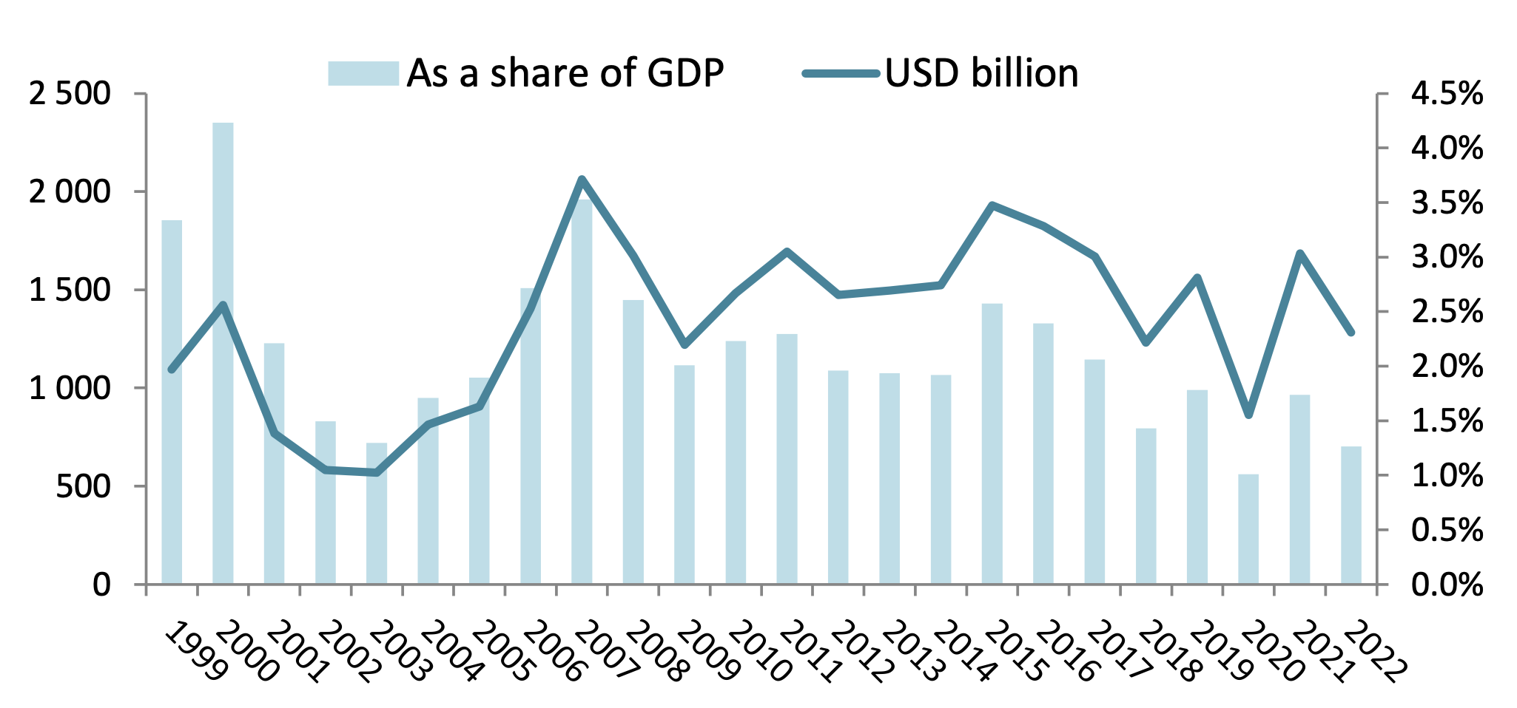
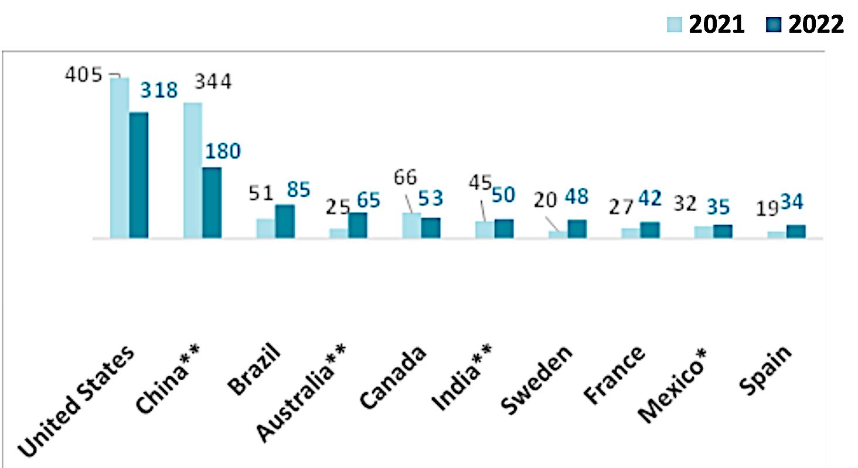
1.1 General picture of foreign investment and overseas NGOs in China
FOREIGN INVESTMENT
Global FDI flows (1999-2022)
Affected by the factors such as the intensification of anti-globalization and trade protectionism, the impact of COVID-19 and the geopolitical conflicts, the transnational investment throughout the world has fluctuated greatly over recent years. As shown in the right figure, global FDI flows dropped by 24% to USD 1286 billion.
However, the foreign capital actually utilized by China has maintained a sustained and stable growth, and especially in the context of a large-scale decline in transnational investment around the world, the foreign capital actually utilized by China still achieved a positive growth.
Top 10 Major FDI Recipients in 2022
Source: OECD International Direct Investment Statistics database

Slide 5
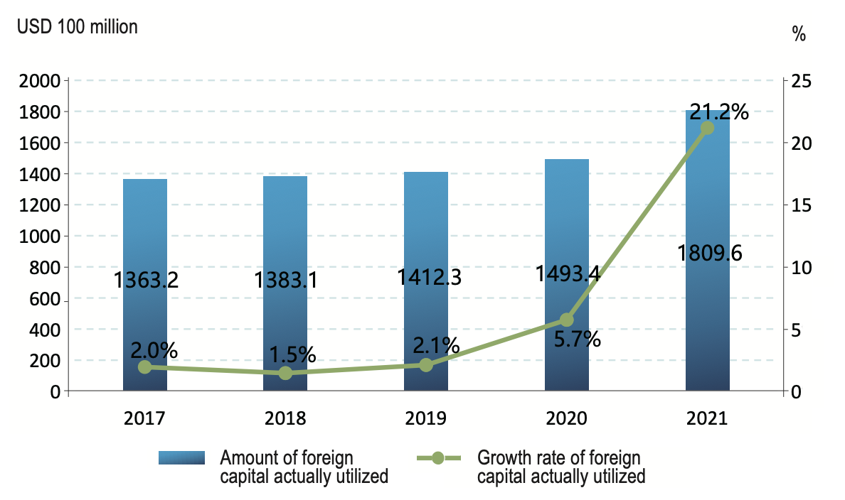
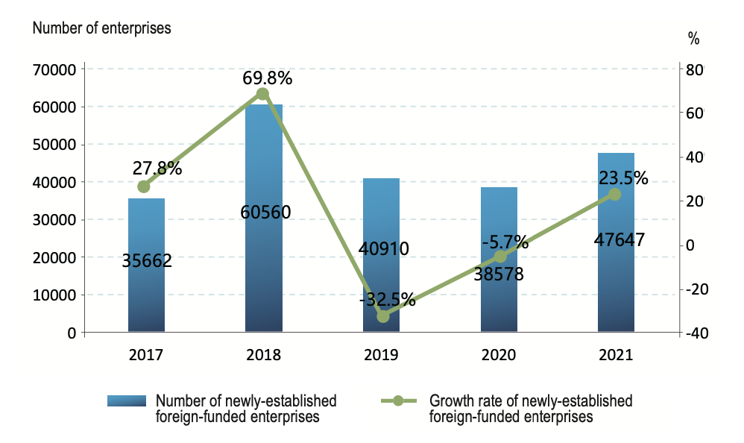
1.1 General picture of foreign investment and overseas NGOs in China
FOREIGN INVESTMENT
According to the latest Report on Foreign Investment in China 2022 issued by the Ministry of Commerce at the beginning of this year, in 2021, the foreign capital actually utilized in China reached a record high of USD 180.96 billion, with a growth rate of 21.2%. 48,000 foreign-funded enterprises were newly established, a year-on-year increase of 23.5%, which indicates a “double growth” in the scale of investment absorbed and the number of enterprises established. The foreign capital actually utilized by China accounted for 11.4% of global transnational investment, up from 8.3% in 2017.
Details of Foreign Capital Actually Utilized by China during 2017-2021
Number of Newly-Established Foreign-Funded Enterprises in China during 2017-2021
Source: Foreign investment statistics of the Ministry of Commerce.
Source: Foreign investment statistics of the Ministry of Commerce.

Slide 6
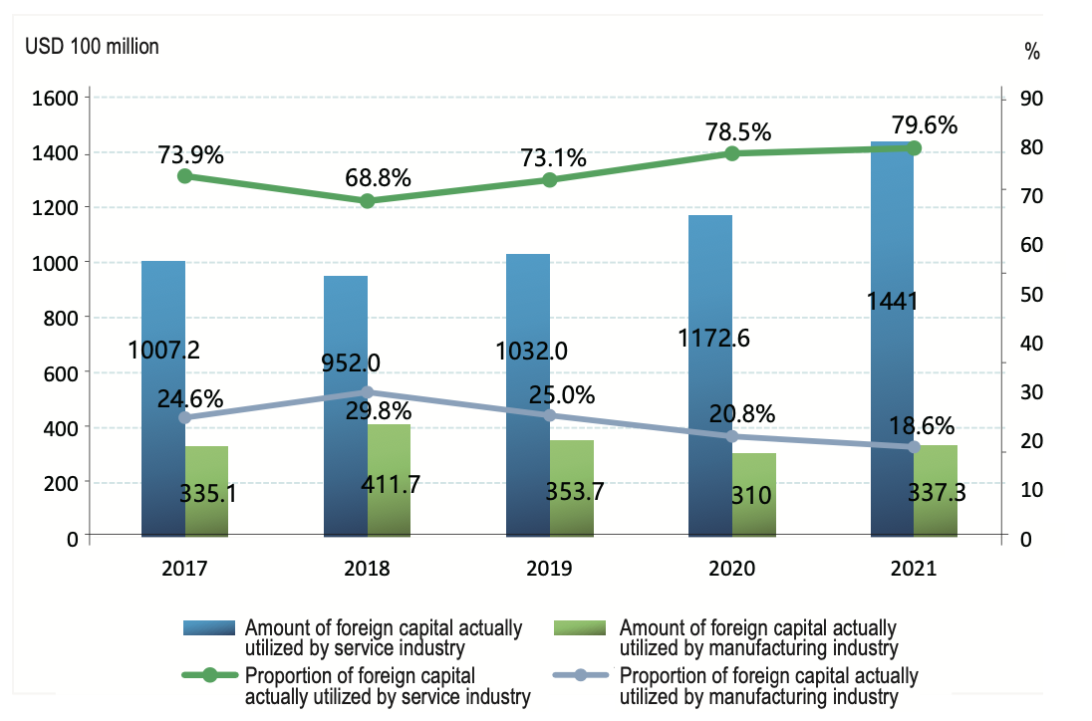
1.1 General picture of foreign investment and overseas NGOs in China
FOREIGN INVESTMENT
Over recent years, affected by the factors such as China's industrial structure upgrade and the accelerated development of manufacturing services, the foreign investment in China has mainly flowed to the service industry.
From 2017 to 2021, the amount of foreign capital actually utilized by service industry increased rapidly at an average annual growth rate of 8.4%, with its proportion in total foreign capital actually utilized by China increased from 73.9% in 2017 to 79.6% in 2021.
The scale of foreign capital actually utilized by manufacturing industry remained relatively stable. Affected by the outbreak of COVID-19, the foreign capital actually utilized by manufacturing industry decreased to USD 31 billion in 2020. With the effective prevention and control of COVID-19 in China, the foreign capital actually utilized by manufacturing industry in China reached USD 33.73 billion in 2021, a year-on-year increase of 8.8%. However, the proportion of foreign capital actually utilized by manufacturing industry in the total foreign capital actually utilized by all industries decreased from 24.6% in 2017 to 18.6% in 2021, showing a downward trend.
Details of Foreign Capital Actually Utilized by Service Industry and Manufacturing Industry during 2017-2021
Source: Foreign investment statistics of the Ministry of Commerce.

Slide 7
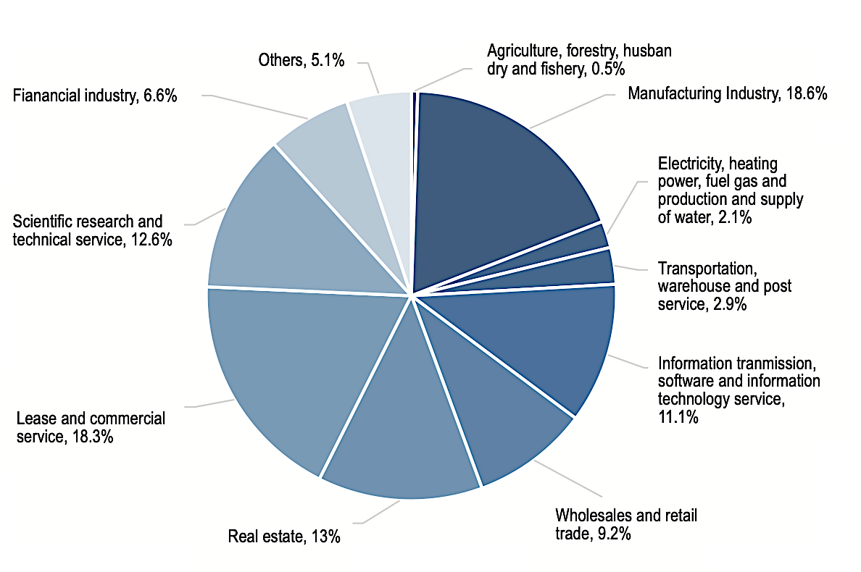
1.1 General picture of foreign investment and overseas NGOs in China
FOREIGN INVESTMENT
In 2021, the (1) leasing and business service industry, (2) real estate industry, (3) scientific research and technical service industry, (4)information transmission, software and information technology service industry and (5) wholesale and retail industry are the five industries with the largest scale of foreign capital utilized in the service industries, respectively accounting for 18.3%, 13%, 12.6%, 11.1% and 9.2% of total foreign capital utilized by service industries, and aggregately accounting for 64.2% of total foreign capital utilized by China.
Among them, the foreign capital actually utilized by wholesale and retail industry increased by 41.1% year-on- year, while the foreign capital actually utilized by leasing and business service industry and information transmission, software and information technology service industry increased by 24.6% and 22.3% respectively, both exceeding the average growth rate of 21.2% of all service industries.
Proportion of Foreign Investment Absorbed by Industries in 2021
Source: Foreign investment statistics of the Ministry of Commerce.

Slide 8
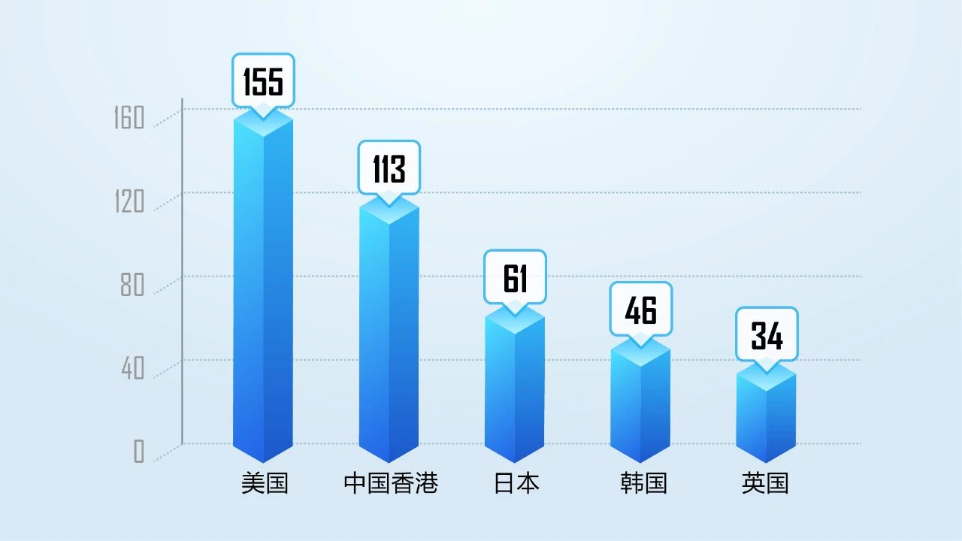
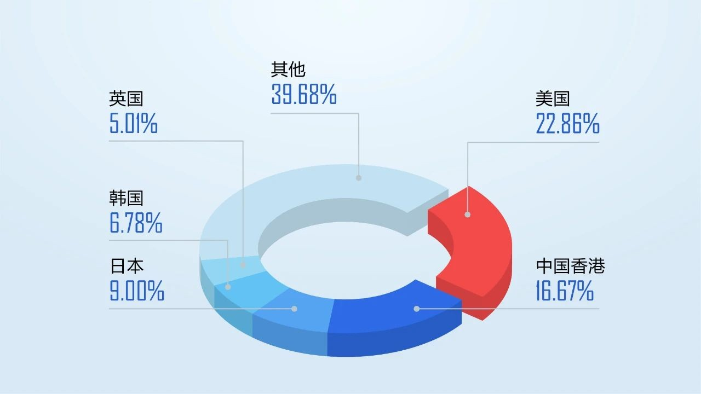
1.1 General picture of foreign investment and overseas NGOs in China
OVERSEAS NGOS
According to the statistical data published on the official Service Platform for Overseas NGOs, as of December 31, 2022, 678 representative offices of foreign NGOs have been registered in accordance with the law. Among the 678 registered representative organizations, the top 5 countries or regions of the registered representative offices are the United States, Hong Kong, Japan, Korea and the United Kingdom, accounting for 60.32% in total.
Others
United Kingdom
United States
Korea
Japan
Hong Kong
United States
Hong Kong
Japan
Korea
United Kingdom
Source: http://www.bscongo.org.cn/hangyezixun/295.html

Slide 9
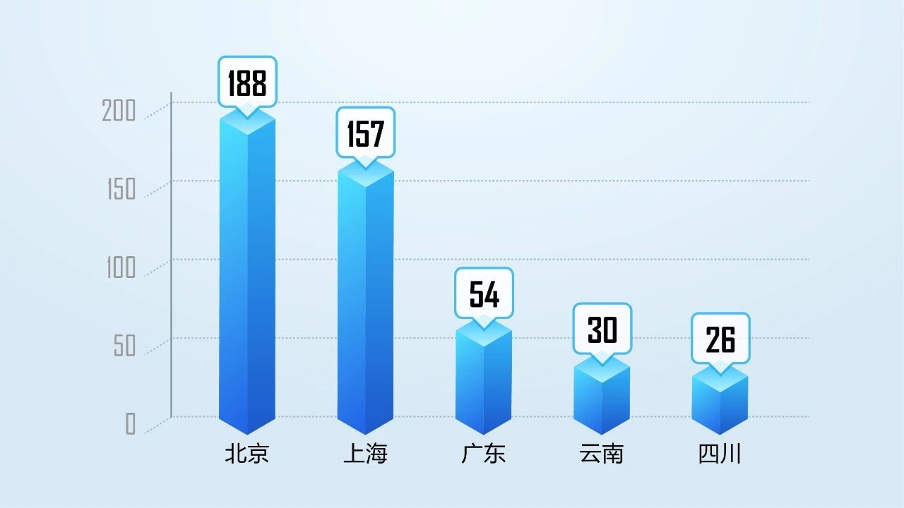
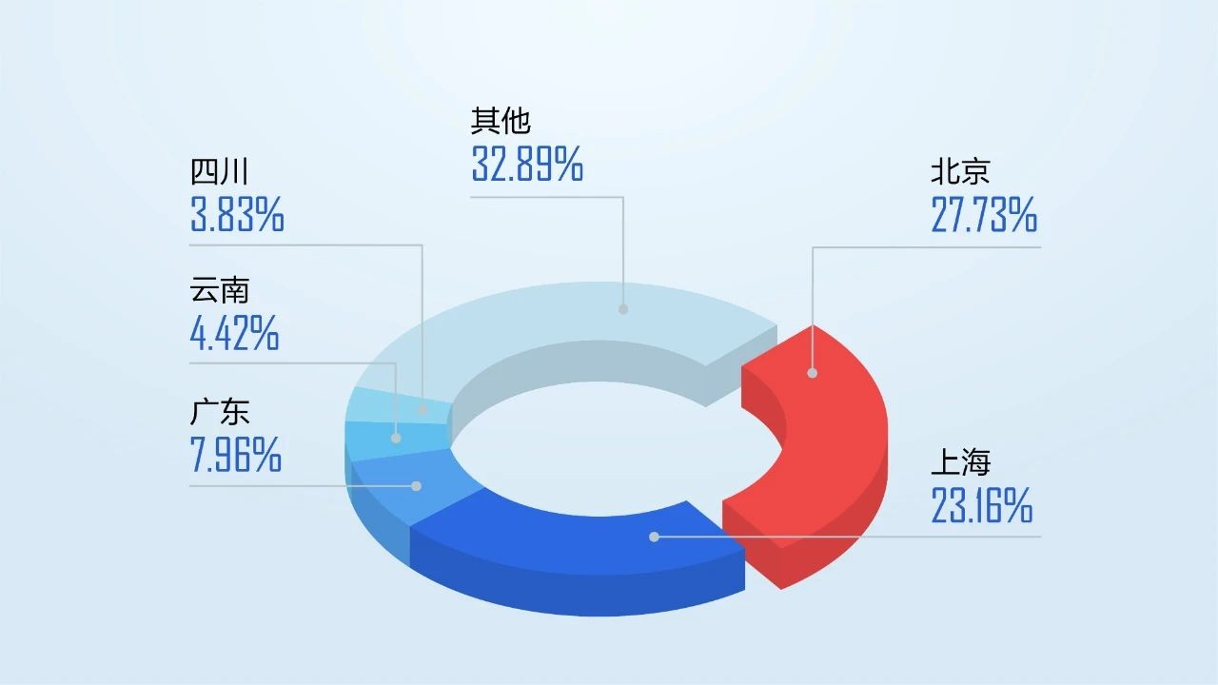
1.1 General picture of foreign investment and overseas NGOs in China
OVERSEAS NGOS
In terms of space, it has formed a regional layout with Beijing as the center and sub centers spreading over major provinces and cities in Northeast, East, South, central and southwest China. Among the 678 registered representative offices, 345 were registered in Beijing and Shanghai, accounting for 50.88% of the total number of representative offices, followed by Guangdong, Yunnan and Sichuan.
Others
Sichuan
Beijing
Yunnan
Guangdong
Shanghai
Beijing
Shanghai
Guangdong
Yunnan
Sichuan
Source: http://www.bscongo.org.cn/hangyezixun/295.html

Slide 10
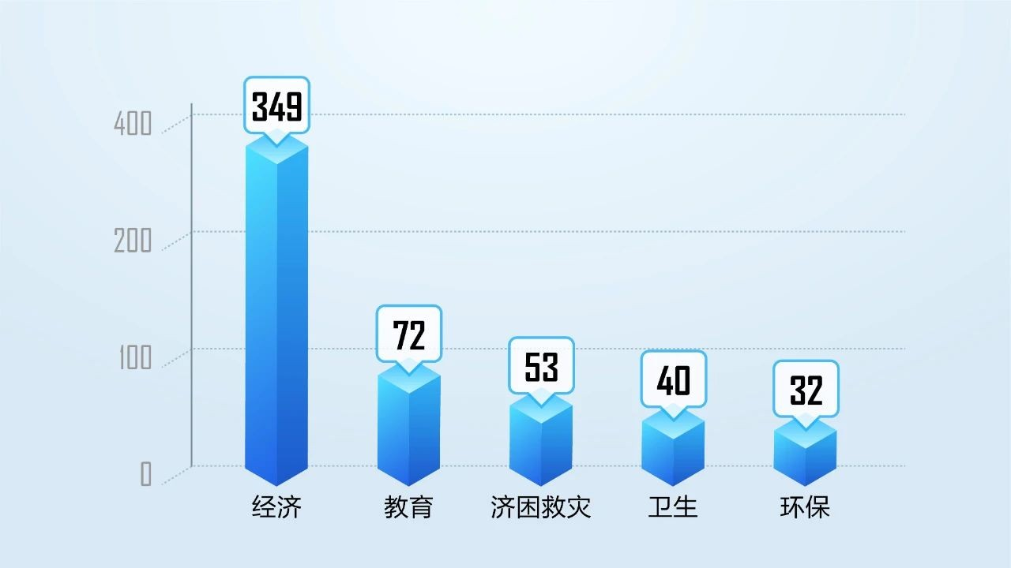
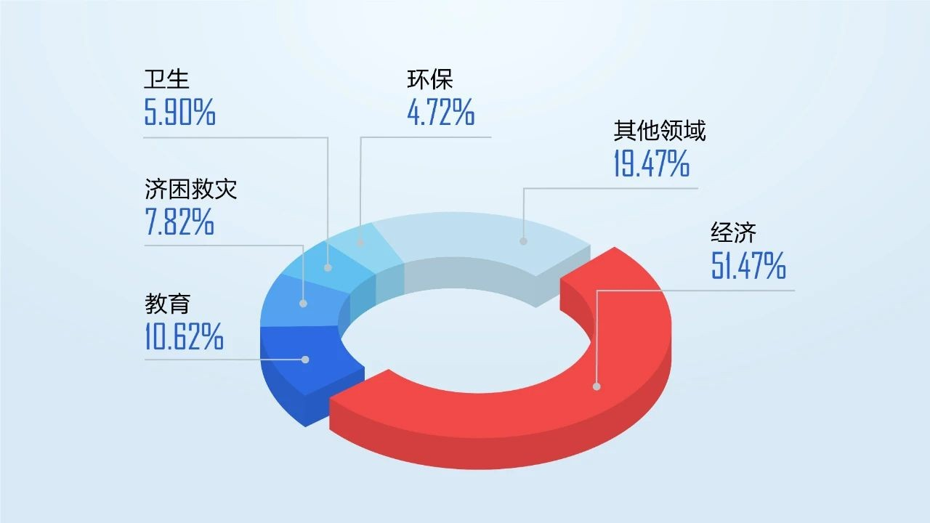
1.1 General picture of foreign investment and overseas NGOs in China
OVERSEAS NGOS
From 1988 to 2009, overseas NGOs cooperated more with government agencies, universities, and research institutions. After 2009, with the rise of local social organizations and private economy, overseas NGOs began to strengthen the contact with social organizations, private enterprises and civil groups in China.
According to the statistic, the economic field is the main field of activities of overseas NGOs in China, followed by education, disaster relief, health and environmental protection, accounting for 80.53% in total.
Health
Environmental Protection
Others
Disaster Relief
Economy
Education
Economy
Education
Disaster Relief
Health
Environmental Protection
Source: http://www.bscongo.org.cn/hangyezixun/295.html

Slide 11
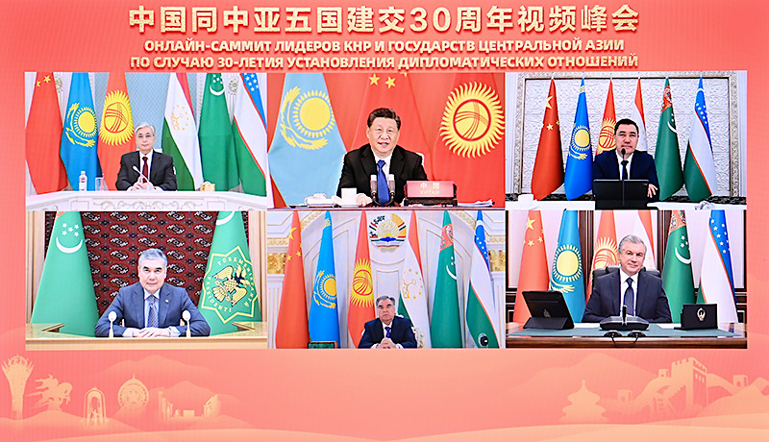
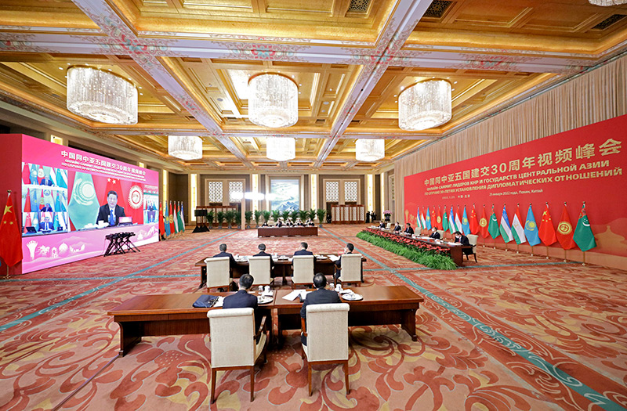
1.2 Investment relations and collaboration with Central Asian countries
THE VIRTUAL SUMMIT IN COMMEMORATION OF THE 30TH ANNIVERSARY OF DIPLOMATIC RELATIONS
The year 2022 marks the 30th anniversary of the establishment of diplomatic relations between China and the five Central Asian countries. On January 25, 2022, President Xi Jinping and the presidents of the five Central Asian countries had a virtual summit in commemoration of the 30th anniversary of diplomatic relations.
In his important speech entitled “Joining Hands for a Shared Future”, President Xi Jinping reviewed the development process of relations between China and Central Asian countries, summarized successful cooperation experience, and proposed the new goal of building an even closer China-Central Asia community with a shared future.
The summit adopted and released the Joint Statement Between Leaders of China and the Five Central Asian Countries on the 30th Anniversary of the Establishment of Diplomatic Ties, in which the parties solemnly announced their determination of jointly forging a strategic partnership featuring rich substance, fruitful results and enduring friendship, building a China-Central Asia community with a shared future and leading the relations between China and Central Asian countries into a new era.
Source: https://www.gov.cn/xinwen/2022-01/25/content_5670395.htm

Slide 12
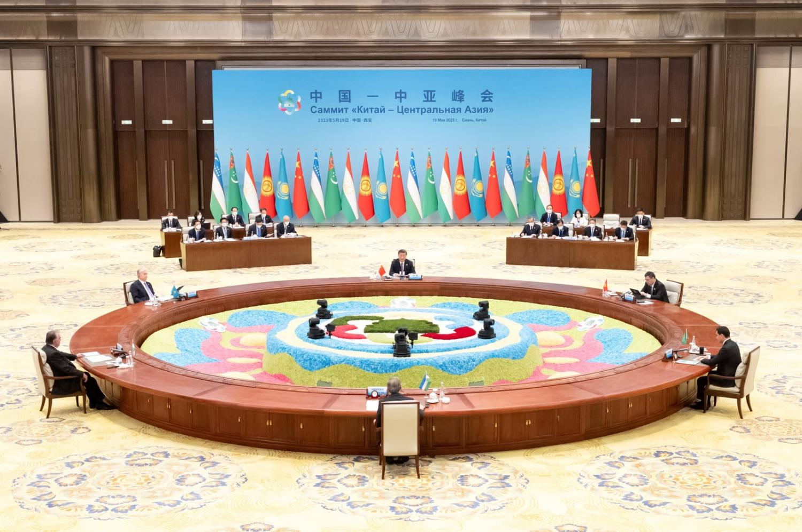
1.2 Investment relations and collaboration with Central Asian countries
THE CHINA-CENTRAL ASIA SUMMIT
On the morning of May 19, 2023, President Xi Jinping chaired the inaugural China-Central Asia Summit in Xi’an, Shaanxi Province. President Kassym-Jomart Tokayev of Kazakhstan, President Sadyr Zhaparov of Kyrgyzstan, President Emomali Rahmon of Tajikistan, President Serdar Berdimuhamedov of Turkmenistan and President Shavkat Mirziyoyev of Uzbekistan attended the Summit.
In an amicable atmosphere, the presidents reviewed the history of friendly exchanges between China and the five Central Asian countries, took stock of cooperation experience in various fields, and envisioned future cooperation directions. With the future in mind, they agreed to work together for an even closer China-Central Asia community with a shared future.
Source: https://www.fmprc.gov.cn/eng/zxxx_662805/202305/t20230519_11080116.html

Slide 13
1.2 Investment relations and collaboration with Central Asian countries
THE CHINA-CENTRAL ASIA SUMMIT
Central Asia is where the Belt and Road Initiative (BRI) began. Economic and trade cooperation between China and the five Central Asian countries has achieved tangible results since the establishment of diplomatic ties. China’s trade with the five countries reached $70 billion in 2022, up by over 100 times since diplomatic ties were established. As of the end of March, China’s direct investment stock in Central Asia stood at over $15 billion.
“Over the past decade, China and Central Asian countries have worked closely together to fully revive the Silk Road and actively deepen future-oriented cooperation, steering our relations into a new era,” Xi said in his speech.
He continued to hail the China-Kyrgyzstan-Uzbekistan highway, the China-Tajikistan expressway, the China-Kazakhstan crude oil pipeline and the China-Central Asia Gas Pipeline as the present-day Silk Road, and the China-Europe freight trains, freight trucks and flights the present-day camel caravans.
“In addition to traditional areas of cooperation, China and Central Asia should also forge new drivers of growth in finance, agriculture, poverty reduction, green and low-carbon development, medical service, health and digital innovation,” said Xi.
Source: https://news.cgtn.com/news/2023-05-19/China-Central-Asia-vow-to-build-closer-community-with-shared-future-1jVLJrBkwuI/index.html

Slide 14
|02
FOREIGN INVESTMENT IN CHINA

Slide 15
2.1 Legal system for foreign investment in China
PHASE I - THREE LAWS ON FOREIGN INVESTMENT
In the early stage of reform and opening- up, China successively formulated
the Law of the People’s Republic of China on Chinese-Foreign Equity Joint Ventures,
the Law of the People’s Republic of China on Wholly Foreign-Owned Enterprises, and
the Law of the People’s Republic of China on Chinese-Foreign Contractual Joint Ventures
(collectively referred to as the “Three Laws on Foreign Investment”), laying the legal foundation for China to attract foreign investment. Since then, in order to meet the needs of foreign capital use, China has continuously established and improved its legal system for foreign investment. This has helped to shore up the confidence of foreign investors and improvement of the investment environment.
PHASE II - FOREIGN INVESTMENT LAW AND ITS IMPLEMENTING REGULATIONS
On March 15, 2019, the Foreign Investment Law of the People’s Republic of China (hereinafter referred to as the “Foreign Investment Law”) was approved at the Second Session of the 13th National People’s Congress, replacing the Three Laws on Foreign Investment as the new fundamental law on foreign investment in China. The Foreign Investment Law sets a basic framework for China’s new legal system for foreign investment, affirms that the “pre-establishment national treatment plus a negative list” management system is to be implemented for foreign investment, and further strengthens investment promotion and protection.
In December of the same year, the State Council issued the Implementing Regulations for the Foreign Investment Law of the People’s Republic of China (hereinafter referred to as the “Implementing Regulations”), detailing the main legal systems defined by the Foreign Investment Law.
On January 1, 2020, the Foreign Investment Law and its Implementing Regulations came into effect. Foreign investment will henceforth enjoy a market environment with higher stability, transparency, predictability, and fairer competition.

Slide 16
2.2 Key policies for business entry and operation by foreign investment in China
FOREIGN INVESTMENT ACCESS POLICIES
China is implementing an administration system of “pre- establishment national treatment plus a negative list” for foreign investment in accordance with the Foreign Investment Law.
The “pre-establishment national treatment” refers to the treatment given to foreign investors and their investment during the investment access stage, which is not lower than that given to their domestic counterparts.
The “negative list” refers to special administrative measures for foreign investment access in specific fields as stipulated by the state.
The Special Administrative Measures for Foreign Investment Access (Negative List) (2021 Edition) and the Special Administrative Measures for Foreign Investment Access to Pilot Free Trade Zones (Negative List) (2021 Edition) were released on December 27, 2021, and took effect on January 1, 2022.
The 2021 editions of the negative lists for foreign investment access for China and pilot free trade zones are further reduced to 31 and 27 entries, down 6.1% and 10%, respectively. The main changes include further opening up the manufacturing industry, widening access to the service sector in pilot free trade zones, improving targeted administration, and optimizing overall implementation. All manufacturing sectors are open to foreign investors in the PFTZs.
In addition to the negative list for foreign investment access, foreign investors and foreign-invested companies should also follow the Negative List for Market Access (2022 Edition). The items in the list are divided into two categories:
For prohibited areas (such as, news gathering, editing, broadcasting and distribution; introduce news published by foreign entities, etc.), foreign investment are NOT allowed to enter, administrative organs are NOT allowed to approve and ratify the relevant matters.
For restricted areas with access under a license (such as, production, management, testing, import and export of specific plants or seeds and seedlings; exploration and exploitation, production and management of mineral resources, etc.), foreign investment must apply in accordance with qualification requirements and procedures, technical standards and licensing requirements. Administrative organs are to make decisions on whether to grant access or not in accordance with laws and regulations.
For businesses NOT included in the Negative List for Market Access, foreign investors shall be treated equally as their domestic counterparts.

Slide 17
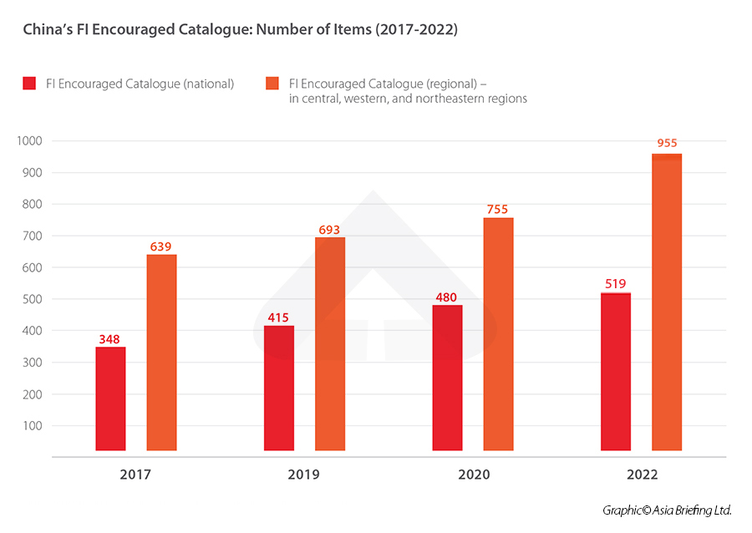
2.2 Key policies for business entry and operation by foreign investment in China
FOREIGN INVESTMENT PROMOTION POLICIES
Catalogue of Industries for Encouraging Foreign Investment
For foreign investment in fields specified in the Catalogue of Industries for Encouraging Foreign Investment (Edition 2022), those qualified are eligible for preferential policies, such as taxation.
Similar to the previous 2020 edition, the 2022 edition also includes two sub-catalogues:
one covers the entire country, known as the “national catalogue”, and
one covers the central, western, and northeastern regions, known as the “regional catalogue”.
However, compared with the 2020 edition, the 2022 edition contains a total of 1,474 items (519 in the national catalogue and 955 in the regional catalogue), increased by 19% from 1,235 items (480 in the national catalogue and 755 in the regional catalogue) in the 2020 version.
The lengthening of the catalogue demonstrates China’s firm standing on economic opening-up and the fact that more investment fields will favor foreign investors.
Source: https://www.china-briefing.com/news/china-2022-encouraged-catalogue-updated-implementation-from-january-1-2023/

Slide 18
2.2 Key policies for business entry and operation by foreign investment in China
FOREIGN INVESTMENT PROMOTION POLICIES
Equal Participation in Competition
With regard to the various policies supporting enterprise development, foreign-invested and domestic-funded enterprises enjoy equal access to rights, including but not limited to, government funding, land supply, tax cuts and fee reductions, licensing and permits, and the setting of standards, project reports, and human resources.
As regards the organization form, institutional framework and standard of conduct, all relevant provisions of the Company Law of the People's Republic of China, the Law of the People's Republic of China on Partnership and other laws shall be applied to both domestic and foreign-invested enterprises.
Foreign-invested enterprises enjoy fair treatment in the formulation and application of various standards. The state shall guarantee that foreign-invested enterprises can participate equally in setting standards in accordance with laws and shall improve information disclosure and social supervision for the setting of standards. Compulsory standards formulated by the state shall apply equally to domestic and foreign- invested enterprises. No technical requirements higher than the compulsory standards shall be specifically applied to foreign-invested enterprises. Domestic and foreign-invested enterprises shall participate in the formulation and revision of national standards, industry standards, local standards, and group standards on an equal basis in accordance with laws. Foreign-invested enterprises may formulate enterprise standards either by themselves or jointly with other enterprises as needed.

Slide 19
2.2 Key policies for business entry and operation by foreign investment in China
FOREIGN INVESTMENT PROTECTION POLICIES
Expropriation and Compensation
According to the Foreign Investment Law, the state does NOT expropriate any investment made by foreign investors. In special cases where expropriation is necessary for the public interest, the state may expropriate or requisition the investment of foreign parties in accordance with laws. Such expropriation or requisition shall be made pursuant to statutory procedures, and fair and reasonable compensation given in a timely manner.
The Implementing Regulations further clarifies that for the expropriation of foreign parties’ investment conducted by the state for the public interest, legal procedures must be followed in a nondiscriminatory manner, and timely compensation must be made based on the investment's market value. Foreign investors who are dissatisfied with the expropriation or requisition decision may apply for administrative reconsideration or file an administrative lawsuit in accordance with laws.
Freedom of Technical Cooperation
According to the Foreign Investment Law and its Implementing Regulations, China encourages foreign investors to engage in technical cooperation with its partners on a voluntary basis by following business rules. Conditions for technical cooperation should be determined by all investment parties through negotiation and on an equal footing. No administrative department (including organizations authorized by laws or regulations to manage public affairs) or its staff member shall force (or compel in disguised forms) foreign investors or foreign-invested enterprises to transfer technology by means of administrative licensing, administrative inspection, administrative punishment, administrative compulsion, or any other administrative means.
It is stipulated in the second paragraph of Article 31 of the Administrative License Law of the People's Republic of China that administrative organs and the staff thereof shall NOT take the transfer of technology as a condition for obtaining an administrative license. It is prohibited to either directly or indirectly request technology transfer in the process of administrative licensing.

Slide 20
2.2 Key policies for business entry and operation by foreign investment in China
FOREIGN INVESTMENT PROTECTION POLICIES
Commitment from Local Governments
Local people's governments at all levels and relevant departments shall strictly keep policy commitments regarding the supporting policies, preferential treatment or conveniences made to foreign investors and foreign-invested enterprises and perform all contracts entered into in accordance with laws.
Breach of contract is prohibited on the grounds of adjustment of the administrative region, change of the government, adjustment of the institution or functions, or replacement of the relevant persons in charge. If government departments make alterations to policy commitments or contractual agreements out of the necessity of national and social interests, they must proceed in accordance with statutory authority and procedures and provide timely and fair compensation for any losses suffered by foreign investors or foreign-invested enterprises in accordance with laws.
Smoothed Complaint Channels for Foreign-invested Enterprises
In 2020, the Rules on Handling Complaints of Foreign-Invested Enterprises (the “Rules”) was promulgated after revision. The Rules clearly stipulates that the Ministry of Commerce, in conjunction with other relevant departments, establishes an inter-ministerial joint meeting system for complaints of foreign-invested enterprises.
By the end of 2021, more than 2,500 Complaint Agencies for foreign investment had been established at all levels across China, complaint systems for foreign investment had been formulated or revised in 26 provinces, complaint handling guidelines for foreign investment had been developed and published by 26 provincial-level Complaint Agencies, well-equipped local complaint networks for foreign investment had been established in 19 provinces, and 17 provinces had published their lists of Complaint Agencies in their respective jurisdictions. With such efforts, an all- around framework for protection of the rights and interests of foreign- invested enterprises has taken shape.

Slide 21
2.2 Key policies for business entry and operation by foreign investment in China
FOREIGN INVESTMENT MANAGEMENT POLICIES
National Security Review
The Foreign Investment Law stipulates that foreign investors and foreign-invested enterprises engaged in investment activities within Chinese territory shall abide by Chinese laws and regulations and shall not jeopardize the national security and public interests of the People's Republic of China. China has established a security review system for foreign investment and conducts security review on any foreign investment that does or may affect the national security of China.
As approved by the State Council, the Measures for the Security Review of Foreign Investment was promulgated on December 19, 2020 and came into force on January 18, 2021. It clearly stipulates the scope of foreign investment that should be subject to security review, which involves two aspects:
investment in fields related to national defense and security, such as the military industry and its supporting industries, as well as investment in areas surrounding military facilities and military industry facilities; and
investment in, and acquisition of actual control over, companies in nine areas concerning national security, including:
important agricultural products,
important energy and resources,
important equipment manufacturing,
important infrastructure,
important transport services,
important cultural products and services,
important information technology and Internet products and services,
important financial services, and
key technologies and other important fields.

Slide 22
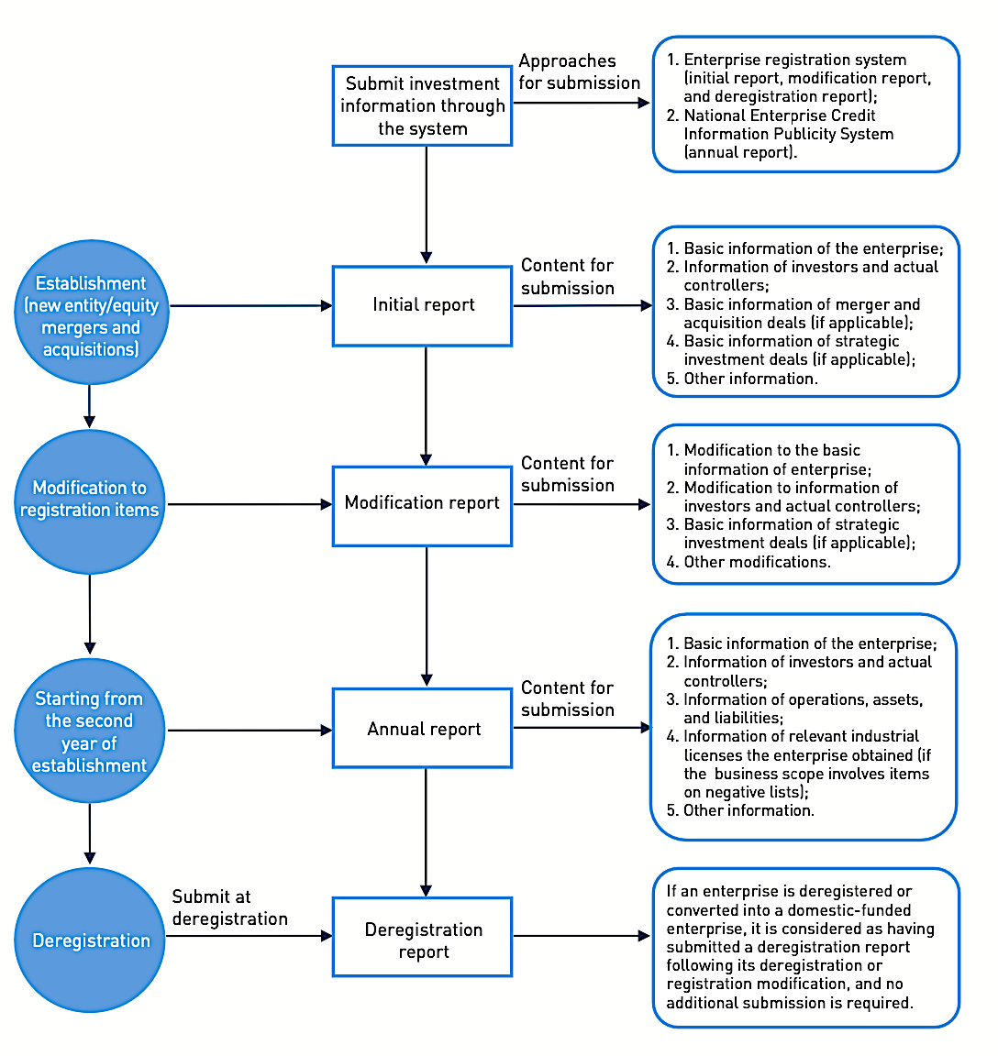
2.2 Key policies for business entry and operation by foreign investment in China
FOREIGN INVESTMENT MANAGEMENT POLICIES
Information Reporting System
China has established an information reporting system for foreign investment. Foreign investors or foreign-invested enterprises shall submit investment information to the competent commercial departments via the enterprise registration system and the national enterprise credit information publicity system. Investment information submitted by foreign investors or foreign-invested enterprises must be authentic, accurate, and complete.
The Measures for Reporting Foreign Investment Information and the Announcement on Matters Related to the Information Report on Foreign Investment have been in effect since January 1, 2020. Foreign investors and foreign-invested enterprises shall submit the initial report, any reports of modification or cancellation, and the annual report to the competent commercial department in accordance with the requirements of the above- mentioned documents.

Slide 23
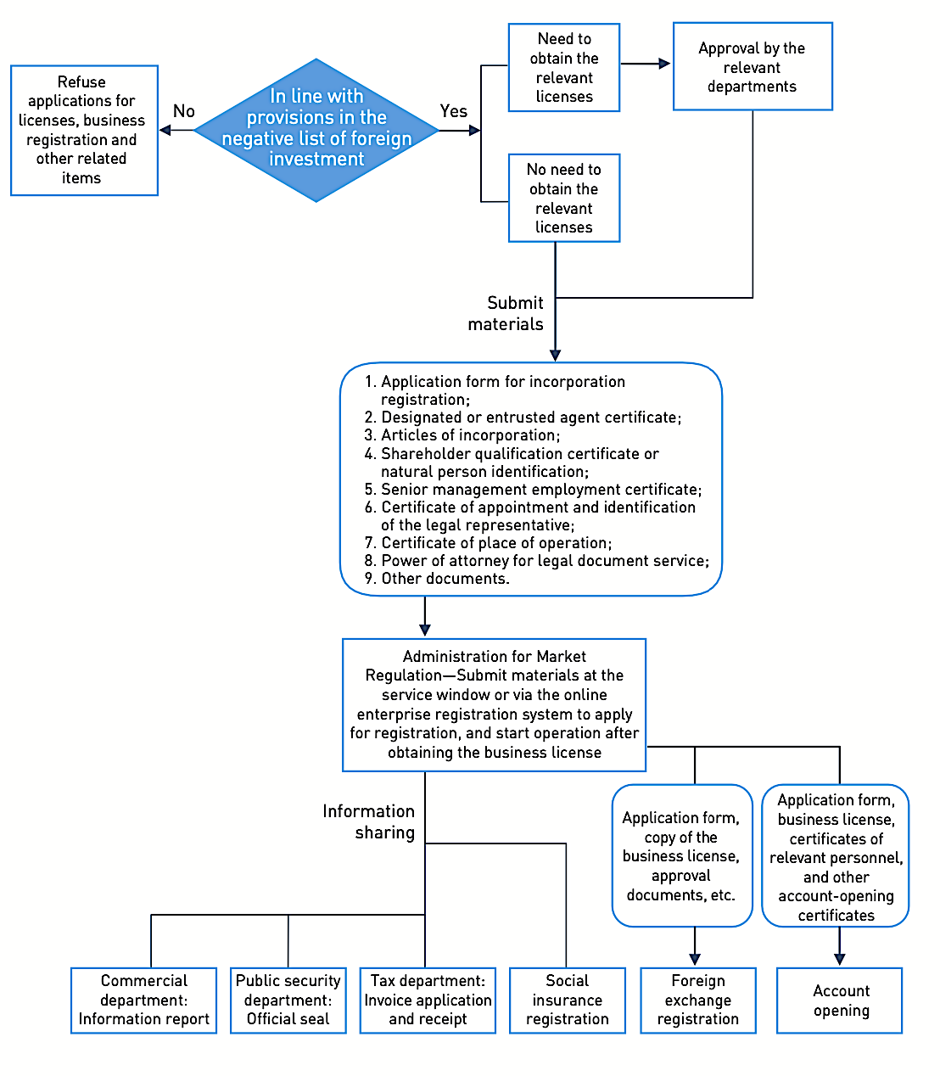
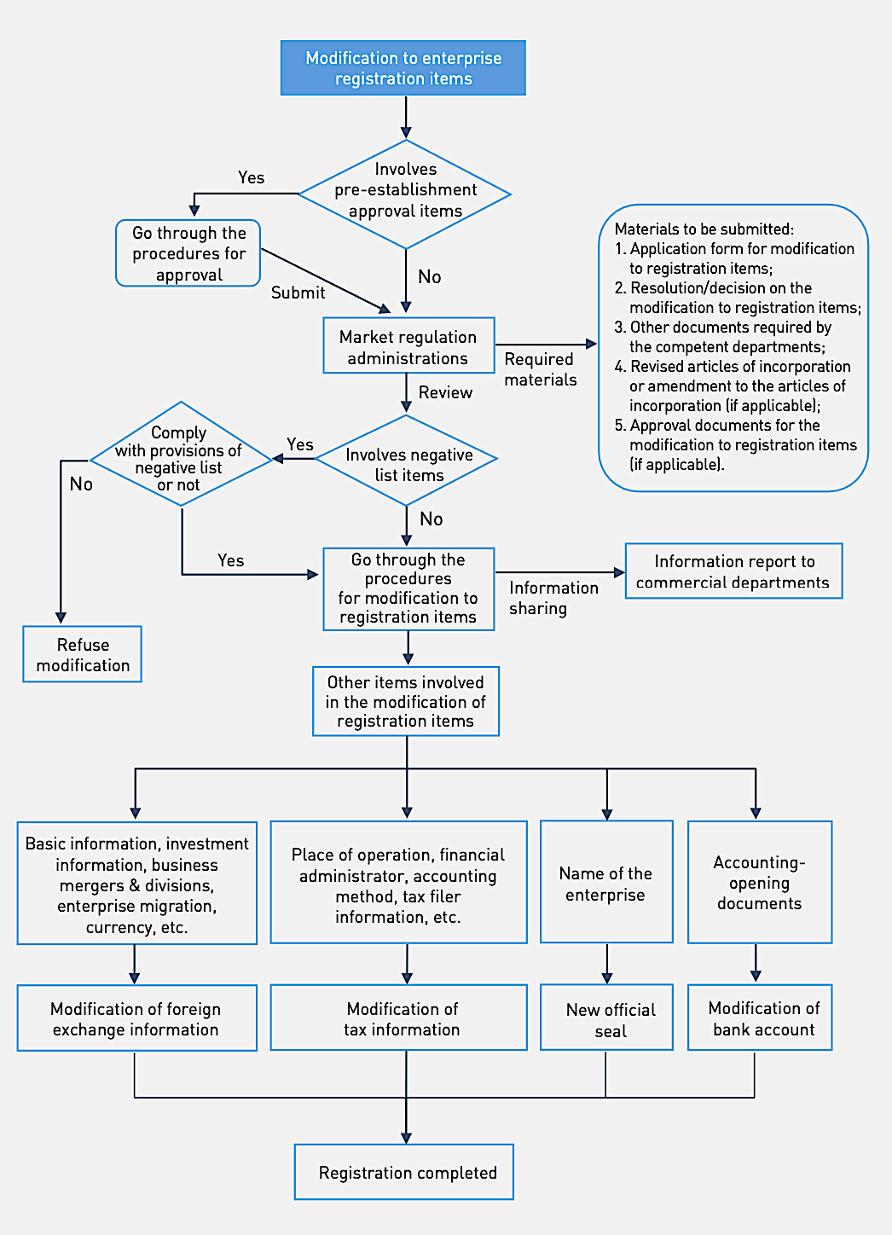
2.3 Procedures for incorporation and operation by foreign investment in China
ENTERPRISE INCORPORATION
ENTERPRISE MODIFICATION

Slide 24
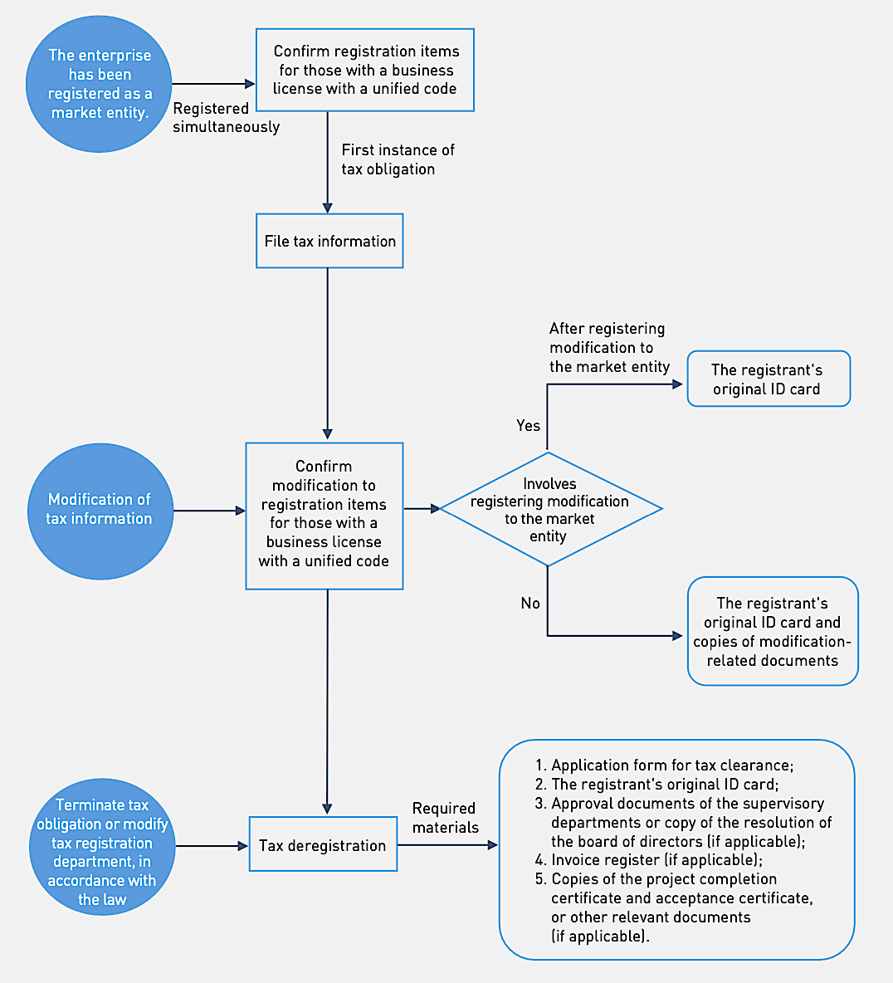
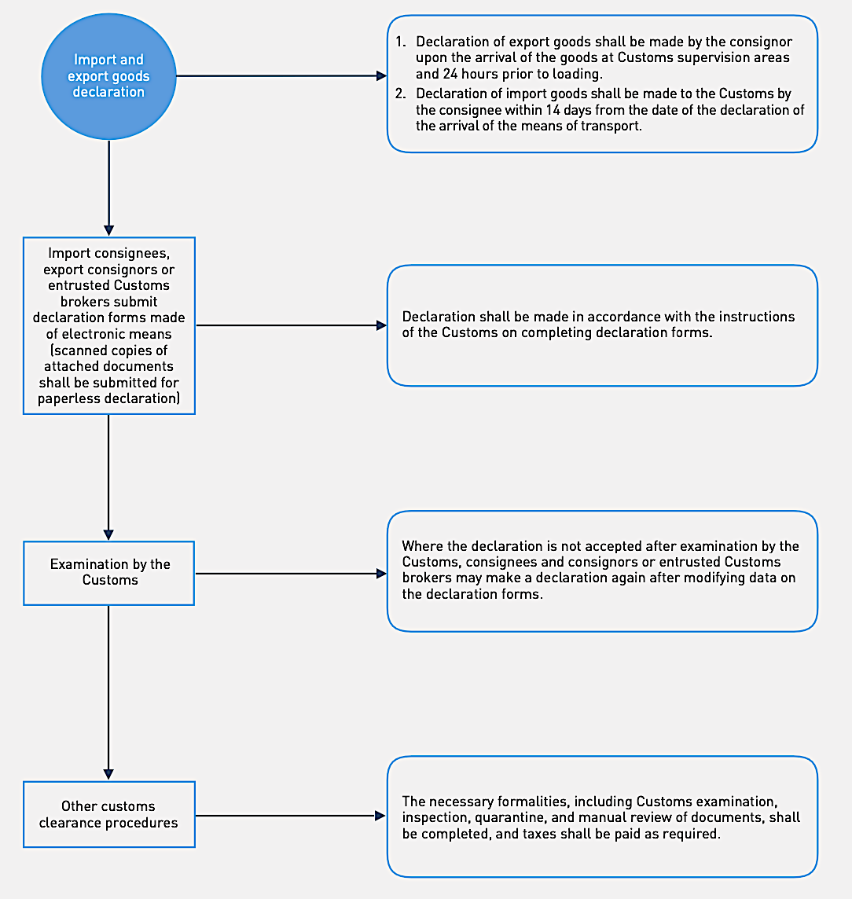
2.3 Procedures for incorporation and operation by foreign investment in China
TAXATION
CUSTOMS

Slide 25
2.3 Procedures for incorporation and operation by foreign investment in China
FOREIGN EXCHANGE
Newly- established enterprises, or foreign acquisition of domestic enterprises
Modifications to registration items, including capital increase, capital reduction, transfer of equity, and change of place of registration
Deregistration of
foreign-invested enterprises, or the conversion of foreign- invested enterprises into non-foreign-invested enterprises
Pre-establishment
remittance
Registering basic information on pre- establishment expenses
Filing basic information on foreign-invested enterprises
Registration of modifications to the basic information on the foreign-invested enterprise
Deregistration of the basic information on the foreign-invested enterprise
List of Materials
List of Materials
List of Materials
List of Materials
1. Application Form for Registering Basic Information on Direct Investment in China;
2. The "Notification on the Self-declaration of the Enterprise's Name" (the actual title of the document may differ depending on different provincial systems) downloaded and printed by the enterprise after it makes declaration through market regulation departments’ self-declaration system for enterprises' names, unless the submission is not required, as otherwise provided.
3. If a foreign investor intends to remit start-up funds to an enterprise under paid-in capital registration system, other supporting materials from competent authorities of the relevant industry shall be provided as well.
1. Written application, with the "Application Form for Registering Basic Information on Direct Investment in China" attached;
2. Copy of the business license, or copy of the modified business license (with official seal);
3. Enterprises under the paid-in registered capital registration system shall also provide approval documents or other supporting materials from competent authorities of the relevant industry;
4. If a foreign investor intends to invest in the mergers and acquisitions or the establishment of foreign-invested enterprises in China using the income legally obtained in the country, tax certificates from competent tax authorities shall be provided as well.
1. Written application, with the "Operation Registration Certificate" attached;
2. Application Form for Registering Basic Information on Direct Investment in China;
3. Copy of the modified business license, unless reissuance is not required, as otherwise provided (with official seal);
4. Enterprises under the paid-in registered capital registration system shall also provide approval documents or other supporting materials from competent authorities of the relevant industry.
5. If a foreign investor intends to invest additional funds in foreign-invested enterprises in China using the income legally obtained in the country, tax certificates from competent tax authorities shall be provided as well.
1. Written application, with the "Operation Registration Certificate" attached;
2. Application Form for Registering Basic Information on Direct Investment in China;
3. If an enterprise has not yet completed the deregistration at the market regulation department, it shall submit a liquidation announcement and a letter of commitment that it has completed liquidation of creditor's rights and liabilities and that its equity (investment interest) has not been frozen, pledged, or mortgaged, or the announcement (document) of the market regulation department revoking the enterprise's business license; or any relevant documents proving the people's court's judgment on the company's dissolution. If an enterprise has completed deregistration at the market regulation department, it shall provide the "Notice on Approval of Deregistration" issued by the market regulation department;
4. Certificate of tax deregistration, unless otherwise exempted;
5. A liquidation audit report issued by an accounting firm (unless deregistration is due to merger or there is no income after liquidation), or the liquidation results as determined by the people's court.

Slide 26
|03
OVERSEAS NGOS IN CHINA

Slide 27
3.1 Legal system for overseas NGOs in China
Effective Date | Authority | Law, Regulations and Guidance
2017.11.05 | Standing Committee of the National People's Congress | Law of the People’s Republic of China on Administration of Domestic Activities of Overseas Non-government Organizations in China (Amended in 2017)
2016.11.28 | Ministry of Public Security | Guide on Registration and Filing for Temporary Activities of Representative Offices of Overseas Non-government Organizations
2018.08.07 | General Administration of Sport | Measures for the Administration of sports activities conducted by Overseas Non-government Organizations in China
2019.04.29 | Ministry of Public Security | Catalogue of Fields, Projects and Supervisory Authorities for Overseas NGOs Carrying out Activities in Mainland China (2019)
2016.12.20 | Ministry of Public Security | Catalogue of Fields, Projects and Supervisory Authorities for Overseas NGOs Carrying out Activities in Mainland China (2017)
2017.01.19 | State Administration of Taxation | Notice on Work Relating to Tax Registration for Representative Offices of Overseas Non-government Organizations
2017.07.27 | State Administration of Foreign Experts Affairs; Ministry of Public Security | Notice on Issues Concerning the Work Permit for Foreign Staff of Overseas Non-governmental Organizations
2017.03.23 | People‘s Bank of China; Ministry of Public Security | Notice on Proper Administration of Renminbi Bank Accounts of Representative Offices of Overseas Non-government Organizations
Note: Except for above national legal and administrative documents, there are also regulations at the municipal level setting forth specific requirements on overseas NGOs.

Slide 28
3.2 Requirements on establishment and operation by overseas NGOs in China
DEFINITION
Overseas NGOs shall mean non-profit, non-government social organisations established overseas legitimately, such as foundations, social bodies, think tanks, etc.
DUAL MANAGEMENT SYSTEM
When overseas NGOs carry out activities in China, they should register and set up representative offices in accordance with the law, and accept the dual management of the registration authority (public security department) and corresponding governing authority.
Public Security Department
registration and annual inspection of representative offices of overseas non-government organisations
Governing Authority
issuing opinions with regards to establishment of representative office by overseas non-government organisation, change registration matters, annual work reports
guide and supervise overseas non-government organisations and their representative offices to conduct activities pursuant to the law
filing for temporary activities to be conducted by overseas non-government organisations
assist public security authorities etc. to investigate and deal with illegal acts of overseas non-government organisations and their representative offices
investigation and dealing with illegal acts of overseas non-government organisations and their representative offices
An overseas NGO which has NOT established a representative office in China intending to conduct activities temporarily in China shall cooperate with a State agency, people‘s organisation, institution, social organisation in China (collectively, the “Chinese Cooperating Party”).

Slide 29
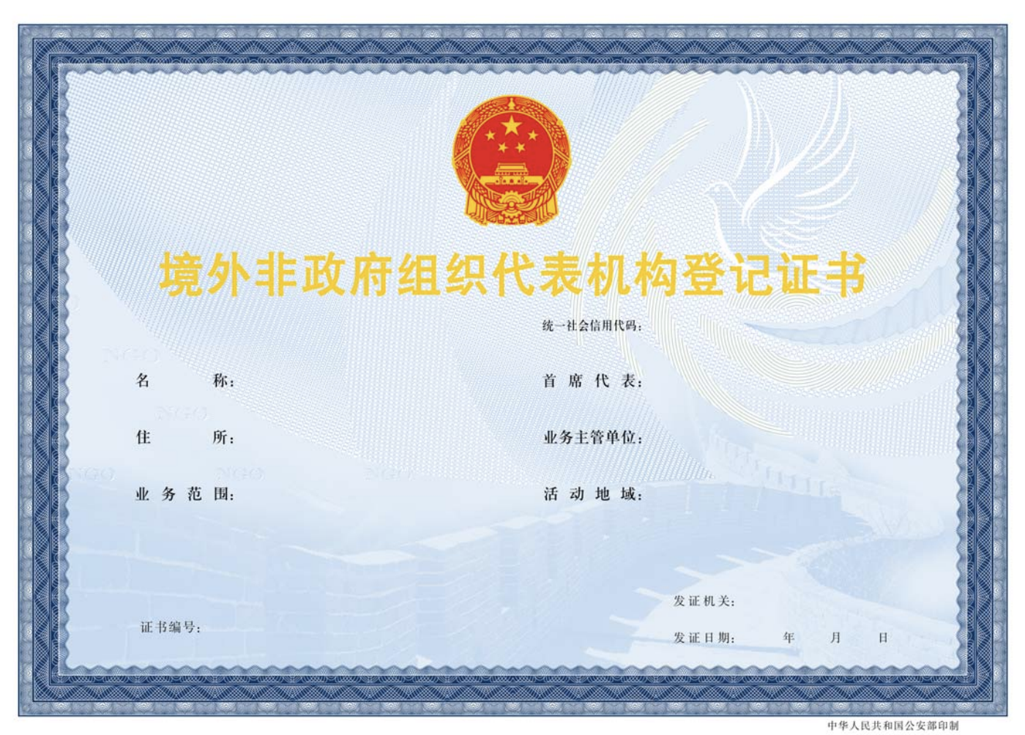
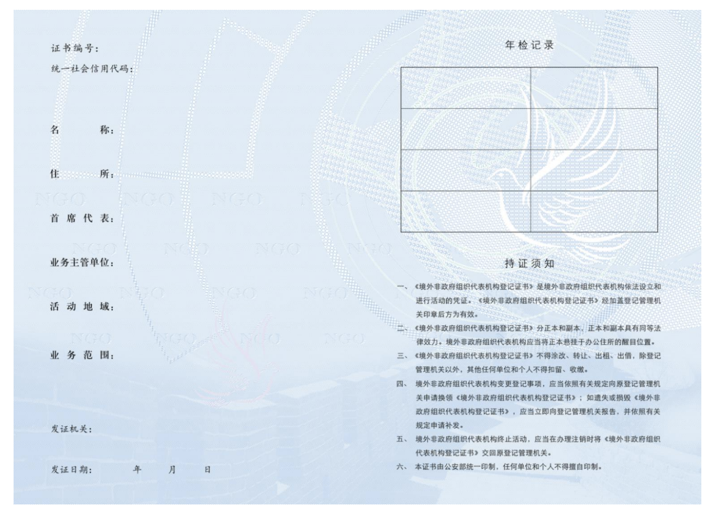
3.2 Requirements on establishment and operation by overseas NGOs in China
CONDITIONS TO REGISTRATION OF ESTABLISHMENT OF REPRESENTATIVE OFFICE
An overseas NGO which satisfies the following criteria may, based on its scope of business, geographical areas of activities and its needs for conducting of activities, apply for registration and establishment of a representative office in China:
it is legitimately established overseas;
it is able to bear civil liability independently;
the objectives and scope of business stipulated in the articles of association are beneficial for public welfare development;
it has existed overseas for two years or more and has conducted substantive activities; and
any other criteria stipulated by laws and administrative regulations.
Where registration is granted for a representative office of an overseas NGO, the registration administrative authorities shall issue a registration certificate and make a public announcement. The representative office of overseas NGO shall present the registration certificate to complete tax registration formalities, procure the representative office seal, open a bank account with a bank in China, and submit a photocopy of the tax registration certificate, seal specimen and bank account information to the registration administrative authorities for record filing.

Slide 30
3.2 Requirements on establishment and operation by overseas NGOs in China
TEMPORARY ACTIVITY FILING
Where the overseas NGO conducts temporary activities, the Chinese Cooperating Party shall complete examination and approval formalities pursuant to the State provisions, and file record with the registration administrative authorities at the locality 15 days before conducting the temporary activities.
The following documents and materials shall be submitted for record filing:
proof documents and materials that the overseas non-government organisation is established legitimately;
the written agreement between the overseas non-government organisation and the Chinese cooperating party;
the relevant materials (such as the name, objectives, geographic area and duration etc.) of the temporary activities;
proof materials for project funding and source of funds, and the bank account of the Chinese cooperating party;
proof document that the Chinese cooperating party has obtained approval; and
any other documents and materials stipulated by laws and administrative regulations.
The duration of temporary activities shall not exceed one year; where there is a genuine need to extend the duration, filing formalities shall be completed afresh.
FILING FOR ANNUAL PLANNED ACTIVITIES AND ANNUAL INSPECTION
A representative office of overseas NGO shall submit its work report of the preceding year to the governing authorities before 31 January every year, submit the same to the registration administrative authorities before 31 March upon issuance of opinion by the governing authorities, and accept annual inspection.
The annual work report shall include an audited financial accounting report, information on activities conducted and changes in staff and organization, etc. The annual work reports shall be released to the public on the unified website of the registration administrative authorities.

Slide 31
HUANG, Ningning (Henry)
Partner, Shanghai
Registered Foreign Lawyer, Hong Kong
Phone： +86 21 5234 1668
Mobile：+86 139 0196 6740
E-mail： huangningning@grandall.com.cn
Education
LL.M, Shanghai University of International Business and Economics
Other Occupations
Vice Director, Foreign Related Legal Service Committee, ACLA
Vice President, Shanghai Bar Association
Director, Hong Kong Basic Law Institute
Arbitrator, CIETAC, SHIAC, HKIAC, BAC/BIAC, HIAC, SHAC, SCIA
Adjunct Professor, SUIBE
Guest Professor, ECUPL
Language Skills
Fluent in English and Mandarin.
Practice Area
Mr. Huang has rich experience in the following areas: cross-border investment and financing, M&A, financial service innovation, commercial dispute settlement. His services include the structural design of cross-border investment, management of onshore and offshore M&A; financial services, in particular, the services relating to innovation and financial regulatory compliance. He is also an expert in corporate and commercial dispute resolution matters.
Professional Experience
Mr. Huang used to work as senior executive for American International Group (AIG) and AIA Insurance Co., Ltd. (AIA), and has in-depth knowledge and practical experiences on the internal control and corporate structural matters of multinational companies.
Mr. Huang has an extensive range of clients, including large-scale state-owned enterprises, listed companies, multinational companies, financial institutions, private owned enterprises and etc.
Mr. Huang had extensive experiences in leading the onshore and offshore legal teams to complete deals and transactions with complicated structures.
Mr. Huang has in-depth knowledge on the free trade zone issues in China. He also leads in the coordination of Grandall’s Belt and Road related legal research and services.

Slide 32
THANKS.

