Slide 1


Tajikistan’s Investment Opportunities in Hydropower

Slide 2
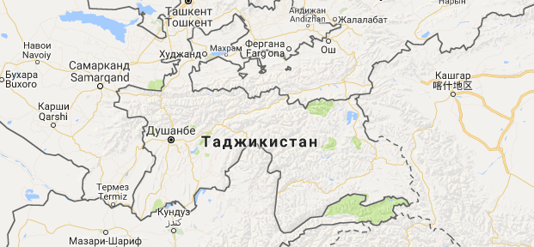


TAJIKISTAN – COUNTRY OVERVIEW
Capital city: Dushanbe
Area: 143,1 sq km
Population: More 10 mln. people (as of 01.01.2023).
Official language: Tajik
Currency: Somoni (TJS)
Independence Day: 9 September 1991
Large cities: Dushanbe, Khujand, Bokhtar, Kulyab, Khorog
The Republic of Tajikistan borders on the North with the Kyrgyz Republic (987 km), in the East with China (494.95 km), in the South with Afghanistan (1344.15 km) and in the West with Uzbekistan (1332.9 km).
High mountains and comfortable climate make Tajikistan a unique home of glaciers, consequently, of signiﬁcant reserves of water and energy resources. The country occupies one of the leading positions in the world by water and energy resources.
02

Slide 3

OVERVIEW OF TAJIKISTAN’S ENERGY SECTOR
HUGE UNTAPPED POTENTIAL
Tajikistan has huge reserves of hydropower resources, which are estimated at 527 billion kWh/year
95% of economically viable hydropower potential is not yet exploited
In addition to hydro, there is a considerable generation potential from wind, solar and other renewable sources
STRONG DEMAND GROWTH PROSPECTS
Domestic and regional demand growth requires construction of new and rehabilitation of existing power generation capacities
Tajikistan is surrounded by countries with a projected structural power deﬁcit (e.g. Afghanistan and Pakistan) or expensive power generation, opening up attractive export opportunities
FAVORAUBLE INVESTMENT CLIMATE
Ensuring Energy Independence and achieving Energy Security is one of the strategic goals of the Government of the Republic of Tajikistan
The Government adopted several laws on attracting investments into the country and creation of more favorable investment environment
Concept of Tariff Regulation, Methodology for Calculation of Electricity Tariffs are adopted. Regulatory body in energy sector is being created
03

Slide 4
LONG-TERM ENERGY SECTOR DEVELOPMENT STRATEGY
MAIN DEVELOPMENT INDICATORS
EXPANSION OF INSTALLED CAPACITY UP TO 10 GW
REDUCTION OF TECHNICAL LOSSES UP TO 10%
EXPORT ELECTRICITY UP TO 10 BILLION KWH
DIVERSIFICATION OF GENERATION CAPACITIES TO 10%
04
Notes:
Achievement of Energy Independence was determined by the Government of the Republic of Tajikistan as one of the four strategic tasks within the framework of the National Development Strategy until 2030.
In the National Development Strategy of Tajikistan up to period of 2030 were identiﬁed main indicators in energy sector as - 10/10/10/10- 500, which means increasing the installed generation capacity to 10 GW, reducing technical and commercial losses in networks up to 10%, increasing electricity exports to 10 billion kWh per year, diversiﬁcation of generation sources by 10% and additional generation of more than 500 million kWh per year from renewable energy sources and application of energy-efficient technologies.

Slide 5













GENERAL STATISTICS
GENERATION VS CONSUMPTION
COMPONENTS OF GENERATION
Billion kWh
Generation Consumption Deﬁcit
Billion kWh
TPP HPP
21,4
18,4
19,2
19,9
19,7
_{17,6} 20,7
19,7
20,6
16,7
16,8
16,1
16,8
16,6
17,1
18,1
18,9
16,9
16,9
18,1
17,2
17,9
18,1
16,2
16,1
16,5
16,6
16,3
16,1
16,1
15,9
16,3
15,6
17
13,9
14,4
14,9
15,6
2,5
2,7
2,6
0,03
0,04
0,05
0,04
0,16
0,3
0,6
0,98
1,3
1,5
1,7
1,7
1,5
3
2,4
1,8
1,1
1,1
0,7
0,9
0,9
1
1
2 0 1 0 2 0 1 1 2 0 1 2 2 0 1 3 2 0 1 4 2 0 1 5 2 0 1 6 2 0 1 7 2 0 1 8 2 0 1 9 2 0 2 0 2 0 2 1 2 0 2 2
IMPORT VS EXPORT
EXPORT BREAKDOWN 2015-2021
Billion kWh
Import Export
Billion kWh 0,04
Afghanistan
2,9
Kyrgyz Republic
2,4
2,4
2,6
5,5
Uzbekistan
Kazakhstan
1,4
1,3
1,3
1,3
1,5
0,74
1
0,797
0,24
0,07
0,16
0,17
0,04
0,045
0,06
0,09
0,097
0,11
0,37
0,2
10,1
0,05
0,05
0,2
2 0 1 0 2 0 1 1 2 0 1 2 2 0 1 3 2 0 1 4 2 0 1 5 2 0 1 6 2 0 1 7 2 0 1 8 2 0 1 9 2 0 2 0 2 0 2 1 2 0 2 2
05

Slide 6
DOMESTIC DEMAND GROWTH REQUIRES AN EXTENSION OF POWER GENERATION
Billion. kWh/year
30
25
20
15
23,9
22,6
10
20,6
5
3,3
0
Current generation
Generation with new capcities up to 2025
Projected demand up to 2025
Projected potential for export up to 2025
Tajikistan and region’s demand for electricity is increasing and requiring more HPP generation capacity.
Even after completing HPPs that are under development, demand in the region will be higher than supply.
06

Slide 7
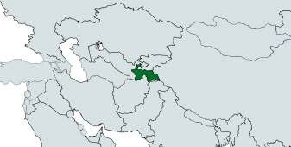
TAJIKISTAN IS SURROUNDED BY COUNTRIES WITH A STRUCTURAL POWER DEFICIT OR EXPENSIVE POWER GENERATION
Tajikistan’s hydropower potential is three times higher than the current consumption of electricity in whole of Central Asia.
PAKISTAN GENERATION DEFICITE
AFGHANISTAN GENERATION DEFICITE
MW
90000
(with Electriﬁcation Development) MW
3502
3100
22797
10000
520
Ins. capacity
Demand in 2030
Deﬁcit in 2030
Ins. capacity
Demand in 2032
Deﬁcit in 2032
07
Notes:
The South-Asia countries as Afghanistan, Islamic Republic of Pakistan and Islamic Republic of Iran have huge electricity demand, especially during summer season.
Hydropower potential of Tajikistan is three times higher than the current consumption of electricity in whole of Central Asia.
If these resources used effectively, the region could be provided with inexpensive and clean energy.

Slide 8
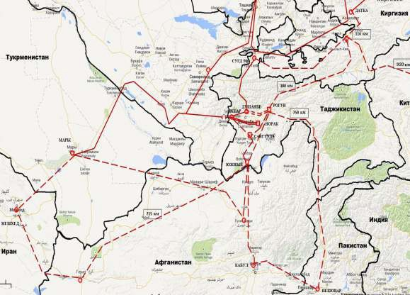
REGIONAL DEVELOPMENT PERSPECTIVE GRID MAP
Reconnection to the Central Asian Power System Project (CAPS)
08
Notes:
In the context of regional cooperation, Development partners are helping
Tajikistan to develop a regional electricity market. Reconnection to the Central Asian Power System Project (CAPS) is intended to provide the necessary infrastructure to achieve a full parallel operation between Tajikistan and Uzbekistan’s electricity grids, meaning the reconnection of Tajikistan to the wider CAPS via Uzbekistan. An interconnected power system in Central Asia will beneﬁt all countries, optimize power use, enhance the regional energy efficiency and transportation and reduce greenhouse gas emissions

Slide 9

RENEWABLE ENERGY SOURCES
Wind energy, 2.58%
Bioenergy, 0.07%
Hydro energy, 21.83%
Solar energy, 75.52%
Resources | Gross potential | Technical potential | Economic potential
Hydropower, total
Including small hydroelectric power plants
Solar energy
Biomass energy
Wind energy
Geothermal energy
Total (without large hydroelectric power plants)

Slide 10
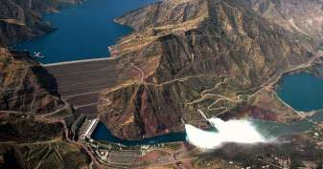
INVESTMENT OPPORTUNITIES - HYDROPOWER
Tajikistan has abundant hydropower resources estimated at 527 billion kWh per year.
About 6 projects for construction of large, 16 micro and small HPPs on the Feasibility Study level with Financial and Technical projections.
LARGE HPP
CONSTRUCTION OF SHUROB HPP (850 MW)
CONSTRUCTION OF NUROBOD–1 HPP (200 MW)
CONSTRUCTION OF NUROBOD–2 HPP (160 МВт)
CONSTRUCTION OF FONDARYO HPP (135 MW)
CONSTRUCTION OF AYNI HPP (160 MW)
CONSTRUCTION OF SANOBOD HPP (208 MW)
SMALL HPP
CONSTRUCTION OF DOMBRACHI MHPP (15 MW)
CONSTRUCTION OF HAFKUL–1 MHPP (10 MW)
CONSTRUCTION OF HAFKUL–2 MHPP (8 MW)
CONSTRUCTION OF ISKANDARDARYO MHPP (6 MW)
CONSTRUCTION OF NAZARMERGAN MHPP (4,7 MW)
CONSTRUCTION OF ERMAZOR HPP (2,3 MW)

Slide 11

VARIOUS MECHANISMS OF COOPERATION
1 | CONCESSION AGREEMENT
2 | PUBLIC PRIVATE PARTNERSHIP (BOT, BOO)
3 | INVESTMENT AGREEMENT
4 | PRODUCTION SHARING AGGREEMENT
Notes:
LEGISLATIVE FRAMEWORK
To stimulate the investment ﬂow and create the most favorable investment environment Tajikistan has adopted several laws as “On Investment Agreements”, “On Concessions”, “On Public Private Partnership”, “On Privatization of State Property of the Republic of Tajikistan”, “On Production Sharing Agreements”, “On Free Economic Zones”, and “On Credit Histories”.
In order to establish a favorable investment environment there has been established a system of guarantees for investors and investment activities, created a uniﬁed regime for both domestic and foreign investors, guaranteed freedom of transferring proﬁts and other forms of revenue from investment activities. Legislation framework provides a system of tax and customs preferences. Special beneﬁts are provided for those investors who operate in priority sectors of the country's economy, especially in the construction of hydropower plants.

Slide 12
FAVORABLE INVESTMENT ENVIRONMENT
EXEMPTION OF INCOME TAX
TAX AND CUSTOMS PRIVILEGES
For 2 years with investments ranging from US$ 200 thousand to US$ 500 thousand
For 3 years with investment ranging from US$ 500 thousand to US$ 2 million
For 4 years with investments ranging from US$ 2 million to US$ 5 million
For 5 years, with investments more than US$ 5 million
Facilities, equipment and their components for hydropower plants
Import of goods made for the implementation of targeted projects approved by the Government
Exemption of all taxes during construction period of hydropower plant
LEGAL STATUS OF INVESTORS
INVESTMENT PROTECTION
Equal rights for domestic and foreign investors
Legal protection of investor
Right to use and transfer income and revenue abroad in foreign currency
Free movement of property and information
Agreement on promotion and mutual protection of investments with 36 countries
Favorable legal framework for investors
Investment Agreements Partnership Agreement

Slide 13
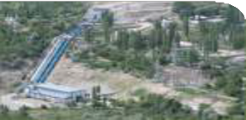
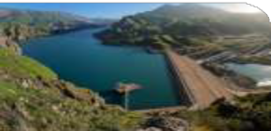
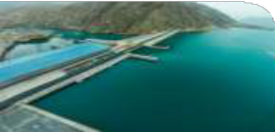

SUCCESS STORIES ON PPP, BOO AND BOT
PAMIR ENERGY
The project is being implemented within the framework of the Concession Agreement and JSC Pamir Energy. Under this agreement, the Government of the Republic of Tajikistan transferred its energy assets in the Gorno Badakhshan Autonomous Region to a concession for a period of 25 years. According to UNECE in 2016, the project was one of the top ten PPP projects. This year Pamir Energy was selected as a contenders for the most valuable achievements in the ﬁeld of energy Ashden Awards in the nomination "Enhancing Access to Energy.”
SANGTUDA HPP-1 (670 MW)
Joint Stock Company "Sangtuda HPP-1" is a Joint Venture between Republic of Tajikistan and Russian Federation. It was formed on February 16, 2005 with the goal to complete the construction and further operation of hydropower plant on the Vakhsh River in the Republic of Tajikistan. The share of Russian companies in the authorized capital of JSC "Sangtuda HPP-1" is 75% minus 1 share, the share of the Republic of Tajikistan - 25% plus 1 share. Up to present date, the station provides up to 11% of the total power generation in Tajikistan.
SANGTUDA HPP – 2 (220 MW)
The construction of Sangtuda HPP-2 officially began in 2006. For the construction of the facility, the Iranian company Sangob allocated US$ 318.9 million, the share of the Tajik side was US$ 40 million. The plant was launched in September 2014. Sangtuda HPP-2 is capable to generate up to 1 billion kW/h of electricity per year. After commissioning the plant will be considered as property of the Iranian company for 12.5 years and then would be transferred to Tajikistan for further operation.
FEZ DANGARA ELECTRICITY SUPPLY
On December 22, 2016, an agreement on Public Private Partnership was signed between the Ministry of Energy and Water Resources of the Republic of Tajikistan and Shaanxi Coal Chemical Industry (People's Republic of China) under the project on construction and operation of 220 kV Transmission Lines and Substation to ensure electricity supply for Free Economic Zone "Dangara " based BOT method. The total amount of the contract is US$ 22.8 million for a period of 8 years.

Slide 14
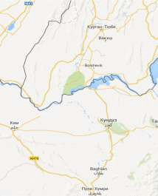
SUCCESSFUL REGIONAL POWER INTERCONNECTION PROJECT
Regional Power Transmission Interconnection Project 220kV Sangtuda-Puli Humri was implemented with support of Asian Development Bank and OPEC Fund for International Development. The total cost of project is 25,1 mln. USD.
The main project objective was to export surplus electricity during summer period from Tajikistan to cover deﬁcit in neighboring Afghanistan. The project was also aimed to achieve following:
GERAN - 2 TAJIKISTAN
increasing the available level of generation in Tajikistan during autumn-winter period;
increasing generation and decreasing the level of technical losses in south Tajikistan;
providing electricity to neighboring Afghanistan with more stable electricity;
enhancing of regional connectivity and improvement of regional electricity market;
ensuring accurate power ﬂow in energy system;
PULI HUMRI-AFGHANISTAN
mln. kWh

Slide 15






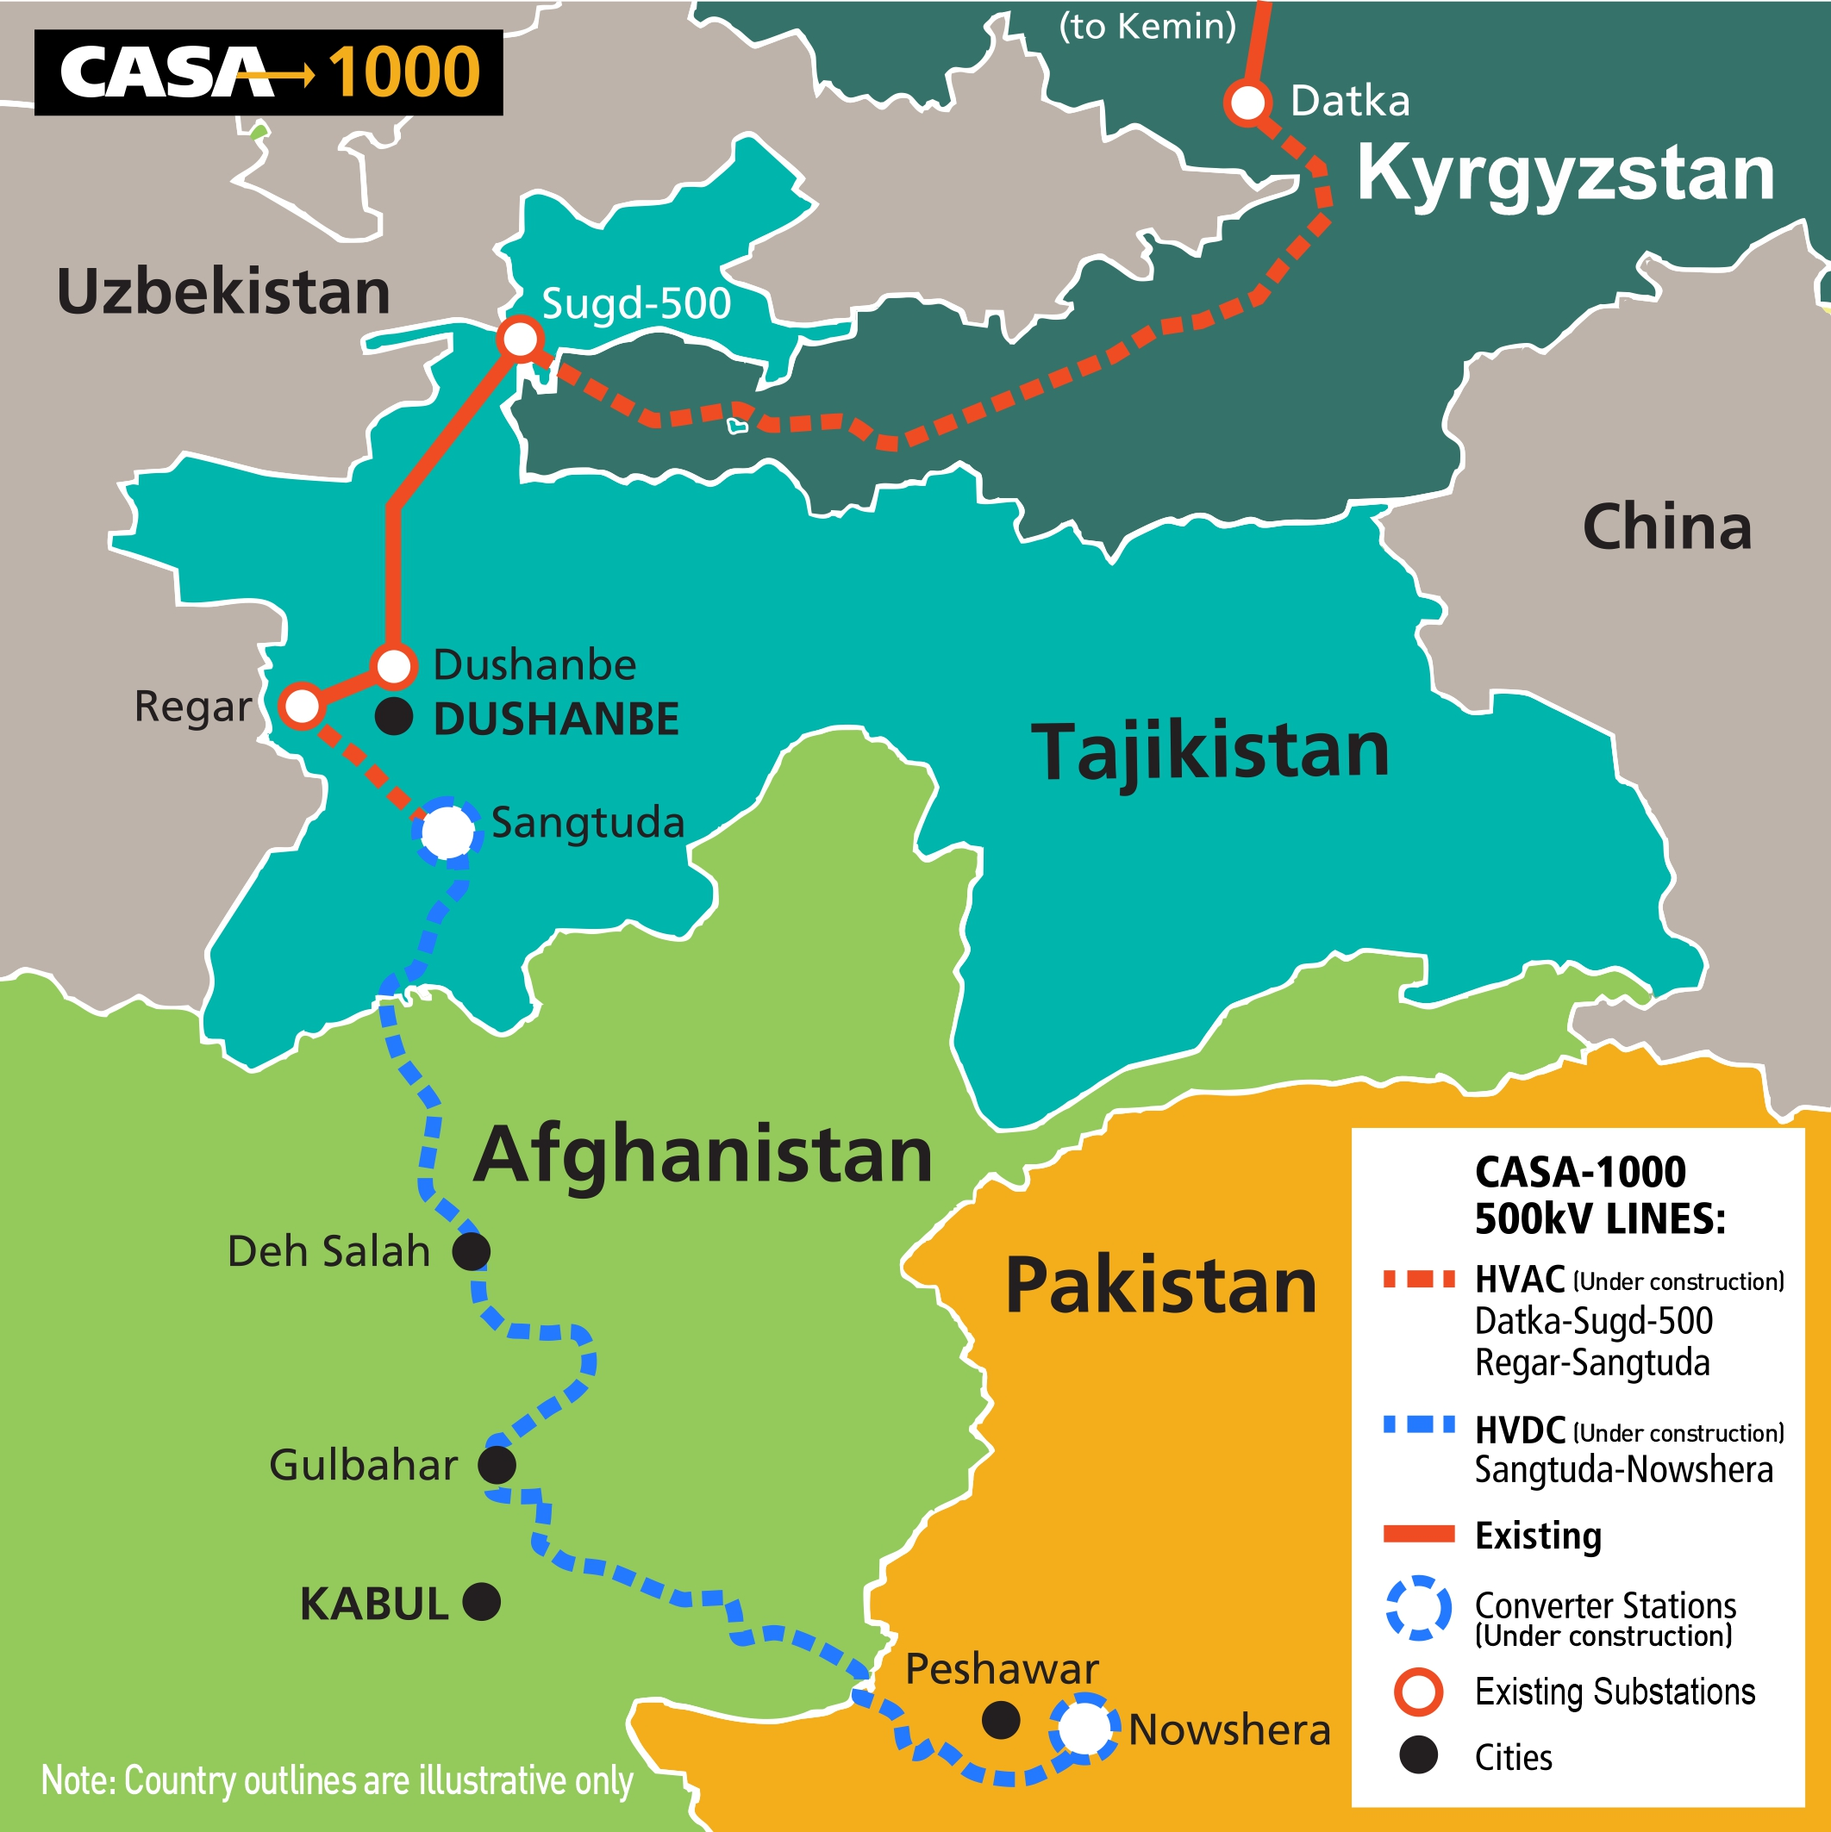



CENTRAL ASIA SOUTH ASIA POWER TRANSMISSION LINE
Kirgizstan
Tajikistan
Afghanistan
Pakistan
Tajikistan internal HV AC Grid HV AC/DC Converter Station
Sangtuda
Datka
Sugd 500 kV
Novshera
HV AC Line – 477 km – 1000 MW
1300 MW
HV DC Line – 750 km – 1300 MW
1300 MW
Total Project Cost: $1,170m
Project Implementation Support, $30m
Community Support Program, $70m
Environmental and Social Cost, $20m
Transmission infrastructure, $801m
Contingencies, $145m
Taxes and IDC, $104m
Notes:
The Central Asia countries – the Republic of Tajikistan and Kyrgyz Republic and the South Asia countries – the Islamic Republic of Pakistan and Islamic
Republic of Afghanistan signed on October 2006 in Dushanbe a four-party Memorandum of Understanding on establishment of Regional Electricity Market between Central and South Asia countries which committed all countries to build the necessary infrastructure and purchase and sale of electricity within the relevant institutional and legal framework.
500 kV AC/DC transmission line will connect the power systems of
Kyrgyzstan, Tajikistan, Afghanistan and Pakistan. It will export up to 1,300 MW to Pakistan and Afghanistan.

Slide 16

BENEFITS FROM THE DEVELOPMENT OF HYDROPOWER RESOURCES OF TAJIKISTAN
USE OF RENEWABLE SOURCES OF ENERGY THAT COMPLIES WITH THE CONCEPTS OF
ENSURE WATER SECURITY
«GREEN ECONOMY»
GENERATION OF AFFORDABLE AND ENVIRONMENTALLY FRIENDLY ELECTRICITY
SUSTAINBLE MANAGEMENT OF WATER RESOURCES
REDUCE GREENHOUSE GAS EMISSIONS
SAVING FUEL RESOURCES, WHICH ARE INTENSIVELY USED NOW FOR GENERATION OF ELECTRICITY
PROTECTION AGAINST MUDFLOWS AND FLOODS AND MITIGATION OF DROUGHT RISKS

Slide 17





























Thank You!
Street: Shamsi str. 5/1, 734064, Dushanbe, Republic of Tajikistan
Tel: Email: Web:
+992 (372) 35-35-66
info@mewr.tj mewr.tj

