Slide 1
Georgia and its Role in Regional Energy Cooperation
Georgian Renewable Energy Development Association
GREDA
28.11.2023

Slide 2
Generation Sources
Georgia’s Installed Capaity
Electricity Generation and Import TWh
www.greda.ge

Slide 3
Operational balance of electricity
www.greda.ge

Slide 4
Electricity Consumption Forecast
5.6% CAGR
2014-2022
4.9% CAGR
2023-2030
www.greda.ge

Slide 5
Increased demand is filled by the imported electricity
Share of local generation in 2021-2022 decreased from 74% to 68%
Electricity consumption growth rate is twice higher that production growth rate
Electricity consumption growth was satisfied with the electricity imports or increased generation of TPPs (which run on imported gas).
Since 2010, only 700MW of Hydro and Wind power plants have been commissioned, while 1,500 MW was needed to match the consumption growth.
www.greda.ge

Slide 6
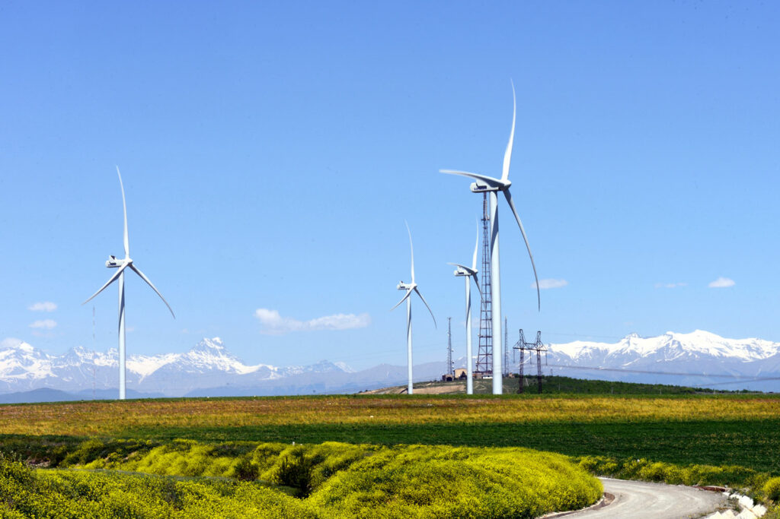
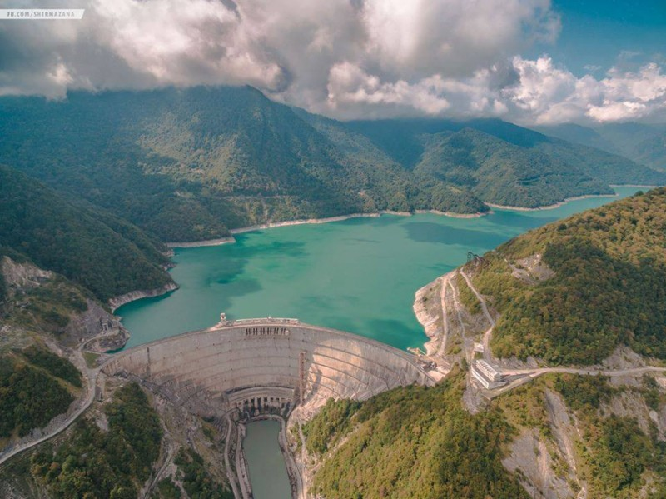
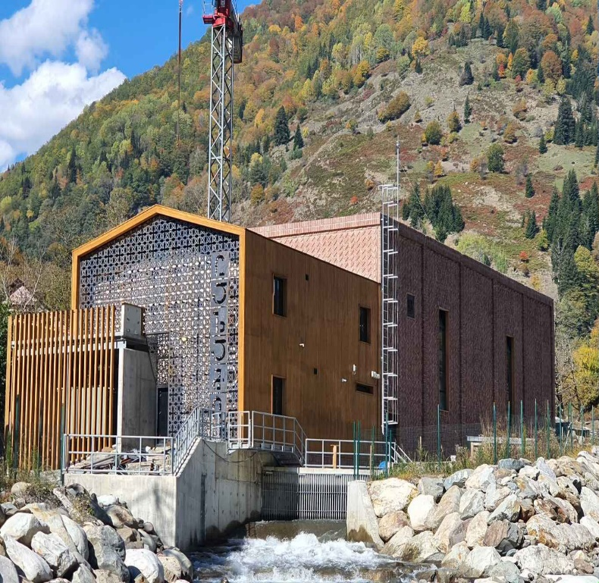
Energy Balance
<1 MW – 21 HPPs
1-10 MW – 60 HPPs
10> MW – 36 HPPs, 1 WPP, 5 TPPs
Total Installed Capacity - 4596,4 MW
HPPs Total Installed Capacity - 3394,3 MW:
Water reservoir Hydro plants 1993.1 MW;
Seasonal Hydro plants 1100.1 MW;
Small Hydro plants (<15 MW) 301,0 MW.
TPPs Total Installed Capacity - 1181,4 MW:
Steam Turbines 572.0 MW;
CCGT 486,2 MW;
Gas Turbine 110.0 MW;
Coal 13.2 MW
Renewable (except for water) - 20.7 MW:
Wind Power Plant is 20.7 MW.
www.greda.ge

Slide 7
Tariff Dynamic of Recent Years
The electricity tariff in Georgia in 2018-2023 mostly ranged from 4 to 6 US cents.
Electricity is the cheapest in the summer months, May and June.
Electricity is the most expensive - from October to March.
Over the years, the maximum price for electricity - $6.21
Over the years, the minimum price for electricity - $2.52
2018
2019
2020
2021
2022
Y7 Average monthly
Average monthly Fact/Est 2023
www.greda.ge

Slide 8
Black Sea Submarine Cable Project
The 1,000-1,500 MW, 1,195 km long Black Sea submarine cable project between Georgia and Romania aims to connect the South Caucasus region to Southeast Europe. The underwater cable will also be equipped with an optical fiber cable.
The estimated launch year is 2030, and the estimated cost is 2.3 billion euros.
Currently, the technical and economic study of the project is being carried out by the Italian consulting company CESI. The deadline for completion is the end of 2023. The final route will also be determined as part of the study.
www.greda.ge

Slide 9
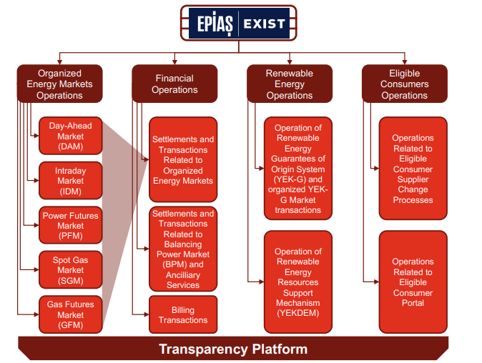
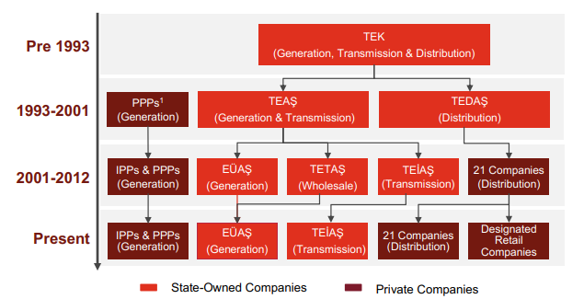
Differences between energy markets
in the Region
Turkey
Liberalisation – Liberalised
Establishment of NRA – 2001
Establishment of the Organized Electricity Market – 2006
Amendment of Renewable Energy Law – 2011
Source: https://www.pwc.com.tr/tr/sektorler/enerji/overview-of-turkish-electricity-market-2023.pdf
www.greda.ge

Slide 10
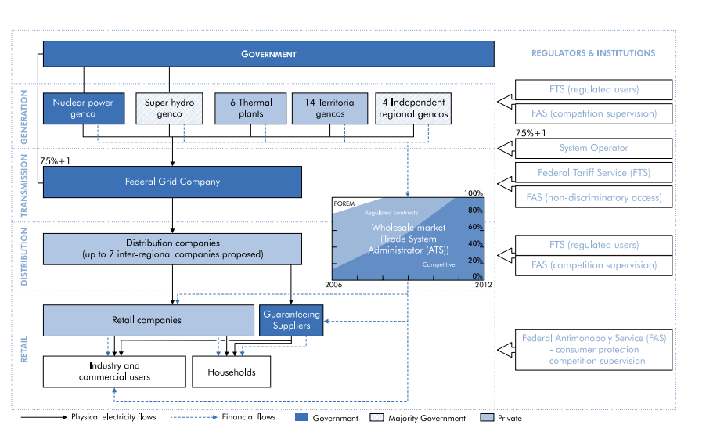
Differences between energy markets
in the Region
Russia
Liberalisation – Liberalised
Establishment of NRA – 2004
Establishment of the Organized Electricity Market – 2012
Amendment of Renewable Energy Law – 2007
Source: https://iea.blob.core.windows.net/assets/2a1df6a4-9929-4c0f-a050-c2c695e694ee/russianelec.pdf
www.greda.ge

Slide 11
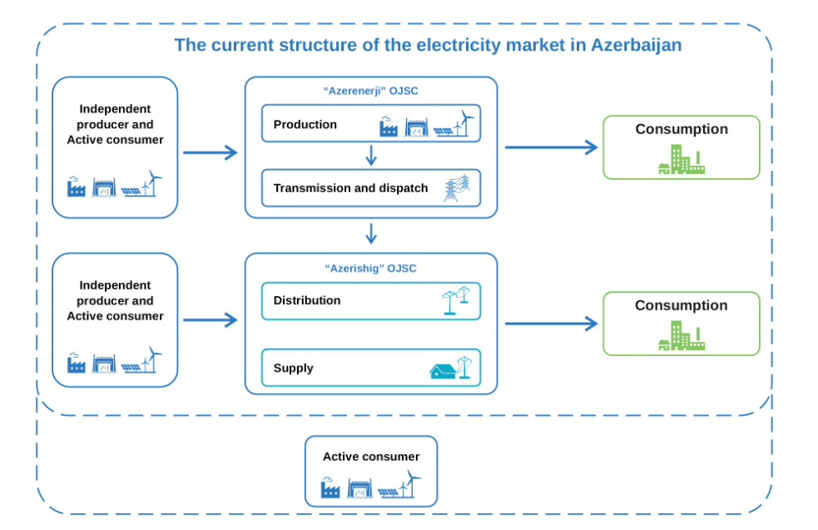
Differences between energy markets
in the Region
Azerbaijan
Liberalisation – non Liberalised
Establishment of NRA – 2017
Establishment of the Current Electricity Market – 2003
Amendment of Renewable Energy Law – 2021
Source: https://regulator.gov.az/en/elektrik/elektrik-enerjisi-sebekesi-ve-daxili-topdansatis-bazari#:~:text=Structure%
20of%20the%20electricity%20market,the%20agreement%20between%20the%20participants.
www.greda.ge

Slide 12
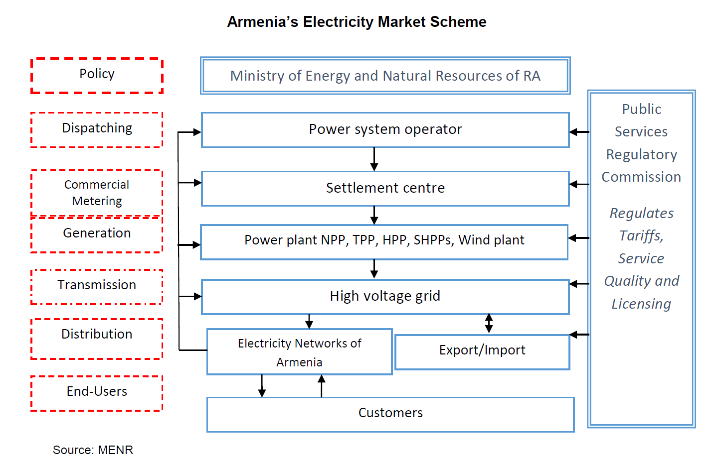
Differences between energy markets
in the Region
Armenia
Liberalisation – Liberalised
Establishment of NRA – 1997
Establishment of the Organized Electricity Market – 2022
Amendment of Renewable Energy Law – 2016
Source: https://regulator.gov.az/en/elektrik/elektrik-enerjisi-sebekesi-ve-daxili-topdansatis-bazari#:~:text=Structure%
20of%20the%20electricity%20market,the%20agreement%20between%20the%20participants.
www.greda.ge

Slide 13
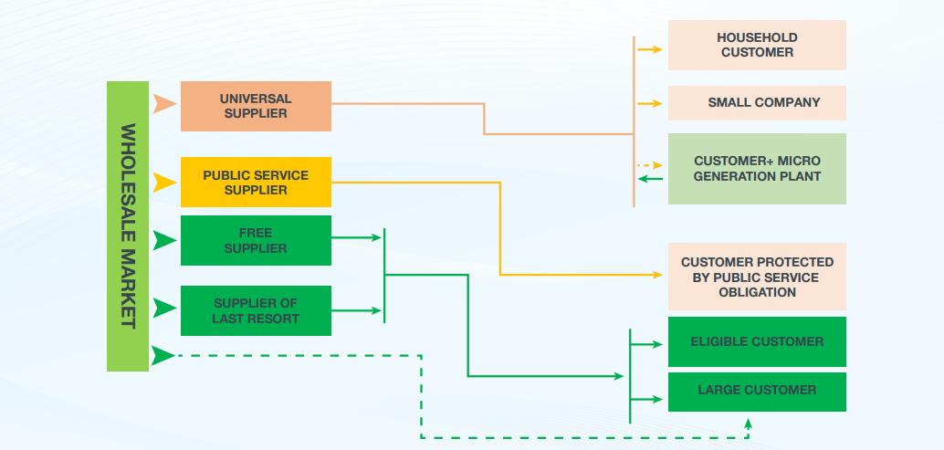
Differences between energy markets
in the Region
Georgia
Liberalisation – non Liberalised
Establishment of NRA – 1997
Establishment of the Current Electricity Market – 2020
Amendment of Renewable Energy Law – 2019
www.greda.ge

Slide 14
Market Reform
The market go-live date - July 1, 2024
Day-ahead market
Intraday market
Simulation trade in the DAM and Balancing and Ancillary Service market continues in accordance with the GNERC resolution. The GNERC resolution regulates the transitional measures ahead of the Georgian power market go-live. Additionally, GENEX also simulates trade in the Intraday Market.
www.greda.ge

Slide 15
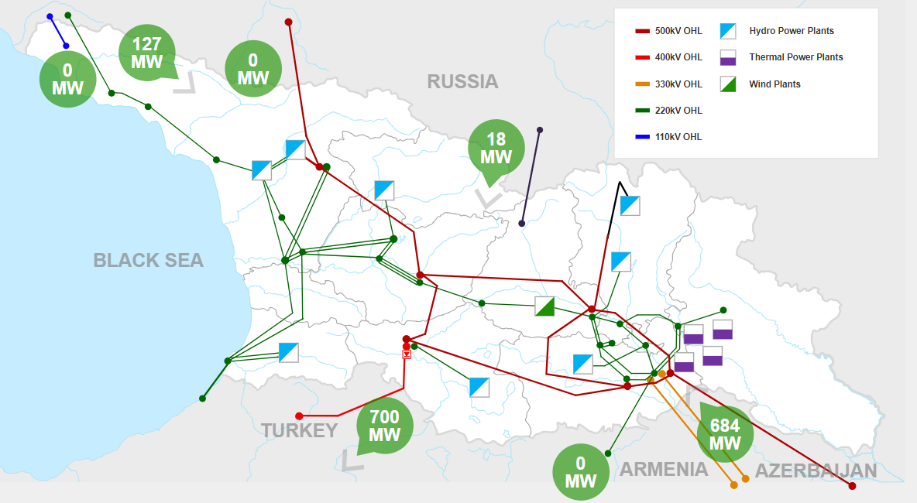
Cross-Country Electricity Trading
Source: GSE’s power flow map
Acces Date: 22.11.2023
www.greda.ge

Slide 16
THANK YOU!
+995 32 2 200 036
info@greda.ge
www.greda.ge
GREDA-საქართველოს განახლებადი ენერგიის განვითარების ასოციაცია
GREDA - Georgian Renewable Energy Development Association
TBILISI, KOTE APKHAZI ST. 44

