Slide 1
GRPH at a Glance
2023
2023

Slide 2



Renewable energy platform at a glance
GRPH | Leading Renewable Energy Platform in Georgia
Georgia Capital | Shareholder profile
Overview: Leading investment management company in Georgia, listed on the premium segment of the London Stock Exchange
Strategy: Focuses on capital-light, larger-scale investment opportunities in Georgia, which can reach at least GEL 300 million equity value in 3-5 years after initial investment and monetize them through exits as investments mature
Core strategy enablers:
  Superior access to capital
  Access to good management
  Strong corporate governance
100%
Georgian Renewable Power Holding JSC
Operational Portfolio
Pipeline Portfolio
4 Hydro Power Plants (HPPs)
1 Wind Power Plant (WPP)
2 Hydro Power Plants (HPPs)
5 Wind Power Plant (WPPs)
1 Solar Power Plant (SPP)
Key Facts and Figures
GRPH | Portfolio Breakdown
OPERATING
PIPELINE
TOTAL
Late-stage
GEL 3.5bn
GEL 3.2 bn
GEL 77
194 MW
71 MW
383 MW
Total Portfolio Value
Net Asset
Value (NAV)
NAV per share
118MW
Early-stage
*Data as of 30 September 2023 unless otherwise noted

Slide 3

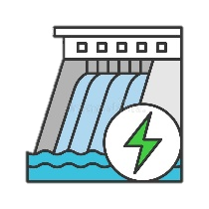




Renewable energy platform development timeline
Late-stage pipeline
Late-stage pipeline
Early-stage pipeline
Renewable energy
platform launched
Acquisition of 20.4 MW Hydrolea HPPs
(Akhmeta HPP, Debeda HPP and Kasleti HPP)
Issuance of $250m Green Eurobonds together with water utility business
Issuance of $80m first Green Bond on
the local market
Target CoD
of 18.0 MW
Darchi HPP
Target CoD of 46.0 MW Zoti HPP
Target CoD early-stage wind farms
2016
2017
2019
2020
2022
2025-2030
Construction works of 30.0 MW
Mestiachala 2 HPP started
Commissioning
of 30.0 MW
Mestiachala 2 HPP
Acquisition of 20.7 MW Qartli Wind Farm,
the only wind farm in Georgia
Demerger of renewable energy business from water utility business
Target CoD of 5.0 MW Qartli Solar Farm
Target CoD of 80.0 MW Kaspi WPP
Target CoD of 50.0 MW Tbilisi WPP
Early-stage pipeline
Late-stage pipeline
Late-stage pipeline
3

Slide 4
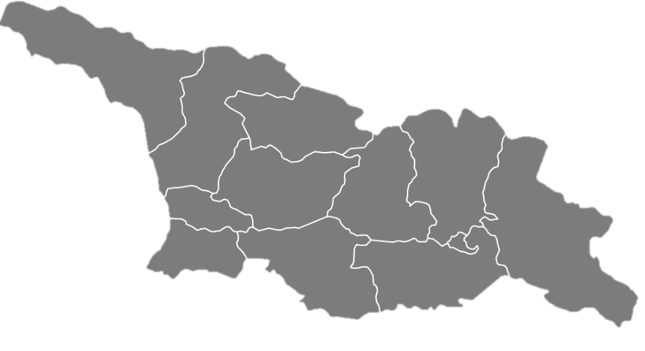










Renewable energy total portfolio at a glance
Key Numbers
Asset Allocation
Mestiachala II HPP
30.0MW
Operational Assets
Total Capacity
∼ 383 MW
Late-stage pipeline
Darchi HPP
18.0 MW
Early-stage pipeline
Qartli Solar Plant
5.0 MW
Kasleti II HPP
8.1 MW
Akhmeta HPP
9.1 MW
Gross Annual Generation
∼ 1.4TWh
Tkibuli WPP
39.6 MW
Kutaisi WPP
24.0 MW
Tbilisi WPP
50.0 MW
Load Factor, %
∼ 42%
Zoti HPP
46.0 MW
Debeda HPP
3.2 MW
Qartli Wind Farm
20.7 MW
Kaspi WPP
80.0 MW
Plevi WPP
49.0 MW
4

Slide 5


The first Green Bond issuance on local market
First ever green secured bond issuance on the Georgian capital market
Largest corporate transaction on the Georgian capital market
  Issuance Overview
BONDS
STRATEGIC INVESTORS
IFC, FMO, EBRD, ADB
OFFERING AMOUNT
$80,000,000
MATURITY
COUPON RANGE
5 years, with redemption options
PLACEMENT AGENTS
7.0%
ISSUE DATE
JSC Galt and Taggart, LLC TBC Capital
October, 2022
USE OF PROCEEDS
Refinancing existing Green Eurobonds issued by GGU
LISTING
Green Secured Bonds, SPO obtained from Sustainalytics
Georgian Stock Exchange

