Slide 1

CAREC Tourism Virtual Portal
www.visitsilkroad.org
National Focal Points’ Meeting
18 October 2023

Slide 2
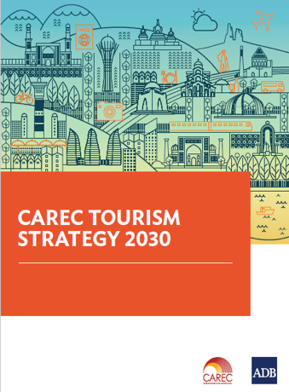
CAREC Tourism Strategy 2030
Institutions and Governance
Connectivity
and
Infrastructure
Marketing
and Branding
Quality
and Standards
Skills
Development
Market
Intelligence
Cross-cutting Themes: Health, Safety and Security, Digitalization, Gender, Environmental Sustainability, Private Sector Participation, Universal Access
Marketing strategies and initiatives to reinforce countries’ image as safe tourism destinations;
Building a common brand “Visit Silk Road” through the development of the CAREC tourism web portal

Slide 3
CAREC Tourism Web Portal: Content
The portal provides content to different audiences which creates traffic synergies and opportunities for sustaining the project.
Tourism Content
Investor Content
Countries, Regions and Assets, Clusters, Partner’s Experiences
(Where, What, How, Who)
Travel Guides and Editorial
(Aggregators, Storytelling, Traffic builders, SEO)
Investment Regulations & Legislation
(Regulatory framework, financing mechanisms and alternatives for each country and for the region)
Investment Projects (R)
(Tourism Investment projects)
synergies
Institutional Content
Education Content
Tourism Development
Tourism Data and Statistics (R)
Tourism Publications (R)
Events
Contacts
Learning Programs
(practical information, scholarships and government sponsored programs for Tourism and Hospitality education on SilkRoad countries)
Notes:
The VisitSilkRoad tourism portal is an important tool to share knowledge, information and direct tourists within the region
The future activities including capacity building programs will support and promote the local private sector and the tourism agencies from CAREC countries to build skills and capacity in delivering sustainable services and embrace a green economy

Slide 4

Welcome to www.visitsilkroad.org CAREC Tourism virtual portal

Slide 5
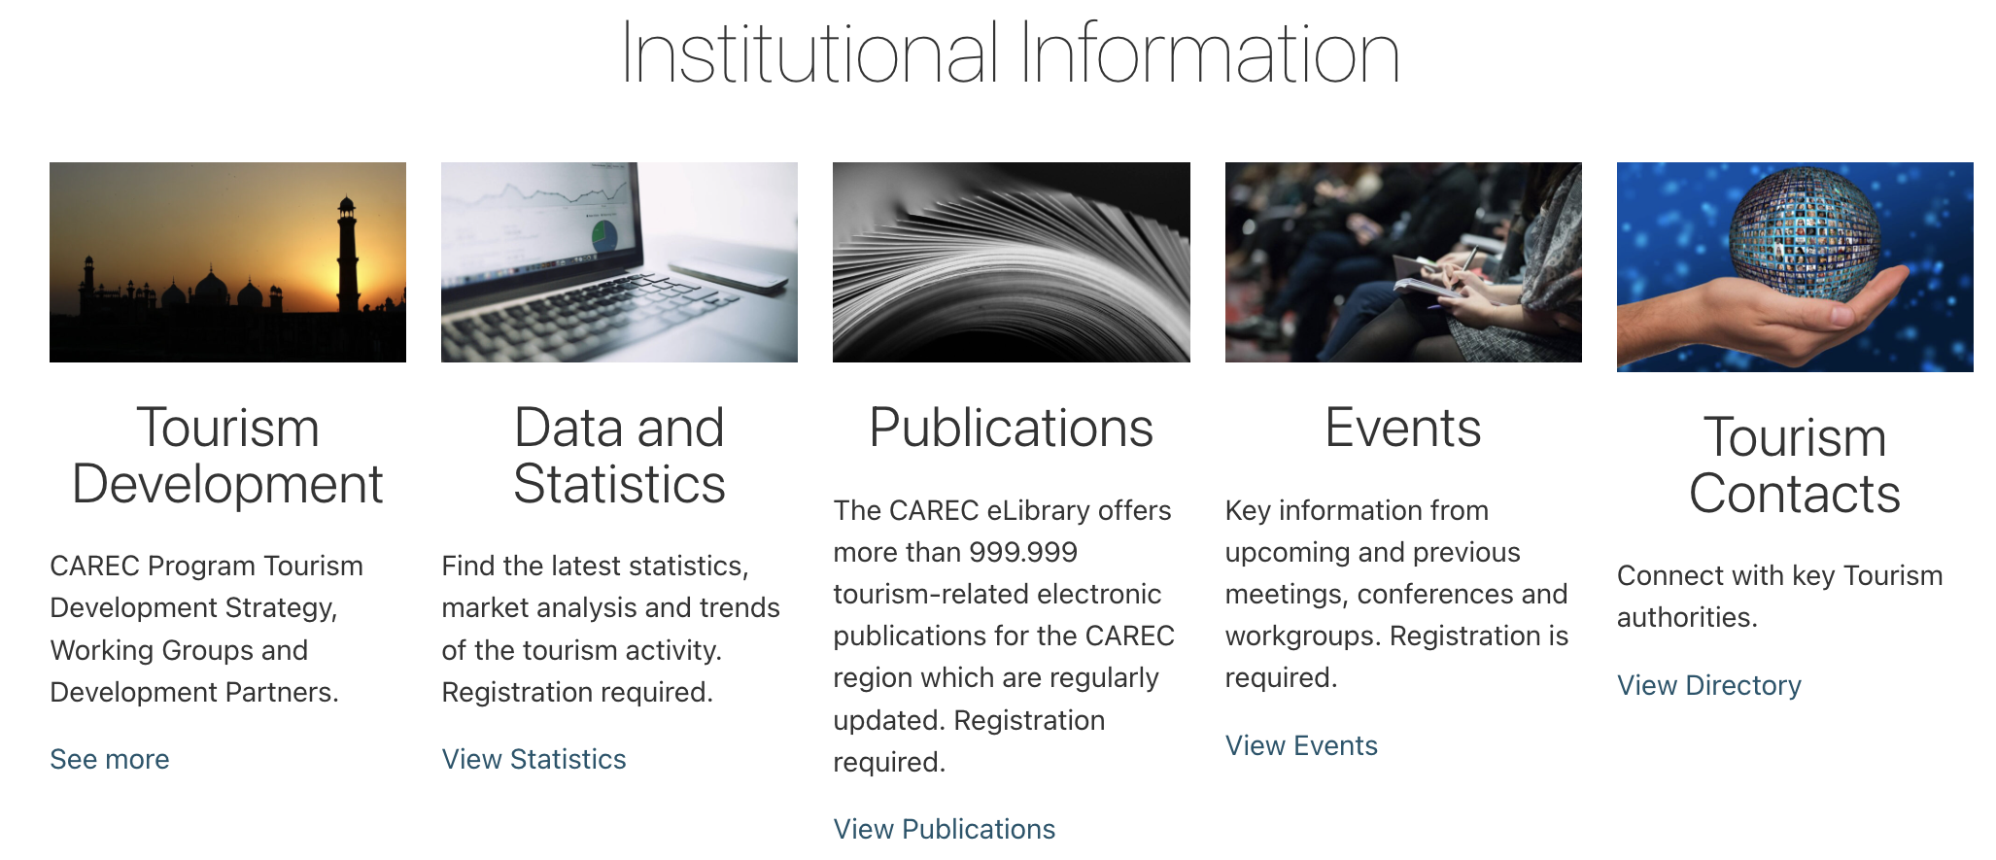
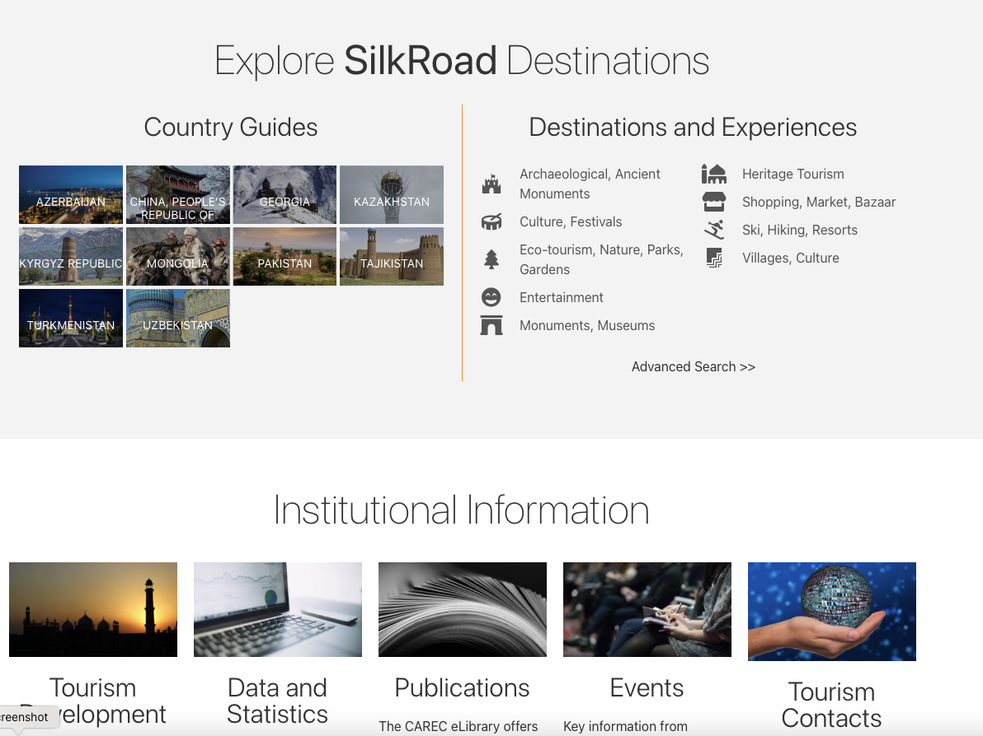
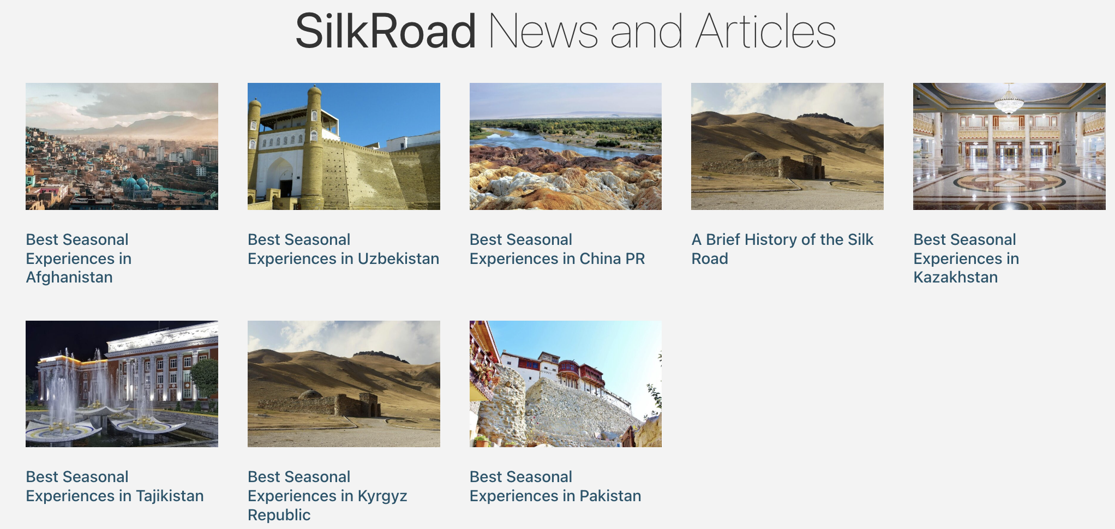
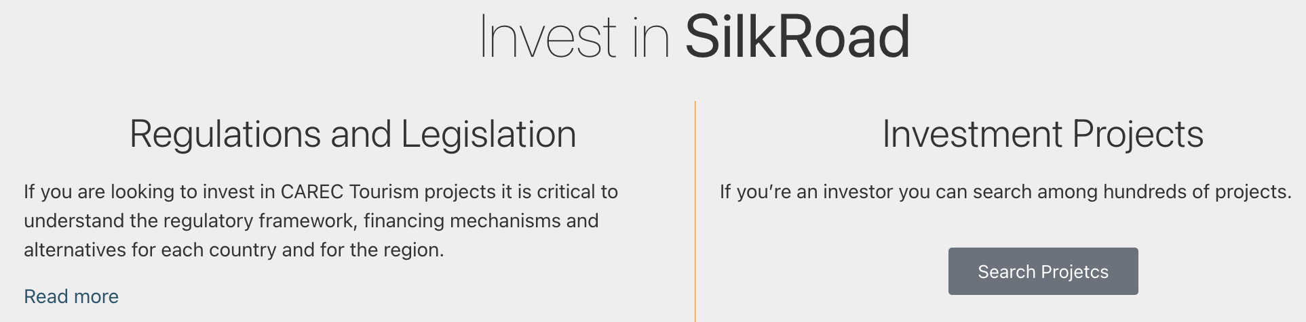
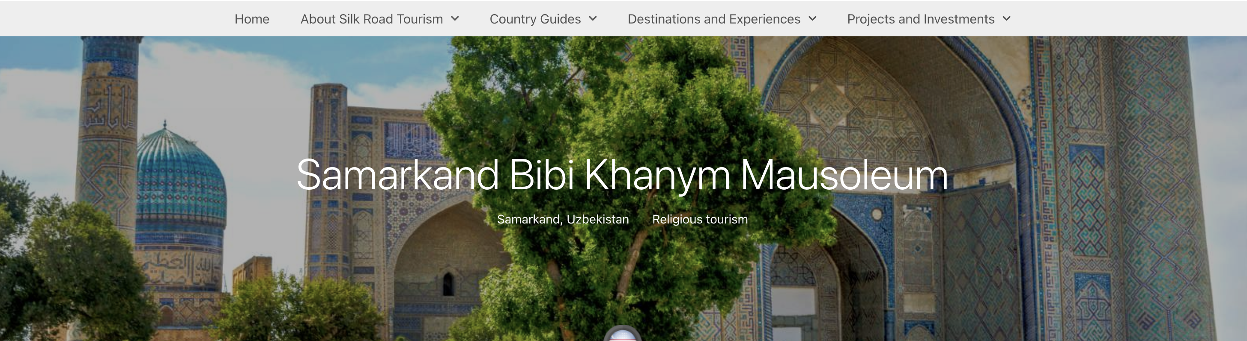
www.visitsilkroad.org
Attraction visit guide

Slide 6


