Slide 1
CAREC Energy Investment Forum What drives success in long-term energy PPPs?
Mr. Chahine Boutouila, Development Director Central Asia, Veolia Group
Tbilisi, Georgia – November 28-29, 2023

Slide 2
Legacy
context

Slide 3
Tashkent DH
Development model
ADB = Transaction Advisor for Tashkent municipality
Bilateral negotiations
Unsolicited
Call for challengers
External
Tender
Solicited
Proposals
Internal

Slide 4
Tashkent DH
perimeter
30
3,200
1,200,000
1,500
7.3
years of PPP contract, started on 1 July 2022
employees hired and trained by Veolia Energy Tashkent
inhabitants + 10,000 legal entities serviced
km of networks operating under open system
GWh of heat energy through 10 central boiler houses and 1 CHP plant

Slide 5
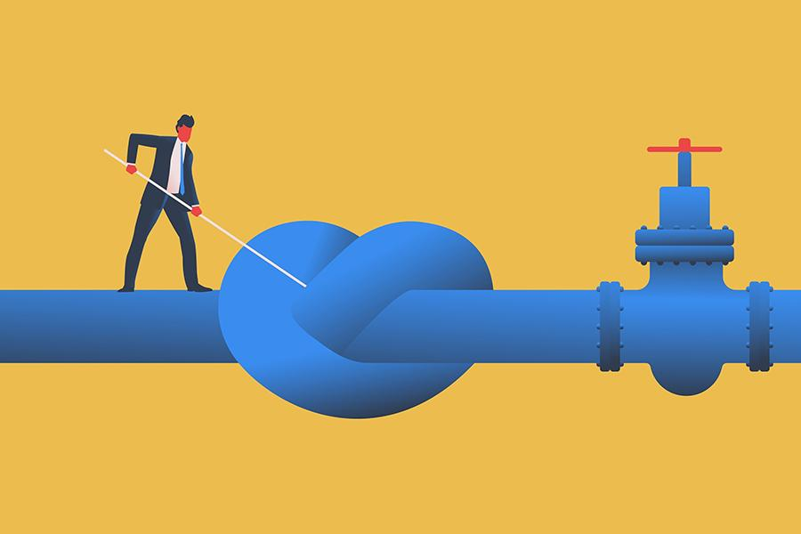
Fuel reliability
challenge

Slide 6
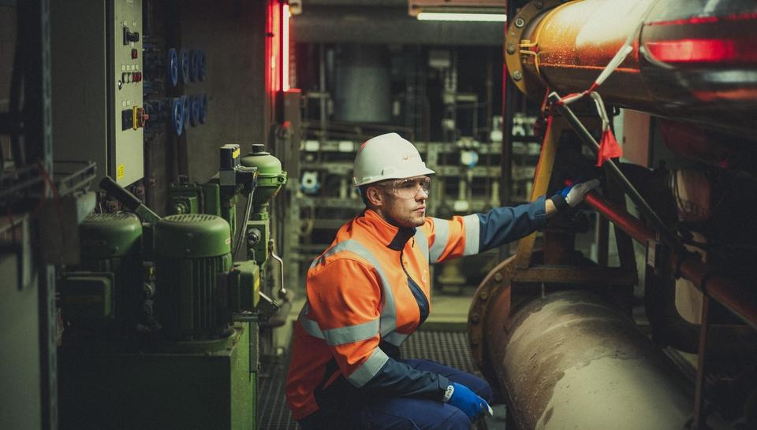
Excellence
challenge

Slide 7
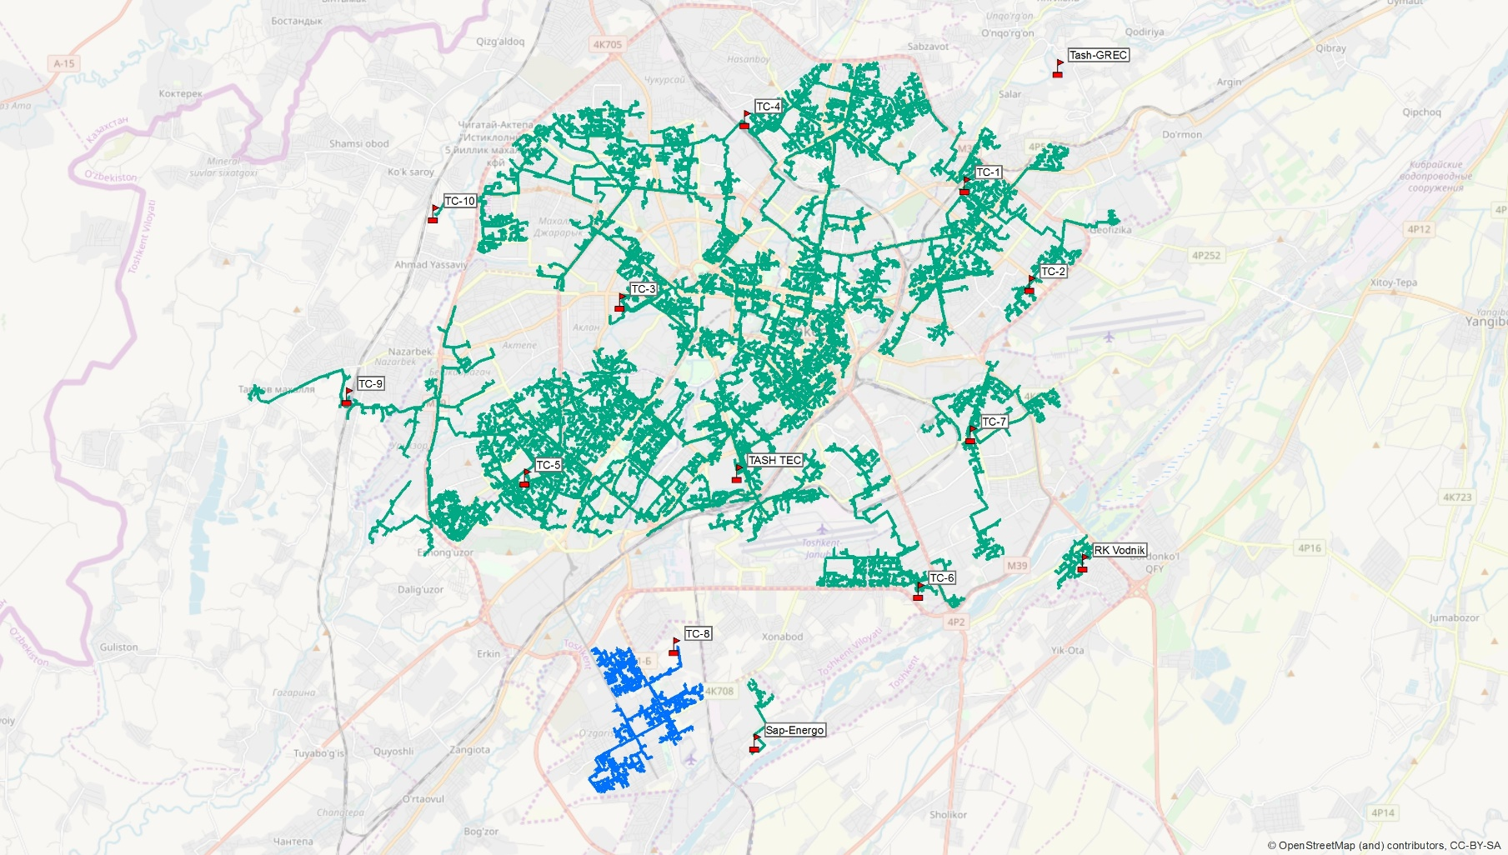
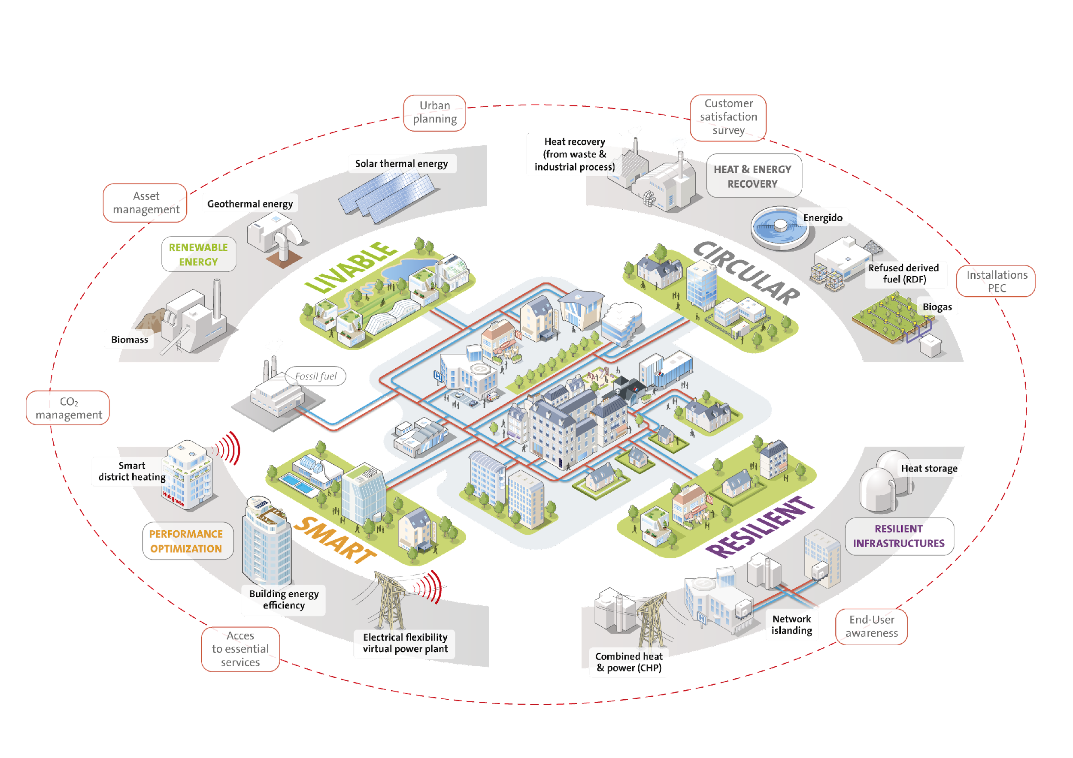
Complexity
challenge

Slide 8
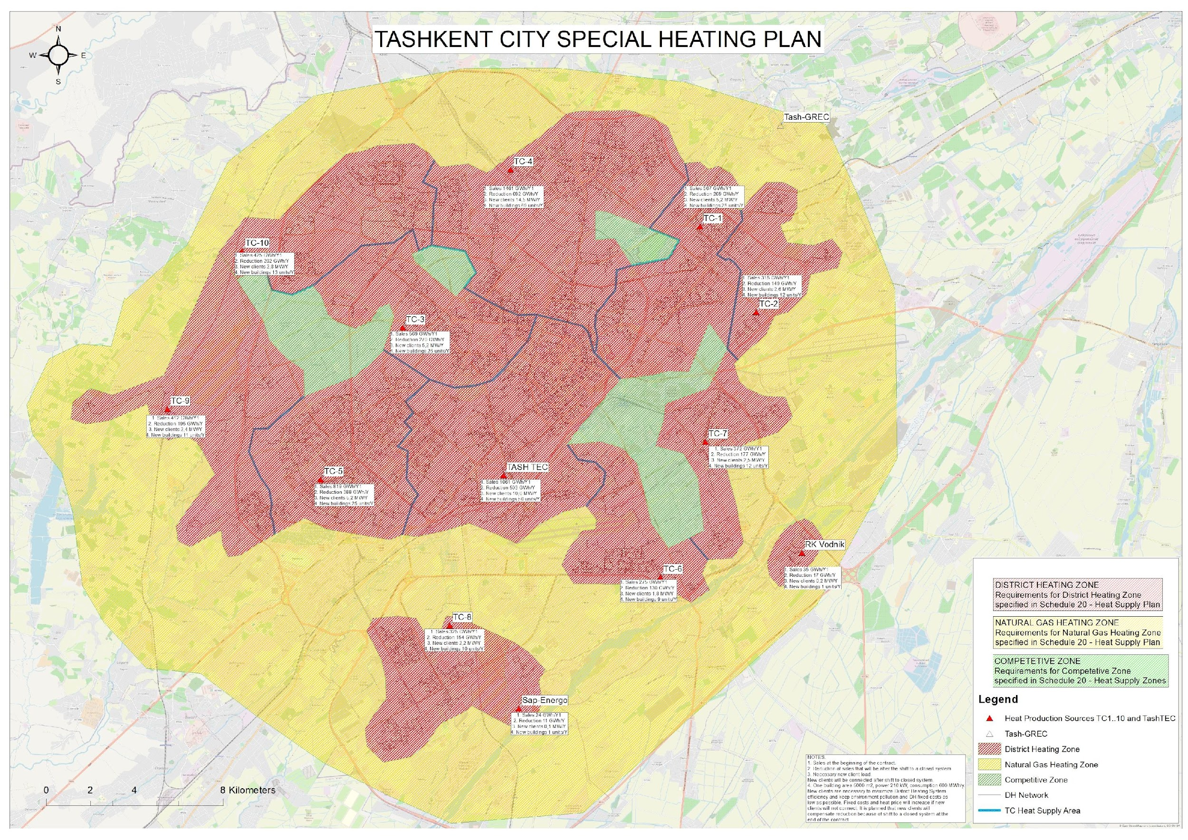
Planification
challenge

Slide 9
THANK YOU!
Mr. Chahine Boutouila, Development Director Central Asia, Veolia Group
Tbilisi, Georgia – November 28-29, 2023

Slide 10
Outline
Slide #2 aims to share contextual information of legacy systems, challenges and opportunities
Slide #3 aims to explain how we developed this flagship project of Tashkent, giving food for thoughts on how to enlarge portfolio of PPP projects while enjoying different perspectives and execution timeframes
Slide #4 aims to present the Tashkent DH project through key numbers
Slide #5 touches upon the energy security issues and needs for thoughtful diversification of energy sources
Slide #6 highlights importance of knowledge and workmanship to optimize and expand infrastructure assets
Slide #7 deals with consequences of not planning holistically and systemically
Slide #8 shows the path towards building a Special Heating Plan

