Slide 1


2023 CAREC ENERGY INVESTMENT FORUM
Unlocking Investment in the CAREC Region

Slide 2
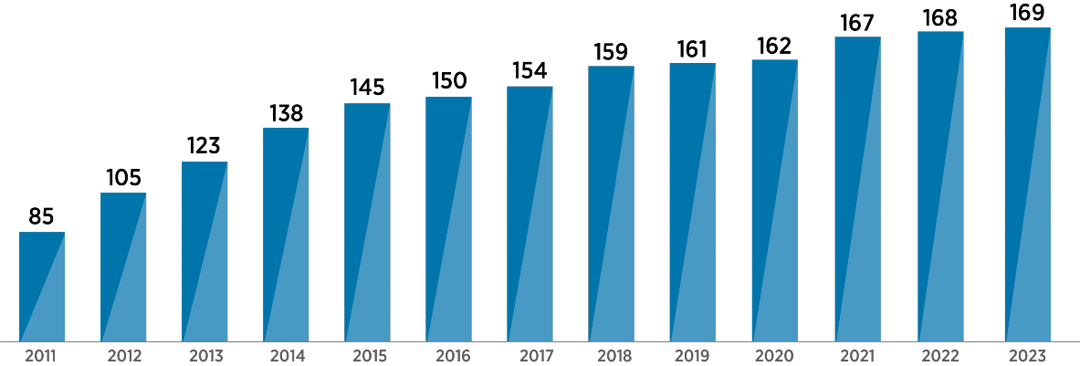
IRENA Membership
IRENA Mission: “Supporting countries worldwide in their transition to a sustainable energy future”

Slide 3
IRENA’s Mandate for Project Facilitation
The Project Facilitation and Support Division aims to:
Support the deployment of renewable energy projects;
Help project developers secure financing more efficiently;
Support investors and lenders to build more robust project portfolios.
Notes:
Finance & Investment
The energy transition will require a cumulative investment of USD 150 trillion in transition-related assets from 2023 up to 2050. And further investment will be needed to create an enabling environment, especially to ensure the transition is just and inclusive.

Slide 4
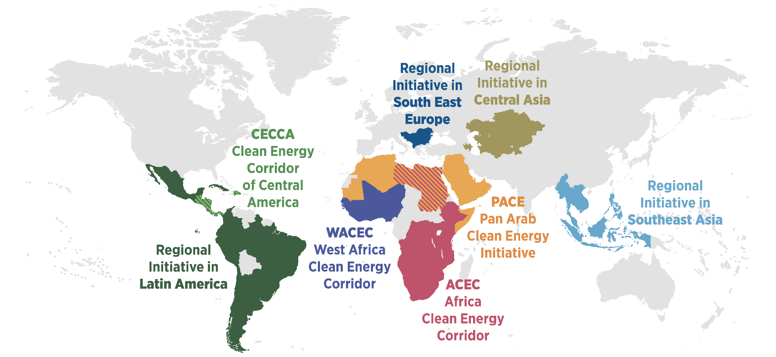
IRENA’s Regional Engagement

Slide 5
IRENA project facilitation platforms (CIP/ETAF): requests for support
Europe
Projects
69
Small Island Developing States (SIDS)
Projects
29
Asia
Projects
94
2 | Albania
1 | Austria
1 | Belgium
4 | Cyprus
1 | Denmark
1 | Finland
8 | France
4 | Germany
3 | Israel
3 | Italy
1 | Latvia
1 | Moldova
1 | Monaco
2 | Macedonia
1 | Norway
1 | Poland
1 | Romania
1 | Russia
8 | Spain
2 | Sweden
4 | Türkiye
6 | Ukraine
12 | UK
4 | Antigua and Barbuda
2 | Bahamas
4 | Barbados
2 | Cuba
1 | Dominica
3 | Dominican Republic
2 | Fiji
1 | Grenada
1 | Haiti
2 | Jamaica
1 | Saint Kitts Nevis
1 | Saint Vincent and the Grenadines
1 | Seychelles
4 | Vanuatu
1 | Afghanistan
3 | Australia
2 | Bangladesh
1 | Bhutan
1 | China
3 | Georgia
27 | India
23 | Indonesia
1 | Kazakhstan
1 | Kyrgyzstan
4 | Malaysia
3 | Mongolia
3 | Nepal
1 | New Zealand
4 | Pakistan
2 | Philippines
1 | Singapore
2 | Sri Lanka
1 | Thailand
1 | Turkmenistan
9 | Uzbekistan
America
Projects
8 1
₄₆₉ Total
projects
14 | Argentina
1 | Belize
8 | Brazil
2 | Canada
1 | Chile
13 | Colombia
3 | Costa Rica
5 | Ecuador
1 | El Salvador
2 | Guatemala
4 | Honduras
7 | Mexico
3 | Nicaragua
1 | Panama
1 | Peru
1 | Suriname
1 | Uruguay
13 | USA
Africa
Projects
₁₆₇
Middle East and North Africa
Projects
29
2 | Angola
1 | Botswana
1 | Burkina Faso
1 | Burundi
4 | Cameroon
1 | Central African Republic
1 | Chad
5 | Congo
2 | Cote d Ivoire
3 | Eswatini
4 | Ethiopia
1 | Gambia
2 | Ghana
1 | Guinea
1 | Guinea Bissau
14 | Kenya
4 | Liberia
3 | Madagascar
4 | Malawi
2 | Mozambique
4 | Namibia
1 | Niger
35 | Nigeria
2 | Other
2 | Rwanda
8 | Senegal
4 | Sierra Leone
1 | Somalia
13 | South Africa
1 | South Sudan
3 | Sudan
9 | Tanzania
4 | Togo
11 | Uganda
2 | Zambia
10 | Zimbabwe
1 | Algeria
2 | Djibouti
3 | Egypt
4 | Iran
2 | Iraq
2 | Jordan
1 | Lebanon
4 | Morocco
2 | Oman
1 | Saudi Arabia
4 | Tunisia
3 | UAE
Disclaimer: This map is provided for illustration purposes only. Boundaries and names shown on this map do not imply the expression of any opinion on the part of IRENA concerning the status of any region, country, territory, city, or area or of its authorities, or concerning the delimitation of frontiers or boundaries. The position of the indicators reflects the submission of one or more projects on the ETAF and/or CIP platforms within the respective country or, if not applicable, the country of origin of the developers.

Slide 6

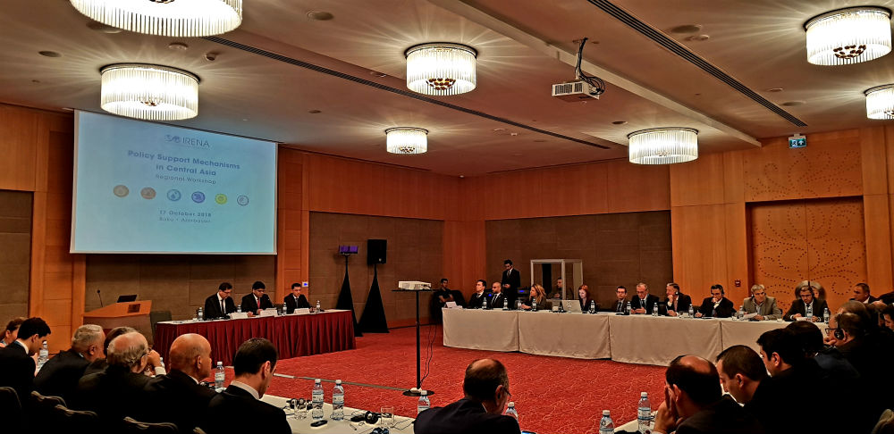
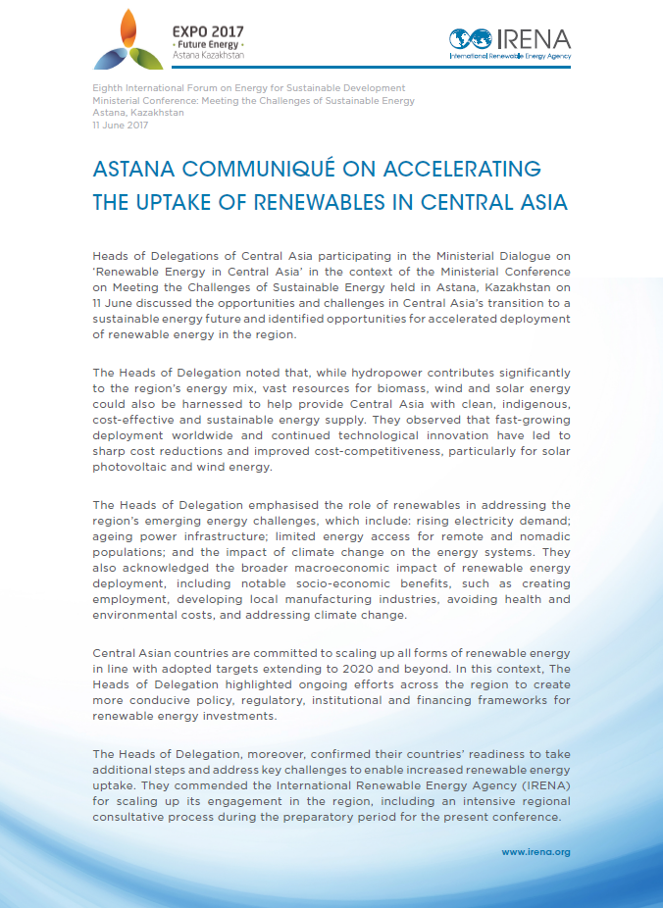
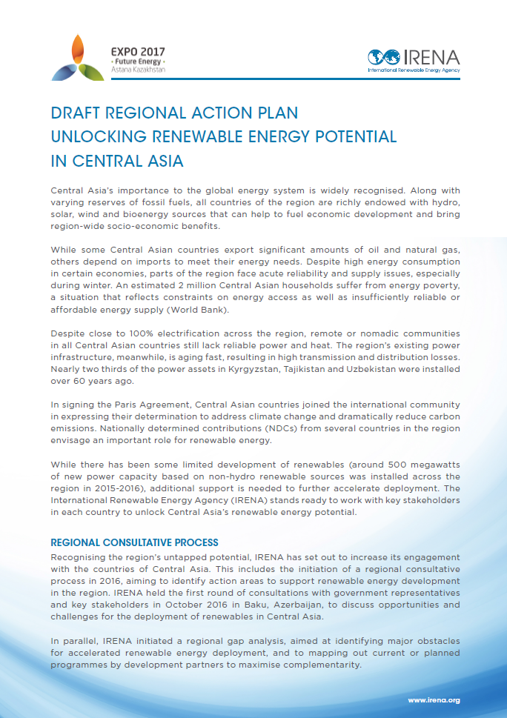
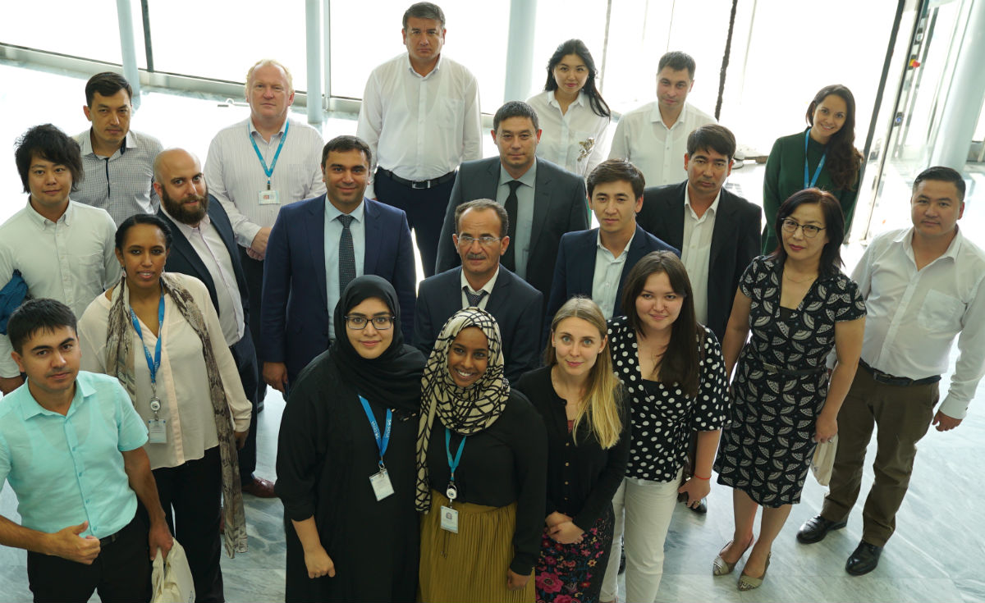
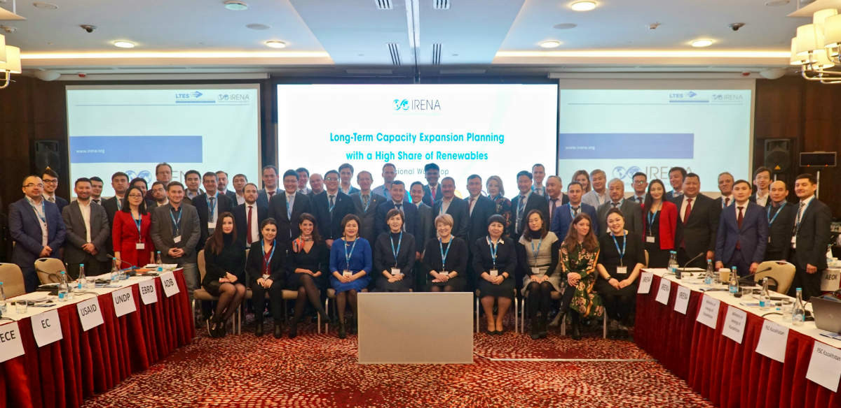
IRENA’s Engagement in the region of Central Asia: regional level
Astana Communiqué on Accelerating the Uptake of Renewables in Central Asia
Enabling Policy and Regulatory Frameworks for Renewables
Regional Workshop on Policy Support Mechanisms
October 2018, Baku, Azerbaijan
June 2017, Nur-Sultan, Kazakhstan
Renewable Energy Statistics and Data Collection
Long-Term Energy Planning
Central Asia Renewable Energy Statistics Training
September 2018, Abu Dhabi, UAE
Central Asia Workshop on Long-Term Capacity Expansion Planning with a High Share of Renewables
March 2019, Nur-Sultan, Kazakhstan

Slide 7







Central Asia Regional Initiative
Astana Communiqué on Accelerating the Uptake of Renewables in Central Asia - 11 June 2017
Action Areas
Renewable Energy Statistics and Data Collection
Policies and Regulation for Renewable Energy Deployment
Resource assessment
Integration on VREs into Power Grids
Project Development Support
Awareness Raising
7

Slide 8
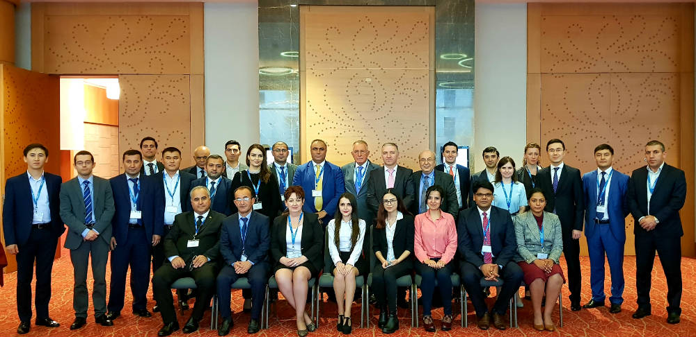
Enabling Policy and Regulatory Frameworks for Renewables
Improving the understanding of design and implementation
of renewable energy targets, policies and support schemes
Regional Workshop on Policy Support Mechanisms 17 October 2018, Baku
Main insights:
Need for adopting comprehensive RE policy with a long-term implementation roadmap
Access to private finance remains limited, therefore fiscal incentives, along with support mechanisms are critical for RE uptake.
Issues relating to technical aspects of grid access could be specified in legal documents, such as grid code
There is an important need to account for the socio-economic benefits in policy-making process

Slide 9
Renewable Energy Statistics and Data Collection
Enhancing capacities to improve the collection of reliable data
on renewables
Central Asia Renewable Energy Statistics Training
25-27 September 2018, Abu Dhabi
Main insights:
There is a need to better define the data requirements
Data collection can be enhanced through improvements in the legal and institutional framework to clarify methodologies and processes
Mechanisms for data dissemination could be adjusted to ensure that the collected data is publicly available through online resources

Slide 10
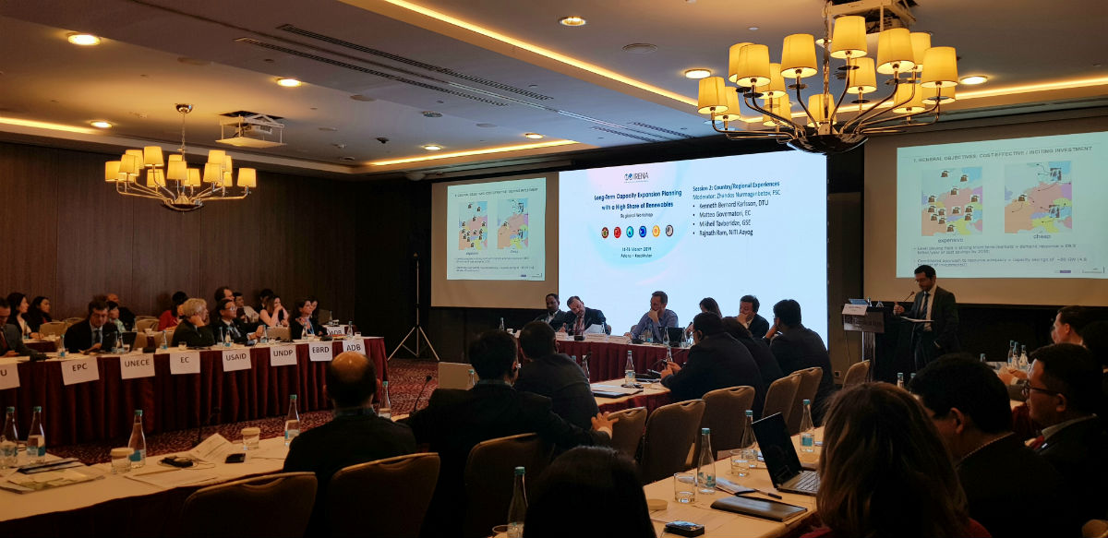
Long-Term Energy Planning
Central Asia Workshop on Long-Term Capacity Expansion Planning with a High Share of Renewables
14-15 March 2019, Astana
Improving understanding of technical and regulatory aspects and facilitate the integration of variable renewable energy into power systems
Main insights:
Very limited application of comprehensive long-term planning tools and methodologies
    Mostly with utilities
Planning process could benefit from the inclusion of a wider set of stakeholders
There is a strong potential for improved regional collaboration on long-term planning, especially involving transmission system operators

Slide 11
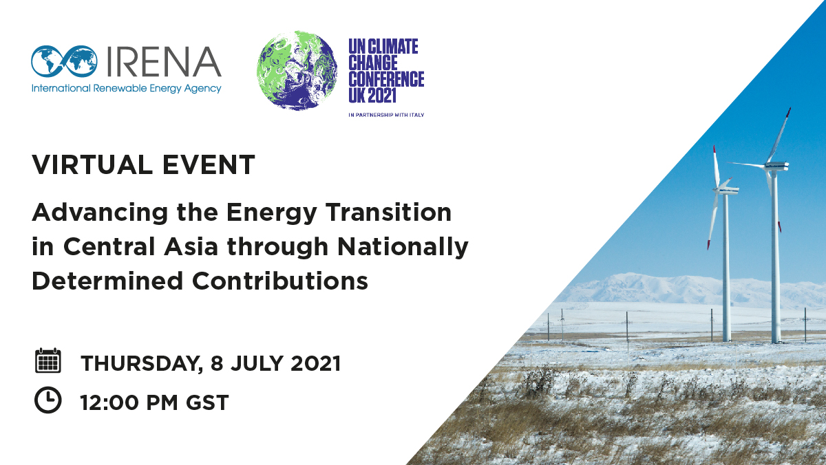
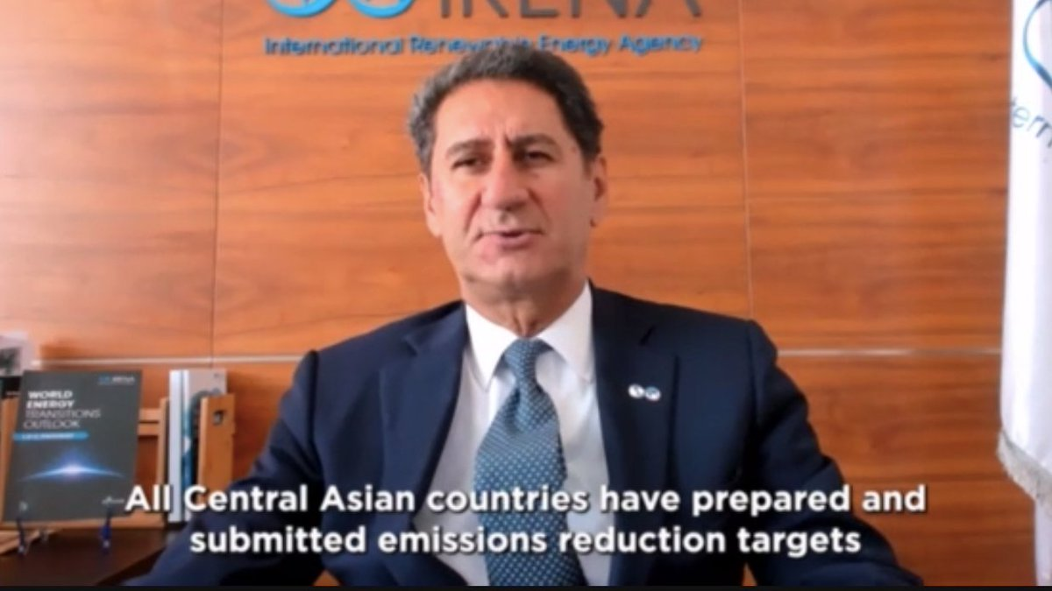
IRENA’s Engagement in the region of Central Asia: regional level
encouraging more ambitious climate action by all governments in Central Asia, including the submission of updated long-term climate/energy strategies in support of the goals set out in the Paris Agreement;
deepening the understanding on the opportunities offered by the energy sector in the decarbonization efforts;
discussing the key role of mobilizing renewable energy financing at scale and de-risking investments in Central Asia to accelerate energy transition;
sharing experience across the region on long-term climate/energy strategies, and from analysis and studies by regional and international institutions.

Slide 12
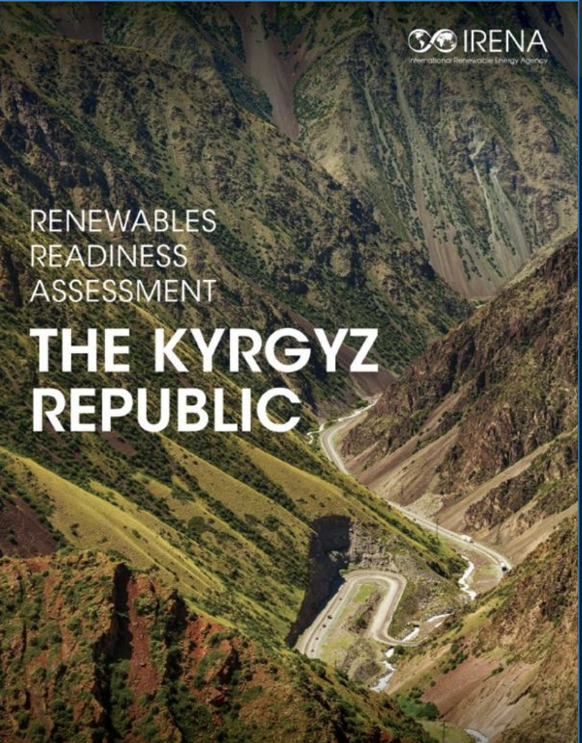
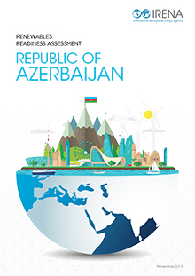
IRENA’s Engagement in the region of Central Asia: country level
Azerbaijan : Renewables Readiness Assessment, December 2019
Kazakhstan : Capacity building for enhancing energy statistics for NDC, 2023
Kyrgyzstan : RRA with resource assessment and RE targets capacity building, December 2022
Uzbekistan : SolarCity Simulator for Tashkent, November 2023
Financial close of 3 solar projects (Sherabad, Samarkand and Jizzakh) through IRENA’s ETAF

Slide 13
Recap – How to make energy investments in the CAREC region bankable?
Adoption of comprehensive RE policy with a long-term implementation roadmap – Involve utilities;
Access to private finance: Fiscal incentives, along with support mechanisms;
More comprehensive grid code, spelling Issues relating to technical aspects of grid access;
Clearly account for the socio-economic benefits in policy-making process;

Slide 14
Recap – How to make energy investments in the CAREC region bankable?
Data collection can be enhanced: Improvements in the legal and institutional framework to clarify methodologies and processes;
Data dissemination mechanism adjustment: Ensure that the collected data is publicly available through online resources;
Inclusion a wider set of stakeholders in planning process;
Build upon the potential for improved regional collaboration on long-term planning – Involving transmission system operators

Slide 15
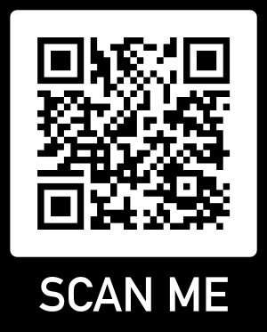
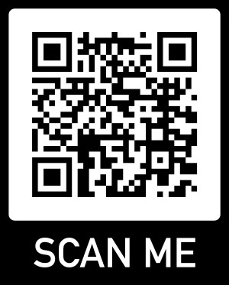
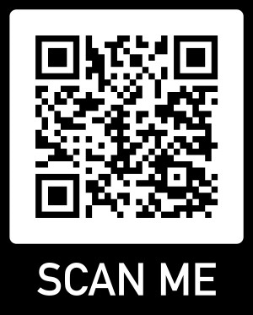
IRENA Project Facilitation Webinars
Mastering Project Submission and Readiness for ETAF Funding and Support
Presentar y preparar proyectos para el financiamiento y apoyo de ETAF: Énfasis en América Latina
Webinar on the Climate Investment Platform
Notes:
1. El proceso: los desarrolladores de proyectos se registran con su email y someten su aplicación en la plataforma, en línea (les voy a ensenar como en un minuto).
2. Después, el Secretariat de ETAF (somos nosotros en IRENA) llevamos a cabo un screening y evaluación de los proyectos. Recomendamos los proyectos que cumplen con los criterios de selección y que sometieron suficiente información a nuestros socios por su consideración. Cuando un socio manifiesta su interés en un proyecto, le ponemos en contacto con el desarrollador.
3. A partir de allí, IRENA ya no está involucrada en la conversación, pero si es necesario, podemos ayudar al desarrollador de proyecto a cumplir con los requisitos de documentación del socio. El socio lleva a cabo su propia due diligence, según sus criterios de créditos. No tomemos parte en la negociación financiera o en el acuerdo de financiamiento. Después de la firma del acuerdo, podemos volver a ser involucrados, para facilitar cualquiera cosa. También hacemos un trabajo de monitoring y reporting, para informar a nuestros países miembros del progreso y del impacto alcanzado con los proyectos que fueron facilitados a través de ETAF.
4. Después de la demonstración del portal en línea, le explicaremos que hace que un proyecto esta recomendado a los socios o no. Si su proyecto no cumple con los criterios de elegibilidad, IRENA tiene otra iniciativa más inclusiva.
5. Hasta ahora, 41 proyectos fueron sometidos en ETAF. Finalizamos la evaluación de 31 de ellos, y la mitad (14) fue recomendada a nuestros socios. De los 14 proyectos recomendados, nuestros socios expresaron su interés en 8 de ellos, y hasta ahora, menos de 1 año después del lanzamiento de la convocación de los proyectos, 3 proyectos alcanzaron cierre financiero.

Slide 16
شكرا لكم
谢谢
Thank you
Merci
Спасибо
Gracias

