Slide 1
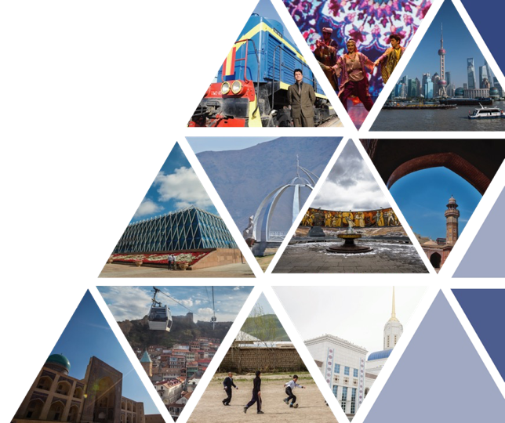
CAREC Tourism Web Portal
Senior Officials’ Meeting to be held on 13-14 June 2023, Tbilisi, Georgia

Slide 2
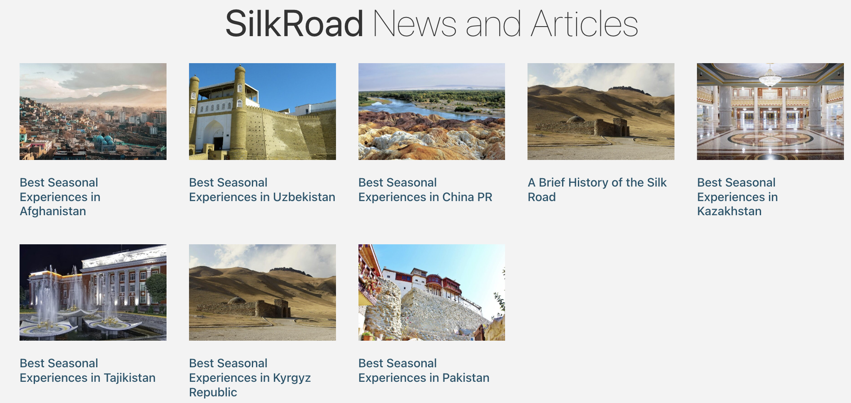
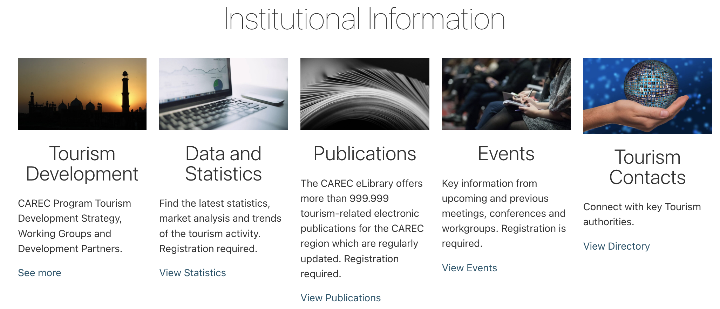
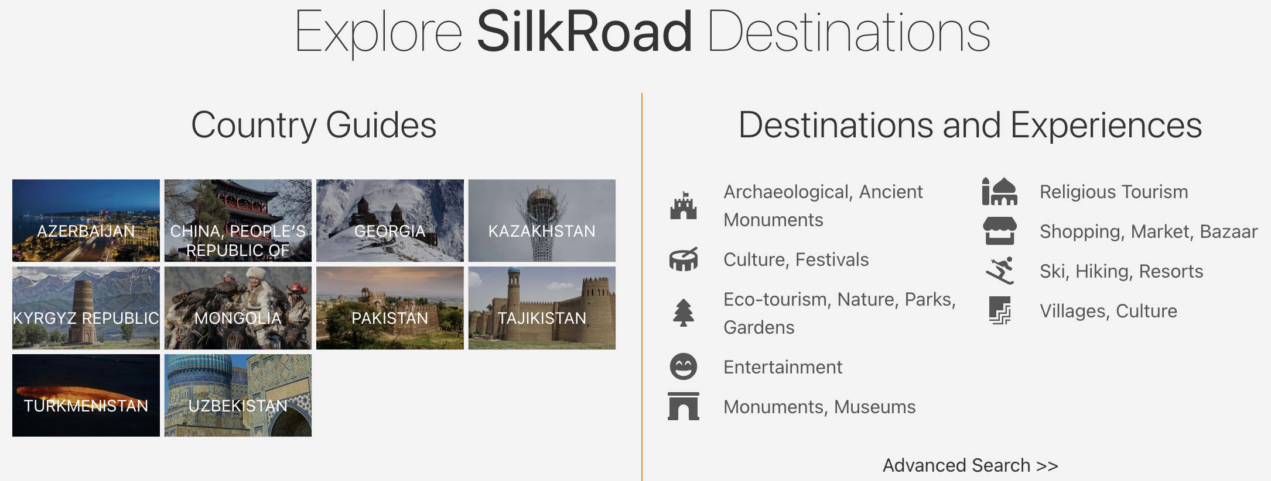
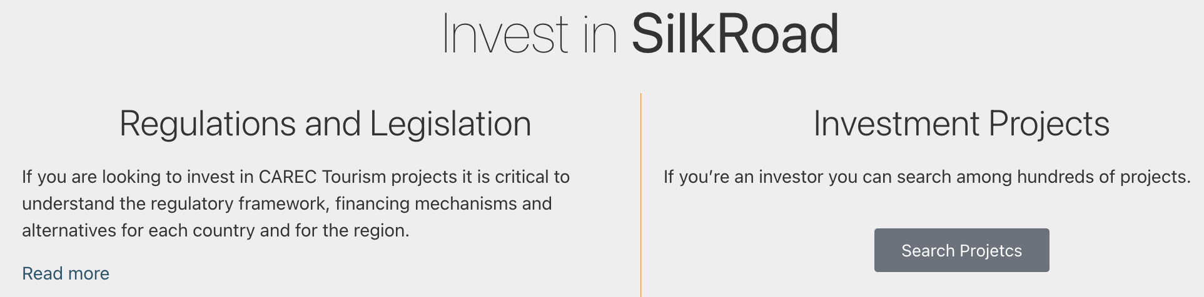
TA 9776 – Sustainable Tourism Development in the CAREC Region
Visitsilkroad virtual portal concept
Maximization of targeted traffic, further channelled to National Institutional pages and Private Sector Tourism Sites

Slide 3
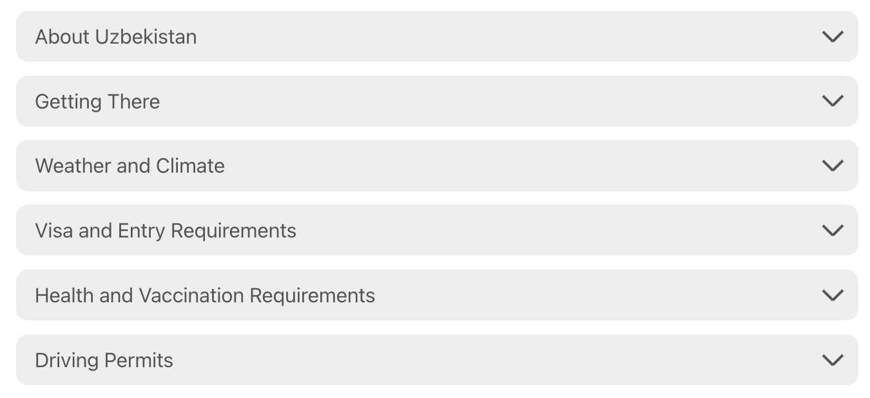
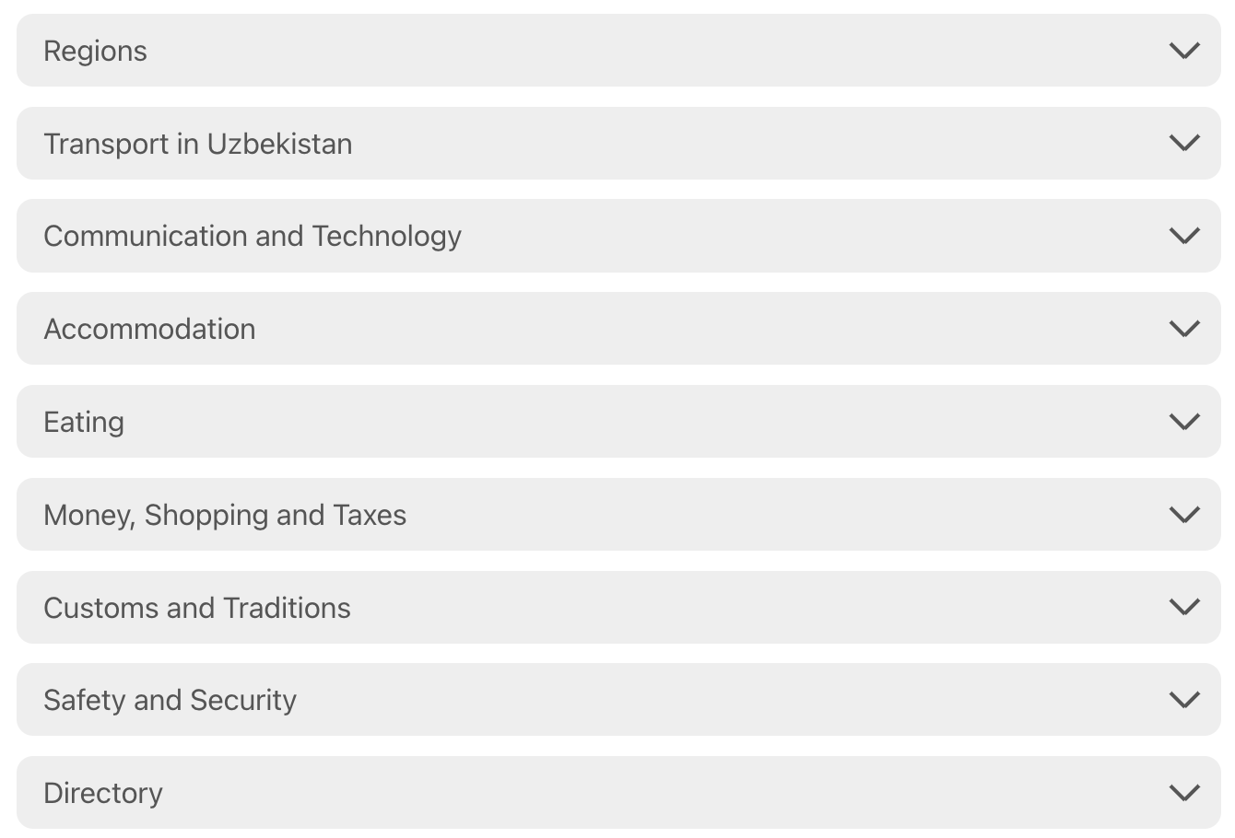
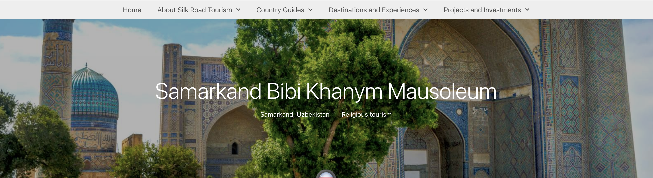
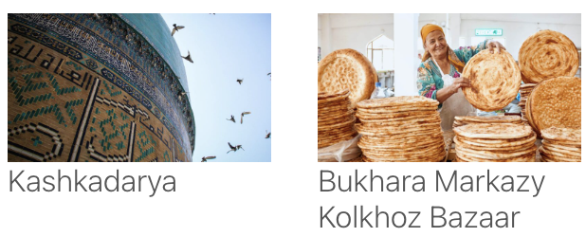
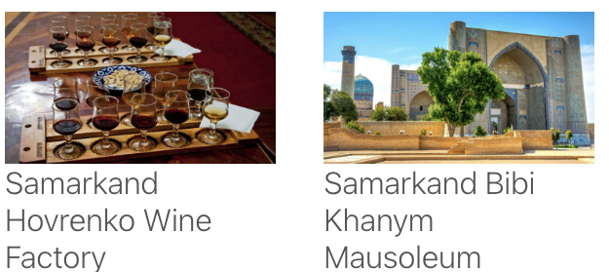
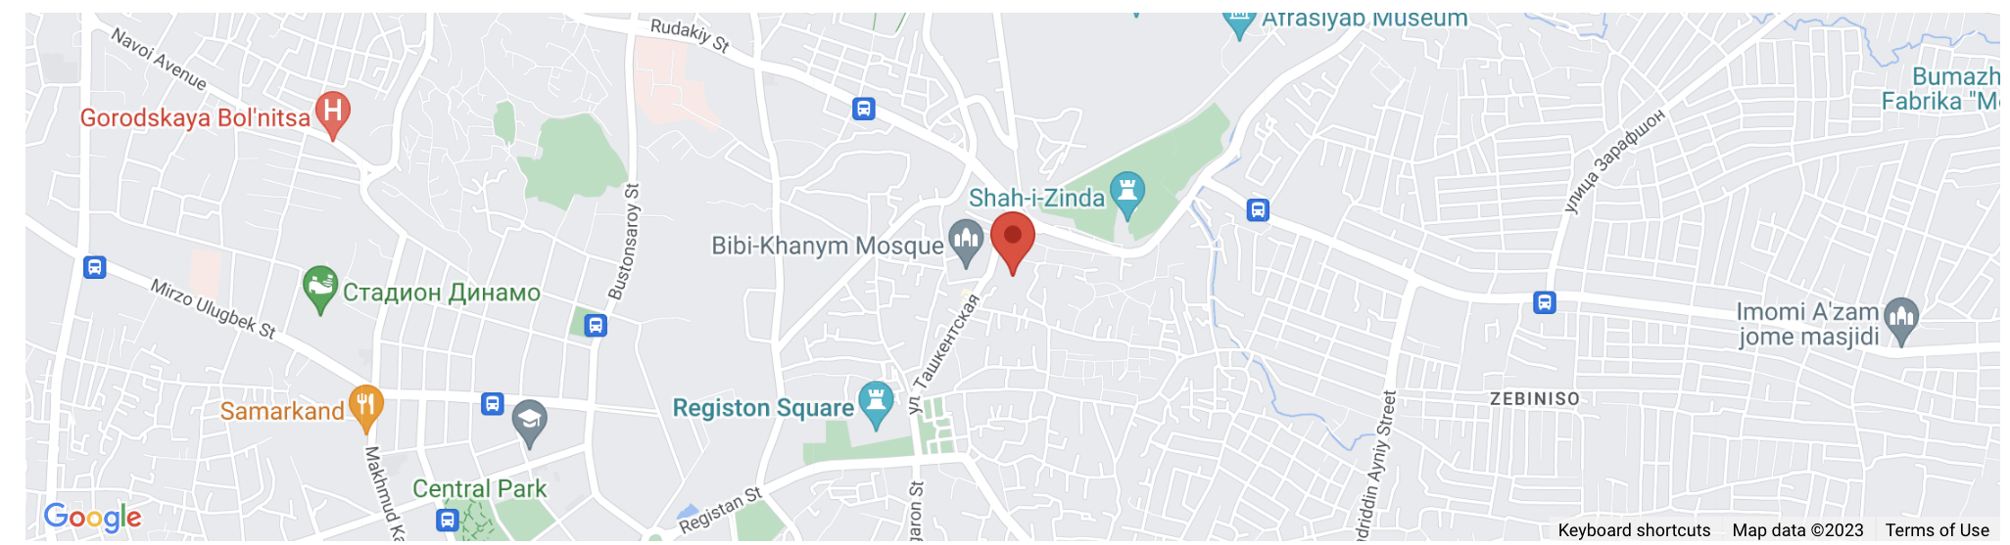
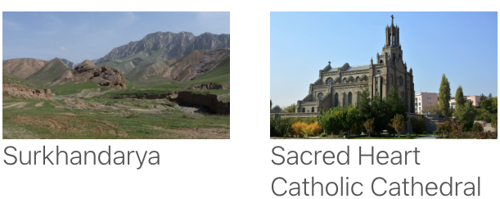
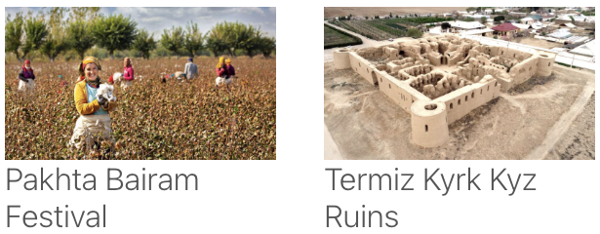
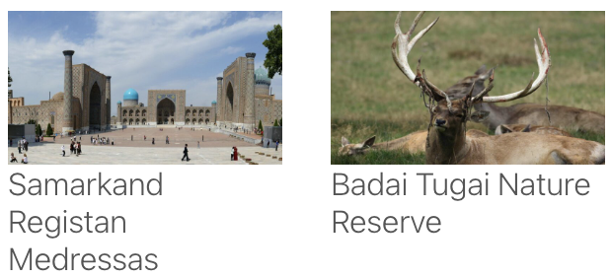
TA 9776 – Sustainable Tourism Development in the CAREC Region
Visitsilkroad virtual portal concept
Direct links to National Tourism Organization(s)
Traveller Oriented area
Country/ Region travel guide
Macro area/ Priority clusters
Regional clusters
Country/ Region attractions
Customized & ADB compliant dynamic maps
Attraction visit guide
Bibi Khanym Mausoleum (bibi being “lady” or “mother”) is the most grandiose, largest and most magnificent structure in Central Asia. The mausoleum was built in 1399 in Samarkand by the order of Amir Temur in honor of his beloved wife. The complex consisted of a painted entrance portal of 33- meter height, Bibi Khanym mosque with blue domes, 4 minarets, and a massive marble bookstand for the Holy Quran in the center of the courtyard.
Getting There
⌃
Nearby Attractions
What to Expect
⌃
Featured Tours
History
⌃
Accommodation
Direct links to private sector pages
Facilities Available
⌃
Restaurants
Entertainment

Slide 4
TA 9776 – Sustainable Tourism Development in the CAREC Region
Visitsilkroad virtual portal concept
Private sector development
Featured Tours
Restaurants
Attraction visit guide
Tour operators offer package tours that include the attraction
Hospitality establishments that are located in the vicinity of the attraction
Accommodation
Entertainment
Bibi Khanym Mausoleum (bibi being “lady” or “mother”) is the most grandiose, largest and most magnificent structure in Central Asia. The mausoleum was built in 1399 in Samarkand by the order of Amir Temur in honor of his beloved wife. The complex consisted of a painted entrance portal of 33- meter height, Bibi Khanym mosque with blue domes, 4 minarets, and a massive marble bookstand for the Holy Quran in the center of the courtyard.
Accommodation establishments that are located in the vicinity of the attraction
Entertainment establishments that are located in the vicinity of the attraction
Getting There
⌃
Each entity has its own page
B 2 B and B 2 C for Businesses
Quality grating for each establishment
What to Expect
⌃
History
⌃
Facilities Available
⌃

Slide 5
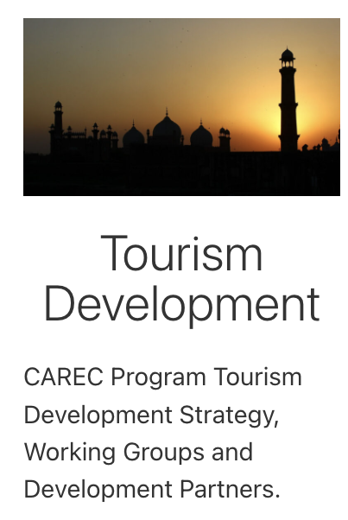
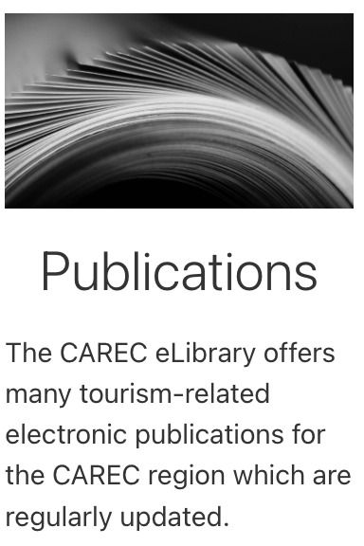


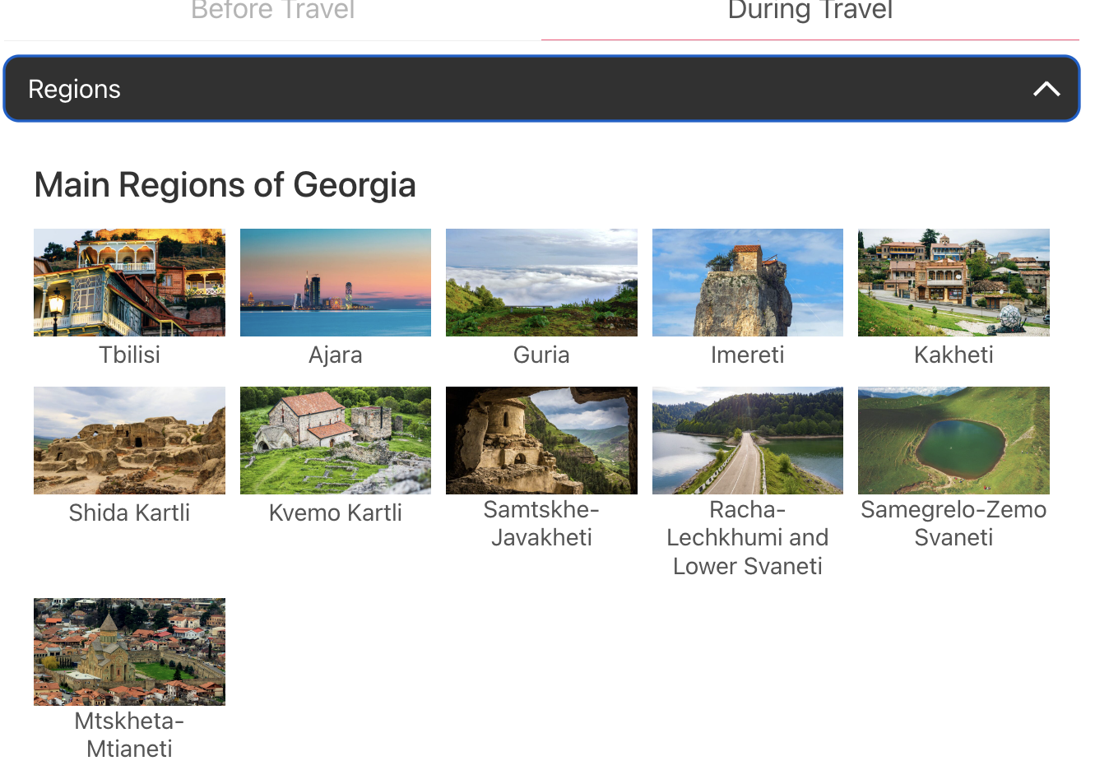



TA 9776 – Sustainable Tourism Development in the CAREC Region
Visitsilkroad virtual portal concept
Institutional
For Tourism Organizations
For Reference
Attractions database
Design product/ grouping
Quick Publishing and time - market
For Support
$ € ¥ £
Training and Education
Investment
TVET
Certifications
Schools & programs
Courses
Regulations and legislation
Investment projects
Financing

Slide 6
Thank you

