Slide 1
Update on the Upcoming Energy Investment Forum Tbilisi, 28–29 November 2023
Altynay Arapova, Economist, CWRD, ADB
aarapova@adb.org

Slide 2
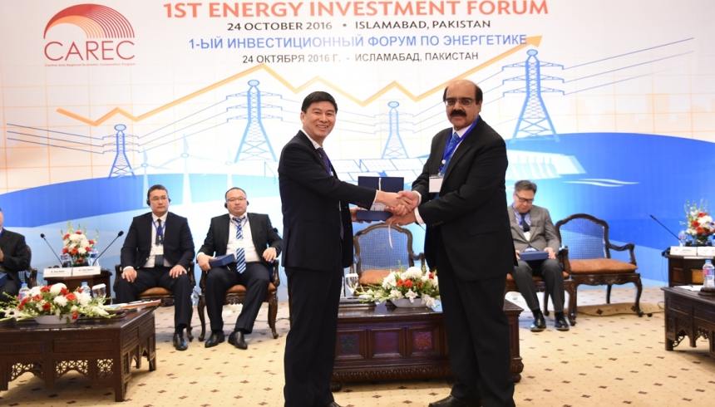
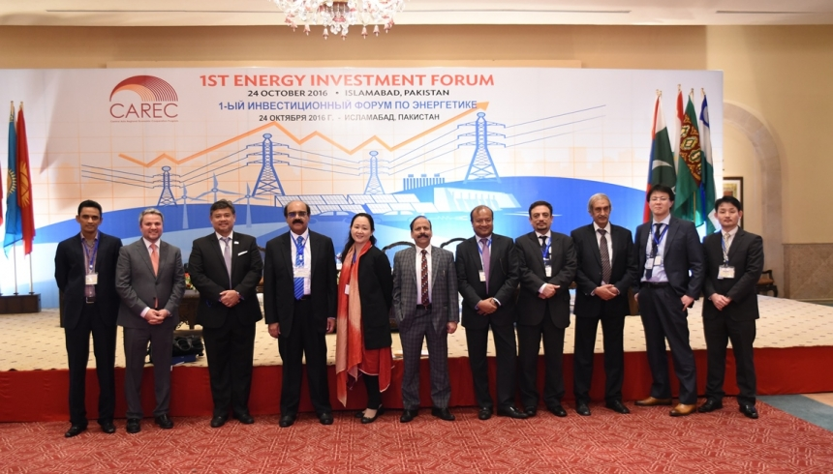
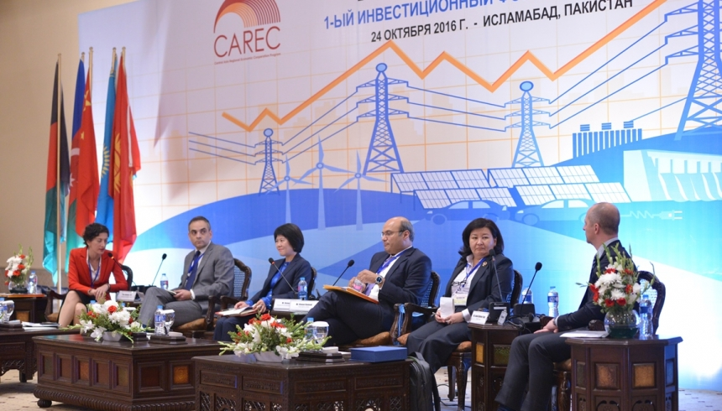
Background
The CAREC Energy Investment Forum (EIF) was first organized in Islamabad in 2016.
Subsequent EIFs were held in Astana in 2017, Batumi (Georgia) in 2018 and Tashkent in 2019.
Due to COVID-19, there were no EIFs in 2020 and 2022.
A virtual EIF was held in 2021.
For 2023, the 6th EIF will be held in Tbilisi on
28 and 29 November.

Slide 3
Purpose
The EIF is a platform for engaging governments in the CAREC region, project developers, development partners, financiers and other stakeholders.
The primary focus is to fast-track the financing of these projects and ensure their timely realization, drawing upon insights from development banks, private developers, and key regional stakeholders.
The primary objective of the forum is to stimulate dialogue that leads to the initiation of new sustainable energy projects and help enable financing for these projects.
At this year’s event, we are putting new energy projects at the center stage.
10 CAREC member countries will unveil upcoming investment opportunities; from solar, wind and hydro to energy efficiency and sustainable heating.
In the program, we have also included a series of compelling “intermezzo presentations”, covering vital topics concerning the energy transition in the region.

Slide 4
Status of 6th CAREC Energy Investment Forum
Status:
Matchmaking:
Forum will be moderated by Nisha Pillai, former BBC World Anchor.
Most key external and internal speakers are confirmed.
Planned two roundtable discussions: (i) with the private sector and (ii) with development partners.
All CAREC government delegations will have a 10–15-minute presentation
Intermezzo presentations to spice up the forum and make it more compelling.
Matchmaking forum on day 2
Our aim is to connect developers, development banks, and CAREC governments.
Each country will have one station. At the station, government officials and potentially other stakeholders will be seated.
Participants will walk around in groups (10 groups), circulating between each station every 15 minutes. A bell will signal that it is time to move on.

Slide 5
Expectations from CAREC Governments
Each CAREC member country will have 10 minutes to present investment opportunities in their country and 5 minutes for questions.
The CAREC members have been requested to compile 2 or more investment-ready projects. These will be presented in the presentation.
The deadline for sending the presentation and project info is 20 October. (We will gladly assist in helping government delegates making as compelling a presentation as possible.)
Please follow up with your country’s delegates regarding this presentation and the project information.
Also, invitations for the CAREC EIF were sent in September. So far, only 8 countries have sent in their nominees.
For the matchmaking event on Day 2
(29 November):
We would appreciate it if each member country could bring some brochures, leaflets, or similar, that can be handed out at each station. i.e., information manual about investing in country A or similar.

Slide 6
Way Ahead
Interconnectivity and regional transmission workshop, in Q1 2024.
A study tour to a developed energy trading market (Nordic Region) in 2024 (exact timing to be announced).
The 7th Energy Investment Forum to be held in Kazakhstan (CAREC chair in 2024) in Q4 2024.
A workshop on sustainable heating and energy efficiency in Q1 2025.
Planned Future CAREC Energy Sector Activities:

