Slide 1
The current energy landscape of the CAREC region
CAREC Energy Investment Forum
November 28, Tbilisi, Georgia
Martin Sommerseth Jaer, ADB

Slide 2
Why are we here?
?

Slide 3
Why are we here?
SDG 7: Ensure access to affordable, reliable, sustainable and modern energy for all.
United Nation’s Sustainable Development Goals (SDGs)

Slide 4
Why are we here?
SDG 7: Ensure access to affordable, reliable, sustainable and modern energy for all.
SDG 13: Climate action
United Nation’s Sustainable Development Goals (SDGs)

Slide 5
Why are we here?
SDG 7: Ensure access to affordable, reliable, sustainable and modern energy for all.
United Nation’s Sustainable Development Goals (SDGs)

Slide 6
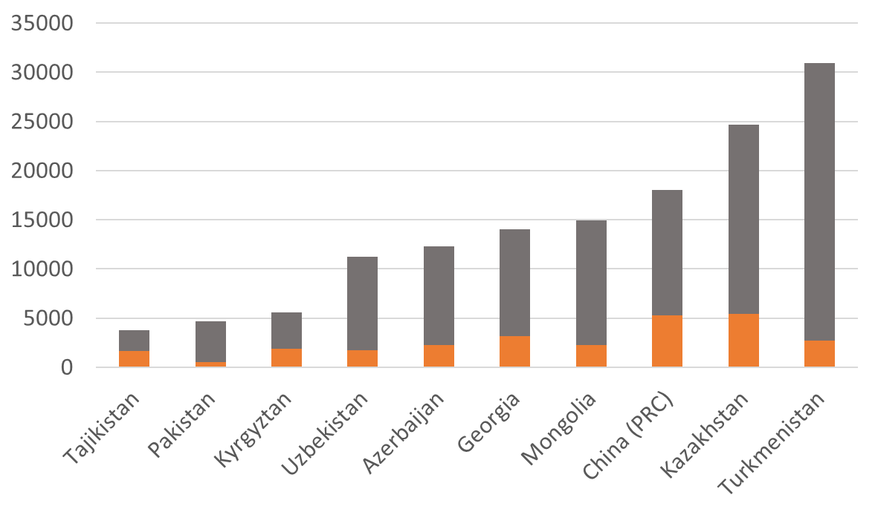
How is the region doing in ensuring energy for all?
Total final energy consumption per capita in the CAREC region
KWh
Heat, transport, industry* ++
Electricity
Source: www.iea.org * 1 GJ=277kwh

Slide 7
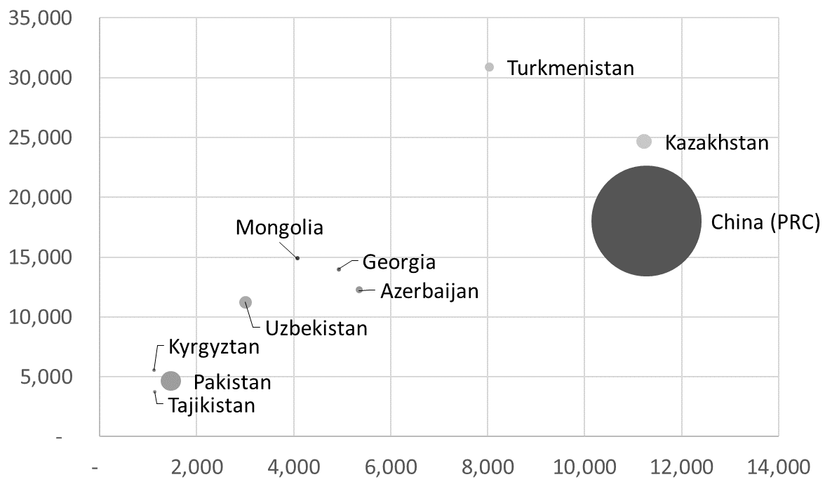
Energy vs economic development
Energy consumption per person vs income in the CAREC region
KWh
Income per person
Source: www.iea.org

Slide 8
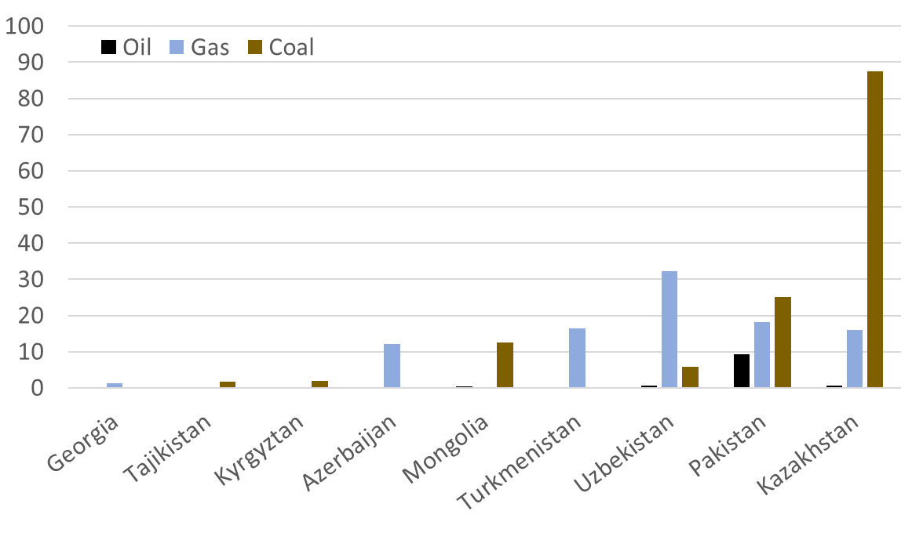
How sustainable is the energy in the region?
Annual CO2 emissions from electricity and heat production in CAREC
Million tons of CO2
In total: ~250 million tons of CO2 emissions from electricity and heat in the region (ex PRC)
Source: www.iea.org

Slide 9
The value proposition from sustainable energy?
(Below, AI generated picture using the prompt “Fossil fueled energy future in the CAREC region” ©Dall-E)

Slide 10
The value proposition from sustainable energy?
(Below, AI generated picture using the prompt “Fossil fueled energy future in the CAREC region” ©Dall-E)
Fast deployment
Enhanced energy security
Long term cost savings
Health benefits+climate

Slide 11
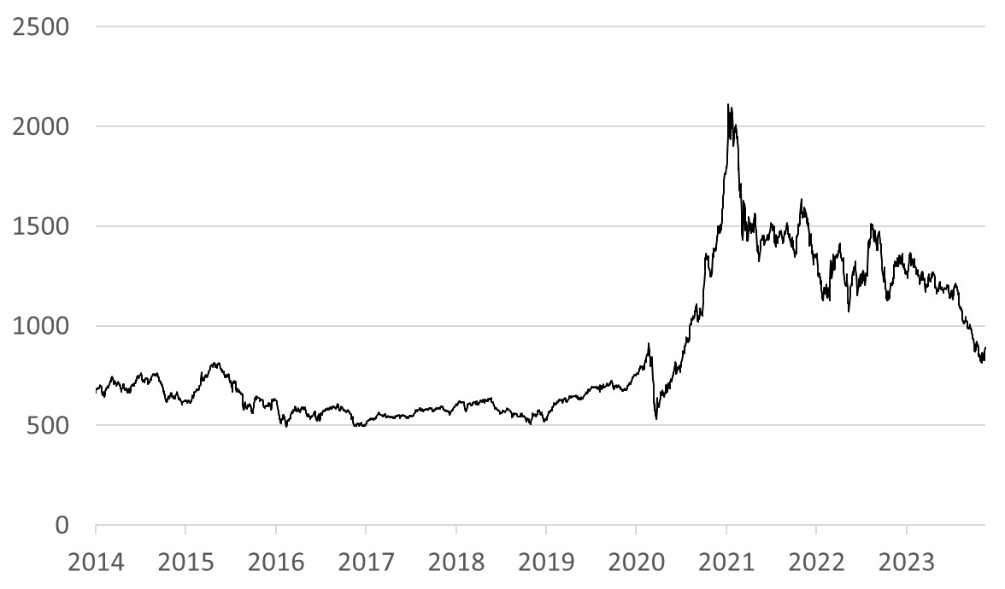
Market realities: Impact of global shifts on Renewable Energy
Global clean energy stock market index
Source: Tradingeconomics.com

Slide 12
Market realities: Impact of global shifts on Renewable Energy
Global clean energy stock market index
Euphoria!!
Source: Tradingeconomics.com

Slide 13
Market realities: Impact of global shifts on Renewable Energy
Global clean energy stock market index
Reality check
Source: Tradingeconomics.com

Slide 14
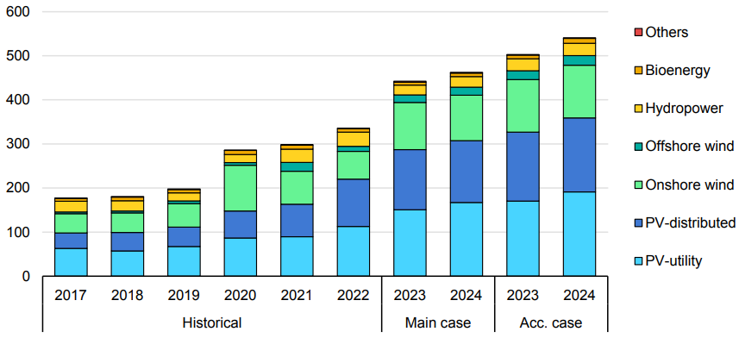
Euphoria: Record high deployment of renewable energy globally
Net renewable electricity capacity additions by technology, globally
GW
Historical
Forecast
Source: www.iea.org

Slide 15
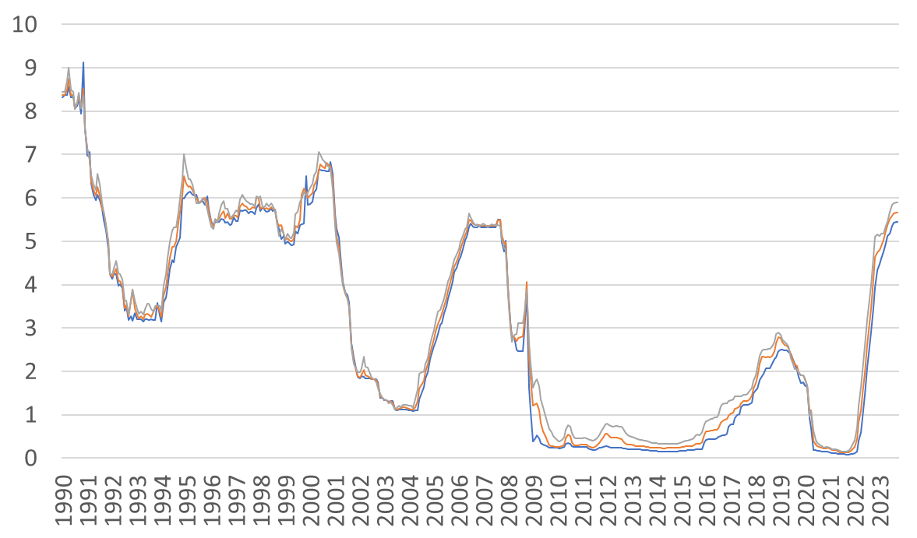
Reality check: Interest rates and cost inflation
USD interest rates (LIBOR and SOFR)
%
Highest interest rates in 23 years..

Slide 16
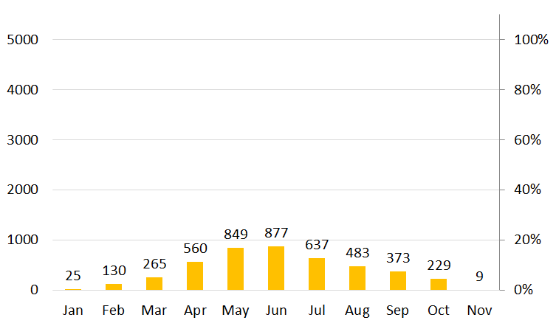
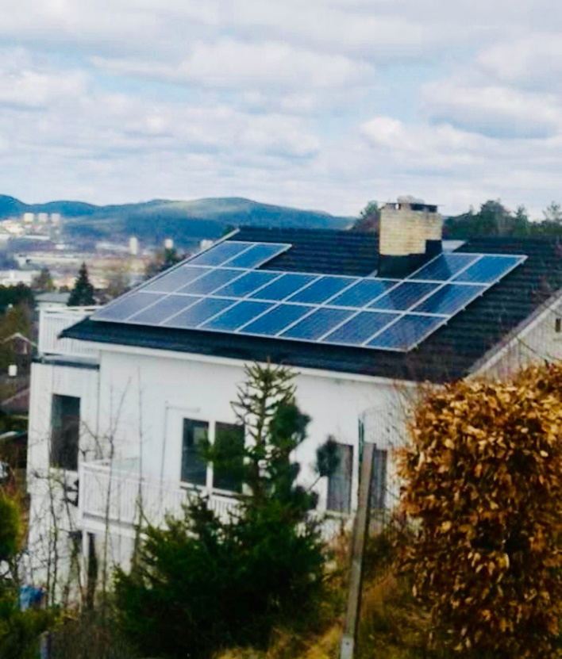
Reality check: The variability of renewable energy generation
5.3KW solar rooftop in a temperate climate. Production vs consumption
Kwh

Slide 17
Reality check: The variability of renewable energy generation
5.3KW solar rooftop in a temperate climate. Production vs consumption
Kwh

Slide 18
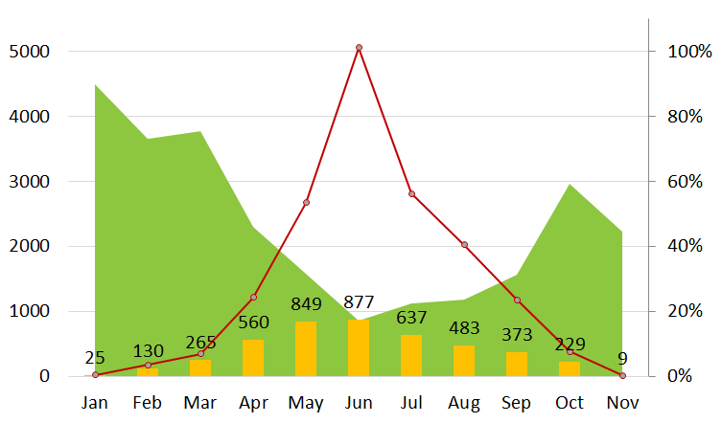
Reality check: The variability of renewable energy generation
5.3KW solar rooftop in a temperate climate. Production vs consumption
Kwh
Solar-share
Consumption

Slide 19
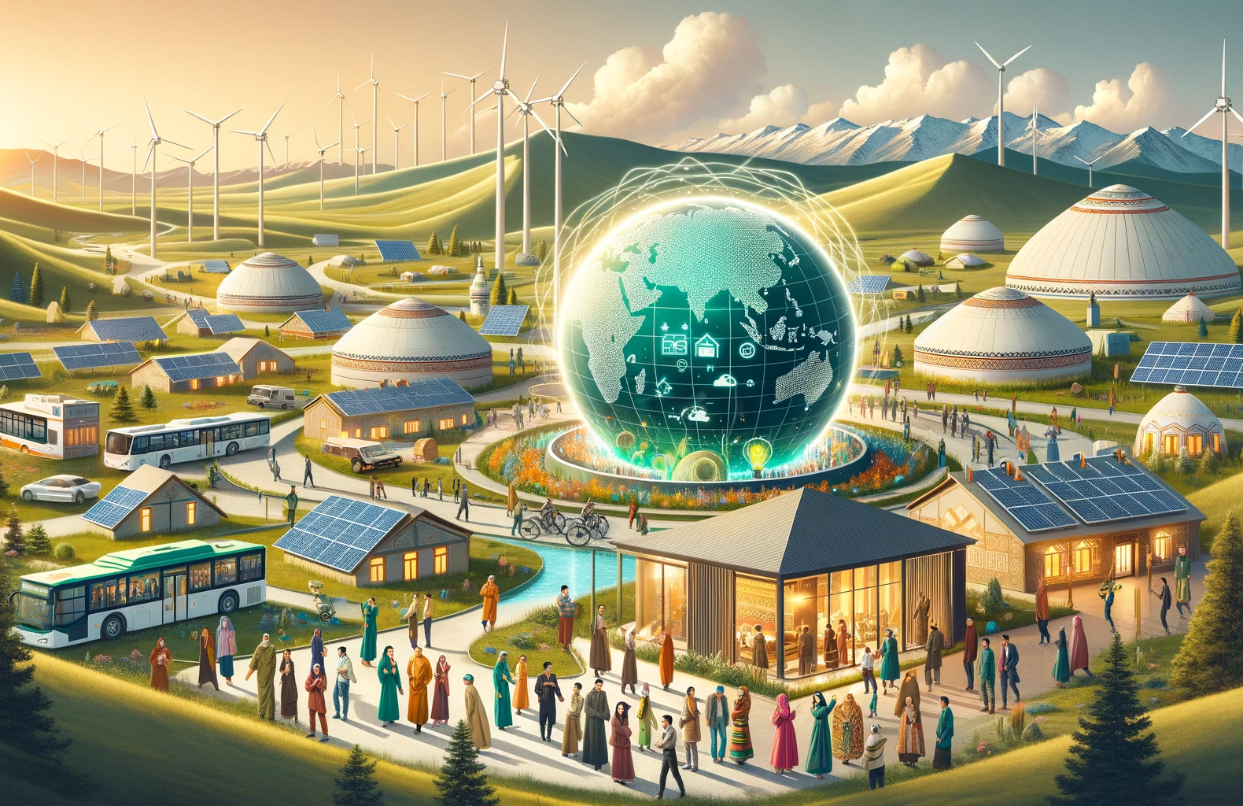
Looking ahead:
(Below, AI generated picture using the prompt “sustainable energy future in the CAREC region” ©Dall-E)

Slide 20
Looking ahead:
(Below, AI generated picture using the prompt “sustainable energy future in the CAREC region” ©Dall-E)
Load balancing/storage
Demand response
Regional interconnectivity

