Slide 1

CAREC Tourism Priority Projects
Senior Officials’ Meeting to be held on 13-14 June 2023, Tbilisi, Georgia

Slide 2
4 Project profiles for conceptualization and pre-feasibility
3 stages
Evaluating Projects – S.C.O.R.E Framework
S
S
Scalability
O
1st Stage
$
C
Commitment
R
O
Operational alignment
C
2nd Stage
$$
R
Regional Cooperation and Integration
E
Economic, financial, environmental, and social sustainability
E
3rd Stage
$$$
The highest scores will be prioritised and further evaluated in the next stage
Assessment costs increase per stage, compared to the previous
Notes:
The TA aims to facilitate increased cooperation among CAREC countries to position the region as a globally attractive tourism destination, and has the following outputs.
Output 1: CAREC tourism sector strategy developed, will set out a vision and a roadmap towards 2030, in alignment with CAREC countries’ tourism priorities.
Output 2: Regional tourism investment framework for 2021–2025 prepared, will complement the CAREC tourism strategy, with specific tourism projects to be implemented.
Output 3: Institutional capacity of tourism authorities and exchange of information enhanced, will support conducting workshops and training activities to enhance the capacity of governments for tourism planning and policy making, market research and collection and analysis of tourism statistics, and will promote information-sharing between public and private tourism stakeholders in the region, including through the development of a CAREC tourism portal.
Output 4: Development and implementation of common health and safety protocols and standards in consideration of the effects of the global COVID-19 pandemic on the tourism sector in CAREC countries.
Note: Total amount includes additional financing approved on 31 October 2022 for $750,000. Remaining uncommitted amount will be used to finance ongoing and additional activities outlined in the next slides. Initial TA amount at approval was $2 million. The TA has been extended until July 2024 (final extension).

Slide 3
4 Project profiles for conceptualization and pre-feasibility
A - Improvement of the infrastructure and services, environmentally sustainable concepts, including building units based on renewable energy sources in pilot areas and a network of public eco-toilets in remote areas.
B - Upgrading and rehabilitating historical and culturally relevant tourist attractions in integration with urban planning and development.
The decision of where to be taken during Senior Officials’ Meeting
C - Development of a common registry of tourism assets and data collection, their content, and their management.
Entire CAREC
Prioritization in using of the web portal
D - Branding, strategy, planning, budgeting, and funding sources for implementing the common brand “Visit Silk Road”, integrating additional features for the CAREC tourism portal, and developing a “CAREC tourism service quality label innovative system”.
3

Slide 4
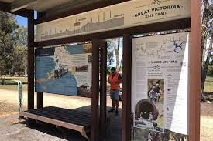


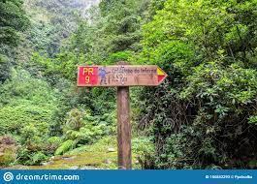
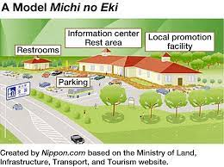

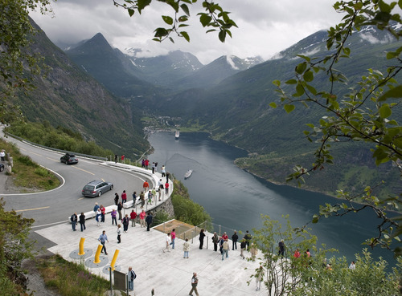
4 Project profiles for conceptualization and pre-feasibility
4 projects for conceptualization
The decision of where to be taken in CAREC during the Senior Officials’ Meeting
Project
A - Improve infrastructure and services, environmentally sustainable concepts, including building units based on renewable energy sources in pilot areas and a network of public eco-toilets in remote areas.

Slide 5
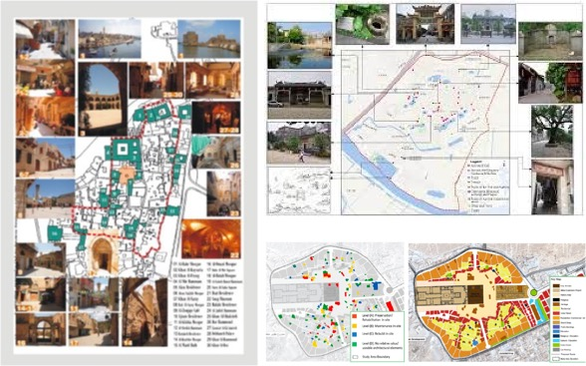
4 Project profiles for conceptualization and pre-feasibility
4 projects for conceptualization
The decision of where to be taken in CAREC during the Senior Officials’ Meeting
Project
B - Upgrading and rehabilitating historical and culturally relevant tourist attractions in integration with urban planning and development

Slide 6
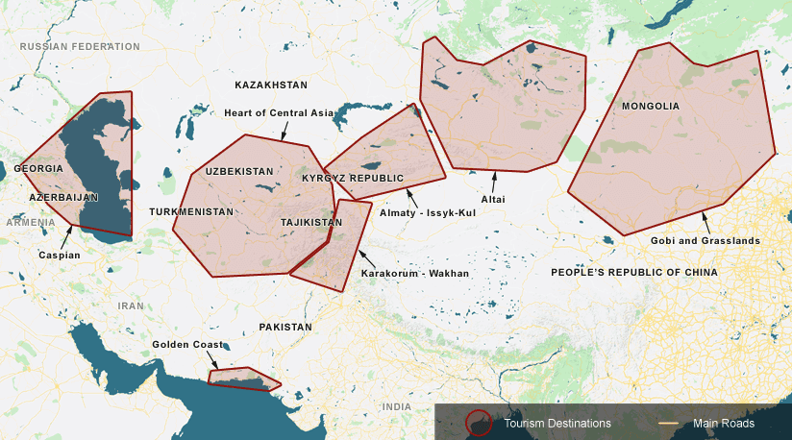
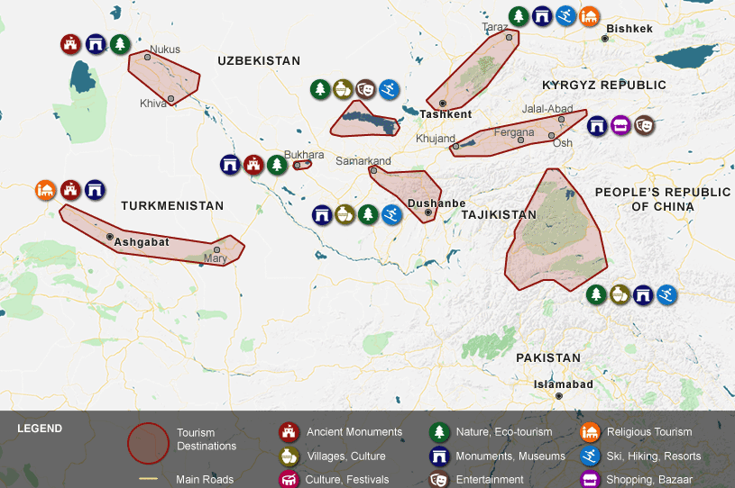
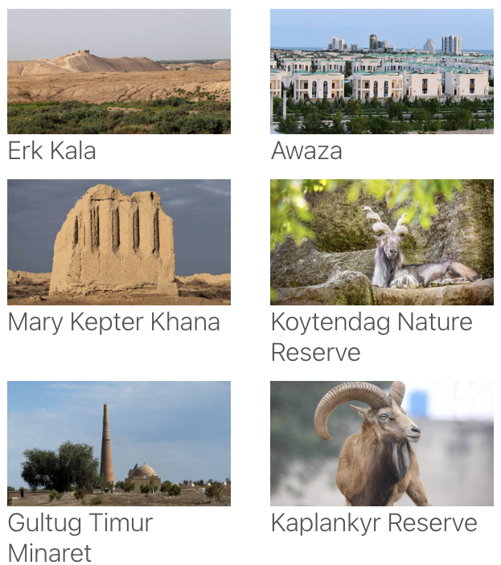
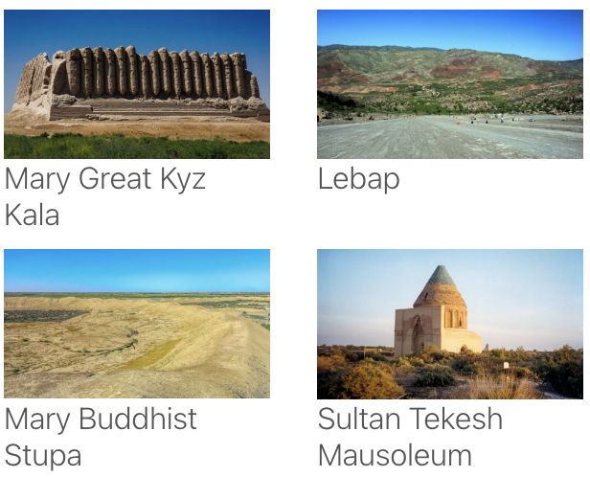
4 Project profiles for conceptualization and pre-feasibility
4 projects for conceptualization
Project
Entire CAREC
C - Develop-ment of a common registry of tourism assets and data collection, their content, and their manage-ment
Main priority clusters
Sub-clusters
Attractions/ Experiences
Country guides
Region guides
Attractions database
Tourism Business Registry
Commonly developed and shared standards/ regulations
B2B/ B2C
Private Sector Development
Quality Label Data
Tourism Statistics
Tourism Product Development
Accommodation database
Hospitality database
Adoption of best cost-effective practices
Tourism services database
Tour Operators database
Quick product/circuit-to-market promotion by all Tourism Organizations in each CAREC Country

Slide 7



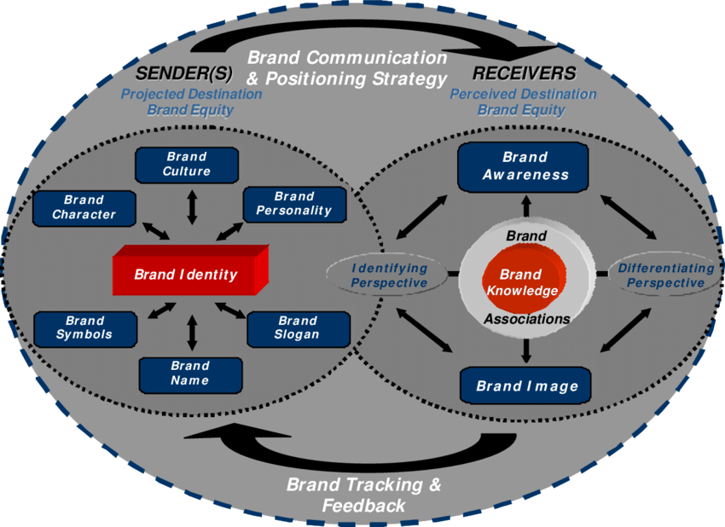
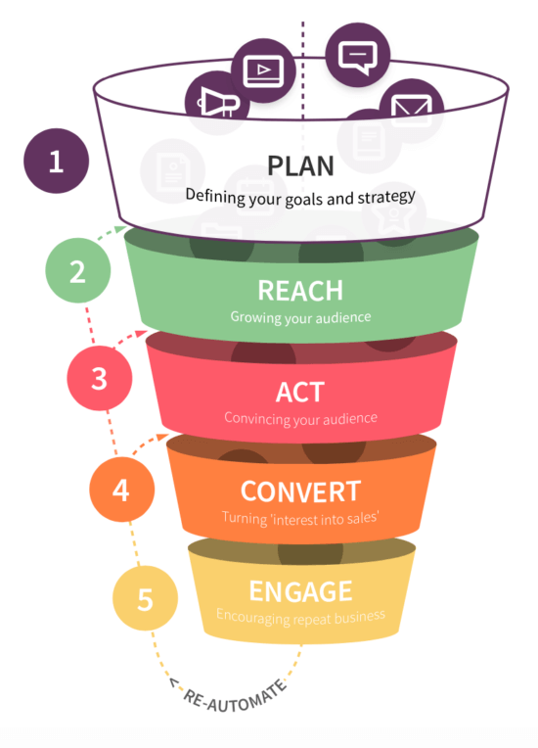
4 Project profiles for conceptualization and pre-feasibility
4 projects for conceptualization
Project
Entire CAREC
D - Branding, strategy, planning, budgeting, and funding sources for implementing the common brand “Visit Silk Road”, integrating additional features for the CAREC tourism portal, and developing a “CAREC tourism service quality label innovative system
Source.
Marcelo Risitano

Slide 8
Sustainability of CAREC Tourism and funding
Governance of CAREC Tourism
CAREC Tourism Strategy 2030 framework for the Institutional Structure of CAREC Tourism
Ministerial Conference functions as the main high-level policy and decision-making body, responsible for providing strategic guidance on issues of regional relevance and accountable for the overall results of the CAREC Program.
The Senior Officials’ Meeting monitors progress, recommends operational improvements, and ensures that the high-level decisions made at the CAREC Ministerial Conferences are effectively implemented.
The CAREC Secretariat will provide technical, administrative, and organizational support during the implementation of the CAREC Tourism Strategy 2030. It also advocates adopting an incremental approach to effectively build countries’ ownership and devise the most appropriate institutional structure based on progress made
CAREC Tourism Focal Points Group (TFPG)
A Tourism Focal Points Group (TFPG) at the Tourism Sector level will lead the overall CAREC tourism work. This group comprises the tourism focal points appointed by each CAREC country since 2018. It manages, organises, coordinates, and prioritises defined and proposed common initiatives in delivering the CAREC Tourism Strategy outcomes.
One or two thematic and/or cluster-based expert groups
Additional thematic and/or cluster-based expert groups
Regional tourism agency
Small centralized office in a CAREC country

Slide 9
Sustainability of CAREC Tourism and funding
Governance of CAREC Tourism
Improving operationality and building countries’ ownership of CAREC Tourism requires the Senior Officials’ Meeting to decide on two critical areas: Governance and Funding to achieve sustainability.
Proposal
Governance
CTCO
Greater engagement and responsibility from the TFPG.
Convene twice a year, hosted by the country having the presidency.
Three countries could lead the TFPG on a half-yearly rotative basis, starting in alphabetic order. The first with the presidency, the second with the “first chair” position, and the third with the “second chair” position.
Objective to provide guidance and professional support for implementing subregional tourism projects.
Creating a CAREC Tourism Coordinating Office (CTCO) to serve as the TFPG secretariat.
CTCO set-up and activities could receive support from ADB
Role evolving continuously depending on progress made
The initial role could be serving as the secretariat for the TFPG to lead the development and promotion of the CAREC Region as a single tourism destination
The CTCO’s office should be staffed (7) and overseen by an Executive Director and supported by an Operations Manager, a Financial Manager, a Brand Manager, and 3 operational staff, allowing interns to gain valuable international tourism experience
Annual estimated budget: meeting costs $150,000/ year; operating costs of CTCO (US$350,000/ year with staff of 7, web portal maintenance, content development, marketing, and other expenses). Total US$350,000

Slide 10
Sustainability of CAREC Tourism and funding
Funding of CAREC Tourism
There are two distinct options to consider: (i) countries’ budgets; and (ii) the development of own revenues supported by the countries’ actions.
Option 1: Countries’ budgets
Option 2: development of own revenues supported by the countries’ actions
Consists of contributions from the member countries to the budget of the CTCO activities and TFPG venues
The annual monetary contribution and the associated criteria should be decided during the Senior Officials Meeting of June 2023
The own revenues model defines revenues
  Fees
  Advertising
  Originating from activities on which all member countries collaborate through enforcement
    A common TVET certificate’s annual fee
    A common quality of service label annual fee
    etc.
Possible to have the difference between the revenues and costs be covered by the countries’ budgets or returned in case of higher revenues than costs

Slide 11
Thank you

