Slide 1
CAREC Digital Strategy 2030
Country Consultations
Dr. asya rudkovskaya
September 23, 2021

Slide 2
CAREC Digital Strategy 2030
Drivers
• COVID-19 crisis and the shift to digital, yet growing digital divide between digital haves and have-nots across the region
• Agreement among CAREC countries on the need to collaborate on digital transformation
• Opportunity in crisis: towards a resilient and inclusive economy and society

Slide 3
CAREC Digital Strategy 2030
Vision and Mission
Vision
A Common CAREC Digital Space that enables digital transformation and a freer flow of data across the region, leading to digital dividends:
  Inclusive economic growth and social well-being (closed digital divide)
  New jobs
  Better public and other services
  Higher regional competitiveness.
Mission
Help CAREC develop a common Digital Space based on a data-driven platform-enabled regional digital economy and society with:
  High speed BB Internet for fast, reliable, online access to relevant information
  Trusted, user-friendly, data-driven digital services for all citizens and organizations across CAREC
  Secure, scalable and interoperable digital platforms resilient to cyberattacks.

Slide 4
CAREC Digital Strategy 2030
Co-creation and Inputs
Consultations with CAREC public, private and NGO stakeholders;
Analysis of stakeholder responses to CAREC questionnaires;
Review of national digital transformation strategy documents;
SWOT analysis of the enabling environment and the non-digital and digital foundations of digital transformation across the CAREC region;
Review of global best practices in digital transformation;
Analysis of secondary sources, including global development organizations reports, global digital development indices;
Alignment with the CAREC 2030 Strategy and CAREC sectoral strategies, including strategies on Energy, Tourism, Trade, and Transport.

Slide 5
CAREC Digital Strategy 2030
Partners
United Nations Economic and Social Commission for Africa and the Pacific (UNESCAP)
CAREC Institute
in consultation with the IsDB, the World Bank and the IFC

Slide 6
SIX Stakeholder Priorities for regional digital cooperation
Demonstrating Political Will and Building Trust in Regional Digital Cooperation
Building Advanced and Basic Digital Skills and universal digital literacy
Developing ant nurturing the Regional Innovation and Entrepreneurship Ecosystem, boosting support for innovation and R&D, and creating the governance structures for regional ICT partnerships and export promotion
Attracting Investment into Networks and the Digital Economy while ensuring systems interoperability
Boosting Digital Resilience and Cybersecurity
Harmonizing regional Regulation and Legislation to enable regional digital cooperation

Slide 7
Digital Dividends:
Jobs, Growth, New Services
CAREC DIGITAL STRATEGY 2030
FIVE PILLARS
CAREC Sectors and Operational Clusters Digital Transformation
(Agriculture, Tourism, Fintech, E-commerce, Smart Cities, etc.)
Leadership Governance Investment
Digital Policy Enablers & Safeguards (Data, AI, Cybersecurity)
Broadband Infrastructure Resilience Digital Platforms
Digital Skills and Competencies
Digital Innovation Entrepreneurship ICT Competitiveness

Slide 8

CAREC Digital Strategy 2030
Pillars
Strengthening regional institutions for digital leadership
Creating incentives for regional cooperation in the CAREC digital space
Attracting investment in the digital economy
Promoting an inclusive regional digital economy
Leveraging Digital Technologies to pursue cross-cutting Sustainable Development Goals
  inclusion, innovation, sustainability, resilience, partnerships, and participation.

Slide 9

CAREC Digital Strategy 2030
Pillars
Harmonizing digital legislature and regulation across CAREC
Enhancing cybersecurity across the region
Aligning Data policies across member countries
Supporting the development of AI in the region

Slide 10
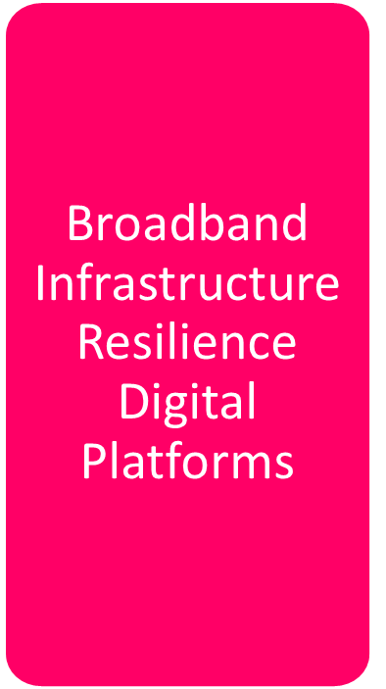
CAREC Digital Strategy 2030
Pillars
Connecting digital infrastructure to bridge the digital divide – ensuring systems interoperability, scalability, and security
Building regional Digital Resilience Capacity
Building a CAREC regional PLATFORM economy

Slide 11

CAREC Digital Strategy 2030
Pillars
Improving education, training, life-long learning
Developing digital skills: basic and professional
Boosting digital competencies

Slide 12

CAREC Digital Strategy 2030
Pillars
Nurturing the Digital Innovation ecosystem across CAREC
Promoting the adoption and effective use of digital technologies by SMEs
Promoting regional content
Boosting ICT exports

Slide 13

CAREC Digital Strategy 2030
Infrastructure and Economic Connectivity
  4G and 5G Broadband, Cloud, Data Centers
  Smart Cities and Villages
Agriculture and Water
  Digital Agriculture
  Geospatial
  Smart Water Management
Human Development
  Education
  Digital Skills
  Job opportunities and mobility platforms
Economic and Financial stability:
  Fintech,
  E-Finance
Trade, Tourism and Economic Corridors:
  eLogistics
  eCommerce
  Digital Tourism
  Cross-border services
  eCustoms
  eProcurement

Slide 14
The CAREC Platform Economy
Digital SMEs Platform
Fintech Platform
CAREC Digital Industry
E-Logistics Platform
Digital Innovation Platform
Digital Skills Platform
Training Platforms
Education Platforms
E-Commerce Platform
E-Procurement Platform
CAREC Digital Transformation Financing Platform
Geospatial Information Platform
CAREC Digital Agriculture and Food Platform
CAREC Digital Space Portal
Content Development Platform
Job Opportunities and Mobility Platform
Open Data Portal
Intelligent Transport Platform
CAREC Smart Cities Platform
CAREC Gastronomy Platform
CAREC Cultural Heritage Platform
CAREC Tourism Platform
Digital Public Services Platform

Slide 15
CAREC Digital Strategy 2030
Key Implementation Areas
Building and maintaining multi-stakeholder consensus
Gathering and sharing best practices for regional digital development
Developing and launching a Strategic Communications plan
Developing the CAREC Digital Transformation Project Portfolio
Prioritizing the CAREC Project Portfolio and creating the CAREC Digital Strategy 2030 Implementation Roadmap
Working with development partners to secure project funding
Launching specific Initiatives to strengthen the enabling environment
Launching specific capacity building initiatives
Building public-private sector partnerships for project implementation
Establishing a monitoring system to measure progress
Future-proofing the strategy

Slide 16
CAREC Digital Strategy 2030
Next Steps:
Stakeholder agreement on the CAREC Digital Strategy 2030
Endorsement of the CAREC Digital Strategy 2030 by the Ministerial Conference
Agreement on the governance model and the creation of the CAREC Digital Strategy 2030 Steering Committee.
Launch of the Strategic Communications Plan
Launch of quick wins and low-hanging fruit projects to gain momentum

Slide 17
CAREC Digital Strategy 2030
Member Countries Feedback Examples
Topic | Suggestion
Attracting investment in the digital economy | creating special simplified tax regimes in the CAREC member countries for investors and start-ups in the field of digitalization.
Promoting an inclusive digital economy in the region | implementation of digital solutions in vaccination, creation of unified registers of vaccinated people and recognition of electronic documents of vaccinated people.
CAREC Open Data Portal | CAREC Secretariat support would be required in the formulation of data governance and data protection policies

Slide 18
CAREC Digital Strategy 2030
Discussion:
Does the Strategy help address the main priorities for regional digital collaboration?
Does the Strategy help address the main challenges to regional cooperation in the digital space?
Does the Strategy help address the top digital transformation priorities in your country through encouraging regional digital collaboration?

Slide 19
Thank you!

