Slide 1
Leveraging the Capital Market to Support Green and Low-Carbon Transition and Development of the Economy
China Securities Regulatory Commission (CSRC)
October 31st, 2023
By Mrs. NI Gaiqin, Deputy Director General (DDG)
and
Mr. ZHU Fagen, Division Director

Slide 2
Overview
China’s capital markets play a significant role in supporting the green and low-carbon transition of the economy
I
An overview of green finance in China’s capital markets
II
III
Next step

Slide 3
I
China’s capital markets play a significant role in supporting
the green and low-carbon transition of the economy
Distinctive functions of the capital market
1
Guiding economic green transition through comprehensive information disclosure.
2
Supporting the technological innovation of green industries.
3
Mobilizing capitals from across the society to promote green transition.

Slide 4
II
An overview of green finance in China’s capital markets
An important feature of China’s green finance is the relatively sound top-level policy design.
1
The macro guidance has been established for green finance at the national level.
2
Financial regulatory bodies have issued policies to guide green financial products.
3
The green financial standard system has been advancing comprehensively.

Slide 5
II
An overview of green finance
in China’s capital markets
Approaches taken by the CSRC
（i）
From the financing side, active support has been provided for the development of
green and low-carbon enterprises.
（ii）
From the investment side, efforts have been made to encourage
securities and fund management institutions to actively participate
in green investments.
（iii）
Efforts have been made in information disclosure to actively support green and low-carbon transition.
（iv）
Efforts have been made to promote the development of green financial standards.
（v）
International exchange and cooperation in green finance has been continuously promoted.

Slide 6
An overview of green finance
in China’s capital markets
II
（i）From the financing side, active support has been provided
for the development of green and low-carbon enterprises.
1
The CSRC has been supporting eligible green and low-carbon enterprises to utilize multiple tools on the capital market, including IPO, refinancing, listing on the National Equity Exchange and Quotation (NEEQ), mergers and acquisitions (M&A) and reorganization, and bond issuance to raise more resources for their green development, which in turn has fostered more capital on green innovation.

Slide 7
An overview of green finance
in China’s capital markets
II
（i）From the financing side, active support has been provided
for the development of green and low-carbon enterprises.
A
Among companies specializing in green industries, a total of 216 are listed on the STAR Market and ChiNext.
9 are listed on the Beijing Stock Exchange, and 255 are listed on the NEEQ.
C
The total issuance of green bonds in the exchange markets has reached 646.6 billion yuan.
As of the end of June 2023

Slide 8
II
An overview of green finance
in China’s capital markets
（ii）From the investment side, efforts have been made to encourage
securities and fund management institutions to actively participate
in green investments.
First, the system of green financial products continues to evolve, with the existing green-themed public funds has reached 393.1 billion RMB yuan, covering areas including ESG, environmental protection, low carbon, and new energy.
Second, green indices and index-linked products have been continuously developed, with index providers including China Securities Index have published a total of 185 green-themed indices, and fund management companies have introduced index-linked products with a total volume of more than 130 billion yuan.
As of the end of June 2023

Slide 9
An overview of green finance
in China’s capital markets
II
(iii) Efforts have been made in information disclosure to actively support
green and low-carbon transition.
Continuous efforts have been made to strengthen environmental information disclosure requirements for listed companies. Companies that are identified as key pollutant-emitting units by relevant environmental protection authorities or their major subsidiaries are required to disclose environmental-related information, such as pollutant emissions, pollution prevention and control measures, environmental monitoring, and responses to emergencies.
Listed companies are encouraged to voluntarily disclose information on their practice on ecological protection, pollution prevention, and fulfillment of ESG responsibilities.
Since the beginning of this year, over 2,500 listed companies in A-share market have disclosed the measures they have taken to reduce carbon emissions and its results, the number of which accounted for more than 50% for the first time.

Slide 10
An overview of green finance
in China’s capital markets
II
(iv) Efforts have been made to promote the development of green financial standards.
A. Guiding financial institutions in identifying, utilizing, and managing carbon financial products.
A
Following the principles of “domestic standardization, international alignment, and clear for implementation”, the CSRC released “Carbon Financial Products” as the financial industry standard.
B. Unifing the domestic criteria for identifying green bond projects.
The “Catalogue of Projects Supported by Green Bonds” (2021) was jointly issued by the PBoC, NDRC and the CSRC.
C. Aligning China’s green bond standards with international ones.
C
The CSRC has guided China Green Bond Standard Committee to issue the “Green Bond Principles”.

Slide 11
An overview of green finance
in China’s capital markets
II
International exchange and cooperation in green finance has been continuously
promoted.
1
Overseas green financing: eligible green industry companies are supported in utilizing overseas capital markets for financing according to their needs.
Since 2022, a total of 12 enterprises specializing in new energy, energy-saving and environmental protection have been approved by the CSRC for overseas listing, raising funds of more than 50 billion RMB yuan.
A
Bilateral cooperation：actively promoting the integration of green finance into the outcomes of bilateral financial dialogues and engaging in exchanges with relevant financial regulatory bodies of other countries.
C
Multilateral cooperation：actively participating in the sustainable finance initiatives of the IOSCO, promoting the formulation and improvement of relevant international standards.

Slide 12
III
Next Step
On market Structure: listed companies in green and low-carbon sectors have witnessed rapid growth, and the transition from traditional fossil energy to new energy has achieved substantial progress.
On the operation of the listed companies: listed companies have generally increased their investment in green transition, and green and low-carbon companies have demonstrated good growth potential.
Positive Results
On market performance: Green and low-carbon companies, on the whole, exhibit relatively high price-to-earnings (PE) ratios and offer attractive investment returns.

Slide 13
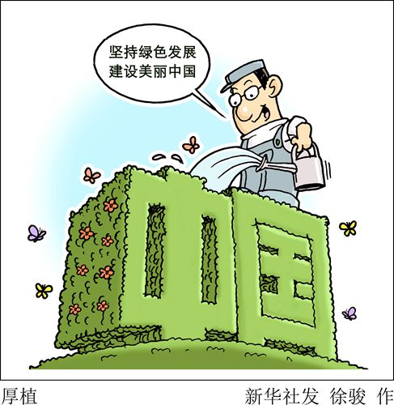
III
Next Step
Promoting the formulation and publication of relevant green finance standards.
with the ongoing improvement of the green finance standard system.
Enriching and enhancing the green finance product system.
guide industry institutions to concentrate on their core business
align with the realities of China’s green industries
enhance their research and development capabilities for financial products and tools
Supporting green and low-carbon enterprises to utilize the capital markets for growth.
support qualified green and low-carbon enterprises in using multiple tools on the capital market, including IPO, refinancing, listing on the NEEQ, M&A and reorganization, and bond issuance to raise more resources for their green development.
Enhancing carbon emission disclosure requirements phase-by-phase.
Actively engaging in international cooperation on green finance.

Slide 14
Thank you!

