Slide 1
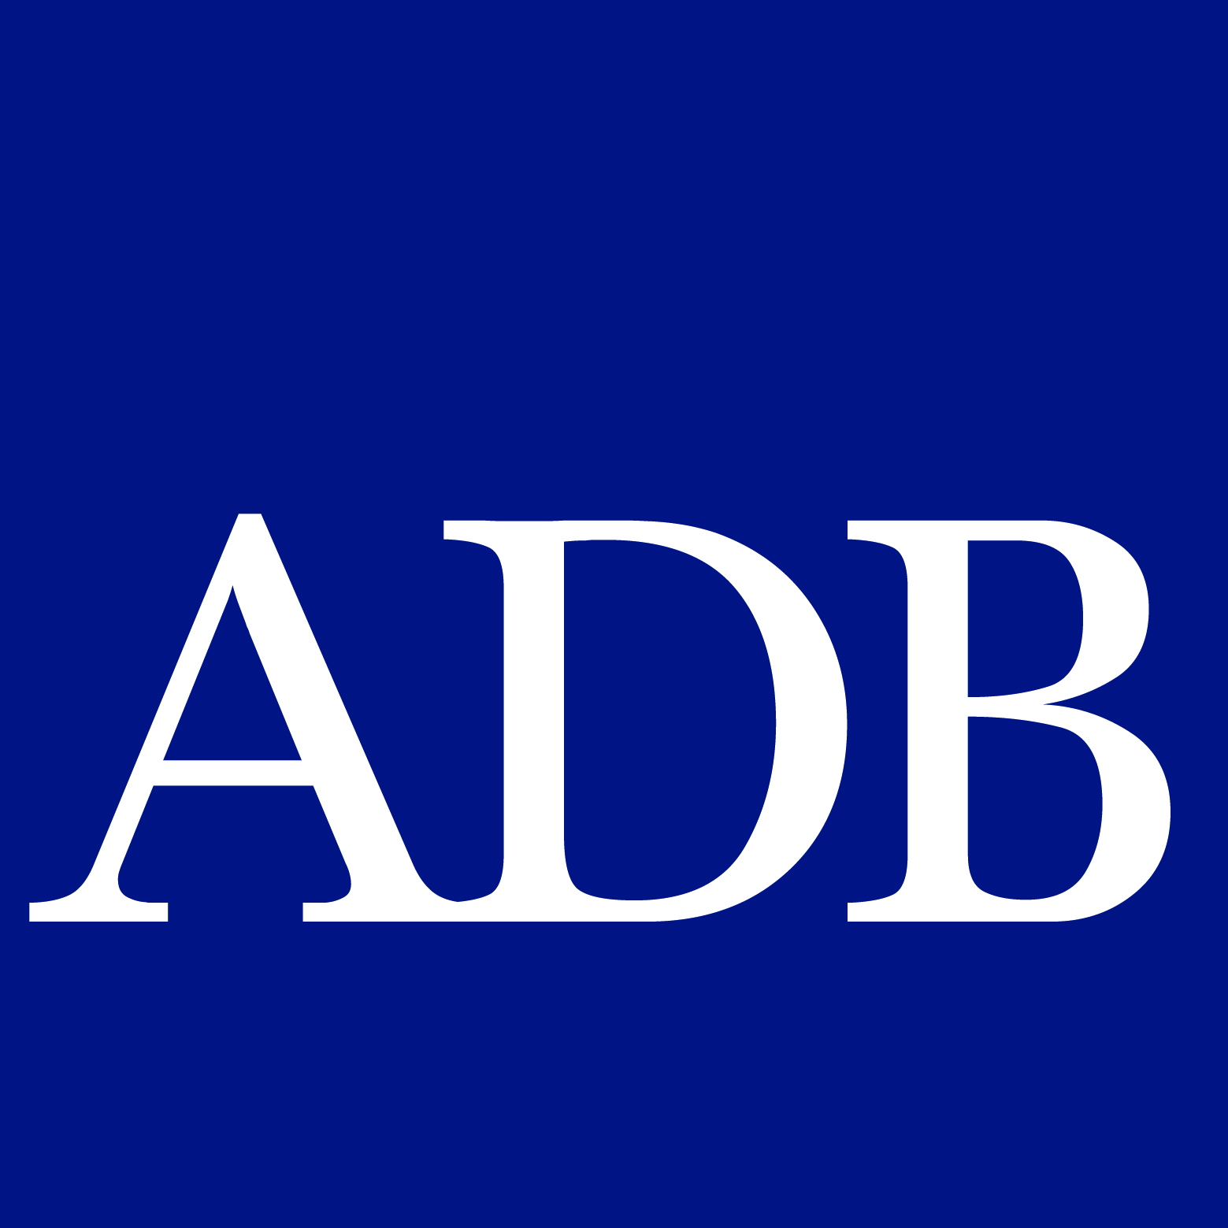
Roadmap for Implementing CAREC Capital Market Regulators’ Forum
– Draft summary for discussion –

Slide 2
Outline
Capital Market Regulators’ Forum (CMRF) as an activity of Economic and Financial Stability (EFS) cluster of CAREC 2030 Strategy
Economy of scale and the use of CAREC savings for CAREC investments
Knowledge and synergy with overall CAREC 2030 agenda
Economic and capital market landscape in CAREC
Motives for capital market development (CMD) cooperation
History and the current status
Looking forward and broader
Challenges of financial cooperation & integration (FCI) in CMD
Importance of leadership by the authorities and the regulators
Choice of scope affects participants and thus institutional framework
Modus operandi of CMRF
Consistency with the CAREC 2030 Institutional Framework
Market scope, leaders and participants of CMRF
Leaders, participants, and the role of ADB
Examples: Asian Bond Markets Initiative (ABMI), ASEAN+3 Bond Market Forum (ABMF), and ASEAN Capital Market Forum
Possible initiatives

Slide 3
1. CMRF as an activity of Economic and Financial Stability (EFS) cluster of CAREC 2030 Strategy
Be consistent with the five driving principles of CAREC 2030
Aligning with national strategies and supporting the new international development agendas, i.e., Sustainable Development Goals (SDGs) and the Paris Agreement (COP21)
Deepening cooperation in the traditional areas (transport, energy, trade, economic corridor), selectively expanding into new areas.
Deepening policy dialogue
Integrating the role of the private sector and civil society
Building an open and inclusive platform
Be aligned with agendas of other operational clusters for maximum synergy
Economic & Financial Stability => CMRF
Trade, tourism & economic corridors
Infrastructure & connectivity
Agriculture & water
Human development

Slide 4
1. CMRF as an activity of EFS cluster of CAREC 2030 Strategy – continued
Three pillars of Economic & Financial Stability Cluster
Macroeconomic policy coordination, countercyclical policy responses => Public finance
Financial regulators to exchange data and knowledge, and harmonize practices
Attract private sector investments, particularly cross-border ones among the members
The CMRF objectives as agreed in the first meeting 2019
Develop knowledge, build capacity, exchange experiences for products and process innovation
Pilot initiatives for regulatory and legal harmonization;
Ultimately support market integration through cross-listing, standard setting and recognition.

Slide 5
2. Economic and Capital Market (CM) landscape in CAREC – motives for CMD cooperation
Varying levels of per capita income, population size/density, resource endowment, industrial/financial development => mutual learning opportunities
Mix of net-saving economies (current account surplus) and net-borrowing ones (current account deficits) => Benefit from recycling CAREC savings to finance CAREC investments.
Net-borrowing members need to enhance the investment climate and the investability of their capital markets (CM) so that net-saving members can invest in them.
Improve sovereign credit ratings. => Improve public debt management and/or develop a credit enhancement/guarantee facility to overcome the sovereign credit ceilings.
Pool resources and utilize them in CAREC, e.g., collective funds to invest in infrastructure/ connectivity; environmental, social, and governance (ESG); agriculture; tourism; etc.
Sovereign wealth funds (SWFs) of net-saving members
Potential vehicles for cross-border investment within CAREC
Need to overcome low sovereign credit ceilings

Slide 6
2. Economic and CM landscape in CAREC – History and the current status
Bank domination and the underdevelopment of CM/nonbanking in a varying degree.
Privatization has given birth to the equity markets but with a varying degree.
Full-fledged privatization with the adoption of the international standards of corporate governance has been challenging for some members.
Market architectures and infrastructures have been built in a varying degree but need to be improved including the cross-border connectivity/interoperability.
Legal and regulatory frameworks have been built with a varying degree. But gaps remain to be filled.
Secondment programs among the CAREC regulators/self-regulatory organizations (SROs) to learn the application of the International Organization of Securities Commissions (IOSCO) Principles, prudential standards, conduct rules for broker-dealers, etc.
Need to examine the legal and regulatory investability across the borders within CAREC

Slide 7
2. Economic and CM landscape in CAREC – Current status and looking forward
Members losing the access to concessional resources need to develop the government securities (G-sec) markets in local currencies.
Key to financing infrastructure including green one.
Banks play different roles in different market segments at different levels of CMD. CMRF initiatives need to take into account their evolving roles.
Can be leading issuers in the equity and corporate bond markets.
Play key roles in the money and G-sec markets as investors, issuers and intermediaries.
Compete with corporate bonds while providing services for them, e.g., custody, payment. The services become more important business for banks when institutional investors grow.
The development of institutional investors varies widely among the members.
Insurance companies and pension funds grow only gradually except for the 2nd pillar pensions.
Investment funds (and asset managers) can grow more freely to stimulate CMD.

Slide 8
2. Economic and CM landscape in CAREC – Looking forward and broader
CM is closely interlinked with money/foreign exchange (FX) and commodities markets. CMRF needs to decide whether and how to tackle challenges in both cash and derivatives markets.
Information on the clearance & settlement infrastructures is limited.
A review of market infrastructures including their connectivity and interoperability is needed.
Common standards and messaging formats should be adapted for interoperability.
The role of individual investors including high net worth individuals (HNWIs) should be explored for both equity and debt markets.
Fintech, mobile banking/investment
Learning from non-CAREC as well as CAREC countries in defining HNWIs as part of professional investors and their markets. Mongolia has recently made a notable success.

Slide 9
3. Challenges of Financial Cooperation & Integration (FCI) in CMD
CM reform challenges tend to be interdependent and require phasing. The role of the regulators/authorities to lead and guide the concerted efforts is crucial.
E.g., Contractual savings (i.e., pension funds and insurance companies) as investors grow only over time. In the initial phase, CMRF can focus on the role of existing investors (e.g., banks, corporate treasuries and individuals).
The choice of market scope for FCI affects that of initiatives and leaders/participants, thus the institutionalization of CMRF.
Equities and corporate debt are to be led by the regulators (and exchanges)
G-sec market needs to be led by MOFs and the Central Banks
Money & FX market should be led by the Central Banks
Who should lead commodities markets?
Legal & regulatory frameworks need to be enhanced in accordance with the international standards. Harmonization and mutual recognition are additionally required.
Market infrastructures need to be upgraded in accordance with international standards. Connectivity and interoperability are additionally required.

Slide 10
3. FCI challenges on CMD – continued
CM integration can involve risks as well as tangible benefits. Avoid initiatives in which some members gain at the expense of others even if CAREC collectively gains.
Such an initiative is likely to fail, e.g., cross-listing, ASEAN exchange linkages
CMRF can learn from FCI initiatives of other regions.
ASEAN Capital Market Forum (ACMF), Asian Bond Markets Initiative (ABMI) of ASEAN+3
MILA in Latin America and EU Capital Markets Union (EU CMU).
Be careful about the applicability of other FCI initiatives using a common currency.
Initiatives of other FCIs have incorporated proposals by individual member countries with different interests and development levels (ADB offered initial drafts for consideration).
Two-track & two speed approach: More developed members can focus on advanced agendas and connectivity. Less developed members need to focus on domestic CMD.
Less developed members need to be supported with TA.
Some FCI initiatives are crisis-driven (i.e., stability-focused), while some others are development-focused
ABMI of ASEAN+3 started in response to a regional financial crisis. It is packaged with the Chiang Mai Initiative Multilateralization (CMIM).

Slide 11
Institutional framework, modus operandi and possible initiatives

Slide 13
4. Modus Operandi of CMRF
Senior Officials Meeting supervises the implementation of CMRF initiatives
ASEAN+3 Senior officials meet semiannually before the deputies meeting and as necessary.
Need a CMRF committee and working groups (task forces)
ABMI of ASEAN+3 is co-chaired by senior officials of two countries. It operates with four task forces (supply, demand, regulation and market infrastructure) each of which are co-chaired by two countries (senior officials). Initiatives are mapped to the four task forces.
Need to decide on the market scope to cover. Different market segments need to be led by different authorities. Which authorities should the senior officials come from?
Consider creating a platform(s) for private market participants to join and work together with the authorities on technical issues with flexible process/meeting frequency.
E.g., ASEAN+3 Bond Market Forum of ABMI (Note that the Cross-border Settlement Infrastructure Forum of ABMI is led by the Central Banks requiring some confidentiality)
ADB can manage/support the delivery of TA. But CMRF needs to mobilize more resources for TA because ADB’s TA resources are limited.

Slide 14
Credit Guarantee and Investment Facility (CGIF)
Asian Bonds Online (ABO)
Asia Bond Monitor
ASEAN+3 Bond Market Forum (ABMF)
Cross-border Settlement Infrastructure Forum (CSIF)
Infrastructure finance (including sustainable finance)
Asian
Prime Collateral Forum
Sub-forum 1
Sub-forum 2

Slide 15
5. Market scope, leaders and participants
G-sec market should be led by MOFs and the Central Banks with support of the regulators.
G-sec market tends to be a priority even if CMRF chooses to work on the broader debt market. But it is not impossible to develop the corporate bond market without G-sec.
Corporate securities market (equities and corporate bonds) should be led by the regulators.
Corporate bonds may be defined broadly to cover a range of nongovernment securities
Exchanges and/or broker-dealers (or their association) may need to play important role.
Mongolia successfully developed the over-the-counter (OTC) corporate bond market without G-sec.
Initiatives on the management of SWFs need to be led and participated by the SWFs
Initiatives on market infrastructures need to be led and participated by the exchanges.
Initiatives on the money market, if covered, should be led by the Central Banks.
Commercial banks should participate but not in certain monetary policy-related issues which are confidential. Issues related to clearance and settlement may require participation of central securities depositories (CSDs), clearing houses/banks and/or custodians.
Q. Should CMRF be renamed as Capital Market Development Forum (CMDF)?

Slide 16
6. Possible pillars of initiatives for CMRF
Improving economic & financial stability (MOFs)
Improve the public debt management and sovereign credit ratings; to overcome sovereign credit ceilings in cross-order investment; to develop the local currency (LCY) G-sec markets
Develop credit information and rating systems and/or a CAREC credit guarantee facility
Improving legal & regulatory frameworks and adapting international standards (FSA)
Observe IOSCO principles, MMOU, PFB, IAS, etc.
Observe the OECD corporate governance codes and the Basel code for bank governance
Improving market infrastructure (FSAs, CBs)
Develop efficient exchanges, the OTC markets, trading platform(s) and/or clearing houses
Improve the payments systems and CSDs in conformity with PFMI; and improve their connectivity and interoperability
Promoting climate/ESG finance (FSAs, MOFs)
Promote green/ESG bonds and/or equity investment
Enhance financial inclusion, SME finance (secured finance, warehouse receipt finance)
Addressing supply and demand issues (MOFs, FSAs?)
Enhance/promote privatization and infrastructure finance;
Develop derivatives markets
Enhance the management of SWFs and pension funds
Develop the professional market with enhanced access by individual investors with fintech

Slide 17
Thank you.

