Slide 1
CAREC Climate and Sustainability Project Preparatory Fund (CSPPF)
CAREC National Focal Points’ Meeting
18 October 2023

Slide 2
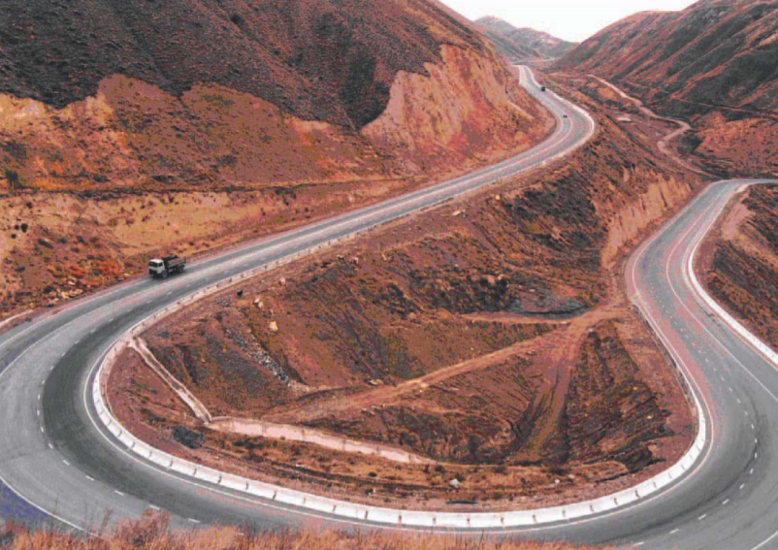
CAREC Climate and Sustainability Project Preparatory Fund (CSPPF)
CAREC 2030 Context
Increased regional macroeconomic stability, improved investment, and financial integration
CAREC Regional Climate Vision and Action
CAREC can play a leading role in supporting coordinated climate actions among member countries.
CAREC CSPPF (previously named as RIPEF) Rationale
Addressing challenges for CAREC regional infrastructure projects: widening infrastructure financing gap, inadequate capacity, falling short on climate change targets and SDG goals, lack of investment ready projects, constrained private sector financing and undiversified financing sources, etc.
Objective
A dedicated multi-donor trust fund created to support CAREC governments in project preparation and readiness in climate change responsive and sustainable way

Slide 3
CAREC Climate and Sustainability Project Preparatory Fund
Multi (single)-Donor Trust Fund - Managed by ADB (CWRD)
OBJECTIVES
More bankable projects
Accelerate SDG & Climate Change Achievement
CSPPF
STAFFING
ADB staff/consultants (ADB TA to support admin and capacity building)
CAPITAL
$ 10-50 million to be drawn in phases
Leverage investments 30x
INSTRUMENTS
Convertible TA, Grants
ACTIVITIES SUPPORTED
Broad range of project preparatory and development activities
until financial close
PARTNERSHIPS
Co-financing & knowledge partners active in the region
Creating expertise pool ready to support

Slide 4
Key Characteristics and Value Addition
Project building, new sectors, climate change, regional SDG focus
Sustainability & bankability – convertible TA & grants
Building a pipeline of greener, climate change resilient, more sustainable regional projects
ADB’s strong relationship, presence and experience
CAREC-focused; better coordination and risk control
Supports sovereign, sub-sovereign, non-sovereign, and PPP Projects
CSPPF VALUE ADDITION & DIFFERENTIATION

Slide 5
Progress and Next Steps
Small-scale Technical Assistance (approved in Sept 2020) – Concept report finalized
Transaction TA Facility (in progress) – to provide project preparation funding for regional infrastructure projects in CAREC and improving institutional capacity. Ongoing Projects: (i) KGZ Issyk-Kul Lake Environmental Management for Sustainable Tourism Development project, and (ii) Almaty–Bishkek Economic Corridor (ABEC) Regional Improvement of Border Services Project (RIBS)
Stakeholder consultation – ADB internal consultations and other fund managers consultations completed. The CSPPF concept reviewed by all CAREC DMCs and comments/suggestions reflected in the concept.
Donor consultation (in progress) – A few rounds of donor consultations completed and ongoing (Republic of Korea, PRC, EU, etc.) with meaningful progress.
Donor commitment to be secured during 1st quarter of 2024 (e.g., Republic of Korea).
Targeting to officially launch the Fund at the 2024 ADB Annual Meeting in Tbilisi.
Deliverable for the Ministerial Conference
CSPPF Concept presented to Ministers for support.

