Slide 1
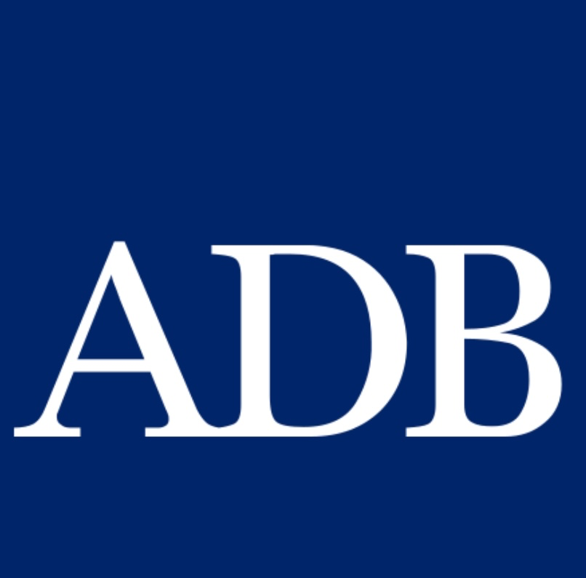
Credit Enhancement in Renewable Energy PPP Projects
2023 CAREC Energy Investment Forum
29 November 2023

Slide 2
1
Agenda
ADB Guarantee Products for PPPs
Case Study on Uzbekistan’s Solar PPP Program
(Guaranteed Letter of Credit)

Slide 3
1
ADB Guarantee Products
Partial Risk Guarantee
Partial Credit Guarantee
Guaranteed Letter of Credit

Slide 4
ADB Guarantee Products
The sovereign counter indemnity provides ADB with direct recourse to the host government in case a claim is paid under an ADB guarantee
In case the host country does not repay ADB as per the terms of the counter indemnity, ADB has the right to call an EoD under its sovereign loan portfolio to the host country
Policy based pricing
No exposure limits
Guarantees priced at market
Exposure limits apply
No sovereign counter indemnity
In both cases an annual guarantee fee and guarantee commitment fee are charged, and an ‘anchor’ is required
Public Sector window - With sovereign counter indemnity to ADB
Private Sector Window - Without sovereign counter indemnity to ADB
Notes:
Add 2020 projections to the stats slides. 2019 into regular blue.

Slide 5
Partial Risk Guarantees – Risks and Rationale
Risks covered by PRGs are as follows.
Transfer Restriction (Inability to convert or transfer currency)
Expropriation
Political Violence
Breach of Contract (arbitral award default and denial of recourse)
The first three risks are classic political risks. If there is a risk that the contracting entity (agency or SOE) may not honor its contractual obligations, then breach of contract cover is needed
Rationale: A partial risk guarantee is typically used when the project is commercially viable, but the political risks deter lenders.
For places with political instability
Guaranteed percentage: between 95 and 99% (lenders are required to have some portion uncovered)
Notes:
Expro includes: Lender’s rights, Collateral rights, Borrower, Funds

Slide 6
Typical Partial Risk Guarantee Structure
Commercial
Lender
Loan
IPP
PPA
Offtaker
(State Owned)
PRG
(Counter-
Indemnity)
MoF
Guarantee
Host Government
Guaranteed percentage: between 95 and 99%

Slide 7
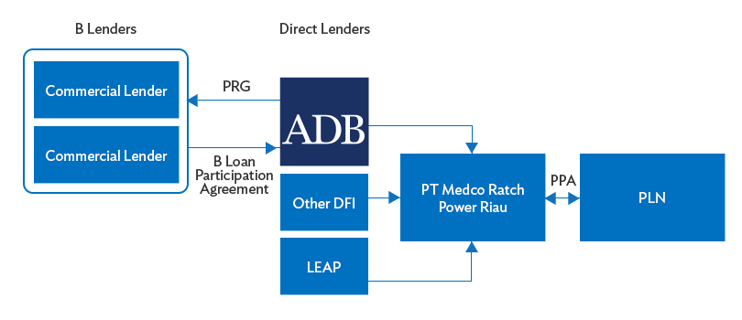
PRG: Riau Natural Gas Power Project (Indonesia)
Competitively awarded independent power project
(275 MW combined cycle gas-fired project) in Indonesia adhering to
international best practices
Sponsors: PT Medco Power Indonesia and Ratchaburi Electricity Generating Holding
ADB PRG Covered Lenders: Sumitomo Mitsui Banking Corp. and MUFG Bank
ADB’s first PRG in Indonesia covering Breach of Contract by PLN without GoI guarantee

Slide 8
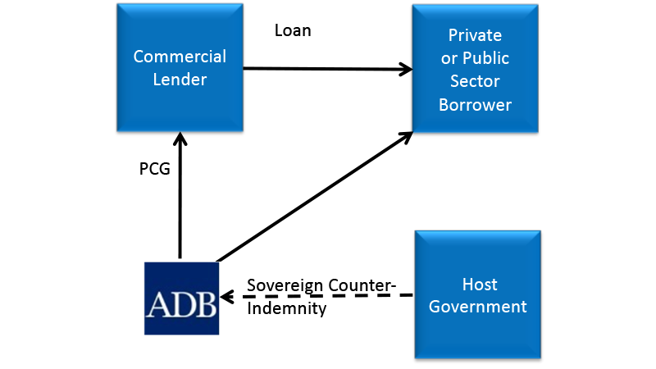
Typical Partial Credit Guarantee Structure

Slide 9
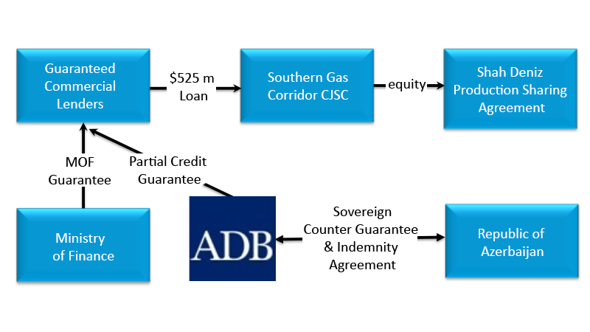
PCG: Southern Gas Corridor (Azerbaijan, 2017)
ADB’s PCG supported a $525 million loan facility to Southern Gas Corridor CJSC backed by a counter-guarantee and indemnity agreement.
Covered Risk: ADB’s PCG covered the risk that the Ministry of Finance would not honor its sovereign obligation to repay the lenders in case of a missed payment of principal, interest or guarantee fees.
Benefits: All-in costs of the commercial bank loans were be reduced, and Tenor was increased thereby improving the viability of the project

Slide 10
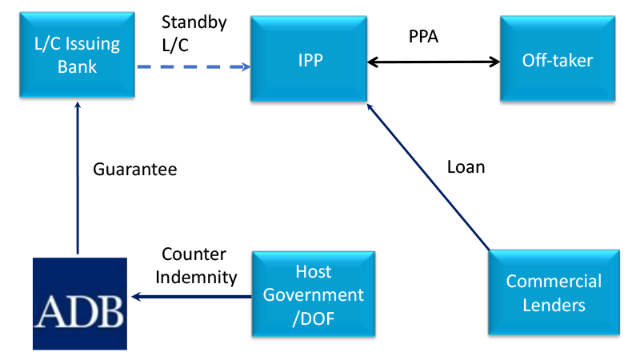
Guaranteed Letter of Credit

Slide 11
1
Agenda
ADB Guarantee Products for PPPs
Case Study on Uzbekistan’s Solar PPP Program
(Guaranteed Letter of Credit)

Slide 12
1
Uzbekistan Solar PPP Program: Rationale and Drivers
Issues
Heavy reliance on fossil fuel call for a shift to deployment of renewables at scale
$40 billion investment needs by 2030 for modernizing power infrastructure and meeting fast-growing power demand
Low creditworthiness of the state-owned off-taker JSC NEGU, along with virtually non-existent track record with private sector projects, is the key stumbling block.
Main Drivers for Project
Government’s strong commitment for macro-economic reforms, and to seeking high economic efficiency and private sector participation in power sector
Well aligned with the Government’s power sector development plan to deploy renewable energy project at scale
Climate commitment under the Paris Agreement and energy strategy to diversify sources using renewables on a large scale
One ADB collaboration provides tailored one-stop-shop solutions to address various sector challenges

Slide 13
2
ADB Support for Solar PPP Program
ADB pioneered solar energy development in Uzbekistan
ADB pioneered solar energy development in UZB since 2011 and developed a solar development roadmap with candidate project sites identified
ADB supported power sector masterplan (2019) triggered a shift to more diversified and renewable energy-based energy mix for 2030
Upstream policy interventions in the sector restructuring and regulatory reforms
Sector reform supported by ADB, EBRD, and World Bank enabled the entry of private sector partners into Uzbekistan’s power sector
Improvement and strengthening of regulatory framework and policy direction (refinement of PPP Law) has formulated enabling environments for the private sector investments.
Downstream One ADB solutions to address various sector challenges
Mainstreaming of transaction structure for replication in the subsequent projects
One ADB Package Deal – transaction advisory + sovereign supported products and supporting infrastructure development + non-sovereign financing

Slide 14
3
One ADB Approach in Program
OPPP
Transaction advisory Services
Technical Assistance through AP3F
Regional Department
Private Sector Operations
Sovereign
Guarantee product with a sovereign counter-indemnity
PPP
Project Delivered
Non-sovereign
Product advice on sovereign guarantee
Project debt
Technical Assistance
Capacity building
Sector/ Policy Reform
Guarantee products
Syndication
One ADB Approach –
Office of PPP: For development of PPP projects, OPPP funds project selection activity, feasibility study, drafting of concession agreement, etc. For select projects and upon request of government and private sector, OPPP advises the client on bankability issues, tender and financial closing.
Regional Department: Provides government and government-owned entities technical assistance for capacity building, sector and policy reforms. Based on counter-indemnity of sovereign, lends to a project or implementation agency. Debt may be subordinated to attract commercial lenders.
PSOD: As a non-sovereign lending arm of ADB, PSOD finances PPP project through project and/or corporate loan and invests in equity for qualified projects. PSOD also provides political risk and credit enhancement guarantees and offer syndication services.

Slide 15
4
Sherabad Solar Project (Initial Design)
Item | Description
Location | Sherabad, Surkhandarya region
Total area | 600 ha
Capacity | Minimum 200 MW
Estimated generation | Minimum 459 GWh per annum
Contractual Arrangement | 25 year “take-or-pay” power purchase agreement, investment agreement, land lease contract
Estimated Total project cost | $ 190 million
Target COD | December 2021
Project Type | BOO or BOOT by private sector
Unique Feature | Including substation/transmission line development and transfer the ownership to the state upon completion

Slide 16
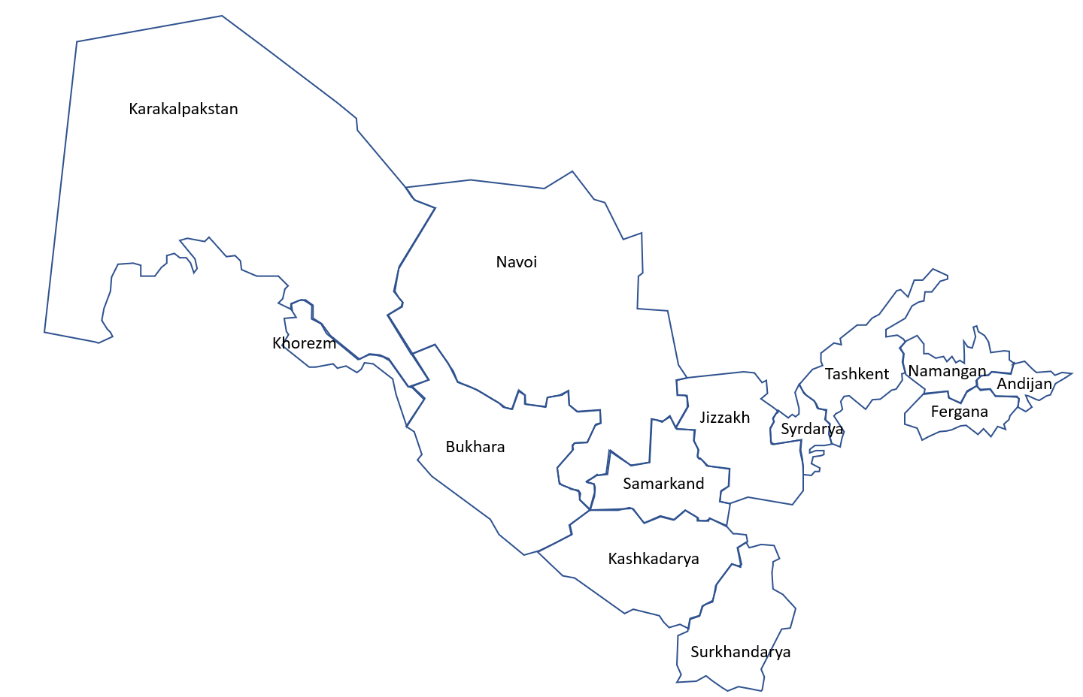
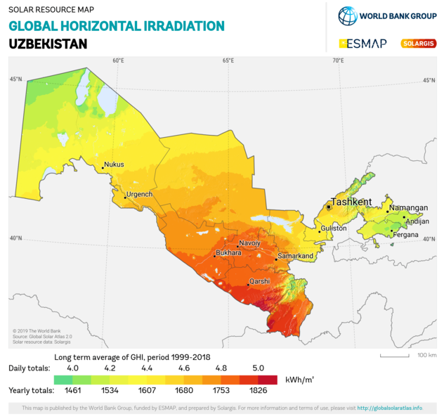
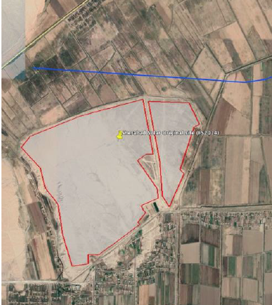
5
Sherabad Solar Project (Initial Design)

Slide 17
6
Off-taker Risk and Solution
Issue: Offtaker Risk |  | Solution: Credit Enhancement Mechanism
JSC NEGU is the off-taker under 25-year PPA. |  | Government credit support: Credit support is needed in order for the off-taker (JSC NEGU) to maintain Project’s bankability.
JSC NEGU was established in 2019 as a result of unbundling of Uzbekenergo. |  | PCG to L/C bank with Sovereign Counterindemnity - PCG to cover a letter of credit issued by a commercial bank in favor of the solar project company (IPP).
Currently, JSC NEGU’s revenue is transferred from the total revenue collected on a fixed percentage basis. |  | L/C will support the payment obligations of JSC NEGU to the IPP under the Power Purchase Agreement (PPA).
Given the above issues, the Offtaker Risk of JSC NEGU may be perceived as HIGH. |  | L/C, with a PCG covered by ADB’s AAA rating, will provide comfort to investors by mitigating payment risks

Slide 18
8
Credit Enhancement Mechanism
Off-taker/GCA defaults in a payment obligation
Project Company draws on the Standby Letter of Credit (L/C)
L/C Issuing Bank will then seek reimbursement from Off-taker/GCA. Reimbursement period of [12 months] commences. If Off-taker or Government pays within reimbursement period [12 months], then the L/C is reinstated, and no further action is taken.
If Off-taker or Government does not pay within reimbursement period [12 months], then ADB pays the L/C Bank under the Partial Credit Guarantee
ADB triggers the counter-guarantee and indemnity and discusses remedies with Government. ADB has the same rights under its counter-guarantee as it does under its sovereign lending agreements.

Slide 19
7
Credit Enhancement Mechanism: Sherabad Solar
JSC NEGU (Purchaser)
Government of Uzbekistan
Power Purchase
Agreement
3. Reimbursement
& Credit Agreement
4. Investment
Agreement
6. Counter Guarantee and
Indemnity Agreement
Project Company (Seller)
L/C Issuing Bank
(A- or Higher)
2.Guaranteed L/C
5. Partial Credit
Guarantee
Asian Development Bank
(AAA)
Shareholders
Lenders

Slide 20
8
Credit Enhancement Mechanism: Benefits
Lenders
Certainty of cash flow makes the project attractive and results in a lower Interest rate loan
Bidders / sponsors
The lower risk in the project, as well as the AAA rating of the ADB, translate into lower cost of capital for the bidder/concessionaire
Government / Consumers
Lower costs results in lower tariffs = cost savings for consumers and better outcome for governments

Slide 21
9
Lessons learned
Project result demonstrates…
Involvement of renowned private sponsors, contractors and lenders means projects incorporate international best practices making projects much more robust and reliable
well-structured tender with bankable PPAs results in true price discovery and better terms for the off-taker although this mainly depends on the PPA bankability, resource abundance, land availability, regulatory certainty and off-taker credit rating
Additional optimizations such as the inclusion of a credit enhancement mechanism and public support for public infrastructure significantly improves the attractiveness of projects for the private sector and, hence, deliver better results for the buyer of power
Bids Received
Cents / kWh
MW
* Exclusive of transmission component

Slide 22
10
Could this mechanism be applied in other sectors?
This structure is needed commercially under the following conditions:
Perception of weak offtaker or government contracting agency by the market
Newer projects/ first in kind, developing market
Government is willing to have a sovereign undertaking for the project
Government credit rating is weak
Project is commercially viable!! This is not a band-aid that can be applied to an unattractive PPP.
Examples of other sectors where this can be applied:
Road projects with availability payments – an LC can backstop government’s payment obligations
Water Supply or Wastewater Treatment – when there is an offtake arrangement for wastewater or bulk water supply
Comprehensive sector intervention needs to be considered
Formulating enabling regulatory framework and addressing fundamental underlying SOE’s offtaking risks need to be carefully addressed.

Slide 23
Thank You!
Q&A
Seung Duck Kim
Senior Energy Specialist, Asian Development Bank
seungduckkim@adb.org
Martin Jaer
Energy Specialist, Asian Development Bank
mjaer@adb.org
Alexander N. Jett
Senior Investment Specialist (Guarantees), Asian Development Bank
ajett@adb.org

