Slide 1



Energy Transition Mechanism
May 2022
Decarbonizing Power Generation:
ADB’s Energy Transition Mechanism
Alfredo Baño Leal
Asian Development Bank

Slide 2

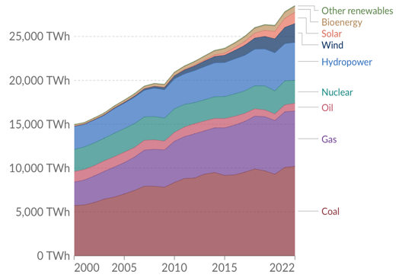
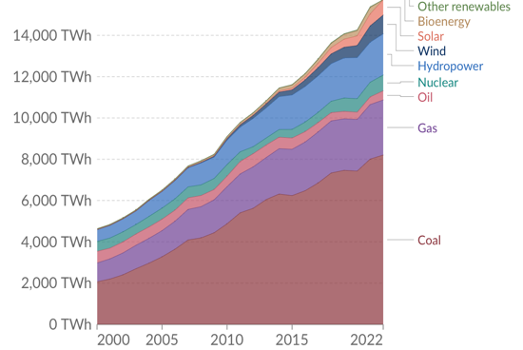
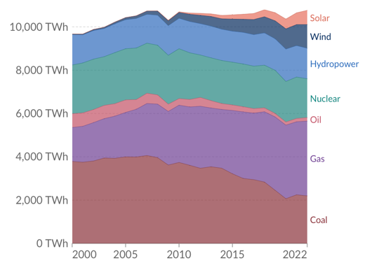
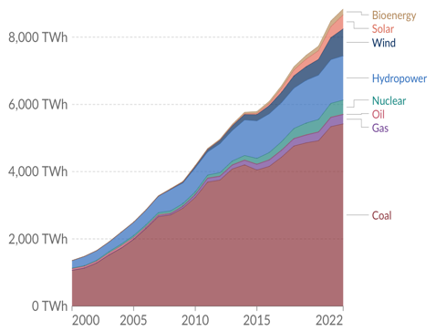
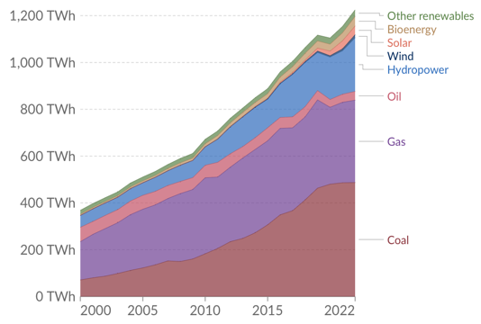
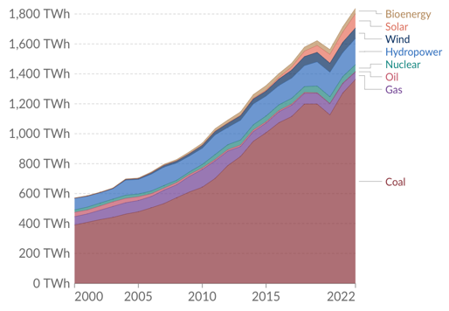
A Coal-Powered Asia…
Electricity Production per source, 2000-2022 (in TWh)
World
Asia
OECD
PRC
ASEAN
India
ASEAN = Association of South-East Asian Nations, OECD = Organisation of Economic Cooperation and Development, PRC = People’s Republic of China, TWh = terawatt hour

Slide 3
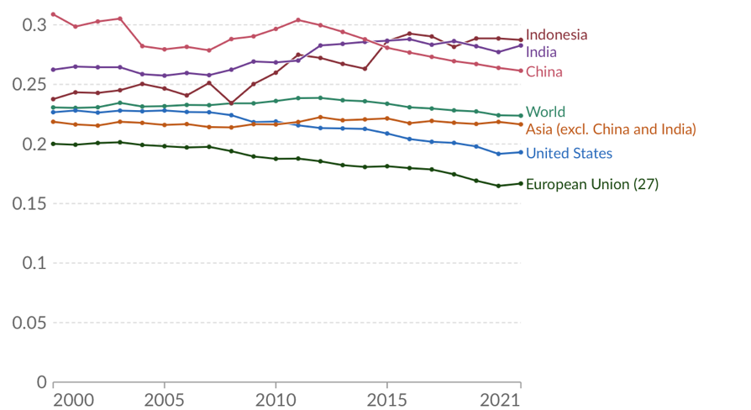
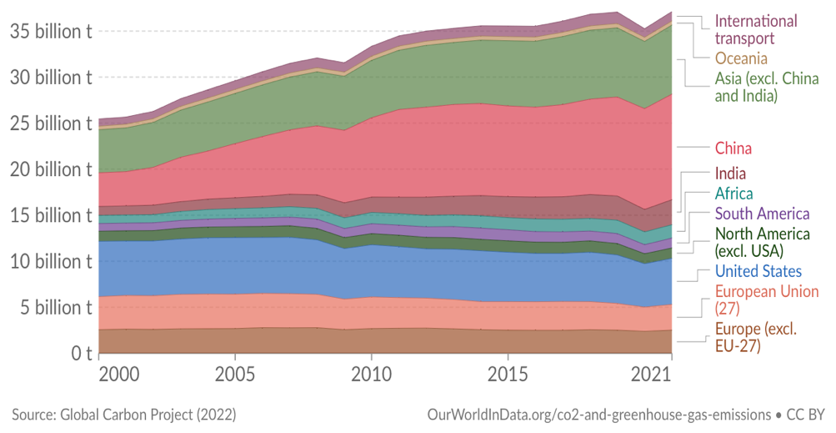

…is contributing to Climate Change
Carbon Intensity of Energy Production, 2000-2021 (kgCO₂ / kWh)
Annual CO₂ Emissions by World Region
(tCO₂ billion)
CO2 = carbon dioxide, EU = European Union, kg = kilograms, kWh = kilowatt hour, t = metric ton, USA = United States of America

Slide 4



Energy Transition Mechanism Overview
Governments and Philanthropies
IFIs and global
climate finance
International and local investors and lenders
Grants and highly concessional funding*
Grant, debt, equity, or guarantee
Concessional finance**
Coal retirement transactions
(asset level)
ETM Partnership Trust Fund
(ADB-administered)¹
ETM Funding Vehicle
Carbon Reduction Facility (CRF)
Clean Energy Facility (CEF)
Clean energy transactions (asset level)
* Grants and highly concessional funding (low-cost equity and debt) are critical to catalyze private capital and make ETM a success.
** Concessional finance may include concessional loans, evergreen debts, junior equities, and guarantees.
Direct ADB Transactions
(Sovereign or nonsovereign sectors with potential IFIs cofinancing)
Corporate transactions (portfolio level)
Technical assistance (e.g.):
Grid, technical, and financial analyses
Just Transition (e.g., skills and livelihood development) and social/environmental safeguards
Policy and regulatory support
Carbon finance (e.g., carbon credit structuring)
Measurement, reporting, and verification
Just Transition activities to be supported in line with agreed JT plan.
¹ ETMPTF has received contributions from the Governments of Japan ($25 million) and Germany (€30 million).
Details are publicly available at:
https://www.adb.org/what-we-do/energy-transition-mechanism-etm

Slide 5
ETM Feasibility Study Process
01
02
03
04
Critical factors to focus on when selecting power plants:
  Grid stability
  Utilization
  Plant age
  Renewable replacement potential
  Transactional appetite
Commercial and legal structure to efficiently retire the assets
Valuation approach
Role of existing stakeholders
Cost of capital needed to achieve a significant lifetime reduction
Potential additional revenue sources or costs (e.g., carbon and decommissioning)
Legal structure of ETM entity
Capital structure and sources of funding
Management structure
Incentive structure
Return expectations
Major risks
Safeguard policy
Governance requirements
Replacement plan for retired capacity to ensure ETM has positive climate impacts
Socioeconomic impact assessment of direct, indirect, and induced impacts in the coal value chain due to CFPP early retirement
Planning of Just Transition activities and funding needs over short- and long-term
Strategic environmental and social assessment of ETM options
Asset-level audits
Project Selection
Transaction Structuring and Financial Analysis
Fund/Vehicle Structuring
Environmental, Social, and Governance

Slide 6
Transaction Structuring Models
Acquisition Model¹
(SPV Level)
Synthetic Model
(SPV Level)
Portfolio Model
(Corporate Level)
01
02
03
ETM acquires share capital in CFPP
ETM invests senior/junior debt and/or other mezzanine capital to the CFPP
ETM provides funding to the corporate sponsor with CFPPs and greenfield clean energy projects
ETM to take role as owner and operator of the coal plant
Equity ownership and operational responsibility kept with the current asset owner
Sponsor guarantees greenfield clean energy projects will be built and coal plants retired ahead of schedule
ETM agrees an early termination date with the utility and operates the plant until that date and then closes it or repurposes
Investment conditional on early termination being contractually agreed with owner and utility and appropriate security being provided
Incentives (such as penalty interest) can be used to ensure that the transition occurs
Most suitable for IPP plants with international bankable PPA
Most suitable for IPP plants with international bankable PPA
Most suitable for Utilities with a portfolio of plants
While multiple transaction options exist, ETM will seek commitments from
  current project owners to not develop any new coal, and
  host country commitment to energy transition as a pre-condition for any deal
¹ The Acquisition Model will be utilized only in exception scenarios.

Slide 7
Synthetic Model
ETM will re-leverage coal-fired power plants with low-cost capital while existing owners remain as equity owners and operators
1
ETM invests in debt-like instrument into the project company and receives repayment based on sculpted cash flow (% of CFADS) over the investment horizon
Lenders
Sponsors
3
4
Existing Debt
Proceeds from ETM investment are paid to existing shareholders as a special dividend as a form of equity return. Existing shareholders continue to receive equity dividends (but at a lower level than without CRF)
2
2
1
ETM-CRF
Loan
Project Co.
Repayment
3
Existing shareholders remain as 100% common shareholders until the end of the shortened PPA tenure
5
PPA
Utility
4
Transaction to be structured for existing financing arrangement to remain (e.g., pari-pasu with CRF) or fully exit
O&M
O&M Provider
Shortening of PPA tenure to be contractually agreed with the Utility; major project agreements (O&M, Fuel) to remain as is but with shorter tenor
Coal Supply
Fuel Provider
5
ETM-CRF = Energy Transition Mechanism – Carbon Reduction Facility; CFADS = Cash Flow Available for Debt Service; PPA = Power Purchase Agreement
Notes:
Debt sculpting is essentially a calculation of debt repayment schedule in such a way, that debt service is tailored to the strength and pattern of the cash flow that the project generates.

Slide 8
Synthetic Model: Illustrative Cash Flows
Business as Usual (without ETM-CRF entry refinancing)
Future cash flow (US$ million)
Net equity cashflow
Net debt cashflow
After ETM-CRF Investment
$300m ETM 10Y loan (funded by ~25% concessional capital) is provided to the project.
ETM loan proceeds are used to repay existing lenders.
Remaining ETM loan proceeds are used to pay a special dividend to sponsors, to compensate them for the economic loss due to the shortened operation period (same IRR as BAU scenario).
Project cash flows are used to repay ETM loan.
1
3
Sponsor remains the owner and operator of the CFPP during the wind down period
Reduction of ~7 years of PPA term
2
2
3
1
4
Net equity cashflow
Net debt cashflow
Net CRF cashflow
4
CRF Entry
ETM’s market-based approach will significantly reduce coal plant life by re-leveraging with lower-cost capital from governments, multilateral banks, philanthropies, and private sector investors
Notes:
ETM re-levers up the Project at a lower cost, from ~25% D/E at 7.5% interest rate to up to 80% D/E at 5%.
This is something that most commercial banks cannot do, as banks are exiting from coal exposure and may not be willing to re-lever a winding down asset.
Other specialized financiers typically require a significant haircut from existing lenders and/or sponsors to do a similar structure.
Note: Carbon abatement is calculated based on 100% avoided carbon emission by the CFPP between early retirement and BAU retirement date, and not based on the difference with existing grid emission factor

Slide 9
Portfolio Model
ETM will establish a performance-linked transition facility with financing provided at corporate level.
1
ETM to provide a corporate loan facility to Utility. KPIs could include items such as:
Individual coal plant shutdown (identified CFPP(s) to close)
Overall GW of coal plants closure by a certain date (Utility choose CFPP(s) to close)
CO2 reduction achievement - Utility and ADB/Financiers to agree a mechanism for calculating current emissions baseline and achieved CO2 reductions vis-à-vis this baseline
Government
Guarantee
Concessional Tranche
(Anchored by ADB)
Commercial
Tranche
4
Performance-linked
Transition Facility
Additional TA for JT
3
2
Utility uses cash receipt to shut CFPPs over time and use funding for renewable energy and grid upgrade projects
Repayment
1
Blended finance
Penalty if Utility fails to meet the KPIs
3
Utility to pay penalty for not meeting KPIs which may include
Penalty interest – level of concessionality of the loan would be reduced if KPIs are not met by applying a penalty interest (potentially cumulative since the inception of the loan)
Default – inappropriate use of funds or failure to meet KPIs could provide financiers the right to withhold future drawdowns and/or immediate repayment
Utility
Share of funds used for JT
Cash-flows
2
Dividends
Blended finance
Just Transition
CFPPs with shortened lifetime
Clean Energy Assets / Grid Upgrades
4
Additional concessional capital/TA could be provided to help fund Just Transition (JT) activities
CFPP: Coal-Fired Power Plant

Slide 10


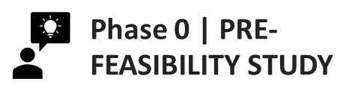
Progress of ETM & Partnerships in ADB DMCs
Indonesia
Ongoing country SESA, JT framework development, and stakeholder engagement
Support for the Indonesia ETM Country Platform
Ongoing studies (captive power analysis, grid impact analysis, generation planning)
MOU for precedent transaction (Cirebon-1) signed in November 2022; Ongoing due diligence
CIF ACT IP approved in June 2023 ($500M concessional funding to leverage $4.5B+ of MDB and other cofinancing and government investment)
Institutional support for JETP Secretariat (TA approved)
Viet Nam
Ongoing discussions with government (Commission for Management of State Capital at Enterprises) for MOU and launching a feasibility study
JETP announced in December 2022; Donor engagement
Kazakhstan
Ongoing preparation for pre-feasibility study
Stakeholder consultation conducted in August 2023
Philippines
Feasibility study ongoing
Pipeline development for private sector transaction opportunities
CIF ACT IP being drafted; for submission October 2023
Pakistan
Pre-feasibility study being finalized
Comments received from the government are being incorporated
$ = United States dollar, ADB = Asian Development Bank, CIF ACT = Climate Investment Funds Accelerating Coal Transition, DMC = developing member country, ETM = Energy Transition Mechanism, IP = investment plan, JT = Just Transition, JETP = Just Energy Transition Partnership, MDB = multilateral development bank, MOU = memorandum of understanding, SESA = strategic environmental and social assessment, TA = technical assistance.

Slide 11
Together with ADB’s social and environmental safeguards, Just Transition provides support for workers, communities, and regions impacted by the intervention of the ETM and associated projects, while preserving the environment.
Comprehensive Approach to Just Transition
Just Transition (JT) activities extend beyond the scope and implementation timeframe of ETM.
National Level
Subnational Level
Community/ District Level
Asset Level
Regional Level
JT considers the geopolitical context and enabling environment, including policy frameworks, education systems, and economic structure.
ETM considers the direct, indirect, and induced impacts along the coal value chain and national system-level effects.
JT entails coordination with other development partners, stakeholders, and national or regional platforms, including the JETP.
JT considers the availability of alternative employment, potential for economic diversification, and impacts on local and subnational budget.
It mobilizes investments in social sector projects to strengthen the enabling environment.
JT activities include asset-level impact assessments, social dialogue, and development of JT plans, considering direct and indirect workers, employers, labor unions, and environmental remediation issues as well as communities in general.

Slide 12

Thank you all for your attention
Alfredo Baño Leal Senior Energy Specialist Energy Sector Office, Sectors Group Asian Development Bank Tel: +632 8632 67690 Email: abano@adb.org

