Slide 1
Towards a new wave of electrification
Hans Holzhacker, Chief Economist CAREC Institute

Slide 2

Outline
Three topics,
14 slides
I. The need for (green) electrification
II. The Fergana Valley project
III. Future research / joining forces?

Slide 3
The need:
About one-third of businesses reported power outages in the World Bank’s
2019 enterprise survey for Uzbekistan.
Source: https://www.enterprisesurveys.org/en/enterprisesurveys

Slide 4
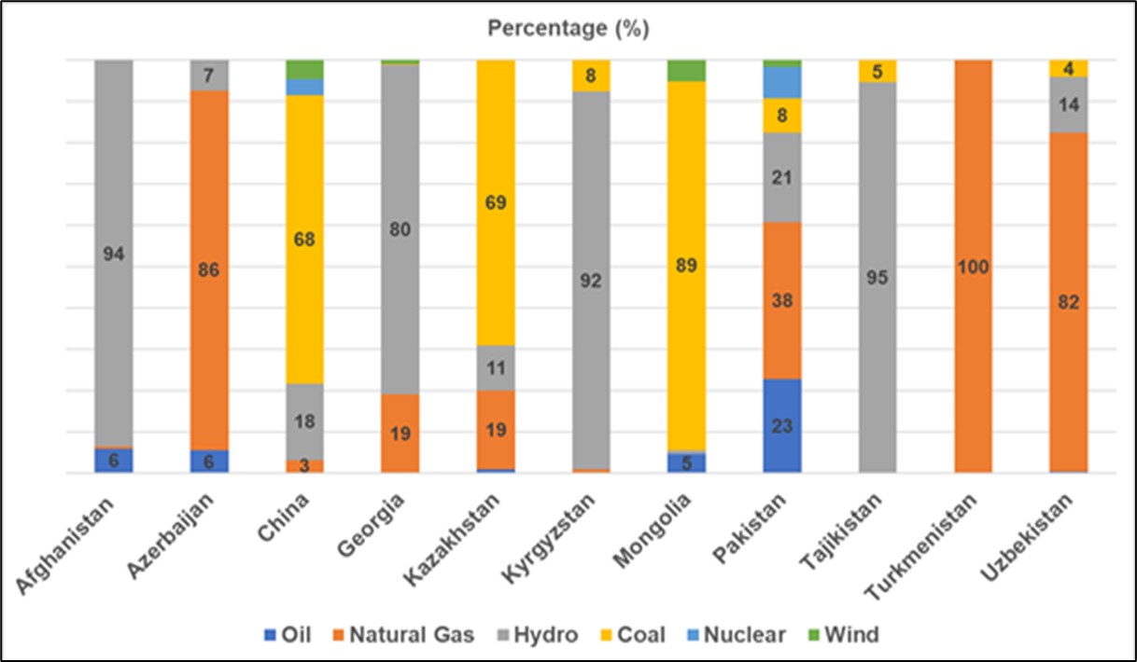
The need:
In most CAREC economies electricity generation relies heavily on fossil fuels.
Sources of electricity/energy
Source: CAREC Institute, 'Climate Vulnerability, Infrastructure, Finance and Governance in CAREC Region.' Research report, 2020, compiled from 2019 IEA data

Slide 5
The potential
Realizable technical potential for RE deployment (MW)
Country | Kazakh-stan | Kyrgyz-stan | Tajiki-stan | Turkmeni-stan | Uzbeki-stan
Small hydro | 4,800 | 1,800 | 23,000 | 1,300 | 1,800
Wind | 354,000 | 1,500 | 2,000 | 10,000 | 1,600
Solar PV | 3,760,000 | 267,000 | 195,000 | 655,000 | 593,000
Biomass | 300 | 200 | 300 | not significant | 800
Source: Compiled from UNDP Renewable Energy Snapshots for respective Central Asian countries. Retrieved from
https://www.eurasia.undp.org/content/rbec/en/home/library/environment_energy/renewable-energy-snapshots.html
What about geothermal energy?
Source: https://review.uz/post/vozobnovlyaemaya-energiya-dlya-ustoychivogo-razvitiya

Slide 6
The area….
(including for cooperation…)
Source:https://www.energycharter.org/fileadmin/DocumentsMedia/News/4_CDC_Energiya.pdf

Slide 7
The Fergana Valley household energy access project:
The sampling in the three Fergana Valley countries

Slide 8
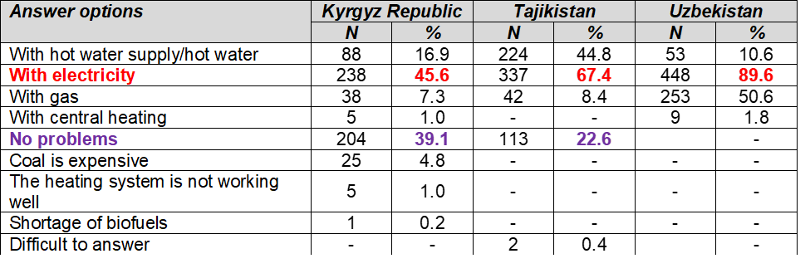
What type of energy supply does your household experience problems with in winter?
The Fergana Valley household energy access project:
There are issues with electricity access in the Valley.
Source: CI-ADBI-PORI Fergana Valley household energy access survey (unpublished)

Slide 9
The Fergana Valley household energy access project:
Issues with electricity vary only slightly even by income levels
Source: Author’s calculation based on the CI-ADBI-PORI Fergana Valley household energy access survey (unpublished)

Slide 10
If you have an autonomous heating system, what energy source do you use to heat your house during the winter season?
The Fergana Valley household energy access project:
Lots of coal in the Kyrgyz Republic and Uzbekistan;
electricity in Tajikistan.
Source: CI-ADBI-PORI Fergana Valley household energy access survey (unpublished)

Slide 11
Did you have any interruptions in supply, difficulties with heating last winter?
The Fergana Valley household energy access project:
In Tajikistan, with heating predominantly by electricity, there are relatively frequent heating issues.
Source: CI-ADBI-PORI Fergana Valley household energy access survey (unpublished)

Slide 12
However, there might be even more demand for electricity in the region in future including for heating… or perhaps not thanks to higher energy efficiency?
Plans to switch from dirty to clean heating
Source: ADBI calculations based on the CI-ADBI-PORI Fergana Valley household energy access survey (unpublished)

Slide 13
The CAREC Institute’s intentions for energy research…
Joining forces?
I. The Fergana Valley project - Phase 2
II. Renewable Energy Investment Ecosystem in Central Asia
III. Businesses' Innovation Plans for energy efficiency and for digitalization
IV. Options for financing of green energy projects – an overview (commercial bank facilities, taxonomies etc.)

Slide 14

Looking forward to
a fruitful exchange of views also in future and perhaps some cooperation!
https://www.carecinstitute.org/
hans.holzhacker@carecinstitute.org

