Slide 1
Current state of the Central Asian Unified Energy System
Tbilisi
November, 2023
Mirzaev A.T., CDC Energia

Slide 2
Central Asian UES
Under the Agreement between the Government of the Republic of Kazakhstan, the Government of the Kyrgyz Republic, the Government of the Republic of Tajikistan and the Government of the Republic of Uzbekistan on the Parallel Operation of the Energy Systems of Central Asia (June 17, 1999, Bishkek), the energy systems of Kazakhstan, Kyrgyzstan and Uzbekistan operate in parallel as part of the Central Asian Unified Energy System.
Tajikistan’s power system has been operating in isolation from the Central Asian UES since 2009. Currently the restoration of parallel operation of the Tajik energy system to the CA UES is underway. Expected date of connection is February 2024.

Slide 3
Central Asian UES
Coordination Electrical Power Council of Central Asia (CEPC) is a consultative body for coordination of parallel operation of power systems of Central Asia. Mutually agreed decisions and rules to ensure economical, mutually beneficial reliable parallel operation of power systems are adopted by open voting of the Participants and are binding.
Coordination of operational and technological activities of power systems and energy facilities included in the Central Asian UES and the Southern part of the UES of Kazakhstan is carried out by the Coordination and Dispatch Center Energia based in Tashkent.

Slide 4
Interconnections
The power systems of Kazakhstan, Uzbekistan and Kyrgyzstan, which operate in parallel, as well as Tajikistan and Turkmenistan, which operate autonomously from the CA UES, are mainly interconnected by 220-500 kV transmission lines.
The power system of Tajikistan will soon be reconnected to the CA UES through the Southern part of the Uzbekistan power system (Guzar-Regar and Surkhan-Regar). In addition, there are plans to interconnect the Sughd SS of Tajikistan with the existing 500 kV transmission line in Uzbekistan under the "Entry-Exit" scheme, as well as construction of a new 500 kV line between the New Syrdarya TPP (Uzbekistan) and the Sughd SS (Tajikistan).

Slide 5
Electricity trade in Central Asian UES
The ADB supported project to connect the energy system of the Republic of Tajikistan to the Central Asian UES is being implemented and is expected to be completed in 2024, which will allow the energy system to exchange electricity in parallel mode.
The power systems of Tajikistan and Kyrgyzstan can export electricity in summer, when their hydroelectric power plants are operating at maximum load, and there is a possibility to import electricity in winter, when there is a shortage of energy.
Electricity trade volumes are determined on the basis of technical flows between energy systems. At the same time, trade takes place not only between the republican energy systems as a whole, but also between individual energy nodes of energy systems.
Electricity supply contracts are concluded on a bilateral basis. Electricity supply through the power grids of third countries also involves a contract for transit of electricity. For example, when electricity is exported from Turkmenistan to Kyrgyzstan through the Uzbekistan grid, a transit contract is concluded between the Uzbekistan and Kyrgyzstan energy systems.
Kazakhstan adopted the Single Buyer and Balancing Electricity Market model on July 1.
This September, Uzbekistan announced the establishment of the Energy Market Regulator and a phased transition to a wholesale and retail electricity market.

Slide 6
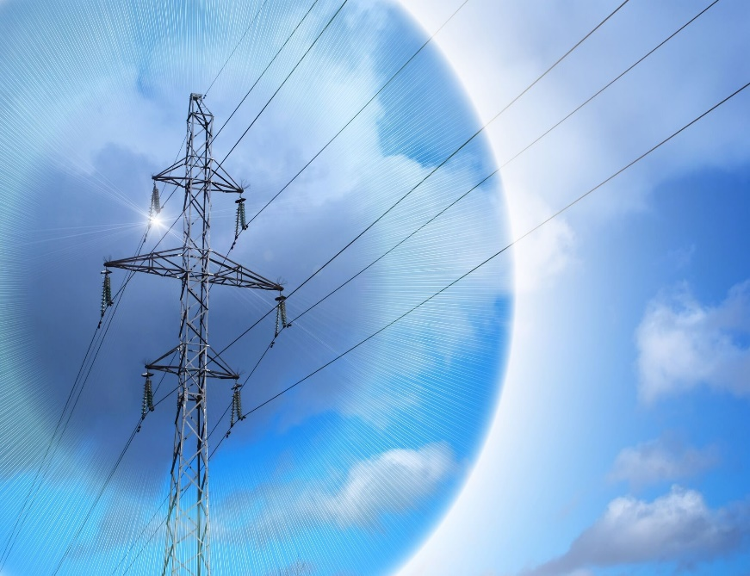
Electricity trade in Central Asian UES
The main exporters in the Central Asian UES are the energy systems of Turkmenistan and Tajikistan.
Turkmenistan exported electricity, mln. kWh: 2021 2022
to Uzbekistan 4209.9 4529.4
to Kyrgyzstan 498.2 813.5
Tajikistan exported electricity, mln. kWh:
to Uzbekistan 1146.8 839.4
Also the energy systems of Uzbekistan, Tajikistan and Turkmenistan
supply electricity to the energy system of Afghanistan.
Thus, in 2022 году export of electricity to Afghanistan amounted to mln kWh:
from Uzbekistan – 1425.6
from Tajikistan – 1663.7

Slide 7
Central Asian UES's electricity consumption growth dynamics

Slide 8
RES integration into CA UES
In recent years, the Central Asian UES's energy systems have been integrating renewable energy sources into the region's energy systems along with modernization and renewal of traditional generating equipment with the commissioning of highly efficient combined cycle gas turbines and modernization of hydroelectric generating units. Renewable energy sources are being integrated into the region's energy systems, mainly solar photovoltaic stations and wind farms are being put into operation.
There are already 2400 MW of renewable energy sources in the energy system of Kazakhstan, including 1200 SPPPs and 1200 MW of WPPs. The Ministry of Energy announces about 16 GW of RES-based generation to be commissioned by 2030.
Uzbekistan currently has two SPPPs with a total capacity of 200 MW. At the same time it is planned to introduce about 11 GW of RES by 2026, and more than 20 GW by 2030.
In Kyrgyzstan's energy system, there are plans to introduce about 3-4 GW of renewable energy within 2-3 years.
In Tajikistan, two SPPPs with a total capacity of 60 MW are expected to be commissioned in 2024.

Slide 9
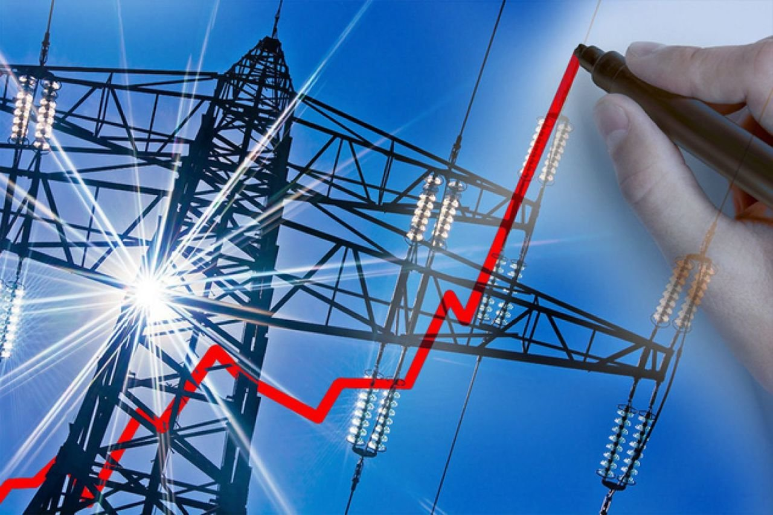
RES integration into CA UES
Large-scale penetration of RES with a variable and intermittent nature of generation has a serious impact on the stability of the operation of energy systems. In this regard, at present, national energy systems are conducting studies to assess the impact of these sources on the grid, and technical requirements for their connection to the grid are being developed.
CDC Energia’s specialists also participate in several studies conducted by USAID, the World Bank and other organizations. The results show that for successful integration of RES into the CA UES, joint coordinated efforts are needed to develop regulation reserves in the region.
It is also necessary to make adjustments in the principles of emergency control of power systems taking into account RES integration, to introduce centralized systems of emergency control and automation of frequency and active power regulation in the CA UES.

Slide 10
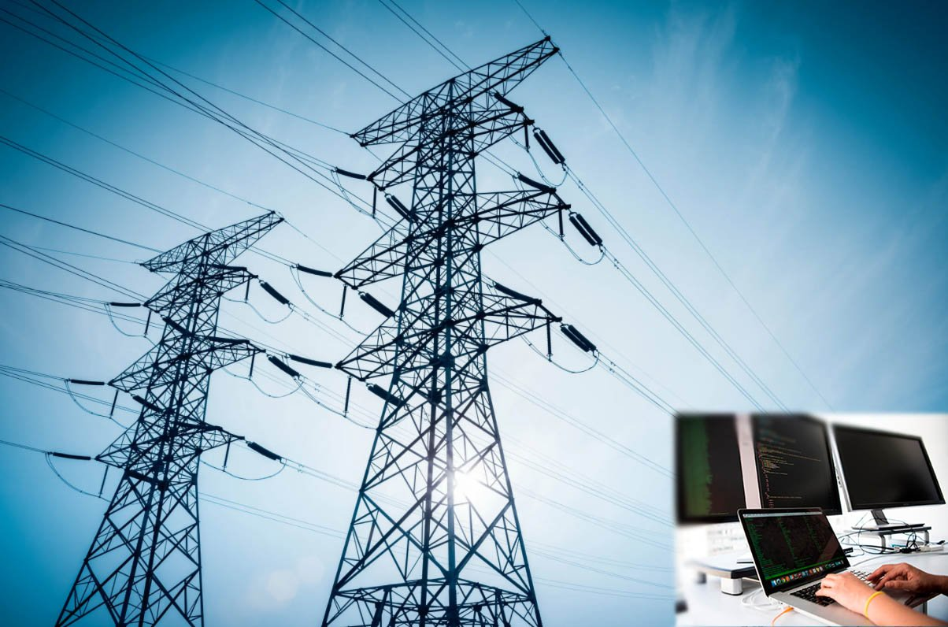
Cooperation on energy systems development
Kyrgyzstan, Uzbekistan and Kazakhstan signed a memorandum of intent on the Kambarata HPP-1 construction project. Work is underway to establish a joint venture between the parties.
Negotiations are ongoing between Tajikistan and Uzbekistan and between Tajikistan and Kazakhstan on the terms of electricity supply from Rogun HPP. It is expected that the relevant Agreement on electricity procurement will be signed before 2025.
Currently, the Republic of Tajikistan and the Republic of Uzbekistan are jointly working on a project for the construction of two hydropower plants with a total capacity of 320 MW on the Zarafshan River in the Sughd Region of the Republic of Tajikistan. The countries have established TAUZ Hydro JSC, which is involved in project management for these purposes.
Uzbekistan and Tajikistan agreed on the construction of a 500 kV interstate transmission line between the New Syrdarya TPP and the Sughd substation.

Slide 11
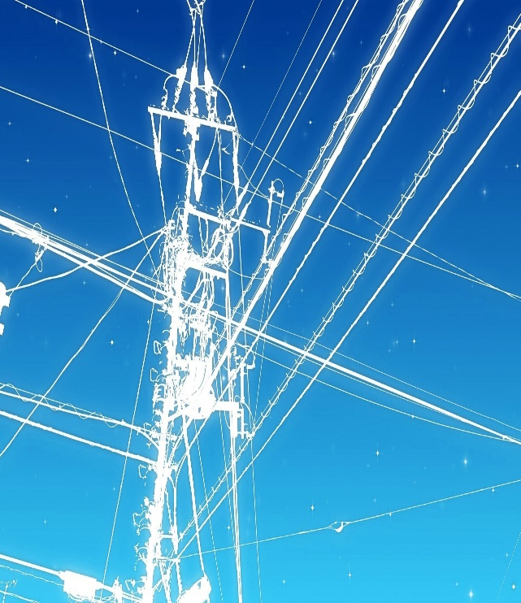
Cooperation on energy systems development
Bottlenecks
According to the analysis of existing power regimes, the main bottlenecks for maintaining stability under emergency disturbances in CA UES are:
- 500 kV North-South and North-East-South transit section of UES of Kazakhstan;
- section of L-5143 "Shu - Frunzenskaya" + L-2193 "Almaty - Glavnaya" + L-2183 "Kemin - Zapadnaya" + L-2283 "YuKGRES - Shyganak" + AT-3 "Shu" SS;
- 500 kV transmission line L-512 "Serdar - Karakul" connecting the energy systems of Turkmenistan and Uzbekistan, which is in dilapidated condition and is mainly used for import of electricity from Turkmenistan to the CA UES countries;
- 500 kV transmission line "Datka - Kemin", which is included in several characteristic sections according to the initial data. When this transmission line is disconnected, the energy center fed from the "Kemin" 500 kV substation remains connected to the energy system by 3 220 kV transmission lines from the "Ala-Archa", "Chuyskaya" and "Zapadnaya" substations. The latter is loaded up to 130.
- L-518 "Sugd-Dushanbe" 500 kV transmission line , connecting the southern and northern parts of the isolated energy system of Tajikistan. In case of disconnection of this transmission line, it is necessary to inject power generating facilities of the corresponding volume or to provide for complete deactivation of the northern energy hub of Tajikistan with isolated operation of the existing power plants with balanced load.

Slide 12
Cooperation on energy systems development
The following potential projects can be recommended for international cooperation on energy systems development:
If the Turkmenistan energy system is to be connected to the parallel operation with CA UES for more reliable parallel operation of the energy systems of Turkmenistan and Uzbekistan, it is recommended to create additional 500kV transmission lines of these energy systems:
- construction of "Dashkhovuz - Sarymay" 500 kV transmission line;
- construction of "Kerky - Surkhan" 500 kV transmission line;
In terms of improving the reliability of the western regions of Kazakhstan and Uzbekistan, as well as the unification of the Western zone of the UES of Kazakhstan with the Northern zone, it is recommended to consider the construction of the additional 500kV transmission line:
- "Ulke - Karabatan - Beineu - Sarymay";
- "Beineu - MAEK";
To strengthen the power supply of the Almaty power hub and the northern part of the NES of Kyrgyzstan, in particular, to increase the reliability of the Kemin power hub, it is proposed to consider the possibility of:
- construction of "Almaty - Kemin" 500kV transmission line.
To ensure the generation output in the Central part of the Uzbekistan energy system and to ensure the reliability of Northern Tajikistan:
Installation of entry-exit to one of the "SDTES - New SDTES" 500kV transmission line with winding of one end to the Sugd substation and the other end to the "Novo Angrenskaya TPP" 500kV switchgear;
Construction of "Novo Angrenskaya TPP - Turakurgan TPP - Lochin" 500 kV transmission line

Slide 13
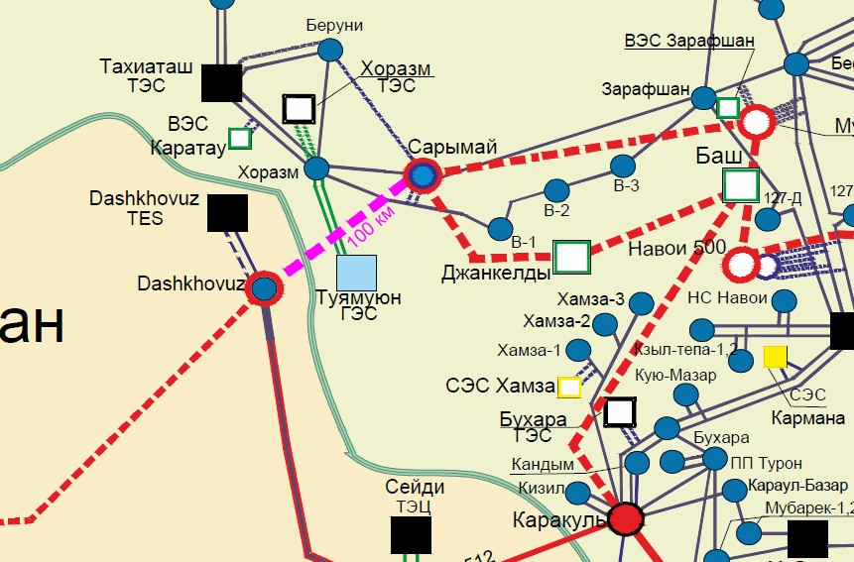
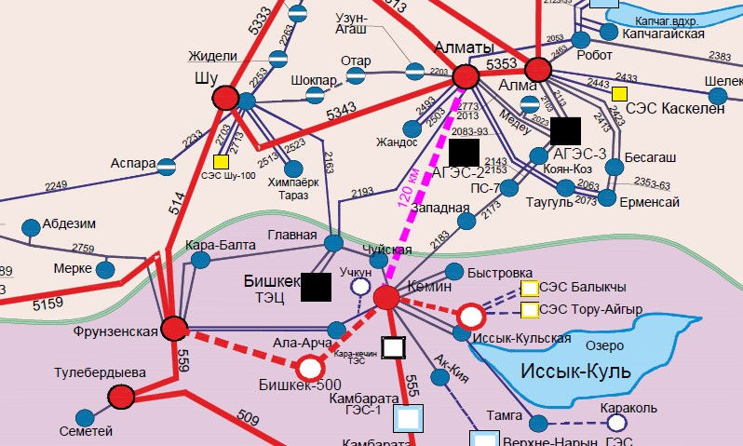
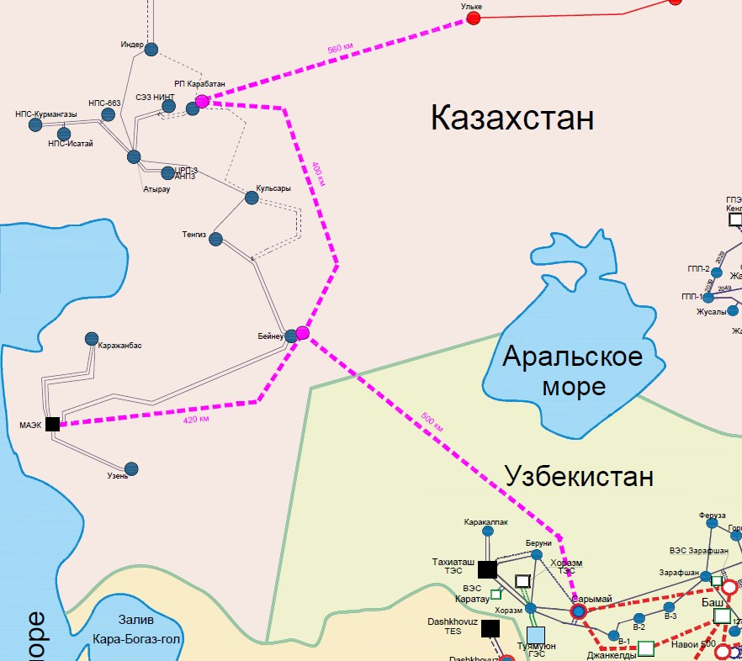
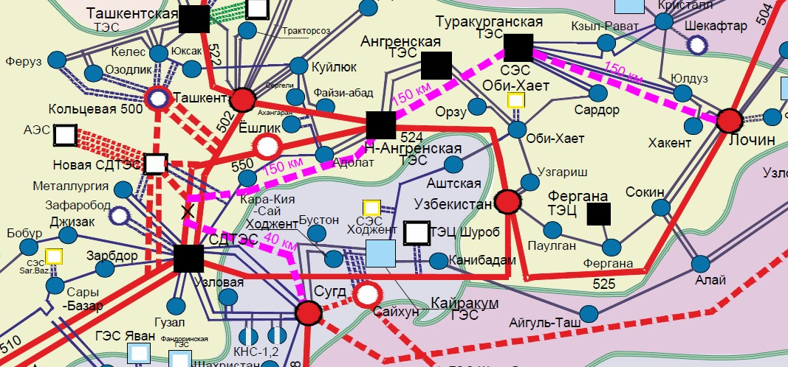
Dashkhovuz - Sarymay" 500 kV transmission line construction option
Almaty - Kemin 500 kV transmission line construction option
The fourth transit circuit of "Ulke - Karabatan - Beineu - Sarymay" 500kV transmission line and "Beineu - MAEK" 500kV transmission line construction option
Option of construction according to the entry-exit scheme into one of the 500kV transmission lines "SDTES - New SDTES" with winding of one side to the "Sugd" 500kV substation

Slide 14
Cooperation on energy systems development
Joint electricity supply to the Central Asian economies is a more economically feasible option than the independent electricity supply by each country separately, and this is achieved by making the most efficient use of the available energy capacities and resources of the Central Asian countries;
Potential strengthening of market interaction between the countries of the Central Asian region will allow to reduce investments on generation increase by each country separately due to joint use of available reserves;
As a result of increase in the RES penetration, as well as due to general load increase in Kazakhstan, Uzbekistan, Kyrgyzstan and Tajikistan, unbalanced capacity at the interfaces between UES of Kazakhstan and CA UES will increase. At the same time, under conditions of parallel operation unbalances of CA UES are transferred to the Kazakhstan and Russian UES interfaces. In order to maintain stable operation it is necessary to provide regulation of power and frequency flows between the countries by creating the Central System of Automatic Generation Control (AGC) in CA UES with step-by-step scaling to the energy systems of Kyrgyzstan, Uzbekistan and Tajikistan;
Central Asian UES's power systems and Kazakhstan UES are characterized by long transmission lines and uneven distribution of load and generation, which determines peculiarities of UES regimes from the point of view of stability problems, equipment overloading. In a number of cases there are dynamic transient processes at occurrence of emergency perturbations with subsequent weakening of the system-forming network, which requires creation of a centralized emergency control system (ECS) of Central Asia in CDC Energia;
In view of Kazakhstan's transition to a balancing electricity market this year and the announced phased
transition to an electricity market in Uzbekistan the announced phased transition to the electricity market in
Uzbekistan, there is a need to to build an automated meter reading and control system (ACEMS) in CDC Energia

Slide 15
THANK YOU FOR YOUR ATTENTION!

