Slide 1
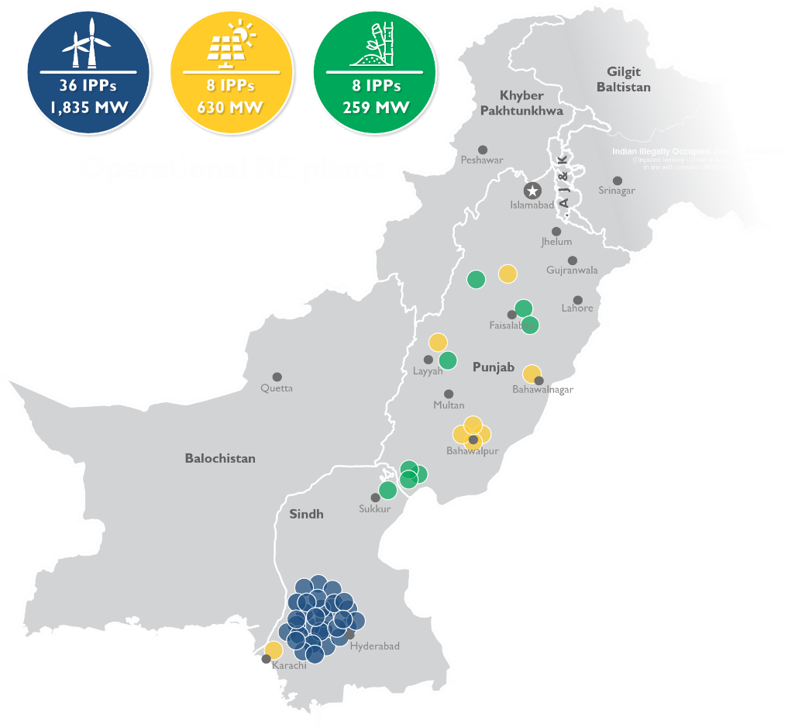
PAKISTAN
POWER SECTOR
OVERVIEW
Shahjahan Mirza
Managing Director
Private Power & Infrastructure Board
Government of Pakistan

Slide 2
Pakistan Power Sector Overview
Current Scenario
Population of over 240 million - 7% (~ 16.8 million) unelectrified
Per capita electricity consumption ~ 440 kWh - World average 3,081 kWh
Target of 100% electricity access by 2030
Projected demand increase of 4.3% per year, annual addition of 3,556 MW
25-year history of reliable operations of IPPs
To attain SDGs, planned increase of RE share to 62% by 2031, including hydro
Consumers are being encouraged to utilize RE potential by self-generation
By 2030, CO₂ emissions reduction to 198 gCO₂/kWh from current 356 gCO₂/kWh which is less than the average of regional countries as well as many member countries of the OECD
Transmission & distribution network augmentation - AMI and smart grid installations

Slide 3
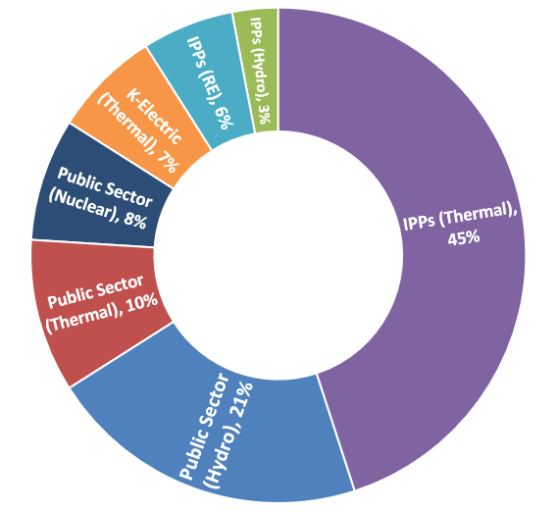
Pakistan Power Sector Overview
Current Installed Capacity
PUBLIC SECTOR
Hydro 9,331 MW (21%)
Thermal 4,507 MW (10%)
Nuclear 3,545 MW (8%)
Total 17,383 MW (39%)
Hydro
23.58%
Gas/R-LNG 29.61%
Oil
16.18%
Coal
16.10%
Nuclear 8.03%
Renewable
Energy
6.51%
PRIVATE SECTOR
Hydro IPPs 1,205 MW (3%)
Thermal IPPs 20,539 MW (45%)
RE 2,854 MW (6%)
KE (Oil/Gas/RE) 2,962 MW (7%)
Total 27,560 MW (61%)
44,943 MW
Total 44,943 MW
NTDC System 41,981 MW
Notes:
3
3

Slide 4
Pakistan Power Sector Overview
Change in Energy Mix in 2031
Future RE Additions
Solar Utility Scale 6,564 MWp
Solar DG 2,000 MW
Solar Net-Metering 4,320 MW
Wind Utility Scale 4,827 MW
Hydro 3,588 MW
Total: 22,289 MW
2023
Total Installed Capacity 45 GW
Total RE 31%
2031
Total Installed Capacity 63 GW
Total RE 62%

Slide 5
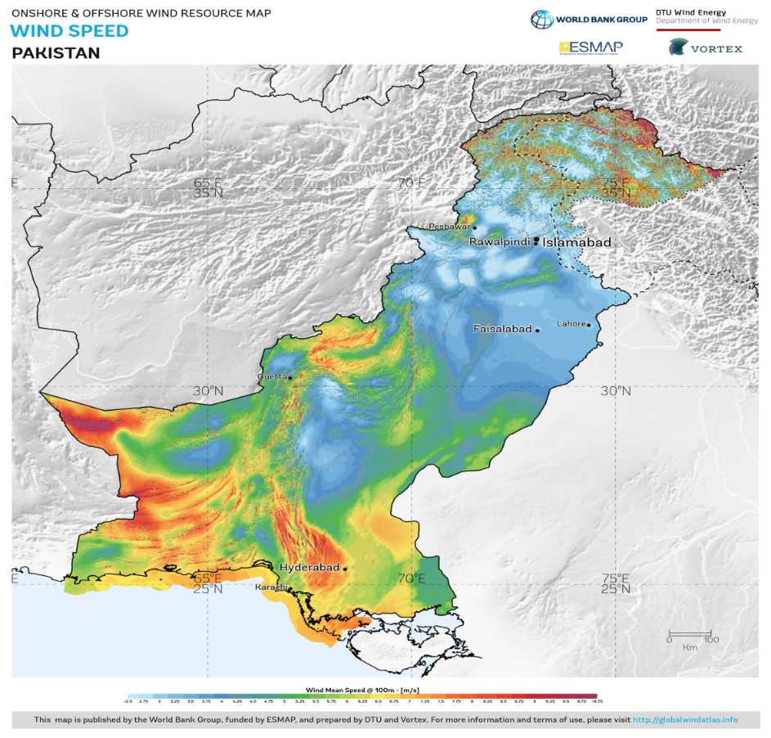
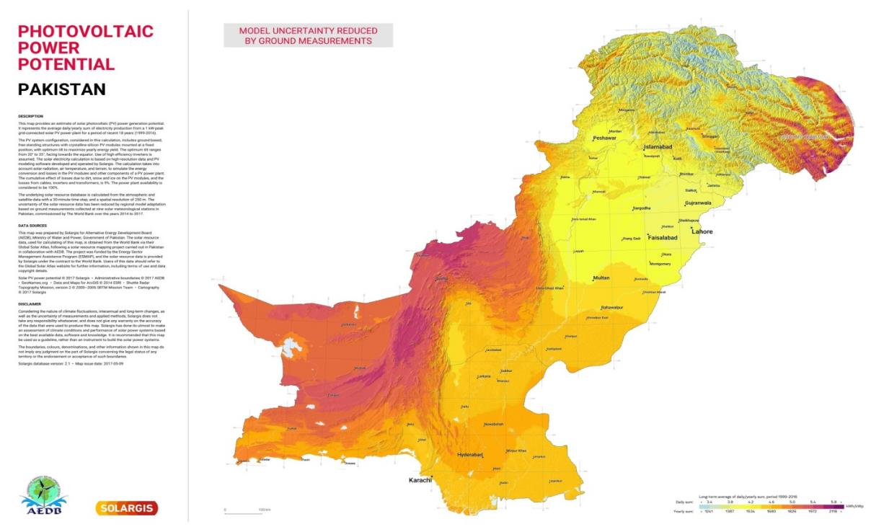
Renewable energy potential
Estimated RE potential
Solar: 2,900 GW
Wind: 132 GW
Hydro: 64 GW
Biomass: 2 GW
Waste-to-energy: 0.4 GW

Slide 6
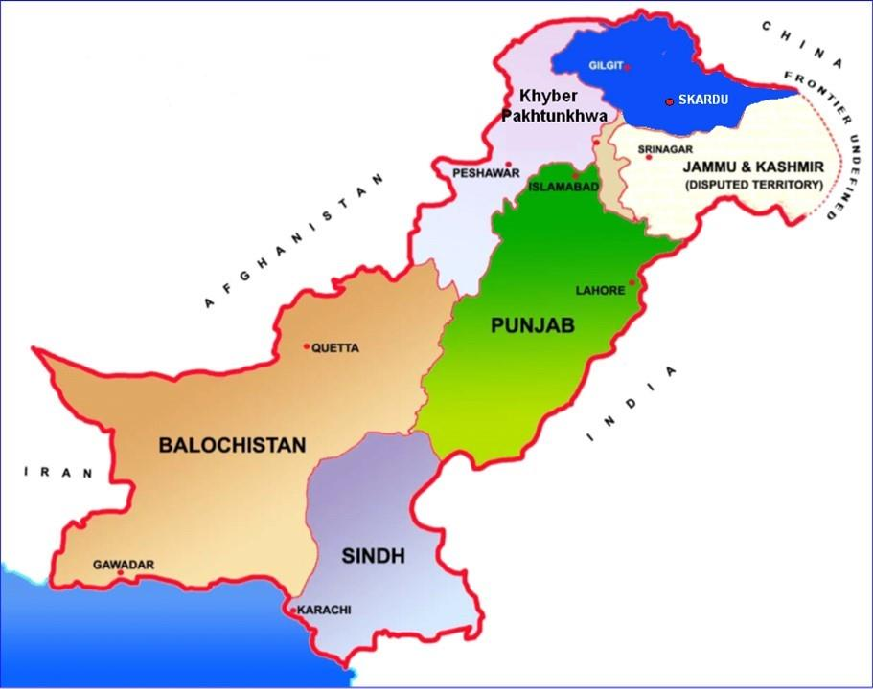
21,162 MW
HYDROPOWER POTENTIAL
64,000 MW
8,296 MW
27,013 MW
7,316 MW
5 MW
208 MW

Slide 7
National Electricity Policy 2021
Vision & Goals / Key Guiding Principles
Key Guiding Principles
Efficiency
Transparency
Competition
Financial Viability
Indigenization, Research & Development
Environmental Responsibility
Universal access to electricity through
Optimal utilization of indigenous resources
Integrated planning approach
Efficient, liquid, and competitive market design
Affordable & environment-friendly outcomes for the consumers.
Goals for the power sector
Access to affordable energy
Energy security
Sustainability

Slide 8
Policy Incentives & Security Package
Targets an on-grid ARE generation mix of 20% by 2025 and 30% by 2030
Long-term contracts of 25 to 30 years
Zero import duties on plant and equipment for RE and 5% for hydro
Assurance of power purchase & evacuation
Protection against political force majeure and changes in law
Exemptions from turnover, withholding and sales taxes
Tariff indexation: Inflation (US CPI and Pak WPI), foreign costs USD/PKR parity
GoP-assured conversion of PKR and remittance of foreign exchange
Standard security package: IA, PPA/TSA, FSA/CSA/GSA/WUA and DIA
Three tier dispute resolution mechanism including arbitration under LCIA / UNCITRAL rules
GoP assurance including compensation in case of termination of project

Slide 9
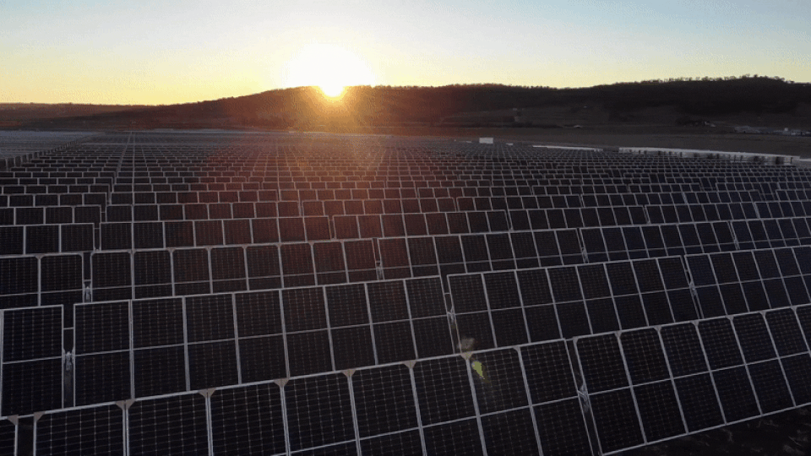
FRAMEWORK GUIDELINES FOR FAST TRACK SOLAR PV INITIATIVES 2022

Slide 10
Framework Guidelines
Fast Track Solar PV Initiatives
GOP approved framework guidelines for the following solar PV initiatives:
Substitution of expensive imported fossil fuels with solar PV energy – 6 GW
Solar PV generation on 11 kV feeders – 2 GW
Solarization of public buildings – 1 GW

Slide 11
Framework Guidelines
Substitution of Expensive Imported Fossil Fuels
Straight-Line Tariff through single-stage, two-envelope bid process
80% $ Indexation of Tariff on quarterly basis
Adjustment on account of interest rate variations (SOFR & KIBOR) allowed
GOP to purchase all Power on 25 Year BOOT basis
GOP to provide land and power off-take
GOP to provide exemption from all Import related Duties and Taxes
In addition to GOP Guarantee, the energy payment also ensured through direct debit mechanism
15% income tax on profits and gains of IPP
COD within 10-24 months of Financial Closing
Foreign Exchange requirement for installation of Projects shall be arranged from abroad

Slide 12
600 MWp Solar Project at Kot Addu / Muzaffargarh
Brief Description
First 600 MWp PV project to be developed in Kot Addu / Muzaffargarh, Punjab
Project Site is finalized keeping in view the resource availability, existing grid infrastructure, water availability and close proximity with load centers
Land for the Project will be provided by the Federal Government on Lease basis
Feasibility Studies required to facilitate the bidders to finalize their bids have been carried out and made part of the RFP
RFP was floated on Sept. 10, 2023 and can be purchased prior to Bid submission deadline
Bid submission deadline is Dec 11, 2023

Slide 13
Investment Opportunities in Pakistan’s Liberalized Power Market
IPPs, merchant & captive generation
Private lines & open wheeling access
Privatization & management contracts
Generation
Transmission
Distribution
G
C
G
G
Trader
Competitive Supplier
(1 MW or more)
Three types of power transactions are allowed in the new wholesale market:
1
Merchant sales – through wheeling arrangements on the grid
2
B2B transactions – opportunity for REs to integrate at a relatively fast pace
3
Bilateral contracts with DISCOs – generation capacity additions through open auctions

Slide 14
Future Plans & Opportunities
Development of large scale ARE projects to achieve the targets set by Government
Construction of transmission lines through private sector investment
Local manufacturing of solar panels and other RE equipment ~ policy to be announced soon
ARE projects based on new-technologies (e.g. solar thermal, geothermal)
Development of distributed generation based ARE projects on B2B mode
Establishment of ARE based mini/micro grids in urban and rural areas
Pumped-storage hydro power projects

Slide 15
Investment Opportunities
Following hydro power projects are available for investment:
S. No. | Name of Project | Location | Capacity (MW) | Estimated Cost (M US$) | Status
1 | Rajdhani HPP | Kotli, AJ&K | 132 | 300 | Initial feasibility study completed
2 | Karakoram International University (KIU) | Jutal, Gilgit | 100 | 300 | Feasibility study completed
3 | Lower Spat Gah HPP | Kohistan, KPK | 470 | 1,031 | Feasibility study completed

Slide 16
132 MW RAJDHANI HYDROPOWER PROJECT
HPP PROJECT AT RAJDHANI AZAD JAMMU & KASHMIR
Opportunity Summary
Project description | 132 MW Rajdhani Hydropower project is located on River Poonch (11 km Upstream of Mangla Reservoir) in Azad Jammu & Kashmir (AJ&K).
Unique value proposition | Local / Project Area: Infrastructure development like roads, bridges in the project and surrounding area Improvement of Educational, Public Health facilities and CSR activities Receipt of applicable taxes and water use charges by GoAJ&K for spending on socio-economic uplift of AJ&K. National: Provision of 694 GWh affordable, clean, green indigenous energy to the national grid Saving of foreign exchange on account of fossil fuel substitution Deployment of indigenous & environment friendly sources to ensure energy security & sustainability of power sector and step toward UN’s SGD Goal 7
Investment | US$ 300 Million Overall cost of the investment. Tentative Break-down of investment: Equity=US$ 60 Million, Debt=US$ 240 Million (EPC Cost=US$ 210 Million, Non- EPC Cost=US$ 90 Million) Cost Plus Model with expected IRR of around 14% to 15% (indexed to US$ / PKR variation)
Market dynamics | Project to be processed under the Power Generation Policy 2015 Project to be implemented on cost plus basis under Build Own Operate Transfer (BOOT) for 30 years Concessionary import duty @ 5% on Plant and Equipment not manufactured locally GoP Guarantee for the payment obligation of the power purchaser (CPPA) Protection against Political Force Majeure risk and changes in certain duties/taxes Min. Equity of 20% and Max. Equity of 30%; Equity in excess of 30% would be treated as debt Majority of investment will be spent directly or indirectly in local economy along with socio-economic uplift of local people, local construction industry and project employment, taxes etc.
Key stakeholders | Ministry of Energy (Power Division), PPIB, CPPA-G, NTDC, NEPRA, and Government of AJ&K
Key facts
132 MW
Plant Capacity
Construction
5 years
694 GWh
Annual output
185 K Electrified
Households
Financials
Costs and projections, USD 300 million
Feasibility Study
A fresh Feasibility Study is to be carried out by the Sponsors
14 – 15 %
Internal Rate of Return (IRR)
Final to be determined by NEPRA

Slide 17
Thank You
Private Power & Infrastructure Board
Government of Pakistan
www.ppib.gov.pk

